Slide 1

SMART INDIA HACKATHON 2026
Mind Mavericks
CivicSync
Problem Statement ID – 26043
Problem Statement Title- A digital platform to crowdsource societal challenges and facilitate collaborative problem solving through universities and industry partnerships
Theme- Smart Education
PS Category- Software
Team ID-
Team Name- Mind Mavericks

Slide 2
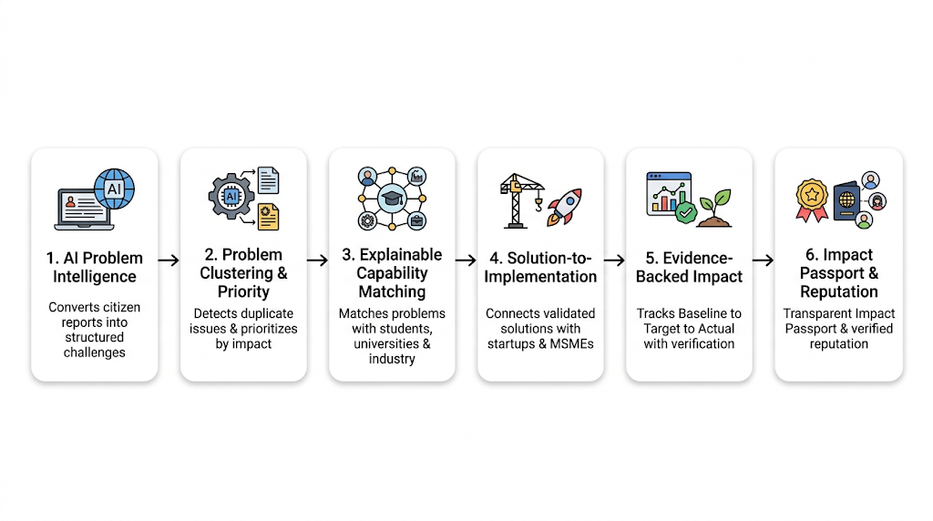


Mind Mavericks
CivicSync
" Al-Powered Platform Connecting Societal Problems with the Right Expertise "
Problem
Proposed Solution
Problems remain unstructured & fragmented
Citizen complaints come from multiple channels, but similar issues are rarely clustered, prioritized, and converted into clear, actionable problems.
Expertise remains disconnected
Universities, faculty, students, researchers, and industry have relevant expertise, but the right problem-solving team is difficult to identify and connect.
The solution journey is disconnected
Problem discovery, solution development, implementation, and impact measurement often happen separately — creating a gap from Problem → Expertise → Solution → Implementation → Impact.
End-to-End Collaborative Problem Solving
  CivicSync connects challenges with students, researchers, universities & industry to develop, implement, and track real-world impact.
  Problem → Expertise → Solution → Impact
AI-Powered Challenge Intelligence
  CivicSync converts citizen reports into structured, prioritized challenges, identifies required expertise, and clusters related issues.
  Understand → Cluster → Prioritize
Innovation & Uniqueness
CivicSync does not stop at finding a problem or an expert — it creates a traceable path from
Problem → Solution → Implementation → Verified Impact

Slide 3
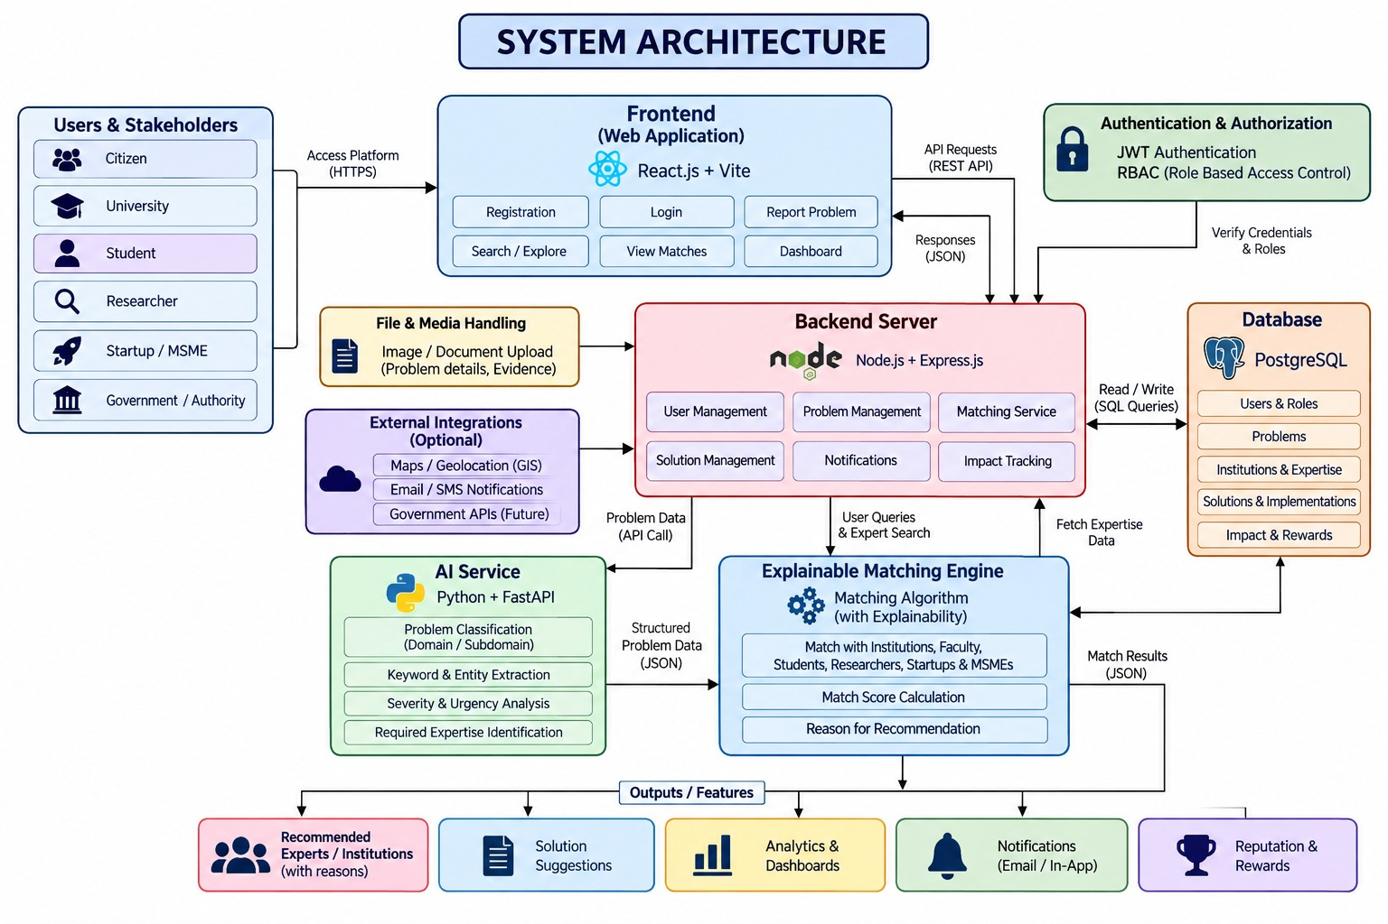



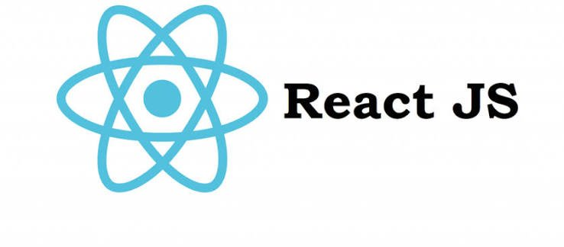
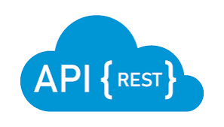



TECHNICAL APPROACH
Mind Mavericks
TECHNOLOGY STACK
Frontend: HTML, Tailwind CSS, JavaScript, React.js
Backend: Node.js, Express.js, REST APIs, bcrypt.
RBAC(Role Based Access Control)
Database: PostgreSQL
Authentication: JWT Authentication
AI/Intelligence: Python, FastAPI, Rule
based NLP, Pattern Analysis, LLMs,
Embeddings

Slide 4


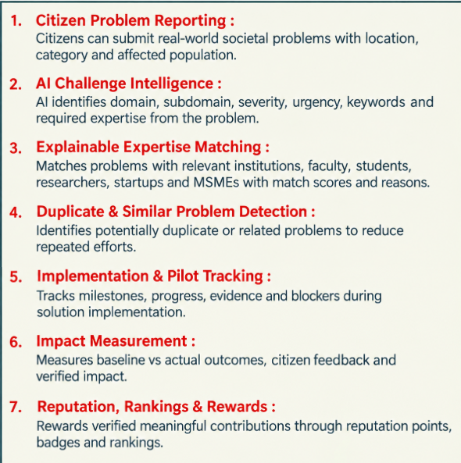
FEASIBILITY AND VIABILITY
Mind Mavericks
FEATURES
Data Feasibility
Modular stack: React + Node.js + FastAPI + PostgreSQL — UI, workflow, DB, and AI cleanly separated
MVP-ready AI: rule-based NLP + pattern matching — no GPU or massive datasets needed
Cold-start ready: bootstrapped with curated capability profiles for institutions, experts, startups
Built for growth: structured schema, ready for future vector/LLM integration
Human-in-the-loop: AI classifies & ranks; authorities validate before action
Multi-role RBAC: tailored dashboards for Citizens, Students, Universities, MSMEs, Govt
Phased rollout: District → State → National deployment
Plug-and-play growth: new civic domains, AI models, GIS layers, and external registries
VIABILITY FORMULA Buildable Now → Low-Cost MVP → Human-Controlled → Modular Ecosystem → Scalable Architecture
HONEST LIMITATION MVP demonstrates rule-based AI with curated capability profiles — semantic vector search, fine-tuned LLMs, and real-time civic-portal API integration are scoped as Phase 2 extensions.
@SIH Idea submission- Template

Slide 5







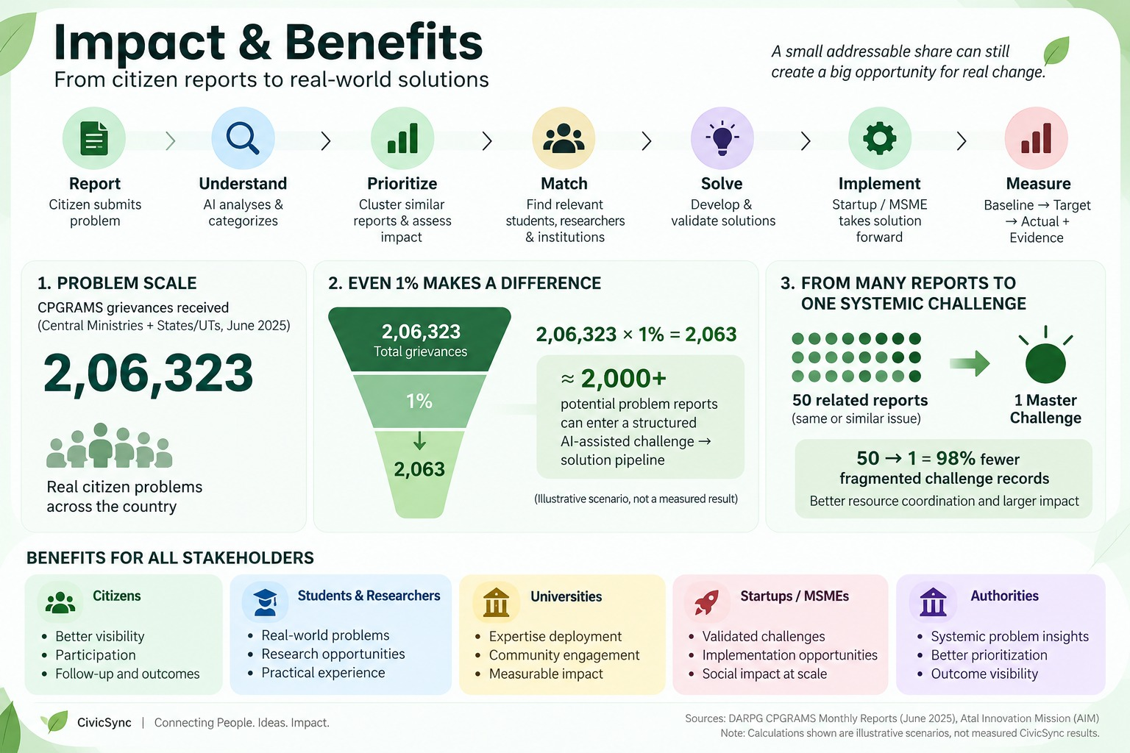








IMPACT AND BENEFITS
Mind Mavericks
Citizen submits problem with description, location and evidence (photo/video)
Al analyses and categorizes the issue(domain, severity, keywords, location)
Cluster similar reports, identify systemic issues and prioritize based on impact and urgency
Find and connect relevant students, researchers, faculty and institutions based on expertise
Validated solutions are taken forward by startups / MSMEs /government partners for real-world deployment
Track outcomes with Baseline -> Target ->
Actual + evidence (photos, data, reports)
Teams develop solutions with mentorship and expert guidance
Citizen voice in
Al-Powered Analysis
From Noise to Insight
Right People, Right Fit
Ideas to Prototypes
From Prototype to Reality
Visible Impact
IMPACT
75,914 received and 61,844 redressed in June 2025.
Shows the need for better prioritization &follow-through.
AIM reports 3,500+startups
supported through
its incubation
ecosystem.
Opportunity for a structured pathway from challenges to solution providers.
Atal Innovation Mission reports 1.1 crore + students engaged through Atal Tinkering Labs.
A huge pool of young problem-solvers exists.
UN E-Government Survey 2024: 66% of surveyed city portals offer complaint/ feedback submission .
Reporting is digital; the next step is solving and tracking.
Benefits for Key Stakeholders
Report local problems easily
Track status and progress
Get solutions from relevant experts
Prioritize problems effectively.
Access wider solution
ecosystem.
Track implementation and outcomes.
Data-driven policy planning
Find real-world problems.
Gain practical experience.
Work on meaningful projects.
Recognition opportunities
Discover validated challenges
Opportunities for pilot projects
Access to academic expertise

Slide 6
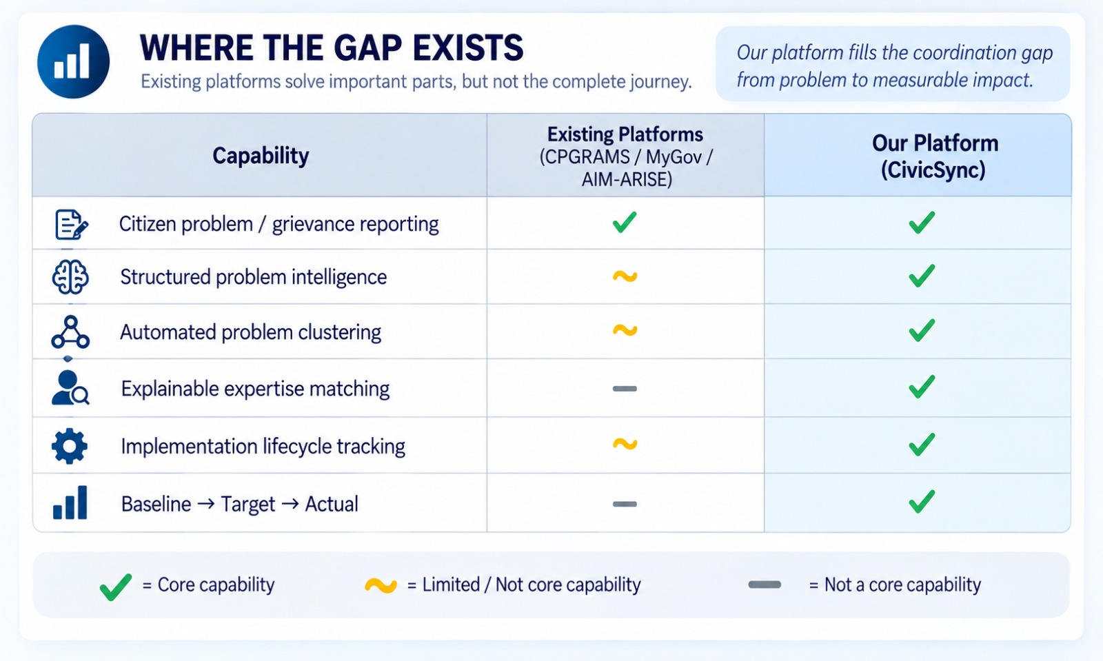
RESEARCH AND REFERENCES
Mind Mavericks
Expert Finding Systems: A Systematic Review
Evidence: Research explores how relevant expertise can be identified for a particular problem or information need.
CivicSync: CivicSync uses the requirements of a reported problem to identify relevant capabilities and potential contributors.
Source: https://www.mdpi.com/2076-3417/9/20/4250
Automated Citizen Request Classification
Evidence: Research shows that large volumes of unstructured citizen requests can benefit from automated classification.
CivicSync: AI-based problem intelligence for domain, severity, urgency and required expertise extraction.
Source: https://www.sciencedirect.com/science/article/pii/S0306457320309055
Citizen Complaint Pattern Analysis
Evidence: Research on citizen complaints identifies spatial and temporal patterns that can reveal recurring or concentrated issues.
CivicSync: Related-problem clustering and creation of systemic/master challenges.
Source: https://www.sciencedirect.com/science/article/pii/S2226585624000037
Government/Ecosystem
CPGRAMS Government of India
Centralized public grievance reporting, tracking, feed backend appeal.
pgportal.gov.in
MyGov Government of India
Citizen engagement through tasks, discussions, polls, campaigns and submissions
mygov.in
Atal Innovation Mission NITI-Aayog
Citizen engagement through tasks, discussions, polls, campaigns and submissions
aim.gov.in
Manthan — Principal Scientific Adviser
Multi-stakeholder collaboration across government, academia & industry.
psa.gov.in/manthan

