Slide 1

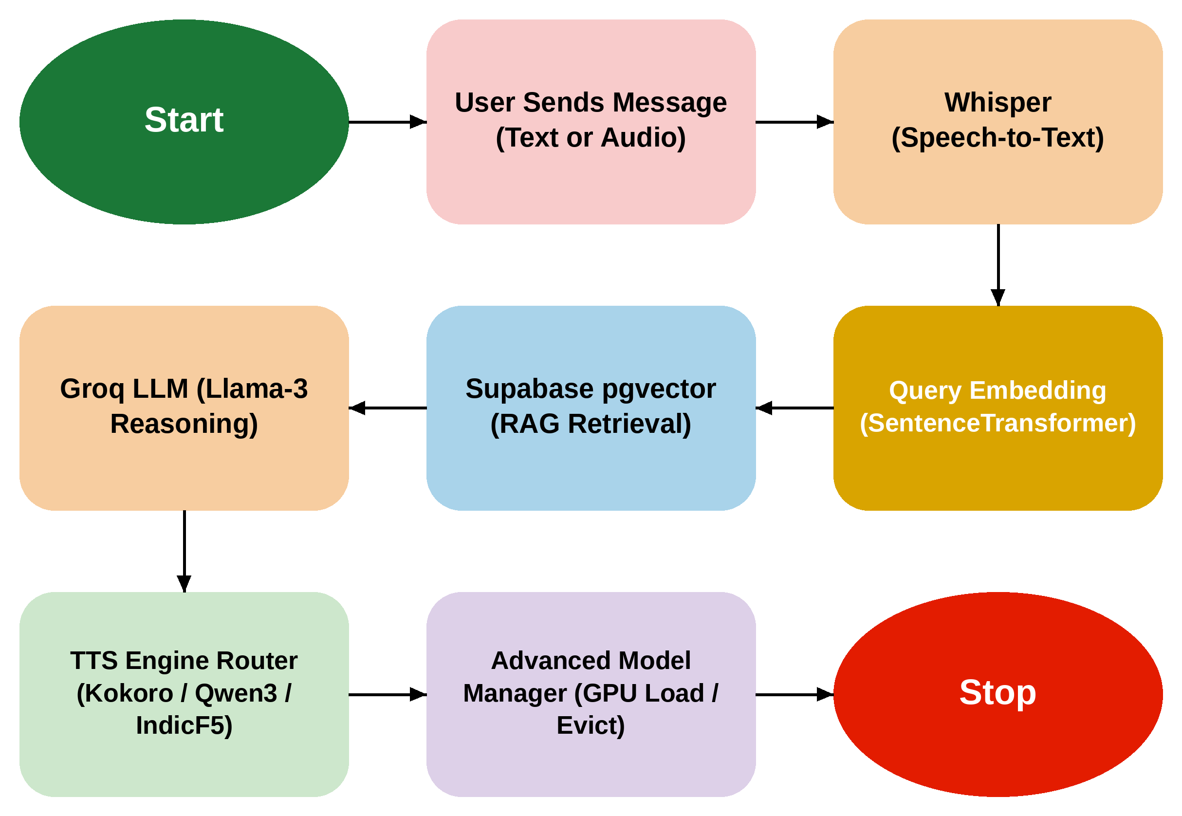
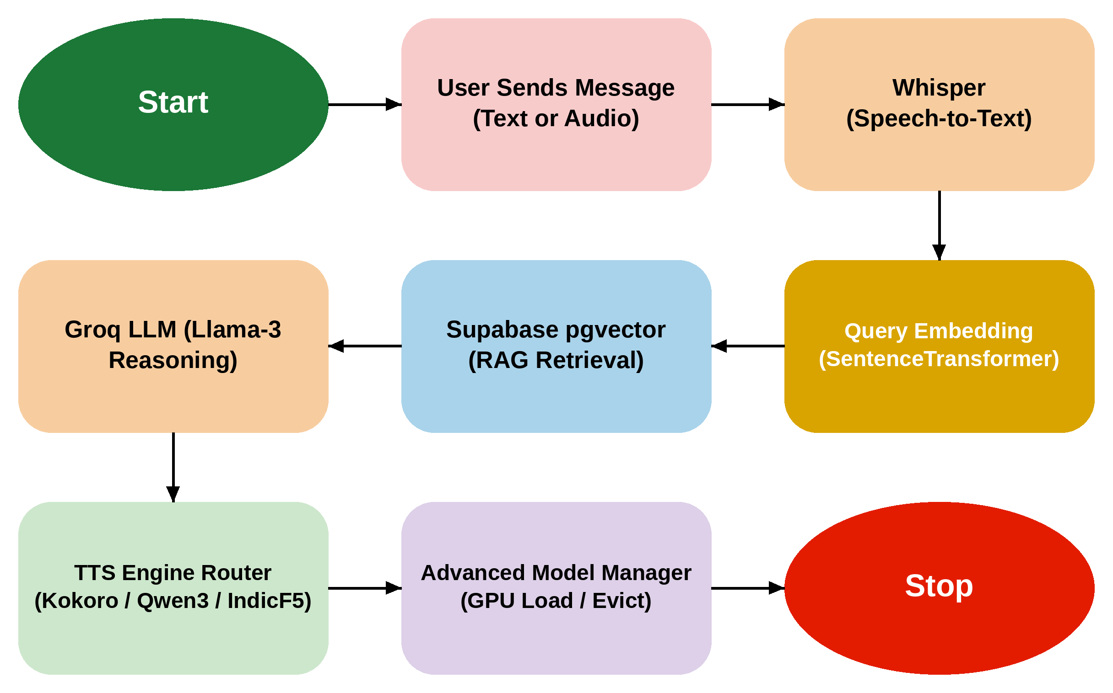
MIT SCHOOL OF COMPUTING
Class: LYAIA3
Team: Learn Veda
Group ID:
BCAIAA45
DEPARTMENT OF COMPUTER SCIENCE & ENGINEERING
AI-Based Platform for Voice Cloning and Conversational Agents
Multi-Engine Voice Cloning and Conversational AI Studio Presented by Atharva Gaikwad, Arnav Raut, Harpalsing Rajput, Ayush Chougula
Faculty Guide: Prof. Neha Chaube
What User Says
What User Thinks
No | Requirements | Proposed Solution
1 | Voice Cloning | Clone a natural voice from a short reference sample using Qwen3-TTS or Audio8-TTS, generating a reusable voice embedding.
2 | Conversational Agent | Combine Whisper for speech recognition with the Groq Llama-3 API for reasoning and TTS for spoken replies.
3 | Multi-Engine Voice Synthesis | Route requests between Kokoro-82M, Qwen3-TTS and IndicF5 based on speed, cloning and language needs.
4 | Knowledge Integration (RAG) | Embed uploaded documents with SentenceTransformers and retrieve context using Supabase pgvector.
5 | GPU Resource Management | An Advanced Model Manager loads and evicts TTS models automatically based on GPU memory pressure.
6 | Storage and Deployment | Use Supabase for authentication, database and storage, with a Next.js and FastAPI web application.
FLOWCHART
“Building a voice agent means stitching together many different platforms.”
“Voice cloning and conversational AI are completely disconnected today.”
“I want to create an AI voice agent without writing complex code.”
“Can I build and deploy a voice agent from a single platform?”
“Will the cloned voice actually sound natural?”
“Can my agent access my own documents and knowledge base?”
USER
What User Does
What User Needs
Uses separate platforms for speech recognition, reasoning and voice synthesis.
Manually connects APIs and debugs integration issues.
Spends significant time wiring different services together.
One unified platform for voice cloning and conversation.
High-quality, natural-sounding cloned voices.
Simple integration with their own knowledge base.
Problem statement
Voice AI development today is fragmented across isolated platforms for speech recognition, reasoning, voice synthesis and analytics. This disjointed ecosystem leads to high integration overhead, inconsistent voice quality and significant friction when developers try to build and deploy personalized, conversational voice agents.
Proposed Solution
Auralis is a unified Voice AI platform that combines zero-shot voice cloning, LLM-based reasoning through the Groq API and RAG-based knowledge retrieval within a single Next.js and FastAPI application. An Advanced Model Manager runs multiple GPU-heavy voice models efficiently on shared hardware, so developers get one platform instead of many disconnected tools.
Scope and Feasibility
The current prototype integrates Whisper, the Groq API and open-weight TTS models including Qwen3-TTS, Kokoro-82M and IndicF5, with Supabase handling authentication, storage and RAG. Feasibility is demonstrated through the working GPU Model Manager and voice cloning pipeline, with real-time transport, containerized deployment and voice security safeguards identified as planned extensions.

