Slide 1
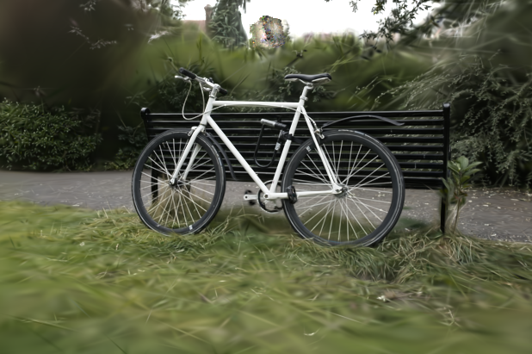
Human Sensing Lab
Technical Assessment
Composing
3DGS Assets
Separately train Bicycle and a synthetic chair, then merge the foreground Gaussians into the scene.
final composed render
Bicycle scene + synthetic chair
June 2026
one merged point_cloud.ply
Rendered with Bicycle cameras for shared depth and alpha ordering.

Slide 2
Composition Method
The foreground asset is transformed in 3DGS parameter space, then merged before rendering.
p_scene = s R p_asset + t
Train
Transform
Merge
Bicycle scene and chair asset as separate 3DGS models.
Apply scale, rotation, and translation to every foreground Gaussian.
Write one composed point_cloud.ply and render with Bicycle cameras.
Gaussian updates
Why this helps
center: similarity transform
scale: add log(s)
rotation: q_place times q_asset
Scene and asset splats are depth-sorted together, avoiding a separate 2D paste step.

Slide 3
Result & Defense
The output is not a 2D paste. It is one merged 3DGS point cloud rendered through the Bicycle cameras.
Result
Separate Bicycle and Chair 3DGS models
merged into one splat point cloud.
Scale reasoning
Cross-dataset scale is ambiguous;
bounds and visual anchors define s, R, t.
Conflicts
One rasterizer pass gives depth sorting;
floaters and soft splats remain visible.
Extension idea
Optimize asset-only SH/exposure
while keeping geometry fixed.
final composed render
Submission assets: code, process notes, Kaggle/Colab runners, final render, and this 3-slide deck.

