Slide 1
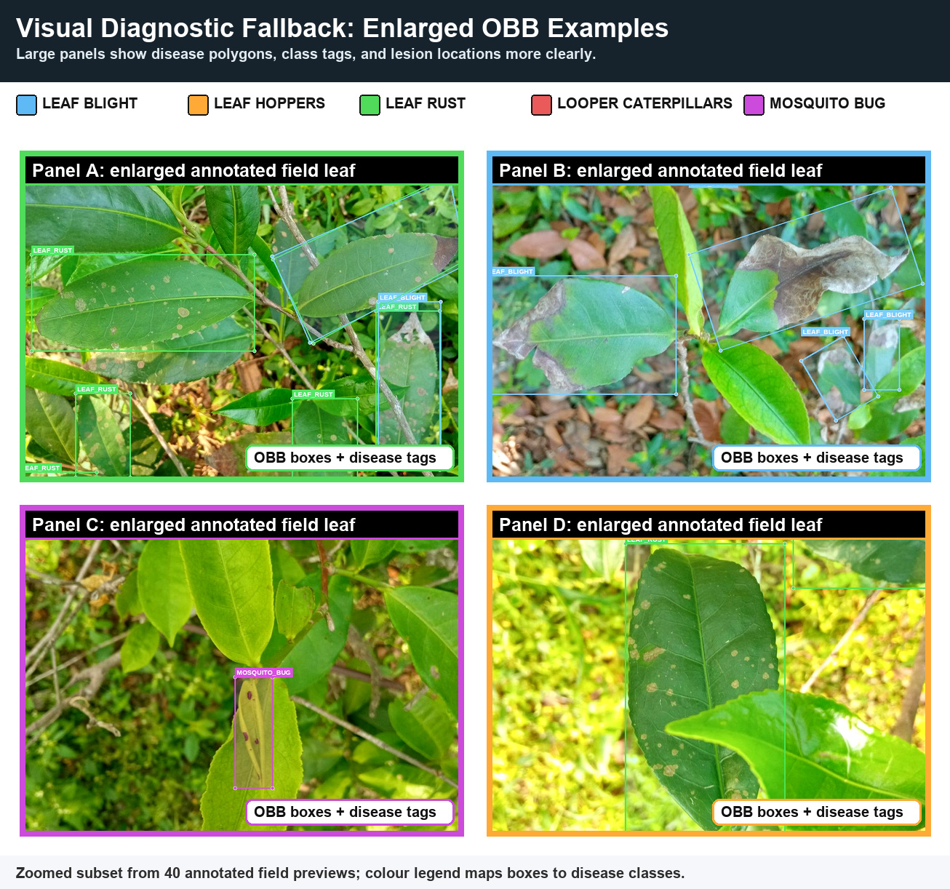
FarmFederate
Multimodal Federated Learning for Tea Leaf Disease Detection
Ayush Debnath
22ME31010 · Mechanical Engineering
Supervisor: Prof. Sudip Misra
Department of Computer Science & Engineering Indian Institute of Technology Kharagpur
5
18
0.949
0
diseases
models
best F1
Kaggle images

Slide 2
ROADMAP
Paper-Aligned Defense Story
The deck now carries the final paper structure, data claims, and result tables.
Block | Slides | What it proves
Problem + data | 3-6 | Five tea diseases, real field source, no Kaggle image corpus
Method | 7-9 | Local multimodal model, FedAvg, training safeguards
Results | 10-15 | VLM top-line gain, federated retention, full ranking, SOTA context
Deployment | 16-18 | RAG fallback, privacy story, limitations, future work
Central claim
FarmFederate gets the best performance from multimodal fusion while keeping raw leaf images, field logs, and advisory documents local to each estate.
98.6%
0.038
VLM federated retention
F1 over best ViT
0.462
F1 over best LLM
FarmFederate
2 / 18

Slide 3
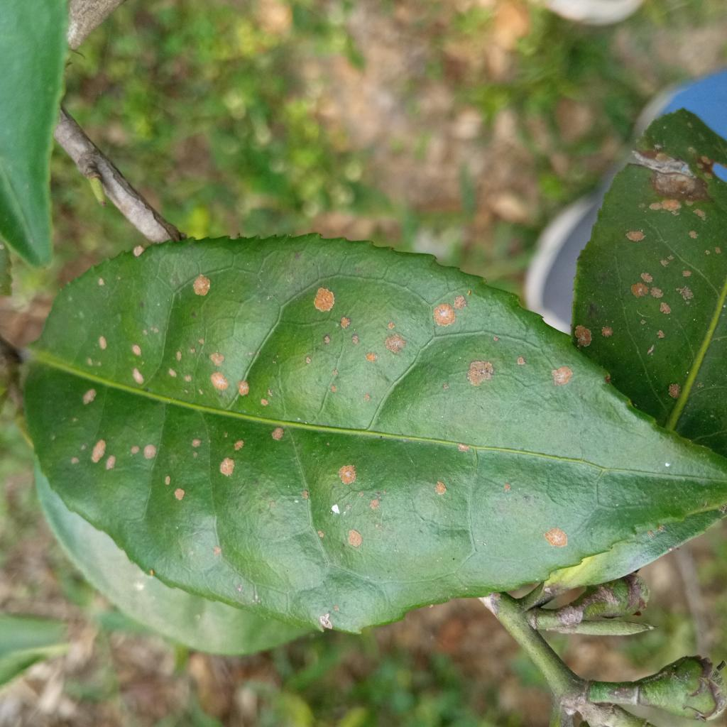
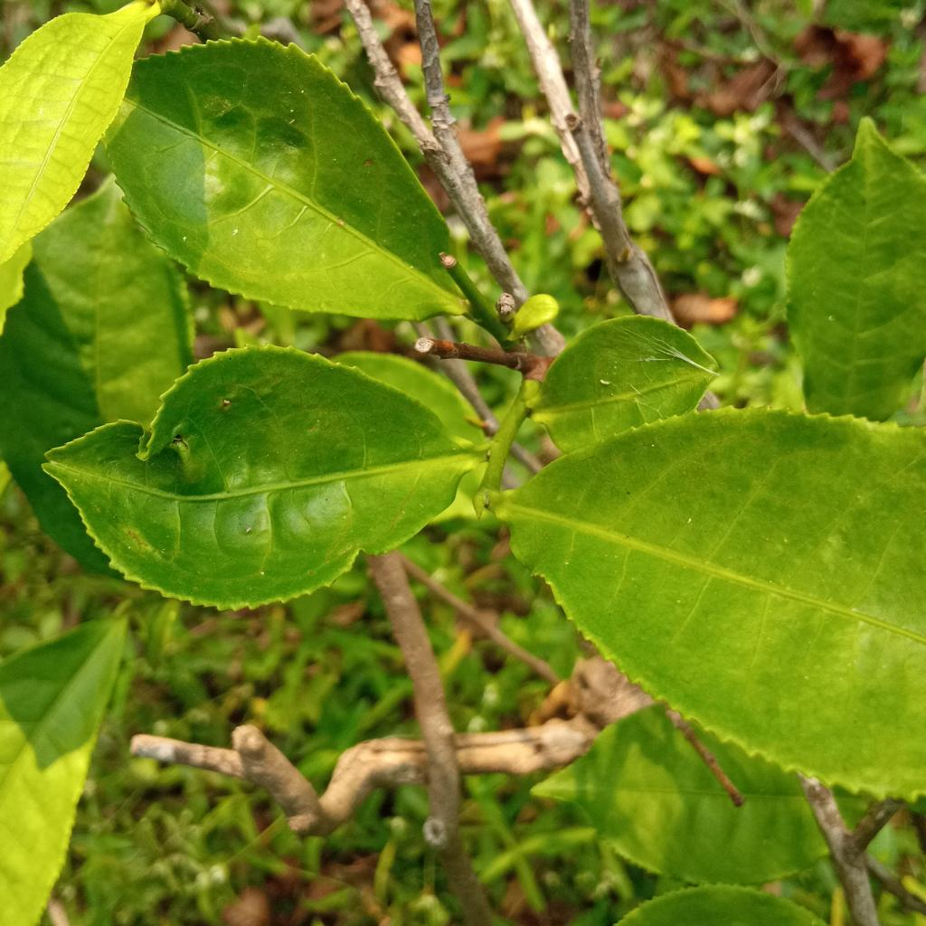
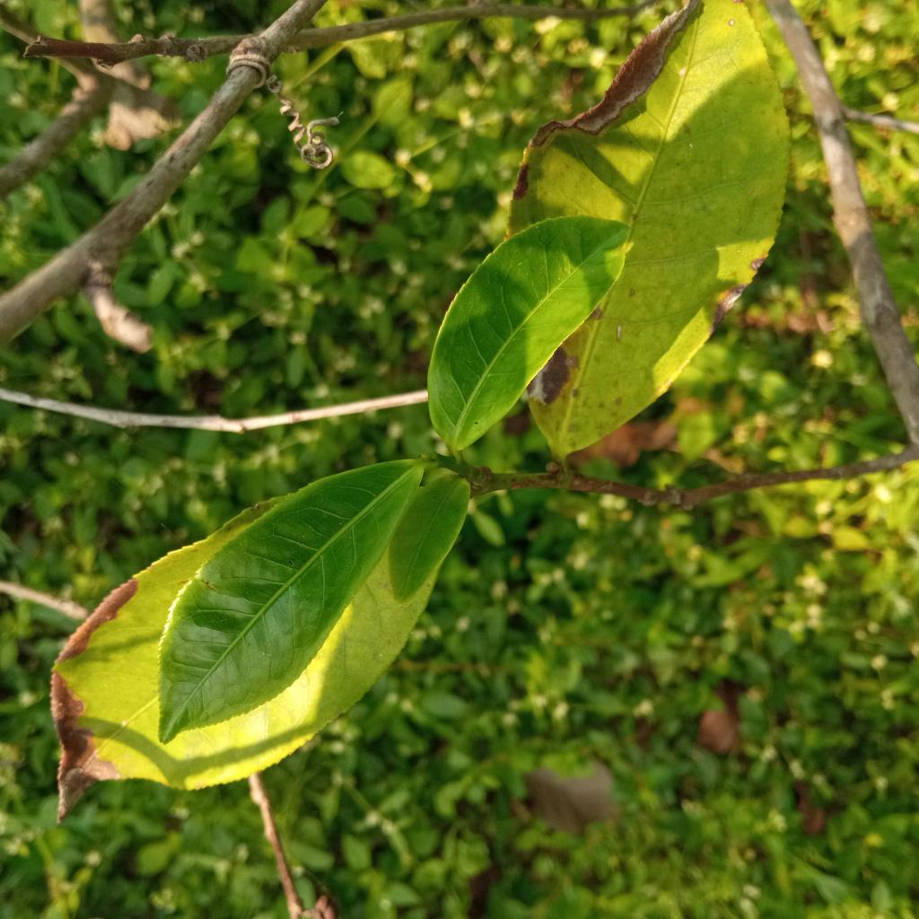
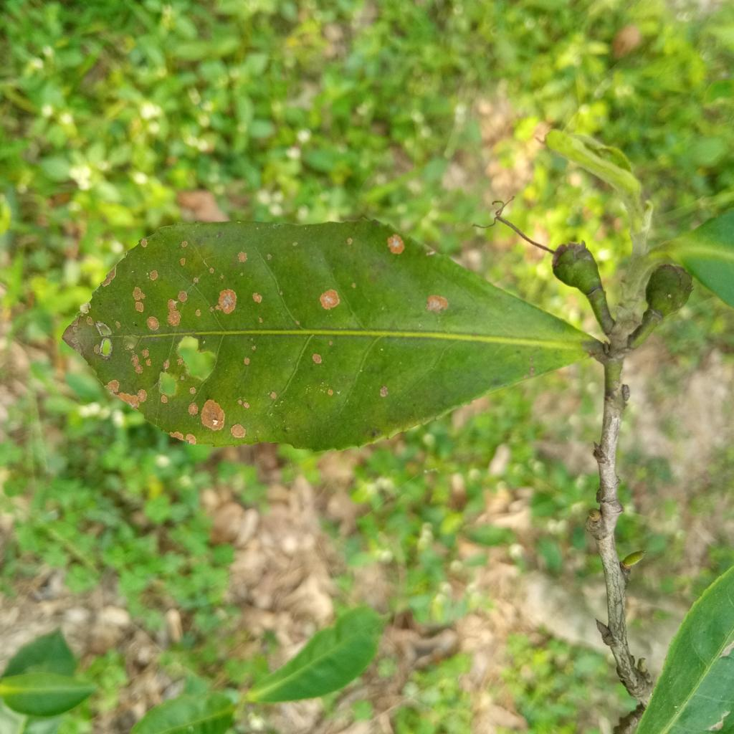
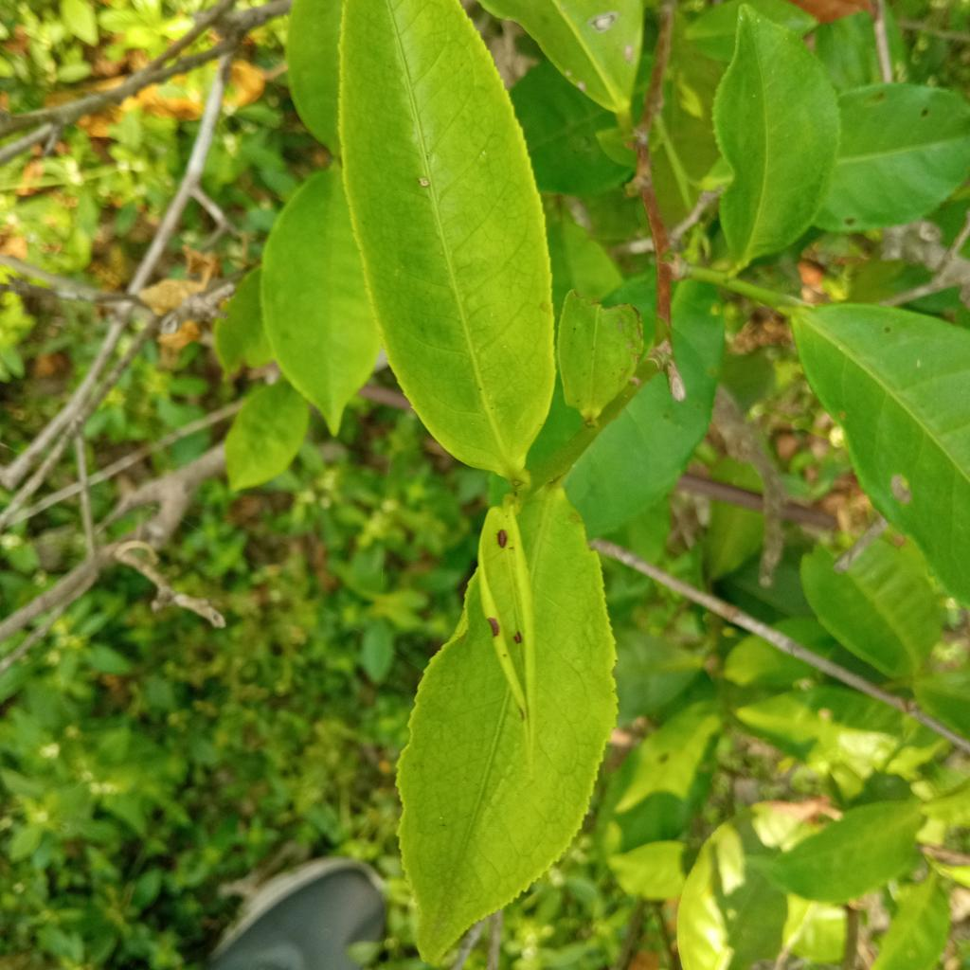
DATASET
Five Tea Leaf Diseases in Scope
The paper now briefly describes what each class looks like in the field.
Class | Real images | Field cue | Type
Leaf blight | 35 | Brown water-soaked necrosis | Fungal/spotting
Leaf hoppers | 8 | Puncture lesions and hopper damage | Insect
Leaf rust | 62 | Orange-yellow pustules | Rust/fungal
Looper caterpillars | 48 | Ragged holes, skeletonised patches | Insect
Mosquito bug | 47 | Corky wounds, shoot-tip dieback | Insect
Why this matters
The dataset mixes fungal spotting, rust pustules, and pest injury. The classifier must learn disease-region texture, not just broad leaf colour.
FarmFederate
3 / 18

Slide 4
DATASET
Dataset Numbers Used in the Paper
These are the final values reflected in FarmFederate_Paper_v3.
Data item | Count | Use in paper
Field photos | 200 | Original localized image source
YOLO-OBB boxes | 371 | Disease-region annotation
Training-run image tensors | 792 | 200 real + 592 minority synthetic fill
Text descriptions | 3,000 | 600 generated symptom records per class
VLM train / val pairs | 633 / 79 | Paired text-image validation
No external Kaggle image corpus in reported training
Colab may write Kaggle credentials, but the paper claim is based on field images + synthetic minority fill + generated symptom text.
FarmFederate
4 / 18

Slide 5
DATASET
Class Balance and Train/Validation Splits
The deck separates the exported balanced folder from the actual reported training loader.
Loader | Train | Validation | Note
Text | 2,400 | 300 | 3,000 rows loaded
Image | 633 | 79 | 792 tensors
VLM pairs | 633 | 79 | Label-matched pairs
Text difficulty | Share | Purpose
Clear templates | 8% | Easy class-specific symptoms
Slightly mixed | 22% | Mild ambiguity
Heavily mixed | 70% | Forces image evidence in VLM
FarmFederate
5 / 18

Slide 6
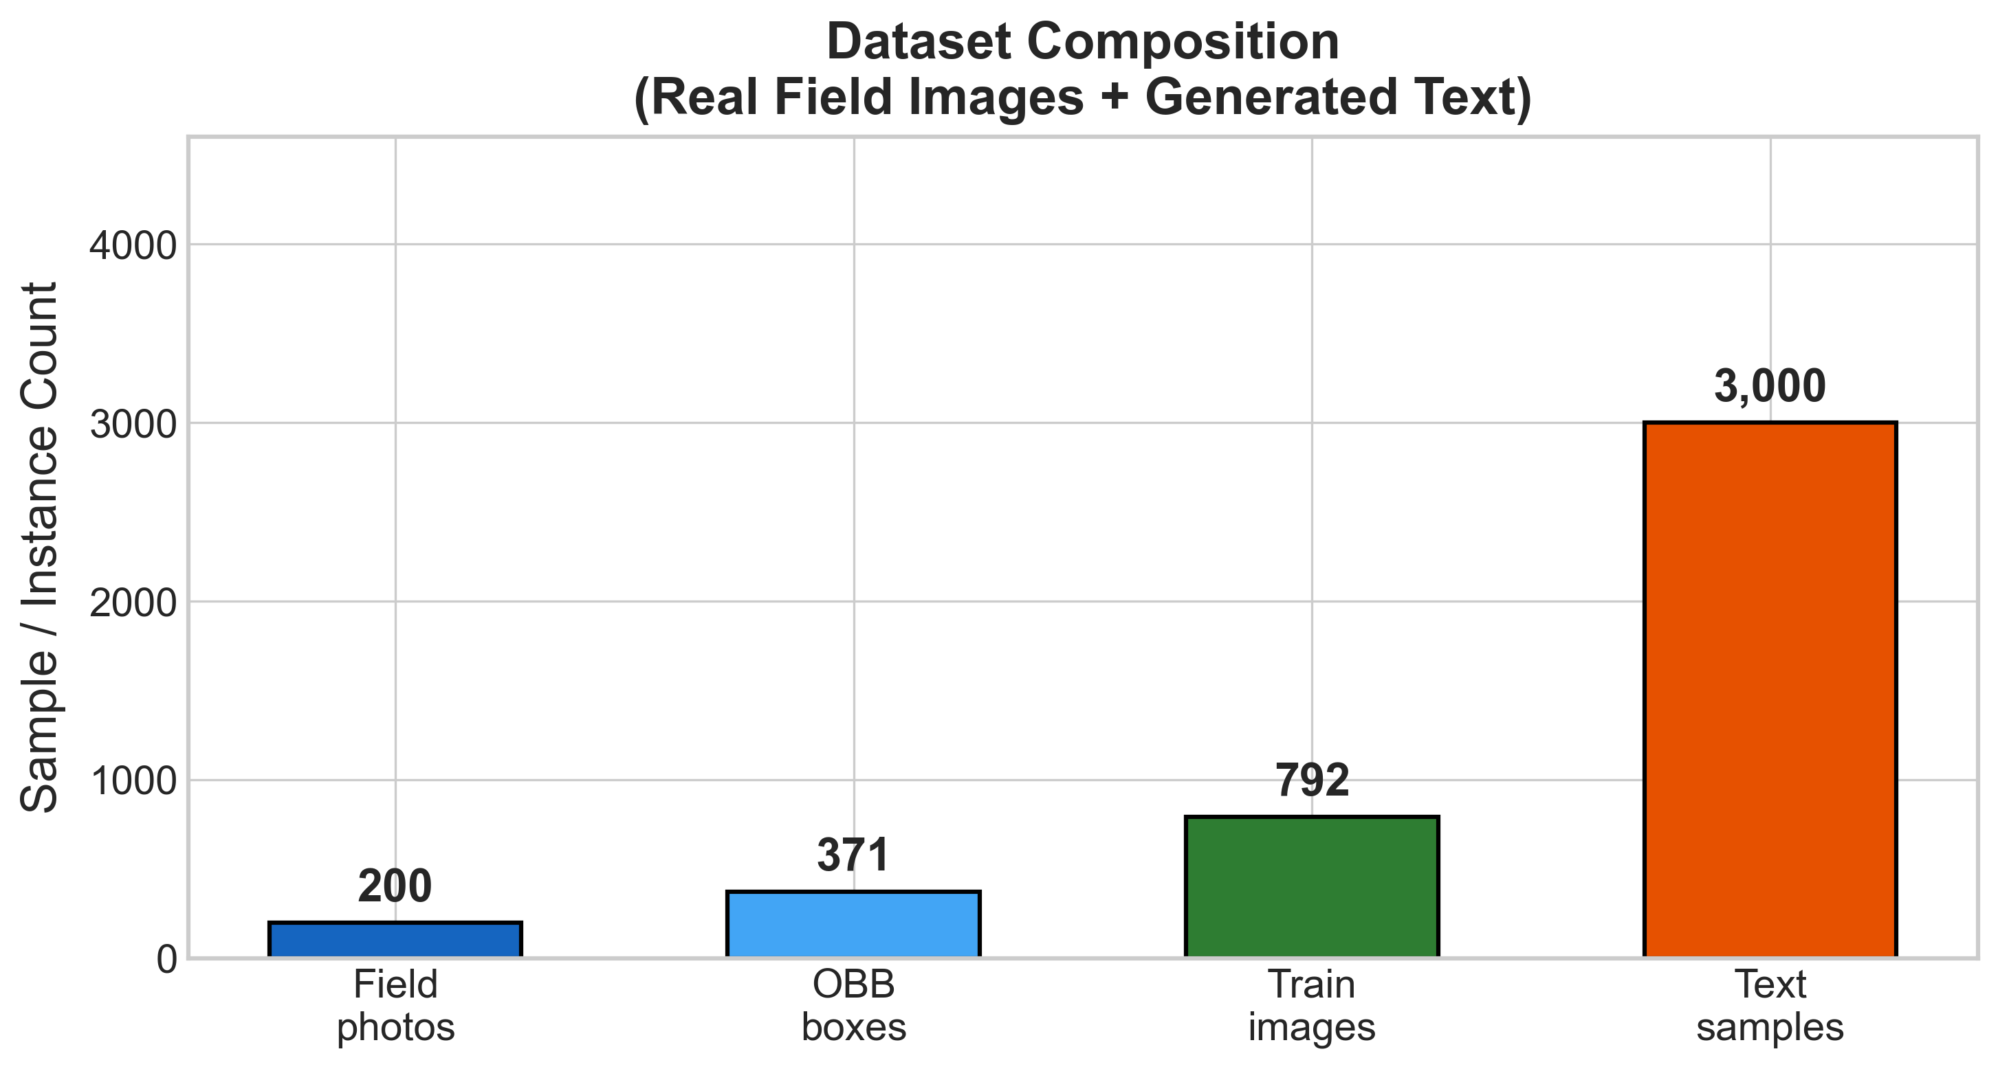
PIPELINE
Field-First Data Pipeline
The pipeline in the deck now matches the Colab logs and paper wording.
Field collection 200 images
Sorted folders 5 diseases
YOLO-OBB labels 371 boxes
Minority fill +592 hoppers
Generated text 600/class
Paper-safe wording
The balanced export folder is described as an inspection/download artifact. The reported training run uses the sorted real dataset and synthetic fill for the rare leaf-hoppers class.
FarmFederate
6 / 18

Slide 7
METHOD
System Architecture
Local text, image, fusion, retrieval, and aggregation components are separated.
Symptom text LLM encoder
Local FAISS RAG advice
8 VLM fusion strategies
Disease classifier
Leaf image ViT encoder
FedAvg server weights only
Privacy boundary
Raw leaf images, symptom logs, and treatment documents remain on garden devices. The global server receives only model updates.
FarmFederate
7 / 18

Slide 8
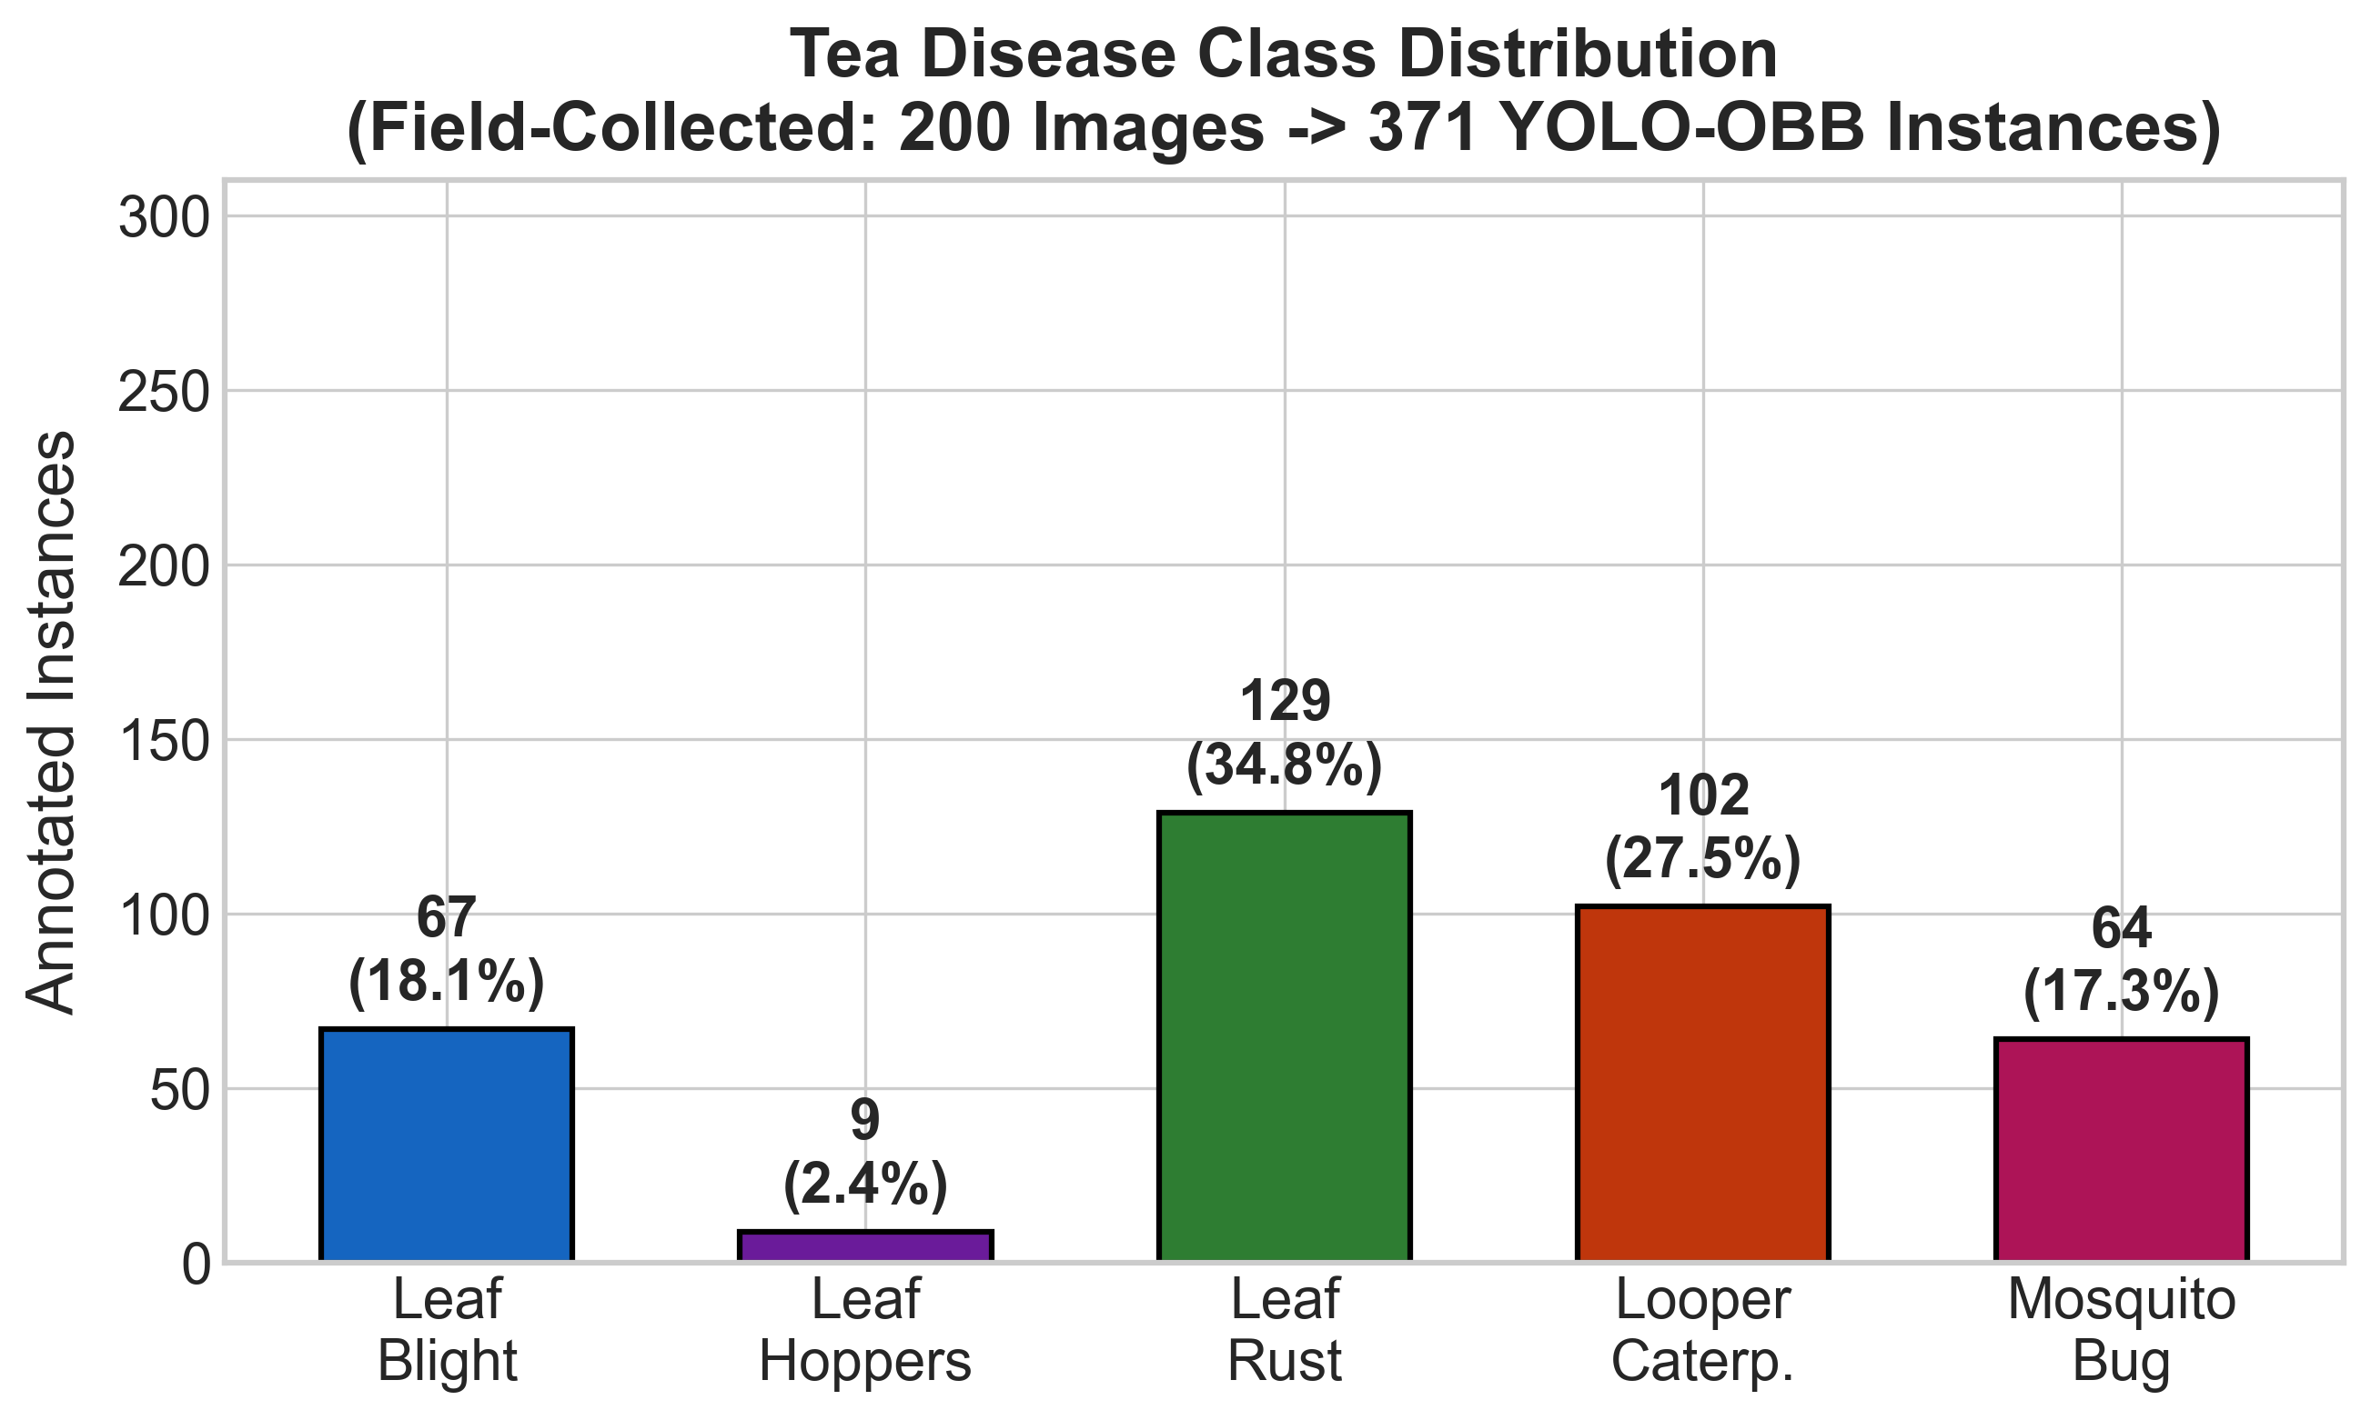
TRAINING
Training Configuration and Anti-Collapse Controls
The final paper reports the safeguards that keep all five classes active.
Component | Setting | Why it matters
Centralized epochs | 12 | Stable comparison across LLM/ViT/VLM
Federated rounds | 8 | Non-IID privacy comparison
Focal loss | enabled | Focuses learning on hard/rare classes
Diversity loss | weight=1.0 | Prevents one-class collapse
Class weights | sqrt damped, max 10x | Avoids over-weight instability
Hardware | Tesla T4 GPU | Colab-realistic training setup
100%
AMP
class diversity target
mixed precision
FarmFederate
8 / 18

Slide 9
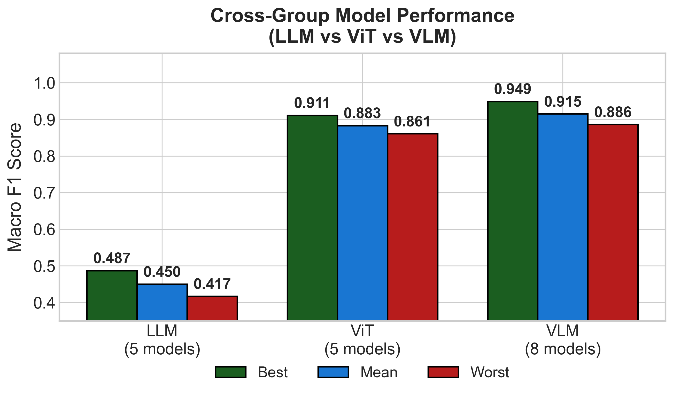
MODELS
Model Families Compared Under One Protocol
5 LLM + 5 ViT + 8 VLM fusion architectures, all reported in the paper.
Family | Count | Best model | Best F1 | Mean F1
LLM | 5 | BERT-tiny | 0.487 | 0.450
ViT | 5 | EfficientNet | 0.911 | 0.883
VLM | 8 | CLIP fusion | 0.949 | 0.915
FarmFederate
9 / 18

Slide 10
RESULTS
Unified Ranking: All 18 Models
A compact table now carries the actual ranking data, not only charts.
Rank | Model | Type | F1
1 | VLM-CLIP | VLM | 0.949
2 | VLM-BLIP-2 | VLM | 0.937
3 | VLM-attention | VLM | 0.924
4 | EfficientNet | ViT | 0.911
5 | VLM-flamingo | VLM | 0.911
6 | VLM-unified_io | VLM | 0.911
7 | ConvNeXT-tiny | ViT | 0.899
8 | VLM-gated | VLM | 0.899
Rank | Model | Type | F1
9 | VLM-coca | VLM | 0.899
10 | VLM-concat | VLM | 0.886
11 | DeiT-tiny | ViT | 0.873
12 | Swin-tiny | ViT | 0.873
13 | ViT-Base | ViT | 0.861
14 | BERT-tiny | LLM | 0.487
18 | MobileBERT | LLM | 0.417
Takeaway: all VLM fusions beat all LLM-only models; top VLM also beats the best image-only model.
FarmFederate
10 / 18

Slide 11
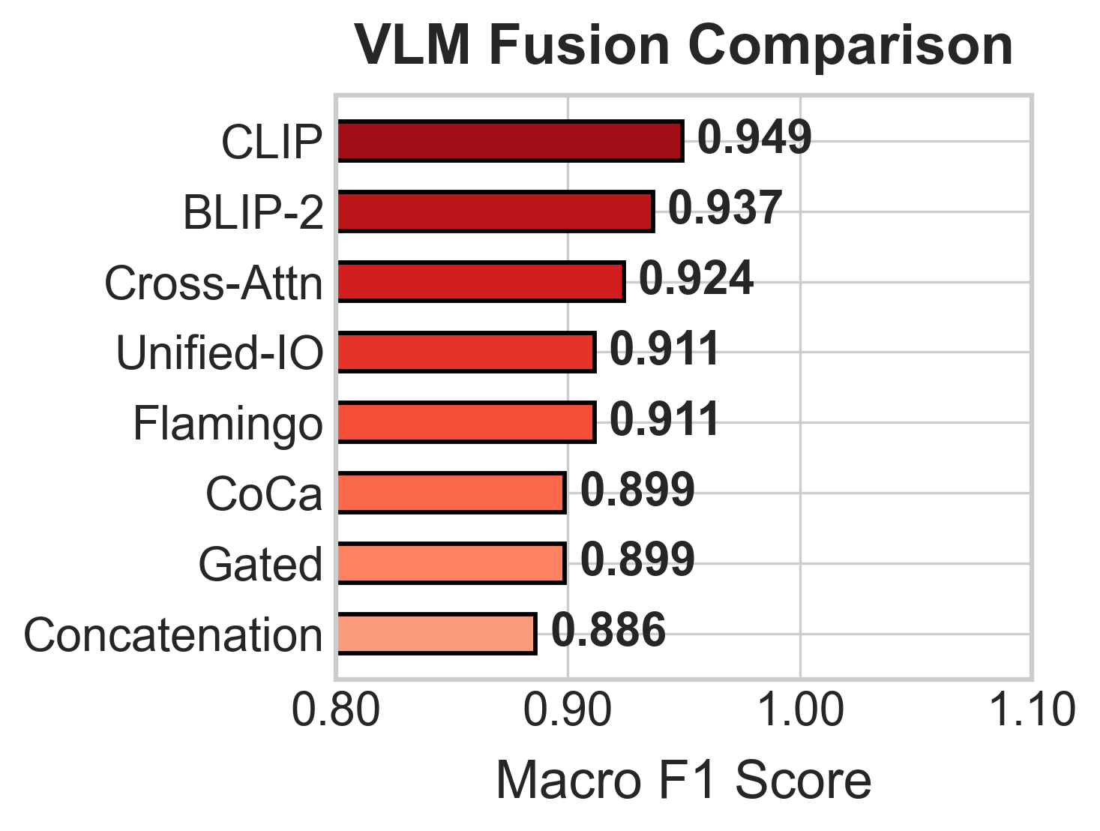
RESULTS
VLM Fusion Details
The model comparison now includes the eight multimodal fusion variants.
Fusion | F1 | Params (M) | Note
CLIP | 0.949 | 15.74 | Best overall
BLIP-2 | 0.937 | 15.94 | Second
Attention | 0.924 | 15.87 | Strong fusion
Flamingo | 0.911 | 16.14 | Tied group
Unified-IO | 0.911 | 17.19 | Largest
Gated | 0.899 | 15.80 | Mid
CoCa | 0.899 | 16.20 | Mid
Concat | 0.886 | 15.61 | Baseline fusion
0.063
15.61-17.19M
VLM F1 range
parameter span
FarmFederate
11 / 18

Slide 12
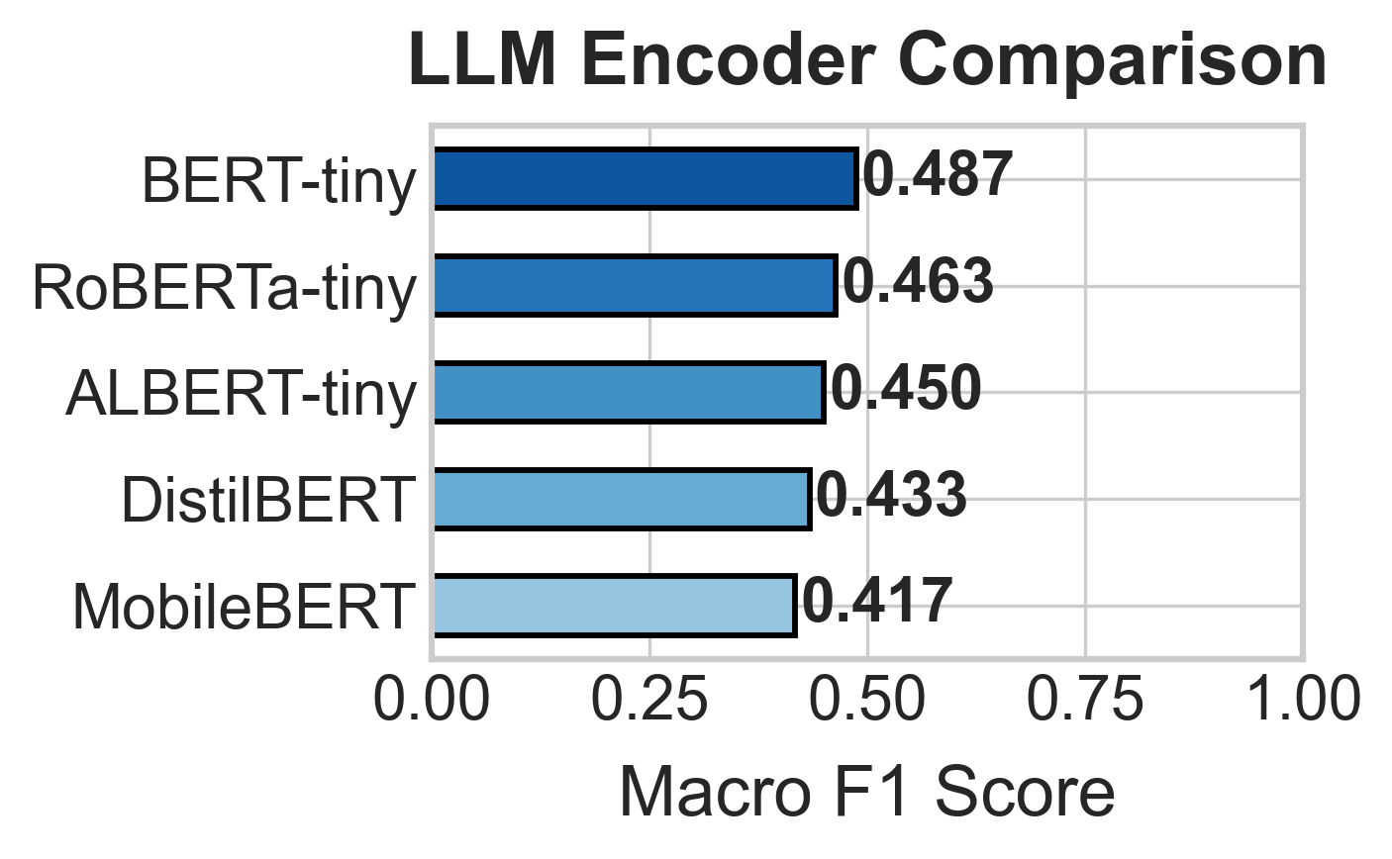
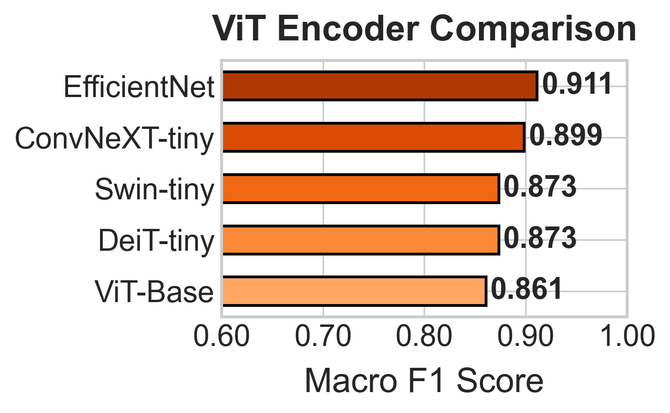
RESULTS
Encoder Baselines: Text vs Image vs Fusion
Side-by-side plots and a data table make the modality gap clear.
Best by modality | Model | F1 | Interpretation
Text-only | BERT-tiny | 0.487 | Symptom text is intentionally ambiguous
Image-only | EfficientNet | 0.911 | Visual disease cues dominate
Multimodal | VLM-CLIP | 0.949 | Text+image fusion adds top-line gain
FarmFederate
12 / 18

Slide 13
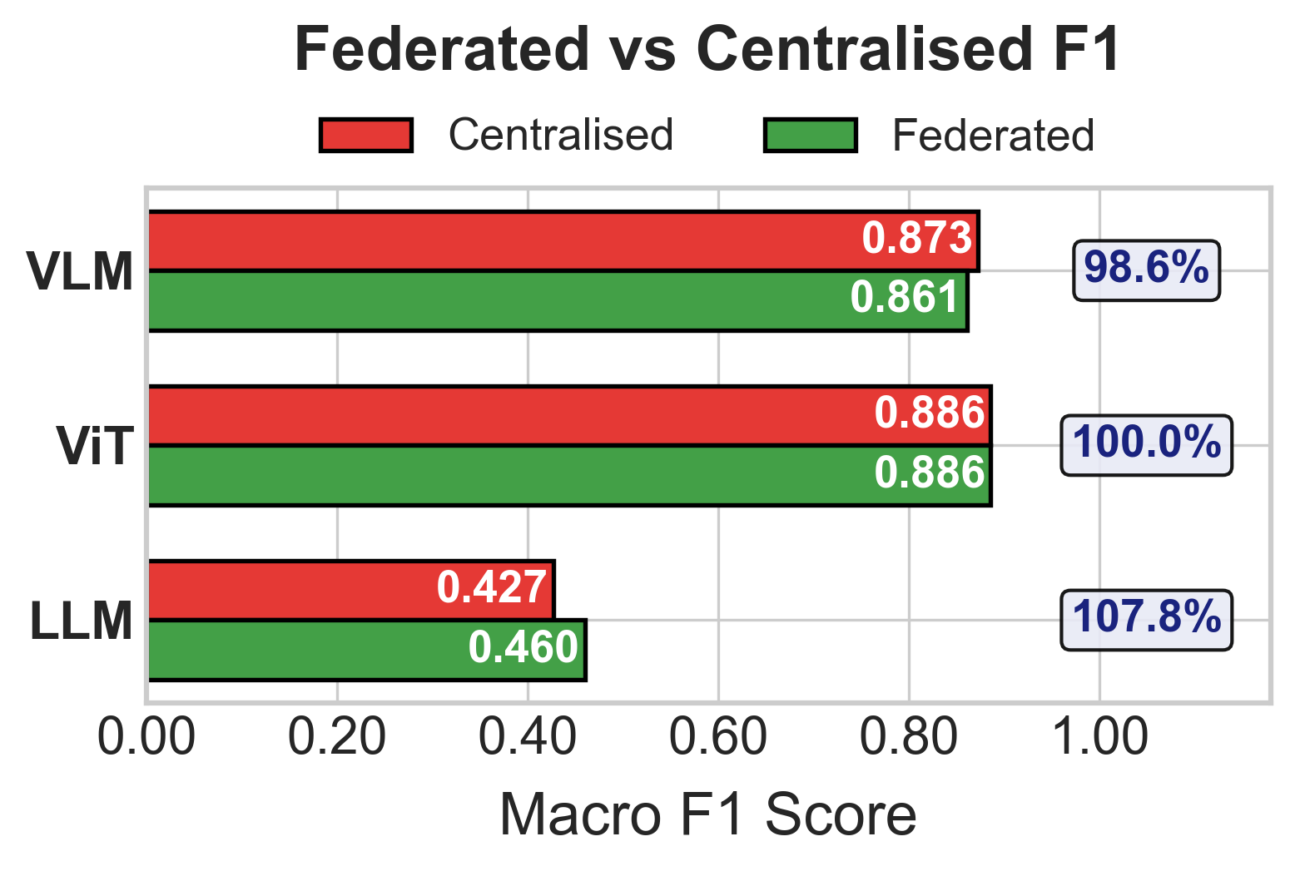
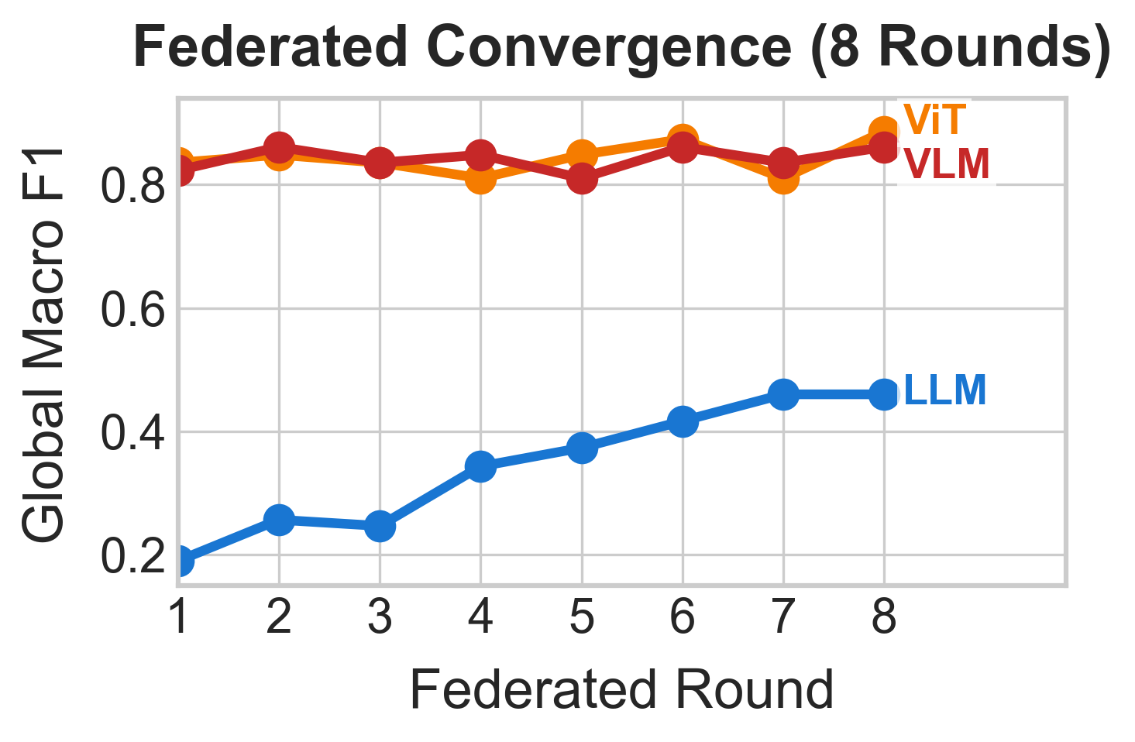
FEDERATED
Centralized vs Federated: Utility Retention
The privacy-preserving setup keeps nearly all VLM performance.
Model | Centralized F1 | Federated F1 | Retention | Winner
LLM | 0.427 | 0.460 | 107.7% | Federated
ViT | 0.886 | 0.886 | 100.0% | Tie
VLM | 0.873 | 0.861 | 98.6% | Centralized
Interpretation
The federated comparison measures whether the multimodal gain survives aggregation, not whether a centrally pooled public image dataset was added.
FarmFederate
13 / 18

Slide 14
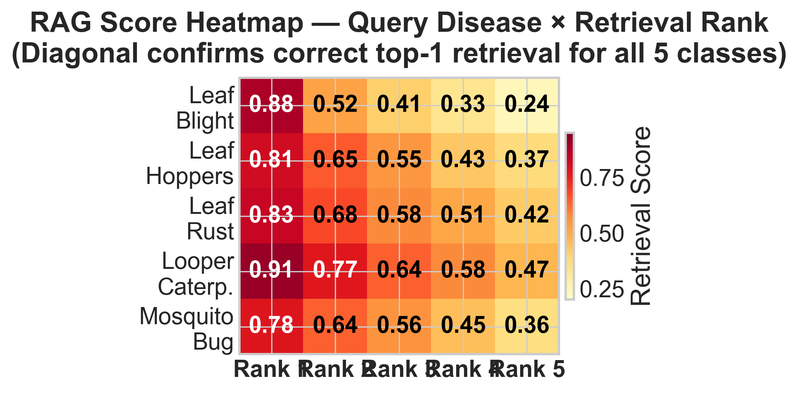
RAG
RAG Advisory + Visual Diagnostic Fallback
Classification is paired with local treatment retrieval and annotated visual references.
RAG element | Paper value
Knowledge base | 5 disease treatment docs
Retrieval | Top-1 correct for all classes
Fallback | OBB annotated leaf reference
Privacy | Per-estate FAISS stays local
Operational value
When symptom text is uncertain, FarmFederate gives a disease label, visual region evidence, and treatment advice without uploading raw records.
FarmFederate
14 / 18

Slide 15
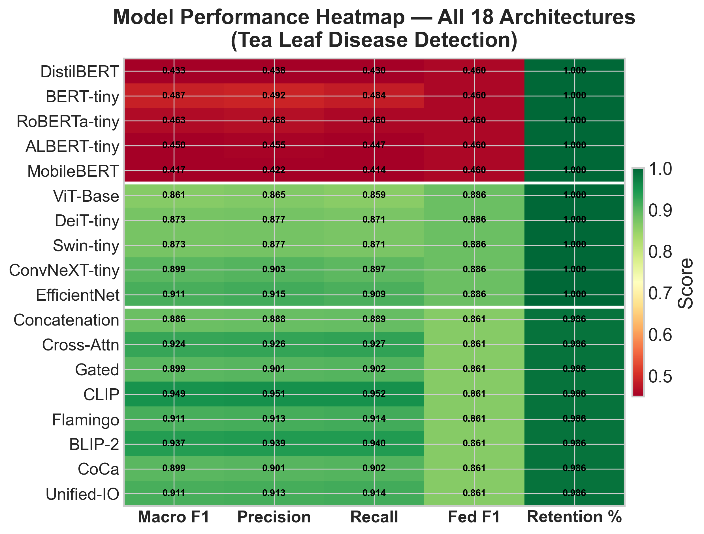
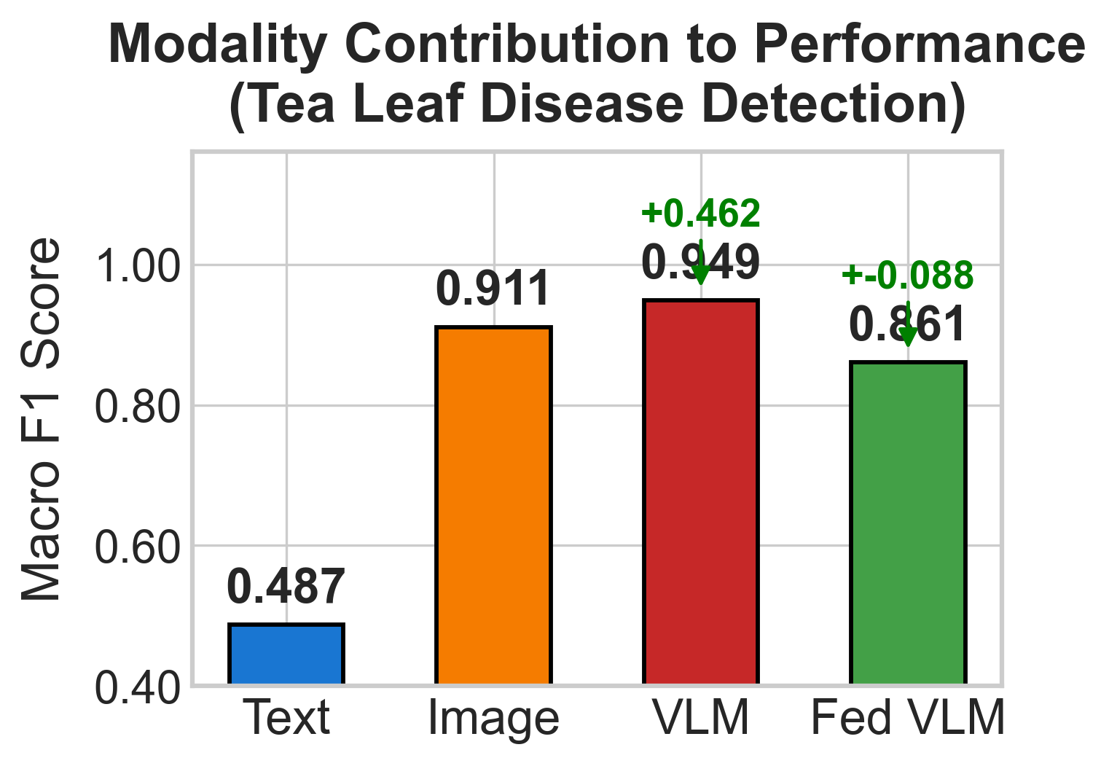
EVIDENCE
Ablation and Model Heatmap
Results stay in the results section; conclusion now only concludes.
Configuration | Text | Image | F1
Text-only BERT-tiny | Yes | No | 0.487
Image-only EfficientNet | No | Yes | 0.911
Multimodal VLM-CLIP | Yes | Yes | 0.949
FarmFederate
15 / 18

Slide 16
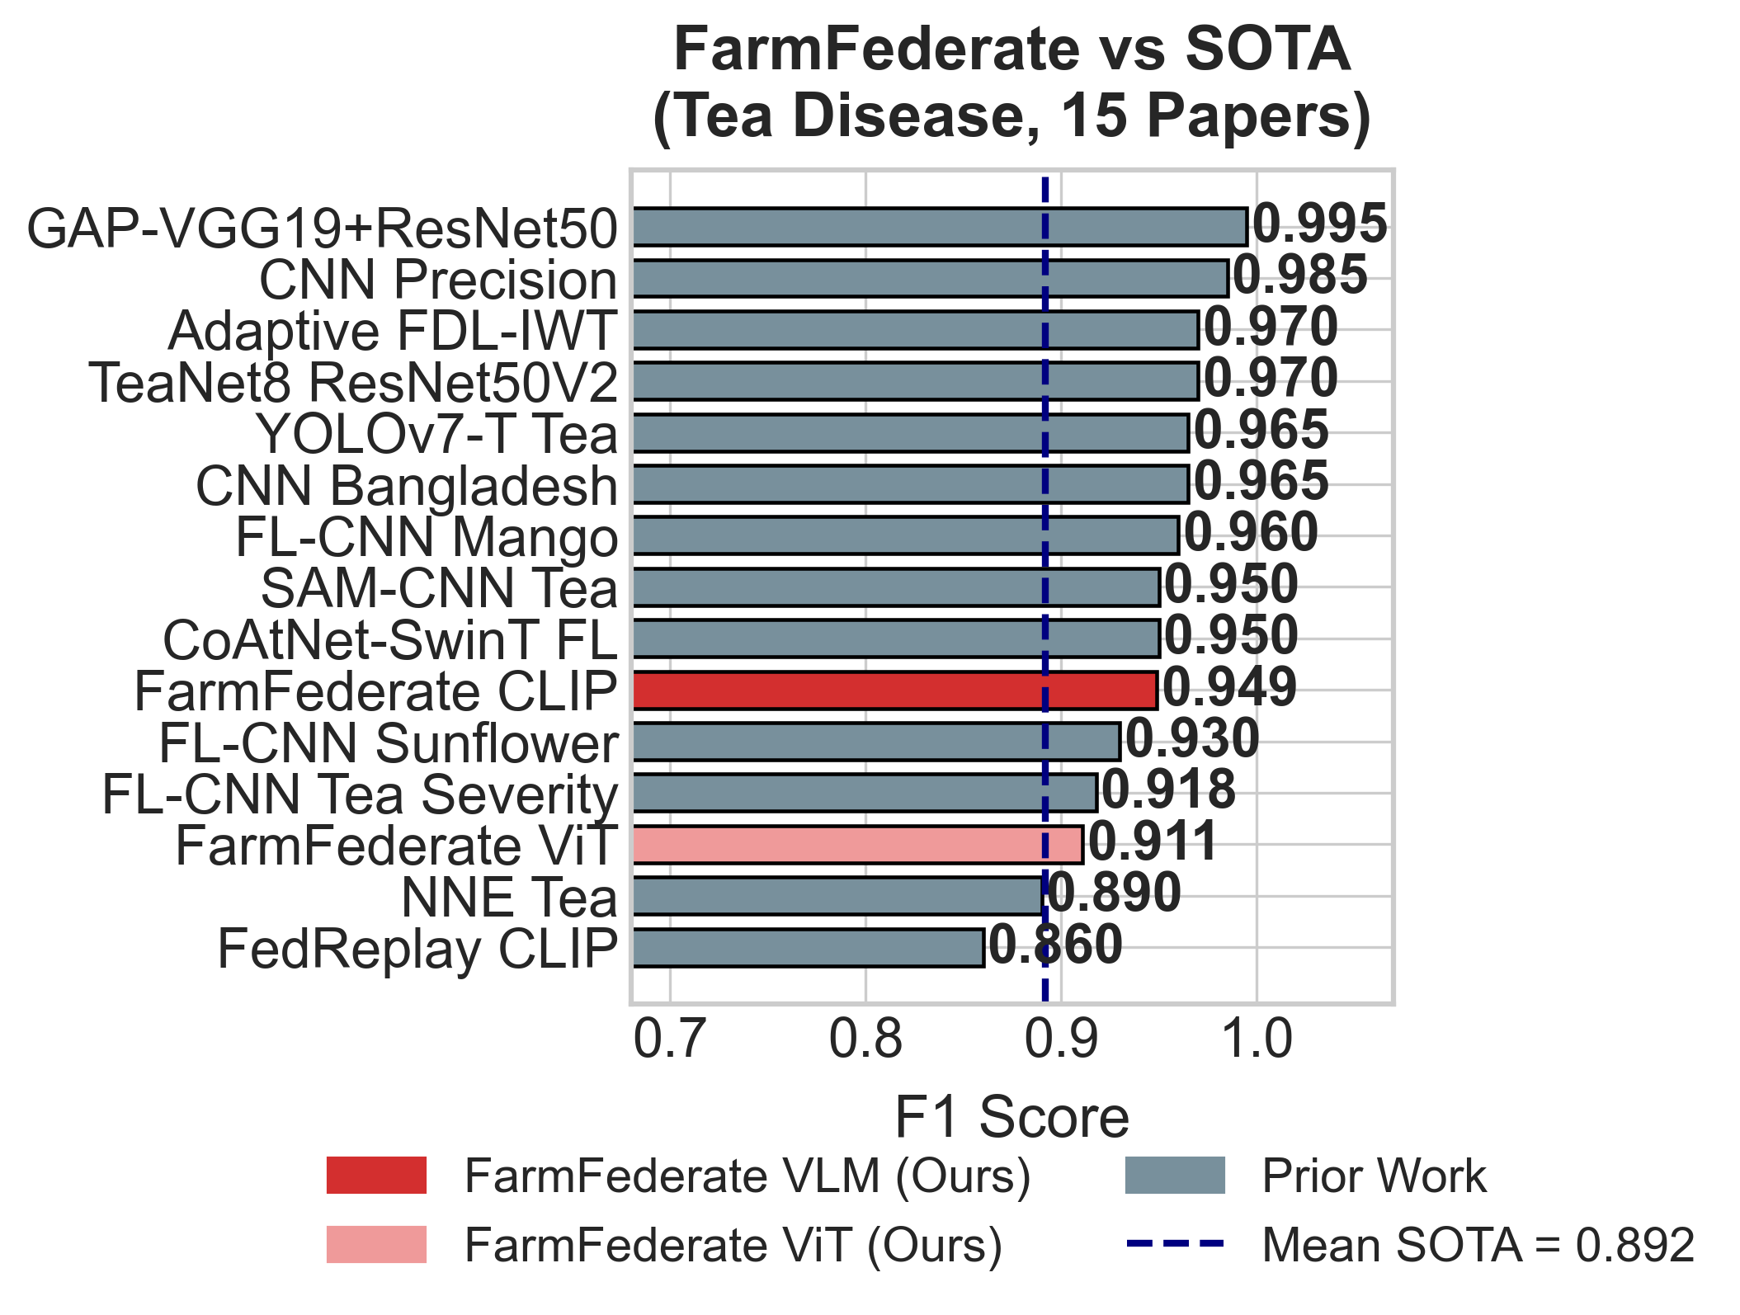
BENCHMARK
SOTA Context: Competitive Performance + Privacy
FarmFederate is near the leading group while adding multimodal FL and local RAG.
Metric | Value | Meaning
FarmFederate rank | #12 / 35 | Top tier of compared tea/plant disease models
FarmFederate F1 | 0.949 | Best VLM-CLIP result
Mean SOTA F1 | 0.892 | FarmFederate exceeds benchmark mean
Best literature F1 | 0.995 | Highest image-centric tea CNN
Fair positioning
The paper presents FarmFederate as competitive, not universally best: its novelty is multimodal federated diagnosis with local advisory retrieval.
FarmFederate
16 / 18

Slide 17
DEPLOYMENT
Deployment Notes, Limitations, and Future Work
The conclusion now combines limitations and future work compactly.
Area | Current paper | Next step
Data | 5 localized tea diseases | Expand crop/disease coverage
Privacy | FedAvg, local records | Formal differential privacy
Clients | Simulated non-IID clients | Physically separated estates
Models | Colab/edge-sized encoders | Compare larger foundation VLMs
Context | Weather/IoT adjustments | Live sensor streams
Deployment claim
Images and symptom records stay local; ViT supports image-only diagnosis, text encoders support symptom logs, and CLIP-style fusion is used when both modalities are available.
No-Kaggle guardrail
The deck and paper state the same thing: no external Kaggle image corpus is used in the reported training pipeline.
FarmFederate
17 / 18

Slide 18
Final Takeaway
Performance
VLM-CLIP is strongest: F1=0.949 across 18 models.
Data integrity
Reported training uses field images, minority synthetic fill, and generated symptom text; no Kaggle image corpus.
Privacy
FedAvg keeps raw images, logs, and advisory documents local.
Utility
RAG + visual fallback turns classification into field-facing advice.
Ayush Debnath · 22ME31010 · Supervisor: Prof. Sudip Misra · IIT Kharagpur
18 / 18

