Slide 1



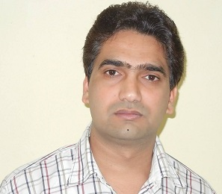
Traffic-Aware Satellite Switch-off Technique for LEO Constellations
Vaibhav Kr GUPTA
Vaibhav.gupta@uni.lu
Co-authors:
Dr. Hayder Al-Hraishaw
Dr. Eva Lagunas
Prof. Symeon Chatzinotas
WS04: Cellular UAV and Satellite Communications Workshop

Slide 2
Outline
Introduction
Problem statement, System and Channel Model
Optimization Problem Formulation and Relaxation
Numerical results
Conclusion
Future Work

Slide 3
Outline
Introduction
Problem statement, System and Channel Model
Optimization Problem Formulation and Relaxation
Numerical results
Conclusion
Future Work
Notes:
Although, the 5G terrestrial networks can provide highspeed, high-capacity, low latency, and reliable communication service for terrestrial mobile users, how to provide high-speed communication service for aeronautical and maritime users still demands a prompt solution. Recent researches have shown that LEO satellite can play an essential role to achieve this global coverage mission in future communication networks due to low latency and high bandwidth per user. Therefore, many big industries are working on LEO mega-constellation projects, e.g., Starlink, OneWeb etc.

Slide 4
motivation
Mobile users
Maritime User locations at different time stamps of a day.
Dynamic demand from SnT traffic emulator https://github.com/hayder-hussein/Satellite-Traffic-Simulator.
Notes:
However, density of maritime/aeronautical users changes both with time and location as shown in this fig. Therefore, traffic demand of these users also changes with time and location. Hence, homogeneus resource allocation leads to inefficient utilisation.

Slide 5
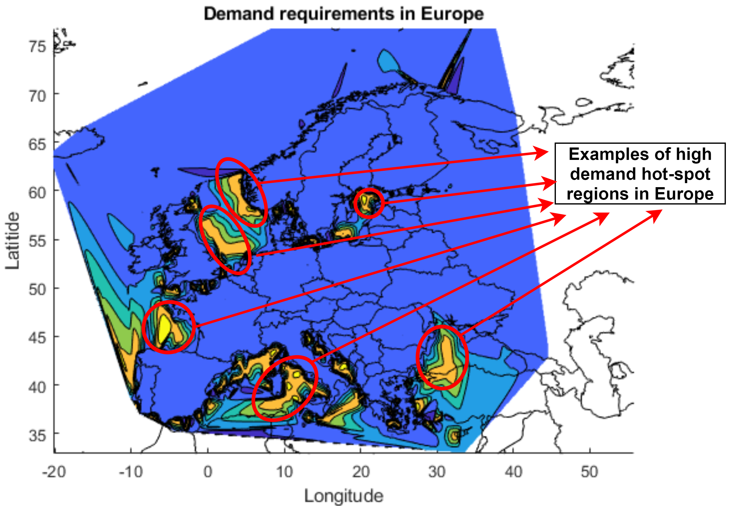
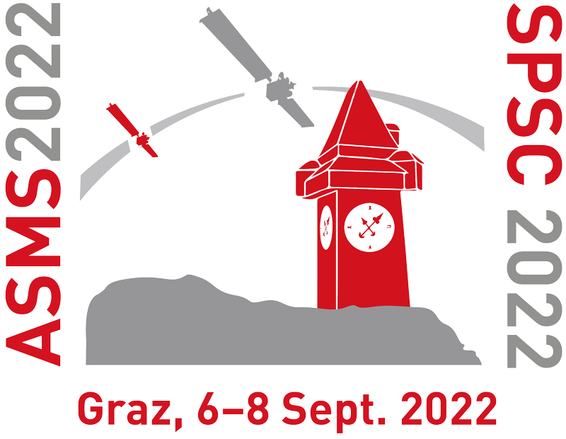
motivation
Non-uniform demand
Even at one time stamp, user distribution is non-uniform on ground and, consequently, the demand-distribution varies geographically.
Hence, resource allocation in current satellite systems need to adapt to the change in demand distribution.
Notes:
LEO constellations still need to address a set of development challenges to ensure long-term viability; particularly, in terms of energy efficiency and satellite lifespan.
More importantly to manage the aggregated interference issues due to the massive number of multi-beam satellites.
In order to retain the small size of LEO satellites, they operate with small sized batteries. In addition, they are in shadow phase for approximately half of their constellation period. Therefore, the battery lifetime is crucial for reliability of LEO satellites, and this coupled with the fact that it is impractical to replace the satellite batteries, make employing energy-efficient mechanisms for extending their lifespan essential.

Slide 6
Outline
Introduction
Problem statement, System and Channel Model
Optimization Problem Formulation and Relaxation
Numerical results
Conclusion
Future Work

Slide 7
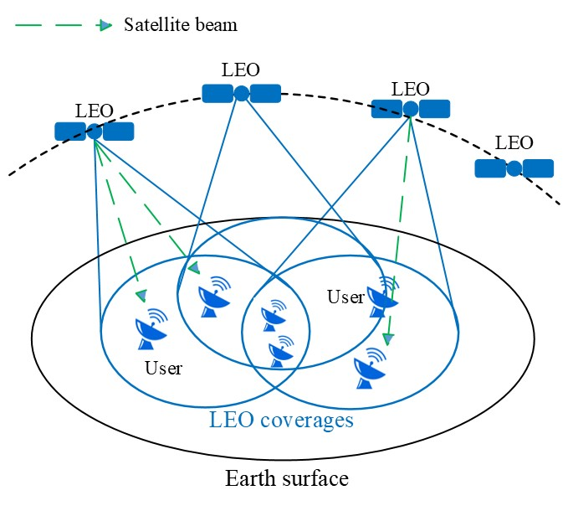
Problem statement, System and Channel Model
Problem statement
Developing a novel joint beam assignment, active beam power allocation, and satellite switch-off technique based on dynamic LEO satellite constellation pattern while considering the practical 3GPP channel model, and realistic user traffic demands.
A layout of multi-beam LEO satellite constellation coverage and ground users distributed over the Earth surface.
Notes:
Developing a traffic-aware and dynamic satellite/beam switching off technique will not only save the onboard energy but also alleviate the aforementioned interference issues.

Slide 8






System and channel model under study
System Model
Set of LEO Satellites:
N$=\{1,…,N\}$
Set of ground users:
M$=\{1,…,M\}$
Satellite user visibility :
V(t)$=\{v_{n,m}|n∈\text{N}, m∈\text{M}$}
The maximum number of beams per satellite:
$$N_{B}$$
The traffic demand of the m-th user at time instance t :
$$D_{m}(t)$$
Gas attenuation Scintillation Loss
Channel Model
Path losses of the link between the n-th satellite and the m-th user :
$${PL}_{m}^{n}= {PL}_{b}\left(n,m\right)+{PL}_{g}+{PL}_{s}$$
SNR from the n-th satellite to the m-th user in dB :
${SNR}_{n,m} =G_{t}+G_{r}+P_{n,m}−$ ${PL}_{m}^{n}$ $−P_{n}$
Transmit Power Noise Power

Slide 9
Outline
Introduction
Problem statement, System and Channel Model
Optimization Problem Formulation and Relaxation
Numerical results
Conclusion
Future Work

Slide 10
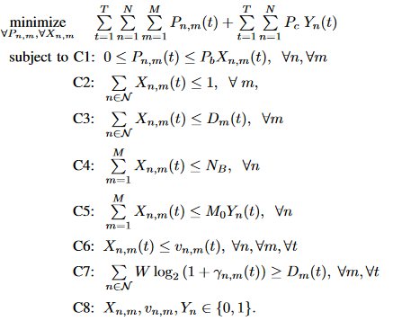




Optimization problem formulation and Relaxation
$P_{c}$:
Fixed circuit power consumption
Max beam power constraint
Each user can be served by 1 satellite
User having demand will be allocated a beam
Max number of beam per satellite
Satellite is ON iff it is serving atleast a user
$$γ_{n,m}(t)$$
: SNR from n-th satellite to
m-th user in linear scale
User can only be served by visible satellite
W : Bandwidth
User QoS (demand) satisfaction

Slide 11

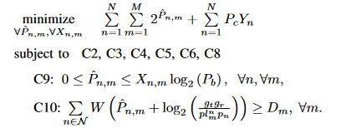

Optimization problem formulation and Relaxation
Problem Relaxation and Proposed Solution
The time horizon T is divided into equal time slots and solve the optimization problem in each time slot.
Constraint C7 can be approximated for high SNR regime as follows:
Now, using change of variable such that
$${\hat{P}}_{n,m}=\log_{2} P_{n,m}$$

Slide 12
Outline
Introduction
Problem statement, System and Channel Model
Optimization Problem Formulation and Relaxation
Numerical results
Conclusion
Future Work

Slide 13
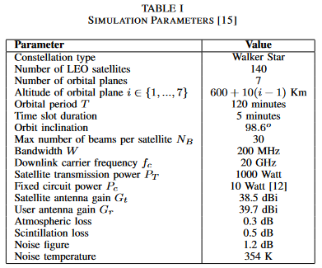
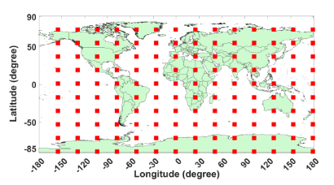
Numerical results
Numerical Results
A schematic diagram of the LEO constellation that includes 140 LEO satellites (represented as red squares) distributed over the Earth surface.
The visibility between a user and a satellite is computed using the Earth-centered, Earth-fixed coordinate (ECEF) coordinates of the satellite and user coordinates.

Slide 14

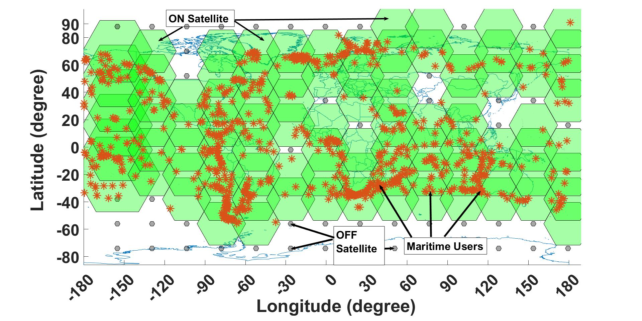

Numerical results
The slant range from a user on the ground to a satellite
Min elevation angle
$$∈_{min}={10}^{o}$$
A snapshot of the constellation coverage showing the association of the active satellites and the users obtained from the proposed solution to satisfy demands of maritime users over the Earth surface

Slide 15
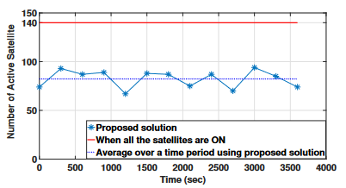
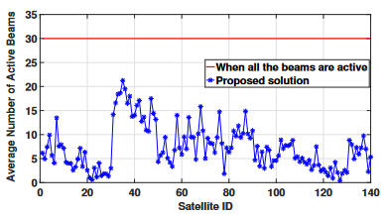
Numerical results
The plot shows the number of active satellite required to satisfy the demand of all the user vs time when every satellite has 30 beams.
The figure plots a comparison in terms of the average number of active beams required to satisfy the demand of all the users over an orbital time period with and without using the proposed solution.

Slide 16
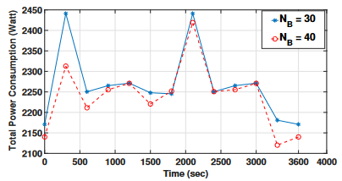
Numerical results
The figure plots a comparison in terms of the total power consumption of the constellation during an orbital time period for two different values of number of satellite beams using the proposed solution.

Slide 17
Outline
Introduction
Problem statement and methods under study
Simulation
Numerical results
Conclusion
Future Work

Slide 18
Conclusion
Conclusion
A dynamic traffic-aware satellite switch-off approach is proposed to minimize the power consumption in LEO satellite constellations.
A mixed binary integer optimization problem has been formulated and solved by relaxation to minimize the total power consumed by the LEO constellation without causing any demand dissatisfaction.
The results have shown that a considerable percentage of the satellite nodes can be dispensable and switched-off, which may reach 40% in some cases.
In short, the developed technique in this paper can significantly reduce energy consumption of satellites, and consequently, extending their lifespan and diminishing the interference impact on the concurrent communications.

Slide 19
Outline
Introduction
Problem statement and methods under study
Simulation
Numerical results
Conclusion
Future Work

Slide 20
Future work
Future work
The effect of inter beam interference shall be evaluated in the future work.
To reformulate the optimization problem by considering binary variables as continuous variables and to propose low complexity heuristic to minimize the power consumption.
Practically, the on-off and off-on transition is not instantaneous and should take some time and consume some energy. Therefore, it is an important aspect how to handle the transition time between on-off and off-on.
Since the formulated joint optimization problem is non-convex and hard to solve, we will develop low complexity algorithm using deep learning for solving more efficiently.

Slide 21
Thank you

