Slide 1
Spiking vs. Standard PointNet
3-D Point Cloud Classification with Temporal Slicing & Early Exit
PointNet-SNN vs. PointNet-ANN on ModelNet10
Purdue Project — SNN Experiment
February 19, 2026
695K
10
ModelNet10
16
Parameters
Epochs
Dataset
Time Slices
1 / 14

Slide 2
Outline
01
Motivation & Research Questions
07
Accuracy vs. Timestep
02
Dataset — ModelNet10 & Radial Slicing
08
Early Exit Analysis
03
Model Architectures (ANN vs. SNN)
09
Confidence Growth & Threshold Tradeoff
04
Training Setup & Loss Function
10
Analysis, Limitations & Next Steps
05
Training Results
11
Conclusion
06
Test Inference — 4 Modes
2 / 14

Slide 3
Motivation & Research Questions
Why Spiking Neural Networks?
Research Questions
• Event-driven, sparse computation
Q1
Can SNN-PointNet match standard ANN accuracy on ModelNet10 with the same training budget?
• Biologically inspired temporal dynamics
• Energy-efficient on neuromorphic hardware
• Natural fit for sequential / streaming data
Q2
Does membrane potential accumulation across slices produce progressively better predictions?
• Integrate-and-fire = running evidence accumulator
Q3
Does confidence grow monotonically, enabling meaningful early exit at test time?
3 / 14

Slide 4
Dataset — ModelNet10 & Radial Temporal Slicing
ModelNet10
Radial Temporal Slicing
Train samples
3,991
1
Compute centroid mu = mean(points)
Test samples
908
2
Compute radial distance d_i = ||p_i - mu||
Classes
10
Points per cloud (N)
1,024
3
Sort points inner -> outer by distance
Point features
(x, y, z) only
File format
.npy
4
Split into T=16 slices (64 pts / slice)
10 Classes:
5
Feed slices sequentially to the network
bathtub · bed · chair · desk · dresser monitor · night stand · sofa · table · toilet
Coarse-to-fine: inner slices = shape skeleton, outer slices = surface detail
4 / 14

Slide 5
Model Architectures — ANN vs. SNN
Slice S_t [B, 64, 3]
Backbone MLP (per-point)
Mean Pool [B, 512]
Temporal Head (stateful)
Logits [B, 10]
->
->
->
->
Shared macro-architecture (695,562 parameters in both models)
PointNet-ANN (Baseline)
PointNet-SNN (Proposed)
Backbone
3 x Linear + ReLU
3->128->256->512
Backbone
3 x LIF layer
3->128->256->512
Temporal head
2 x Linear + ReLU
512->512->512->10
Temporal head
2 x LIF + FC
512->512->512->10
State across slices
Cumulative mean
of slice embeddings
State across slices
Membrane potential
u_t = tau*u_(t-1)+Wx
Activation
ReLU (standard)
f(x) = max(0,x)
Activation
Heaviside + surrogate
grad: 1/(1+|u|)^2
Generalisation
76.2% test accuracy
(after 10 epochs)
Generalisation
58.3% test accuracy
(after 10 epochs)
5 / 14

Slide 6
LIF Neuron Dynamics & Training Loss
Leaky Integrate-and-Fire (LIF)
Training Loss Function
Membrane update:
L = L_CE(y_hat_T, y) + lambda * SUM L_CE(y_hat_t, y)
u_t = tau * u_(t-1) + W * x_t
Spike emission:
L_CE(y_hat_T, y)
s_t = Theta(u_t - theta)
Final-slice loss
Supervises the last timestep (T=16). Drives end-to-end accuracy.
Soft reset:
u_t <- u_t * (1 - s_t)
Surrogate grad:
ds/du ~ 1 / (1 + |u|)^2
lambda * SUM L_CE(y_hat_t, y)
Parameters
Auxiliary loss (lambda=0.3)
Supervises ALL intermediate steps. Forces every slice to carry class information -> enables early exit.
tau (decay)
0.9
theta (threshold)
1.0
Reset type
Soft (subtract)
Gradient approx.
Surrogate
Optimizer: AdamW | LR: 1e-3 | Grad clip: 1.0 | Batch: 16
6 / 14

Slide 7
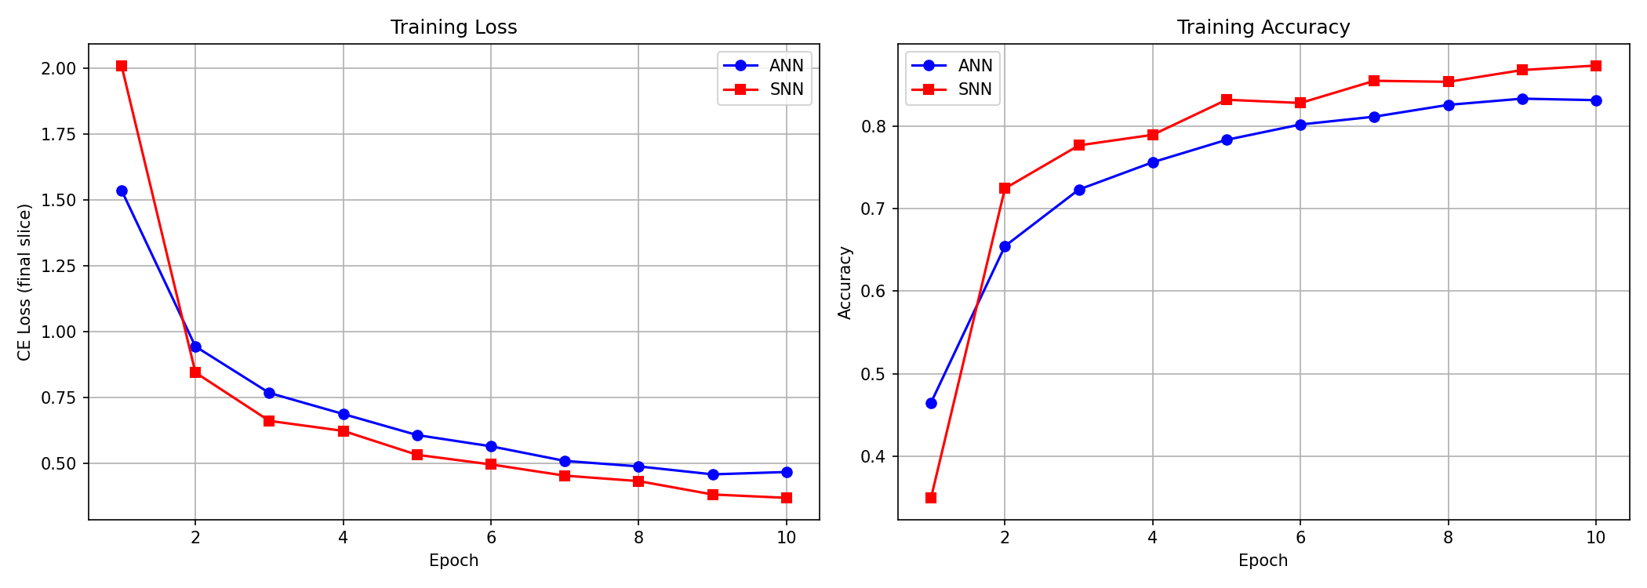
Training Results — 10 Epochs
Key Numbers
ANN Epoch 1
46.5%
ANN Epoch 10
83.2%
SNN Epoch 1
35.0%
SNN Epoch 10
87.4%
SNN starts slower (membrane calibration) but surpasses ANN by epoch 2
Both models converge stably with no spikes or instability.
7 / 14

Slide 8
Test Inference — Four Evaluation Modes
ANN + Full
ANN + Slice
Why is SNN+Full near-random (9.25%)?
SNN + Full
SNN + Slice
Test Accuracy
Test Accuracy
Test Accuracy
Test Accuracy
The SNN temporal head is designed to integrate across 16 slices, with membrane potential acting as a running accumulator. Feeding all 1024 points in ONE step gives only a single integration tick — the membrane never builds meaningful state. The correct comparison is SNN+Slice (58.3%).
76.21%
76.21%
9.25%
58.26%
Mean Exit Step
Mean Exit Step
Mean Exit Step
Mean Exit Step
--- / 16
7.25 / 16
--- / 16
8.82 / 16
Single forward pass on all 1024 points. No slicing. Serves as the main baseline.
Cumulative mean of slice embeddings. Matches Full; exits at step 7 on average.
Single pass, one membrane step. NOT the intended mode — near-random (temporal dynamics not engaged).
Sequential slices + persistent membrane. Intended SNN mode. Mean exit: step 8.82.
8 / 14

Slide 9
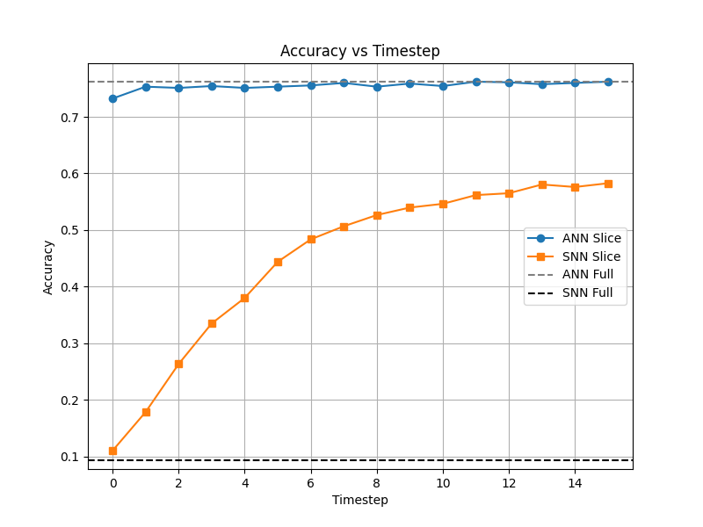
Accuracy vs. Timestep
Observations
ANN rises steeply, plateaus by slice 6-8
SNN shows slower but sustained growth
Both exceed baselines well before T=16
Early exit viable from slice 6 onward
9 / 14

Slide 10
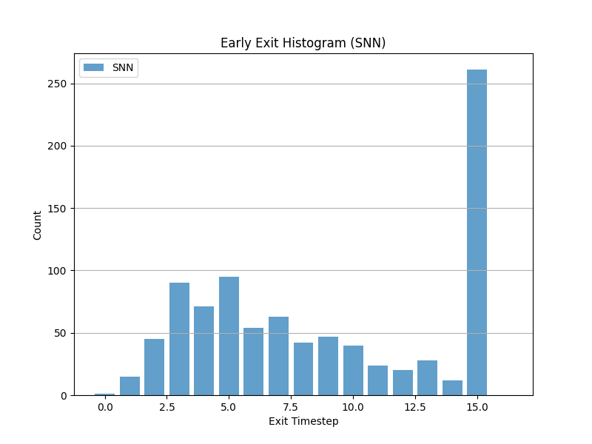
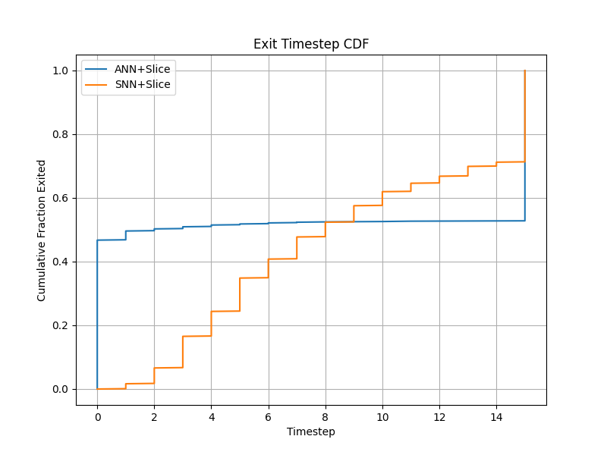
Early Exit Analysis
SNN exit histogram (theta = 0.80)
Cumulative exit distribution
ANN exits earlier on average (mean 7.25) vs. SNN (mean 8.82), reflecting faster confidence build-up via cumulative averaging. Both models allow substantial compute savings: at theta=0.80, roughly half the slices can be skipped on average without waiting for the final step.
10 / 14

Slide 11
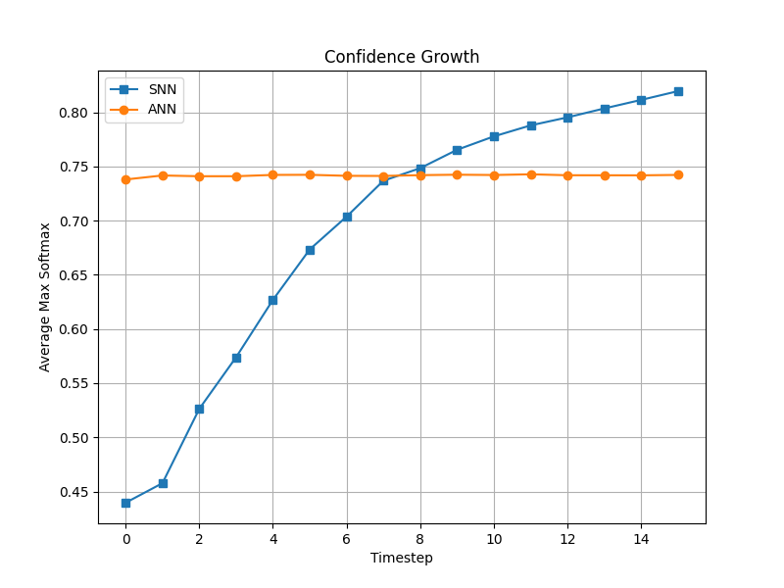
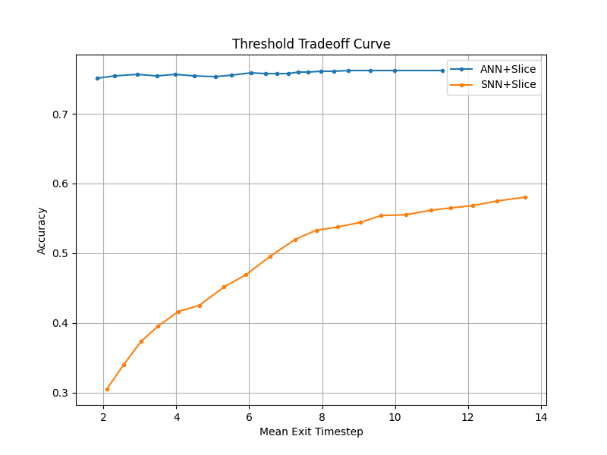
Confidence Growth & Threshold Tradeoff
Avg. max-softmax confidence per slice
Accuracy vs. mean exit step (theta sweep)
Confidence grows monotonically for both models — validating temporal slicing. The threshold curve (right) sweeps theta in [0.50, 0.99]: low theta gives early exit with lower accuracy; high theta defers to the final slice and recovers full accuracy. This tradeoff can be tuned at inference time with no retraining.
11 / 14

Slide 12
Analysis & Limitations
Key Findings
Limitations
✓
SNN achieves higher training acc (87.4%) than ANN (83.2%) in 10 epochs
No GPU
Training on CPU only; 30+ epochs feasible with GPU in same time
✓
Test gap (ANN 76% vs SNN 58%) signals overfitting in the SNN
Fixed LR
No schedule used; cosine/step decay expected to improve SNN generalisation
✓
Radial slicing enables early exit: ~45% avg compute savings at theta=0.80
Small dataset
ModelNet10 has only 3991 train samples; ModelNet40/ScanObjectNN would stress-test more
✓
Confidence grows monotonically for both models — early exit is viable
No augmentation
✓
SNN+Full is invalid for this architecture (temporal dynamics not engaged)
Random rotation, jitter, scale would reduce overfitting significantly
12 / 14

Slide 13
Recommended Next Steps
01 LR Scheduling
02 Data Augmentation
03 Regularisation
Cosine decay or step schedule; 30+ epoch training on GPU
Random rotation, jitter, scale; expected to close train-test gap
Dropout in temporal head; weight decay tuning for SNN
04 Learnable Thresholds
05 Larger Benchmarks
06 Energy Profiling
Per-layer adaptive LIF thresholds; learnable tau parameter
ModelNet40, ShapeNet, or ScanObjectNN for broader coverage
Measure spike rates and SynapticOps to quantify energy savings
13 / 14

Slide 14
Conclusion
We presented a Spiking PointNet that processes 3-D point clouds as a temporal sequence of radial slices, enabling biologically motivated integrate-and-fire dynamics for 3-D shape classification.
SNN Train Acc
ANN Test Acc
SNN Test Acc
Early Exit
87.4%
76.2%
58.3%
~45%
Surpasses ANN training accuracy (83.2%)
Strong ANN baseline; gap to close with more training
Slice mode only; room to improve with regularisation
Avg compute savings at theta = 0.80
These results demonstrate the viability of spiking temporal processing for point cloud classification and motivate further work on GPU-accelerated, regularised SNN training for 3-D perception.
14 / 14

