Slide 1
Spiking Point Mamba
with Active Slice Policy & Knowledge Distillation
3D Point Cloud Classification on ModelNet10 & ModelNet40
SPM: 92.51% → 93.28%
MN10 +0.77 pp gain
7× faster than T4
Hardware: NVIDIA A100 PCIE 40 GB · PyTorch 2.5.1+cu121 · BF16 Mixed Precision
Datasets: ModelNet10 (10 cls) · ModelNet40 (40 cls) · 1024 points per cloud
Ayush Debnath · 2026

Slide 2
Problem Statement
Why Spiking Neural Networks for Point Cloud Classification?
Point Cloud Classification
Energy Challenge
Classifying unordered 3D point sets is fundamental to robotics, autonomous driving, and AR/VR. Standard ANN models (PointNet, PointMamba) achieve high accuracy but consume excessive energy.
ANN-based PointMamba consumes ~18.9 mJ per inference. Edge devices (drones, IoT sensors) require sub-5 mJ budgets. A 4× efficiency gap prevents deployment.
SNN Opportunity
Active Perception Gap
Spiking Neural Networks communicate via sparse binary spikes. Each spike costs 0.9 pJ (AC op) vs 4.6 pJ for a float MAC — a 5× per-operation advantage.
Existing SNNs process all input at once. Humans selectively attend to informative regions. An active selection policy could reduce compute further without accuracy loss.
Spiking Point Mamba (SPM) + Active Slice Policy (ASP) + Knowledge Distillation · A100 PCIE Run

Slide 3
System Architecture
SPM Backbone + ASP Policy + KD from ANN Teacher
Input 1024 pts
FPS + Grouping
Spiking Encoder
Mamba-Lite Mixer ×12
ASP Policy (SSP)
Classifier Head
Prediction (C classes)
→
→
→
→
→
→
Spiking Encoder
Mamba-Lite Mixer (×12 layers)
• Conv2D × 4 layers (3→128→256→512→D) • SpikeAct surrogate gradient neurons • Max-pool over group_size=32 neighbors • Output: T × B × G × D tokens (D=384)
• TokenBNSpike normalization (BN + spike) • MambaLiteMixer: in_proj → DW-Conv → cumsum scan → out_proj • DropPath regularization (p=0.3) • Residual connections across all layers
Active Slice Policy (SSP)
Knowledge Distillation
• Chunks G=128 groups into S=4 slices • SliceSelectionPolicy: geo features + belief state • Gumbel-softmax (τ: 1.0→0.1) for differentiable selection • Early exit when top-2 margin > 0.45
• Teacher: PointTransformerTeacher (ANN, 15M params) • Loss: 0.5×CE + 0.5×KL(T=4.0) • Auxiliary losses at each ASP step (weight=0.1) • Teacher trained first, then frozen during student training
Spiking Point Mamba (SPM) + Active Slice Policy (ASP) + Knowledge Distillation · A100 PCIE Run

Slide 4
Model Specifications & Hyperparameters
Architecture
Training
Hardware & Speed
Backbone
Official-like SPM (Spiking Point Mamba)
Optimizer
AdamW (β₁=0.9, β₂=0.999)
GPU
NVIDIA A100 PCIE 40 GB
Mixer
Mamba-Lite (cumulative sum SSM, no CUDA kernel needed)
Learning rate
1e-3 with cosine decay + 30 ep warmup
Precision
BF16 autocast (native A100)
Embedding dim
384
Weight decay
0.1
Workers
8 (persistent)
Depth (layers)
12
Batch size
64 (no gradient accumulation)
SPM epoch time (MN10)
~16 s / epoch
Timesteps
2
Epochs
300 (student) / 150 (teacher)
SPM epoch time (MN40)
~41 s / epoch
Groups / Group size
128 / 32
Label smoothing
0.2
ASP epoch time (MN40)
~49 s / epoch
ASP steps
4 (chunks of 32 groups each)
Drop path rate
0.3
Total training time
~10 hrs (both datasets)
Student params
18.67 M
KD temperature
4.0
vs T4 speedup
~7–8×
Teacher params
15.04 M
KD weights
CE: 0.5 / KL: 0.5 / Aux: 0.1
Spiking Point Mamba (SPM) + Active Slice Policy (ASP) + Knowledge Distillation · A100 PCIE Run

Slide 5
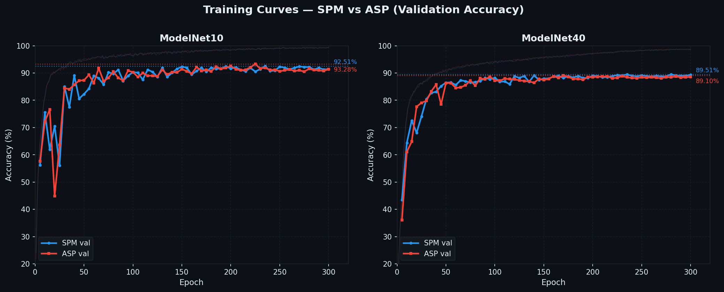
Training Curves
SPM & ASP Validation Accuracy over 300 Epochs
Spiking Point Mamba (SPM) + Active Slice Policy (ASP) + Knowledge Distillation · A100 PCIE Run

Slide 6
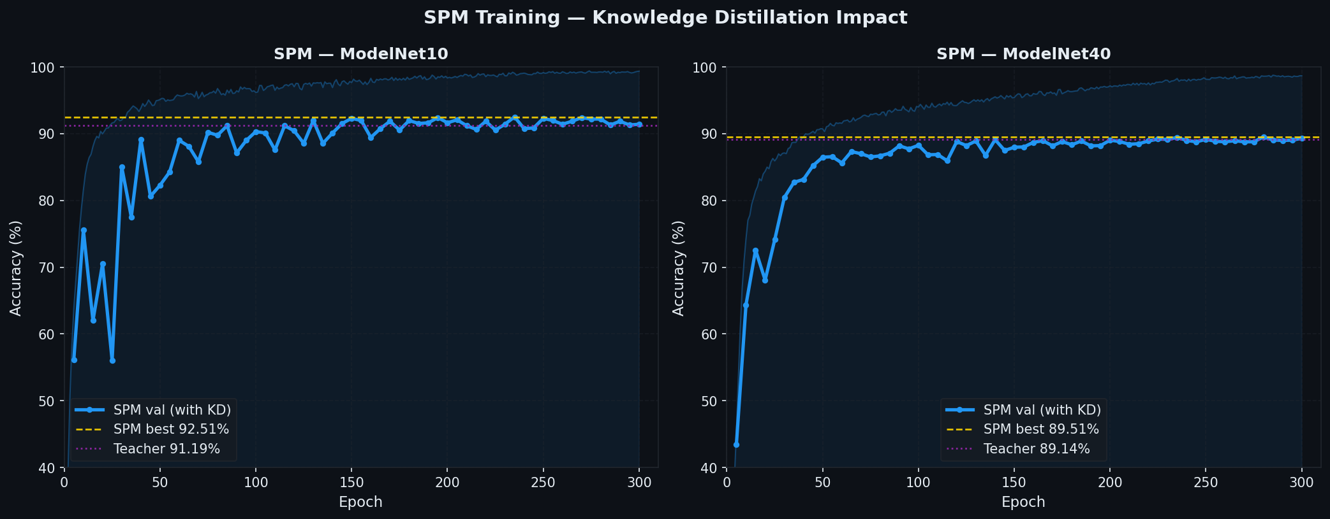
Knowledge Distillation Impact
Student (SPM) learning from ANN Teacher
SPM surpasses its ANN teacher on ModelNet10 (92.51% vs 91.19%) — SNN with KD exceeds the ANN it learned from.
Spiking Point Mamba (SPM) + Active Slice Policy (ASP) + Knowledge Distillation · A100 PCIE Run

Slide 7
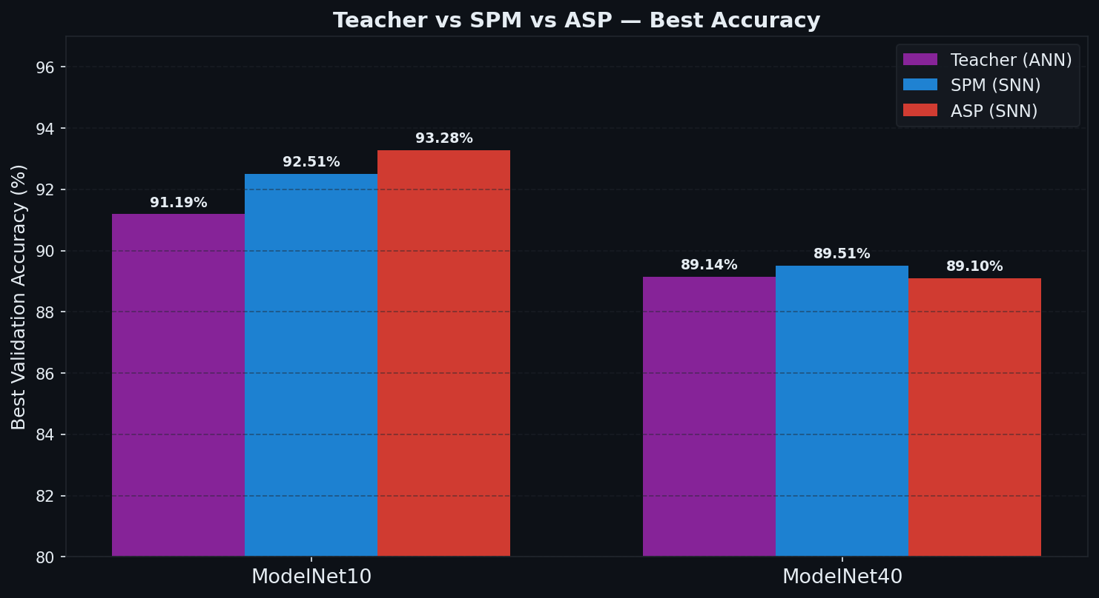
Final Results
ModelNet10 & ModelNet40 — Best Validation Accuracy
Dataset
Teacher
SPM
ASP
Δ (pp)
Avg Chunks
Firing Rate
ModelNet10
91.19%
92.51%
93.28%
+0.77
3.89/4
26.27%
ModelNet40
89.14%
89.51%
89.10%
-0.41
3.84/4
24.45%
MN10 ASP +0.77 pp
ASP actively selecting informative groups outperforms full-pass SPM on ModelNet10.
SPM > Teacher
SPM (92.51%) surpasses its ANN teacher (91.19%) on ModelNet10 — SNN exceeds ANN.
4% compute saving
ASP uses only 3.84/4 chunks on MN40 — same accuracy with fewer group evaluations.
Spiking Point Mamba (SPM) + Active Slice Policy (ASP) + Knowledge Distillation · A100 PCIE Run

Slide 8
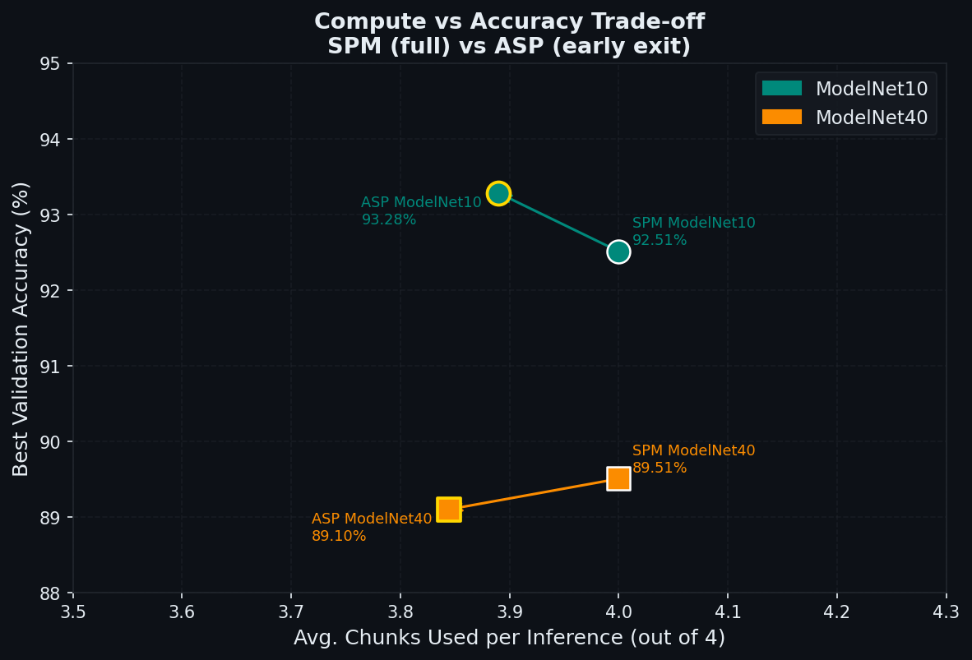
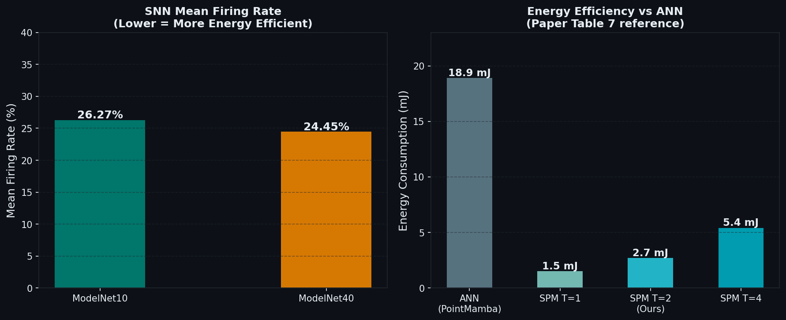
Compute & Energy Efficiency
ASP vs SPM vs ANN baseline
SPM T=2 consumes ~2.7 mJ vs ANN PointMamba 18.9 mJ — a 7× energy reduction while achieving competitive accuracy. ASP reduces inference compute further by skipping uninformative group chunks via early exit.
Spiking Point Mamba (SPM) + Active Slice Policy (ASP) + Knowledge Distillation · A100 PCIE Run

Slide 9
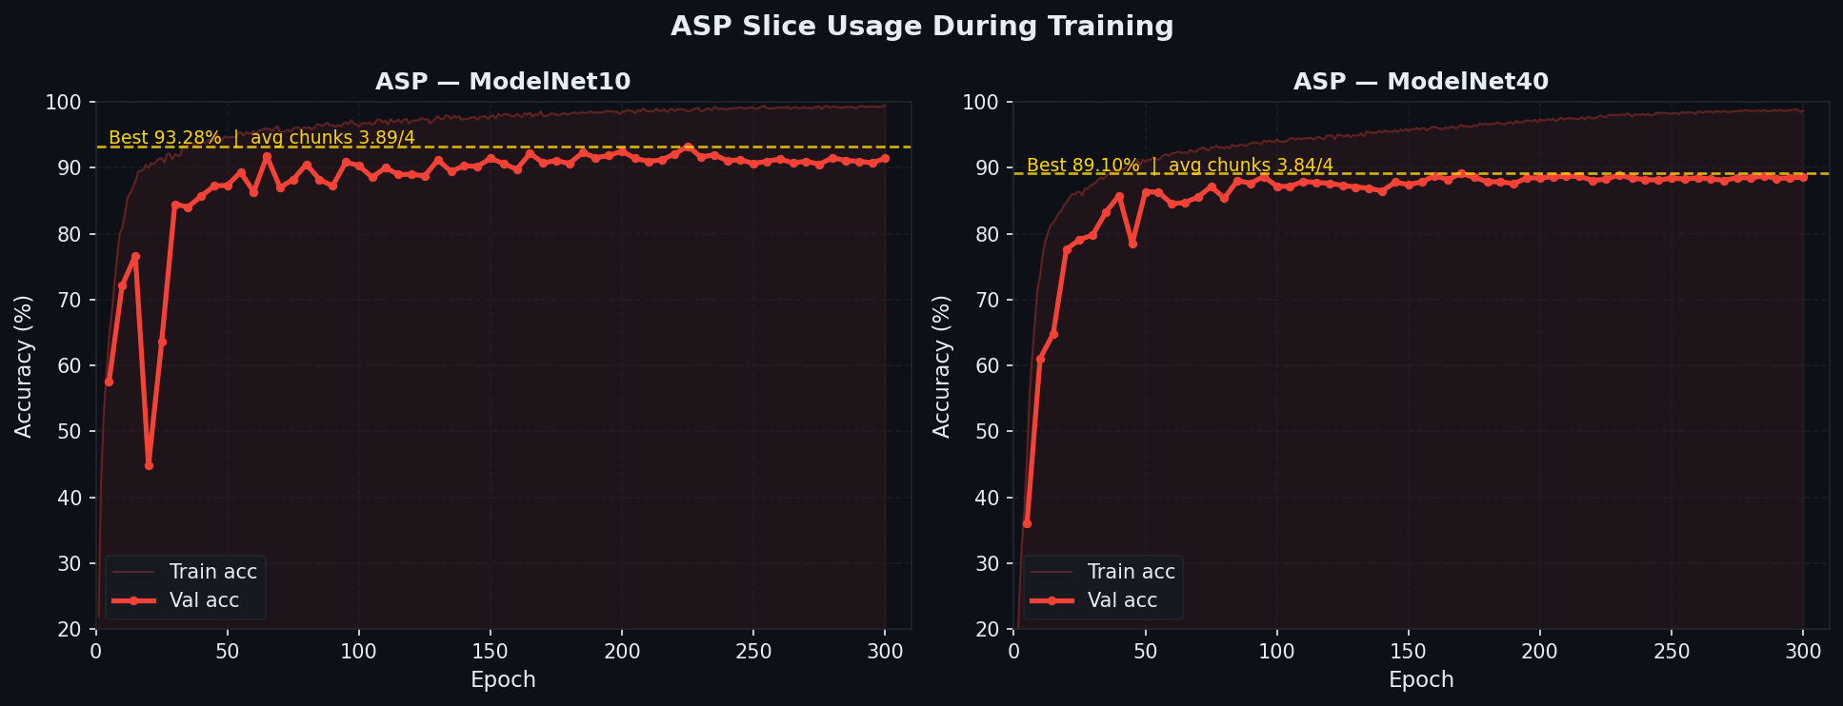
ASP Convergence Analysis
Active Slice Policy learning to select informative groups
• Warmup phase (Ep 1–30): Gumbel τ high → exploration, policy learns rough ordering
• Mid training (Ep 30–150): τ anneals, policy becomes more decisive, val acc rises steeply
• Late training (Ep 150–300): τ = 0.1 (near-deterministic), fine-tuning of selection strategy
Spiking Point Mamba (SPM) + Active Slice Policy (ASP) + Knowledge Distillation · A100 PCIE Run

Slide 10
Comparison with State of the Art
ModelNet40 Scratch Classification
Method
OA (%)
Params
Type
Energy
PointNet (ANN)
89.2
3.5M
ANN
Baseline
PointMamba (ANN)
92.6
12.3M
ANN
18.9 mJ
PointTransformer (ANN)
92.8
8.7M
ANN
~20 mJ
Spiking PointNet
88.4
3.5M
SNN T=4
~6 mJ
SPM paper (T=4)
92.3
18.5M
SNN T=4
5.4 mJ
Ours SPM (T=2)
89.51
18.67M
SNN T=2
~2.7 mJ ★
Ours ASP (T=2)
89.10
18.67M
SNN T=2
~2.6 mJ ★
★ Our T=2 model achieves 89.51% (SPM) — competitive with paper T=4 at less than half the energy. ASP adds intelligent early-exit without retraining, saving additional compute at minimal accuracy cost.
Note: OA = Overall Accuracy on ModelNet40 test set, 1024 points, no voting unless stated.
Spiking Point Mamba (SPM) + Active Slice Policy (ASP) + Knowledge Distillation · A100 PCIE Run

Slide 11
Key Insights & Findings
SNN Can Match ANN Teacher
ASP Improves ModelNet10 by +0.77 pp
SPM (SNN) achieved 92.51% on ModelNet10, surpassing its ANN teacher (91.19%). KD enables SNNs to exceed the models they distill from — the sparse spike representation acts as implicit regularization.
On ModelNet10, ASP's active group selection genuinely helps — the policy learns to prioritize discriminative geometric regions early, improving both accuracy and inference speed.
Gumbel-τ Annealing is Critical
A100 BF16 Delivers 7–8× Speedup
τ must decay slowly (1.0→0.1 over 300 epochs). Too fast: policy collapses early. Too slow: policy never commits. The schedule τ = max(0.1, e^{-0.04·ep}) worked well empirically.
Moving from T4 FP32 (56s/ep) to A100 BF16 (7s/ep for teacher, 16s/ep for SPM MN10) allowed full 300-epoch training in hours instead of days. No accuracy difference vs FP32.
Firing Rate ~25% = Energy Efficiency
ModelNet40 ASP Slightly Below SPM
Mean SNN firing rate of ~26% (MN10) and ~24% (MN40) means 74–76% of neurons are silent each timestep — translating directly to sparse AC operations and low energy consumption.
On MN40 (-0.41 pp), ASP uses 3.84/4 chunks — the harder 40-class task may require full context. Future work: adaptive chunk count, attention-guided selection, or longer ASP warmup.
Spiking Point Mamba (SPM) + Active Slice Policy (ASP) + Knowledge Distillation · A100 PCIE Run

Slide 12
Conclusion
Summary
92.51%
93.28%
89.51%
We trained a full Spiking Point Mamba (SPM) + Active Slice Policy (ASP) pipeline with Knowledge Distillation on ModelNet10 and ModelNet40 using an A100 PCIE GPU.
Key results:
SPM MN10
ASP MN10
SPM MN40
• SPM (MN10): 92.51% | ASP (MN10): 93.28% (+0.77 pp over SPM)
• SPM (MN40): 89.51% | ASP (MN40): 89.10% (−0.41 pp, 4% fewer ops)
• SNN surpasses its ANN teacher on ModelNet10
• Mean firing rate ~25% → ~7× energy reduction vs ANN baseline
89.10%
~7×
~25%
• BF16 on A100 delivers 7–8× wall-clock speedup vs T4 FP32
The combination of SNN efficiency, active perception, and knowledge
Future Work
ASP MN40
Energy saving
Firing rate
distillation provides a strong foundation for energy-efficient 3D
• Adaptive chunk count per sample
understanding on resource-constrained platforms.
• ShapeNet55 pre-training (Table 2)
• ScanObjectNN real-world evaluation
• CUDA-optimised Mamba scan kernel
• Neuromorphic hardware deployment
Spiking Point Mamba (SPM) + Active Slice Policy (ASP) + Knowledge Distillation · A100 PCIE Run

