Slide 1

MSc PROJECT PRESENTATION
Lightweight ECG Signal Classification
Using Machine Learning and Deep Learning
Ayush Nitin Deshmukh MSc Data Science · School of Electronic Engineering and Computer Science Queen Mary University of London · ID: 250123427 Supervisor: Dr Tayyab Ahmad Ansari
00
Notes:
Hi, I'm Ayush Deshmukh. This is Lightweight ECG Signal Classification Using Machine Learning and Deep Learning — my MSc dissertation project, supervised by Dr Tayyab Ahmad Ansari.

Slide 2
THE PROBLEM
Wearable ECG has a hidden constraint
A smartwatch can quietly record the heart's electrical signal for 24 hours, in the real world — not a lab. That's what makes wearable ECG powerful. But the devices that capture it run on tiny batteries and limited memory.
THE TENSION
Accuracy
vs
Efficiency
So the real question isn't only “can a model classify the signal accurately?” It's whether it can do that while staying small and fast enough to actually live on the device.
That tension is exactly what this project investigates — for a physiological-state classifier running on free-living ECG.
Ayush Deshmukh · MSc Data Science · Queen Mary University of London
02
Notes:
Imagine a smartwatch quietly recording your heart's electrical signal for twenty-four hours, out in the real world, not in a lab. Wearable ECG makes that kind of monitoring possible almost anywhere. But these devices run on tiny batteries and limited memory. So the real question isn't just whether a model can classify the signal accurately — it's whether it can do that while staying small and fast enough to actually live on the device. That tension, between accuracy and efficiency, is exactly what this project investigates.

Slide 3
BACKGROUND & RESEARCH GAP
Two research threads, never tested together
REPRESENTATION
EFFICIENCY
Sun et al. (2020) showed ECG waveforms can support sleep-state classification — but flagged that raw waveforms might behave differently across recording devices.
Kim et al., Ribeiro et al. and Liu et al. proved ECG models can be pruned and quantised — shrunk — without wrecking predictive performance.
Open question: is the full waveform worth its cost?
But tested on different datasets, tasks, environments.
THE GAP: nobody had tested representation choice and compression together, on the same participants, inside one pipeline. This project closes it.
Ayush Deshmukh · MSc Data Science · Queen Mary University of London
03
Notes:
Existing research gives us two separate half-answers. Sun and colleagues showed ECG waveforms can support sleep-state classification, but flagged that raw waveforms might behave differently across recording devices. Separately, work on pruning and quantisation has proven ECG models can be compressed without wrecking performance. But here's the gap — nobody had tested representation choice and compression together, on the same participants, inside one pipeline. That's exactly what this project sets out to do.

Slide 4
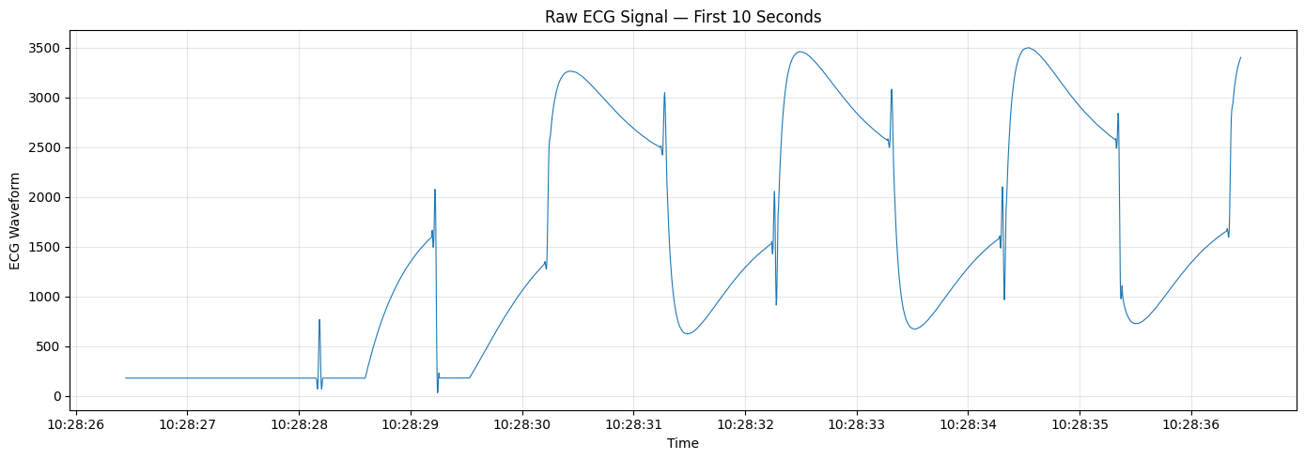
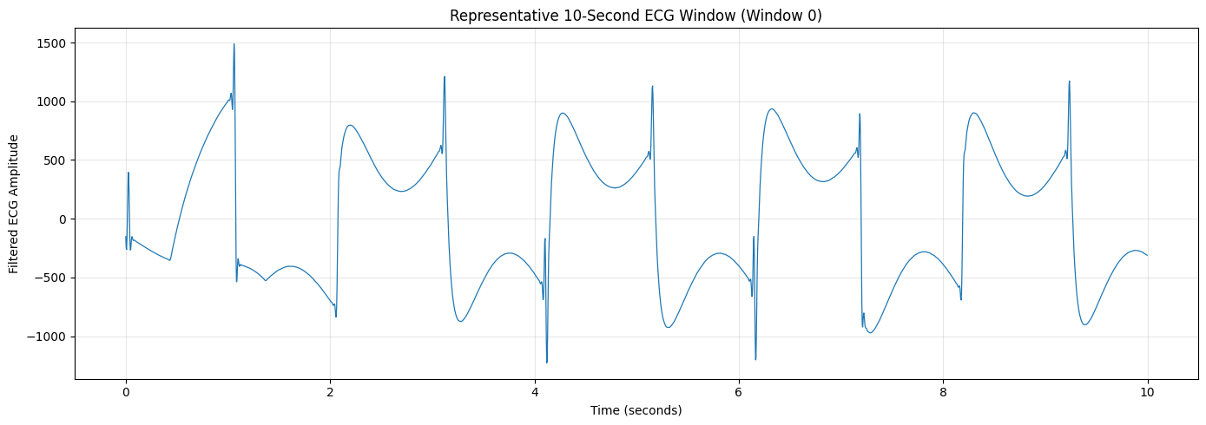
DATA & METHODOLOGY
From free-living recordings to model-ready windows
30
250 Hz
421,166
participants, 58 free-living recordings
ECG sampling rate
labelled 10-second windows
The original plan was arrhythmia detection — but the data told a different story: the labels that actually existed were Wake and Sleep. The project pivoted, and every recording was band-pass filtered, then windowed with 50% overlap and matched to the nearest annotation within ±15 minutes. Splits are strict at the participant level — no leakage.
Raw ECG → filtered, windowed ECG (10 s, 2,500 samples)
Ayush Deshmukh · MSc Data Science · Queen Mary University of London
04
Notes:
I used the Dryad 24-hour physiological monitoring dataset — thirty participants, fifty-eight free-living ECG recordings, sampled at 250 hertz. My original plan was arrhythmia detection, but dataset inspection told a different story: the labels that actually existed were Wake and Sleep. So the project pivoted. Every recording was cleaned with a fourth-order Butterworth band-pass filter, then sliced into ten-second windows with fifty percent overlap. Each window's centre timestamp was matched to the nearest Wake or Sleep annotation, within a fifteen-minute tolerance. The result: over four hundred and twenty-one thousand labelled windows — and every split was done at the participant level, so no one person's data could leak between training, validation, and test.

Slide 5
METHODOLOGY
Two pathways, one signal
1
Feature-based ML
2
Waveform-based DL
9 hand-crafted statistics (mean, energy, RMS...) → Logistic Regression & Linear SVM
Full 2,500-sample waveform → compact CNN & LSTM, learning their own representation
Same participant-level splits. Same evaluation. Only the representation differs.
BUILT WITH
Python
NumPy / SciPy
TensorFlow
scikit-learn
Jupyter
Ayush Deshmukh · MSc Data Science · Queen Mary University of London
05
Notes:
From here, two parallel pathways ran on the exact same signal. The first: nine hand-crafted statistical features — mean, energy, root-mean-square — feeding a Logistic Regression and a Linear SVM. The second: the raw two-thousand-five-hundred-sample waveform, fed directly into a compact CNN and an LSTM. Everything was built in Python, using NumPy and SciPy for signal processing, TensorFlow for the neural models, scikit-learn for the classical ones, all developed inside Jupyter notebooks.

Slide 6
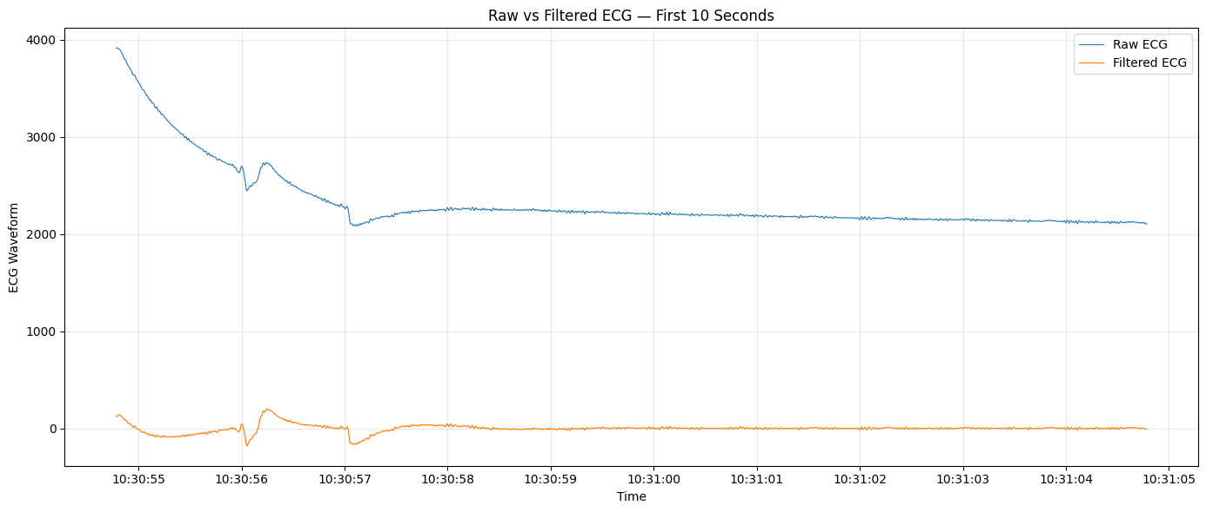
DEMONSTRATION
From noisy signal to model-ready input
WHAT YOU'RE SEEING
Blue: the raw ECG trace — drifting baseline, noisy.
Orange: after the 0.5–40 Hz Butterworth filter — clean, stable, ready for windowing.
The CNN learns directly from this waveform. No hand-crafted features. No shortcuts.
Live notebook walkthrough — preprocessing pipeline, Notebooks 1–2
Ayush Deshmukh · MSc Data Science · Queen Mary University of London
06
Notes:
Here's the pipeline in action. This is the raw ECG signal — noisy, drifting, hard to trust. After filtering, the waveform cleans up beautifully, and you can already see individual heartbeats emerging inside each ten-second window. This is exactly what the CNN sees — no hand-crafted features, no shortcuts, just the waveform itself, learning its own representation directly from the signal.

Slide 7
RESULTS — BASELINE COMPARISON
The waveform wins, decisively
0.7932
CNN validation F1-score — strongest of all four models
3,809
trainable parameters — deliberately compact
Logistic Regression and the Linear SVM stayed close to chance level. The nine hand-crafted features simply lose information the raw waveform keeps. The CNN was selected as the optimisation candidate using validation evidence only — held-out participants stayed untouched.
Ayush Deshmukh · MSc Data Science · Queen Mary University of London
07
Notes:
So which pathway won? The lightweight CNN, decisively. It reached a validation F1-score of 0.79, compared with just 0.14 for Logistic Regression and 0.13 for the Linear SVM — both barely above chance. Even the LSTM, at 0.49, couldn't keep up. The takeaway is striking: for this task, the raw waveform carries information that nine summary statistics simply throw away. The CNN was selected as the optimisation candidate — using validation evidence only, with the held-out participants left completely untouched.

Slide 8
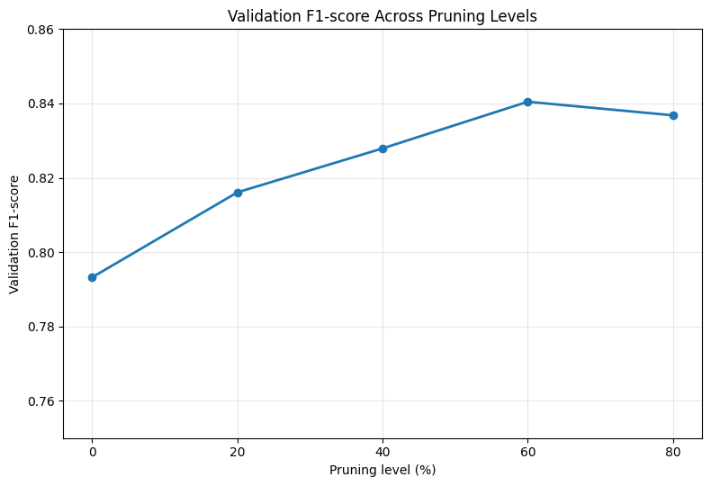
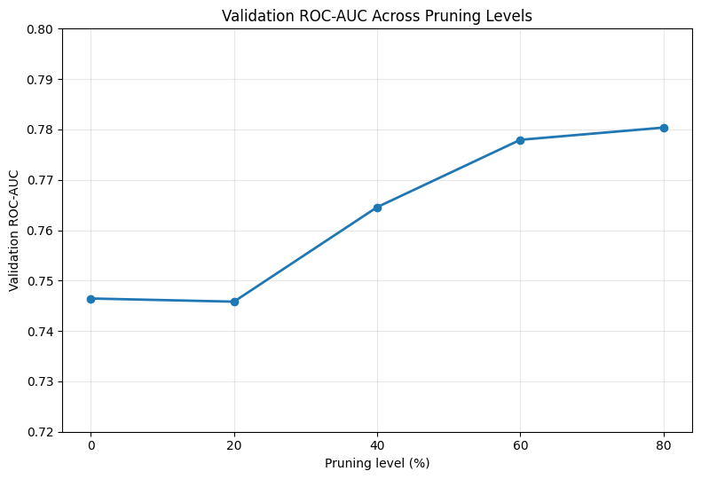
OPTIMISATION — PRUNING
More compression didn't mean worse performance
60%
target sparsity produced the strongest validation F1-score
80% gave the best ROC-AUC instead.
Magnitude-based pruning was evaluated at 20%, 40%, 60% and 80% target sparsity — on validation data only. The relationship wasn't a straight line: sometimes trimming more of the network improved behaviour rather than hurting it.
Ayush Deshmukh · MSc Data Science · Queen Mary University of London
08
Notes:
With a winner chosen, the real engineering question became: how small can it get? I pruned the CNN at 20, 40, 60 and 80 percent target sparsity. And the result wasn't a straight line — the 60 percent target actually gave the strongest F1-score, while 80 percent gave the best ROC-AUC. More compression didn't always mean worse performance. Sometimes, it meant better.

Slide 9
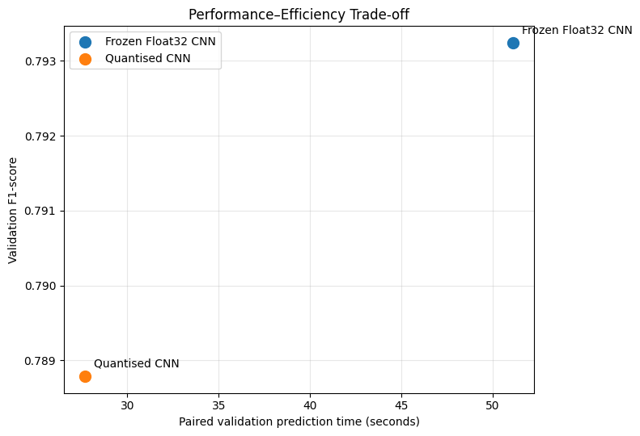
OPTIMISATION — QUANTISATION
Smaller, faster, almost no accuracy cost
34.1% smaller
14.88 KB → 9.80 KB after dynamic-range quantisation
45.8% faster
51.09 s → 27.69 s paired validation prediction time (1.85×)
−0.0045 F1
validation performance barely moved: 0.7932 → 0.7888
Ayush Deshmukh · MSc Data Science · Queen Mary University of London
09
Notes:
Then came quantisation. Converting the frozen CNN to eight-bit dynamic-range weights shrank it from 14.88 kilobytes down to 9.80 — a 34 percent reduction — and nearly halved prediction time, from 51 seconds down to 27.7. Validation F1 barely moved, dropping by just 0.0045. This chart says it all: the quantised model sits almost exactly where the full model does on accuracy, but miles ahead on speed and size. That's the entire promise of this project, in one picture.

Slide 10
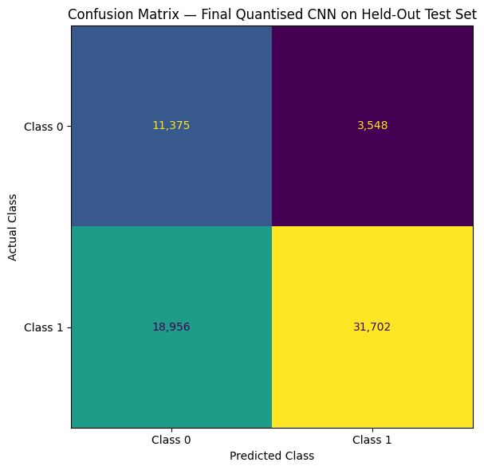
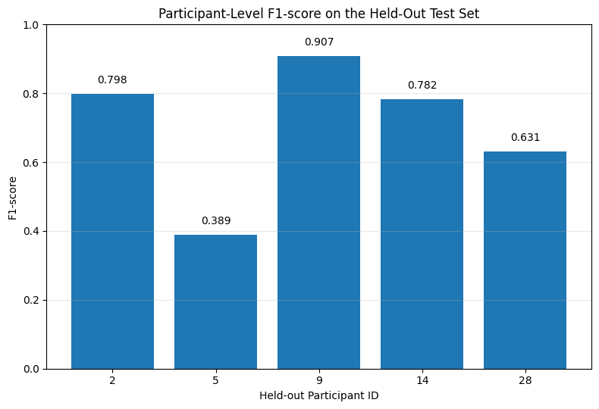
FINAL HELD-OUT EVALUATION
Tested once, on five unseen participants
0.738
F1-score
0.774
ROC-AUC
0.90
Precision
Class 1 (Awake) recalled far better than Class 0 (Asleep) — an honest, uneven result.
Best participant F1: 0.907 · Weakest: 0.389 — individual physiology still matters.
Ayush Deshmukh · MSc Data Science · Queen Mary University of London
10
Notes:
Finally, the moment of truth: five participants the model had never seen. The quantised CNN scored an F1 of 0.738 and a ROC-AUC of 0.774, with precision as high as 0.90. But performance wasn't uniform — one participant scored 0.91, another just 0.39. I'm not hiding that. It's an honest, positive-and-negative result, and it says something important: this model works well on average, but individual physiology still matters.

Slide 11
DISCUSSION
Closing the gap — within its scope
WHAT THIS SHOWS
HONEST LIMITATIONS
✓ A compact waveform CNN outperforms hand-crafted ML features for this task
✗ Only 5 held-out participants — limits generalisation claims
✓ The same model compresses well — smaller and faster — with minimal F1 loss
✗ ±15-minute label tolerance, not clinical-grade ground truth
✓ Representation choice and compression evaluated together, in one pipeline
✗ ML and DL pipelines aren't preprocessed identically
Ayush Deshmukh · MSc Data Science · Queen Mary University of London
11
Notes:
So, does this close the gap I opened with? Yes — within its scope. A compact waveform model does outperform hand-crafted features, and it does compress well. But I'll be upfront about the limits: only five held-out participants, a fifteen-minute label-matching tolerance, and preprocessing that isn't perfectly matched between the ML and DL pipelines. These aren't flaws to hide. They're the honest boundaries of what this evidence can claim.

Slide 12
CONCLUSION
A lightweight CNN can tell Wake from Sleep
using raw ECG alone — and compress to a
fraction of its size with almost no loss
in performance.
0.738
34.1%
1.85×
Held-out F1
Smaller
Faster
Thank you for watching.
Ayush Deshmukh · MSc Data Science · Queen Mary University of London
12
Notes:
In short: a lightweight CNN can tell wake from sleep using raw ECG alone, and it compresses to a fraction of its size with almost no loss in performance. Thank you for watching.

