Slide 1
SECURE & ENCRYPTED REPORTING CHANNEL
W-CERT
Women-Centric Cyber Emergency Response & Threat-analysis Framework
DETECT. DEFEND. EMPOWER.
Nishinth Venkatesh • Ayush Dhore • Neel Karnavat • Sarthak Anil Paymode
Group No. 6 | Panel B | MIT World Peace University
Department of Computer Engineering & Technology | Capstone Project

Slide 2
Objectives & Scope
01
Design a secure, anonymous incident reporting system for women facing phishing & social engineering attacks
02
Build an AI-assisted threat analysis engine to classify attacks and assign severity (Low / Medium / High / Critical)
03
Implement forensics-friendly evidence management using SHA-256 hashing and timestamping for data integrity
04
Develop a Role-Based Access Control (RBAC) analyst dashboard for structured incident triage and monitoring
05
Simulate real-world CERT operational processes within a scoped, privacy-preserving threat environment
Scope: Web-based system | Phishing & Social Engineering threats only | Privacy-first design | Role-based multi-user access
W-CERT | Women-Centric Cyber Emergency Response & Threat-analysis Framework
Capstone Project | MIT World Peace University

Slide 3
Problem Statement
P1
P2
P3
Rising Cyber Threats on Women
Fragmented Reporting Systems
No Dedicated Response Framework
Phishing & social engineering attacks exploit trust, urgency, and social manipulation — causing financial, identity, and psychological harm to women at disproportionate rates.
Current cybercrime portals are fragmented, reactive, and slow. They fail to prioritize incidents based on actual risk severity or provide any victim-centric, privacy-preserving experience.
No mini-CERT system specifically addresses phishing and social engineering attacks on women with structured triage, evidence management, and role-based analyst workflows.
W-CERT directly addresses all three gaps — building a practical, privacy-first cyber incident response system designed specifically for women.
W-CERT | Women-Centric Cyber Emergency Response & Threat-analysis Framework
Capstone Project | MIT World Peace University

Slide 4
What is W-CERT?
W-CERT is a mini-CERT cybersecurity incident response system designed exclusively for phishing and social engineering attacks targeting women.
W-CERT
RPT
Secure incident intake with AES encryption & evidence upload
Women-Centric Cyber Emergency Response Team
AI
AI-powered threat analysis for phishing & social engineering
TRG
Severity-driven triage: Low / Medium / High / Critical
Cyber Security
Incident Response
EVD
Forensics-friendly evidence management (hashing + timestamps)
Threat Intelligence
Artificial Intelligence
RBK
Role-based dashboard for Admin & Analyst workflows
INHOUSE PROJECT | MIT World Peace University
PVT
Full victim anonymity & data confidentiality preserved
W-CERT | Women-Centric Cyber Emergency Response & Threat-analysis Framework
Capstone Project | MIT World Peace University

Slide 5
System Architecture — High Level Design
PRESENTATION
LAYER
Web Interface
(HTML/CSS/JS)
Report Incident Form
(3-step secure flow)
Analyst Dashboard
(Admin / Analyst)
APPLICATION
LAYER
Threat Analysis
Engine
(Rule-based + AI)
Evidence Manager
(SHA-256 Hash +
Timestamp)
Incident Triage
& RBAC Control
(Access layer)
DATA
LAYER
Incident
Database
(SQLite / PostgreSQL)
Evidence
Store
(Encrypted files)
Audit Log
& Session
Records
SECURITY LAYER
HTTPS / TLS
AES Encryption at rest
SHA-256 Evidence Hashing
RBAC Middleware
Anonymous Incident IDs
W-CERT | Women-Centric Cyber Emergency Response & Threat-analysis Framework
Capstone Project | MIT World Peace University

Slide 6
System Flow — Victim to Resolution
1
2
3
4
5
Victim Reports
Encryption
AI Classification
Incident Created
Analyst Reviews
Fills 3-step form
Evidence upload (optional)
AES encrypt data
SHA-256 hash evidence
Rule engine detects
Attack type & severity
Unique ID assigned
Timestamp + stored in DB
RBAC dashboard
Triage & prioritize
Incident Outcome States:
OPEN
ESCALATED
INVESTIGATION
CLOSED
All incidents are logged to the Secure Audit Trail. Evidence integrity is maintained via SHA-256 hashing at every stage. Victim identity remains anonymous throughout.
W-CERT | Women-Centric Cyber Emergency Response & Threat-analysis Framework
Capstone Project | MIT World Peace University

Slide 7
Core System Modules
RPT
Secure Incident Reporting
AI
Threat Analysis Engine
3-step guided reporting flow
Rule-based Python classifier
Evidence upload: screenshots, PDFs
Phishing & social engineering detection
AES encryption + SHA-256 hashing
AI-assisted pattern recognition
Anonymous victim protection
Severity: Low / Med / High / Critical
DSH
Analyst Dashboard
EVD
Evidence Management
Role-based access: Admin / Analyst
Forensics-friendly file storage
Live incident monitoring & triage
Integrity via SHA-256 + timestamp
Threat intelligence overview
RBAC-controlled document access
Incident volume & severity charts
Secure audit trail logging
W-CERT | Women-Centric Cyber Emergency Response & Threat-analysis Framework
Capstone Project | MIT World Peace University

Slide 8
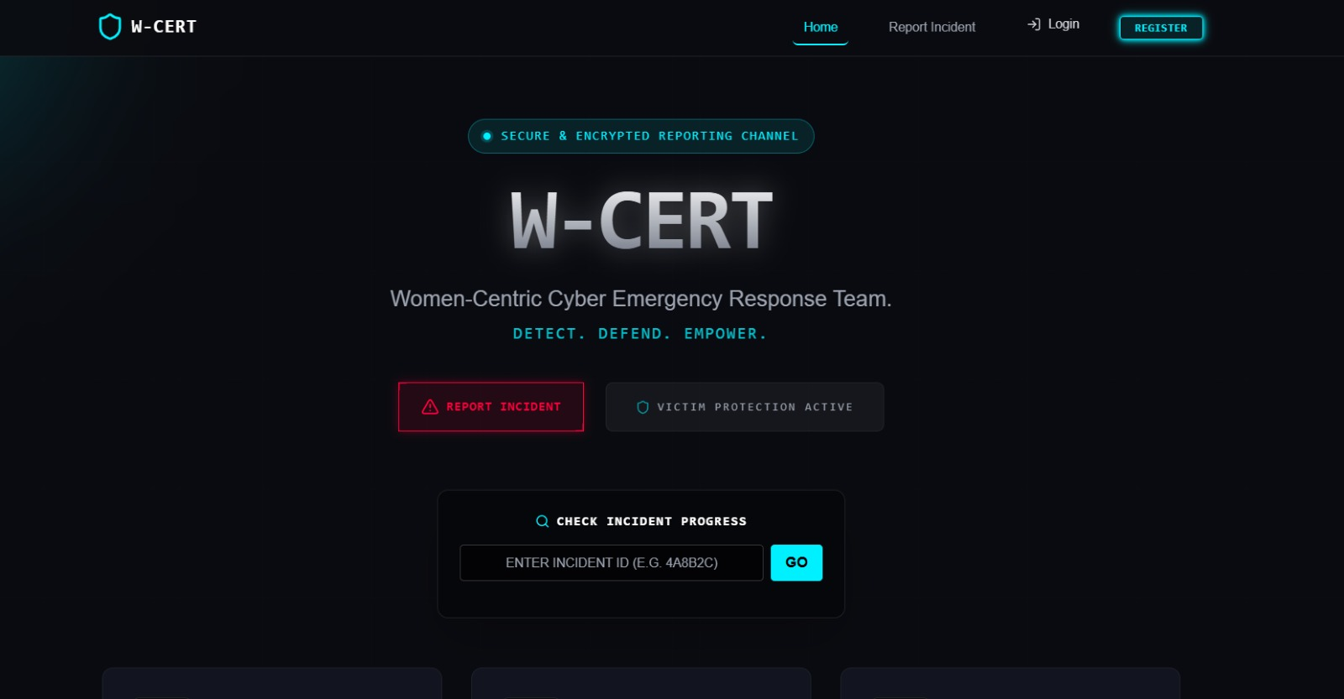
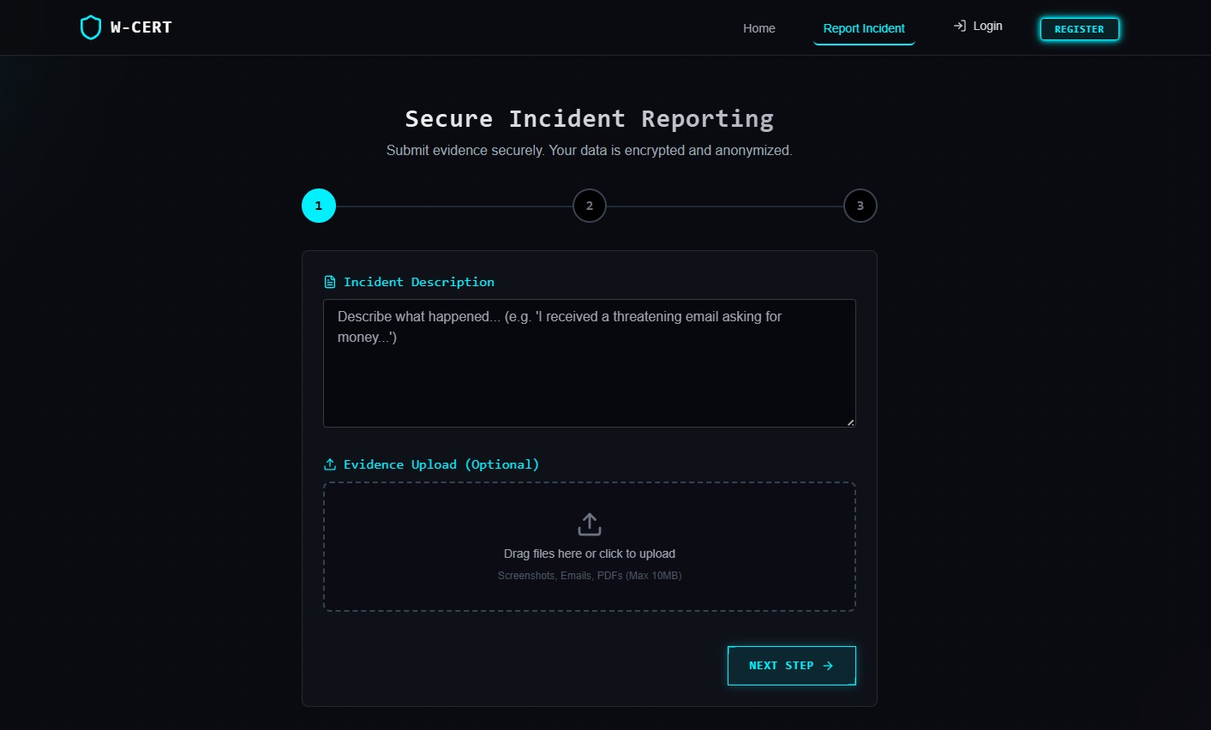
Live Screenshots — Public Interface
HOME PAGE
SECURE INCIDENT REPORTING (STEP 1/3)
W-CERT Branding
3-Step Encrypted Form
Tagline, incident progress tracker & victim protection badge
Incident description + evidence upload (screenshots, PDFs, emails)
W-CERT | Women-Centric Cyber Emergency Response & Threat-analysis Framework
Capstone Project | MIT World Peace University

Slide 9
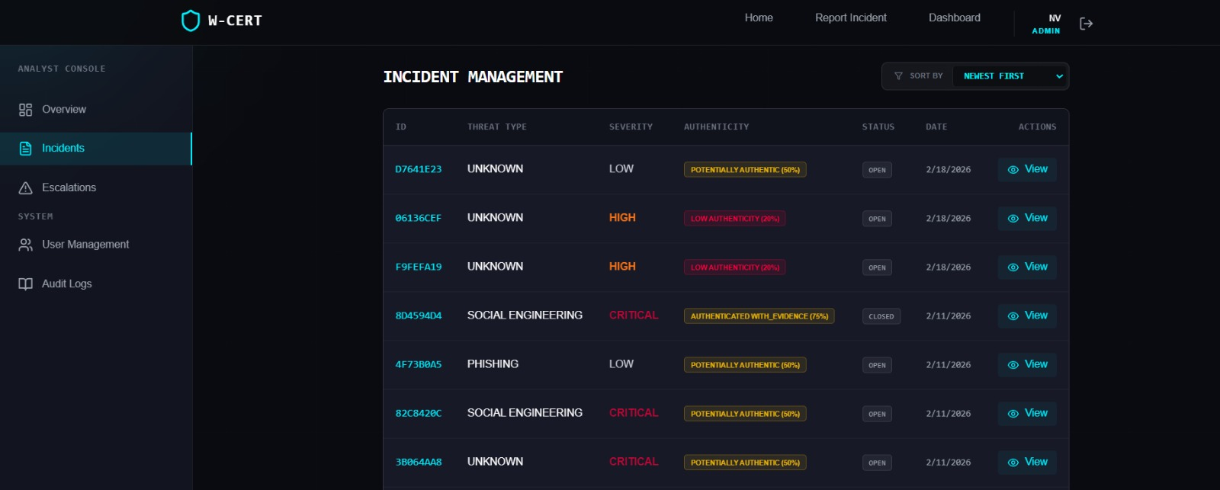
Live Screenshots — Admin Console
INCIDENT MANAGEMENT — Analyst Console
CRITICAL SEVERITY
AI AUTHENTICITY
STATUS TRACKING
SORT & FILTER
Color-coded severity tags: Low / High / Critical
Scoring: 20%–75% authenticity confidence
Open / Closed with date & incident ID
Sort newest first; filter by type or severity
W-CERT | Women-Centric Cyber Emergency Response & Threat-analysis Framework
Capstone Project | MIT World Peace University

Slide 10
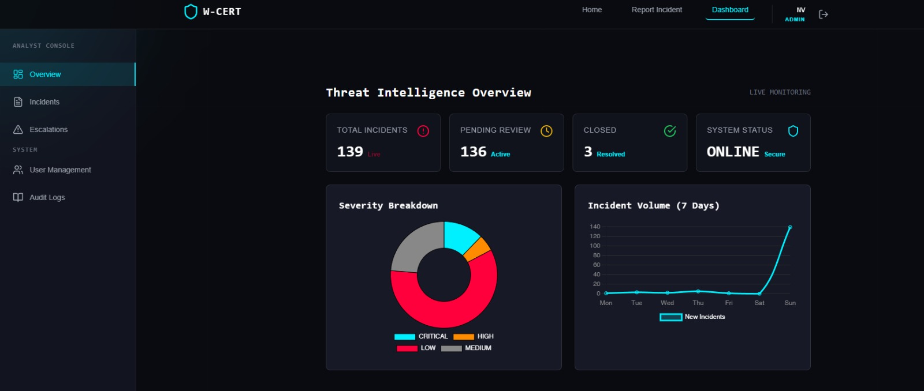
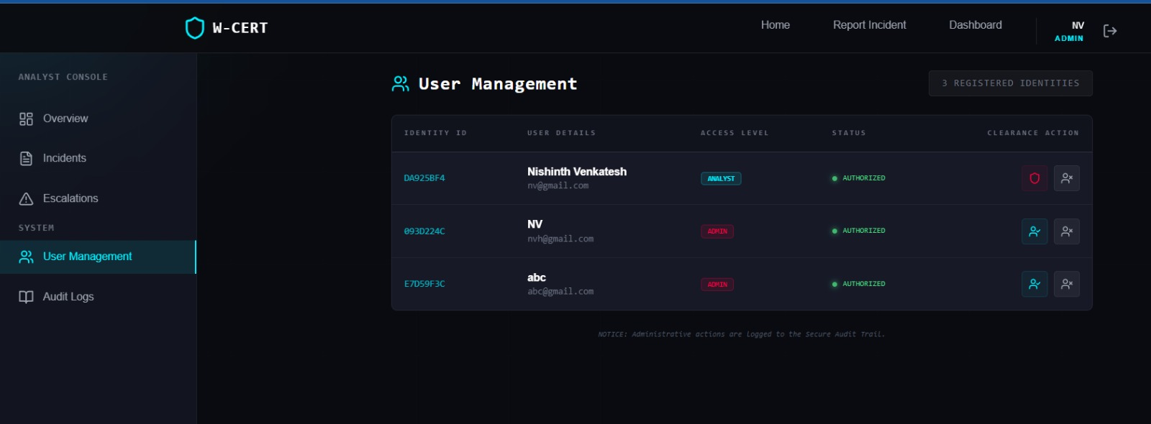
Live Screenshots — Dashboard & User Management
THREAT INTELLIGENCE DASHBOARD
USER MANAGEMENT
Role-Based Access Control (RBAC)
ADMIN
Full system access & user management
ANALYST
Incident review, escalation & audit
139
136
3
Total Incidents
Pending Review
Resolved
W-CERT | Women-Centric Cyber Emergency Response & Threat-analysis Framework
Capstone Project | MIT World Peace University

Slide 11
Technology Stack
FRONTEND
BACKEND
SECURITY
DEV TOOLS
HTML5, CSS3, Bootstrap
Python Flask / Django
HTTPS / TLS encryption
VS Code / PyCharm
JavaScript (Vanilla)
RESTful API architecture
AES encryption at rest
Git / GitHub
Chart.js / Plotly
Rule-based threat engine
SHA-256 evidence hashing
Postman (API testing)
Dark Cyber-themed UI
RBAC middleware
Anonymized incident IDs
SQLite / PostgreSQL
W-CERT | Women-Centric Cyber Emergency Response & Threat-analysis Framework
Capstone Project | MIT World Peace University

Slide 12
Literature Review — Key Research
Author(s) & Year
Focus Area
Gap / Limitation
Zhuo et al. (2022)
Human-Centered Phishing Susceptibility Model (PSM)
Systematic review; no automated response
Ribeiro et al. (2024)
Eye-tracking study of phishing email attention patterns
Small sample; controlled lab only
Desolda et al. (2022)
Human factors in phishing attacks — Systematic Literature Review
Broad survey; no response mechanism
Marshall (2024)
Evidence for email phishing training outcomes
Limited long-term effectiveness data
Sommestad (2024)
Large-scale phishing susceptibility experiment
Focused on variables, not response
Khadka (2024)
Persuasion tactics analysis in phishing content
Content-focused; not incident response
Frauenstein et al. (2020)
Women's phishing susceptibility via survey models
Not a full incident response framework
W-CERT | Women-Centric Cyber Emergency Response & Threat-analysis Framework
Capstone Project | MIT World Peace University

Slide 13
Conclusion & Future Scope
KEY OUTCOMES
FUTURE SCOPE
Fills the gap between theoretical cybersecurity and practical incident response for women
NLP-based AI model for deeper threat content analysis
Enables secure, anonymous reporting with full evidence integrity
Multi-language support for broader accessibility
AI-assisted classification improves prioritization of high-risk incidents
Integration with national cybercrime portals (CERT-In)
RBAC dashboard gives analysts a structured, efficient workflow
Mobile app for faster field reporting by victims
Raises awareness of phishing & social engineering attack vectors
Real-time threat intelligence feed & alert system
W-CERT: A privacy-preserving CERT solution — making the digital world safer for women.
W-CERT | Women-Centric Cyber Emergency Response & Threat-analysis Framework
Capstone Project | MIT World Peace University

Slide 14
Our Team — Group No. 6 | Panel B
NV
AD
NK
SP
Nishinth Venkatesh
Ayush Dhore
Neel Karnavat
Sarthak Paymode
Lead Developer
Backend & Security
Frontend & UI/UX
Analysis & Testing
PRN: 1032220939
9551165281
PRN: 1032220255
7709571603
PRN: 1032220469
7020107558
PRN: 1032220213
9960009018
Department of Computer Engineering & Technology | MIT World Peace University, Pune
W-CERT | Women-Centric Cyber Emergency Response & Threat-analysis Framework
Capstone Project | MIT World Peace University

Slide 15
W-CERT
Thank You
DETECT. DEFEND. EMPOWER.
W-CERT — Women-Centric Cyber Emergency Response & Threat-analysis Framework
Open for Questions & Discussion
Group No. 6 | Panel B | MIT World Peace University | 2025–26

