Slide 1


Slide 2
Project Description
Our research is founded on the principles of machine learning and data augmentation, which entails the training and testing of data in order to predict the correct output, in this case, to assist us in marking attendance.
The major goal of this project is to create a facial recognition-based attendance monitoring system for educational institutions in order to improve and update current attendance system information more efficiently and effectively than before.

Slide 3

To begin with, one of the most important reasons why our team chose this project is our desire to learn more about the principles of machine learning and artificial intelligence.
Furthermore, the present tools for attendance systems are very time intensive, making them inefficient and time consuming. This endeavor will undoubtedly aid us in honing our artificial intelligence skills. This project will demonstrate our tenacity and commitment to our studies.

Slide 4
Proposed solution
approach
This project not only solves one problem, but many. Such as :-
The most significant issue with current biometric attendance systems is that they are frequently time consuming. As a result, our project will undoubtedly assist us in overcoming these time related issues.
Facial recognition systems are easier to repair than biometric systems, as well as more cost effective.
In the future, this project could be used to track individual employee attendance mistakes and help us improve an employee's working hours.

Slide 5
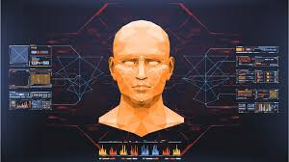
Covid-19 has taught the world today the importance and absolute necessity of sanitization and not coming into contact with anything foreign to your body. A fingerprint based biometric attendance scanner contradicts this very factor of personal safety. And on contrast of that the facial recognition system gains much advantage in the safety criteria's because theirs's physical contact which can act as a problem.

Slide 6
Work was done so far
Working on the frontend code :-
The layout of the website is designed and finalized.
The coding of the website has started and the 2/3rd part of the website has been completed so far.
The CSS and JavaScript parts are in progress.
The layout of login and registration pages is yet to be done.
The overall backend part is still under developmental stages.

Slide 7
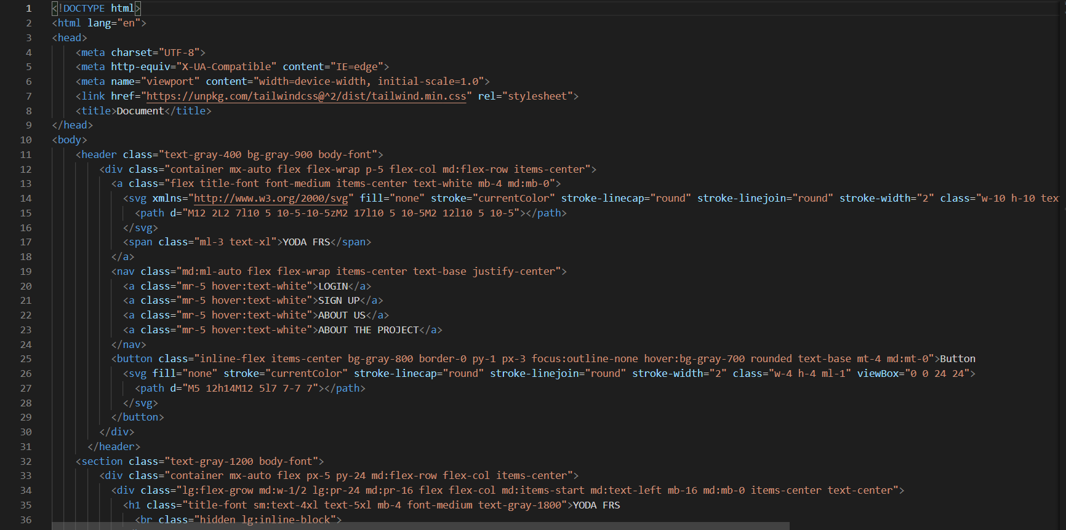

Slide 8
Planned individual contribution
A project is successfully completed only when there is contribution of all the members of a team.​
Each member in the project has a required objective to accomplish .In same way to complete this project we divided our work in equal manner .
Tejesh Boppanna and Anuj Rawat are working on the facial recognition software.
Nazar E Moin Sheikh and Ayush Dhyani are making the website for user interaction.
All are making the documentation, presentation etc. works together.

Slide 9
References
www.google.com
www.Javapoint.com
YouTube
GitHub
Books
Teachers
Thank You

