Slide 1
College Times
Website Proposal
Team Members:
Ayushi Gupta (MS194412)
Kanupriya Guha (MS194415)
Sumithra M (MS194440)
Sanjana M C (MS194444)

Slide 2
Introduction
Extra curriculum plays a key tool in the personal development of a student. It not only provides entertainment but also helps in networking and improving skills. These activities offer opportunities for students to learn the value of teamwork, individual strength and group responsibility, competition, diversity, and a sense of communication. The mission is to develop students holistically.
This website provides a user-friendly interface that can be accessed by any student without hindrance and the main part is composed of the different tabs which segregates all the events to avoid chaos and confusion, a search bar that ensures quick access to the events of a particular college reducing the search time effectively, the chatbot that clears all the queries and problem encountered while using our site and login portal that enhance the security, so that information is only from an authentic source and no random people has access to it.

Slide 3
Problem Statement
As college students, we face a lot of issues when it comes to knowing and segregating information about all college’s day-to-day events and activities, which may seem tricky for some of us. Most of the time as college students, we may not get the opportunity to communicate with other colleges directly, which may lead to losing out on beneficial career opportunities. Currently, there is no such website where the users can get all information related to webinars, seminars, internships, competitions, and events, etc. that are organized by various colleges within the state.
So, we came up with the idea of “College Times” which is a website where the visitors specifically the college students and teachers will get all the relevant and authentic information on the webinars, seminars, internships, competitions, and events, etc. organized by various colleges within the state which is directly given by the college authorities.

Slide 4



Existing System
No Registration or
Participation opportunity
No such Website
For College Events
Only Commercial
News Website

Slide 5
Proposed System
Educational News Website for College Events
Can Register
for Events
01
02
03
04
Platform for Students
And College Authorities
Secure and Authentic informations directly from colleges

Slide 6
Objective
The main objective of “College Times” is to make it easy for college students to know about the current and upcoming activities or events organized by various colleges.
There is a variety of categories such as webinars, seminars, internships, and so on.
We aim to develop an online platform that will allow college authorities to update their current activities and upcoming ones by which students can be benefited.
We also have a feature of Chatbot for feedback and queries/guidance.
It is a time-saving and economically feasible application.

Slide 7
Modules
ADMIN
SEARCH
BOX
CHATBOT
SIGN IN/ SIGN UP
USER (STUDENT)

Slide 8
Software & Hardware
Softwares
Web Editor/ Text Editor
Bootstrap (Front end)
MySQL (Back end)
Hardwares
Microsoft® Windows® 10 (64-bit)
4 GB RAM minimum, 8 GB recommended
2 GB of available disk space
1280 x 800 minimum screen resolution
Hard Drive: 60 GB
Intel Core: i5 8th Gen
Computer System with Internet

Slide 9
Data Dictionary
TABLE 1.1 - REGISTRATION
Field Name | Data Type | Field Size | Constraints | Description | Example
college_name | varchar | 50 | PRIMARY KEY | College name | MCC
user_id | varchar | 20 | NOT NULL | College User Id | mcc_blr
pwd | varchar | 10 | NOT NULL | Login Password | 1234
cmf_pwd | varchar | 10 | NOT NULL | Confirm Password | 1234
email | varchar | 30 | NOT NULL | User Email | abc@gmail.com
contact_no | integer | 10 | NOT NULL | User Phone No. | 9237635122

Slide 10
Data Dictionary
TABLE 1.2 - EVENT FORM
Field Name | Data Type | Field Size | Constraints | Description | Example
news_matter | varchar | 150 | NOT NULL | News Content | CulAh at MCC
options | varchar | 20 | NOT NULL | Category of News | Event
upload | BLOB |  | NOT NULL | Image Upload | poster.jpg
date | date | 10 | NOT NULL | Event Date | 18/09/2021
time | time | 10 | NOT NULL | Event Time | 10:00:00

Slide 11
Data Dictionary
TABLE 1.3 - FEEDBACK
Field Name | Data Type | Field Size | Constraints | Description | Example
ratings | varchar | 10 | NOT NULL | 1-10 Ratings | 9
reviews | varchar | 50 | NOT NULL | Website Review | Good Website

Slide 12
Data Dictionary
TABLE 1.4 - QUERY
Field Name | Data Type | Field Size | Constraints | Description | Example
name | varchar | 20 | NOT NULL | Name of the Person | Julia Michaels
email | varchar | 30 | NOT NULL | Email Address | julia.mic@gmail.com
questions | varchar | 50 | NOT NULL | Query Question | How to access news?

Slide 13
Data Dictionary
TABLE 1.5 - STUDENT_DETAILS
Field Name | Data Type | Field Size | Constraints | Description | Example
name | varchar | 20 | NOT NULL | Name of the Student | Julia Michaels
course | varchar | 20 | NOT NULL | Course of the Student | BCA
year | integer | 10 | NOT NULL | Year of Study | 2
register_no | varchar | 10 | NOT NULL | Register No. of the Student | MA181234
college_name | varchar | 50 | FOREIGN KEY | College Name of the Student | MCC
contact_no | integer | 10 | NOT NULL | Student Contact No. | 9237635122
email | varchar | 30 | NOT NULL | Email Address | julia.mic@gmail.com
Organizing College Name | varchar | 50 | DEFAULT | Organizing College’s Name | Christ University

Slide 14
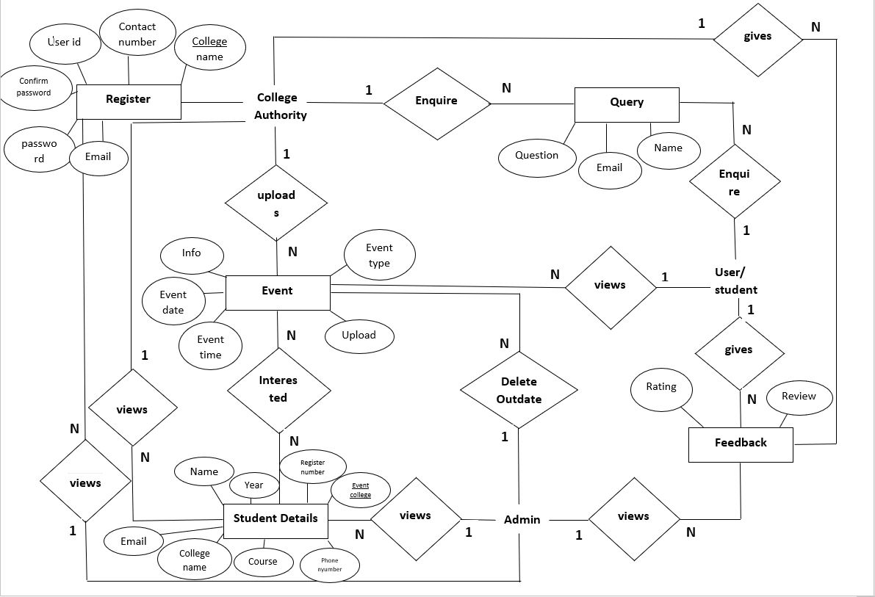
ER Diagram

Slide 15
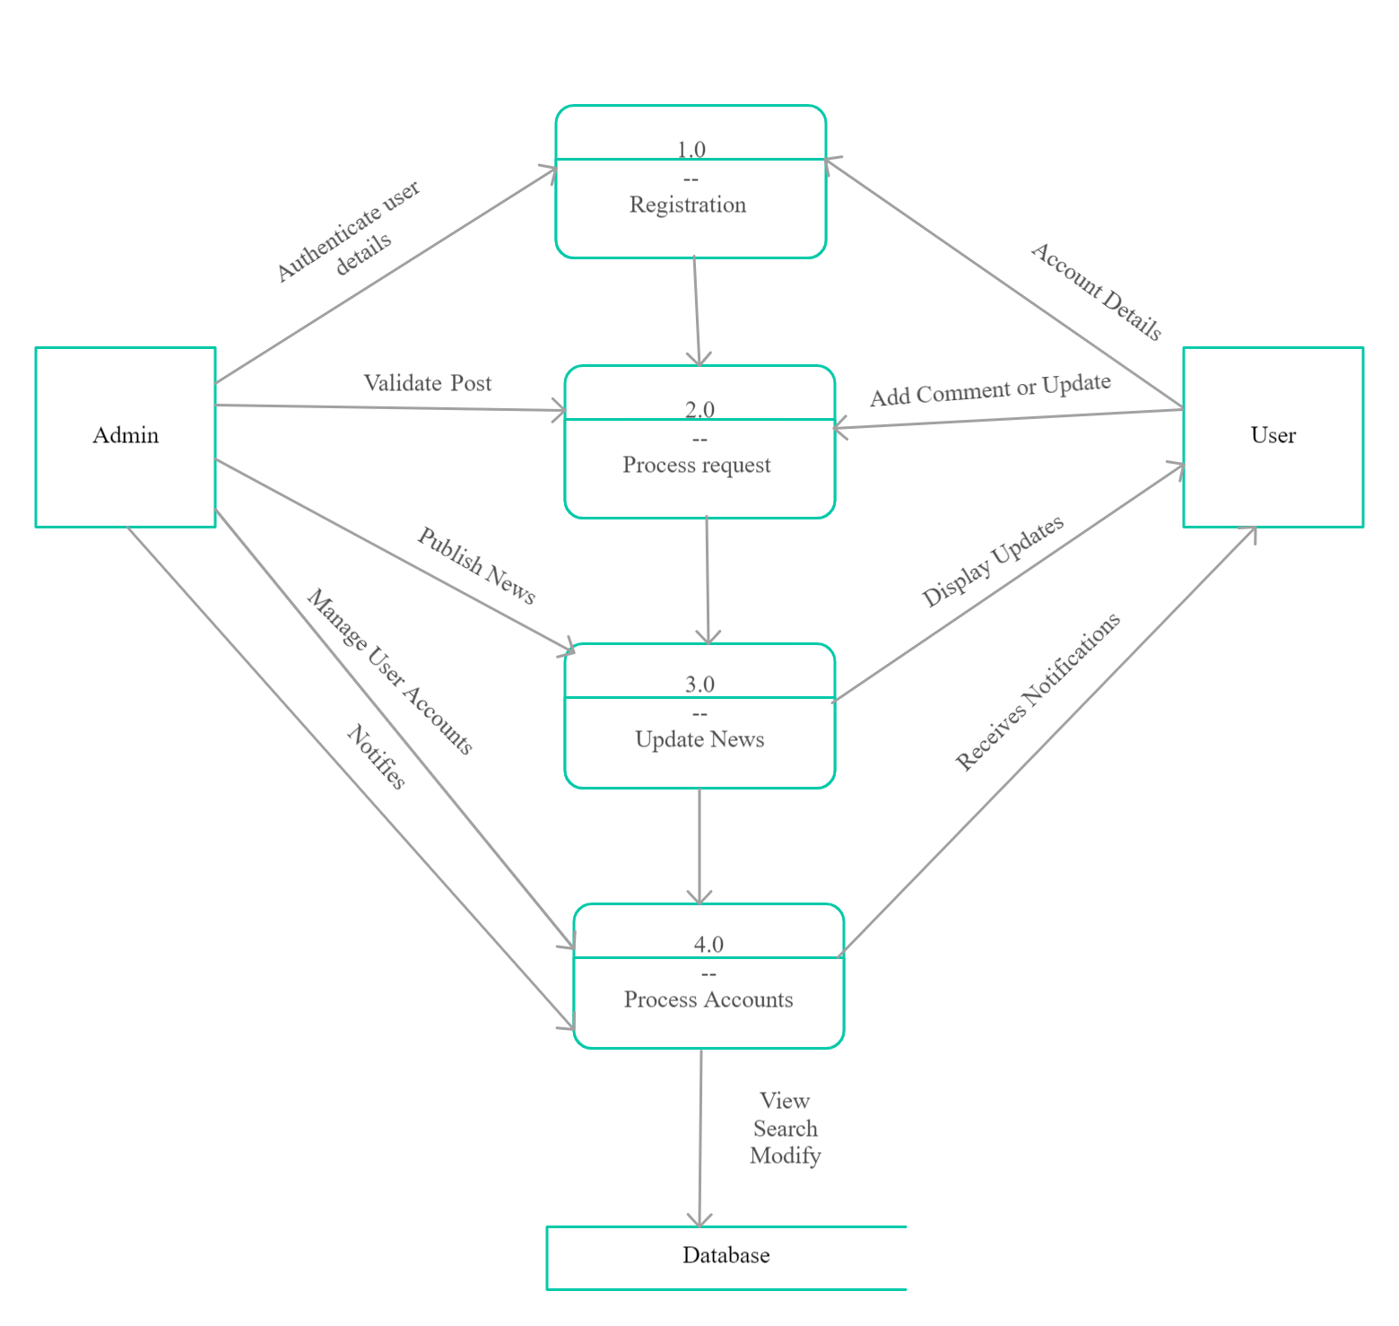
Data Flow Diagram (DFD)
LEVEL 0

Slide 16
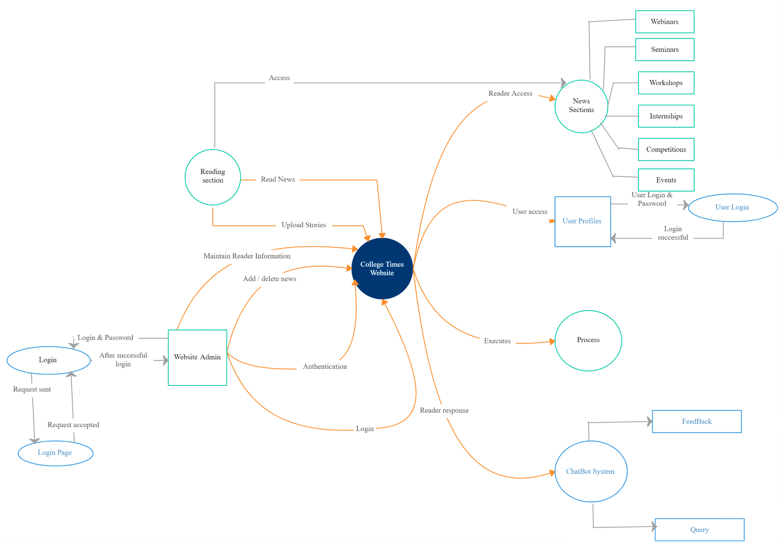
Data Flow Diagram (DFD)
LEVEL 1

Slide 17
Our process is easy
open
view
register

Slide 18
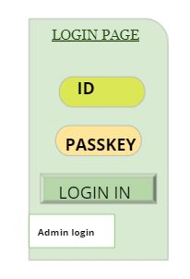
Demo Pages - Mobile View
Demo Pages in the Mobile View:
LOGIN PAGE -
User_id and pwd as attributes, also we have Admin Login for database operations

Slide 19
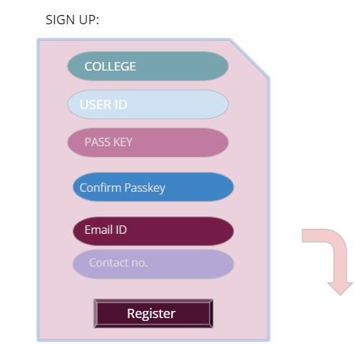
Demo Pages - Tablet View
Demo Pages in the Tablet View:
SIGN UP PAGE -
College name, user id, pass key, confirm pass key, email id, contact no. will be given by the user and that will get saved in the database.

Slide 20
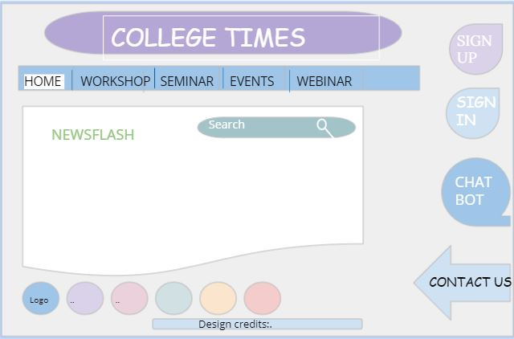
Demo Pages - Desktop View
Demo Pages in the Desktop View:
WEBSITE LOOK:
Our website will look as shown in the picture.

Slide 21
Conclusion
“College Times” is a web application that completely helps students to know about current and upcoming updates on various activities and events organized by various colleges within the state. It will be of greater advantage for students as well as college authorities. This project covers all basic features for an easy and user-friendly interface. The core part of the website is mainly composed of the main interface, menus, login, registration, search bar, and chatbot. This is the combined management of Web programming, specifically HTML, CSS, JavaScript, PHP along with database support from MySQL.

Slide 22
Bibliography
https://www.geeksforgeeks.org/ (DFD Diagram)
https://www.guru99.com/ (ER Diagram)
https://www.geeksforgeeks.org/ (DFD Diagram)
http://library.ucmerced.edu/ (Data Dictionary)
https://www.tutorialspoint.com/ (Data Dictionary)
https://www.trifacta.com/ (Data Dictionary)

Slide 23
Introduction
Extra curriculum plays a key tool in the personal development of a student. It not only provides entertainment but also helps in networking and improving skills. These activities offer opportunities for students to learn the value of teamwork, individual strength and group responsibility, competition, diversity, and a sense of communication. The mission is to develop students holistically.
This website provides a user-friendly interface that can be accessed by any student without hindrance and the main part is composed of the different tabs which segregates all the events to avoid chaos and confusion, a search bar that ensures quick access to the events of a particular college reducing the search time effectively, the chatbot that clears all the queries and problem encountered while using our site and login portal that enhance the security, so that information is only from an authentic source and no random people has access to it.

Slide 24
Problem Statement
As college students, we face a lot of issues when it comes to knowing and segregating information about all college’s day-to-day events and activities, which may seem tricky for some of us. Most of the time as college students, we may not get the opportunity to communicate with other colleges directly, which may lead to losing out on beneficial career opportunities. Currently, there is no such website where the users can get all information related to webinars, seminars, internships, competitions, and events, etc. that are organized by various colleges within the state.
So, we came up with the idea of “College Times” which is a website where the visitors specifically the college students and teachers will get all the relevant and authentic information on the webinars, seminars, internships, competitions, and events, etc. organized by various colleges within the state which is directly given by the college authorities.

Slide 25
Existing System
No Registration or
Participation opportunity
No such Website
For College Events
Only Commercial
News Website

Slide 26
Proposed System
Educational News Website for College Events
Can Register
for Events
01
02
03
04
Platform for Students
And College Authorities
Secure and Authentic informations directly from colleges

Slide 27
Objective
The main objective of “College Times” is to make it easy for college students to know about the current and upcoming activities or events organized by various colleges.
There is a variety of categories such as webinars, seminars, internships, and so on.
We aim to develop an online platform that will allow college authorities to update their current activities and upcoming ones by which students can be benefited.
We also have a feature of Chatbot for feedback and queries/guidance.
It is a time-saving and economically feasible application.

Slide 28
Modules
ADMIN
SEARCH
BOX
CHATBOT
SIGN IN/ SIGN UP
USER (STUDENT)

Slide 29
Software & Hardware
Softwares
Web Editor/ Text Editor
Bootstrap (Front end)
MySQL (Back end)
Hardwares
Microsoft® Windows® 10 (64-bit)
4 GB RAM minimum, 8 GB recommended
2 GB of available disk space
1280 x 800 minimum screen resolution
Hard Drive: 60 GB
Intel Core: i5 8th Gen
Computer System with Internet

Slide 30
Data Dictionary
TABLE 1.1 - REGISTRATION
Field Name | Data Type | Field Size | Constraints | Description | Example
college_name | varchar | 50 | PRIMARY KEY | College name | MCC
user_id | varchar | 20 | NOT NULL | College User Id | mcc_blr
pwd | varchar | 10 | NOT NULL | Login Password | 1234
cmf_pwd | varchar | 10 | NOT NULL | Confirm Password | 1234
email | varchar | 30 | NOT NULL | User Email | abc@gmail.com
contact_no | integer | 10 | NOT NULL | User Phone No. | 9237635122

Slide 31
Data Dictionary
TABLE 1.2 - EVENT FORM
Field Name | Data Type | Field Size | Constraints | Description | Example
news_matter | varchar | 150 | NOT NULL | News Content | CulAh at MCC
options | varchar | 20 | NOT NULL | Category of News | Event
upload | BLOB |  | NOT NULL | Image Upload | poster.jpg
date | date | 10 | NOT NULL | Event Date | 18/09/2021
time | time | 10 | NOT NULL | Event Time | 10:00:00

Slide 32
Data Dictionary
TABLE 1.3 - FEEDBACK
Field Name | Data Type | Field Size | Constraints | Description | Example
ratings | varchar | 10 | NOT NULL | 1-10 Ratings | 9
reviews | varchar | 50 | NOT NULL | Website Review | Good Website

Slide 33
Data Dictionary
TABLE 1.4 - QUERY
Field Name | Data Type | Field Size | Constraints | Description | Example
name | varchar | 20 | NOT NULL | Name of the Person | Julia Michaels
email | varchar | 30 | NOT NULL | Email Address | julia.mic@gmail.com
questions | varchar | 50 | NOT NULL | Query Question | How to access news?

Slide 34
Data Dictionary
TABLE 1.5 - STUDENT_DETAILS
Field Name | Data Type | Field Size | Constraints | Description | Example
name | varchar | 20 | NOT NULL | Name of the Student | Julia Michaels
course | varchar | 20 | NOT NULL | Course of the Student | BCA
year | integer | 10 | NOT NULL | Year of Study | 2
register_no | varchar | 10 | NOT NULL | Register No. of the Student | MA181234
college_name | varchar | 50 | FOREIGN KEY | College Name of the Student | MCC
contact_no | integer | 10 | NOT NULL | Student Contact No. | 9237635122
email | varchar | 30 | NOT NULL | Email Address | julia.mic@gmail.com
Organizing College Name | varchar | 50 | DEFAULT | Organizing College’s Name | Christ University

Slide 35
ER Diagram

Slide 36
Data Flow Diagram (DFD)
LEVEL 0

Slide 37
Data Flow Diagram (DFD)
LEVEL 1

Slide 38
Our process is easy
open
view
register

Slide 39
Demo Pages - Mobile View
Demo Pages in the Mobile View:
LOGIN PAGE -
User_id and pwd as attributes, also we have Admin Login for database operations

Slide 40
Demo Pages - Tablet View
Demo Pages in the Tablet View:
SIGN UP PAGE -
College name, user id, pass key, confirm pass key, email id, contact no. will be given by the user and that will get saved in the database.

Slide 41
Demo Pages - Desktop View
Demo Pages in the Desktop View:
WEBSITE LOOK:
Our website will look as shown in the picture.

Slide 42
Conclusion
“College Times” is a web application that completely helps students to know about current and upcoming updates on various activities and events organized by various colleges within the state. It will be of greater advantage for students as well as college authorities. This project covers all basic features for an easy and user-friendly interface. The core part of the website is mainly composed of the main interface, menus, login, registration, search bar, and chatbot. This is the combined management of Web programming, specifically HTML, CSS, JavaScript, PHP along with database support from MySQL.

Slide 43
Bibliography
https://www.geeksforgeeks.org/ (DFD Diagram)
https://www.guru99.com/ (ER Diagram)
https://www.geeksforgeeks.org/ (DFD Diagram)
http://library.ucmerced.edu/ (Data Dictionary)
https://www.tutorialspoint.com/ (Data Dictionary)
https://www.trifacta.com/ (Data Dictionary)

