Slide 1

Shri Ramdeobaba College of Engineering and Management
Department of
Computer Science and Engineering
Lab Project :
RASWALL
Subject: Computer Networks
Subject Code: CST 353
Submitted by-
Abhirag Kulkarni(21)
Ayush Shete(29)
Fazal Mohammad(33)
Faysal Khan(41)
Isha Mankar(14)

Slide 2
RASWALL

Slide 3
TABLE OF CONTENTS
01
03
Introduction
Implementation
02
04
Requirements
Advantages
05
Conclusion

Slide 4
INTRODUCTION
RASWALL
Firewall
It is a firewall made with raspberry pi.
A firewall is a software. It allows us to add security policies in the router.
The role of a firewall is to block or allow access from a specific IP to another.
The Raspberry Pi (RPi) makes a great internet firewall/router for small networks, and it does not cost a lot of money.
The Raspberry Pi is a general-purpose computer, not a specialized firewall/router.
It has WiFi, Ethernet, and Bluetooth, and it runs Linux.
In comparison, a common choice for small networks is the small combination firewall/router/wireless access point/ Ethernet switch

Slide 5
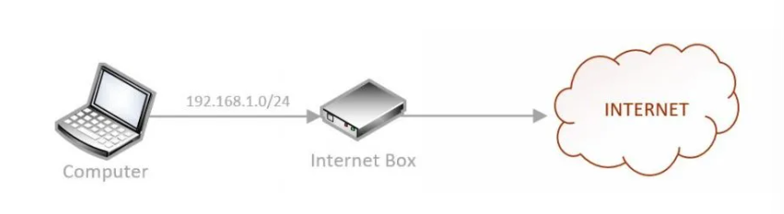
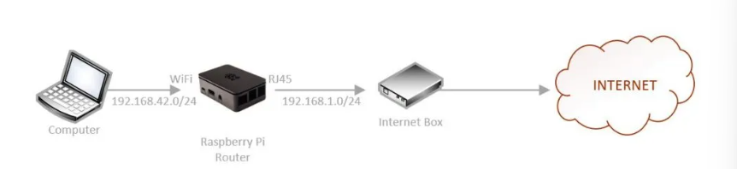
Our Goal
Our objective is to build a brand-new wireless access point that has a Private firewall and traffic filtering Functionality.
Our Current Network –
What Our Vision Is –

Slide 6
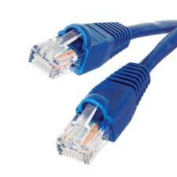
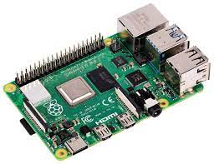

REQUIREMENTS
Raspberry pi
Ethernet Cable
Device having wifi support

Slide 7

IMPLEMENTATION
(I) Installing Raspberry Pi
Install Raspberry Pi OS
Plug the Raspberry Pi on the network with an RJ45 cable
update your system by doing:
sudo apt update
sudo apt upgrade
sudo reboot
4. Enable SSH in raspi-config > Interfacing options

Slide 8

IMPLEMENTATION
(II) Creating wireless router
Configuring the Wi-fi for the use of wireless access point.
Installing and configuring the services.
(a) Services
Hostapd - To Create the wireless access point
DNSmasq – To forward the DNS requests to another DNS server

Slide 9
FEATURES OF CONFIGURING WIRELESS ROUTING:
Configured hotspot starts automatically on boot, no extra configuration necessary
Configured WiFi network is WPA encrypted.
Default SSID of "RaspberryPiFi" and WPA key of "0123456789A" can be modified during install
Once set up, the local network facilites of the Pi will still operate as normal
Easy setup of either a custom or preconfigured DNS server.

Slide 10
(IIl) Configuration of Firewall service
See current configuirations
sudo iptables –L
2. Enable internet forwarding
sudo iptables -A FORWARD -i wlan0 -o eth0 -j ACCEPT
3. Add a forward rule
sudo iptables -F
4. Add a drop rules
a. sudo iptables -A FORWARD -p tcp --dport 80 -j DROP – we add a new rule (-A) – in the forward section (FORWARD) – for the tcp protocol (-p tcp) – for the HTTP port (–dport 80) – and the action is to DROP everything (timeout connection)

Slide 11

IMPLEMENTATION
5. Create and Execute a firewall script
Create a new file with nano.
Add the script for white and Black.
#Whitelist mode iptables -P INPUT ACCEPT iptables -P FORWARD DROP iptables -P OUTPUT ACCEPT
Add execution right to this script and run it.
sudo chmod +x firewall.sh
sudo /usr/local/bin/firewall.sh

Slide 12

Features :
Unified Security Management
Threat Prevention
Application and Identity-Based Inspection
Hybrid Cloud Support
Scalable Performance

Slide 13
PROXY AND WEB FILTER
(IV) Squid and SquidGaurd Implementation
What is Squid ?
Squid is a fully-featured HTTP/1.0 proxy which is almost a fully-featured HTTP/1.1 proxy.
Squid offers a rich access control, authorization and logging environment
Squid offers a rich set of traffic optimization options
What is SquidGaurd ?
SquidGuard is a URL redirector software.
It can be used for content control of websites users can access.
A plug-in for Squid and uses blacklists to define sites for which access is redirected.

Slide 14
PROXY AND WEB FILTER
(IV) Steps For the Implementation of Squid and SquidGaurd
Instal and restart Squid
Configure your web browser to use the Raspberry Pi as the HTTP Proxy
Configure iptables
Install the squidguard package
Download a list of websites and Extract files from the archive
Move files to the SquidGuard folder and Archive the original SquidGuard
configuration file
Create a new configuration file
Build SquidGaurd and restart Squid
a. sudo squidGuard -C all -d
b. sudo service squid restart

Slide 15
ADVANTAGES OF RASWALL
1. Cost efficient
The raspberry pi does not have an OS like windows which requires a license cost. This is what makes it cost efficient
2. Portability
The small size of the device makes it portable which is the best part of the raspberry pi.
3. Speed
Normally, the hardware firewalls are tailored for faster response times, and hence handle more traffic loads.
4. Security:
A firewall with its own operating system (proprietary) is less prone for attacks. This in turn reduces the security risk. In addition, hardware firewalls have enhanced security controls.

Slide 16
CONCLUSION
Raswall is a firewall made with raspberry pi that gives Numerous connection points (HDMI, different USB, Ethernet, locally available Wi-Fi, and Bluetooth, numerous GPIOs, USB fueled, and so forth) as straightforward commands and is simply cost-effective in view of keeping its processing power.

