Slide 1

NEIC Earthquakes Analysis
Presented by
Ayush Gupta
©INSAID All rights reserved.

Slide 2
Agenda
1.
Introduction
7.
Observations
2.
Problem statement
8.
3.
Data Acquisition
9.
4.
Data Pre-profiling
5.
Data pre-processing
6.
EDA

Slide 3
Introduction
Earthquakes happen when two large pieces of the Earth's crust suddenly slip. This causes shock waves to shake the surface of the Earth in the form of an earthquake.
The National Earthquake Information Centre (NEIC) files an average of 20,000 earthquakes every year around the world. The edges, which are called fault lines, can get stuck, but the plates keep moving. Pressure slowly starts to build up where the edges are stuck and, once the pressure gets strong enough, the plates will suddenly move causing an earthquake.
After reading about earthquakes, we came to realize that earthquakes are one of the major causes of destruction of life and property and we wanted to use this project to get some valuable insights from the earthquakes data available from National Earthquake Information Center(NEIC).

Slide 4
Problem statement
Have the number of earthquakes increased over the years?
What is the distribution of Earthquakes across the globe?
How has this distribution of earthquakes changed over the years , starting 1965?
Is there any correlation between Earthquakes distribution and tectonic plates distribution?
What is the distribution of earthquakes in India?

Slide 5
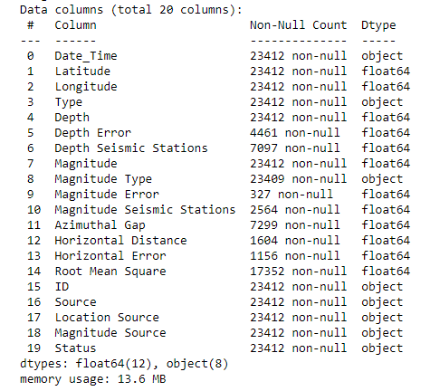
Data Acquisition
The following data set was available from NEIC at: 'https://raw.githubusercontent.com/insaid2018/Term-2/master/Data/earthquake.csv‘
Important feature of the data are as follows:
Records | Features | Dataset Size
23412 | 20 | 2.29 MB

Slide 6
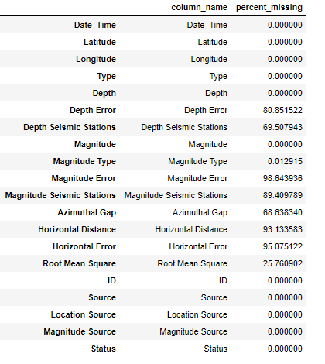
Data pre-profiling
In data profiling we come to know that 7-8 features have more than 50% missing values.

Slide 7
Data Cleaning
Handling missing data:
We have removed following columns having more than 50% data missing:
Depth Error
Magnitude Error
Magnitude Seismic Stations
Horizontal Distance
Azimuthal Gap
Horizontal Error
Depth Seismic Stations
Missing values of ‘Root mean square’ column have been replaced with mean of the available values.

Slide 8
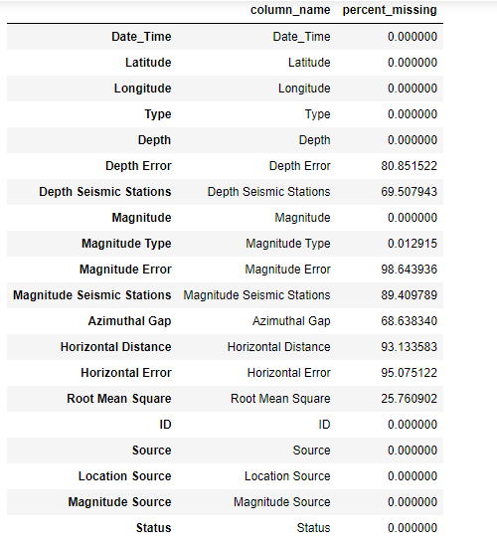
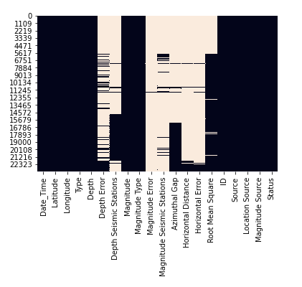
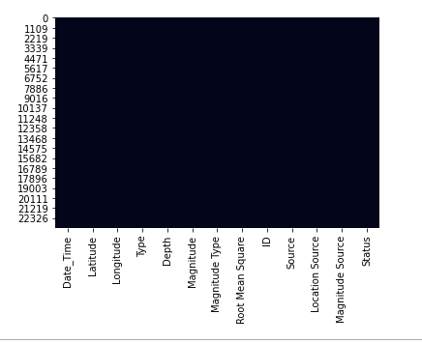
Data Pre-processing
After removing the columns with missing data

Slide 9
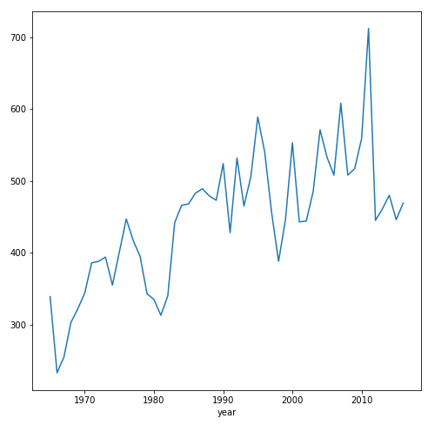
EDA
Question 1 - Have the number of earthquakes increased over the years?
By seeing the yearly data of the nos. of earthquakes occurring each year, we could see that the number of earthquakes have been increased and maximum no. of earthquakes occurred in 2011 since then the nos. of earthquakes have been decreased.

Slide 10
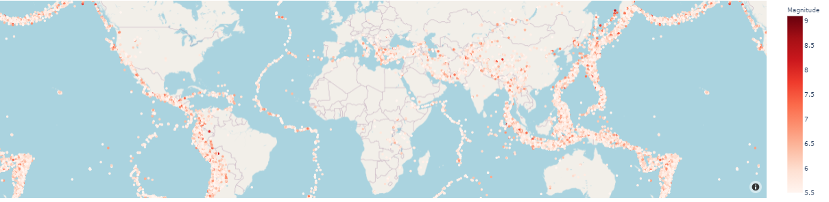
EDA
Question 2 -What is the distribution of Earthquakes across the globe?

Slide 11
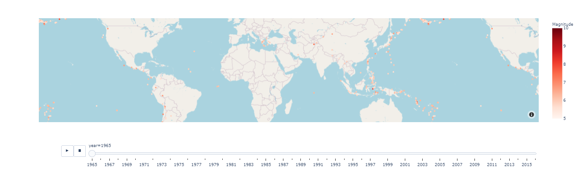
EDA
Question 3 -How has this distribution of earthquakes changed over the years , starting 1965?

Slide 12
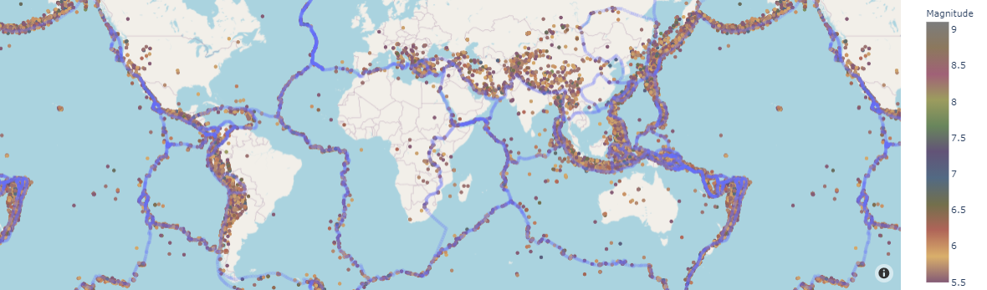
EDA
Question 4 -Is there any correlation between Earthquakes distribution and tectonic plates distribution?
We can see that most earthquakes (red dots) frequently occur near the tectonic fault boundaries (blue line).

Slide 13
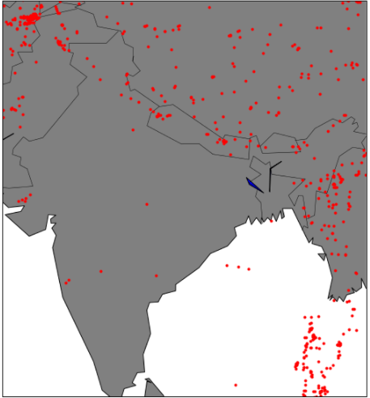
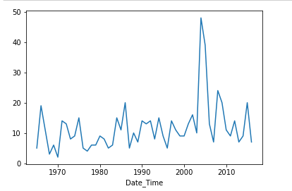
EDA
Question 5 -What is the distribution of earthquakes in India?
For India most number of earth quakes occurred in 2004.

Slide 14
Observations & Insights
Number of earthquakes have increased over the years.
We can clearly see the distribution of earthquakes on a global map based on the magnitude as well as over the years.
We can see that there is an overlap in location of tectonic plates and location of occurrence of earthquakes.
Most earthquakes in India occur around the Himalayan belt which overlay on the Indo- Eurasian tectonic boundary, making this region of India a hotspot for earthquakes. The infrastructure of this region needs to prepared for future earthquakes.

