Slide 1
Agent-based modeling and social system simulation
Reinforcement learning for markets Ayush Garg, Virgile Troude, Martin Fiebig, Simon Hasenfratz

Slide 2
Agenda
Market setting
Learning mechanism
Results and discussion
Q&A

Slide 3
Market setting
1

Slide 4


Agents are trying to buy or sell one unit of a given good
Buyer
Bid price b_{i} ≤ Budget
Seller
Ask price a_{j} ≥ Production cost
If b_{i} ≥ a_{j} then they might get matched at deal price d_{i,j}

Slide 5
They can change their bids and asks until they get matched
Asumptions:
Opposite side information setting
Punishments for staying in the game
Increase/decrease offer in discrete steps
Agents are rational and reward-maximizing

Slide 6

We picked a generic and unbiased matching mechanism
Randomly sort all remaining buyers and sellers
Pick the first seller s_{i}
Find the first buyer with s_{i} ≤ b_{i}
Match them at random price within [a_{j}, b_{i}]

Slide 7
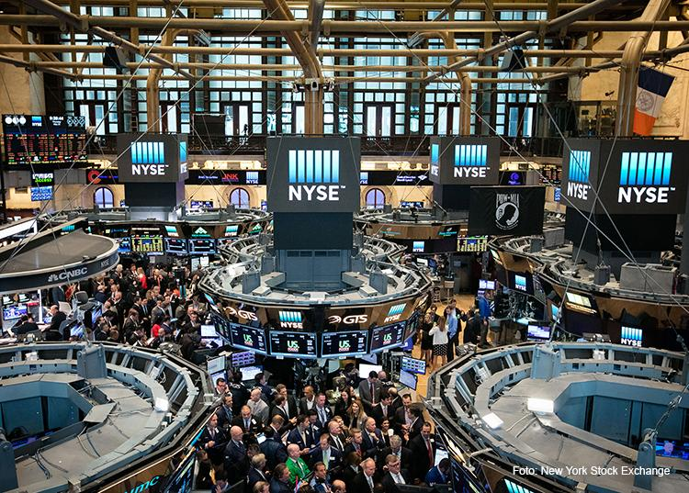
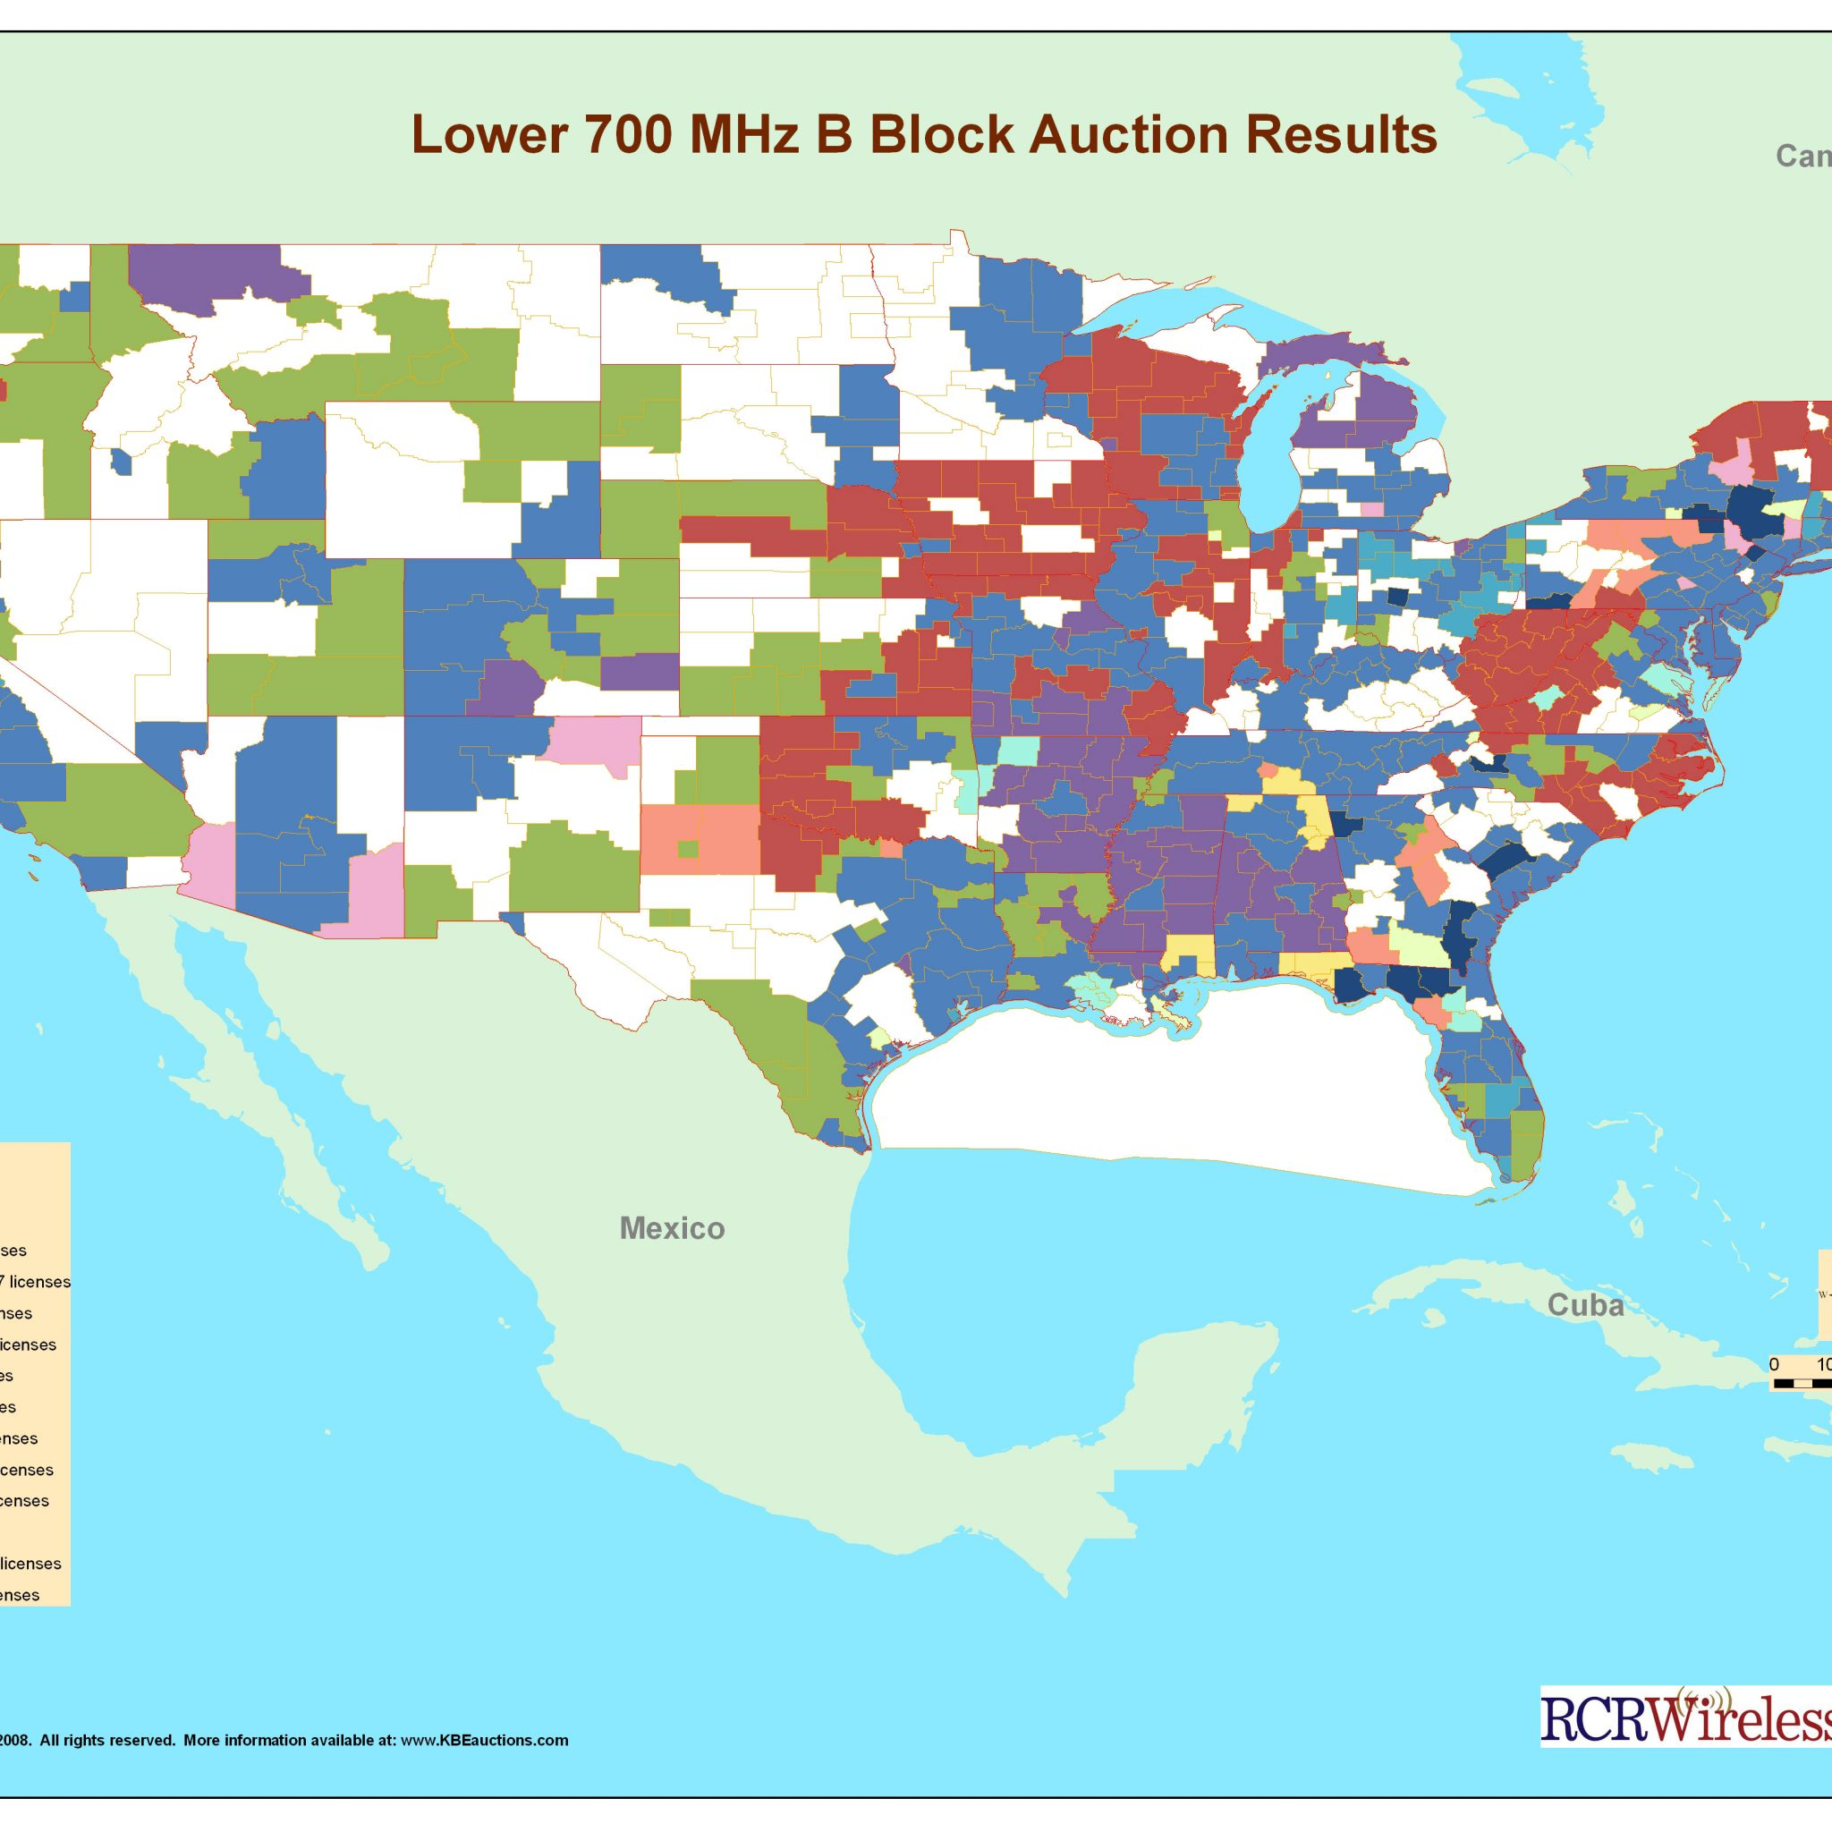
Some real life examples of double auctions

Slide 8
Learning mechanism
2

Slide 9

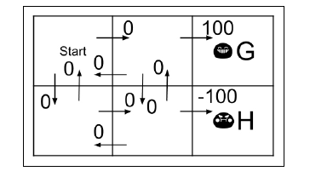
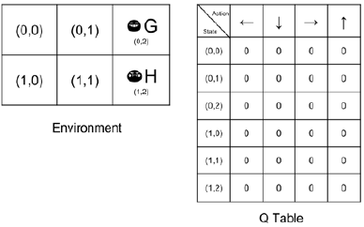
Q-Learning Example
Bellman Equation: Core of Q-Learning
Fig.1: 6 state deterministic system
Fig.2: Initial Q table
Source: Rowel Atienza, Advanced Deep Learning with Keras,2018

Slide 10
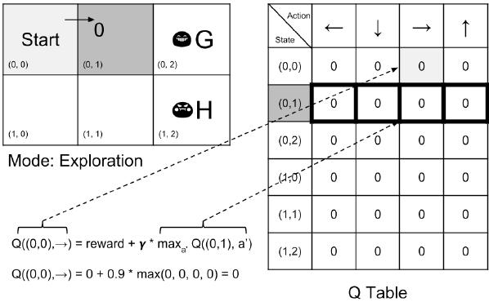
1st step
Source: Rowel Atienza, Advanced Deep Learning with Keras,2018

Slide 11
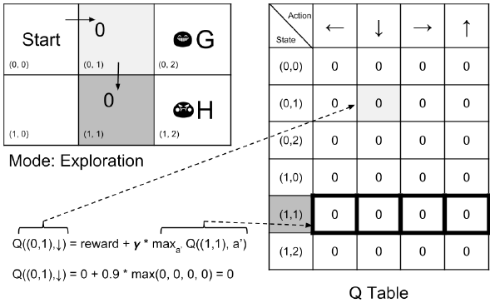
2nd step
Source: Rowel Atienza, Advanced Deep Learning with Keras,2018

Slide 12
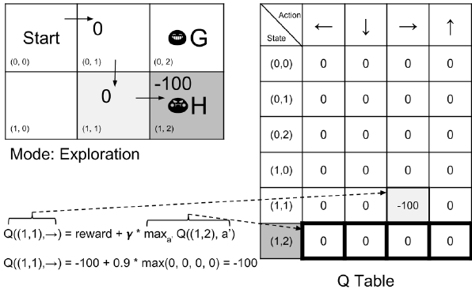
3rd step
Source: Rowel Atienza, Advanced Deep Learning with Keras,2018

Slide 13
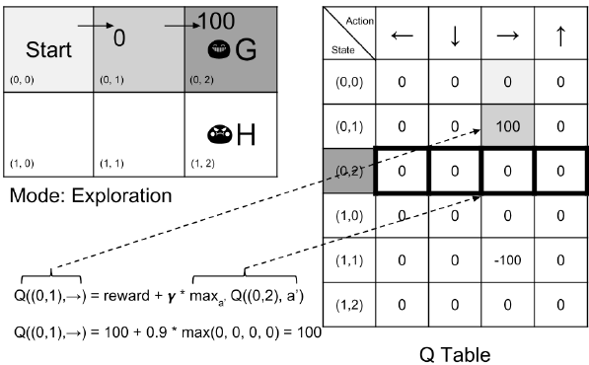
4th step
Source: Rowel Atienza, Advanced Deep Learning with Keras,2018

Slide 14
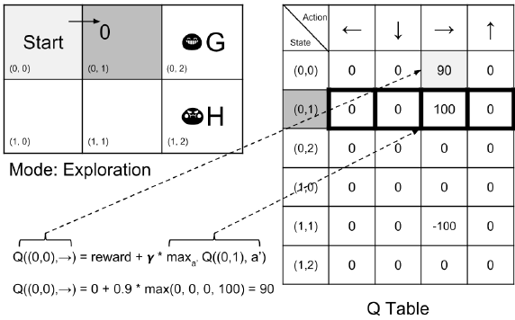
5th step
Repeated use of Bellman update equation will lead to convergence under mild conditions of determinism and bounded rewards

Slide 15
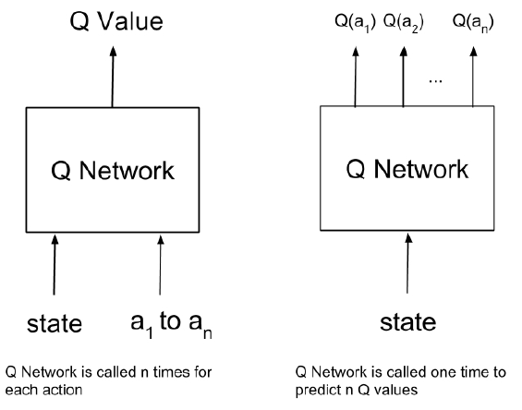
Our formulation
Repeated use of Bellman update equation will lead to convergence under mild conditions of determinism and bounded rewards

Slide 16
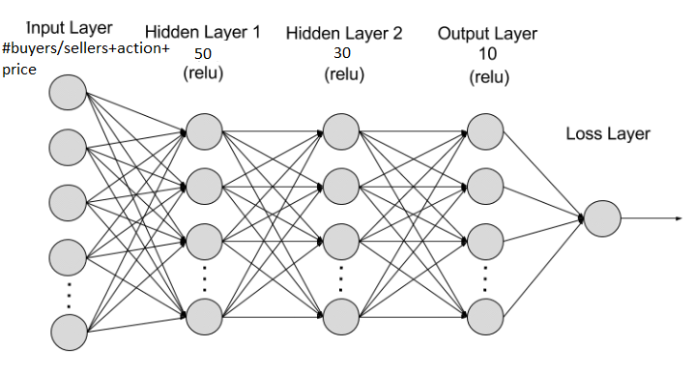
...contd

Slide 17
Results and discussion
3

Slide 18
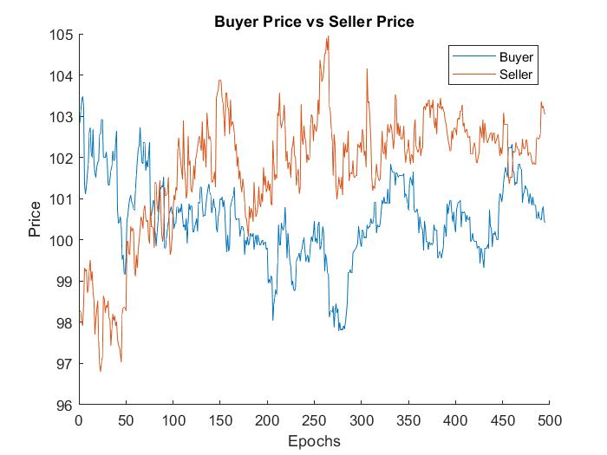
As expected sellers want to sell at a higher price while buyers want the opposite

Slide 19
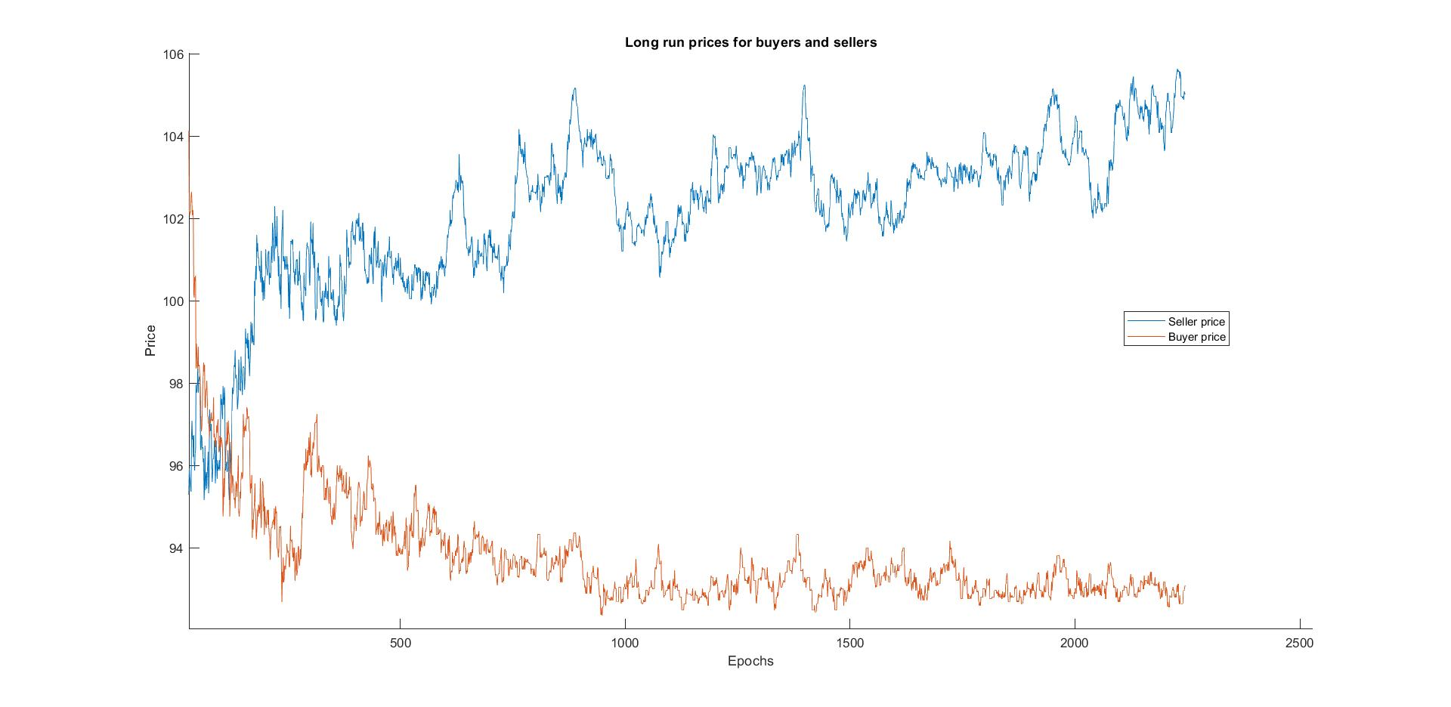
In the long run prices for both buyers and sellers saturate

Slide 20
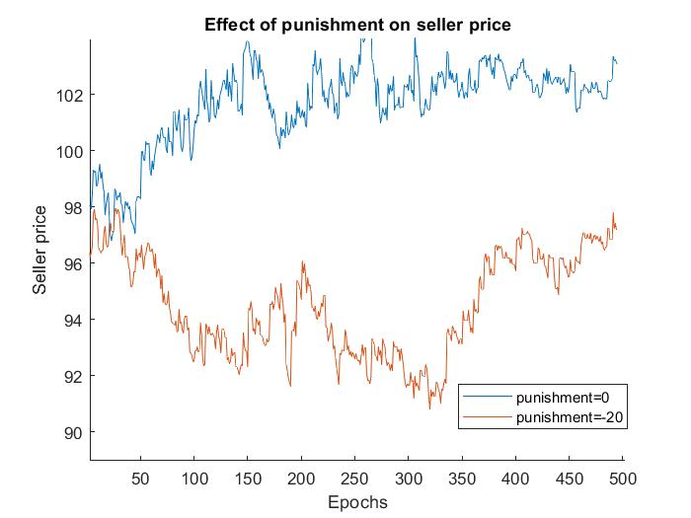
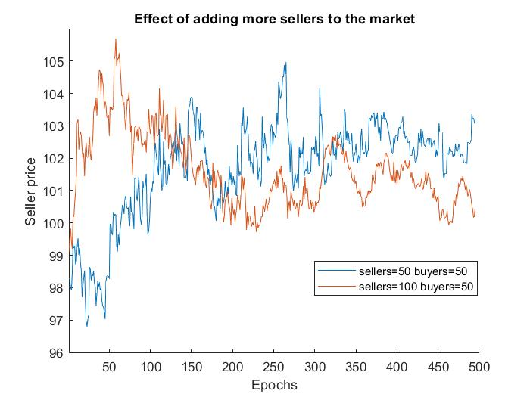
Opportunity costs and supply & demand drive prices

Slide 21

4

