Slide 1
Multiplayer Agents: Workbook 2
A shared live session layer for human-agent collaboration
Data engineering (section 3) and model development (section 4)
Ayush Gawai, Naman Vipul Chheda, Manav Patel, Shriram Dundigalla, Pramod Satya Dindukurthi
Section 21, Topic 4. Advisor: Prof. Simon Shim
github.com/ayushgawai/multiplayer-agent-sessions
Team 4 | DATA 298A | Workbook 2 | 12 Nov 2026
1
Notes:
Sections 3 and 4 of the report: data engineering and model development, plus the pipeline demo.

Slide 2
Since Workbook 1
On main | In review | Not started
Session service, event log, client, CRDT editing, presence | Shared M1 evaluation harness (DAT-61): fixes requested | Product-session recording (0 sessions)
LangGraph agent runtime (DAT-18, merged 11 Nov) | BM25 baseline m1-a (DAT-58) | Model 2 and Model 4 configurations (298B)
MAST download, audit, manifest, prompt, parser, batch, metrics | M1 candidate train and inference paths (m1-b, c, d) | Cloud deployment (deferred to 298B)
QMSum download, frozen m1_v1 splits; M1 contract ADR-005 | Warehouse pipeline demo (PR #33); CI and lock refresh (PR #32)
M1 smoke dataset: 18 examples, 12 sessions (DAT-53) | Learning-event store (DAT-56)
No bake-off result and no baseline agreement figure exists yet. Everything on the following slides is data, design and committed evaluation rules.
Team 4 | DATA 298A | Workbook 2 | 12 Nov 2026
2
Notes:
Be exact about what is merged and what is in review. No model results exist yet.

Slide 3
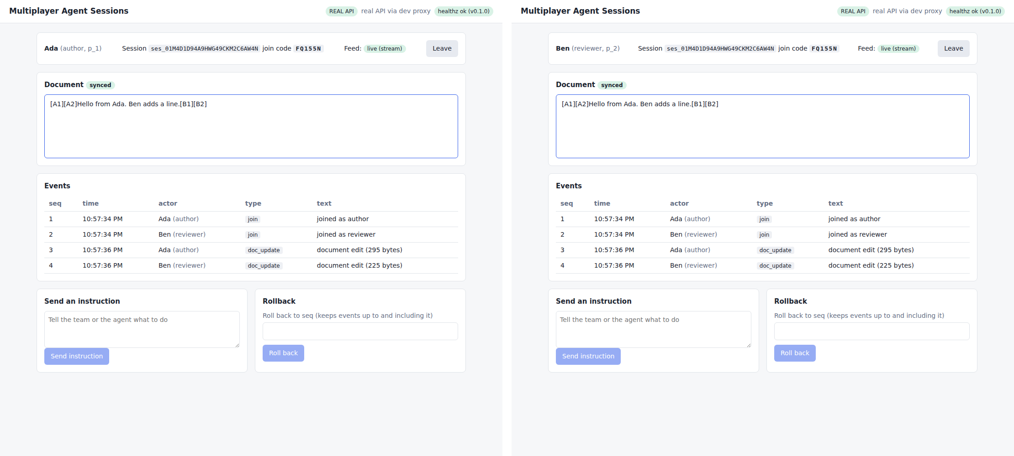
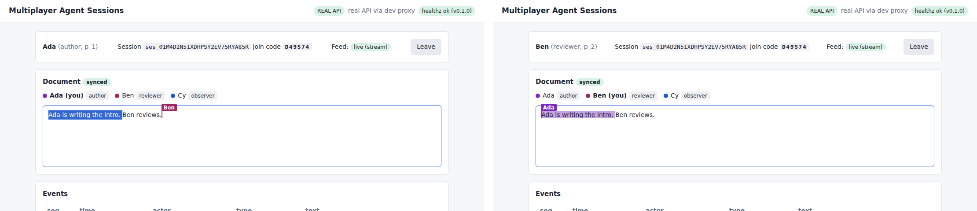
Prototype today: shared editing, presence and roles
Two people edit one document at once; edits merge through a Yjs CRDT, so nothing is lost.
Each edit is also written to the session event log as a doc_update event.
Presence bar: author, reviewer, observer, each with a stable colour and a named cursor. Observers can read but not edit.
Real: client talking to the real session service.
Team 4 | DATA 298A | Workbook 2 | 12 Nov 2026
3
Notes:
Client runs against the real session service (REAL API badge). No model output is shown in the client yet.

Slide 4
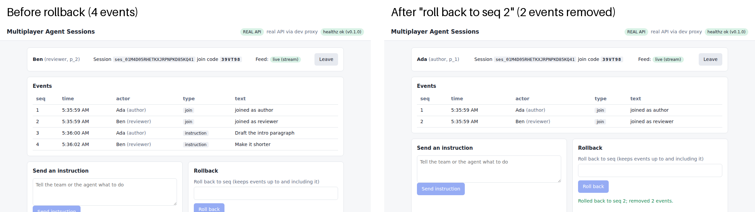
Prototype today: one ordered event log, with rollback
Left: four events (two joins, two instructions). Right: after 'roll back to seq 2', the two instructions are removed for everyone in the session.
This log is the source of our own data and the input that the Model 1 catch-up reads.
Team 4 | DATA 298A | Workbook 2 | 12 Nov 2026
4

Slide 5
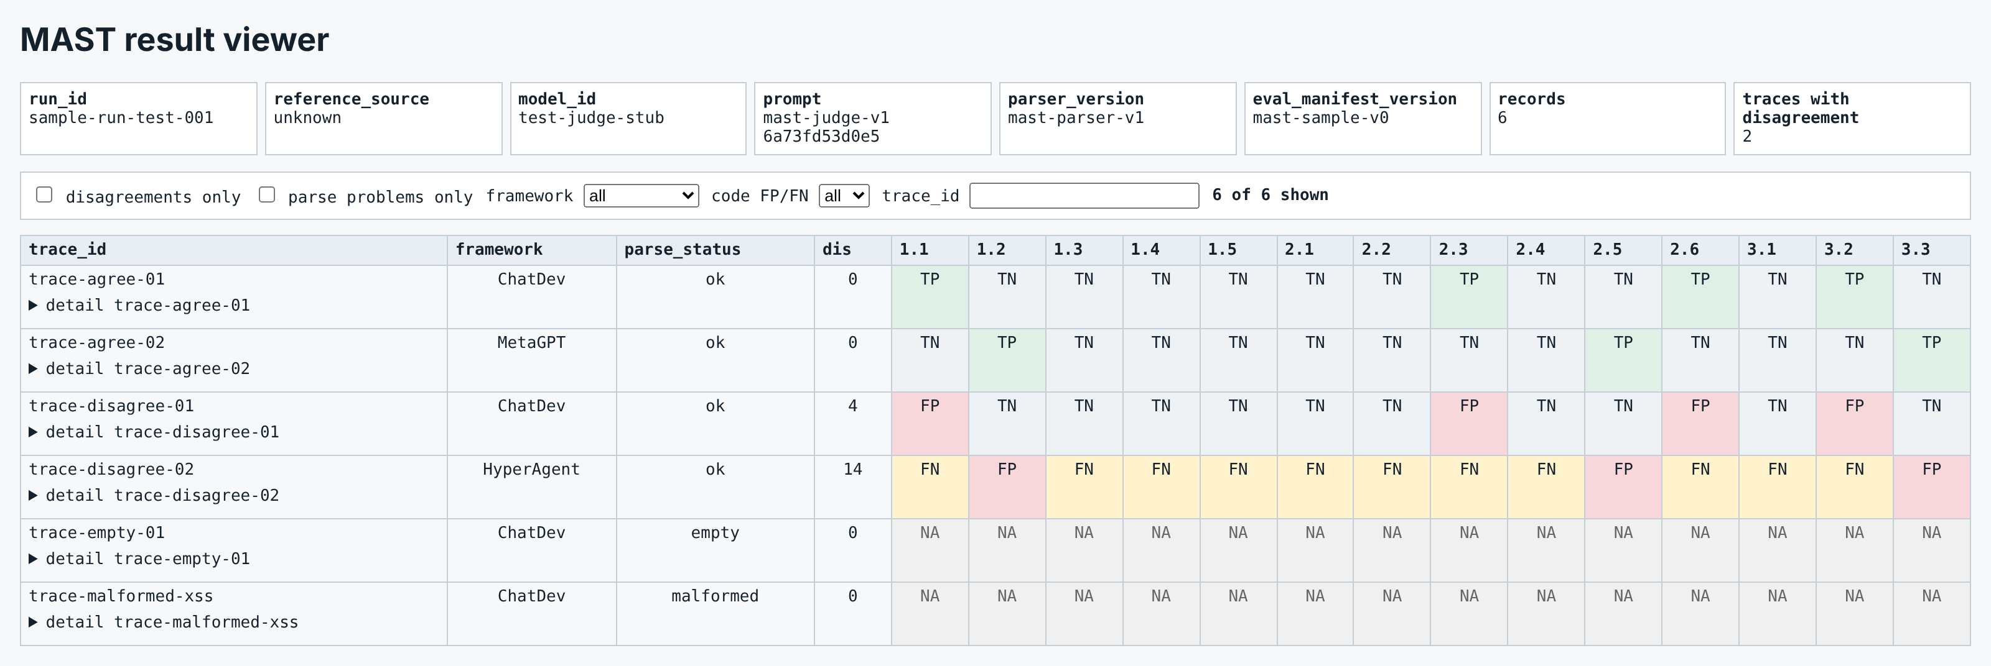
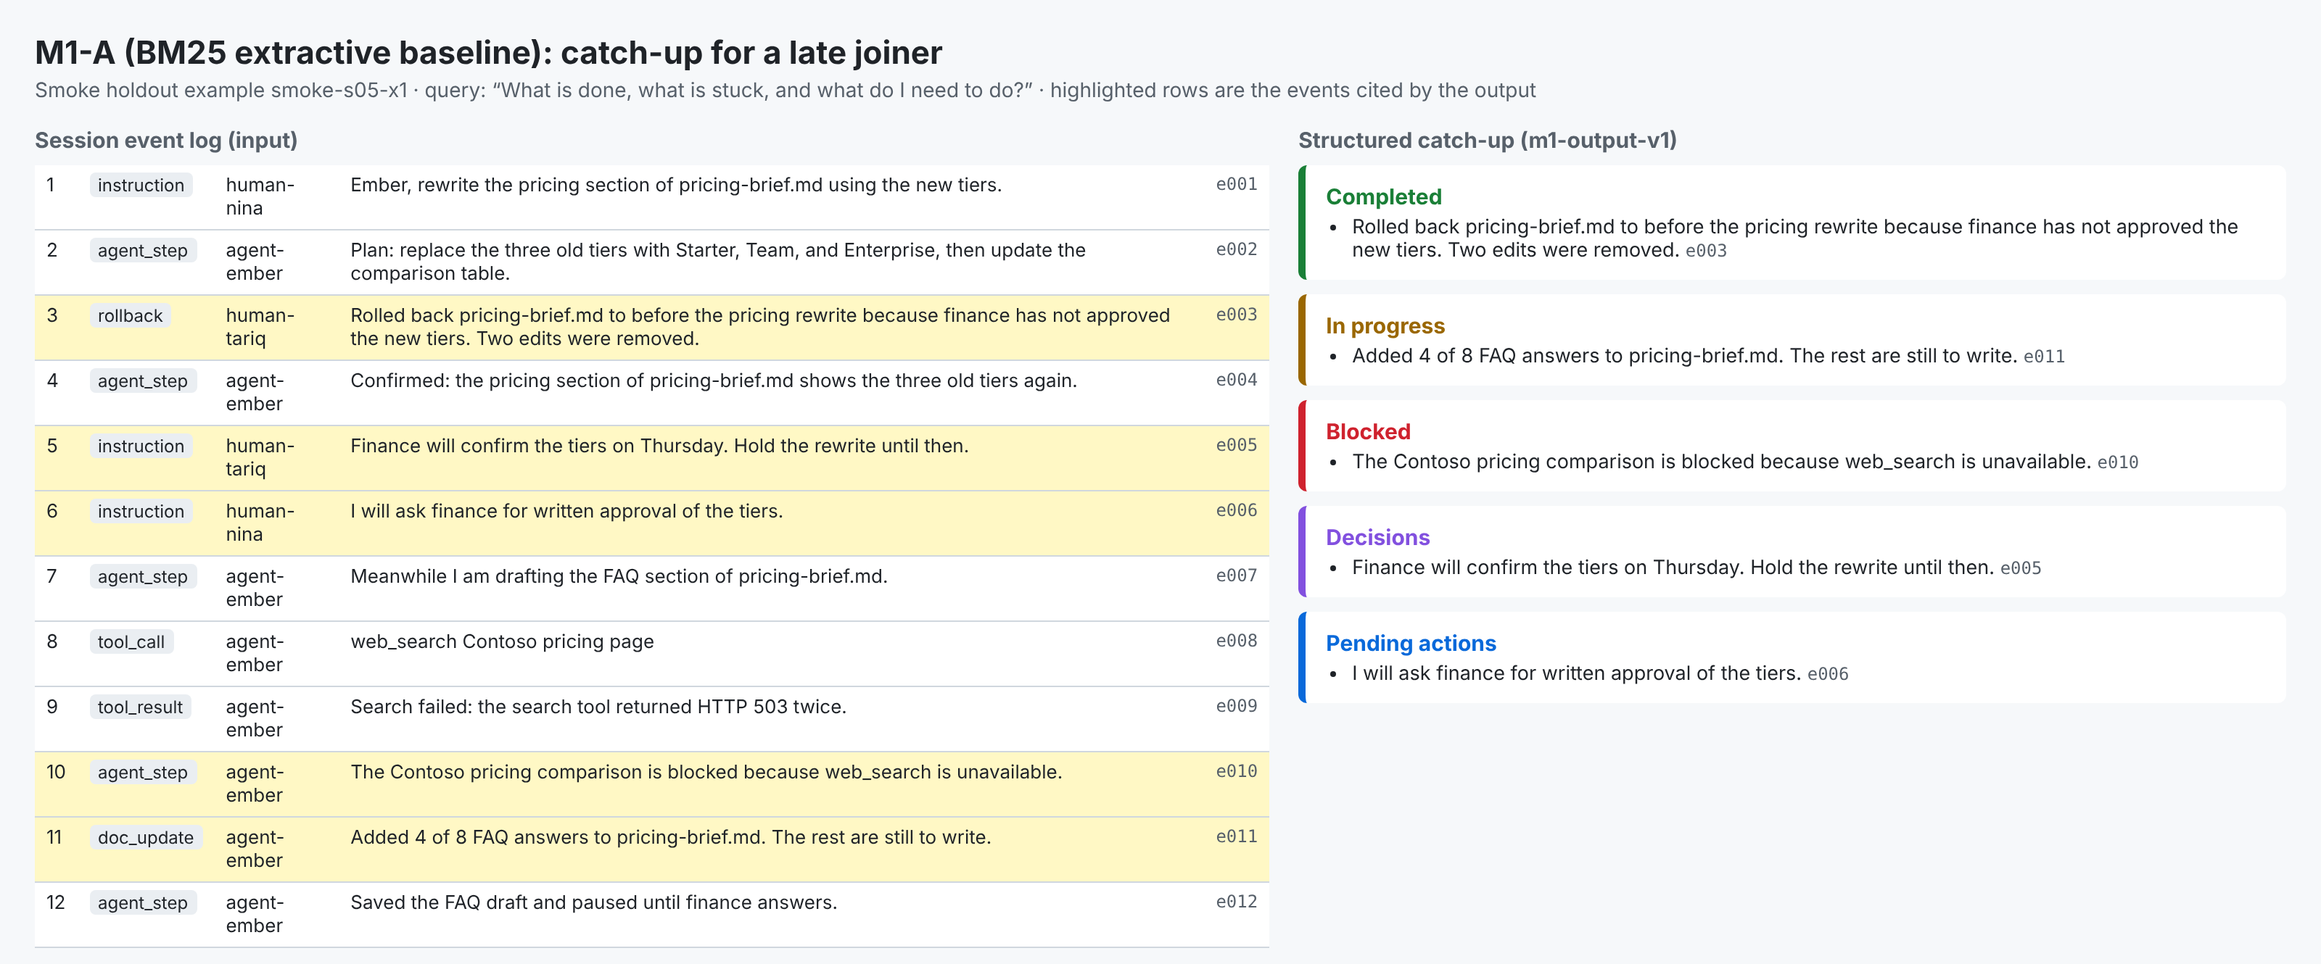
Evaluation tooling: MAST result viewer and an M1-A example
Judge label against reference label per trace and failure code (TP, FP, FN, TN, NA).
Header carries prompt version and hash, parser and manifest versions.
Left: session events. Right: BM25 catch-up in five categories; every line cites its source event.
M1-A is the floor the learned candidates must beat (draft PR #26).
Both screenshots use test data: a 6-record fixture with a stub judge, and a synthetic smoke session. Neither is a result.
Team 4 | DATA 298A | Workbook 2 | 12 Nov 2026
5

Slide 6
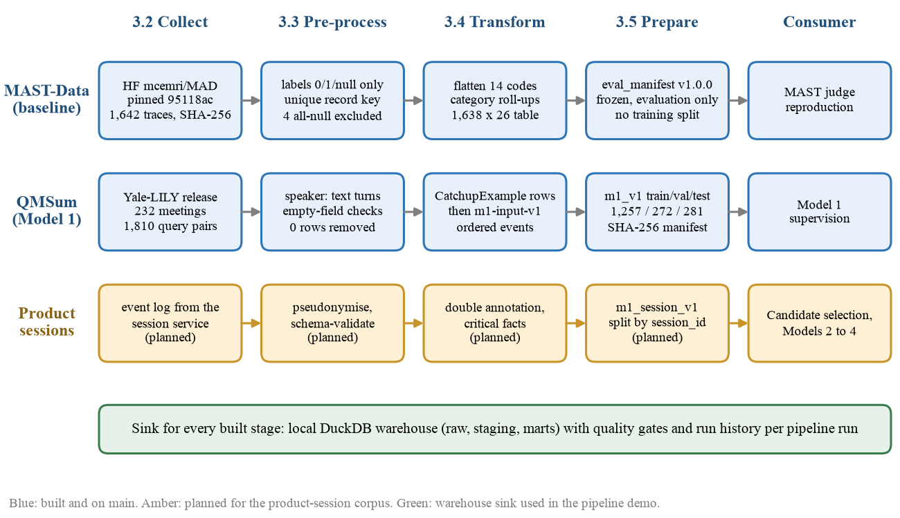
Data process: three sources, five steps
3.1 Data Process
Public data is never committed: it is rebuilt from pinned revisions.
Nothing is dropped silently.
Test data is read once.
Team 4 | DATA 298A | Workbook 2 | 12 Nov 2026
6
Notes:
Three paths never mix. Amber is planned.

Slide 7
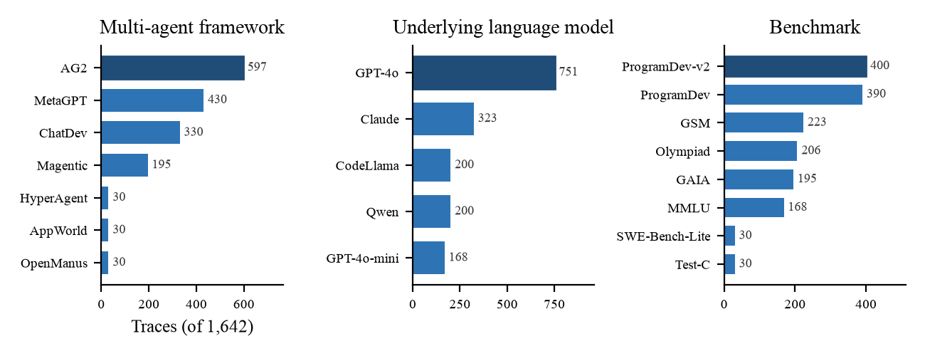
Data collection
3.2 Data Collection
Source | Quantity | Role
MAST-Data (HF mcemri/MAD, pinned 95118ac9), CC-BY-4.0 | 1,642 traces, 199.6 MB; 19 human-labelled | Baseline corpus
QMSum (Yale-LILY), MIT | 232 meetings, 129,177 turns, 1,810 query pairs | Model 1 supervision
Smoke fixtures (team-authored) | 18 examples, 12 sessions | Pipeline validation only
Product sessions (event log) | 0 recorded; target about 30 | Winner selection, Models 2 to 4
Every file verified by SHA-256; MAST count equals the paper's 1,642.
7 frameworks, 5 language models, 8 benchmarks.
Team 4 | DATA 298A | Workbook 2 | 12 Nov 2026
7

Slide 8
Pre-processing: rules that run, and what each removed
3.3 Pre-processing
Rule | Tool | Effect
Digest and record count equal the pinned values | download_mast.py, download_qmsum.py | Pass; 0 removed
Record key (trace.key, trace_id) is unique | eda_mast.py | 1,642 unique; 0 duplicates
Each of 14 labels is exactly 0, 1 or null | eda_mast.py | 0 invalid in 22,988 cells
A null label stays null, never 0 | eda_mast.py | 56 null cells preserved
Exclude a record only if all 14 labels are null | eda_mast.py | 4 removed (0.24%)
QMSum: non-empty query, context, summary; unique ids | make_splits.py, data tests | 0 removed of 1,810
The four excluded traces are named in the committed summary: ChatDev_ProgramDev-v2_CodeLlama, traces 4, 72, 73, 81.
Ten quality gates pass; two runs give byte-identical summaries.
Team 4 | DATA 298A | Workbook 2 | 12 Nov 2026
8
Notes:
Four rows removed in total. The value is the guarantee, not the volume.

Slide 9
Transformation: same facts, usable shape
3.4 Transformation
From | To | Why
MAST nested mast_annotation | 14 columns fail_1_1 to fail_3_3, n_failures, 3 category counts (1,638 x 26) | A flat table can be aggregated and compared with the paper's categories
MAST trajectory text (up to 2.0M chars) | trace_chars | Analysis table is 142 KB, not 199.6 MB
QMSum meeting with many queries | One CatchupExample per query (1,810 rows) | Model 1 answers one query at a time
CatchupExample context spans | m1-input-v1: ordered events with ids row:span:0000 | Same input shape as live sessions; claims must cite event ids
Reference summary | Kept outside the input | A target inside the input leaks the answer
Example event: {"event_id": "qmsum_test_9_s3:span:0000", "sequence": 0, "event_type": "doc_update", "text": "Grad B: And they wouldn't look pretty . So ."}
Team 4 | DATA 298A | Workbook 2 | 12 Nov 2026
9

Slide 10
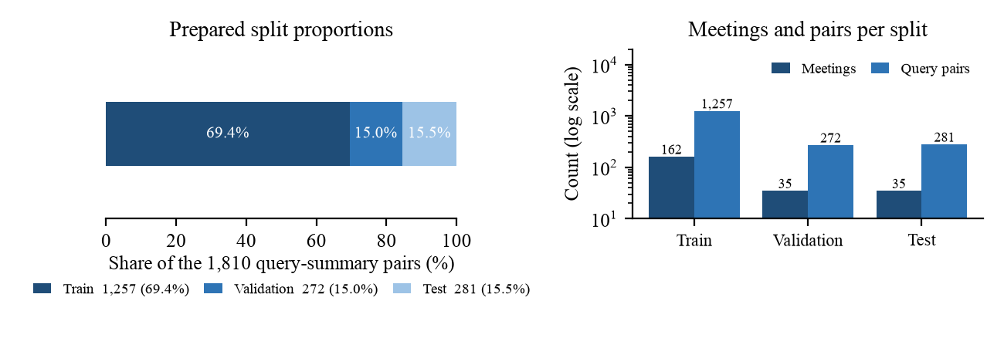
Prepared splits and the leakage check
3.5 Data Preparation
Split | Rows | % | Meetings | Leakage result
Train | 1,257 | 69.4 | 162 | 0 meetings, ids, contexts shared
Validation | 272 | 15.0 | 35 | 0 shared
Test | 281 | 15.5 | 35 | 0 shared; read once
Frozen in data/splits/m1_v1/ with SHA-256 manifest (commit 330603f, 21 Oct); digests recomputed and match.
Found: two reference-summary strings recur across splits (4 of 1,810 rows, 0.22%). Upstream duplicates, left in place and reported.
The split that selects the winner (m1_session_v1, by session_id) is not prepared: no sessions yet.
Team 4 | DATA 298A | Workbook 2 | 12 Nov 2026
10
Notes:
Not stratified: we inherit the official QMSum partition by meeting.

Slide 11
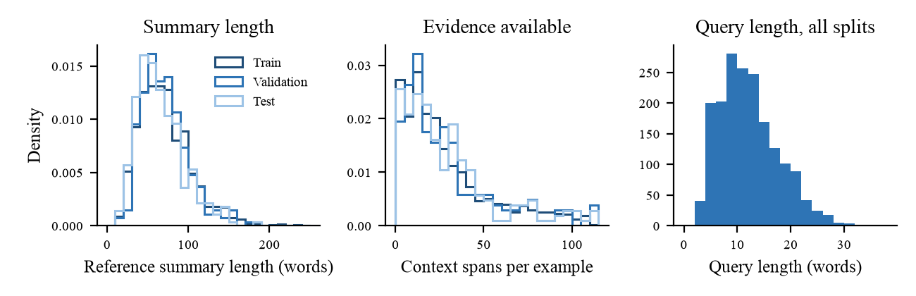
Statistics: Model 1 supervision
3.6 Data Statistics
Summaries are short: median 59 to 68 words. One missing fact is a large share of the answer.
Context is right-skewed: median about 660 words, 95th percentile over 10,000.
Splits overlap closely, although we did not stratify.
These three facts drive the metric choices: recall before overlap, latency at p95, truncation as a named failure.
Team 4 | DATA 298A | Workbook 2 | 12 Nov 2026
11

Slide 12
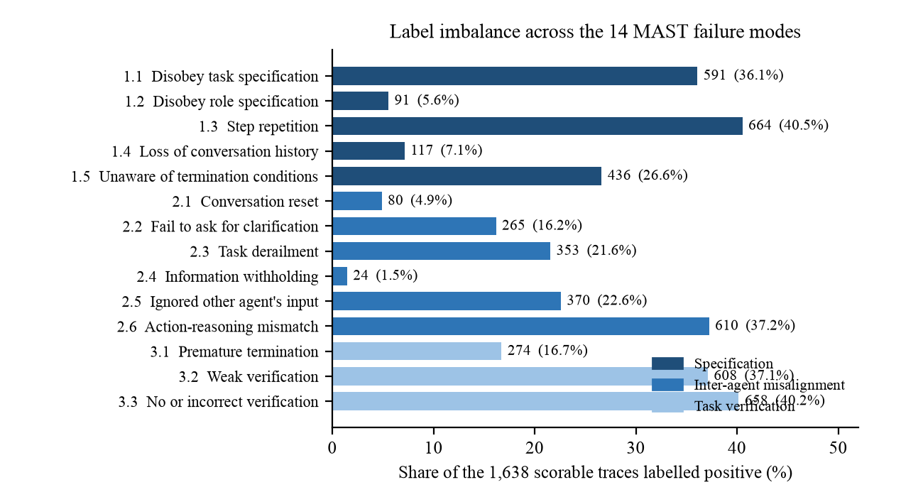
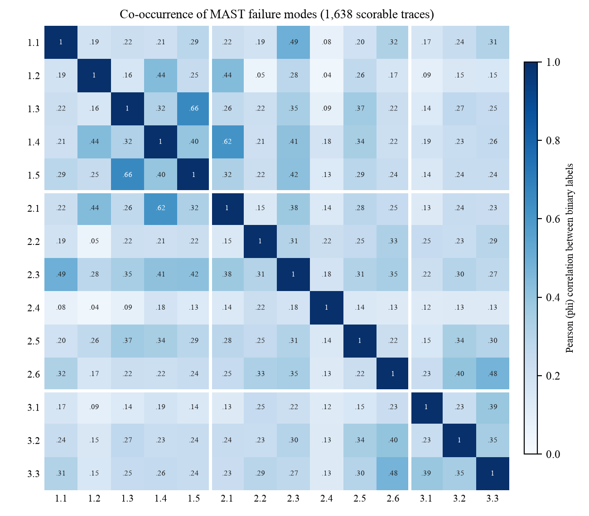
Statistics: MAST imbalance and co-occurrence
3.6 Data Statistics
Prevalence from 40.5% (1.3) to 1.5% (2.4): 664 against 24 traces.
24.5% of traces have no failure; mean 3.14 per trace.
All pairwise correlations positive (0.04 to 0.66): accuracy alone would mislead.
Team 4 | DATA 298A | Workbook 2 | 12 Nov 2026
12

Slide 13
Coverage gaps and who they would disadvantage
3.6 Data Statistics
Gap | Who is disadvantaged | What we do
QMSum is English meeting speech in three settings | Other languages; terse tool-and-code sessions | Supervision only; cannot select the winner
QMSum has no status, owner or evidence labels | Anyone trusting 'blocked' or 'owner' in a catch-up | Safety gates measured on annotated product sessions
MAST: three frameworks are 82.6% of traces | Users of under-represented frameworks | Per-framework results with sample sizes
MAST has agents only, no multi-human steering | Exactly our target teams | Baseline and taxonomy only, not training data
Only 19 human-labelled MAST traces | Readers taking agreement as precise | Sample size and 95% CI beside every value
No product sessions yet; first ones from five team members | Non-experts, larger teams, other domains | State the population with every result
Team 4 | DATA 298A | Workbook 2 | 12 Nov 2026
13

Slide 14
Four models and one reproduced baseline
4.1 Model Proposals
# | Model | Concept | Candidates | Built | Owner
1 | M1 catch-up | Structured, evidence-cited summary of session state | BM25; ModernBERT; Phi-4-mini QLoRA; Qwen3.5-4B QLoRA | 298A | Ayush
2 | M2 intent attribution | Which participant an instruction addresses | TF-IDF; DeBERTaV3; ModernBERT; Qwen head | 298B | Naman
3 | M3 merge arbitration | Accept A, accept B, merge, or escalate | Last-writer-wins; ModernBERT; Qwen LoRA; few-shot Qwen | 298B | Manav
4 | M4 decompose and route | Task DAG and assignment | Rules; planner + learned router; planner; single prompt | 298B | Shriram
- | MAST LLM-as-a-Judge | Reproduce Table 2, o1 few-shot: accuracy 0.94, F1 0.80, kappa 0.77 | Inference only | 298A | Pramod
Every candidate is a YAML file pinning model repository and a 40-character revision; all share frozen data, one contract, one harness, seeds 13, 29, 47.
Team 4 | DATA 298A | Workbook 2 | 12 Nov 2026
14
Notes:
Sixteen candidate configurations plus the baseline. The baseline is not one of the four.

Slide 15
Model 1 in detail, and what is new
4.1 Model Proposals
ID | Candidate | Role
m1-a | BM25 ranker + fixed template, CPU | Transparent floor
m1-b | ModernBERT-base selector + same template | Learned extractive arm
m1-c | Phi-4-mini-instruct, 4-bit QLoRA | Compact generator
m1-d | Qwen3.5-4B, 4-bit QLoRA (r=16) | Larger generator
What is new
1. Evidence-cited by construction: a claim without a valid source event id is invalid, not low-scoring.
2. Safety-gated before quality-ranked: one unsafe seed disqualifies.
3. Approved memory can change behaviour but can never be evidence.
Each neighbouring pair isolates one question: learned relevance (a to b), generation (b to c), capacity (c to d).
3 epochs, 4,096 tokens, effective batch 16, adapters only.
Team 4 | DATA 298A | Workbook 2 | 12 Nov 2026
15

Slide 16
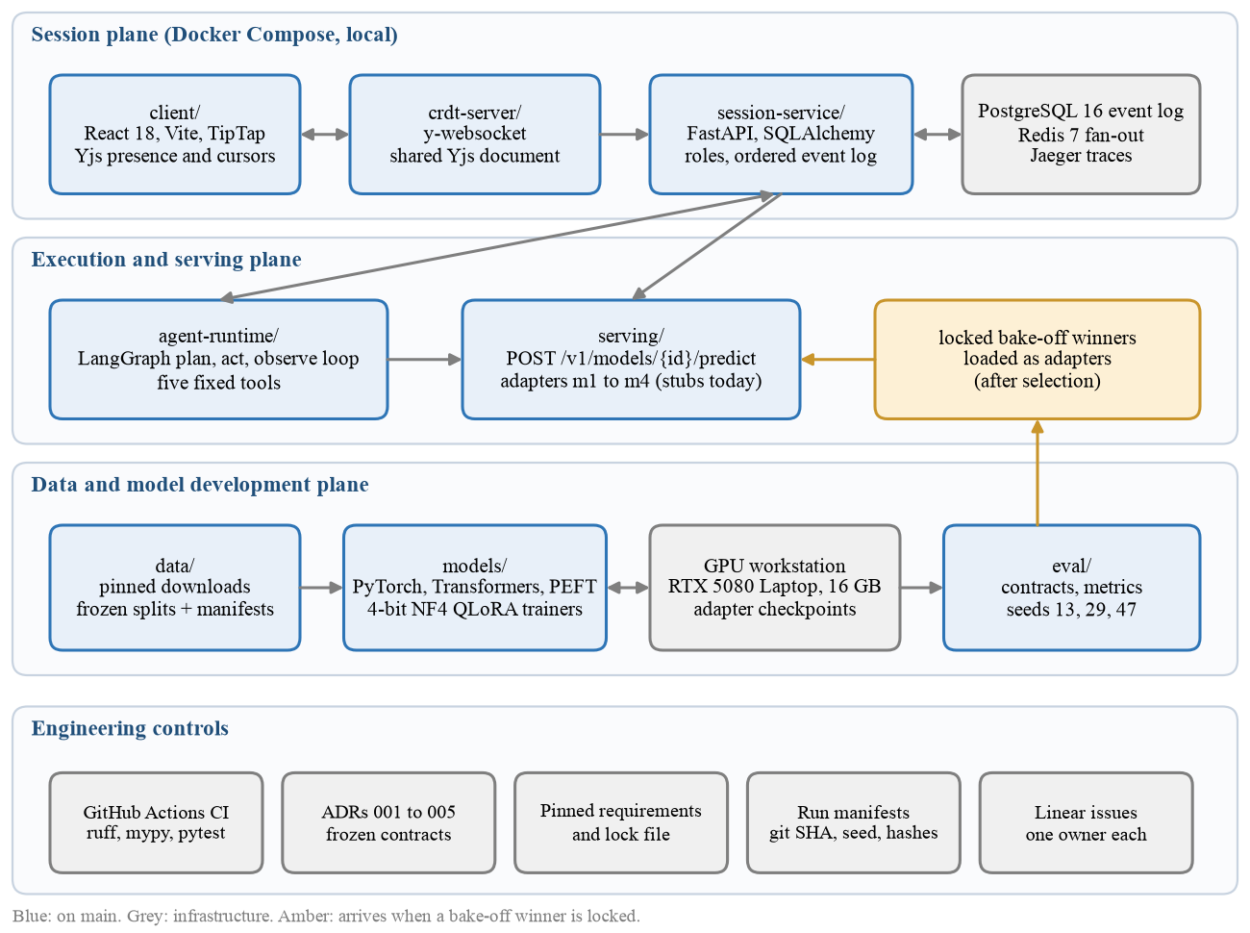
Supporting platform
4.2 Model Supports
Python 3.11, FastAPI, PostgreSQL 16, Redis 7, React 18, Yjs, LangGraph.
Training: one RTX 5080 Laptop GPU, 16 GB, university lab, $0.
CI on every pull request.
Team 4 | DATA 298A | Workbook 2 | 12 Nov 2026
16
Notes:
Owners communicate by network call or committed file, never shared memory.

Slide 17
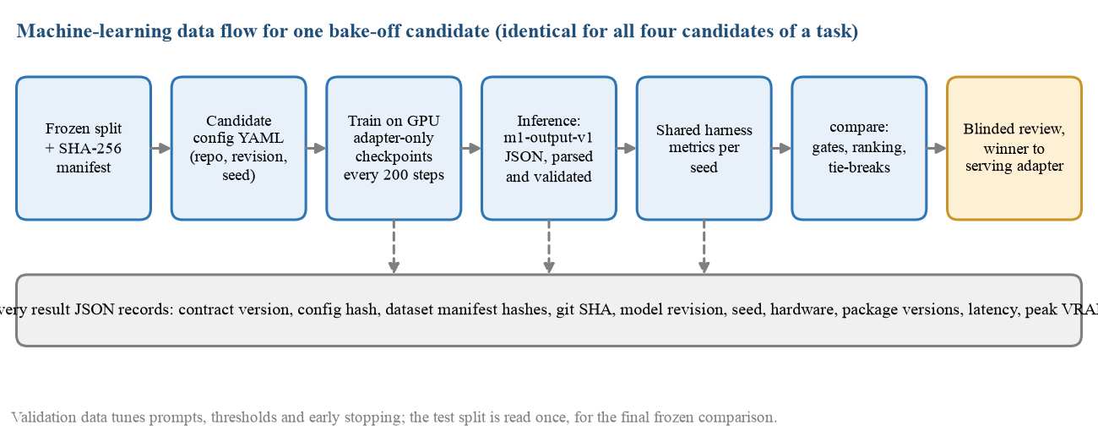
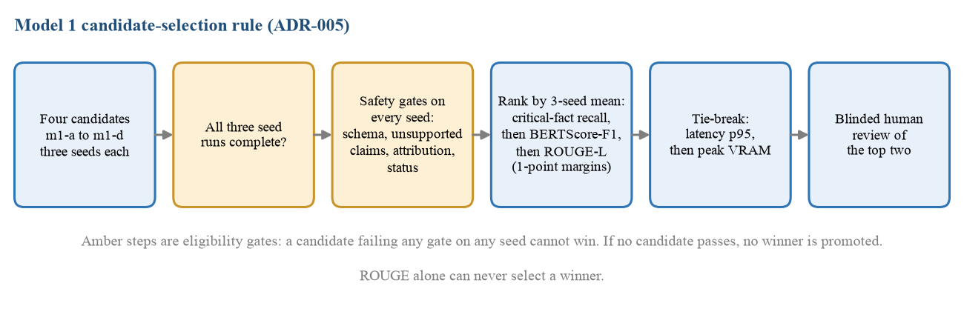
Machine-learning data flow and selection rule
4.2 / 4.3
Preferred, stated before results: a QLoRA generator.
It loses if, on any one seed, unsupported claims exceed 2% or are worse than BM25; or schema validity is under 98%; or attribution or status is under 95%.
It loses a tie within 0.01 recall on latency and memory.
If nothing passes, nothing is promoted.
Team 4 | DATA 298A | Workbook 2 | 12 Nov 2026
17

Slide 18
Metrics committed before results
4.4 Evaluation Methods
Model | Metric | Why | Committed
M1 | Critical-fact recall (primary) | A catch-up that omits the blocker has failed | ADR-005, 22 Oct
M1 | Gates: unsupported claims <= 2%, attribution >= 95%, status >= 95%, schema >= 98% | Measured on every seed | ADR-005, 22 Oct
M1 | BERTScore-F1, ROUGE-L, latency p50/p95, peak VRAM, human edit rate | Ranking after gates; tie-breaks; cost to the user | ADR-004/005
M2 | Macro-F1 with per-class F1 | Imbalanced classes | Workbook 1, 7 Oct
M3 | Macro-F1, harmful-merge rate, escalation precision and recall | A wrong merge is worse than an escalation | m3 configs, 8 Oct
M4 | DAG validity (gate), routing accuracy, completion, latency, cost | An invalid plan cannot run | Workbook 1, 7 Oct
Baseline | Accuracy, precision, recall, F1, Cohen's kappa | The paper's five figures, with n and 95% CI | Workbook 1, 7 Oct
Three seeds, per-seed values and mean, no pooling across seeds. Test split read once.
Team 4 | DATA 298A | Workbook 2 | 12 Nov 2026
18
Notes:
ROUGE-L is reported but is no longer the primary metric: carry-forward from Workbook 1.

Slide 19
Pipeline demo: source to warehouse
4.5 Data Pipeline Demo
Layer | Tables | Rows
raw | mast_traces, qmsum_examples | 1,642; 1,810
staging | mast_traces_clean, mast_labels_long, qmsum_examples_clean | 1,638; 22,932; 1,810
marts | fact_trace, fact_trace_failure, fact_m1_example, 4 dimensions | 1,638; 5,141; 1,810
meta | quality_checks, pipeline_runs | 19 and 4 per run
python data/scripts/download_mast.py
python infra/warehouse/pipeline.py
python infra/warehouse/pipeline.py --report
Ingestion: pinned sources, SHA-256 verified, landed with digest and load time.
Transformation: validate, clean, star schema.
Warehouse: DuckDB, 14 tables.
Monitoring: 19 of 19 quality gates pass; per-stage run history with rows in and out, duration, status, git commit.
Management: fail-fast, idempotent reruns, tests in CI.
Team 4 | DATA 298A | Workbook 2 | 12 Nov 2026
19
Notes:
Live: run pipeline.py twice, then --report. About 6 seconds per run.

Slide 20
Why not AWS or Airflow, for now
4.2 Model Supports
Question | Our workload | Decision
Is anything scheduled? | No. Two static datasets pinned to a commit | A scheduler would be idle; code changes trigger CI
Is the graph complex? | Four stages in a line | Ordered functions with fail-fast; each maps to one Airflow task
Is the data large? | About 220 MB; pipeline runs in about 6 s | DuckDB on a laptop; a cloud warehouse adds cost, not capability
Cloud compute? | One 16 GB GPU, university lab, $0 | No cloud GPU
Reproducibility? | Clone and two commands, no account | Local-first is verifiable by anyone
We adopt them when: (1) sessions are recorded more often than weekly, so the event-log export becomes a real schedule; (2) the first participant outside the team joins (298B study, FR-8).
Already prepared: checkpoint utility accepts s3:// URIs (PR #32); layers map to S3, Airflow tasks and a cloud warehouse.
Team 4 | DATA 298A | Workbook 2 | 12 Nov 2026
20
Notes:
Declined for stated reasons, with the conditions that would change the decision.

Slide 21
Carry-forward and next steps
Item | Status | Owner | Target
M1 candidates changed: BM25, ModernBERT, Phi-4-mini, Qwen3.5-4B | Done (ADR-005) | Ayush, Pramod | 11 Nov
M1 selection: safety gates, then critical-fact recall (was ROUGE-L) | Done (ADR-005) | Pramod | 11 Nov
Product-session corpus | 0 sessions; risk trigger fired; fallback in effect | Naman | 2 Dec
Shared harness end to end | In review; per-seed gate fix needed | Pramod | 18 Nov
M1 bake-off and winner | At risk: needs the annotated session split | Ayush | 7 Dec
MAST judge environment and final runs | Open | Ayush, Shriram | 2 Dec
Cloud deployment (FR-8) | Deferred to the 298B study | Ayush | 298B
Team 4 | DATA 298A | Workbook 2 | 12 Nov 2026
21
Notes:
Honest list. The session corpus is the critical dependency.

Slide 22
Questions
Workbook: docs/reports/T4.A6.docx
Pipeline demo: infra/warehouse/README.md
Decisions: docs/decisions/ADR-001 to ADR-005
Team 4 | DATA 298A | Workbook 2 | 12 Nov 2026
22

