Slide 1
STRUCTURAL INSPECTION · COMPUTER VISION
Concrete Wall
Computer Vision Based Structural Concrete Crack Measurement Gauge (CRACKGAUGE)
Camera Device
From Manual Inspection to Digital Crack Measurement
Crack Detection
Raspberry Pi
Computer Vision
OpenCV
Image Processing
Digital Reporting
Width · Length · Orientation
TEAM MEMBERS
Manish Saini
Ayush Gigras
Sachin Chauhan
Digital Report
Mentor: Anuska Shukla
01 / 12
Notes:
Our project aims to develop a low-cost portable system that can capture concrete cracks using a camera and automatically detect and measure their width, length and orientation. Instead of relying completely on manual visual measurement, our system combines controlled imaging, computer vision and physical calibration to produce digital inspection records.

Slide 2
THE CHALLENGE
The Problem With Manual Crack Inspection
Concrete cracks develop due to
Key Problems
•
Structural loading
1
Time-consuming
2
Subjective
•
Shrinkage & thermal effects
Inspectors must manually locate and measure every crack.
Results vary by person, viewing angle and measurement method.
•
Environmental exposure
3
Poor digital traceability
4
Hard to track progress
•
Aging and deterioration
Measurements, images and locations are recorded separately.
Comparing the same crack across inspections is inconvenient.
Current inspection process
WHY THIS MATTERS
Visual Inspection
Manual Crack Measurement
Manual Recording
Report Preparation
>3mm
30–50 yrs
₹60K–1.2L
crack width is a recognised trigger for a formal structural audit
building age when Indian municipal bodies mandate periodic audits
typical professional structural audit cost, mid-rise building
The real challenge isn't detecting a crack - it's measuring it consistently and keeping a digital history of how it changes over time.
02 / 12
Notes:
The problem is not simply detecting whether a crack exists. The real challenge is measuring it consistently and maintaining a digital history of how it changes over time. Cracks wider than about 3mm, or buildings past the age thresholds cities set for mandatory audits, are exactly where consistent measurement matters most - yet today it still depends on a person with a tape and a notebook.

Slide 3
LANDSCAPE
How Is It Done Today?
Method
Advantage
Limitation
The Gap
Crack Comparator Card
Cheap & simple
Manual reading
Handheld Microscope
More precise
Requires trained operator
Manual
Comparator
Digital Crack Gauge
Digital measurement
Costly
Low cost →
Our Target
Smartphone Apps
Portable
Accuracy depends on imaging/calibration
Digital Gauge
ACI identifies crack comparators and scaled optical devices such as handheld microscopes as established crack-width measurement approaches.
Existing manual tools are affordable but need human measurement; digital gauges automate but cost more; smartphone apps are portable but accuracy hinges on imaging and calibration. Our target is the middle ground.
Automation →
Low-cost + Portable + Calibrated + Automated + Digitally Traceable
A 2025 study on smartphone-based concrete crack-width measurement stresses standardized calibration and repeatable testing as the key validation requirement.
03 / 12
Notes:
Existing manual tools are affordable but require human measurement. Commercial digital gauges provide automation but can be expensive. Smartphone-based approaches provide portability, but engineering accuracy depends strongly on imaging and calibration. Our project targets the middle ground: a low-cost physical device with controlled imaging and computer-vision-based measurement.

Slide 4
OUR ANSWER
Our Solution: CrackGauge
①
Captures
②
Detects
③
Measures
Concrete surface image under controlled lighting.
Automatically extracts crack regions.
Calculates max width, avg width, length, orientation.
④
Calibrates
⑤
Records
⑥
Reports
Converts pixels to millimeters via a physical marker.
Stores image + measurements + timestamp.
Generates a digital inspection report.
CRACKGAUGE
Hardware
Vision Engine
Digital Platform
• Camera
• OpenCV
• Dashboard
• LED
• Mask
• Database
• Marker
• Measure
• PDF
Not just a crack-detection app - a complete inspection system: physical imaging device + vision measurement engine + digital reporting platform.
04 / 12
Notes:
Our solution is not just a crack detection app. It is a complete inspection system consisting of a physical imaging device, a computer vision measurement engine and a digital reporting platform.

Slide 5
HARDWARE
Portable Crack Measurement Gauge
CONCRETE SURFACE
Components
Raspberry Pi 4 (4GB)
Pi Camera / USB Camera
crack
LED Ring Light
ArUco / Reference Marker
Fixed-distance Spacer
3D-Printed Enclosure
REFERENCE MARKER
Power Bank
Optional USB Microscope
fixed distance
LED RING
+ CAMERA
APPROXIMATE PROTOTYPE COST
₹9,000 – ₹14,000
Raspberry Pi
Design decision
We don't just point a camera at the wall - imaging is controlled. The LED gives consistent illumination, the spacer keeps camera distance fixed, and the marker gives physical scale for calibration.
05 / 12
Notes:
The important design decision is that we are not simply pointing a camera at the wall. We want to control the imaging conditions. The LED provides consistent illumination, the spacer maintains approximately fixed camera distance, and the reference marker provides physical scale for calibration.

Slide 6
FULL STACK
Complete System Architecture
Camera + LED
Three layers
Raspberry Pi - Image Capture
1
Hardware
Image Quality Check
Captures a controlled image of the concrete surface.
Calibration & Perspective Correction
2
Vision Processing
Preprocessing
Segments the crack and extracts its geometric properties.
Hessian / Ridge Filtering
Adaptive Thresholding
3
Digital Reporting
Calibration converts pixels to millimeters; results are stored and displayed.
Crack Mask
Width
Length
Orientation
Don't read every box - walk the audience through hardware → vision → reporting.
Calibrated to mm → stored in database & PDF dashboard
06 / 12
Notes:
Our architecture has three major layers: hardware, vision processing and digital reporting. The camera captures a controlled image. The vision engine segments the crack and extracts its geometric properties. Finally, calibration converts pixel measurements into physical millimeter values, which are stored and displayed digitally.

Slide 7
VISION PIPELINE
How Will The Crack Be Detected?
Input Image
Why these techniques?
Grayscale
Hessian / Ridge Filtering
Emphasizes thin, elongated crack-like structures.
Noise Reduction
Adaptive Thresholding
Contrast Enhancement
Handles uneven illumination better than one global threshold.
Hessian / Ridge Filtering
Morphological Processing
Removes noise and cleans up the crack mask.
Adaptive Thresholding
Output
Morphological Processing
ORIGINAL IMAGE
CRACK MASK
Crack Segmentation
07 / 12
Notes:
Concrete surfaces are not clean backgrounds. They contain texture, stains, shadows and irregularities. Therefore, a simple threshold is not sufficient. Our proposed pipeline uses Hessian-based ridge enhancement to highlight line-like crack structures, followed by adaptive thresholding and morphology to obtain a cleaner crack mask.

Slide 8
FROM PIXELS TO GEOMETRY
How Will We Measure The Crack?
From crack mask → physical measurement
Width
Length
Orientation
Crack Mask
Crack Skeleton
Crack Coordinates
Skeletonization
Path Length
PCA
Distance Transform
Pixel Length
Dominant Direction
Local Width
mm Length
Angle in Degrees
If distance from skeleton to boundary = D pixels
Width ≈ 2D pixels
Skeleton path length, scaled from pixels to millimeters.
Principal Component Analysis finds the crack's dominant direction.
After segmentation, the skeleton gives the crack's centerline; distance-transform gives local width; the skeleton path gives length; PCA gives dominant orientation.
08 / 12
Notes:
After segmentation, we convert the crack into a skeleton representing its centerline. Distance transform gives us the local distance from the centerline to the boundary, allowing us to estimate crack width. The skeleton path gives crack length, while PCA gives the dominant crack orientation.

Slide 9
CALIBRATION
How Do Pixels Become Millimeters?
The camera sees pixels. The engineer needs millimeters. So, we use a known physical reference.
CRACKGAUGE REPORT
EXAMPLE
Maximum Width
1.50 mm
Reference marker = 50 mm
Average Width
0.82 mm
Detected marker = 400 pixels
Length
84.3 mm
Scale = 400 / 50 = 8 pixels/mm
Orientation
47°
Severity
Moderate*
If crack width = 12 pixels:
Crack Width = 12 / 8 = 1.5 mm
Date
04/09/26
Calibration matters because a pixel has no fixed physical size across imaging conditions - the reference marker and controlled camera geometry fix the pixel-to-mm scale before we calculate crack dimensions.
Original Image
Crack Mask
*Severity thresholds are configurable and will be validated against engineering references; the prototype alone does not determine structural safety.
09 / 12
Notes:
Calibration is critical because a pixel does not have a fixed physical size in every imaging condition. By using a known reference marker and controlling camera geometry, we estimate the pixel-to-millimeter scale before calculating the crack dimensions.

Slide 10
MARKET LANDSCAPE
Where Does Our Solution Stand?
Feature
Manual Gauge
Digital Gauge
Smartphone App
CrackGauge
Crack Detection
✕
!
✓
✓
Width Measurement
✓
✓
✓
✓
Length Measurement
✕
!
✓
✓
Orientation
✕
!
!
✓
Digital Image
✕
✓
✓
✓
Controlled Lighting
✕
!
✕
✓
Inspection History
✕
!
!
✓
Commercial digital gauges (e.g. SISCO) already offer image/data storage over a stated 0–10 mm width range; smartphone apps (e.g. Crack Detector) already use marker-based mm calibration for width and length. We're not claiming crack measurement is new.
Our differentiation:
Controlled physical imaging + computer-vision measurement + digital inspection history, combined in one low-cost device.
10 / 12
Notes:
We are not claiming that crack measurement itself is new. Existing manual gauges, digital instruments and smartphone applications already address parts of the problem. Our differentiation is the combination of controlled imaging, physical calibration, automated multi-parameter measurement and digital traceability in a low-cost prototype.

Slide 11
PROOF
Ground-Level Research & Validation
1
Ground-Level Research
2
Controlled Testing
3
Compare vs Ground Truth
Interview civil engineering faculty, site engineers, structural inspectors, contractors.
Concrete specimens with different:
Ground Truth / Manual Reference
• Crack widths
Q1. How are cracks measured today?
• Crack orientations
COMPARE
Q2. What tools are used?
• Surface textures
Q3. Biggest difficulty?
• Lighting conditions
CrackGauge Measurement
Q4. Would digital records help?
• Camera distances
Validation Metrics
Measurement
Detection / Segmentation
System
MAE
RMSE
Relative Error
Precision
Recall
F1
IoU / Dice
Repeatability
Processing Time
We don't want to show the system only produces a number - we need to show that number is close to a reliable reference, across widths and imaging conditions.
11 / 12
Notes:
We don't want to demonstrate only that the system produces a number. We need to demonstrate that the number is close to a reliable reference measurement. Therefore, we will test different crack widths and imaging conditions and calculate measurement error and repeatability.

Slide 12
THE ROAD AHEAD
Roadmap & Expected Impact
P1
P2
P3
P4
P5
P6
FINAL PROTOTYPE
P7
Camera + Sample Images
Crack Segmentation
Width/Length/Orientation
Physical Calibration
RPi Prototype
Dashboard + Database
Validation
Expected Final System
Portable
Low-cost
Automated
Easy to carry during inspection
Uses affordable hardware
Reduces manual measurement effort
Calibrated
Digital
Trackable
Converts image measurements to physical units
Images + measurements + timestamps
Future inspections can be compared
Future: Crack Growth Analysis
Our goal is to move concrete crack inspection from manual observation to measurable, repeatable and digitally traceable inspection.
Insp. 1 – 0.40mm
Insp. 2 – 0.52mm
Insp. 3 – 0.71mm
Thank You
12 / 12
Notes:
Our goal is to move concrete crack inspection from manual observation to measurable, repeatable and digitally traceable inspection. Thank you.

Slide 13
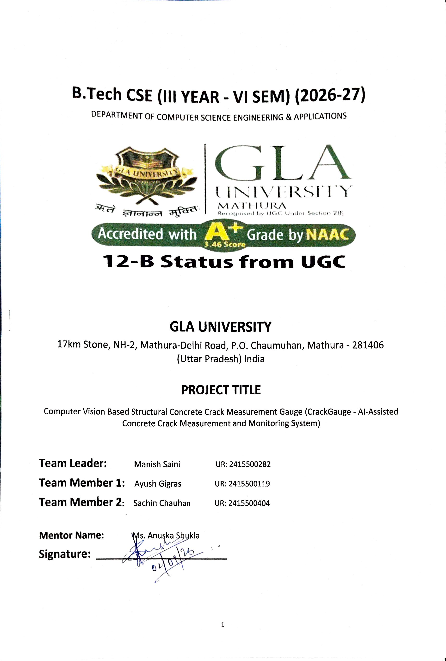
Notes:
Our goal is to move concrete crack inspection from manual observation to measurable, repeatable and digitally traceable inspection. Thank you.

