Slide 1

SUMMER TRAINING IN MATLAB
Ayush girdhar
ECE-2
03415002814
Undertaken from
AEDIFICO TECH. PVT. LTD.

Slide 2
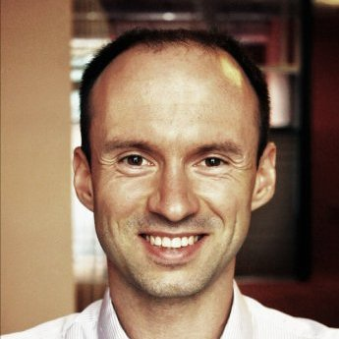
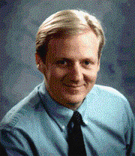
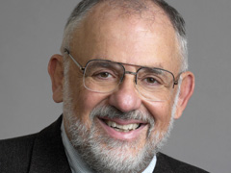
HISTORY
MATLAB stands for MATrix LABoratory
Creator : CLEVE MOLER
Co-Creators : Jack Little and Steve Bangert
Developer: Mathworks
Year : 1984

Slide 3
CAPABILITIES OF MATLAB
High-level language for scientific and engineering computing
Graphics for visualizing data and tools for creating custom plots
Apps for curve fitting, data classification, signal analysis, and many other domain-specific tasks
Add-on toolboxes
Tools for building applications with custom user interfaces
Interfaces to C/C++, Java®, .NET, etc.

Slide 4
STRENGTHS AND WEAKNESSES OF MATLAB
STRENGTHS
Basic data element : matrix
Vectorized operation require single command
Additional toolboxes
Simulink
Built-in graphing tools and GUI builder
Functions’ support by experts.
WEAKNESSES
Occupies large memory
Licensing
Call by reference not supportive
Interpreted language.

Slide 5
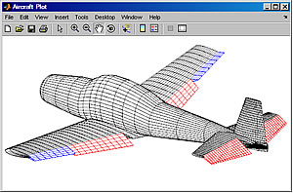
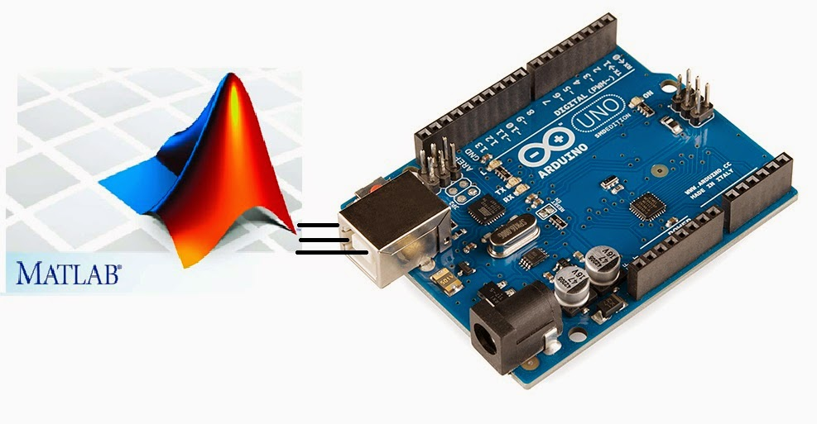
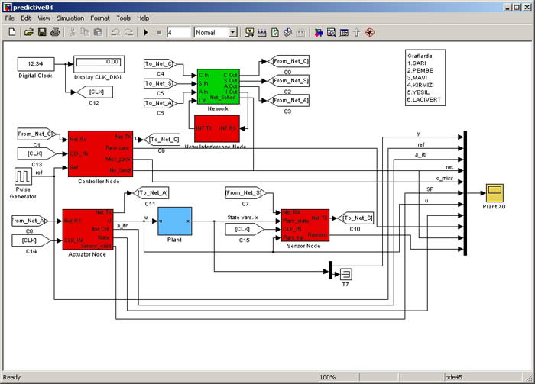
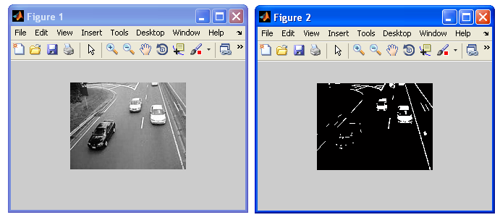
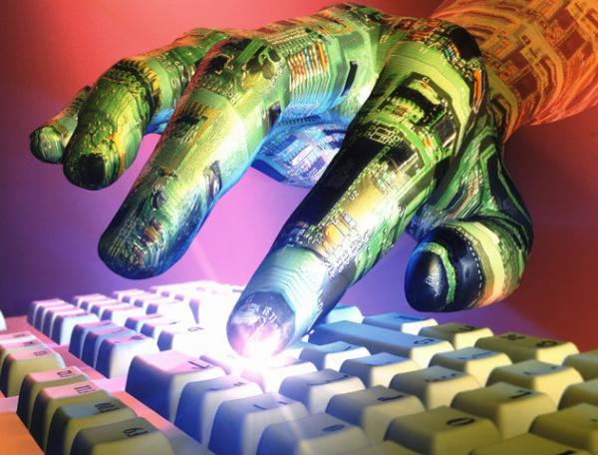
APPLICATION OF MATLAB IN ENGINEERING
MATLAB finds its applications in following fields of engineering:
Aerospace Engineering
Automobile Engineering
Bioscience and Biomedicals
Control Systems
Embedded Systems
Earth Sciences
Electronics
Image and Video Processing
…..etc.

Slide 6
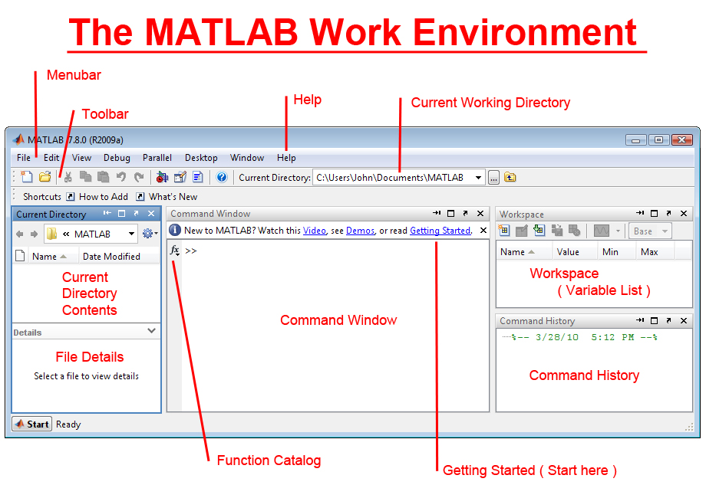
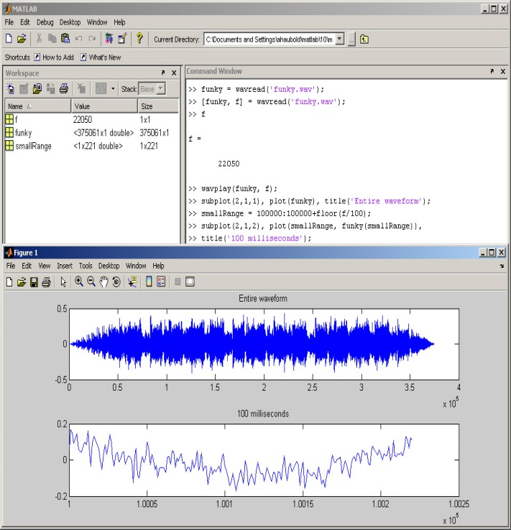
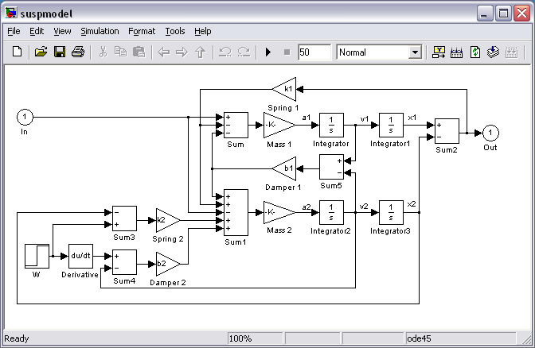
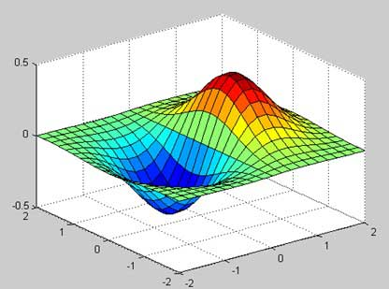
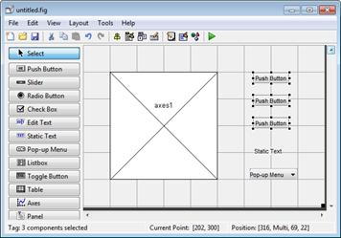
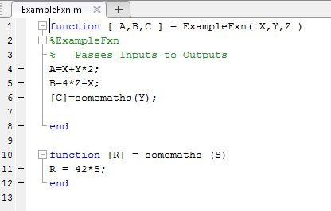
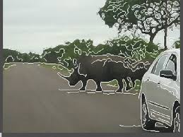
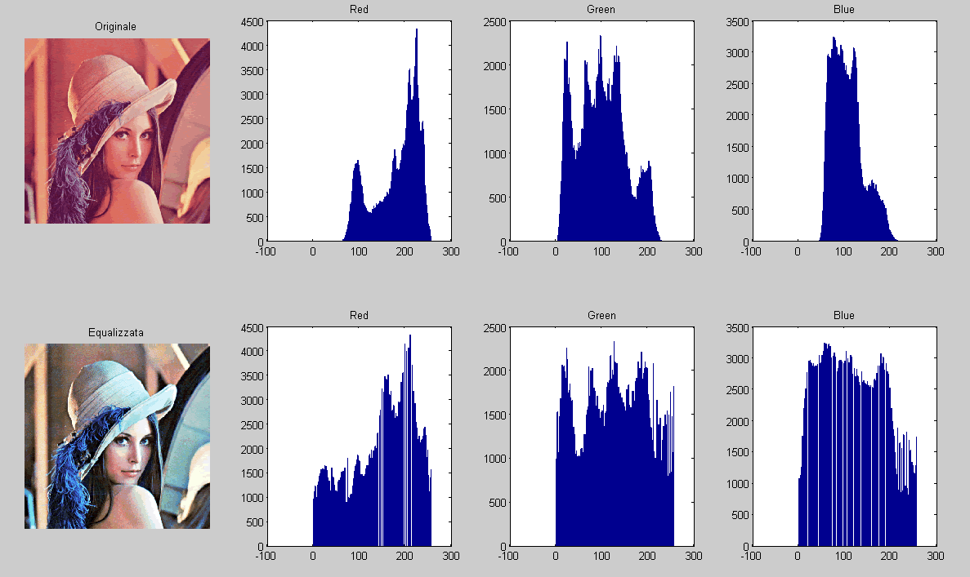
MODULES COVERED DURING TRAINING
MATLAB working environment
Basic syntaxes and functions
Graphical Programming
Graphical User Interface
Simulink
Image Processing
Audio Processing
Video Processing

Slide 7
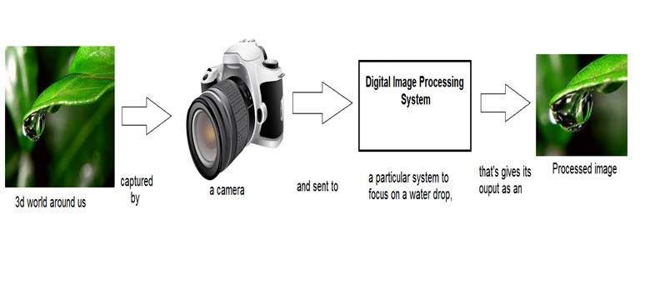
IMAGE PROCESSING
Steps involved:
Importing the image via image acquisition tools;
Analyzing and manipulating the image;
Output in which result can be altered image or report that is based on image analysis

Slide 8
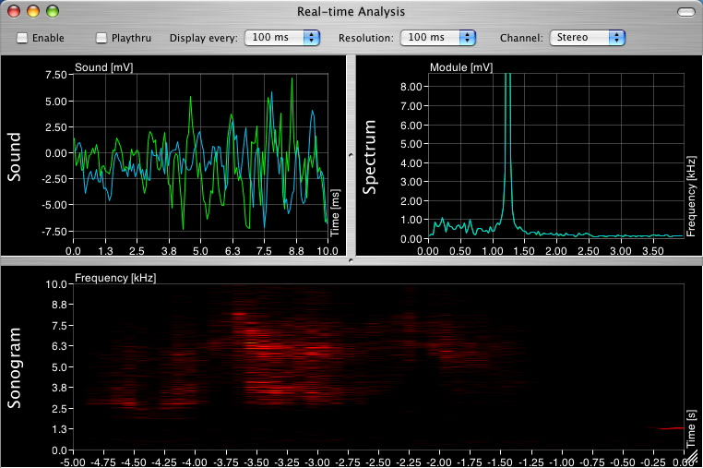
AUDIO PROCESSING
Audio processing means changing the characteristics of a sound or audio signal
NEED:
Enhance audio
Fix problems
Separate sources
Create new sounds
Compress, store and send data.

Slide 9
VIDEO PROCESSING
Processing sequence of time varying images
Spatial intensity distribution varies with time
Areas of Video Processing:
(i)Video Compression (iii) Video Segmentation
(ii) Video Indexing (iv) Video tracking etc.

Slide 10
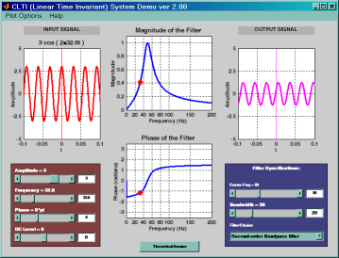
GUI
Interactive tasks through graphical display.
No script or type commands at the command line required.
No need to understand the mechanism of task.
UI Components include:
1. Radio buttons
2. List Box
3. Static Text field
4. Push buttons
5. Axes
6. Check box
7. Edit box
8. Pop-Up Menu and many more

Slide 11
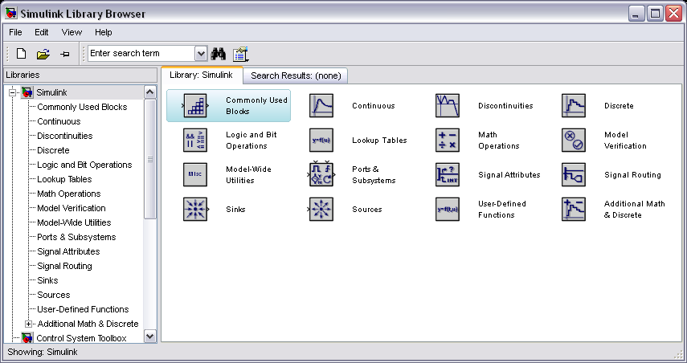
SIMULINK
data flow graphical programming language tool
modeling, simulating and analyzing multi domain dynamic systems
Simulink supports −
system-level design
simulation
automatic code generation
testing and verification of embedded systems

Slide 12
About Project : Morse code transmitter Reciever
Objective of the project is to develop a Morse code transmitter and receiver integrating MATLAB and EMBEDDED SYSTEMS
What is MORSE CODE
Morse code is a language of dots and dashes which is used for quick transmission

Slide 13
Steps involved :
Reading: Read the text to be transmitted.
Processing: Processes the morse code or the text which is being transmitted and pops up the image.
Transmitting: Transmit the character which has been entered
Receiving : Receive the transmitted character and glow the led and buzz the buzzer accordingly

Slide 14
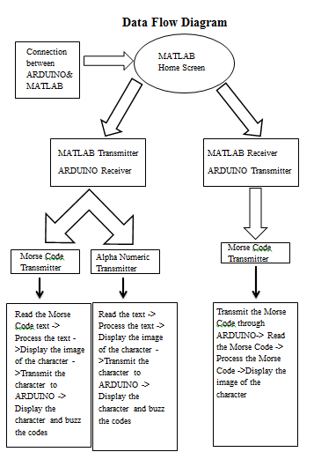
Data Flow Diagram :

Slide 15
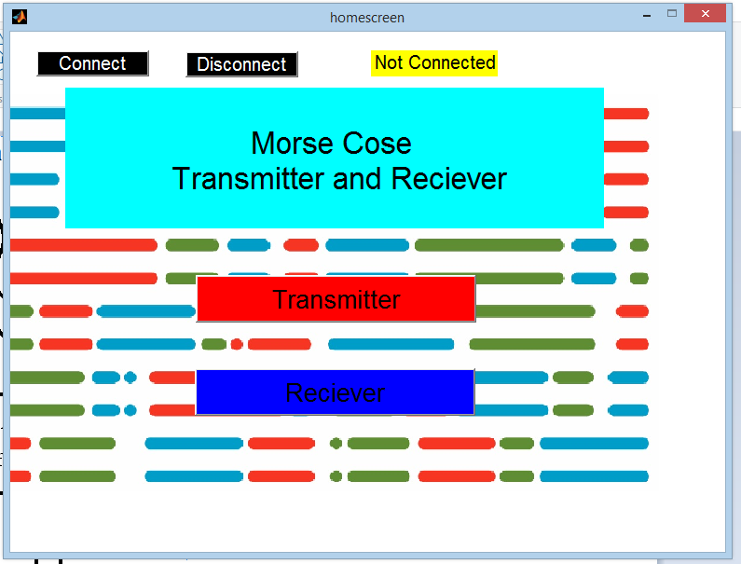
Reading
Choose the way you want MATLAB to work as a transmitter or a receiver

Slide 16
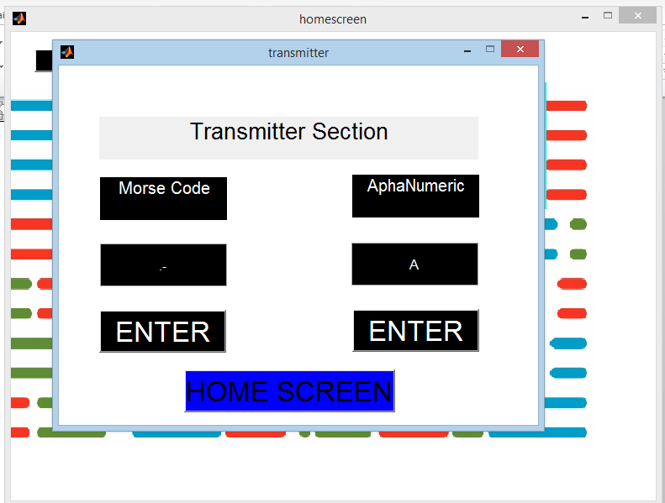
Reading
Enter the text to be transmitted either in alpha numeric character or the corresponding morse code for the character.

Slide 17
Processing
It involves checking the entered text with the standard Morse Code key
The checked morse key is then isolated and the corresponding alphabet is displayed on the screen
If the entered text is in morse code then the alpha numeric character is displayed and if alpha numeric character is entered then morse code of corresponding character is shown

Slide 18
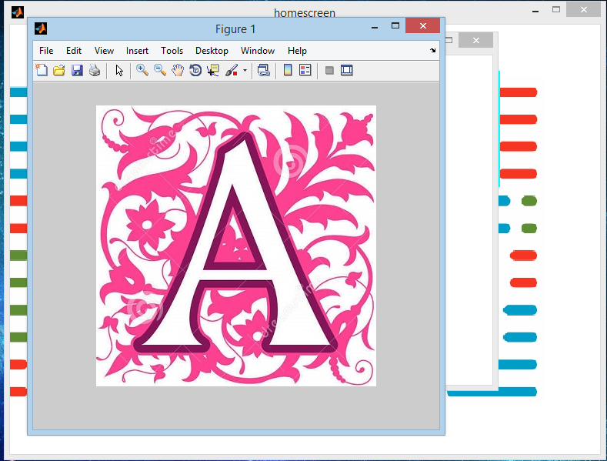

Slide 19
Transmitter
The character is transmitted from one environment to another.
As it transmitts the Arduino recieves the character and beeps the buzzer and glows the LED of the corresponding character which can be seen or heard and analysed apart from being seen on the screen.

Slide 20
Reciever
The sent character is received on the other platform to mark the transmission and get a view of what has been transmitted and was it correct or not.
After each and every character is received the next character is transmitted and the sequence moves on like this.

Slide 21
Applications
As a Morse Code Trainer for HAM training students.
It acts as both transmitter as well as receiver so can be used by personal checking for the correctness and no other person is required.
It can also be used for PILOT training on radio in a graphical manner.

Slide 22
Future Scope
I plan to develop a mobile app for this so that person can use their mobile phones to send the Morse code as well as receive the transmitted characters.
To increase the range I am planning to use Wi-Fi module instead of Bluetooth.
Graphic LCD can be used instead of Character LCD to make it look attractive

Slide 23
Thank you

