Slide 1
Customer Retention and Dynamic Pricing Analysis
Final deliverables
Clean dataset
EDA reports
20+ visuals
Baseline model
Business deck
Revenue actions
Hotel Booking Demand dataset | Week 4 final handoff
86,638 bookings · 27.69% canceled · Best model ROC-AUC 0.854
Travel, Tourism & Hospitality Analysis
01

Slide 2
Executive KPI snapshot
The portfolio has meaningful cancellation leakage and clear pricing seasonality.
86,638
27.69%
107.04
0.854
Cleaned bookings
Cancellation rate
Average ADR
Best model ROC-AUC
Validated after duplicates, invalid rows, and outlier treatment.
Primary retention KPI and input for expected revenue.
Baseline daily price after ADR outlier capping.
Logistic Regression ranks cancellation risk effectively.
Business implication: pricing decisions should use expected revenue, not raw bookings alone.
Travel, Tourism & Hospitality Analysis
02

Slide 3
Data foundation is ready for decisioning
Week 1 created a reliable analytics base for reporting, modeling, and dashboards.
Cleaning actions
Engineered features
Removed 31,994 duplicates
Handled missing company, agent, country, and children values
Removed zero-guest, zero-night, and negative ADR records
Capped ADR and lead-time outliers
total_stay and total_guests
booking_season and arrival date
booking_value and ADR per guest
lead-time, stay-length, traveller, and value segments
Output: cleaned_hotel_bookings.csv with 57 columns and no remaining missing values.
Travel, Tourism & Hospitality Analysis
03

Slide 4
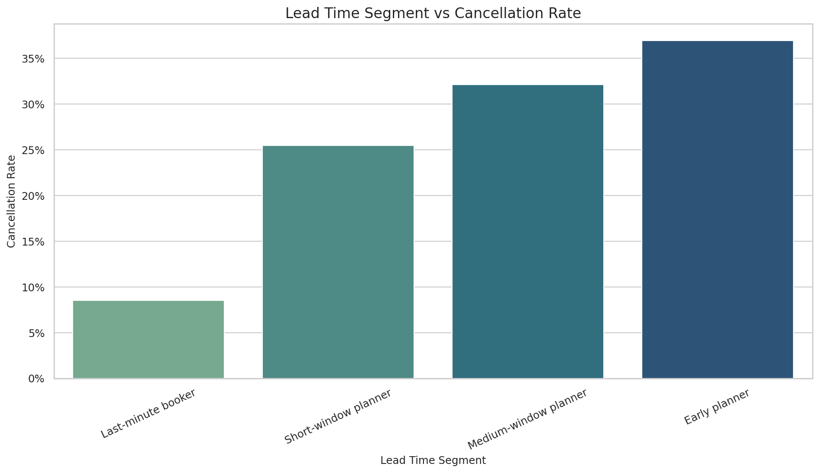
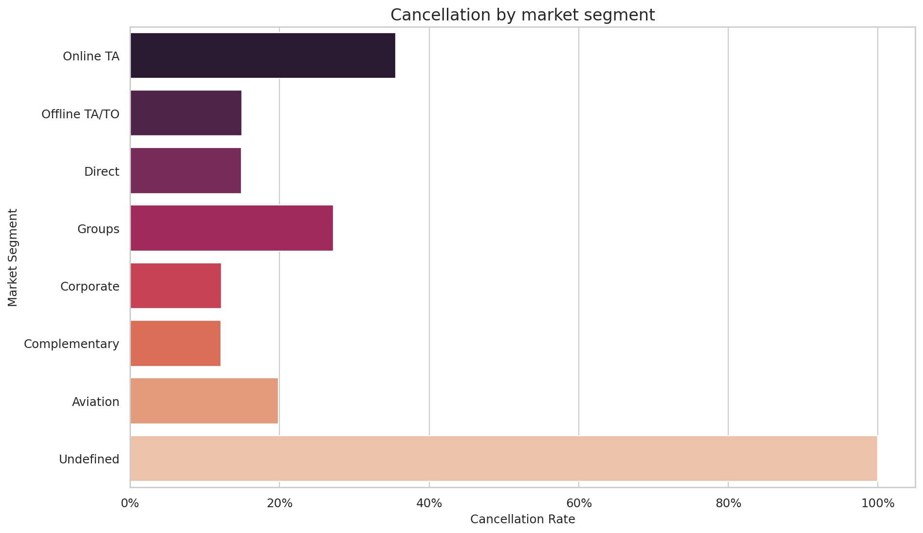
Cancellation risk is segment-driven
Lead time, hotel type, market segment, deposit type, and geography materially change risk.
Recommendation: prioritize high-risk lead-time and market-segment combinations for pre-arrival retention campaigns.
Travel, Tourism & Hospitality Analysis
04

Slide 5
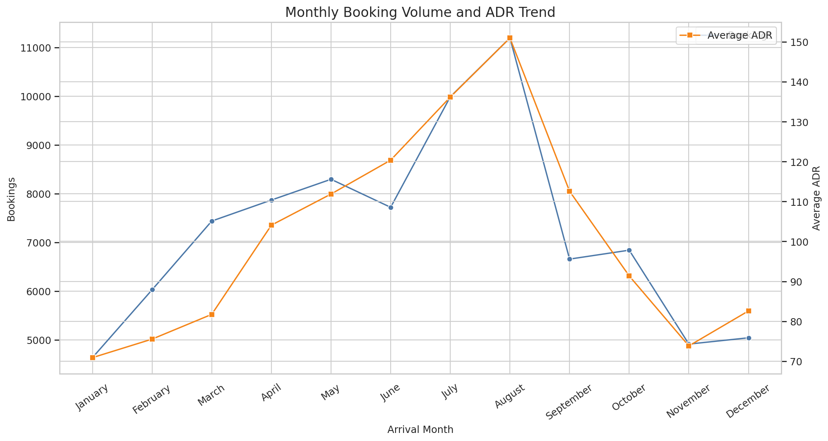
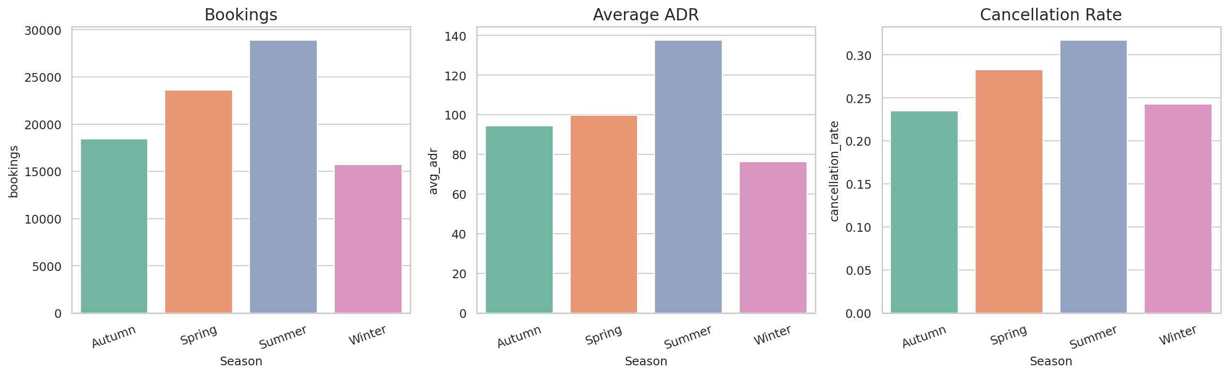
Seasonality supports dynamic pricing
Demand and ADR peak patterns justify month- and season-aware rate rules.
Recommendation: set seasonal price floors, then adjust by cancellation probability and inventory pressure.
Travel, Tourism & Hospitality Analysis
05

Slide 6
Customer segmentation creates action paths
Segments convert descriptive analysis into campaign and pricing decisions.
Segment | Primary action | Business goal
Business travellers | Weekday corporate packages | Protect midweek occupancy
Leisure travellers | Seasonal bundles | Increase ancillary value
Early planners | Pre-arrival reminders | Reduce long-lead churn
Last-minute bookers | Yield controls | Capture remaining demand
High-value customers | Retention offers | Protect booking value
Use model risk scores inside each segment to decide who receives discounts, reminders, or stricter deposit rules.
Travel, Tourism & Hospitality Analysis
06

Slide 7
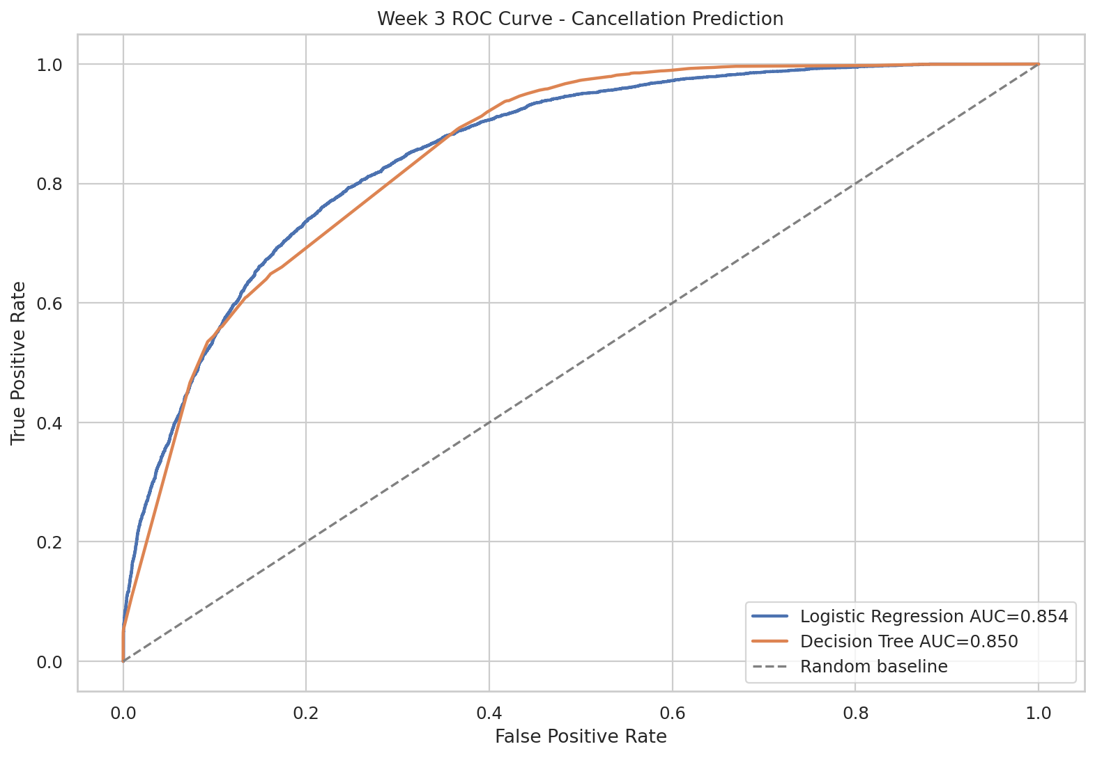
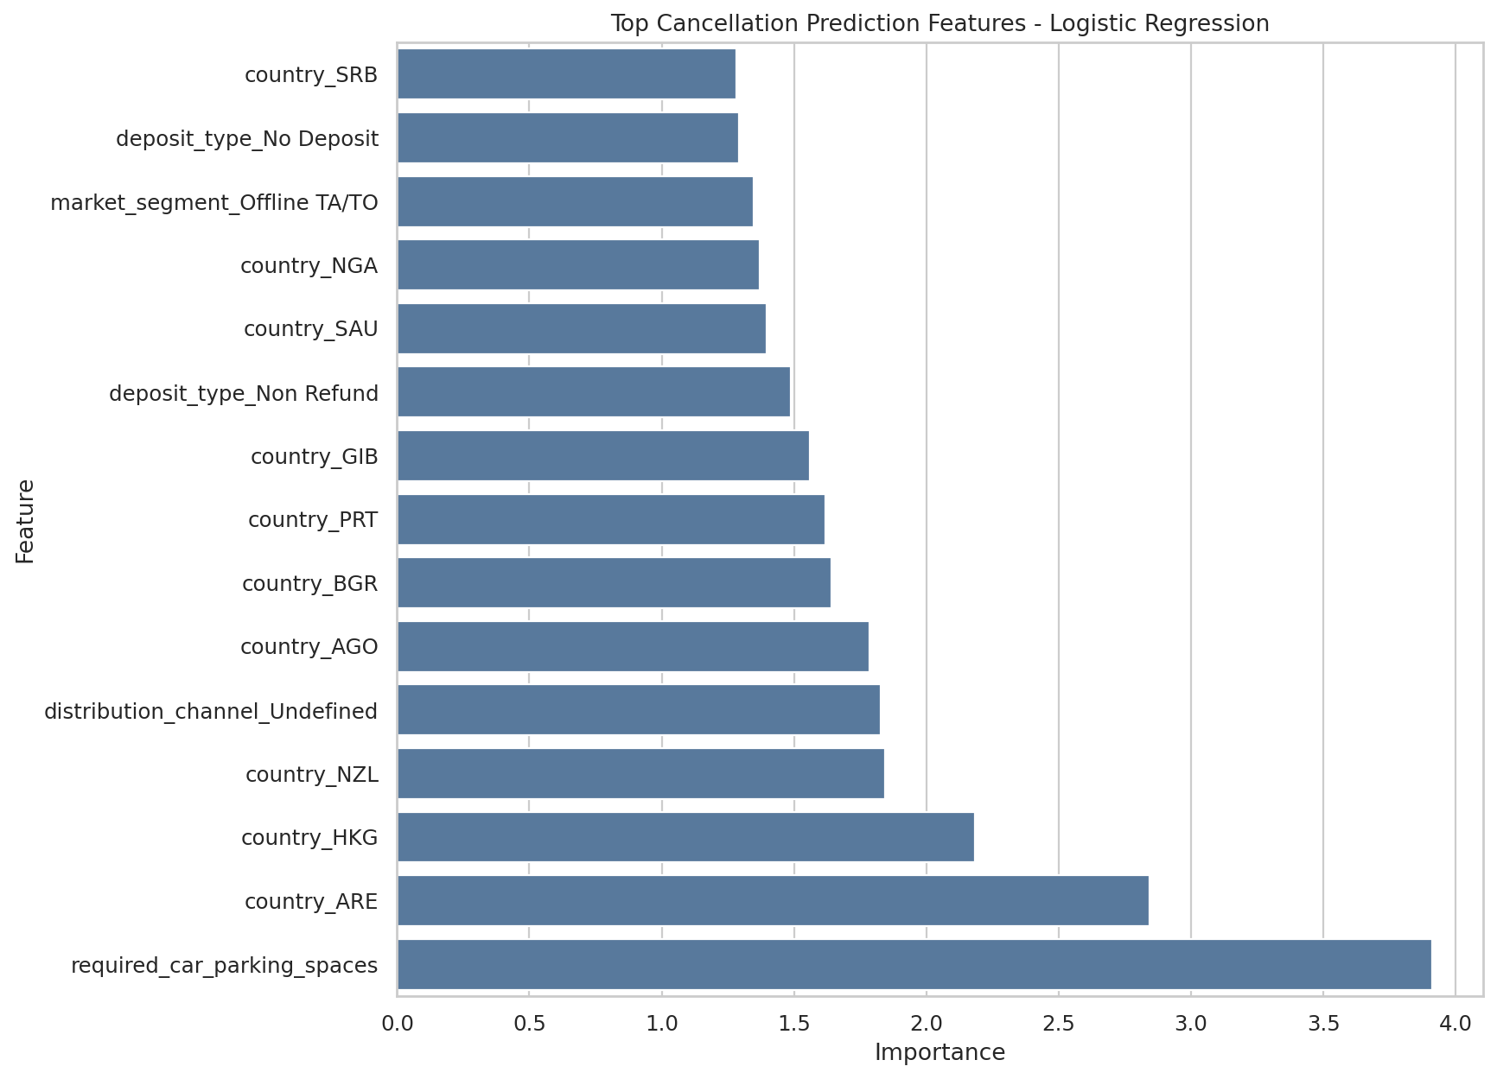
Baseline model prioritizes cancellation risk
Week 3 established a predictive foundation, not a final production model.
Logistic Regression: 76.5% accuracy, 78.8% recall, 0.854 ROC-AUC. Use it to rank cancellation risk and tune thresholds by business cost.
Travel, Tourism & Hospitality Analysis
07

Slide 8
Operating model for revenue and retention
Convert analysis into repeatable daily actions for revenue managers and marketers.
1
Score
2
Adjust
3
Retain
Generate cancellation probability for every active booking.
Calculate expected revenue and modify rate rules by season and risk.
Target high-risk, high-value guests with relevant pre-arrival offers.
Expected revenue = booking value × (1 - cancellation probability)
Travel, Tourism & Hospitality Analysis
08

Slide 9
Final handoff and next steps
The project is ready for submission and future Week 4 dashboard expansion.
Delivered
Next build
Cleaned data
EDA notebook and visuals
Modeling notebook and report
Dashboard summary table
Final business report
Final presentation deck
Interactive Power BI or Tableau dashboard
Cross-validation and threshold tuning
Automated refresh workflow
Business-cost matrix for retention offers
Pilot campaign measurement plan
Submission link: GitHub repository contains all source code, reports, visuals, SQL, notebooks, and generated outputs.
Travel, Tourism & Hospitality Analysis
09

