Slide 1


SMART ARDUINO
BLIND STICK
BY: RISHI MEHTA & AYUSH GOYAL
UNDER THE GUIDANCE OF DR JUHI SINGH

Slide 2
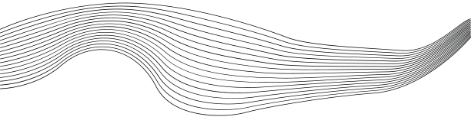
CONTENT
01
ABSTRACT
Aim and Objective
Hardware Requirements
Software Requirements
Implementation
Circuit Diagrams
Conclusion/Future Scope
References
02
03
04
05
06
07
08

Slide 3


ABSTRACT
Visually impaired people find difficultiesdetecting obstacles in front of them , during walking in the street, which makes it dangerous. The smart stick comes as a proposed solution to enable them to identify the world around. In this model we propose a solution, represented in a smart stick with water level sensor to identify any water hurdles in front of the user. This stick is capable of detecting all obstacles in the range of 50cm and gives suitable message empowering blind to move twice his normal speed because he/she feels safe . This smart stick is of low cost, fast response, low power consumption, light weight and ability to fold.

Slide 4
AIM AND OBJECTIVE
AIM:
THE MAIN AIM OF THE SYSTEM IS TO PROVIDE A EFFICIENT NAVIGATION AID FOR THE BLIND PERSONS WHICH GIVES A SENSE OF VISION BY PROVIDING THE INFORMATION ABOUT THEIR SURROUNDINGS AND OBJECTS AROUND THEM
OBJECTIVES:
THE MAIN OBJECTIVE IS TO MAKE THIS MODEL COST EFFECTIVE. AND GIVE A BLIND PERSON MORE CONFIDENCE MOVING AROUND.

Slide 5
HARDWARE REQUIREMENTS
·CAMERA MODULE (ESP-32)
·GPS module (NEO-6M)
·Buzzer (3 V)
·Ultrasonic sensors (HC-SR04)
·Power supply components
·Arduino - Uno board
·Water level sensor
·A cane/stick
·Jumper Wire

Slide 6
SOFTWARE REQUIREMENTS
·ARDUINO IDE
·PYTHON PROGRAMMING ENVIRONMENT
·OPENCV
·TEXT-TO-SPEECH LIBRARIES

Slide 7
IMPLEMENTATION
- ASSEMBLE THE ARDUINO UNO, SENSORS (OBSTACLE DETECTION, OBJECT IDENTIFICATION, WATER HAZARD DETECTION), GPS MODULE, BUZZER, AND OTHER PERIPHERALS ACCORDING TO THE DESIGN SPECIFICATIONS.
- ENSURE PROPER WIRING AND CONNECTIONS BETWEEN COMPONENTS TO FACILITATE COMMUNICATION AND FUNCTIONALITY.

Slide 8
INTEGRATION & TESTING
- INTEGRATE HARDWARE AND SOFTWARE COMPONENTS TO CREATE THE FUNCTIONING BLIND STICK SYSTEM.
- Conduct rigorous testing, including unit testing of individual components, integration testing to ensure seamless communication between modules, and system testing to validate overall functionality.
- Address any bugs or issues identified during testing, refining the implementation as needed to enhance performance and reliability.

Slide 9
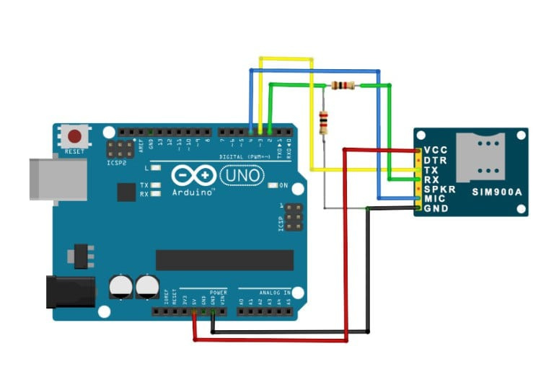
GSM MODULE

Slide 10
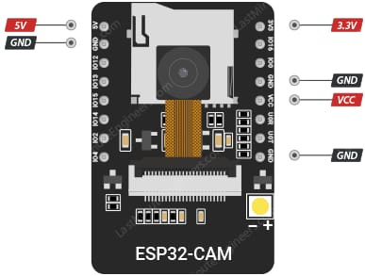
CAMERA MODULE

Slide 11
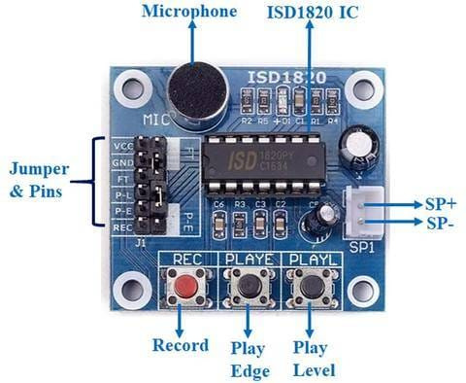
VOICE MODULE

Slide 12
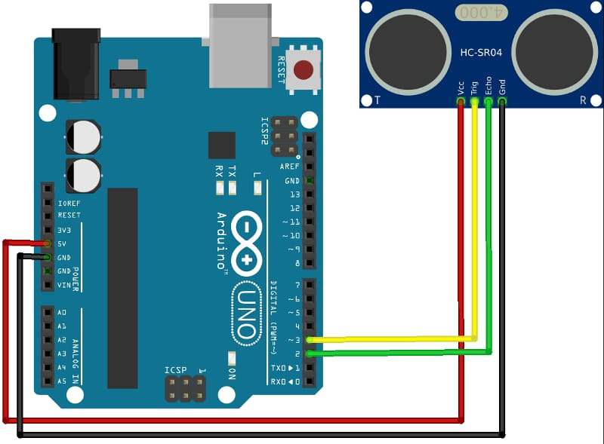
ULTRASONIC SENSOR

Slide 13
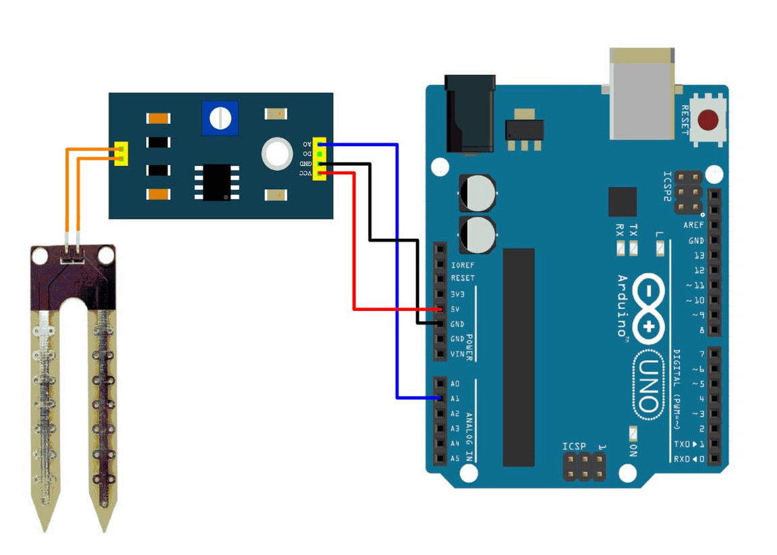
WATER SENSOR

Slide 14
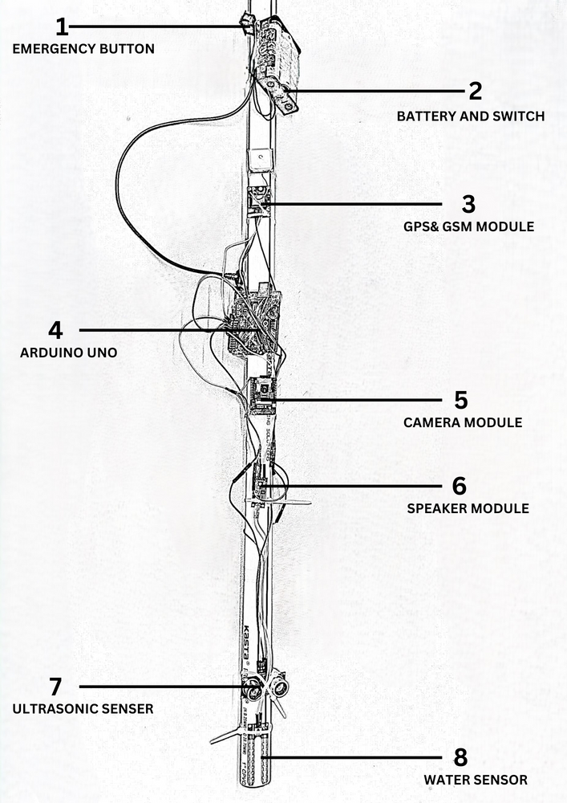
PROTOTYPE

Slide 15
CONCLUSION/FUTURE
INTEGRATION OF ADVANCED SENSORS AND GPS NAVIGATION ENHANCES MOBILITY, SAFETY, AND INDEPENDENCE FOR VISUALLY IMPAIRED USERS, MARKING A SIGNIFICANT ADVANCEMENT IN ASSISTIVE TECHNOLOGY.
FUTURE SCOPE INCLUDES INTEGRATION OF ADVANCED SENSORS, COLLABORATION WITH WEARABLE TECHNOLOGY, AND CUSTOMIZATION OPTIONS, UNDERSCORING THE COMMITMENT TO ACCESSIBILITY AND INCLUSIVITY FOR VISUALLY IMPAIRED INDIVIDUALS.

Slide 16
REFERENCES
[1] KUMAR, R., SHARMA, P., AND GUPTA, S. (2017). “DESIGN AND DEVELOPMENT OF SMART BLIND STICK USING ULTRASONIC SENSOR.” INTERNATIONAL JOURNAL OF ADVANCED RESEARCH IN COMPUTER SCIENCE, 8(5), 250-256.
[2] Kadam, D., Jain, A., and Patel, R. (2018). “Smart Cane: Assistive Navigation Device for Visually Impaired People.” International Journal of Engineering and Technology, 7(4), 152-158.
[3] Zadeh, L.A. (1981). “Possibility theory and soft data analysis.” Mathematical Frontiers of the Social and Policy Sciences, L. Cobb and R.M. Tharall, eds., Westview, Boulder, Colo., 69-129.
[4] Cotton, F.A. (2003). Chemical Applications of Group Theory, McMilan, London.
[5] Garrett, D.L. (2003). “Coupled analysis of floating production systems.” Proc., Int. Symp. on Deep Mooring Systems, ASCE, Reston, Va., 152-167.

Slide 17

QUESTIONS?

Slide 18
THANK YOU

