Slide 1

01 / 05 PROBLEM UNDERSTANDING
PROBLEM UNDERSTANDING AND OBJECTIVE
A UK consumer lending and mortgage servicing desk takes a continuous stream of requests by email, web form and shared inbox. Today a person reads every one of them and decides what happens next.
THE BRIEF'S OWN THREE WORDS — TAKEN AS THE DESIGN TARGETS
Slow
Inconsistent
Judgment-dependent
Nothing moves until a human has read it. Handle time and SLA breach risk scale straight with volume.
The same request resolves differently depending on who opens it, and how busy the floor is that hour.
Nothing records why a case went where. Quality lives in individual heads, and leaves when they do.
OBJECTIVE
Execute the correct remediation end to end — and know when not to.
The brief asks for automatic processing of every request, and every request is processed automatically. Automatic closure is a different question: on a regulated desk, a system that resolves a hardship disclosure or a disputed charge by itself is a compliance incident, not a feature.
The model decides. The state machine executes.
HANDOFF · AYUSH GUPTA
handoff-triage.vercel.app

Slide 2
02 / 05 SOLUTION ARCHITECTURE
SOLUTION ARCHITECTURE AND DESIGN FLOW
Classification is the only place the model acts. Everything after it — control flow, side effects, every drafted word — is deterministic code and configuration.
INTAKE
›
DUPLICATE CHECK
›
CLASSIFY
›
GUARDRAILS
›
FOUR GATES
web form · batch upload
shared inbox
content fingerprint,
before any model call
LLM: type × urgency,
entities, rationale
phrase filters,
escalate only
guardrails · confidence
grounding · floor
TYPE SELECTS THE BRANCH · URGENCY MODULATES WITHIN IT: SLA CLOCK, SENIOR ROUTING, CONDITIONAL STEPS
billing_dispute
draft acknowledgement › suppress collections › route to Disputes › SLA follow-up › log
awaiting_human
general_enquiry
KB match › sourced draft, cited › log the only branch permitted to close itself
auto_resolved
service_request
extract details › route to Servicing Ops › start SLA timer › follow-up › log
awaiting_human
financial_hardship
PAUSE AUTOMATION › escalate › notify supervisor › supportive draft › follow-up › log
escalated
other
route to Triage Queue › log honest spam / misrouted branch
awaiting_human
FOUR GATES DEMOTE A CASE TOWARD A HUMAN. NONE PROMOTE ONE.
Every case stores the model's proposal and the system's decision as separate records, the full step trace, and which provider tier decided it. A human override re-runs the corrected branch and is kept as labelled training signal.
HANDOFF · AYUSH GUPTA
handoff-triage.vercel.app

Slide 3
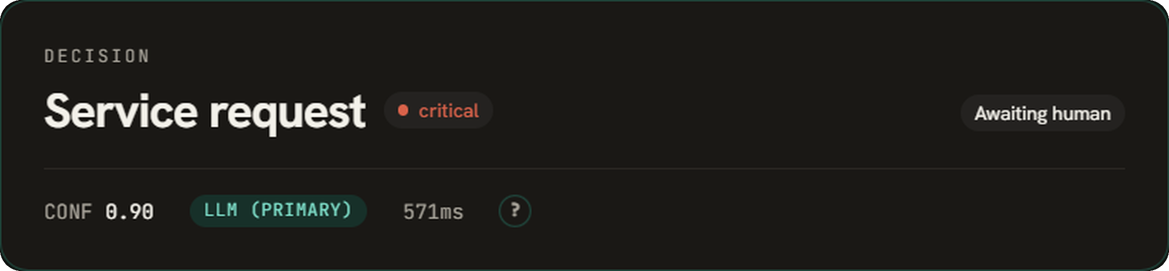
03 / 05 IMPLEMENTATION HIGHLIGHTS
IMPLEMENTATION HIGHLIGHTS
88.0%
47.0%
100%
91%
KEYWORD-FLOOR BASELINE
BRANCH COMPLETION
URGENCY WITHIN ONE
TYPE ACCURACY
The deterministic fallback on the same split. The model earns +41 points over it.
100 of 100 on test, 40 of 40 on the cross-family holdout. No branch stalled.
52% exact. Adjacent errors only shift queue position; the branch absorbs them.
Held-out 100. Executed once, scored once, on the quality tier. 95% CI 80.2–93.0.
THE BRIEF'S FOUR NAMED ACTIONS, ACROSS ALL FIVE BRANCHES
BRANCH | generate | route | follow-up | log | OUTCOME
billing_dispute | ✓ | ✓ | ✓ | ✓ | awaiting_human
general_enquiry | ✓ | — | ✓ | ✓ | auto_resolved
service_request | ✓ | ✓ | ✓ | ✓ | awaiting_human
financial_hardship | ✓ | — | ✓ | ✓ | escalated
other | — | ✓ | — | ✓ | awaiting_human
A live decision: type and urgency, the confidence that cleared no gate, the provider tier that decided it, and the status the branch ended in.
Every named action is exercised by at least two branches. Every branch runs two to six steps. Hardship pauses automation as its first step and can never auto-resolve.
WHAT THE SAFETY LAYER COSTS, AND WHY IT IS PRICED THAT WAY
On the holdout the model proposed the correct type 39 times in 40 — 97.5%. The system scored 92.5%, because the hardship guardrail overrode two of those correct calls, both on the phrase “cannot afford”. One was a disabled customer on benefits asking for a redemption statement: the model read the surface request, the guardrail read the disclosure underneath it. Two thirds of the measured error is the safety layer doing its job.
HANDOFF · AYUSH GUPTA
handoff-triage.vercel.app

Slide 4
04 / 05 CHALLENGES AND LEARNINGS
CHALLENGES AND LEARNINGS
01
02
The bounded-autonomy tension
A configuration that lied
The brief invites an agent. A regulated lending desk is the wrong place to give a model authority over side effects.
workflows.yaml declared the enquiry branch grounded while the engine returned a hardcoded placeholder. Thirty-four cases were reported auto-resolved having resolved nothing.
Resolved by splitting perception from control: the model proposes a classification, the state machine disposes. Four gates — guardrails, confidence, grounding, provider floor — can each demote a case toward a human, and not one of them can promote a case toward automation.
Found by clicking through the console, not by a test — config asserted a capability the code never implemented. A real knowledge base and a grounding gate now make that flag an enforced contract. Fixing it moved automation from 17.0% to 8.5%: the honest direction for a number to move.
03
04
Measuring instead of asserting
Leaving the suggested stack
The corpus is LLM-generated, so its labels are an upper bound. A single accuracy figure with nothing beside it says very little.
The brief suggests Streamlit or Gradio with n8n or Retool. We used none of them, which needs justifying rather than assuming.
Published against a keyword baseline on the same split with Wilson intervals, and checked against a holdout generated by a different model family, which converges at 92.5%. Calibration error is 0.027 but rests on only three distinct confidence values. Critical recall of 0 in 11 was audited row by row, not relabelled.
A system with authority to pause collections needs control flow that is replayable, unit-testable and reviewable in version control. workflows.yaml keeps the declarative benefit those tools sell: an operations manager adds a request type by editing config, with no developer and no deploy.
HANDOFF · AYUSH GUPTA
handoff-triage.vercel.app

Slide 5
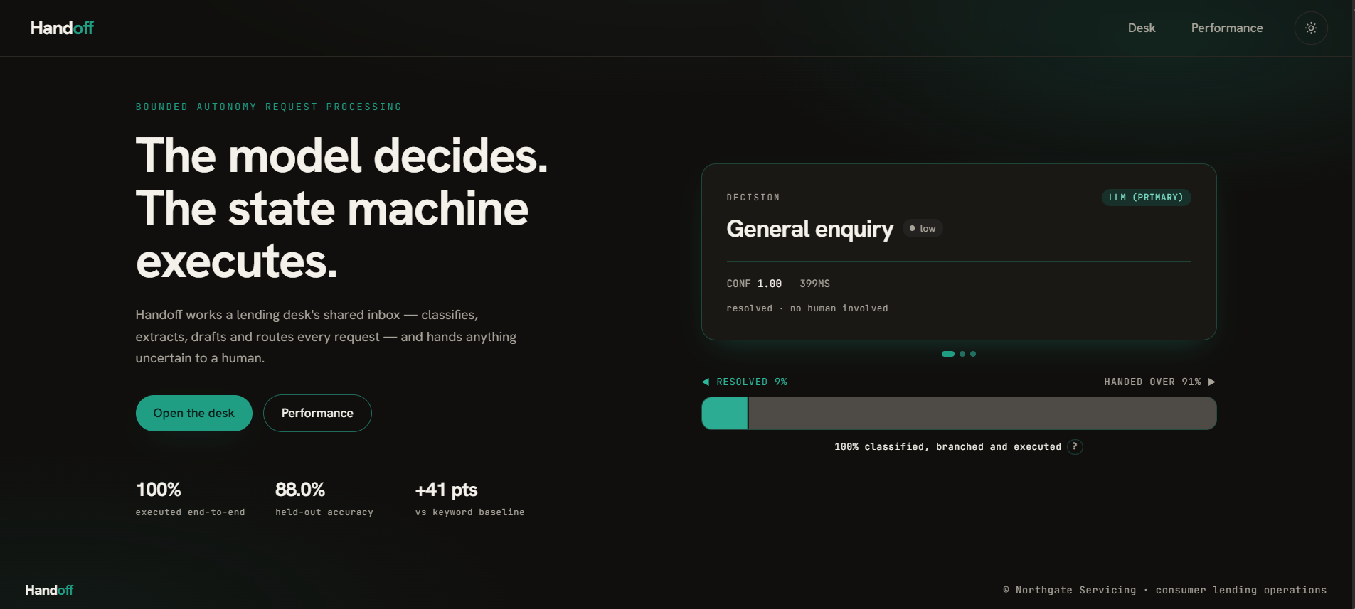
05 / 05 DEMO SUMMARY AND NEXT STEPS
DEMO SUMMARY AND NEXT STEPS
SUBMISSION LINKS
handoff-triage.vercel.app
github.com/ayushgupta07xx/Request-Triage
NEXT STEPS, ORDERED BY LEVERAGE
1
Expand the knowledge base
Automation is bounded by coverage, not model quality.
2
Fine-tune on the override queue
Every correction is already stored as labelled signal.
3
Embeddings behind kb.lookup
The interface to swap is already isolated.
Demo mode opens cold from committed batch data — no keys, no network. Live mode runs a pasted message through the same pipeline, with a provider-outage toggle that degrades on the real code path, and persists every case to libSQL — so a repeat send is caught as a duplicate before any model call.
4
Queue workers and per-class routing
The storage swap is already done: hosted cases persist to libSQL.
WHAT THE RECORDING SHOWS
5
Wire review to a real rota
Overrides become the next version's training set.
Five request types arriving across three intake channels, each taking a visibly different branch — including a hardship disclosure the model under-read and a guardrail escalated over it.
HANDOFF · AYUSH GUPTA
handoff-triage.vercel.app

