Slide 1


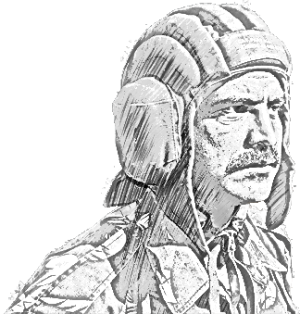
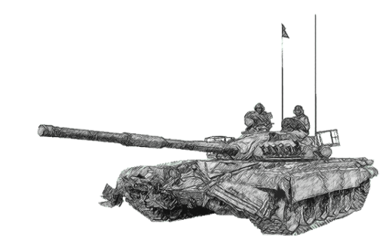
SCHOOL OF TECH TRG
ELECTRONICS WING

Slide 2
CALLING FOR ATTACK HEPTR (AH)

Slide 3
AIM
TO ACQUAINT YOU WITH ATTACK HEPTR RADIO TELEPHONY GUIDANCE

Slide 4
SCOPE
PART I : AH Gen Data
PART II : Capabilities & Limitations of AHs
PART III : Need for AH RT Proc
PART IV : Abvns
PART V : Checklist
PART VI : AH RT Proc

Slide 5
PART I : AH GEN DATA

Slide 6
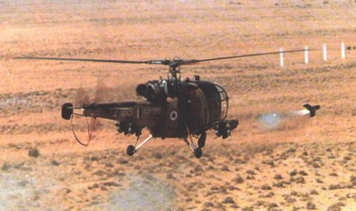
ARMED HEPTR
Normal heptr armed with msls / cannons w/o armr protection
Good loiter capb
Armt. 04 X ATGM &7.62 mm MMG

Slide 7
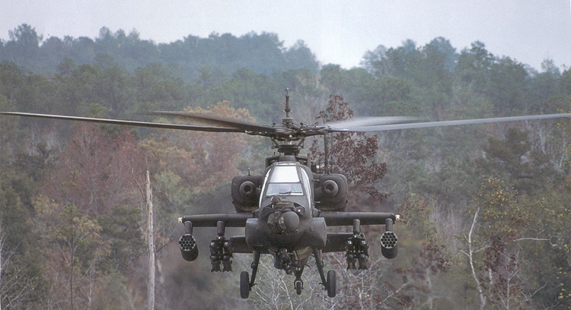
ARMED HEPTR
Highly mvre, designed to provide highly responsive fire with speed & flexibility unmatched by any other wpn sys
Armr protection, Fire power, & Survivability
Low visual, acoustic, thermal & radar sign
Ability to use grnd for cover

Slide 8
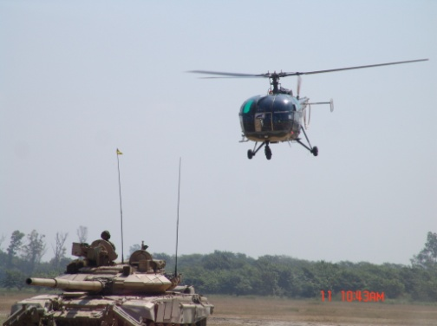

SCOUT HEPTR
Small, agile & highly mvre, designed to function in close concert with an AH
Min armr protection & wpns
Good loiter capb
Recce & selection of fire posns
Acqn of info
Watch over AH engagement

Slide 9
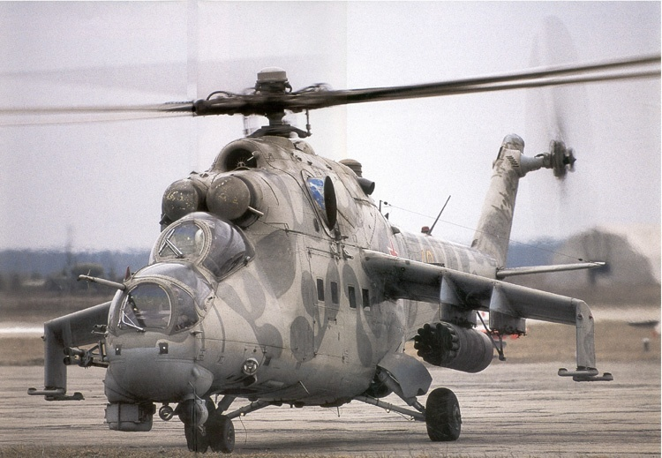
GUNSHIPS
10,000 Kg cl
Rapid fire sys - MI 25 / MI 35
Armt
MI – 25
4 x SKORPION with 4 Km rg
MI – 35
4/8 x SHTRUM msls with 4.5 Km rg

Slide 10
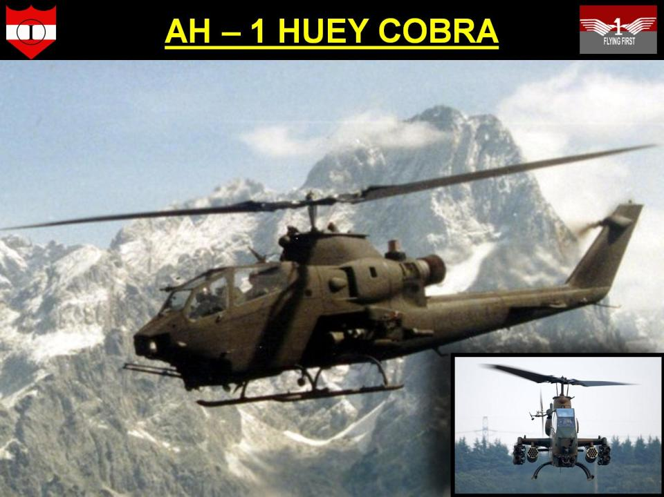
HUEY COBRA
USA, Pakistan
Armt
8 x TOW msls
38 x 75mm rkt pods
2 x 7.62 mm turret guns

Slide 11
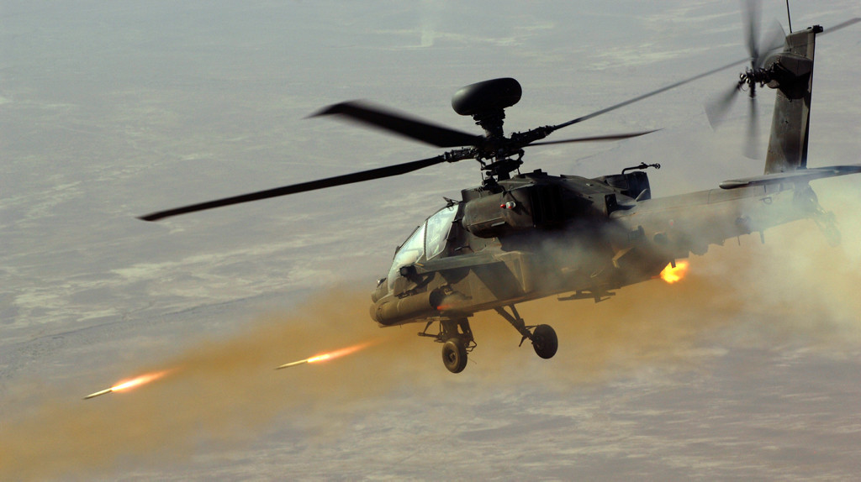
AH-64 APACHE : USA
AH-64 ‘APACHE’:USA
Hellfire msls
70 mm rkts
30 mm auto cannon
Adv Radar and Targeting Sys Tracks 256 contacts
Stinger air-to-air msl
Being procured by Pakistan and India

Slide 12
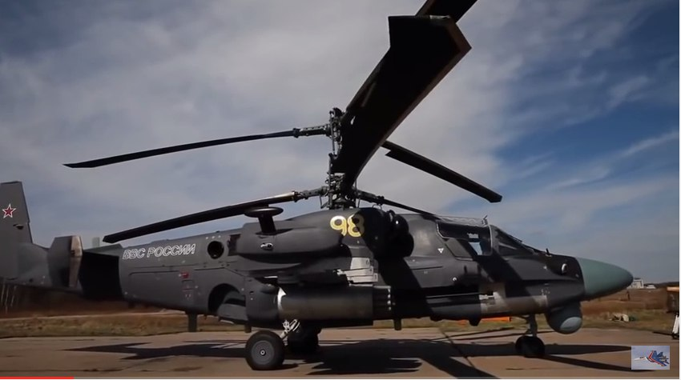
KA 52 ALLIGATOR : RUSSIA
KA-52 ‘ALLIGATOR’: RUSSIA
Armt similar to AH-64 APACHE

Slide 13
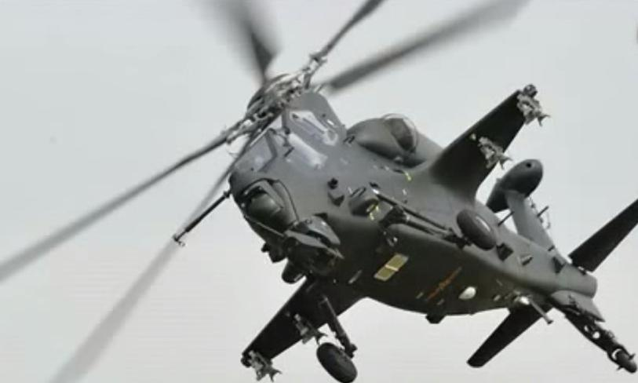
Z 10 : CHINA
Z-10: CHINA
Country
CHINA
Armament
Hellfire missiles
70mm rockets
30mm automatic cannon
Advanced radar and targeting systems- Tracks and prioritizes 256 contacts
Stinger air-to-air missile
Ceiling – 6,200 m
30 mm auto cannon
TY-90 air-to-air msls
Designed by Kamov
Note : Chinese AHs & SHs have ltd payload carrying capb because of Service Ceiling (WGE, OGE, FSC)

Slide 14
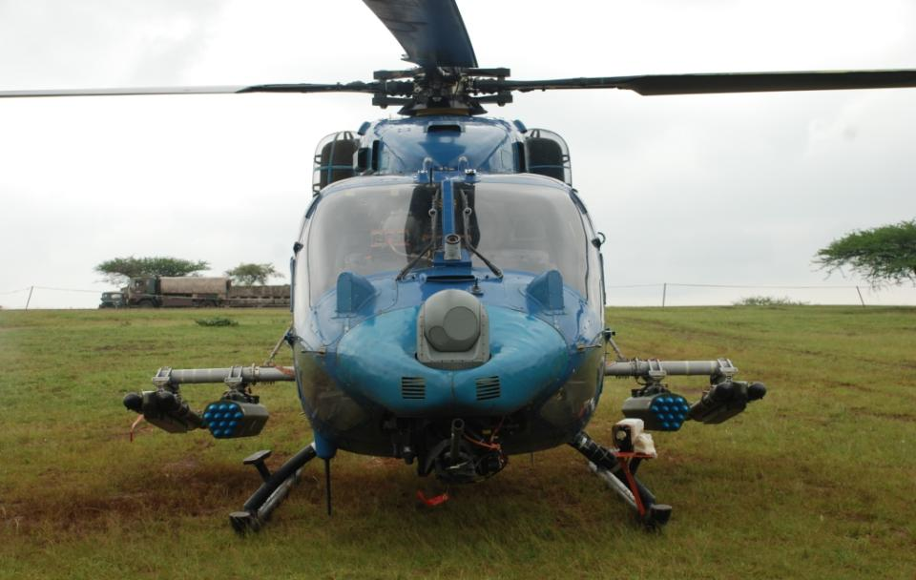
INDIAN RUDRA / ALH(WSI)
ALH(WSI)
Armt
8 x ATGMs (Nag)
70 mm rkts
Chin Mounted 20 mm Gun
4 x Air to Air Msls
To be available at each Corps after completion of raisings

Slide 15
PART II : CAPABILITIES & LIMITATIONS

Slide 16

CAPABILITIES
Fire Power
Mob & Agility
Shock Action
Comn
Loiter Capb
Availability
Survivability

Slide 17
LIMITATIONS
Navig
Vis
Maint
Vulnerability
Wx
Rarity & High Cost

Slide 18
PRINCIPLES OF EMP &
ROLES OF AHs

Slide 19
PRINCIPLES OF EMPLOYMENT
Principles of
Emp
Basic Guidelines
New
Int
Suppression
Mutual Support
Fire & Move
Surprise
Survivability
Flight integrated with grnd and other forces
Obtain adequate int to enable thorough plg
Suppress en wpns and acqn means
Exploit mob, firepower and flexibility
Mass forces for decisive results
Integrate fire and mvre elements
Emp surprise by utilising trn and wx
Exploit endurance capb
Enhance survivability

Slide 20
ATTACK & ARMED HEPTR : ROLES
Principles of Emp
Int
Suppression
Mutual Sp
Fire and Mov
Surprise
Survivability

Slide 21
ATTACK & ARMED HEPTR : ROLES
Primary Role : A tk
Engage en mech forces & Sp own mech forces
Engage en adm echs, comd & cont eles & lgs bases
Engage en fire sp sys

Slide 22
ATTACK & ARMED HEPTR : ROLES
Secy Role : Fire Sp & Protection
Bunker bursting & Suppression of en fire
Sp own AB / HB ops
Fire sp to aslt tps
Ae recce
Flk protection & asst in expl
Engage en withdrawing forces
CA / CP, part of rft / res force
Reinforce own blocking posns in the rear
Protect Br H in initial stg

Slide 23
PART III : NEED FOR AH RT PROCEDURE

Slide 24
NEED FOR AH RT PROCEDURE
Primary Role : A tk
Engage en mech forces & Sp own mech forces
Engage en adm echs, comd & cont eles & lgs bases
Engage en fire sp sys

Slide 25
NEED FOR AH RT PROCEDURE
Secy Role : Fire Sp & Protection
Bunker bursting & Suppression of en fire
Sp own AB / HB ops
Fire sp to aslt tps
Ae recce
Flk protection & asst in expl
Engage en withdrawing forces
CA / CP, part of rft / res force
Protect Br H in initial stg

Slide 27
PART IV : ABVNS

Slide 28
BASIC ABVNS
SER NO | ABVN | FULL FORM
1. | JOC | JT OP CENTRE
2. | GLO | GRND LIASION OFFR
3. | AH / UH | ATTK / UTILITY HEPTR
4. | ALG | ADV LDG GRND
5. | FLOT | FWD LINE OF OWN TPS
6. | FARRP | FWD ARE REARMAMENT AND REFUELLING PT
7. | SHBO | SPL HELI BORNE OPS

Slide 29
PART V : CHECKLIST

Slide 30
CHECKLIST : TGT DESCRIPTION
Tgt Def : AAD , MMG , ETC
Type Of Tgt : Rdr , Tks, B Veh , Fd Fortifications
Dispersion Of Tgt : Any Prominent Grnd Feature, Tgt –Static Or Mov
Trn : Effect On Flying

Slide 31
CHECKLIST : TGT DESCRIPTION
CP - Prominent Land MK(BR, Town , Cnl , Rds, BUA)
Obst - Ht Wire , Tower, Mobile Tower, Chimneys , Etc
Dist From FLOT
Break Off In Safe Directions

Slide 32
PART VI : AH RT PROCEDURE

Slide 33
AH RT PROCEDURE
CALL SIGN | RT TXN
FIREBIRD | FIREBIRD FOR VICTOR RT CHECK.
VICTOR | VICTOR FOR FIREBIRD STR 5.
FIREBIRD | VICTOR READING YOU STR 5
VICTOR | FIREBIRD TGT FOR YOU IS ONE TP OF TK
FIREBIRD | ROGER
VICTOR | TGT DISPERSED BY 400M AND PERPENDICULAR TO YOUR RUN IN DIRECTION
FIREBIRD | ROGER

Slide 34
AH RT PROCEDURE
CALL SIGN | RT TXN
VICTOR | COURSE FROM CP 230 DIST 8 KM
FIREBIRD | 230 DIST 8 KM
VICTOR | IN THE TGT AREA THERE IS A PROMINENT DCB RUNNING NW TO SE
FIREBIRD | ROGER
VICTOR | EN TANKS LOCATED SW OF DCB
FIREBIRD | ROGER
VICTOR | FLOT RUNS PERPENDICULAR TO YOUR ATTACK DIRECTION AND NE OF THE DCB

Slide 35
AH RT PROCEDURE
CALL SIGN | RT TXN
FIREBIRD | ROGER
VICTOR | OWN LOC 6 O CLOCK TO ATTACK DIRECTION 300 M NORTH A PROMINENT HIGH GRND AND NE IS CATTLE FENCE
FIREBIRD | ROGER
VICTOR | BREAK OFF WILL BE RT AND GET AWAY COURSE 330
FIREBIRD | ROGER
VICTOR | CALL SETTING COURSE FROM CP
FIREBIRD | WILCO

Slide 36
AH RT PROCEDURE
CALL SIGN | RT TXN
FIREBIRD | FIREBIRD FOR VICTOR SETTING COURSE NOW
VICTOR | CONTACT WITH ONE HEPTR
FIREBIRD | ROGER
VICTOR | LOOK 12 O CLOCK 1KM DCB RUNNING SE TO NW
FIREBIRD | CONTACT WITH DCB
VICTOR | LOOK 12 O CLOCK 500 MTR FOR ONE TROOP TANK
FIREBIRD | CONTACT NO1 WILL ENGAGE THE TGT

Slide 37
AH RT PROCEDURE
CALL SIGN | RT TXN
VICTOR | CLEAR TO FIRE
FIREBIRD | ROGER
FIREBIRD | BREAKING OFF RT 330 GIVE DMG ASSESSMENT
VICTOR | TWO EN TKS DESTROYED
FIREBIRD | ROGER

Slide 38
ANY QUESTIONS ?

Slide 39
SCOPE
PART I : AH Gen Data
PART II : Capabilities & Limitations of AHs
PART III : Need for AH RT Proc
PART IV : Abvns
PART V : Checklist
PART VI : AH RT Proc

Slide 40
BDE SVL CENTRE & DIV INT SVL CENTRE

Slide 41


Slide 42
DEMAND PROCEDURE, COMD & CONT

Slide 43
DEMAND PROCEDURE
Centralised Cont
Dedicated Allotment
Response
Originator
- Tgt description
- Task & time
- Fwd Line of Tps
- Cont Pt (designation & call sign)
Accepted / Rejected
Originator info
No of teams
Msn call sign
ETA
No formal demand essential
AD clearance from JADC

Slide 44
ORG OF UNITS
Attack Heptr Sqn
(MI-25/35)
10 x Attack Heptrs
ALH (WSI)
Sqn
Flight
5 x ALH (WSI)
Heptrs
Flight
5 x ALH (WSI)
Hetrs
Air Force Units
Emp cont at Comd level
Op with Corps / Armr Fmns
Army Units
One for each Corps (Under raising)
Op with Corps / Armr Fmns

Slide 45
VETTING OF DEMAND
Time gap between demand raised to the msn exec may be 20-40 mins:-
Vetting at each level till JOC
JADC clearance
Other ac op in the TBA
Availability of NO fire lanes
AD sit
Availability of AHs
Heptr prep & configuration
Msn bfg of pilots and prep
Loc / dist of FARRP from the tgt

Slide 46

COORD ASPECTS
Detailed plans of grnd forces and that of emp of AHs
Affiliation of AHs flts with fmn
Air Force plans, battlefield Air Sp and own ac flying through / in vicinity
AD Plan, restd / prohibited Z
IFF own tks, ICVs, self propelled guns and other eqpt
Comn with grnd forces and Air Force
COMD & CONT ASPECTS
Emp be coord at Corps / Div level
Grouping done at the earliest
LOs of AH unit to be with Div HQ / with Comb Comd
Avoid frequent changes in grouping & affiliation

Slide 47
TAC POSNS, FLT MODES & ENGAGEMENT TECHS OF AHs

Slide 48
TAC POSNS
Battle Posn
Firing Posn
Covered & concealed posn used by AH for tgt engagement
Team Ldr designates battle posns & sect for fire based on info from scouts
Posn within the battle posns to give max stand off rgs with good fd of fire
Should not give away posn of AHs
Well covered entry & exit routes

Slide 49
TAC POSNS
ATTACK ROUTE
HOLDING AREA
BATTLE
POSN
FAA
ENGAGEMENT AREA
BATTLE POSN

Slide 50
FWD AREA REARMING AND REFUELLING PT (FARRP)
Temp facilities, transitory in nature, est for a specific duration & msn
Manned by AH unit pers and re-sup by sp fmn
Loc approx 20 -30 Km from border and outside med arty rg
Size based on reqmt - for five AH and three Scout heptrs size is1.5 Km X 1.5 Km

Slide 51
FARRP
25 M
25 M
H
H
15 M
15 M
75 M
OPS
ROOM
150 M
50 M
TECH
ACCN
H
AMN
VEHS
100 M
FUEL
BOWSERS
TARMAC / ATW
STAB SOIL

Slide 52
AIR SPACE MGT
Users of Air Space
- Army Aviation ac
- Air Force ac
- Fd Arty
- AD Arty
- Remote Piloted Vehs / UAVs
- Hostile Air Activities
Air Space Mgt Cont Org in Tactical Battle Area
- Corps HQ – Joint Air Def Centre (JADC)
- Div HQ – Air Space Mgt Cell (ASMC)

Slide 53
FLT MODES
Low Flying
Contour Flying
Nap of Earth
Constant alt & speed
Contact with en - not likely
No danger of acqn by en radars
Rear areas
Constant speed but varying alt conforming to “the earth’s contours”
Adopted ahead of Div Rear bdy
En contact possible but not imminent
Flying as close to Earth’s surface as feasible – max use of vegetation and trn
Alt, speed and dirn are variable
In close proximity of en
Facilitates evasion

Slide 54
LOW FLYING
100ft
B
A
Rear of Div rear bdy
Contact with en is unlikely

Slide 55
CONTOUR FLYING
50ft
B
A
Fwd of Div rear bdy
Contact possible but not Imminent

Slide 56
NAP OF EARTH FLYING
50ft
B
A
Contact with en imminent

Slide 57
EXEC OF MSN
GRND
FMN
FWD
HELIPAD
BATTLE
POSN
CONT
POINT
JOC
ACCEPT
DEMAND
Liaise / Establish communication with ground Formation
If required land and pick up the ground representative
BASE
OPS
BRIEFING
ATTACK HEPTR
OPS ROOM
POST MSN
REPORT

Slide 58
TECH & TAC TO ENGAGE TGTS
Mov to fwd Mtg Base / FARRP
Optimum coord with scouts
Appropriate time to mov to battle posn
Prep for engagement & carry out vital armt checks
Acquire tgts & mov to firing / battle posns
Engage Tgts. Attacks are mounted as follows:-
Phased Emp
Continuous Emp
Max Destr
Mov to alt firing posn / holding area
Return to FARRP / Mtg Base / Hide
Note : Scouts often remain in battle A and AH cycle into & out of fight

Slide 59
ATTACK HEPTRS OF OTHER COUNTRIES

