Slide 1


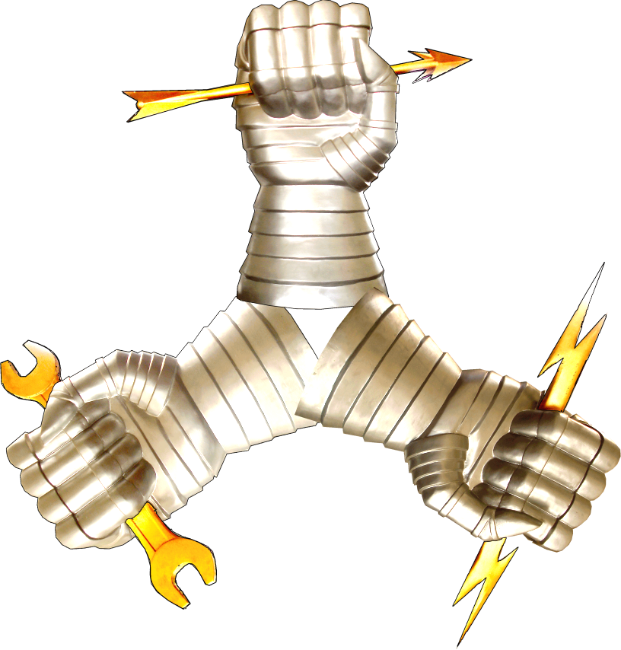
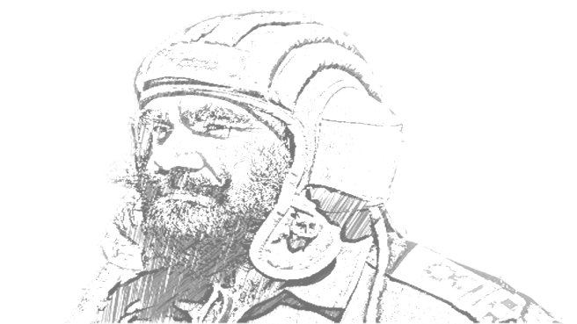
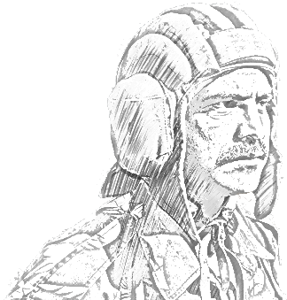


Slide 2
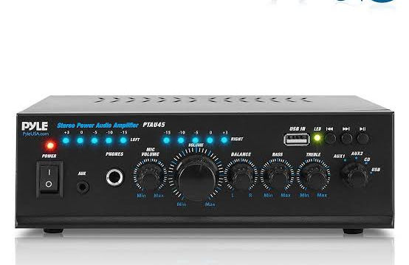
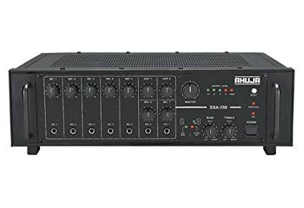
AMPLIFIER

Slide 3

SIGNAL
General term used to refer to any A.C. or D.C.
Can be large or small, AC or DC or even non-electrical such as sound or light.
Can be referred as waveform

Slide 4
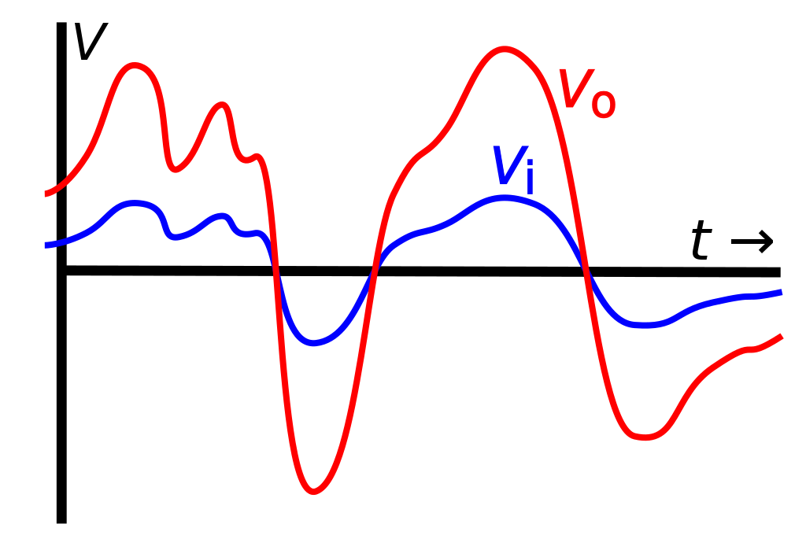
AMPLIFICATION
Amplification means increasing the amplitude (voltage or current) of a time-varying signal

Slide 5
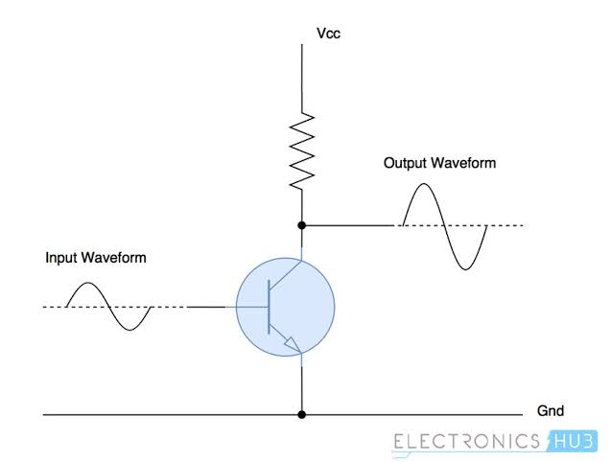
EXAMPLE : AMPLIFICATION
A 5 volt AC signal would be larger in amplitude than a 4 volt AC signal.

Slide 6
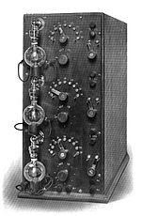
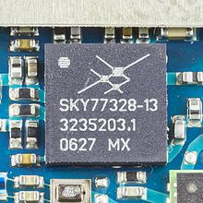
WHAT IS AN AMPLIFIER
Any device that changes (usually increases), the amplitude of a signal.

Slide 7
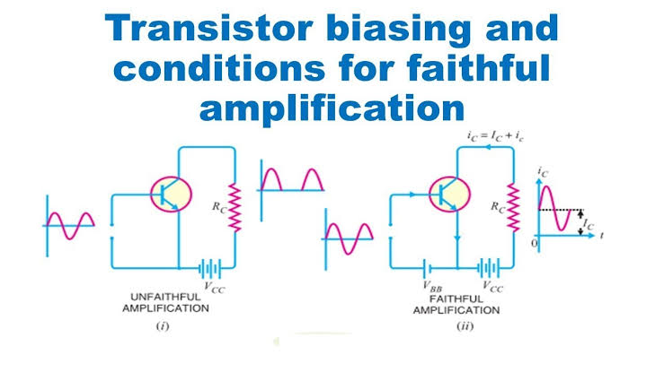
FAITHFUL AMPLIFICATION
Raising the strength of a weak signal
without any change in its general shape

Slide 8
AMPLIFIER AS USED IN RADIO RECEIVER

Slide 9
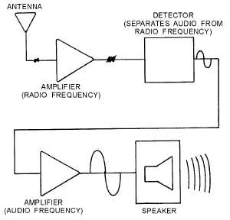
AMPLIFIER AS USED IN RADIO RECEIVER

Slide 10
CLASSIFICATION OF AMPLIFIERS

Slide 11
BASIS OF CLASSIFICATIONS
Usage
Frequency capabilities
Coupling methods
Mode of operation

Slide 12
BASIS OF USAGE
VOLTAGE AMPLIFIER
  Output signal voltage is larger than input signal voltage.
  Amplifies the voltage of the input signal.
POWER AMPLIFIER
  Output signal power is greater than the input signal power.
  Amplifies the power of the input signal
  Output device could be a speaker, indicating device, antenna or heads on a tape recorder.

Slide 13
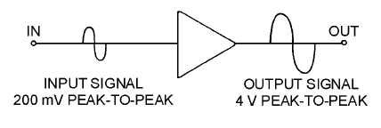
BLOCK DIAGRAM : VOLTAGE AMPLIFIER
Output signal voltage is larger than the input signal voltage.
Figure below show a simple block diagram

Slide 14
BASIS OF FREQ
  AUDIO AMPLIFIERS
    Amplify the signals lying in the audio range i.e 20 Hz TO 20 Khz
  RADIO FREQUENCY AMPLIFIERS
    Amplify signals having very high freq

Slide 15
BASIS OF COUPLING METHODS
  Output from a single stage amplifier is usually insufficient to meet the practical reqmt
  Addl amplification is often necessary
  To do this output of one stage is coupled to the next stage.
  Classified as
    R-C coupled amplifiers
    Transformer coupled amplifiers

Slide 16
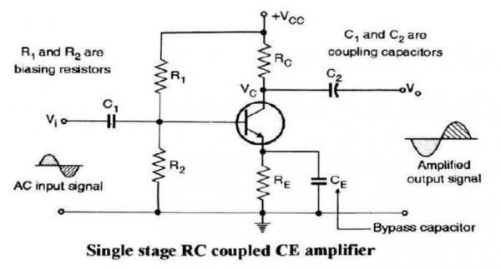
RC COUPLED AMPLIFIER
  USING RESISTOR AND CAPACITORS COMBINATION

Slide 17
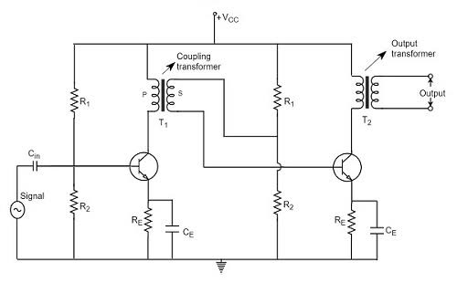
TRANSFORMER COUPLED AMPLIFIER
  USES TRANSFORMER

Slide 18
BASIS OF MODE OF OPERATION
  CLASSIFIED AS
    CLASS A
    CLASS B
    CLASS C
    CLASS AB

Slide 19
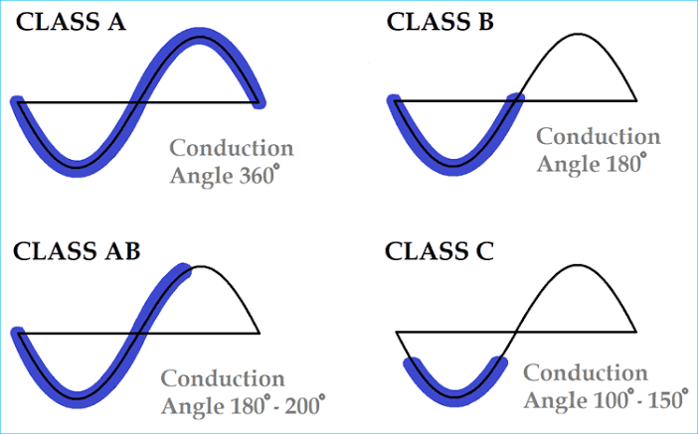
MODE OF OP

Slide 20
THANK YOU

Slide 21
OSCILLATORS

Slide 22
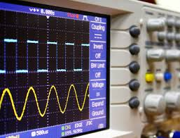
INTRODUCTION
The basic signal-generating source for various applications in electronic circuits is 'oscillator'.
It will change the DC to an AC signal and can generate any frequency required by the circuit.

Slide 23
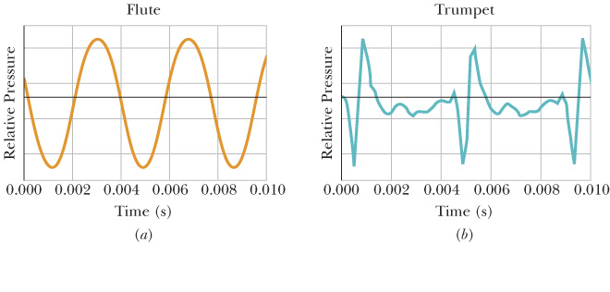
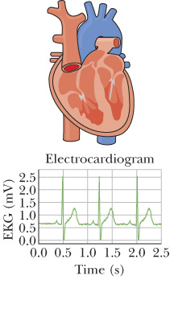
OSCILLATIONS

Slide 24
USES OF OSCILLATORS
Radio and television stations require oscillators to develop the basic signal to transmit their information.
Cell phones, electronic keyboards, and remote controls use oscillators to produce the required frequencies for operation.
Digital devices such as computers, watches, calculators, and I-pods all require oscillators to generate the rectangular waveform required for operation.
Variable oscillators, known as signal generators are used to generate frequencies and waveforms needed for troubleshooting and the testing of electronic equipment.

Slide 25
OSCILLATIONS
Oscillations - Motions that repeat themselves.
  Oscillation occurs when a system is disturbed from a position of stable equilibrium.
      Clock pendulums swing
      Boats bob up and down
      Guitar strings vibrate
      Diaphragms in speakers
      Quartz crystals in watches
      Air molecules
      Electrons

Slide 26
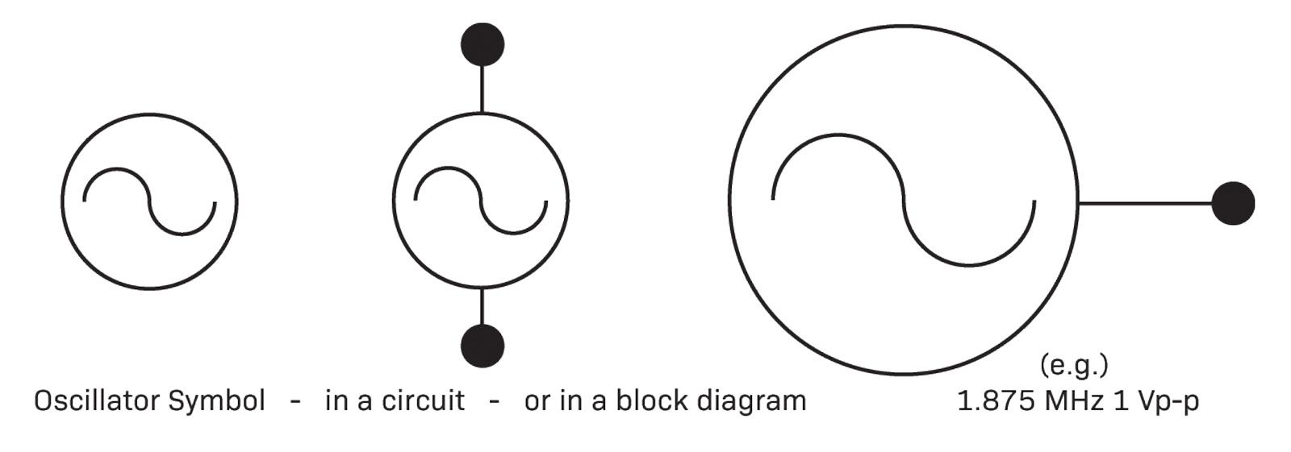
SYMBOL OF AN OSCILLATOR

Slide 27
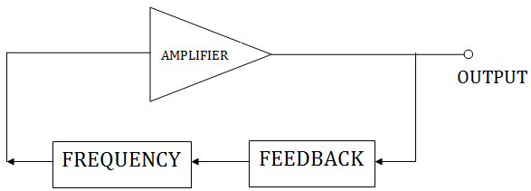
REQUIREMENT OF AN OSCILLATOR CIRCUITS
The basic oscillator circuit consists of :
i. Amplifier
ii. Feedback
iii. Frequency generation circuit.
Amplifier
An “oscillator” is device that produces oscillations (back-and –forth) charges-usually an electronic circuit that produces AC-from a steady (DC) source of power.
The amplifier circuit requires a DC power supply source to bias the transistor.

Slide 28
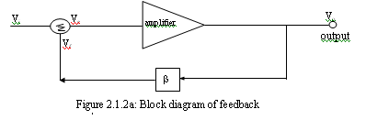
REQUIREMENT OF AN OSCILLATOR CIRCUITS
2) Feedback
Feedback is a condition in which part of the output signal supplied to the input.
When the oscillator has no input signal, the feedback signal is the input signal for the amplifier in the oscillator circuit.
There are two principles of the feedback, negative feedback and positive feedback.
Oscillators using the principle of positive feedback. Figure shows the basic block diagram of a feedback system:

Slide 29
REQUIREMENT OF AN OSCILLATOR CIRCUITS
3) Frequency generation circuit
Feedback signal and the amplifier can not be sure of the swing, it requires the control / frequency generation and it usually placed in the feedback.
The frequency generation circuit of the oscillator in the consumer products can divided into:
i. Oscillator that generates audio frequency
RC Oscillator Network (Resistance-Capacitor). It is to produce medium and low frequency signals.
ii. Oscillator that generates radio frequency:
The oscillator LC network (inductor-capacitor). . It is to produce high frequency signals (> 1MHz), and often it produces a stable frequency.

Slide 30
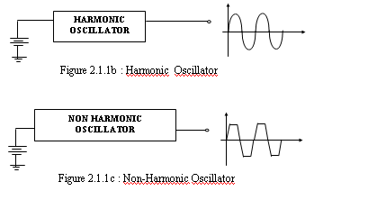
TYPES OF OSCILLATORS
There are two types of an oscillators:
i. Harmonic oscillator - the sine wave.
ii. Non-harmonic oscillator - in the fourth wave, triangle wave, etc..

Slide 31
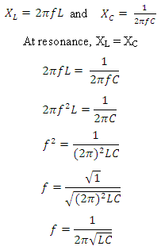
Basic LC Oscillator Tank Circuit
Resonant Frequency of a LC Oscillator
The frequency of the oscillatory voltage depends upon the value of the inductance and capacitance in the LC tank circuit. For resonance to occur in the tank circuit, there must be a frequency point were the value of XC, the capacitive reactance is the same as the value of XL, the inductive reactance (XL = XC).

Slide 32
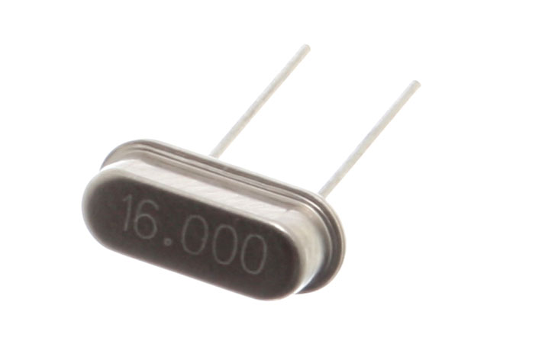
CRYSTAL OSCILLATOR
Oscillator is the most stable and precisely when using a piezoelectric crystal in a feedback circuit. When the alternating voltage is applied to the crystal produced the mechanical vibrations.
These vibrations has the natural resonant frequencies are depend on the thickness of the crystal (high frequency, the thinner of the crystal).
Symbol Figure

Slide 33


