Slide 1
OSCILLATORS

Slide 2
INTRODUCTION
The basic signal-generating source for various applications in electronic
circuits is 'oscillator'.
It will change the dc to an ac signal and can generate any frequency
required by the circuit.

Slide 3
OSCILLATIONS
Oscillations - Motions that repeat themselves.
Oscillation occurs when a system is disturbed from a position of stable equilibrium.
Clock pendulums swing
Boats bob up and down
Guitar strings vibrate
Diaphragms in speakers
Quartz crystals in watches
Air molecules
Electrons

Slide 4
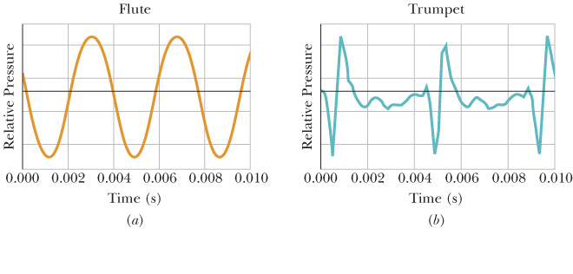
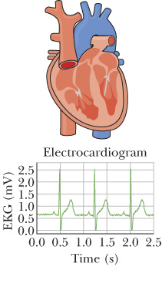
OSCILLATIONS

Slide 5
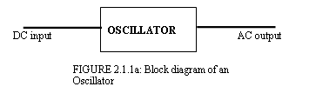
BLOCK DIAGRAM OF AN OSCILLATOR

Slide 6
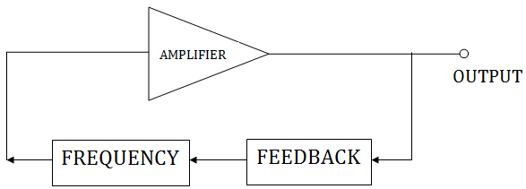
REQUIREMENT OF AN OSCILLATOR CIRCUITS
The basic oscillator circuit consists of :
i. Amplifier ii. Feedback iii. Frequency generation circuit.
Amplifier
An “oscillator” is device that produces oscillations (back-and –forth) charges-usually an electronic circuit that produces AC-from a steady (DC) source of power.
The amplifier circuit requires a DC power supply source to bias the transistor.

Slide 7
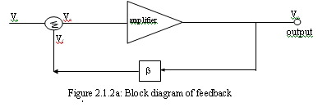
REQUIREMENT OF AN OSCILLATOR CIRCUITS
2) Feedback
Feedback is a condition in which part of the output signal supplied to the input.
When the oscillator has no input signal, the feedback signal is the input signal for the amplifier in the oscillator circuit.
There are two principles of the feedback, negative feedback and positive feedback.
Oscillators using the principle of positive feedback. Figure shows the basic block diagram of a feedback system:

Slide 8
REQUIREMENT OF AN OSCILLATOR CIRCUITS
3) Frequency generation circuit
Feedback signal and the amplifier can not be sure of the swing, it requires the control / frequency generation and it usually placed in the feedback.
The frequency generation circuit of the oscillator in the consumer products can divided into: i. Oscillator that generates audio frequency
RC Oscillator Network (Resistance-Capacitor). It is to produce medium and low frequency signals. ii. Oscillator that generates radio frequency:
The oscillator LC network (inductor-capacitor). . It is to produce high frequency signals (> 1MHz), and often it produces a stable frequency.

Slide 9
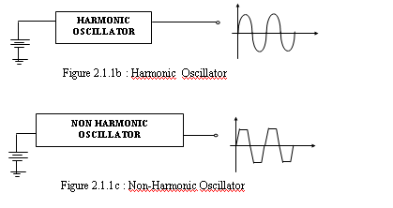
TYPES OF OSCILLATORS
There are two types of an oscillators: i. Harmonic oscillator - the sine wave. ii. Non-harmonic oscillator - in the fourth wave, triangle wave, etc..

Slide 10
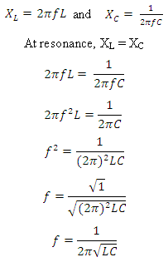
Basic LC Oscillator Tank Circuit
Resonant Frequency of a LC Oscillator
The frequency of the oscillatory voltage depends upon the value of the inductance and capacitance in the LC tank circuit. For resonance to occur in the tank circuit, there must be a frequency point were the value of XC, the capacitive reactance is the same as the value of XL, the inductive reactance (XL = XC).

Slide 11
CRYSTAL OSCILLATOR
Oscillator is the most stable and precisely when using a piezoelectric crystal in a feedback circuit. When the alternating voltage is applied to the crystal produced the mechanical vibrations.
These vibrations has the natural resonant frequencies are depend on the thickness of the crystal (high frequency, the thinner of the crystal).
Symbol Figure

Slide 12
USES OF OSCILLATORS
Radio and television stations require oscillators to develop the basic signal to transmit their information.
Cell phones, electronic keyboards, and remote controls use oscillators to produce the required frequencies for operation.
Digital devices such as computers, watches, calculators, and I-pods all require oscillators to generate the rectangular waveform required for operation.
Variable oscillators, known as signal generators are used to generate frequencies and waveforms needed for troubleshooting and the testing of electronic equipment.

