Slide 1



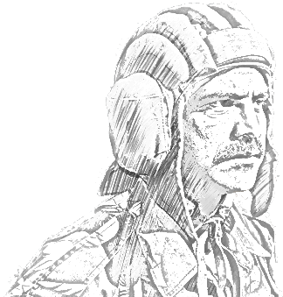

SCHOOL OF TECH TRG
ALWAYS CONNECTED
ELECTRONICS WING

Slide 2
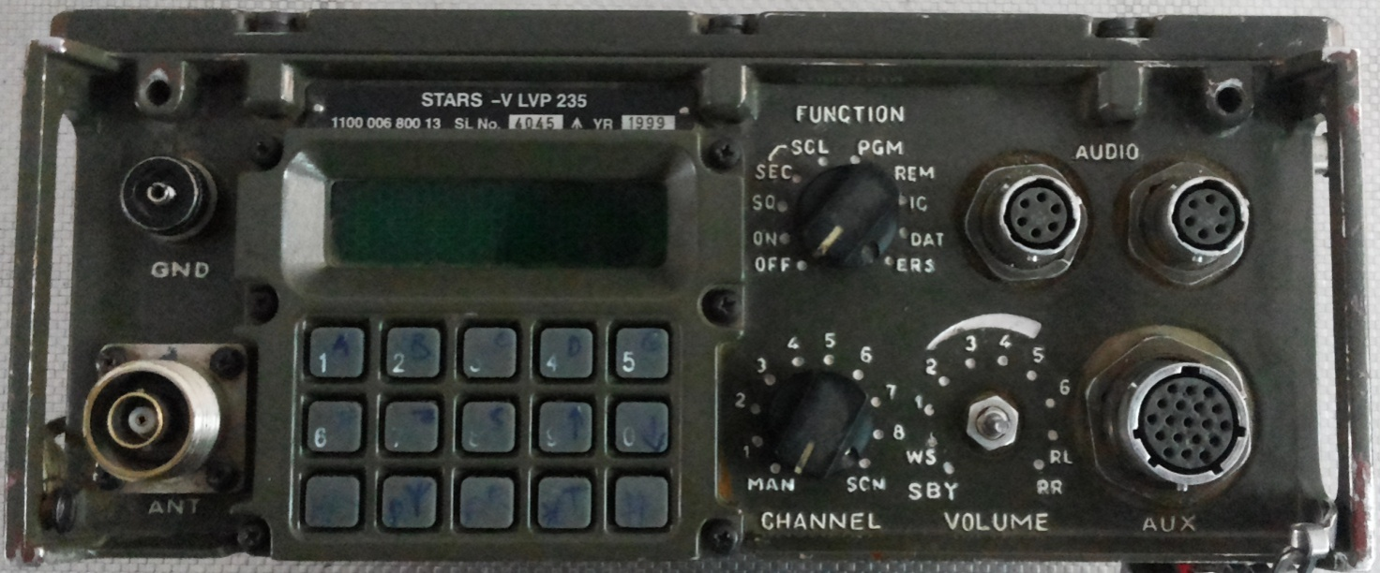
RADIO SET STARS V MK-I
GENERAL & CONTROLS

Slide 3
SCOPE
  Bhag No – I. General
  Bhag No – II. Controls

Slide 4
UDDESH
RADIO SET STARS-V MK I KE BARE MEIN JANKARI DENA HAI.

Slide 5
BHAG NO -1 GENERAL
Aambayan
Radio set STARS-V MK-II(Secure Tactical Army Radio System)
VHF, FM,
simple voice comn, secrecy mode comn aur data mode comn .
Nirman BEL Panchkula Haryana
VHF sets ke sath comn karta hai.

Slide 6
FREQ RANGE
Freq rg - 30 mhz to 51.975 mhz
Low band - 30 mhz to 51.975 mhz
High band - 52.000mhz to 87.975 mhz
Channel Spacing - 25 Khz
Total no of channel - 2320
IF - 1st – 10.7mhz, 2nd – 455 khz
Operating temp - 30° to +55°C
Receiving sensitivity - 0.75µv
Mike sensitivity - 2 mv across 300 ohm
Note: (Nominated 67 freq per yeh kam nahi karta)

Slide 7
POWER SUPPLY
Note : Is set ko 10.8v se kam aur 13.5v se jyada power nahi deni chahie.
Low bty alarm - 10.8v to 10.5v dc (on lode)

Slide 8
POWER SUPPLY
1. BTY SEC NiCd 12V 7AHC RECHARGEABLE (BLACK).
CAPICITY - 7AHC
CHARGE/DISCHARGE CYCLE - 500
BTY WEIGHT - 2.8KG
BTY LIFE- TX TO RX RATIO OF 1:9- CLR – 11HRS,
SEC – 10.5 HRS
TX TO RX STANDBY RATIO OF 1:2:7(CLR – 14 HRS, SEC – 13.5V)
TOTAL CELL IN BTY - 10 CELL 1.2V/CELL

Slide 9
POWER SUPPLY
2. LiSo2 12 V 15 AHC NOT RECHARGEABLE, (GREEN).
CAPICITY - 15AHC
SELF LIFE - 65 MONTH
BTY WEIGHT - 1.3KG
BTY LIFE- TX TO RX RATIO OF 1:9- CLR – 26HRS, SEC – 25.5 HRS
TX TO RX STANDBY RATIO OF 1:2:7(CLR – 35HRS)
3. 12V DC BY MAIN ADAPTOR UNIT.

Slide 10
CURRENT CONSUMPTION
1. ON Receive - 260ma (Clear) and 320 ma (sec)
ON Transmit - 3.0 Amp at 5w
Control Extender Current Consumption - 15ma
RCU Current Consumption - 90ma

Slide 11
POWER OUTPUT
1. LOW - 1W
2. MED - 2W
3. HIGH - 5W

Slide 12
WEIGHT
1. Only Set - 5.5KG
2. As a man pack with two ni cd bty - 15.5kg
3. As man pack with liso2 bty qty 2 - 12.6kg
4. RCU - 1.9kg
5. COMET - 4.4kg
6. Control Extender - 0.5kg
7. Dual charger - 6kg
8. Solar charger - 5kg
9. Fill gun (old) - 0.55kg
10. Fill gun (new) - 0.25kg
11. Hand set - 0.4kg
12. Head gear - 0.6kg

Slide 13
DIMENSION
1. Height - 104mm
2. Width - 260mm
3. Depth - 220mm

Slide 14
ANTENNA SYSTEM
ANTENNA SYSTEM-Iss Radio set ke sath char qism Ant istemaal hote hai.
1.5 MTR TAPE TYPE ANTENNA
3.1 MTR WHIP ANTENNA
3. ANT GPA (FOR STATIC COMN) (11.4MTR/ 8SECTIONS)

Slide 15
COMMUNICATION RANGE
1.5 mtr tape type antenna - 5 to 7km
3.1 mtr whip antenna - 9 to 12km
3. GPA antenna - 25km

Slide 16
SPARES
1. RCU
2. Fill Gun
3. Comet
4. Control Extender
5. Dual charger
6. Solar charger system

