Slide 1

BRACT’S, Vishwakarma Institute of Information Technology, Pune -48
(An Autonomous Institute affiliated to Savitribai Phule Pune University) (NBA and NAAC accredited₁, ISO 9001:2015 certified)
Department of Information Technology
Nodejs CI/CD Pipeline Using Jenkins and Docker with GITHUB Integration
Roll No. | Name | GR No.
333003 | Arshad Attar | 22010173
333004 | Ayush Gupta | 22011191
333011 | Vrushabh Chudiwal | 22011174
333025 | Kaustubh Joshi | 22010030

Slide 2
INDEX
Technologies used
Steps
References

Slide 3
Technologies Used
Jenkins
Docker
Jenkins is a widely used open-source automation server that is used to build, test, and deploy software applications. Jenkins can be used to automate almost any task related to software development, including building and testing software, deploying applications, and managing infrastructure.
Jenkins is highly extensible and customizable, with a vast library of over 1,500 plugins that allow developers to add new functionality and integrate with a wide range of tools and services. Jenkins plugins are available for popular tools and services such as Git, GitHub, Docker, AWS, and many others.
Jenkins is designed to support continuous integration (CI) and continuous delivery (CD) workflows, allowing teams to automate the process of building, testing, and deploying software applications
Docker is a popular platform that allows developers to package and deploy applications as lightweight, portable containers that can run virtually anywhere. With Docker, you can create containers that include everything your application needs to run, such as the code, runtime, system tools, libraries, and settings.
Docker provides a flexible and efficient way to manage your application infrastructure, allowing you to easily scale up or down, roll out updates and changes, and manage dependencies across different environments. Docker's containerization technology also helps to reduce the risk of conflicts between applications, as each container is isolated from the host system and other containers.
Docker has a large and active community of developers and users, who have contributed a wide range of tools, plugins, and integrations to extend its functionality. Some popular Docker-related tools and technologies include Docker Compose, Docker Swarm, Kubernetes, and Docker Hub, which is a repository for storing and sharing Docker images.

Slide 4
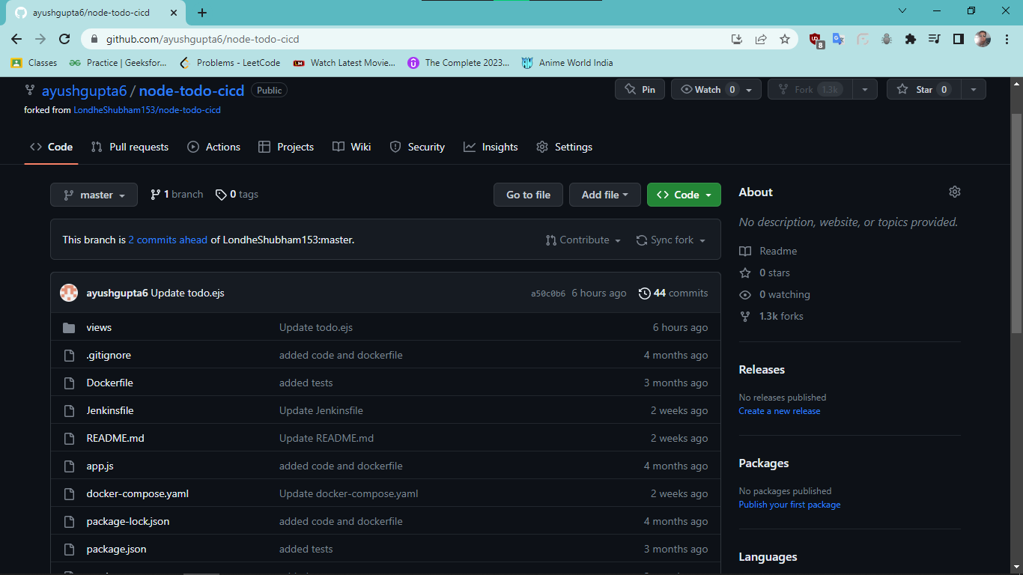
Step1: Forks the GIT Repo
Link: https://github.com/ayushgupta6/node-todo-cicd.git

Slide 5
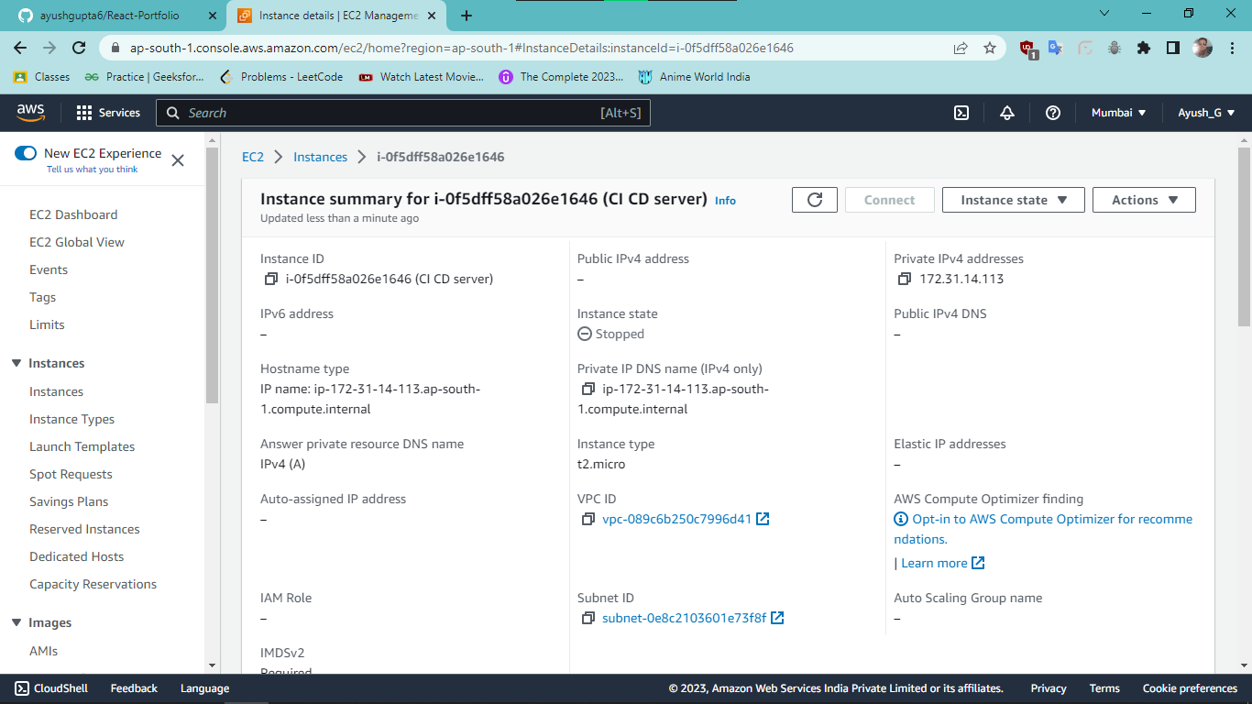
Step2: Create the EC-2 server on AWS

Slide 6
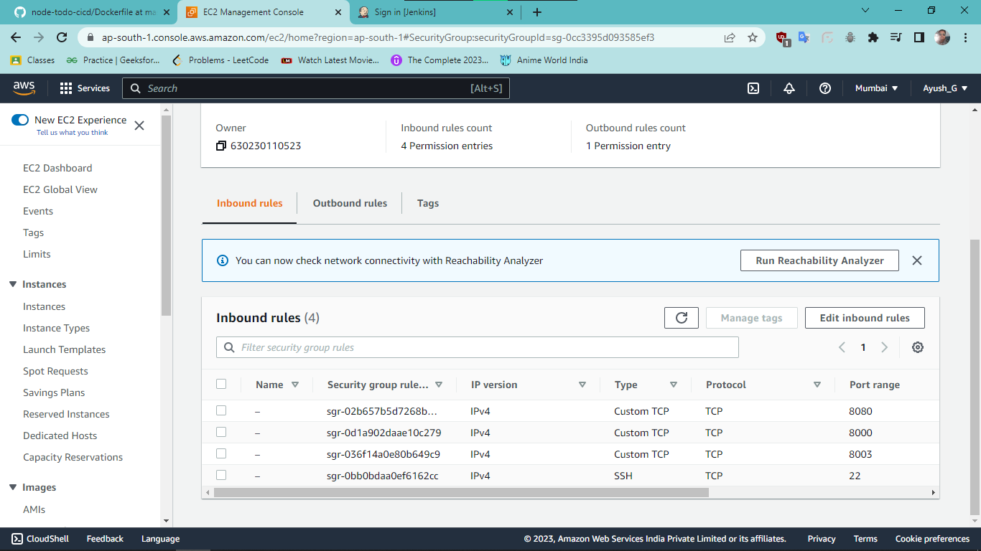
Security group Photo

Slide 7
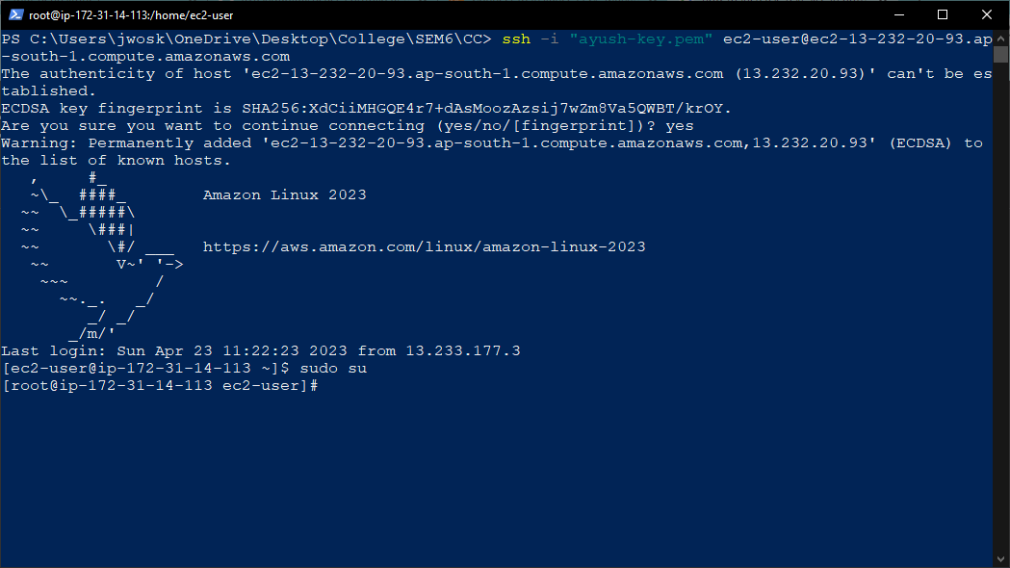
Step3: Connect to our EC-2 server
We connected through SSH

Slide 8
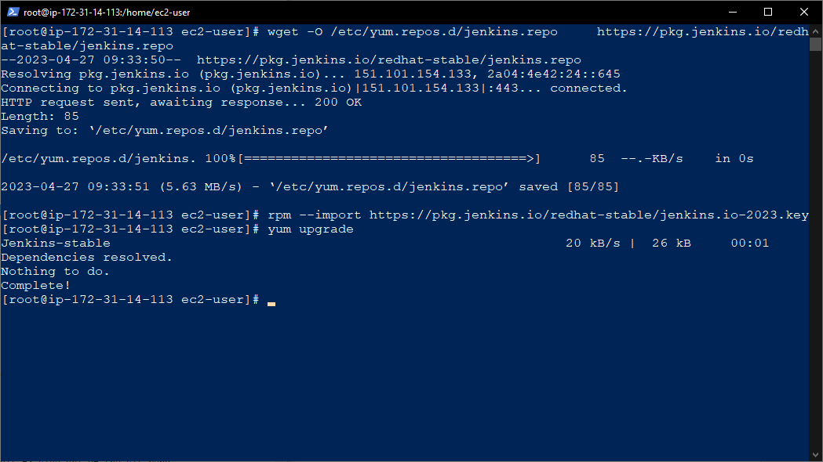
Step4.1: Jenkins Install

Slide 9
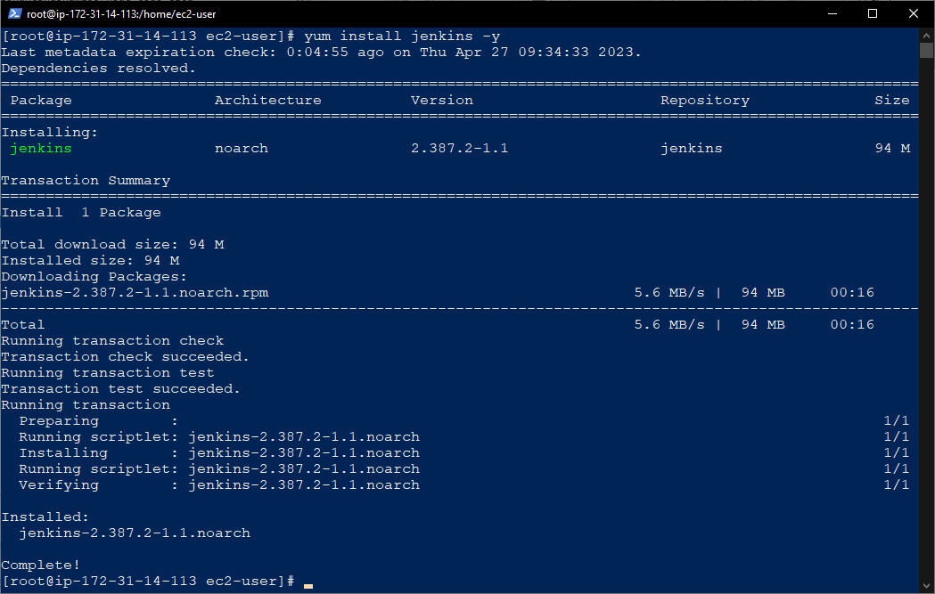
Step4.2: Jenkins Install

Slide 10
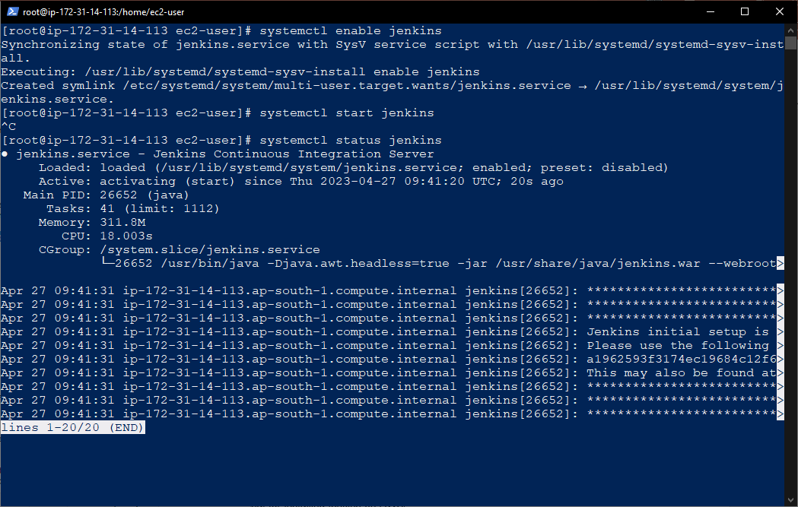
Step4.3: Jenkins Install

Slide 11
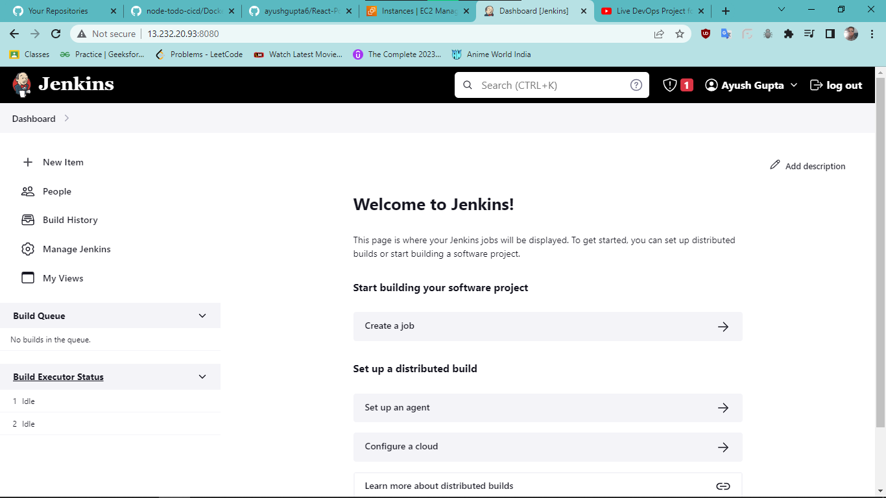
Step4.4: Jenkins Install

Slide 12
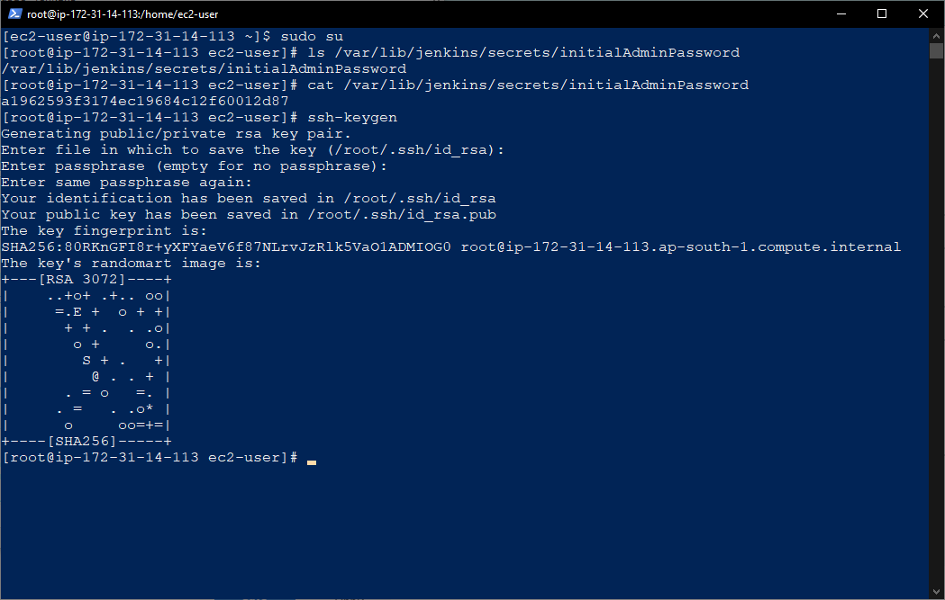
Step5.1: Key Generation and Adding

Slide 13
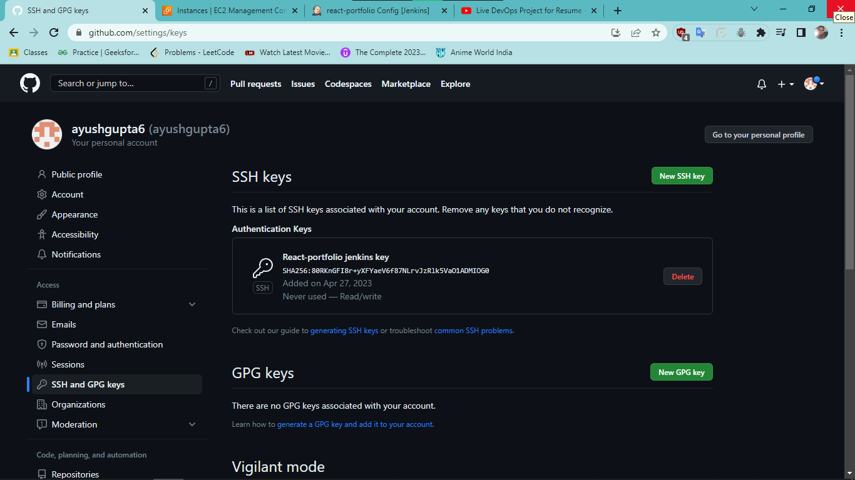
Step5.2: Key Generation and Adding
Adding Public SSH to the Github

Slide 14
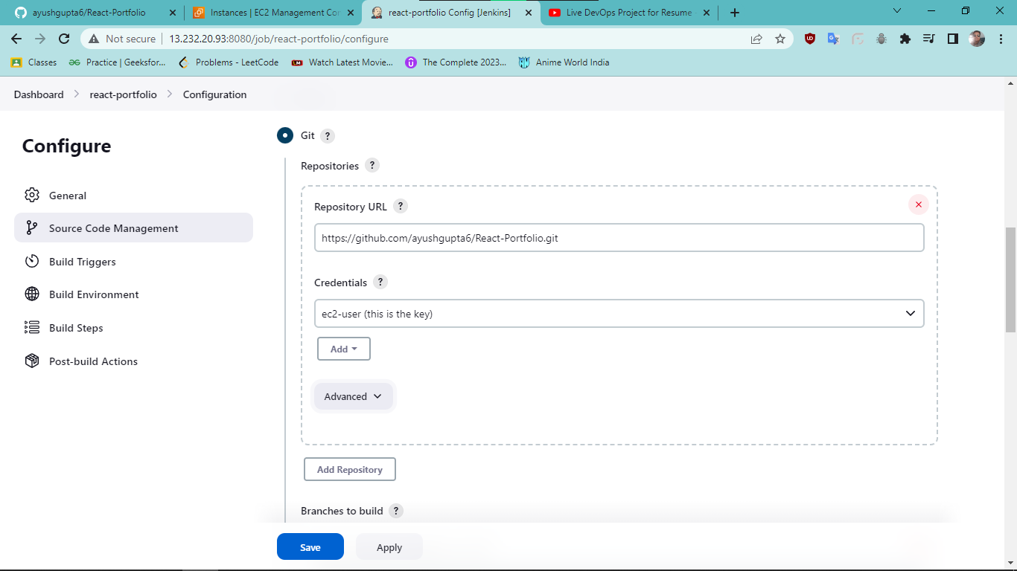
Step5.3: Key Generation and Adding
Adding private key to the Jenkins

Slide 15
DockerFile Code
FROM node:12.2.0-alpine
WORKDIR app
COPY . .
RUN npm install
RUN npm run test
EXPOSE 8000
CMD ["node","app.js"]

Slide 16
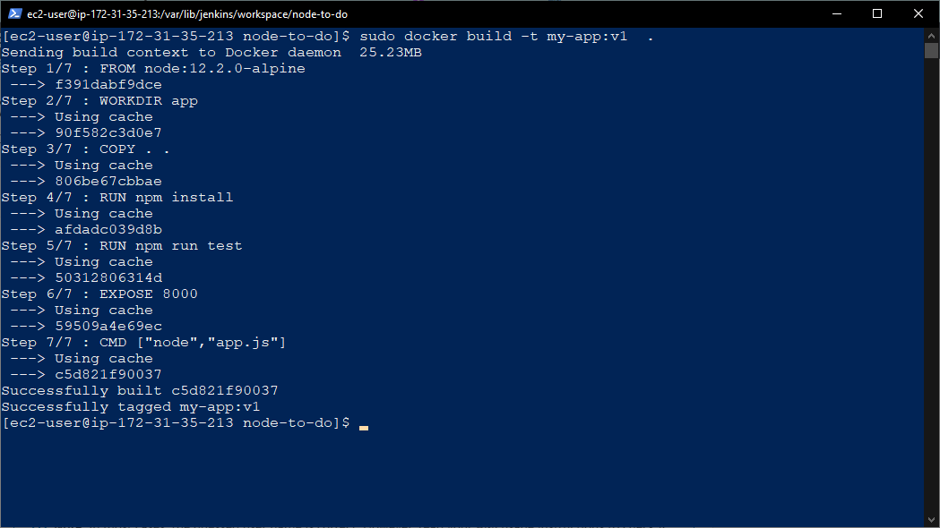
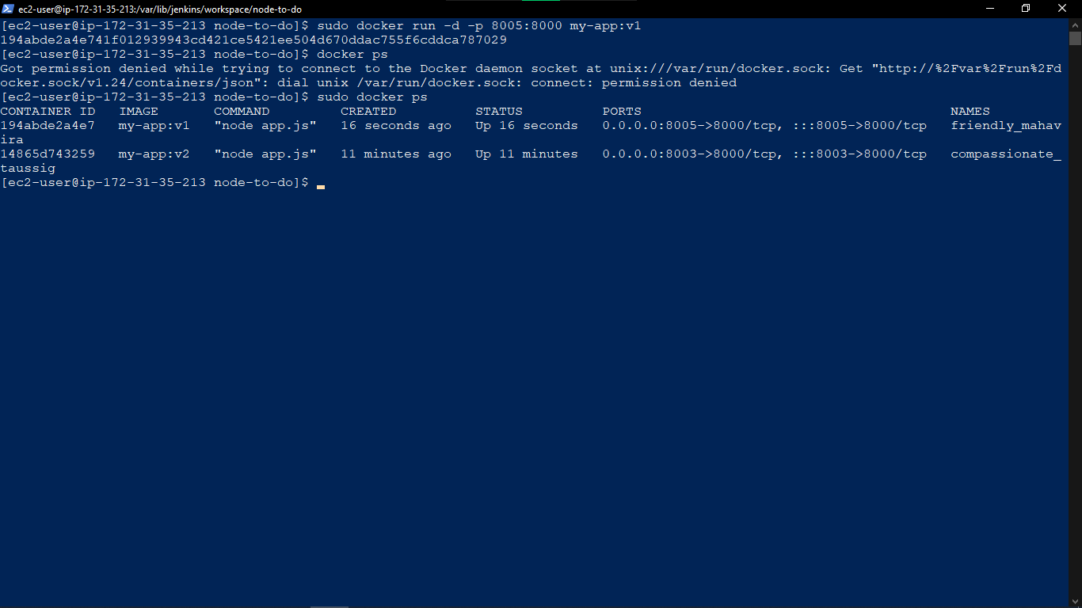
Step 6: Docker Installing and Running

Slide 17
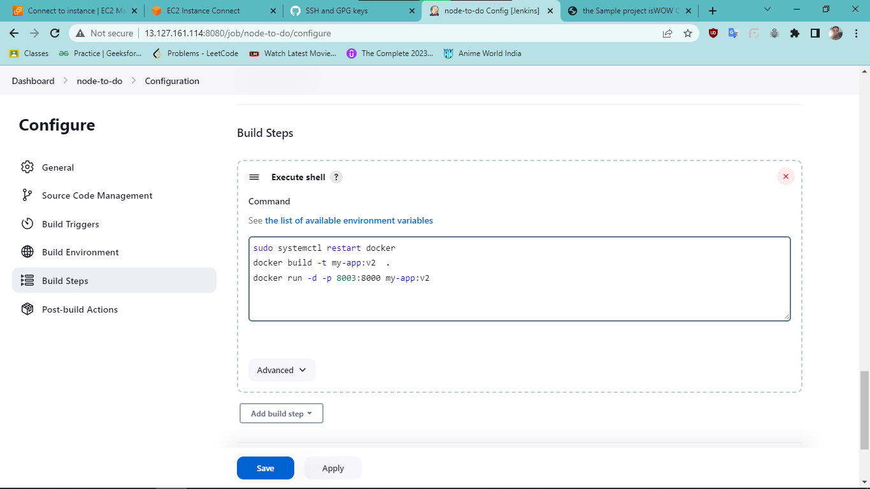
Step7: Exectuble Shell

Slide 18
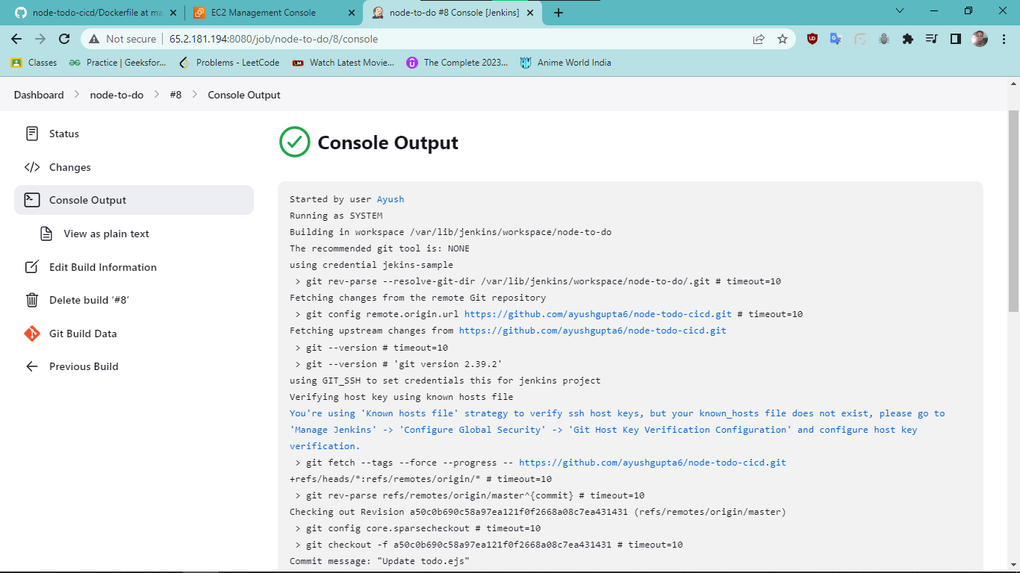
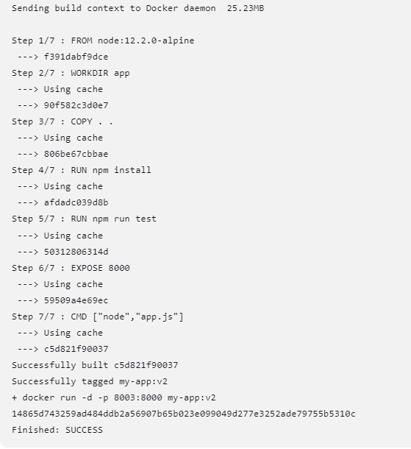
Step8: Console Output

Slide 19
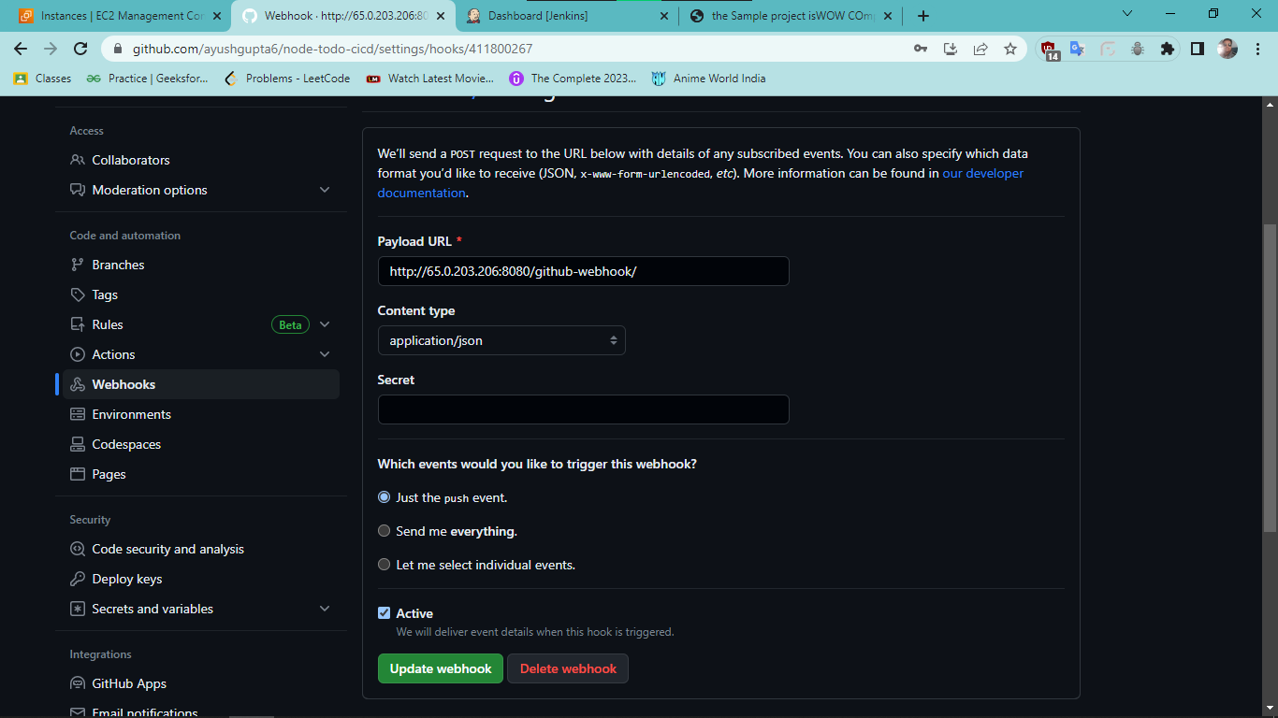
Step9: GitHub integration(WebHooks)

Slide 20
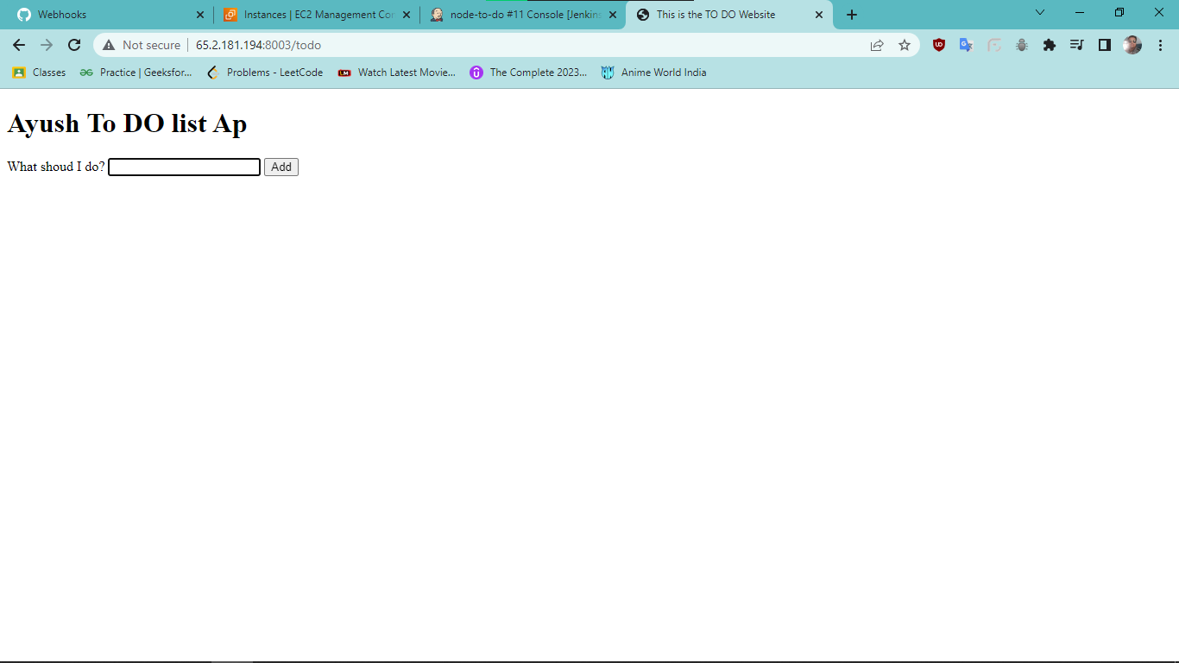
Step10: WebSite

Slide 21
References
https://www.youtube.com/live/nplH3BzKHPk?feature=share
https://youtu.be/I_FmJGtOePk
https://www.jenkins.io/doc/

Slide 22
THANK YOU

