Slide 1
AADIGRA
Phase 1 Survey — Strategic Deep Analysis
Synthesising SPSS Statistical Outputs with Cross-Signal Business Interpretation
N = 313 Responses | SPSS Validated | IITK- IIMA Analysis | Multi-Variable Compound Insights
February 2026

Slide 2
THE CORE TENSION
71.2%
Women know they need help.
They just can't stick to anything.
report moderate–severe
menstrual disruption
This is not a motivation problem. The data proves it.
54.3%
follow a routine for
10 days/month or less
71.2% of women report moderate-to-severe menstrual disruption affecting daily life. Only 17.9% maintain near-daily wellness routines (21+ days/month).
17.9%
maintain near-daily
routines (21+ days)

Slide 3
Severity & Symptom Landscape
The problem is systemic, not singular — avg. 3.61 symptoms per person
Target Segment (23-32, WP, Metro, n=63)
3.36 avg symptoms | 84.1% moderate-to-severe
Mood swings LEAD cramps in this segment
Emotional burden = Physical burden

Slide 4
Current solutions used and level of satisfaction
Satisfaction by Solution Type
Solution | Sat. Mean | Dissat % | Neutral+Below
Painkillers (n=67) | 2.94 | 28.4% | 74.6%
Nothing Specific (n=145) | 3.42 | 15.9% | 52.4%
Home Remedies (n=85) | 3.40 | 12.9% | 55.3%

Slide 5
CROSS-SIGNAL INSIGHT 01
Pain Is Universal — But It Doesn't Drive Behaviour
What the Data Says
What This Means for Aadigra
Pain creates awareness, not action.
The product doesn't need to wait for a pain moment. Demand exists regardless of severity — the barrier is behavioural, not motivational.
Design for the busy, forgetful user — not the high-pain user.
Forgetting (54.3%) + Busy routine (60.4%) dominate Q14 barriers. Format and reminder design matter more than symptom targeting.
71.2% experience moderate–severe disruption (Q5)
Even in the highest-pain group (rated 4–5), 42.3% still manage only 0–5 days/month of continuous routine for wellness

Slide 6
The Adherence Crisis
82.2% cannot sustain near-daily routines — 54.3% drop off by day 10
Top Barriers (Q14)
Busy routine: 60.4% | Forgetting: 54.3%
No visible benefit: 19.8% | Fear of side effects: 20.1%
Product design must deliver perceptible benefit in first 10 days. The adherence crisis is designable — format choice is the intervention.

Slide 7
INSIGHT 02
Format Is a Variable That Might Move Adherence
Key Inference
Low-friction formats dominate preference → users favour options that fit easily into daily routines
Formats requiring preparation or effort see lower preference → higher drop-off risk
Format choice can materially influence adherence and repeat usage, not just trial
Strategic Takeaway
Prioritise capsules/gummies for core SKU; use teas as a secondary, ritual-based extension format

Slide 8
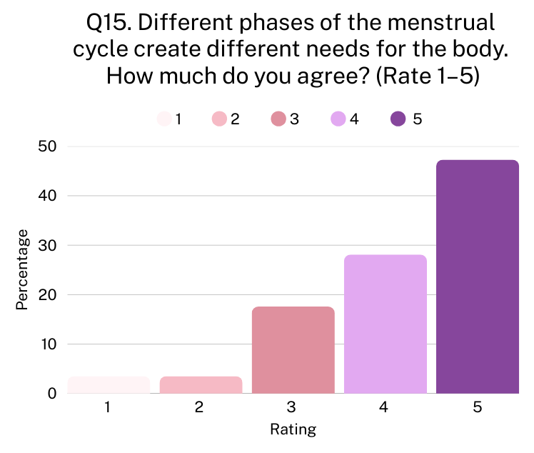
CROSS-SIGNAL INSIGHT 03
75.4%
50.6%
→
believe cycle phases
need differentiated support
action-ready for
personalised products
Demand is UNIVERSAL — NOT a pain response
Dissatisfied vs Satisfied respondents show NO difference in personalisation openness.
81.82% of respondents Dissatisfied with their current menstrual wellness routine and 81.78% Satisfied respondents show their openness to personalization.
TAM = entire market, not just 17.6% dissatisfied.
Current market solutions are largely one-size-fits-all, while 75.4% of women believe cycle phases need differentiated support, and 50.6% are action-ready for personalised products. Daily supplement users (n=37) are 3.0× more likely to pay ₹900+/month.

Slide 9



FACTOR ANALYSIS
Three Consumer Mindsets — Each Needs a Different Strategy
The Believer
The Quitter
The Validator
Personalised Wellness Orientation
Routine Fragility & Usage Barriers
Trust-Led Motivation
Key signals:
Key signals:
Key signals:
Q17 (0.771) + Q15 (0.748) + Q16 (0.499)
Openness, cycle belief, long-term dosing
Q14 barriers (−0.669) + Q13 adherence (−0.423)
High friction, low routine days, stops easily
Q25 motivation (0.741) + Q18 trust (−0.517)
High bar to start — but longest retention once in
Product implication:
Product implication:
Product implication:
She already believes — needs clinical proof to commit. Lead with science and cycle-phase content.
Product UX must do the work. Single daily dose, habit-anchoring format, taste non-negotiable.
Doctor recommendation or clinical claim unlocks her. Highest LTV segment once converted.

Slide 10
Trust Architecture: Medical Credibility Wins
Same formula for every age — but completely different activation channels
Trust-to-Trial Pathway by Age
Age | Trust Anchor | Activation | Combo %
18-22 | Doctor + peer + ingredient | Doctor collabs, social proof | 13.8%
23-27 | Full trust stack (all 4) | Clinical data, certifications | 27.4%
28-32 | Doctor + real outcomes | Science + user stories | 23.1%
33-38 | Safety + self-research | Safety labels, long-term msgs | 15.8%
39-45 | Safety + clinical + outcomes | Outcome testimonials | 13.8%
Doctor recommendation #1 (65.5%), social media LAST (4.5%). Allocate <10% to influencers. Build trust through gynaecologist partnerships, clinical claims, safety certs, and transparency — in that order.

Slide 11
CROSS-SIGNAL INSIGHT 04
Price Is Driven by Geography & Age — Not Value
Segment Pricing Strategy
Metro, 28-38
Metro, 23-27
₹900-1,000
₹500-600
29% willing to pay premium.
Primary launch segment.
51% at ₹300-400. Affordable
entry product needed.
Tier 2 Cities
Semi-urban/Rural
₹300-400
₹300-400
46% in lowest bracket.
Volume opportunity.
Zero uptake above ₹900.
Aspirational product only.
Chi-square City×Price: p=0.030 (Significant) — tier-based pricing warranted. Target segment 49% no change at +20%.

Slide 12
Target Segment: Full Funnel (n=63)
Women aged 23-32 • Working Professionals • Metro Cities
Impact 3+
84.1%
Dissat + Neutral (≤3)
57.1%
Cycle Belief 4+
79.4%
Personalisation 4+
50.8%
App Sharing Yes/Maybe
77.8%
Simple Daily Pref
65.1%
1-3mo Commitment
88.89%
₹500+/month
66.7%
No Change at +20%
42.9%
20.1% of total sample | Avg. 3.36 symptoms | Top: Mood, Cramps, Fatigue, Bloating | Conversion-ready micro-segment (6.4%): Doctor-triggered, ₹500+, commit 2-3mo

Slide 13


Strategic Recommendations
Product Design
Pricing Architecture
Capsule (41.2% preference), bedtime anchor
Gummy (38.7%) for habit-anchoring
Multi-phase (cramps + mood + fatigue triad)
Invisible complexity — app manages phases
First 10 days must show perceptible benefit
Entry: ₹499/mo (67% mass comfort zone)
Premium: ₹899-999/mo (personalised + app)
3-month pack at ₹449/mo post-trial
Discovery kit ₹299 (one-time buyers)
Tier by geography, NOT psychographics
Trust Stack (Non-Negotiable)
1. Doctor/gynaecologist endorsement (65.5%)
2. Safety and compliance assurance (52.1%)
3. Clinical validation claims (51.4%)
4. Real user outcomes (47.0%)
5. Ingredient transparency (44.1%)

Slide 14




Why This Works: Investor-Grade Signals
TAM Signal
PMF Signal
Survey-Validated (N=313): 71.2% moderate-to-severe symptoms requiring intervention. 46.3% currently use no structured solution. 100M+ Indian women structurally underserved.
75.4% believe cycle phases need differentiated support; demand is universal, cutting across satisfaction levels. 12.8% conversion-ready TODAY.
Retention
Unit Economics
40.9% zero sensitivity at +20%. Safety = #1 retention lever (44.1%). Results + Safety tension drives 52.3% to trial first.
High-LTV 8.9% at ₹500+, 2+mo, price-resilient. Daily users: 56.8% at ₹900+/mo. 40.9% of urban professional cohort willing at ₹900–1,000/month.

Slide 15
The Market Is Ready.
The Barrier Is Design.
71.2% of women suffer from menstrual wellness issues. 75.4% believe the solution should be personalised.
The market hasn't failed because women don't want help —
it failed because no product has earned trust, fit real routines,
or addressed the multi-dimensional nature of the problem.
Simple format. Clinical credibility. Tiered by geography.
That is the product-market fit formula.
N = 313 | SPSS + IIT-IIM Strategic Analysis + Multi-Variable Compound Insights | February 2026

