Slide 1
AES thermal prediction pipeline
Input files, transformations
and constraint verification
OpenROAD physical design and power estimates
Therm-FM input construction and temperature outputs
Run status: execution succeeded. Timing closure and AES thermal accuracy remain unresolved.
01
Notes:
Source evidence (paths relative to /Users/ayush/Arch_Gen/aes_thermfm):
README.md; RESULTS_AND_BOTTLENECKS.md; docs/SCALING_AUDIT.md

Slide 2
Complete pipeline
Each step produces the files consumed by the next step.
Step | Tool / operation | Main output
1 Circuit definition | Verilog + SDC + LIB/LEF + floorplan | RTL, constraints and technology inputs
2 Physical design | Yosys, then OpenROAD | Netlist, ODB/DEF, SDC, SPEF, GDS
3 Cell power | OpenSTA inside OpenROAD | Cell geometry and power CSV
4 Thermal input | Python overlap rasterization | input.mat + cases.json
5 Temperature inference | Therm-FM + saved normalization | temperature_K.npy + predictions.mat
6 Visualization | Python plotting | Power and temperature heatmaps
02
Notes:
Source evidence (paths relative to /Users/ayush/Arch_Gen/aes_thermfm):
scripts/run_pipeline.sh; scripts/run_openroad.sh; scripts/export_power.tcl; scripts/build_inputs.py; scripts/infer.py; scripts/analyze_results.py

Slide 3
Starting files
AES means Advanced Encryption Standard. Our implementation occupies one die.
File | Contents | Purpose
aes_cipher_top.v + helper .v files | Encryption logic and registers | Describe circuit behaviour
constraint.sdc | Clocks and I/O delays | Set timing requirements
config.mk | Top module, platform and paths | Select design and flow settings
aes_ng45_fp.def | Die area and placement rows | Provide the starting floorplan
Nangate45 .lib and .lef files | Cell timing/power and geometry | Map logic and build a physical layout
Top module: aes_cipher_top. Technology: Nangate45, typical library corner.
03
Notes:
Source evidence (paths relative to /Users/ayush/Arch_Gen/aes_thermfm):
inputs/rtl/; inputs/orfs_config/config.mk; inputs/orfs_config/constraint.sdc; vendor/nangate45/

Slide 4
Timing constraints in the saved design
Verification compares source intent with the final exported SDC.
Constraint | Configured value | Saved result
Physical clock clk | 0.82 ns period (~1.22 GHz) | Present, propagated clock
Virtual I/O clock vclk_clk | 0.82 ns period, 0.210 ns latency | Present in final SDC
Input delay | 0.20 × 0.82 = 0.164 ns | 258 of 258 non-clock input bits
Output delay | 0.164 ns | 129 of 129 output bits
Clock network latency | Initial clk latency: 0.210 ns | Propagated clock-tree delay
Final SDC has no explicit clock uncertainty, input drive/transition or output load commands. These need a target environment definition.
04
Notes:
Source evidence (paths relative to /Users/ayush/Arch_Gen/aes_thermfm):
inputs/orfs_config/constraint.sdc; flow/results/nangate45/aes/base/6_final.sdc; inputs/rtl/aes_cipher_top.v

Slide 5
Physical and timing verification
Applying a constraint and meeting that constraint are different checks.
Check | Observed result | Interpretation
Die dimensions | 249.85 × 250.60 µm | Initial DEF matches final geometry
Setup timing | −0.03803 ns, 19 violations | FAIL at the 0.82 ns clock target
Hold timing | +0.10568 ns, 0 violations | PASS in the saved timing corner
Slew and capacitance | 0 reported violations | PASS in the saved analysis
Route DRC / antenna | 0 DRC errors, 0 antenna nets/pins | Router checks pass
Fresh OpenSTA check confirms rounded slack: −0.04 / +0.11 ns. No full sign-off or functional AES validation.
05
Notes:
Source evidence (paths relative to /Users/ayush/Arch_Gen/aes_thermfm):
flow/logs/nangate45/aes/base/6_report.json; flow/logs/nangate45/aes/base/5_2_route.json; outputs/geometry.json; inputs/orfs_config/aes_ng45_fp.def

Slide 6
Synthesis and physical design stages
Yosys creates gates. OpenROAD determines their physical implementation.
Stage | Operation | Stage outputs
Synthesis | Map RTL into library cells | 1_2_yosys.v and .sdc, 1_synth.odb
Floorplan | Use die boundary, rows and power grid | 2_*.odb and floorplan reports
Placement | Place cells and repair timing | 3_*.odb and placement reports
Clock tree | Insert and route clock buffers | 4_1_cts.odb and clock reports
Routing | Global route, detailed route and fill | 5_*.odb and routing reports
Final extraction / export | Extract parasitics and export layout | 6_final.odb, .def, .gds, .sdc, .spef, .v
Archive includes final design files and stage logs. Intermediate design files were not copied.
06
Notes:
Source evidence (paths relative to /Users/ayush/Arch_Gen/aes_thermfm):
scripts/run_openroad.sh; flow/results/nangate45/aes/base/; flow/logs/nangate45/aes/base/

Slide 7
Physical design outputs
All files below share the base name 6_final.
Extension | What it stores | Use in this experiment
.v | Mapped gates and connections | Circuit connectivity / review
.odb / .def | Physical database / exchange layout | Cell locations and dimensions
.sdc | Final timing constraints | Timing for power analysis
.spef | Extracted wire resistance and capacitance | Electrical loading for analysis
.gds | Physical layout geometry | Layout export only
OpenROAD creates the layout. Therm-FM directly reads none of these physical-design files.
07
Notes:
Source evidence (paths relative to /Users/ayush/Arch_Gen/aes_thermfm):
flow/results/nangate45/aes/base/6_final.*; scripts/export_power.tcl

Slide 8
Per-cell power extraction
OpenSTA combines the routed design, final SDC, SPEF and Liberty power tables.
Power component | Activity 0.10 result | Meaning
Internal | 9.2362 mW | Power consumed inside cells
Switching | 8.1584 mW | Charging and discharging electrical loads
Leakage | 0.4608 mW | Static cell power
Total | 17.8554 mW | Sum used to construct the AES power map
Activity 0.10 and duty 0.5 are assumptions. No workload VCD/SAIF was used. Library nominal conditions: 1.10 V and 25°C.
08
Notes:
Source evidence (paths relative to /Users/ayush/Arch_Gen/aes_thermfm):
scripts/export_power.tcl; outputs/cells_0.10.csv; outputs/power_0.10.rpt; outputs/power_summary_0.10.txt; vendor/nangate45/lib/NangateOpenCellLibrary_typical.lib

Slide 9
Cell power becomes a spatial map
OpenSTA estimates watts per cell. Python places those watts on a grid.
01
Read each cell’s bounding box and total power from the CSV.
02
Allocate power by exact cell–grid overlap area.
03
Divide each bin’s watts by its area × assumed source thickness.
04
Check that the density integral recovers the original total watts.
Grid: 101 × 101. Source thickness: assumed 200 µm. Original maximum integration error: 3.47 × 10⁻¹⁸ W.
09
Notes:
Source evidence (paths relative to /Users/ayush/Arch_Gen/aes_thermfm):
scripts/build_inputs.py; outputs/cells_0.10.csv; inputs/thermfm/conservation_arrays.npz

Slide 10
Therm-FM tensor construction
Four fields describe each layer slot. Layer slots and channels are different concepts.
Representation | Shape / fields | Transformation
Per layer slot | Power density, x, y, layer ID | 4 fields on the same spatial grid
Stored input.mat | [N, 4, 2, 101, 101] | HDF5 dataset named data
Model input | [N, 8, 101, 101] | Reorder to layer-major, flatten fields
Normalization | (value − saved mean) / saved std | Use training statistics per channel
Adapter conventions: W/m³, x/y in mm, z as IDs 1 and 2. Exact original source-field scaling still needs generator confirmation.
10
Notes:
Source evidence (paths relative to /Users/ayush/Arch_Gen/aes_thermfm):
scripts/build_inputs.py; scripts/infer.py; inputs/thermfm/cases.json; vendor/checkpoint_IND8C_GWL2_T/normalization_constants.json

Slide 11
The checkpoint used for this run
Existing Therm-FM-T, trained on IND-8C with the user’s GW-L2 loss, alpha 0.5.
File | Role
pytorch_model.bin | Saved trained neural-network weights
config.json | 101² grid, 8 inputs, 2 outputs and architecture
normalization_constants.json | Input standardization and output temperature scaling
vendor/Therm-FM/scOT/ | Archived model implementation
scripts/infer.py | Loads inputs and executes label-free inference
No AES fine-tuning occurred. This is a custom experiment checkpoint, not an untouched paper checkpoint.
11
Notes:
Source evidence (paths relative to /Users/ayush/Arch_Gen/aes_thermfm):
vendor/checkpoint_IND8C_GWL2_T/config.json; vendor/checkpoint_IND8C_GWL2_T/normalization_constants.json; outputs/aes_inference/inference_report.json

Slide 12
Temperature prediction and plotting
The network predicts numerical grids. The plotting script produces the graphs.
01
Feed the normalized 8-channel tensor into the shared network.
02
Receive 2 normalized output maps, each 101 × 101.
03
Recover kelvin: prediction × output standard deviation + mean.
04
Save temperature_K.npy / predictions.mat, then plot x/y heatmaps.
One output map per modeled slot. Both maps use the shared input. Output shape: [N, 2, 101, 101].
12
Notes:
Source evidence (paths relative to /Users/ayush/Arch_Gen/aes_thermfm):
scripts/infer.py; scripts/analyze_results.py; outputs/aes_inference/inference_report.json

Slide 13
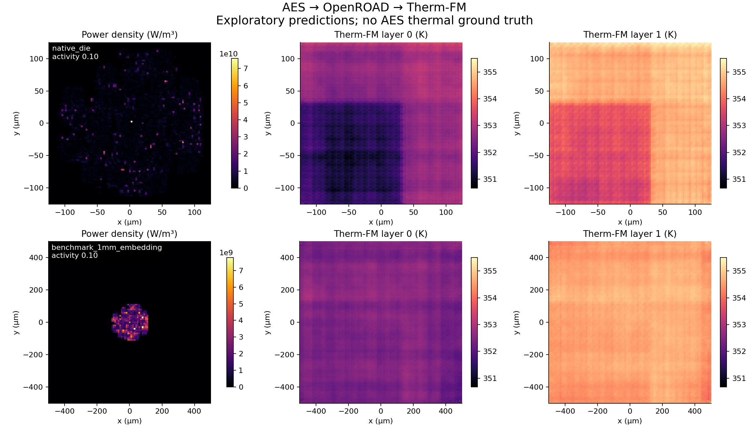
Power and predicted temperatures
Top: native die. Bottom: 1 mm domain. Columns: power and two predicted temperatures. Unvalidated.
13
Notes:
Source evidence (paths relative to /Users/ayush/Arch_Gen/aes_thermfm):
outputs/aes_inference/aes_temperature_maps.png; outputs/aes_inference/case_summary.csv

Slide 14
Why the experiment has two slots
The selected checkpoint requires two slots. Our OpenROAD AES layout has one die.
Input slot | Power field | Origin
Slot 0 | Estimated AES power density | OpenSTA power + OpenROAD geometry
Slot 1 | All zeros | Synthetic placeholder created by Python
Zero heat generation does not remove a physical layer.
This input fits the checkpoint’s shape but does not establish a matching thermal stack. The model retains its learned package behaviour.
14
Notes:
Source evidence (paths relative to /Users/ayush/Arch_Gen/aes_thermfm):
scripts/build_inputs.py; docs/THERMAL_ASSUMPTIONS.md; vendor/checkpoint_IND8C_GWL2_T/config.json

Slide 15
The second slot affects the AES prediction
Controlled test: keep every AES input fixed, change only power in the second slot.
Second-slot power | Mean AES temperature change | Largest absolute local change
0 mW | Baseline | Baseline
8.93 mW | +0.0051 K | 0.0716 K
17.86 mW | +0.0102 K | 0.1429 K
35.71 mW | +0.0206 K | 0.2752 K
Native-domain results demonstrate model dependence. They do not measure adding/removing a physical layer or validate the learned heat transfer.
15
Notes:
Source evidence (paths relative to /Users/ayush/Arch_Gen/aes_thermfm):
outputs/layer_coupling_20260930/coupling_report.json; docs/LAYER_COUPLING_TEST.md

Slide 16
Constraint status across the pipeline
Verified file compatibility and unresolved physical assumptions must stay separate.
Requirement | Status | Evidence / remaining work
SDC coverage and floorplan | Verified from saved files | Clock, port delays, DEF dimensions
Timing target | Not met | 19 setup violations at 0.82 ns
Power-to-grid conservation | Verified | Original integral error ≤ 3.47e−18 W
Tensor / checkpoint compatibility | Verified | Shapes, hashes, normalization, exact replay
Activity and thermal setup | Assumed / unmatched | Workload trace, materials and cooling needed
AES temperature accuracy | Not established | No matching solver reference temperatures
16
Notes:
Source evidence (paths relative to /Users/ayush/Arch_Gen/aes_thermfm):
docs/THERMAL_ASSUMPTIONS.md; outputs/verification.json; docs/SCALING_AUDIT.md; flow/logs/nangate45/aes/base/6_report.json

Slide 17
A new design needs a matching thermal setup
The paper captures each benchmark’s fixed structure through model adaptation.
01
Supply the new RTL, timing constraints, floorplan and technology.
02
Generate layout and workload-based power, then verify units and power conservation.
03
Define the die/package stack, interfaces, cooling and temperature output planes.
04
Generate solver references and adapt the model’s channels and weights as needed.
A single-die AES model could use 4 input fields and 1 temperature output plane. It needs compatible projections, normalization and fine-tuning.
17
Notes:
Source evidence (paths relative to /Users/ayush/Arch_Gen/aes_thermfm):
docs/SCALING_AUDIT.md; https://arxiv.org/html/2605.22663v2#S3.SS1

Slide 18
Files for review and reproduction
All paths below are relative to /Users/ayush/Arch_Gen/aes_thermfm.
Folder / file | What to review
inputs/rtl/ + inputs/orfs_config/ | Starting circuit and physical/timing configuration
flow/results/nangate45/aes/base/ | Final layout, netlist, SDC and SPEF
outputs/cells_*.csv + scripts/build_inputs.py | Power extraction and grid conversion
inputs/thermfm/ + vendor/checkpoint_IND8C_GWL2_T/ | Model inputs, case descriptions and saved checkpoint
outputs/aes_inference/ | Numerical predictions, figures and run report
docs/SCALING_AUDIT.md | Bottlenecks and ordered validation experiments
18
Notes:
Source evidence (paths relative to /Users/ayush/Arch_Gen/aes_thermfm):
README.md; scripts/run_pipeline.sh; docs/SCALING_AUDIT.md; docs/LAYER_COUPLING_TEST.md

