Slide 1
HR Scout
AI-Powered Candidate Shortlisting Agent
Automated JD Parsing • Resume Ingestion • Semantic Scoring • Human-in-the-Loop
Built by Ayush Aryan
2026

Slide 2
The Problem
Manual resume screening is broken
250+
resumes per job posting on average
23 hrs
average recruiter time per hire on screening alone
37%
of qualified candidates rejected due to keyword-only ATS
High bias
inconsistent scoring across HR reviewers
No audit
manual processes leave no traceable decision trail

Slide 3
The Solution
HR Scout — end-to-end AI shortlisting pipeline
JD Parser
Resume Ingestion
Semantic Scoring
Extract structured requirements from any job description
PDF, DOCX, and LinkedIn JSON in one drag-drop
5-dimension weighted rubric with embeddings
Shortlist Reports
Human Override
JSON, HTML, and PDF — ready for sharing
Audit-trailed corrections with full justification log

Slide 4
System Architecture
Custom pipeline — no LangChain overhead
Input Layer
Parse Layer
Score Layer
Output Layer
PDF/DOCX/JSON LinkedIn Export JD Text
JD Parser Resume Parser LinkedIn Parser
Embeddings Rubric Engine LLM Scoring
JSON Report HTML Report PDF Report
→
→
→
FastAPI REST backend • React 18 SPA (CDN, no build step) • Pydantic validation • sentence-transformers embeddings

Slide 5
AI Workflow
LLM + semantic embeddings + heuristic fallback
1
Sanitize
2
Parse JD
3
Parse CVs
Strip prompt-injection patterns 12 regex rules
LLM → structured JDProfile Heuristic fallback
PDF/DOCX text extraction LLM → CandidateProfile
4
Embed
5
Score
6
Rank
sentence-transformers cosine similarity
5-dimension rubric Weighted 30/25/15/20/10
Sort by total score Recommendation threshold
No API key required — heuristic mode enables full demo without LLM

Slide 6
Scoring Rubric
5 dimensions — tamper-proof via Pydantic validators
Dimension
Weight
Bar
What it measures
Skills Match
30%
Semantic overlap + exact keyword match
Experience Relevance
25%
Years, seniority, domain alignment
Education & Certs
15%
Degree level, relevant certifications
Project Portfolio
20%
Relevant projects, GitHub, impact
Communication Quality
10%
Writing clarity, formatting, structure
Pydantic model_validator recomputes weighted_contribution after every LLM response — scores cannot be inflated

Slide 7
Security Mitigations
Defense-in-depth for production use
1
Prompt Injection Defense
12 regex patterns block 'ignore previous instructions', jailbreaks, system tags
2
PII Masking
Email, phone, SSN, passport masked in all audit logs before persistence
3
API Key Auth
X-API-Key header; .env-only storage; never hardcoded in source
4
Input Validation
Pydantic strict types on every model field; scores clamped to 0–10
5
Audit Trail
Append-only JSONL log; all overrides signed with HR user + timestamp

Slide 8
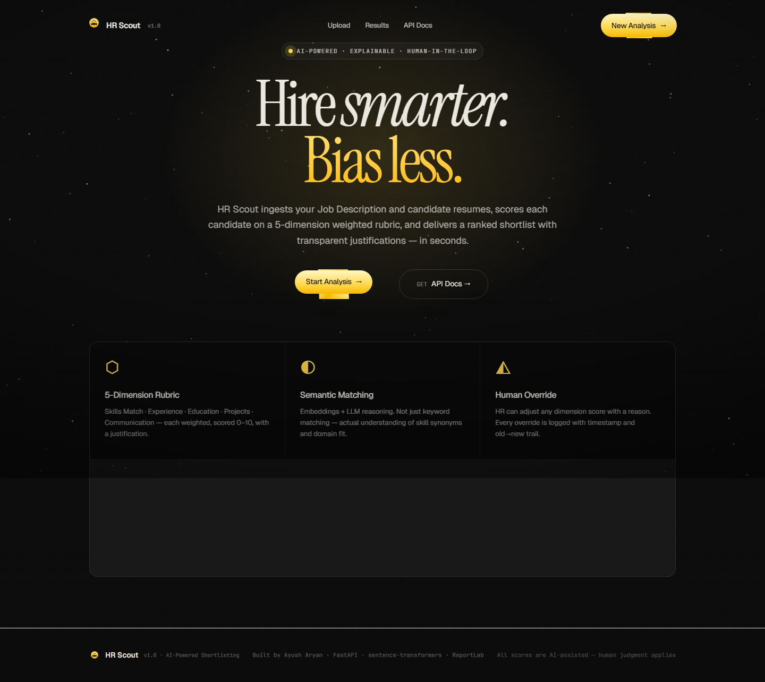
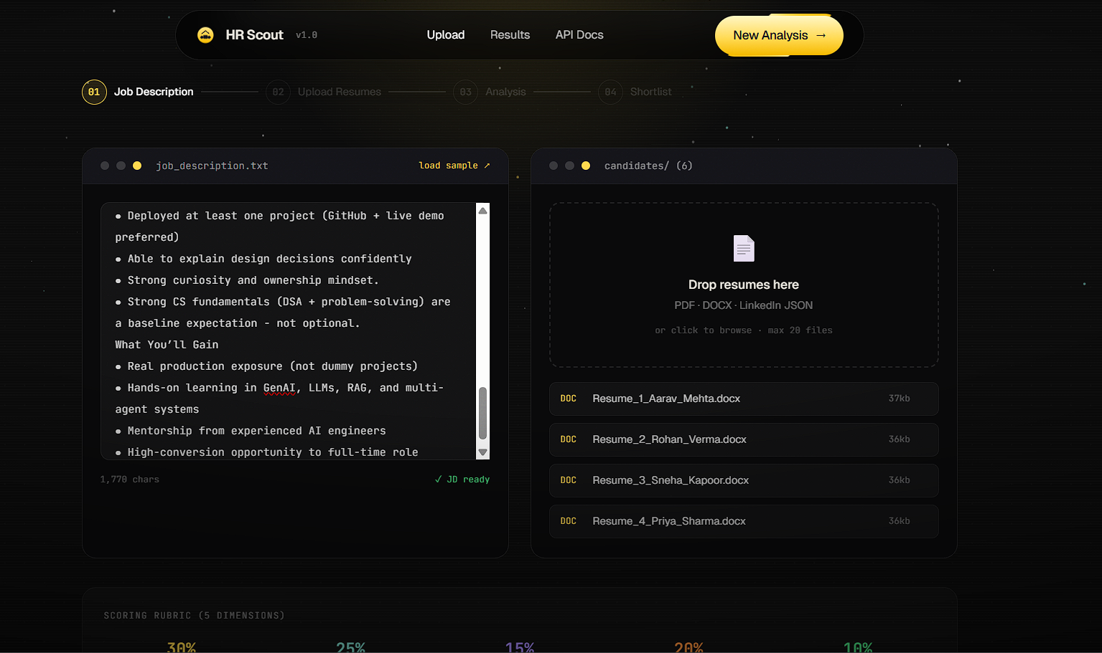
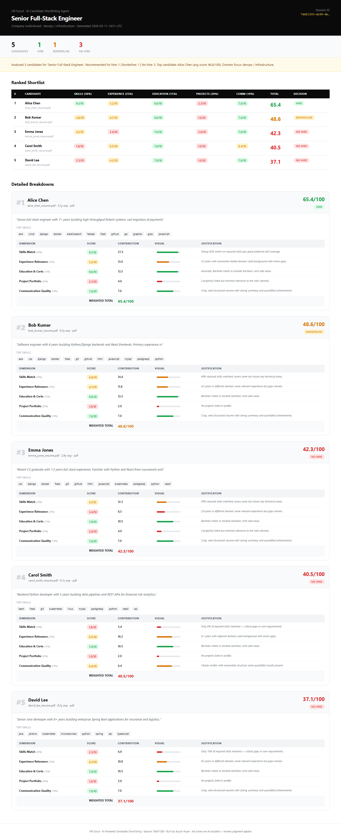
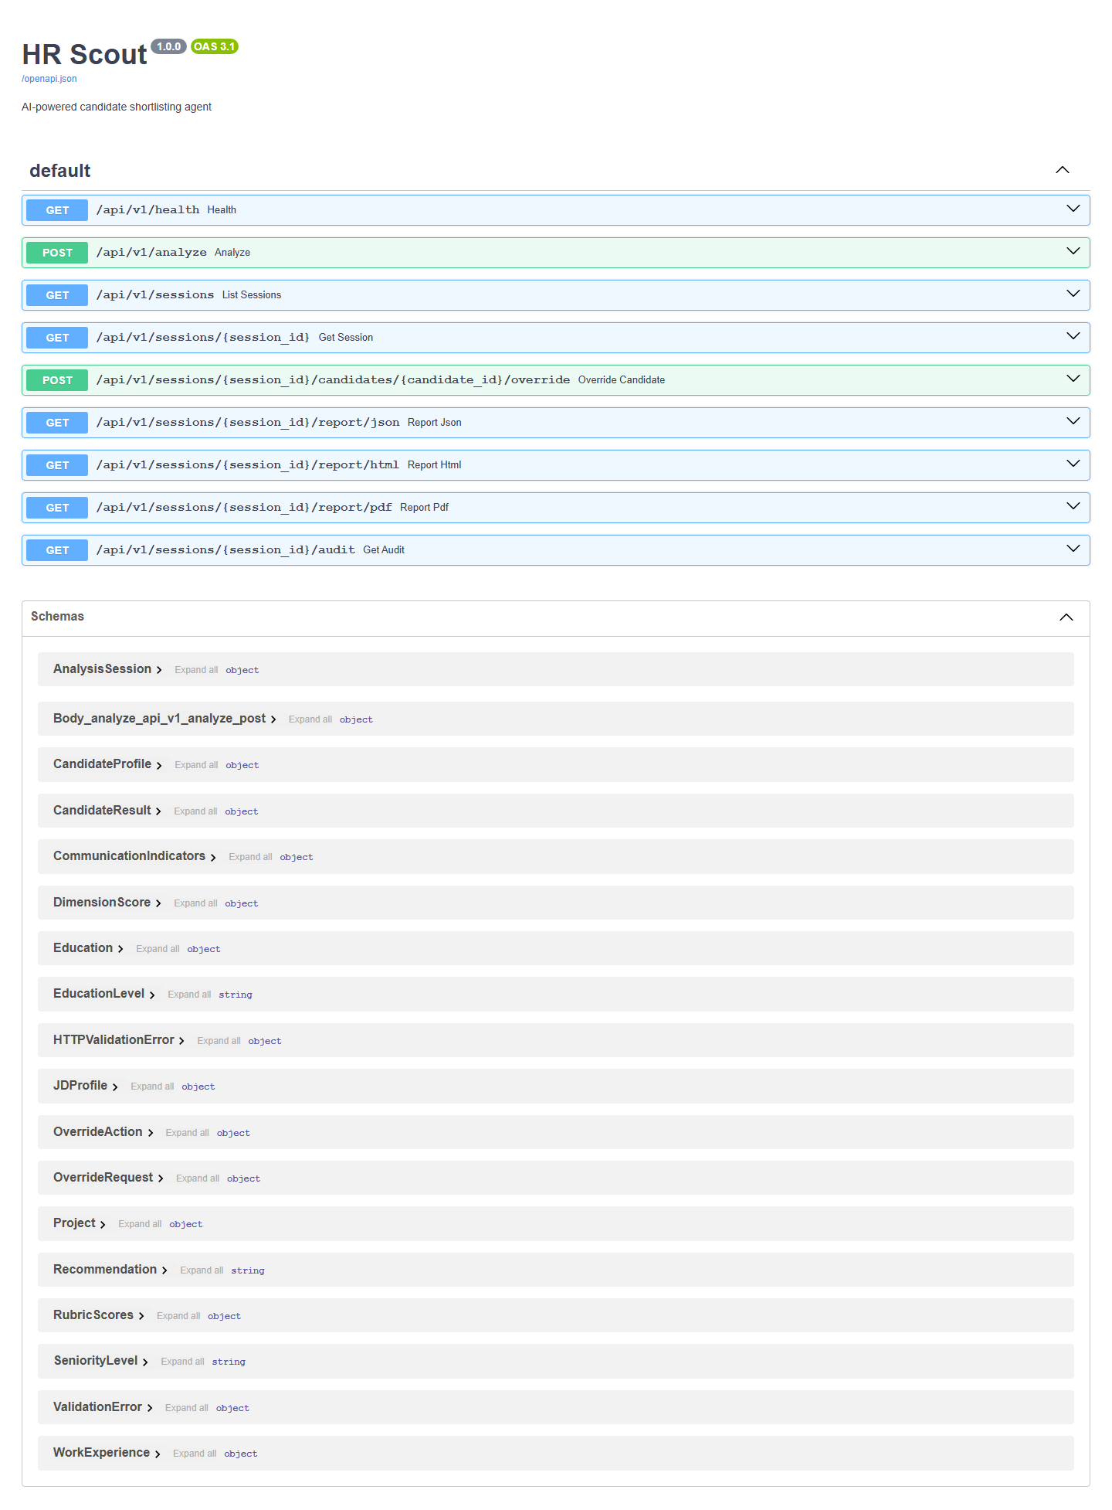
Demo Screenshots
Live app — React SPA + FastAPI
Dashboard / Landing
Upload & JD Entry
Ranking Table
API Documentation

Slide 9
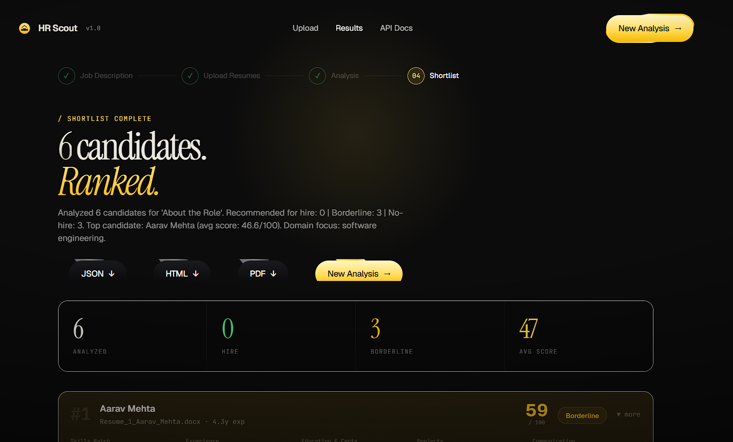
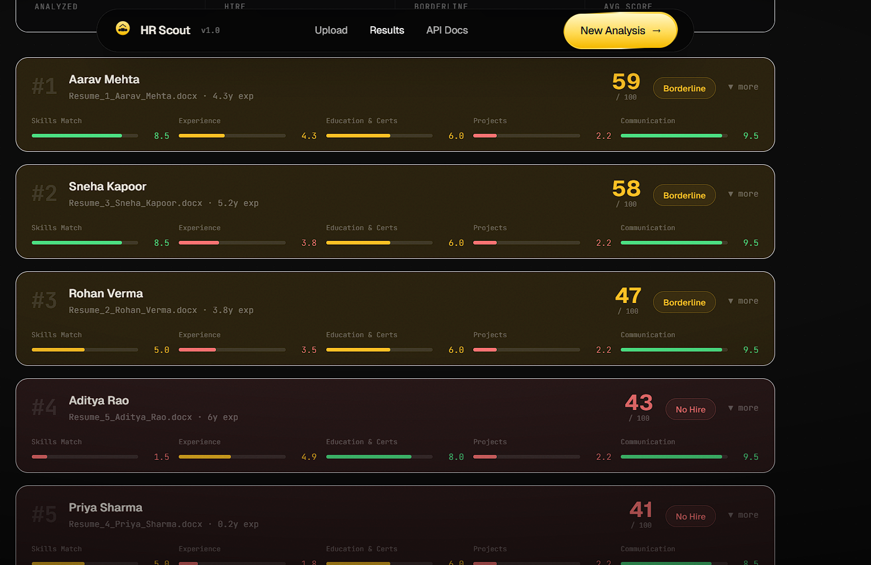
Sample Results
5 candidates scored against AIML Engineer JD
#
Candidate
Total Score
Decision
1
Alice Chen
82.8 / 100
HIRE
2
Carol Smith
71.5 / 100
HIRE
3
Bob Kumar
65.2 / 100
HIRE
4
David Lee
51.7 / 100
BORDERLINE
5
Emma Jones
32.4 / 100
NO HIRE

Slide 10
Future Improvements
Roadmap for production deployment
LinkedIn Scraper Integration
Vector DB (Pinecone / Weaviate)
Directly pull profiles via LinkedIn API or scraper
Store all candidate embeddings for cross-role search
Bias Audit Module
Calendar Integration
Flag demographic proxies; ensure EEOC compliance
Auto-schedule interviews for HIRE-tier candidates
Multi-Tenant SaaS
Candidate Portal
Per-org scoring weights; SSO; usage metering
Self-service profile updates + status tracker

Slide 11
HR Scout
Faster hiring. Fairer scoring. Full audit trail.
FastAPI • React 18 • Claude Sonnet • sentence-transformers • ReportLab • Playwright
github.com/ayusharyan/hr-scout
Built by Ayush Aryan — 2026

