Slide 1
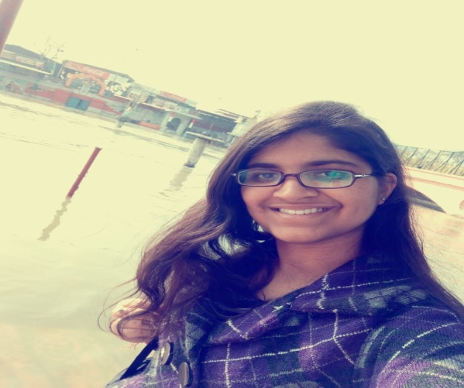
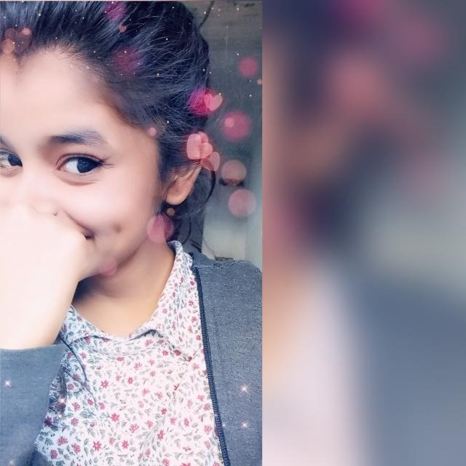
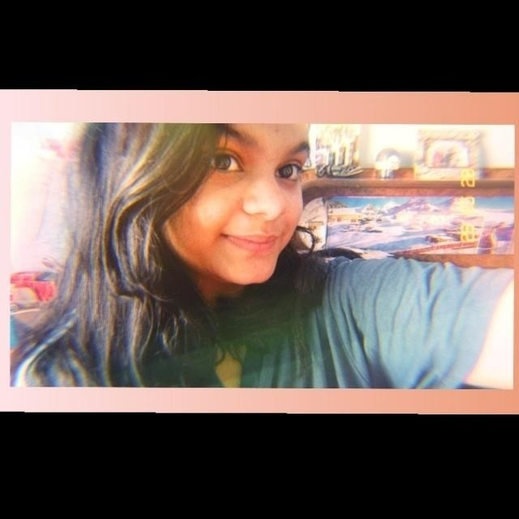
TECH_CURIE
AYUSHI TYAGI
HARSHITA SAXENA
VANSHIKA NAMDEV

Slide 2
COVID-19 patients are depressed ,feared and experiencing loneliness. They are facing challenge in coping up with their situation…..

Slide 3
So We come up with the solution:
WE_NET
i.e. We connect

Slide 4
This website is meant to connect worldwide Covid-19 patients
With their loved ones through video calls
WHAT IS THE PRODUCT VISION?
Our goal is to ensure that billion people can get connected to their loved ones who are suffering from COVID-19.We will provide the latest updates of the patients and their stories how they are recovering …the list of the patients of each country with their valid information including their names, place, address so that their relatives can and we can communicate with them.
You can pay tribute to corona warriors and patients by delivering your messages and songs to them...

Slide 5

WHY ARE WE BUILDING THIS PRODUCT?
We all know this is a very difficult time for everyone but especially for those who are suffering from covid-19. Corona patients get isolated and they have to stay away from their family and friends which gives them a hard time by making them feel alone.
So, to support and motivate the corona patients from all across the world we thought of this idea to make a platform for covid-19 patients where they can communicate, share and can get hope to fight.

Slide 6

SEE THIS VIDEO:

Slide 7

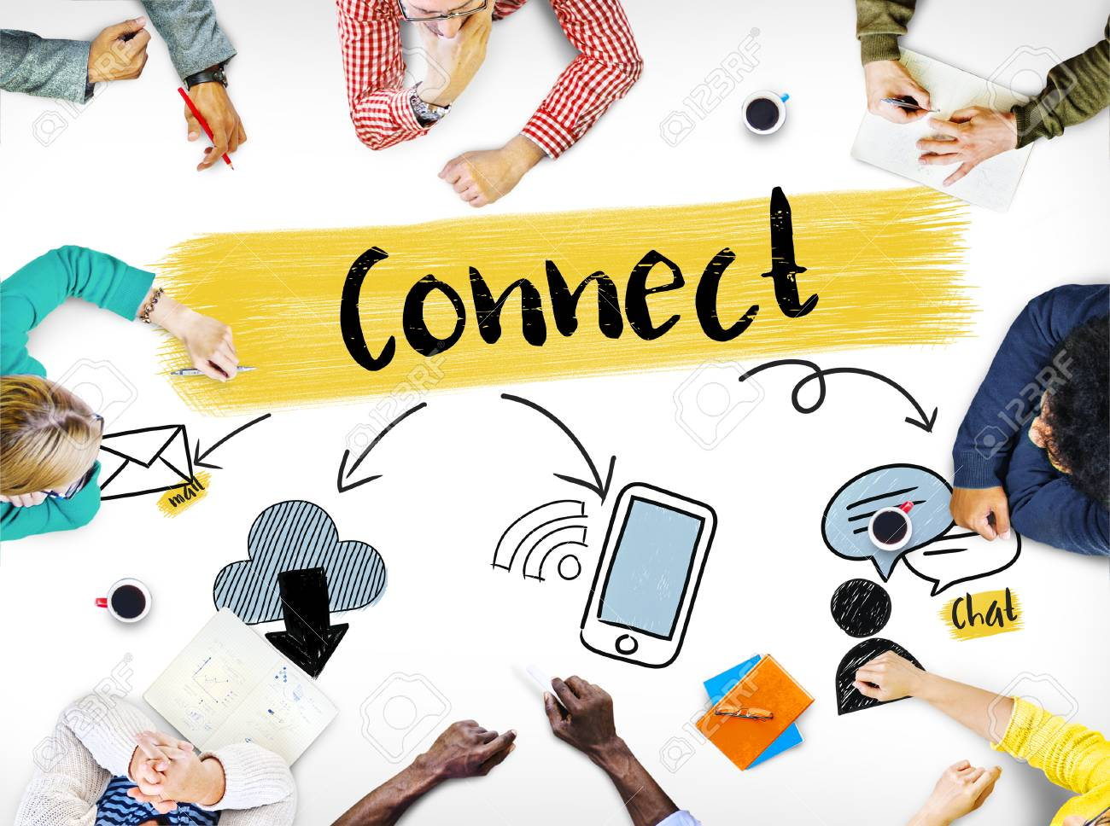
HOW IS IT UNIQUE FROM OTHER PRODUCTS?
There is no platform for corona patients yet to connect from all across the world.
Those persons who wanna help the corona patients can reach them through this platform and can send their message.
Stories of recovered patients will be available on platform which will motivate the patients.

Slide 8

HOW ARE WE PLANNING TO BUILD THE PLATFORM?
We are making a website which we named WE NET and we are working on it.
First we are making the front end and then we will work on back end of our website and will include the cheering features in it.
We are doing as best as we can to contribute something to our society in this difficult time.
We hope we can motivate and support the covid-19 patients in this pandemic condition and ensure them that they are not alone..

Slide 9

PROTOTYPE OF THE PRODUCT BUILT

