Slide 1

ABES ENGINEERING COLLEGE GHAZIABAD
DEPARTMENT OF COMPUTER SCIENCE
Detection of possible vulnerability to Depression before its onset
Presented By:
Ayushi Gupta
Sanidhiya Sharma
Sanjana Jain
Vartika
Supervisor Name:
Ms. Disha Mohini Pathak
HET Trainer Name:
Mr. Ashwin Perti
Ms. Sapna Jain

Slide 2
INTRODUCTION
As per WHO, Depression is a leading cause of disability worldwide and is a major contributor to the overall global burden of disease, with estimated lifetime prevalence rates of 20% . Whilst the majority of individuals with depression and anxiety are treated in primary care settings, over 50% of people are not recognized or adequately treated .
With the rising spread of COVID19 and peak in the awareness of mental health, there is a vast increase in the subclinical population. The earlier the detection, the earlier can intervention stunt the symptoms.

Slide 3
OBJECTIVES
To predict the anxiety level of the user accurately.
A machine learning model to calculate anxiety and depression score by performing four internationally acclaimed anxiety predicting test.
Perform regular analysis to draw the conclusion .
Different engaging activities to help the users to interact .
Consultation available based on the score calculated.
ChatBot : online companion to share your feelings

Slide 4
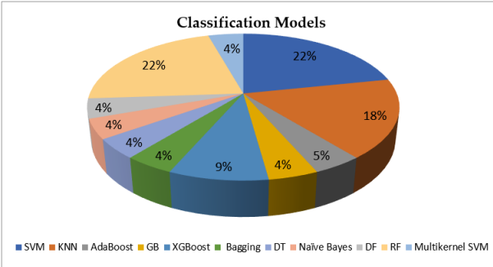
RELATED WORK
Predictive modeling of depression and anxiety using electronic health records and a novel machine learning approach with artificial intelligence.

Slide 5
GAP ANALYSIS
Through Literature survey , There are many models to predict the anxiety and depression level , But there is lack of system to check the current state of mind .
To fill the Gap , We are making a web - app portal that will calculate the anxiety scores based on Psychometric tests , Based on the scores , if they are below normal range ,There are different activities that are specially curated to boost an individual and lighten up and reduce the anxiety count.

Slide 6
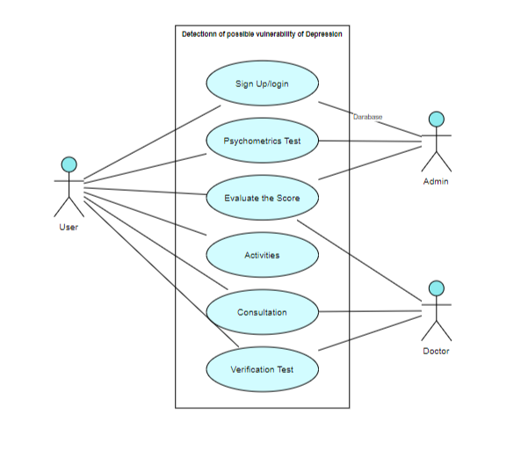
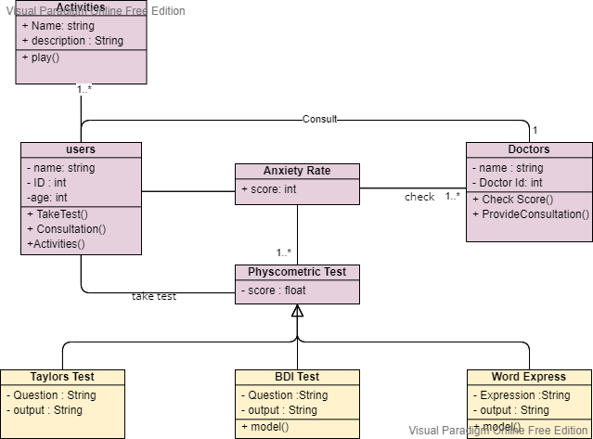
PROCESS FLOW

Slide 7
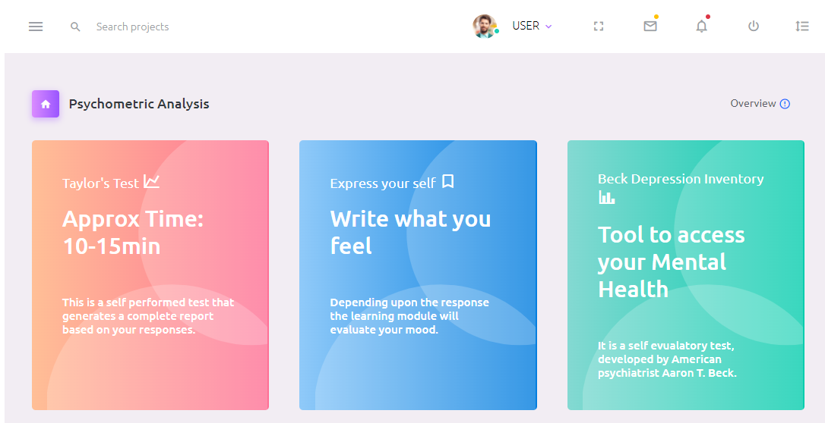
APPLICATIONS

Slide 8
THANK YOU

