Slide 1
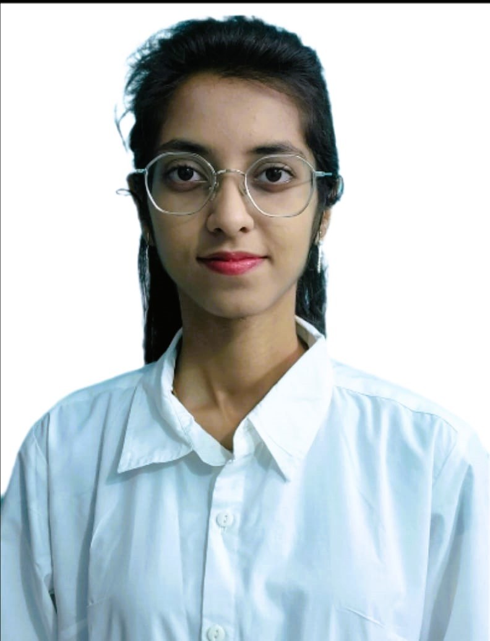

Ayushi Pradosh Das
Analyst/Software Engineer
Bachelor of Technology,
Computer Science And Systems Engineering : 2018-22
I Transform L&D Left shift batch
MUMBAI
Skills
ayushi.pradosh-das@capgemini.com
C# | Basics, OOPS, Exception Handling ,Arrays ,Collection and Generics, Delegates and Events, File Io and Serialization.
.NET Framework | ADO.NET,ASP.NET with MVC5 and WEB API, Entity Framework
C++ | Basics, OOPS, Exception Handling ,Arrays
Database | SQL
Tools | GIT,POSTMAN
UI Technology | HTML5 ,CSS & Angular
Add On Skills | Time Management Skills, Decision-making
+91 9078673204
A4
Full Stack Developer
Understanding of RDBMS concepts using SQL Server.
Practical understanding of C# and SQL concepts using Visual Studio and SQL Server
Hands on experience in developing applications using .NET Framework, ASP .NET Core
Understanding of HTML5 , CSS and Angular CLI.
Understanding of C++ and C
Completed case study on Pharmacy Management System which is a Web-based System. Pharmacy Management System Project is a great system for storing data, maintaining, controlling the inventory and making drug orders, handling billing etc. in the pharmacy. This computer software is programmed to perform the various tasks required in the operation of a pharmacy. The system will improve the efficiency of the pharmacy and enable the storing of digital record such as sales report,placed orders.
Technologies used:
ANGULAR
ASP.NET CORE
Microsoft SQL Server
Video Link:click
Github Link
https://github.com/sdsameer07

