Slide 1
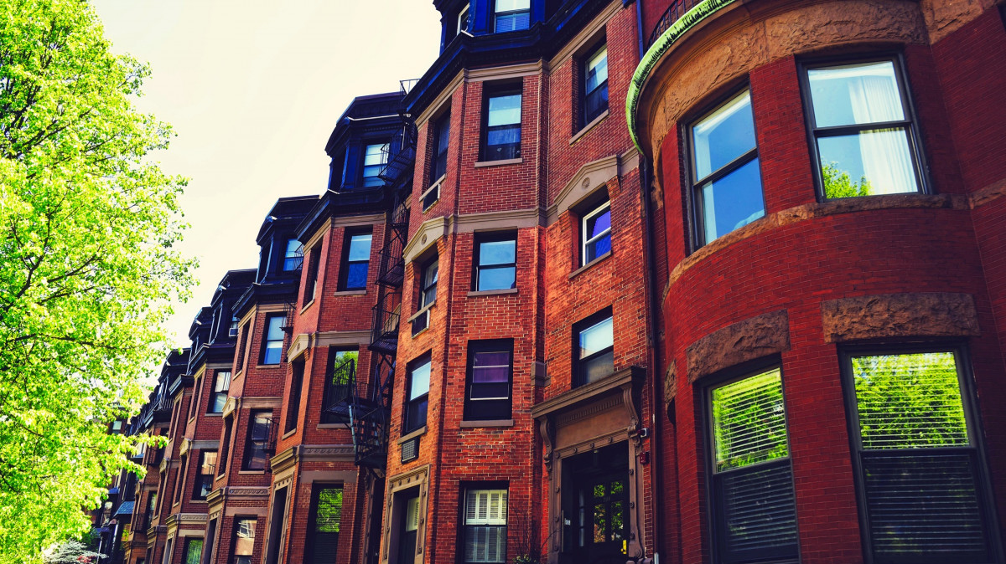
2015 Boston Housing Assessment
ALY6015 20384 Intermediate Analytics SEC 02 Winter 2023 CPS [BOS-B-HY]
Group 5: Kyla Arajuo, Ayushi Ajay Walia, Fnu Abhishek, Balram Marni
Prof. Wada Roy

Slide 2
Key Understanding:
Dataset provides information on taxable and non-taxable properties throughout the city in 2015 to provide accurate and up-to-date information on property values to assist in determining tax assessments and property valuations and real-estate research
Goal:
Explore and analyzing the data to gain insights into the factor(s) that influence property values in Boston

Slide 3


Key Notes
External Social Impacts such as the personalization movement and 2008 housing recession impacted land value, total cost within the municipal cities throughout the year
While variables may impact AVG Total Cost, the strongest relationship comes from Gross Tax and ATC as expected

Slide 4
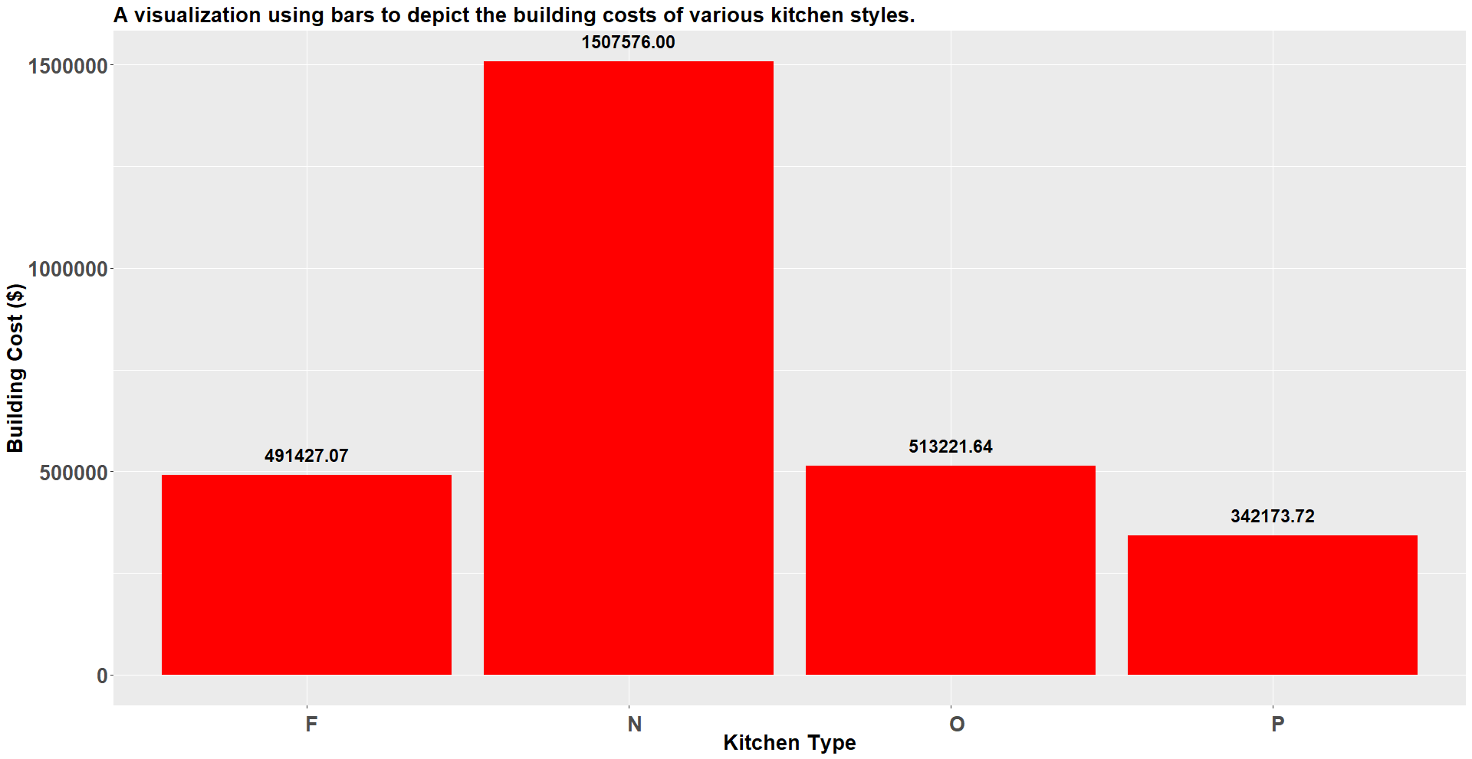
Approximately $1.51 million in None category has highest average building costs, whereas in Pull category it has the lowest average building cost $342k
A visualization using bars to depict the building costs of various kitchen styles
F: Full eat-in
O: One person
N: None
P: Pull/Clove

Slide 5
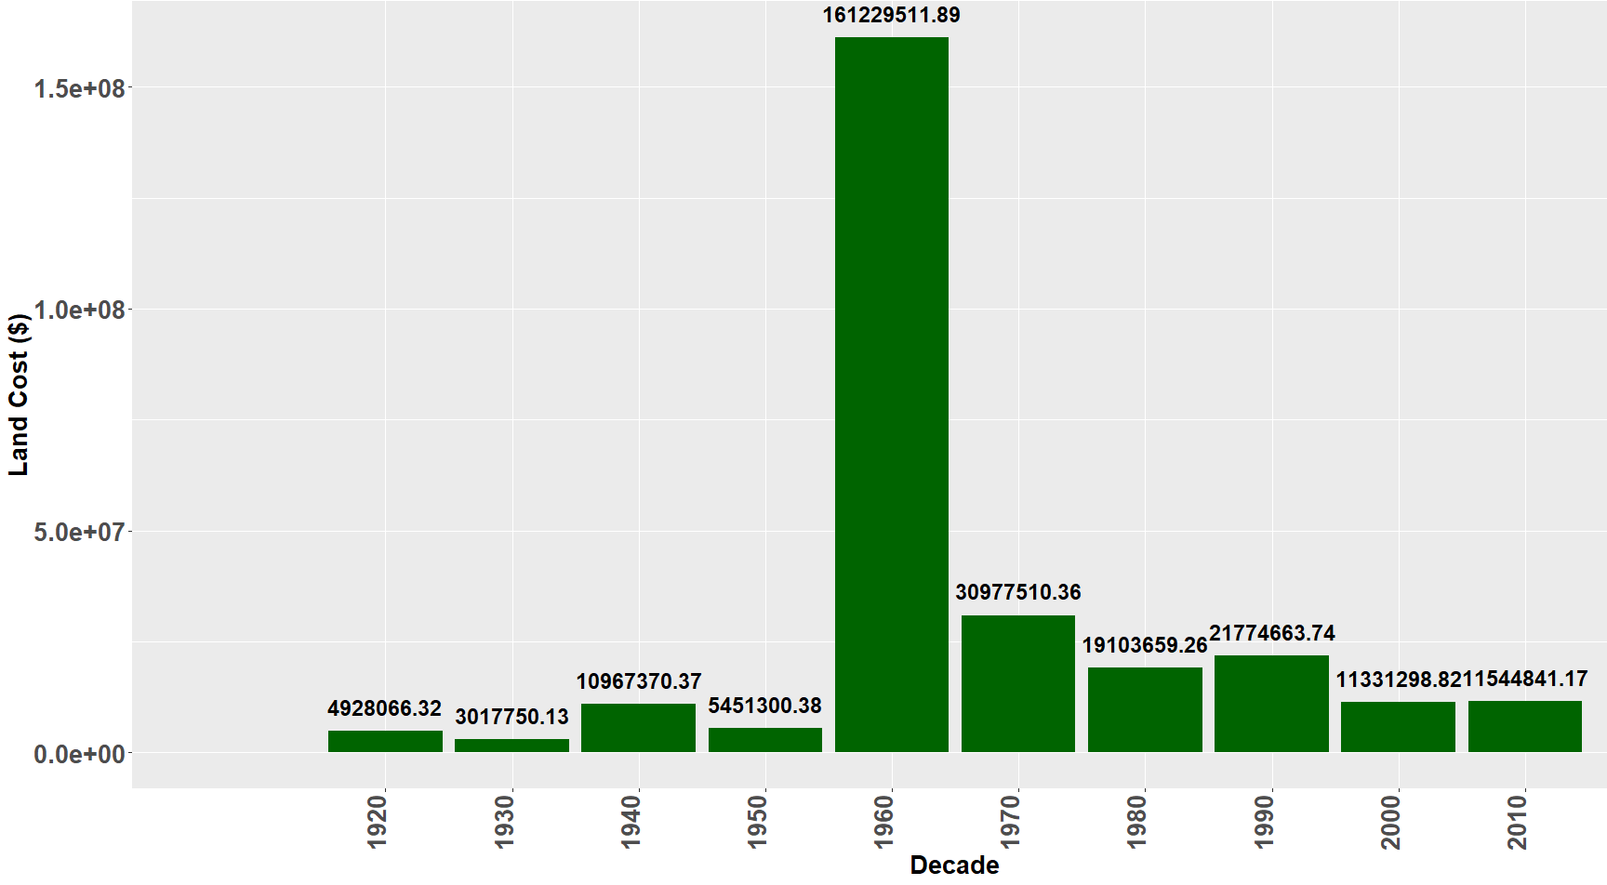
1960s grasped the highest land cost of $161M for the city because of the booming "Personalization Movement"
A visualization using bars to depict the building expenses across several decades

Slide 6
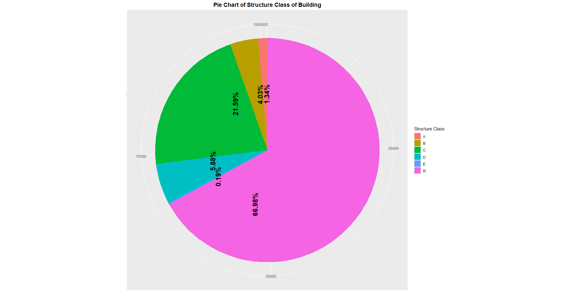
Residential Properties contribute more than half of Buildings, with brick historical buildings being the second highest
A: Struct Steel
B: Reinforced Concrete
C: Brick/Concrete
D: Wood/Frame
E: Metal
R: Residential

Slide 7
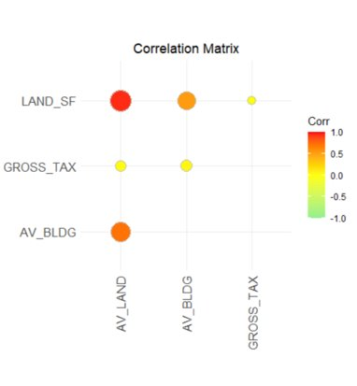
Highest value for Land cost and Land Surface Area has highest value of 0.8087 in comparison to gross tax and Land Surface Area has the lowest value of 0.0021

Slide 8
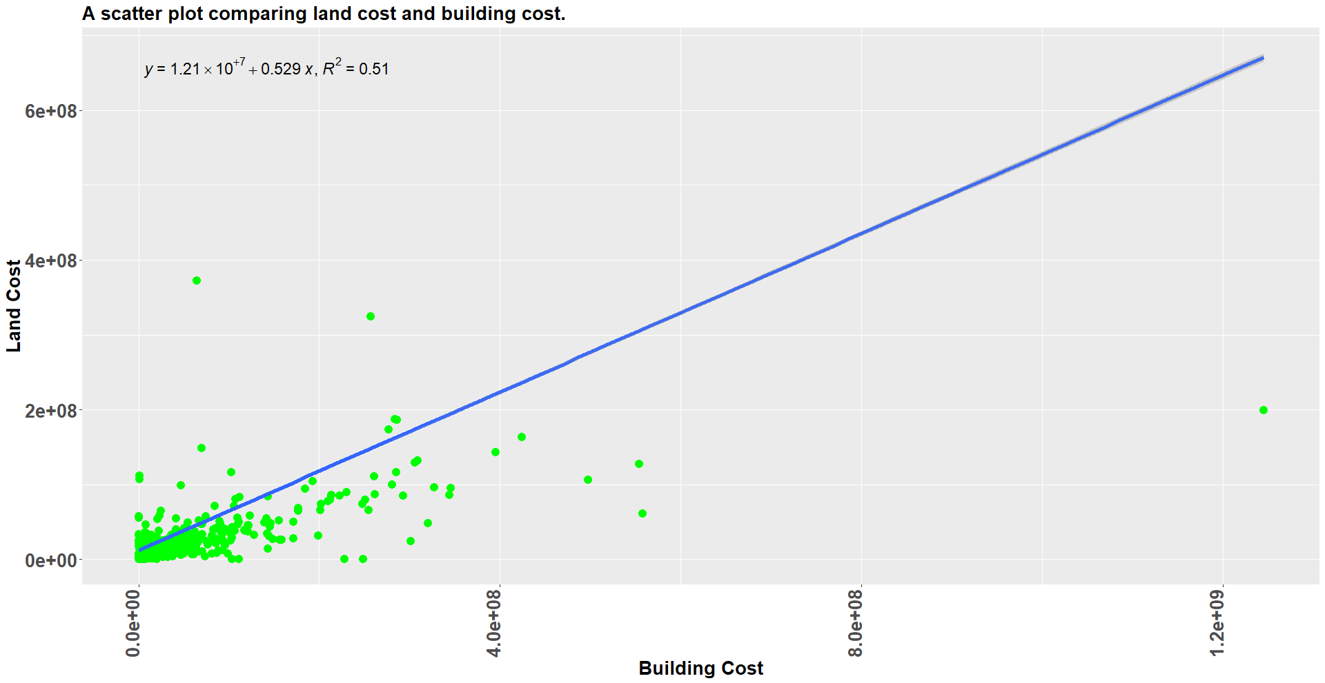
Scatter plot land cost and building cost. As slope of linear equation is almost zero, so we can conclude that linear relationship between these variables still does not have optimal solution.​
A scatter plot comparing land cost and building cost

Slide 9
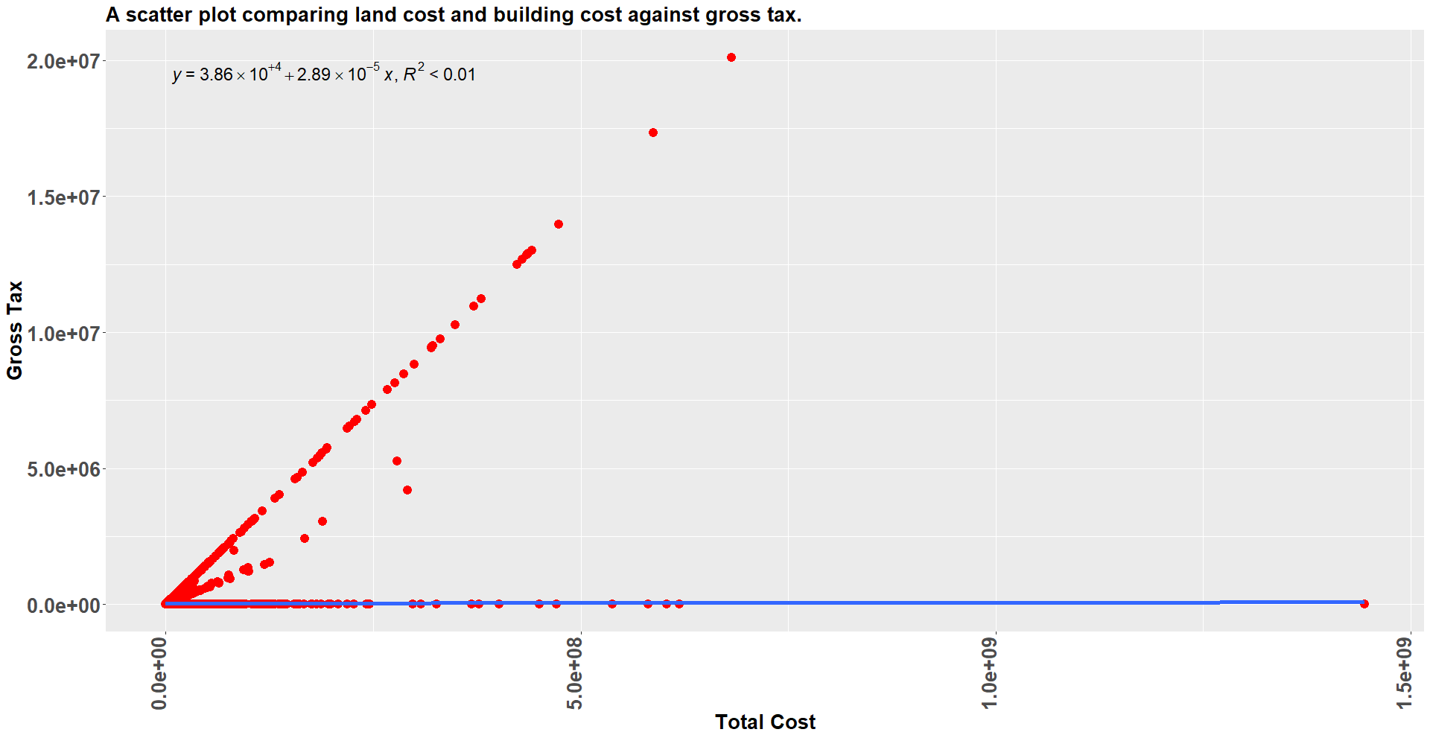
A scatter plot comparing land cost and building cost against gross tax
Scatter plot land cost and building cost against gross tax. As slope of linear equation is almost zero, so we can conclude that these variables are not linearly dependent to each other.

Slide 10
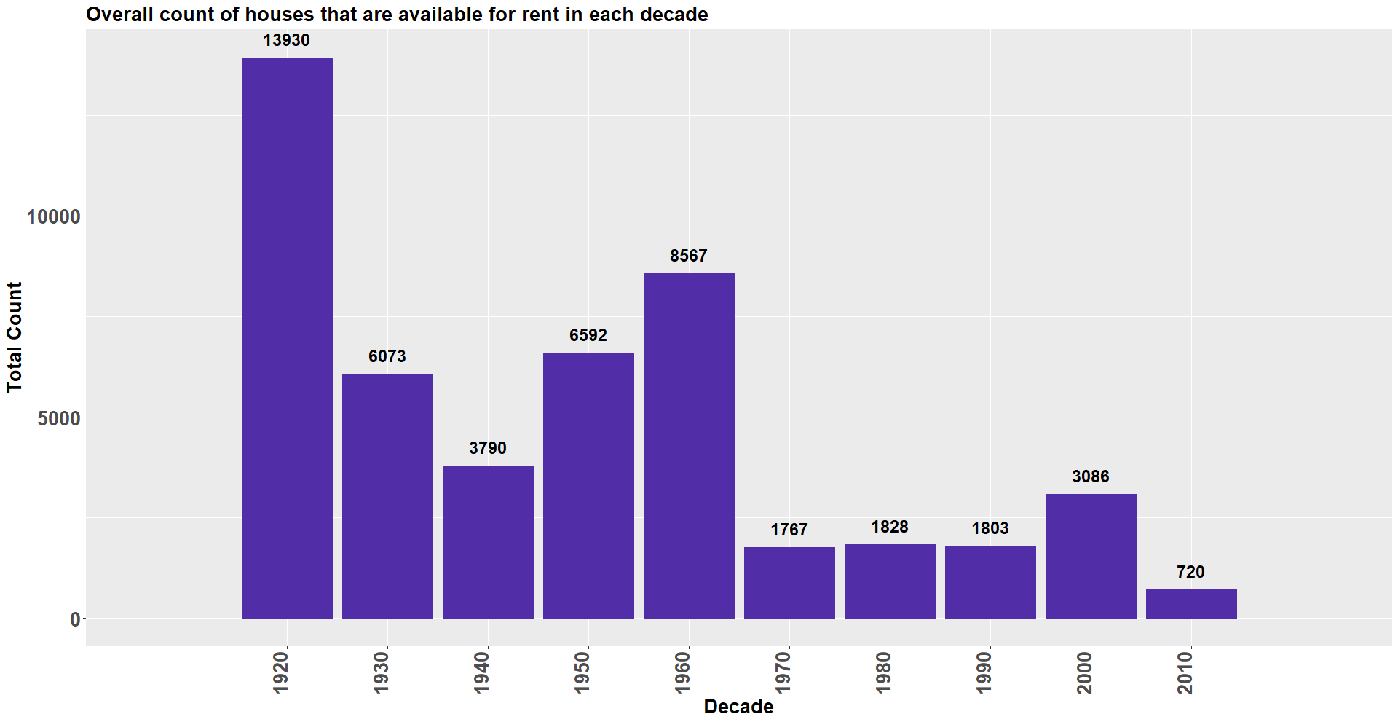
In 1920 there were 13930 houses available to people and least in 2010 there were 720.
Overall count of houses that are available for rent in each decade

Slide 11
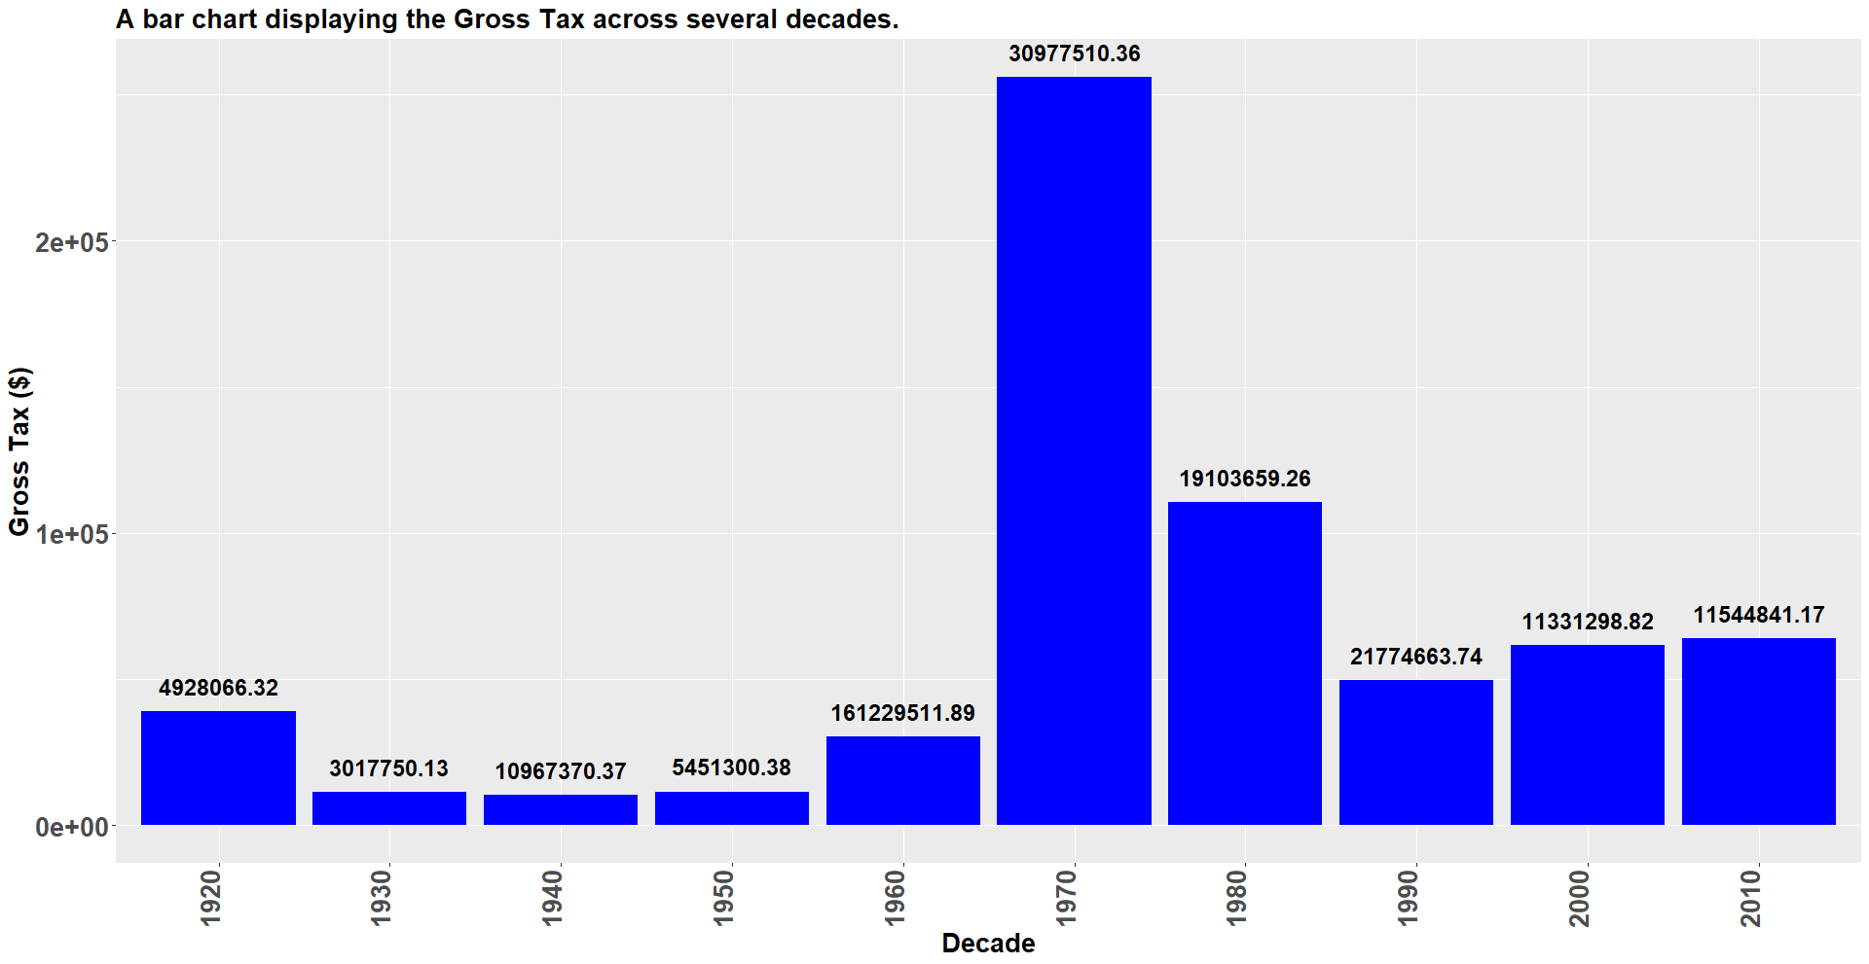
Gross Tax over the decades have shown a drastic change, where in 1970 taxes have been increased drastically to $30.9 million and then significantly it has become normal.
A bar chart displaying the Gross Tax across several decades.

Slide 12
Conclusion
In the 1940s and 1950s redevelopment and urban renewal, which included the creation of new homes and businesses in Boston.
In 1960s and 1970s there was a declining population and economic activity, property values fell and the number of unoccupied homes rose.
In 1980s and 1990s, there was a revival in real estate market due to thriving economy and a rush of new construction.
In 2008, the housing bubble burst, causing a significant drop in property values and a wave of foreclosures.
Although the market has faced difficulties such a lack of supply and rising housing prices, it continues to be one of the most sought-after and active real estate markets in the United States.

Slide 13

Thank you

