Slide 1

Communicate/Visual Data Analysis – ALY 6070 Assignment 1 – Tableau Dashboard Professor : Hema Seshadri By : Ayushi Walia and Aditi Rajmane - Group 6

Slide 2

Chicago Case files

Slide 3
Ayushi Walia
Hi Class,
I am Ayushi Walia. I am from Vadodara, Gujarat. I am glad to be a Part for the course ALY6070 202325 – Communication & visualization for Winter 2023 CPS quarter (A term) with Prof. Hema Seshadri.
I am in my 2nd quarter of Masters in Analytics with Statistical Modelling as concentration.
I have completed my Bachelors in Computer Engineering in 2021. I have done internships as Project Manager and Manual Tester in 2021. I have knowledge of Customer services and good at handling databases and UI.
I love exploring places and like thrilling stories and adventurous treks.
We can connect on Linked in : https://www.linkedin.com/in/ayushi-walia-551514117/

Slide 4
Aditi Rajmane
Hi Everyone,
My name is Aditi Rajmane. I am from Sangli, Maharashtra. However, I have stayed in Mumbai for over 5 years for my undergrad and work. I have a bachelor's degree in electronics and telecommunications from the K. J. Somaiya Institute of Engineering and Information Technology.
After completing my degree, I worked as a survey scripter for about 2.9 years before joining NEU. I have experience with the first step of data analytics, which is the collection of data through surveys. Now I want to work with data and interpret meaning from it; this is where my interest lies.
I only have database experience from previous courses, and I am eager to learn anything new that comes my way in the journey of data analytics.
You can connect to me on LinkedIn Links to an external site : https://www.linkedin.com/in/aditi-rajmane-8a5254152/

Slide 5
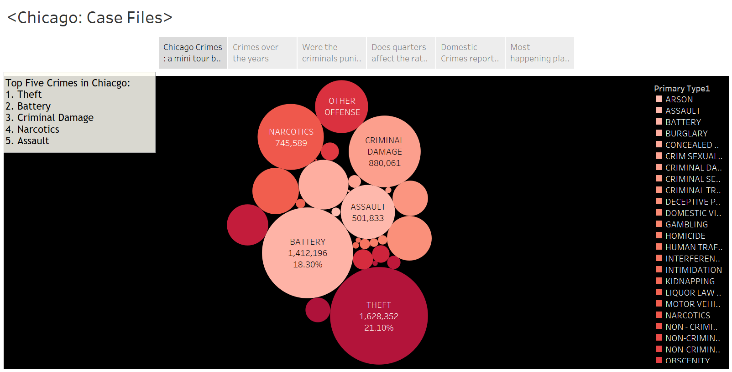
Distribution of crimes

Slide 6
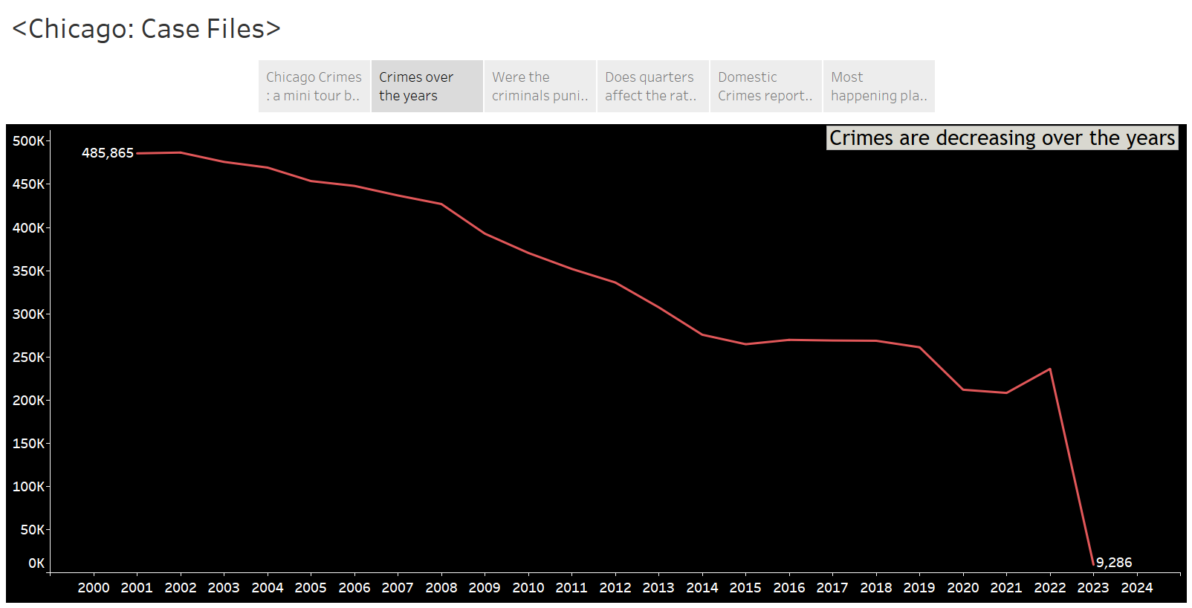
Crimes over the years

Slide 7
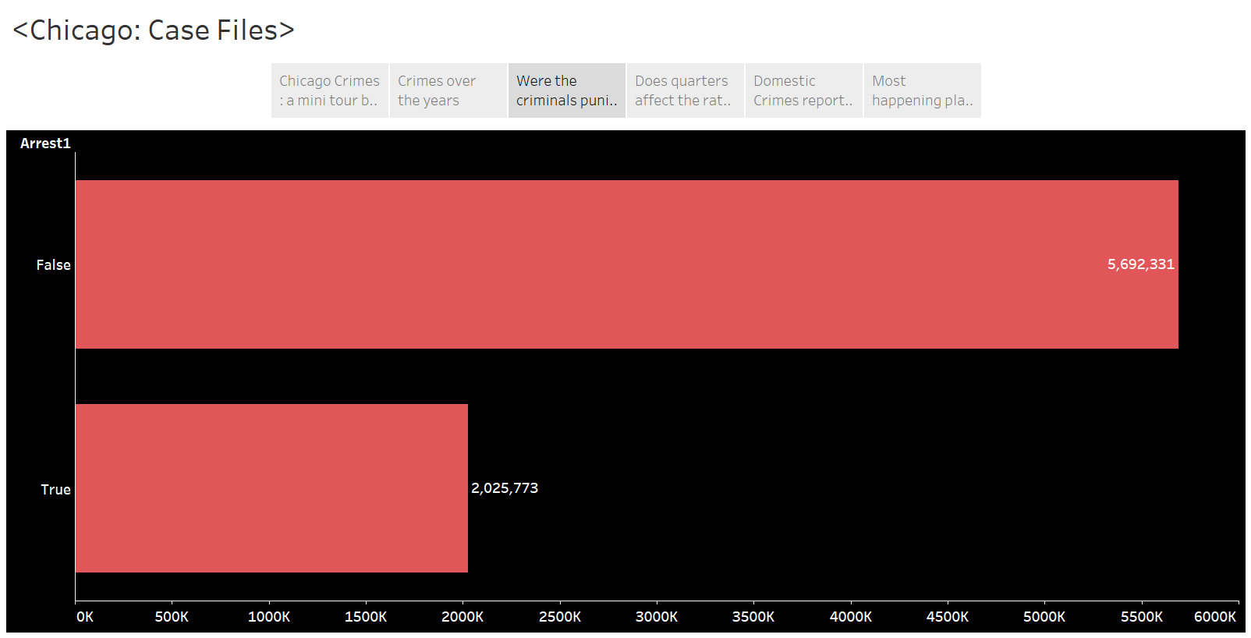
Reported incidents and arrested criminals with census data

Slide 8
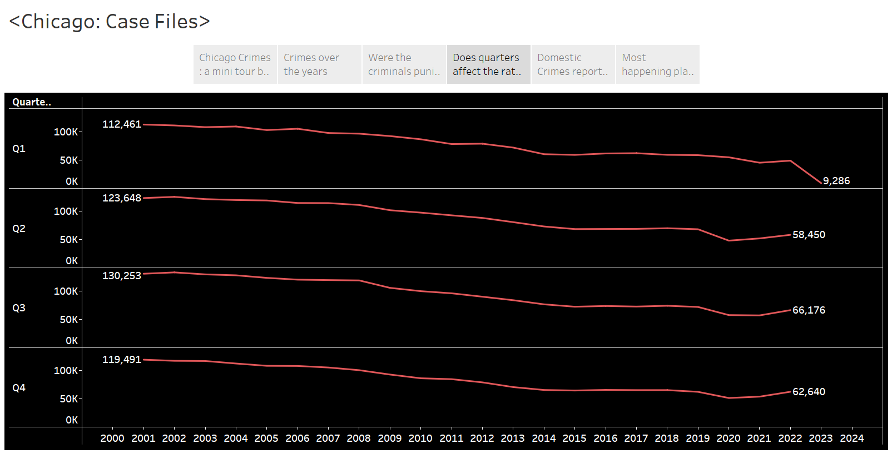
Crimes over the quarters

Slide 9
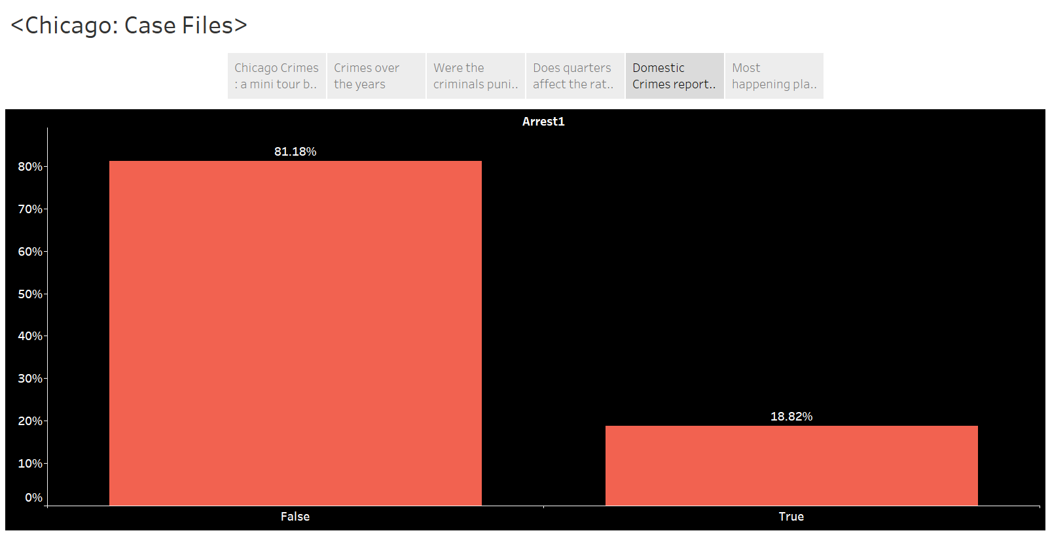
Arrest rate for domestic crimes

Slide 10
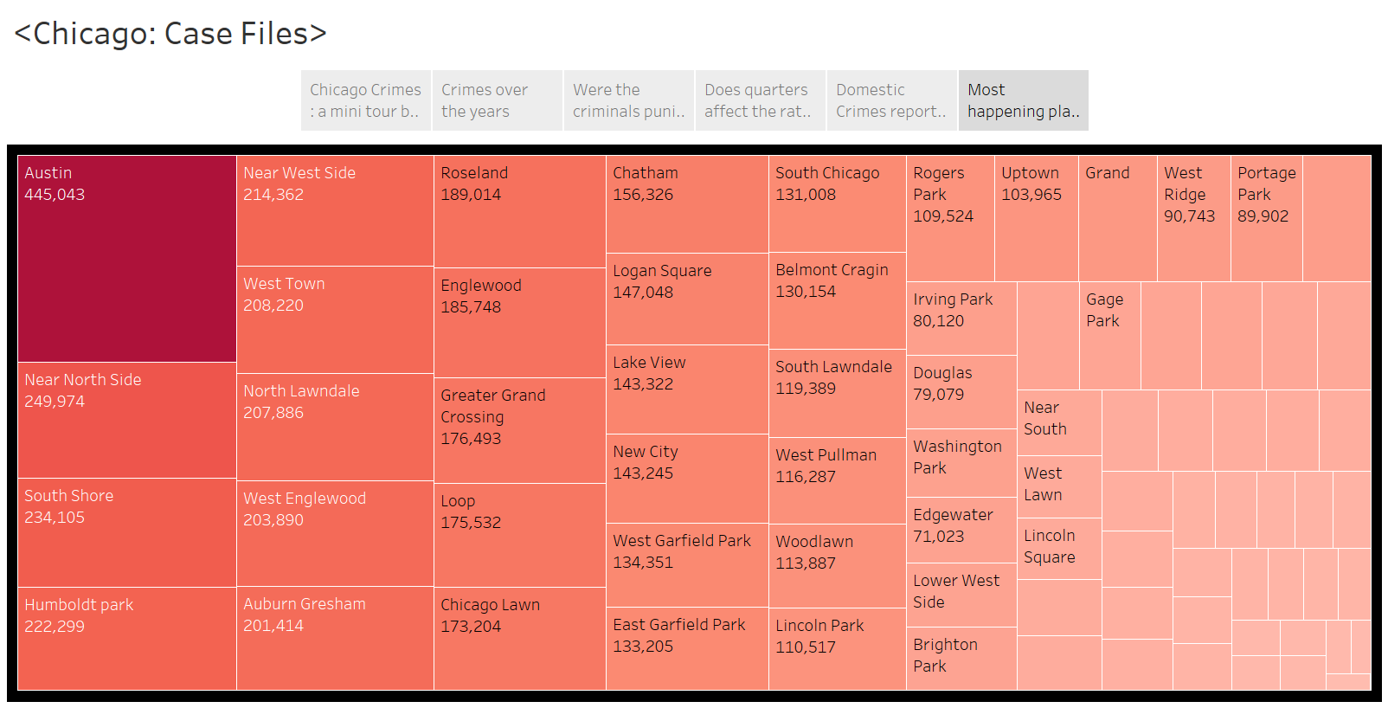
Distribution of crimes over Community area

Slide 11
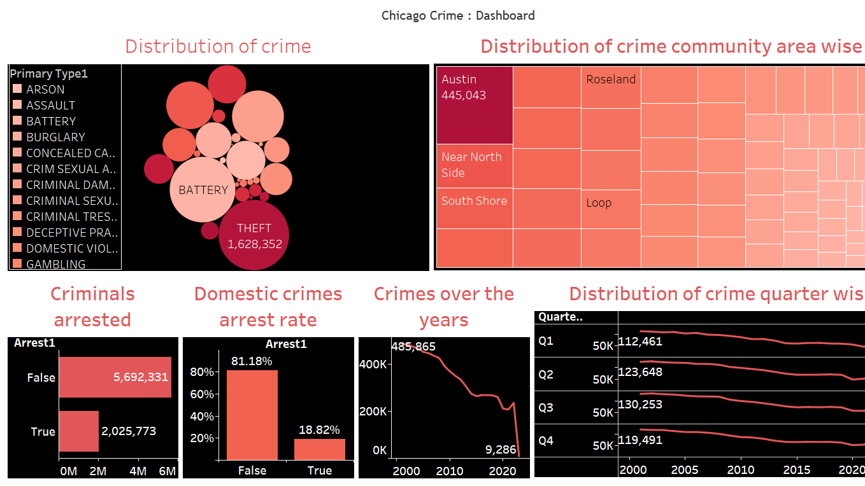

Slide 12
Summary
Crimes have been decreasing over past two decades.
Most number of crimes happened in Austin.
Most of the reported crimes were of Theft which accounted for 21.10%.
First quarter of the year showed less number of crimes than rest of the year.
Most of the criminals were not arrested in reported crimes case.

Slide 13
Thank you!
Resources:
Dataset 1: https://data.cityofchicago.org/Public-Safety/Crimes-2001-to-Present/ijzp-q8t2
Dataset 2: https://www.chicago.gov/dam/city/depts/zlup/Zoning_Main_Page/Publications/Census_2010_Community_Area_Profiles/Census_2010_and_2000_CA_Populations.pdf

