Slide 1
Communicate/Visual Data Analysis – ALY6070
Assignment 2 – Chicago Crimes Dataset
Prof. Hema Seshadri
By Ayushi Walia and Aditi Rajmane
Group 6

Slide 2
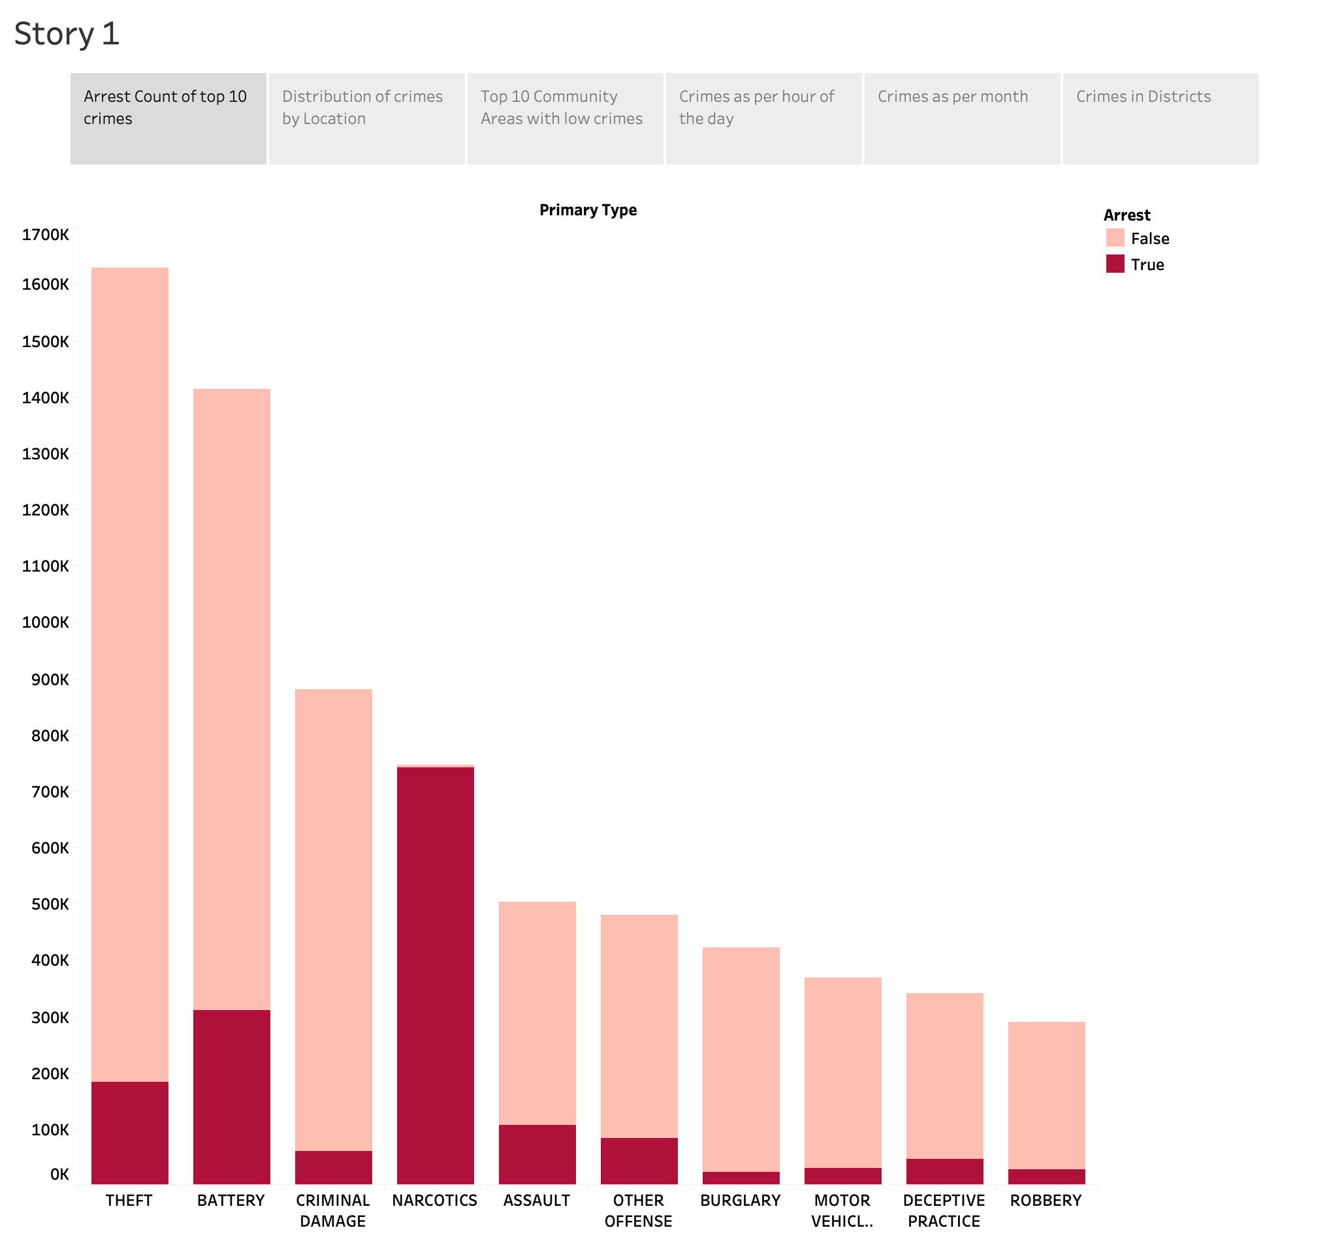
We can see here Top 10 crimes who have been arrested and not arrested .
Theft being the topmost crime.
Narcotics is the only crime where all arrests were made.
Most of the criminals are not arrested in theft cases.
Arrest Count of Top 10 Crimes

Slide 3
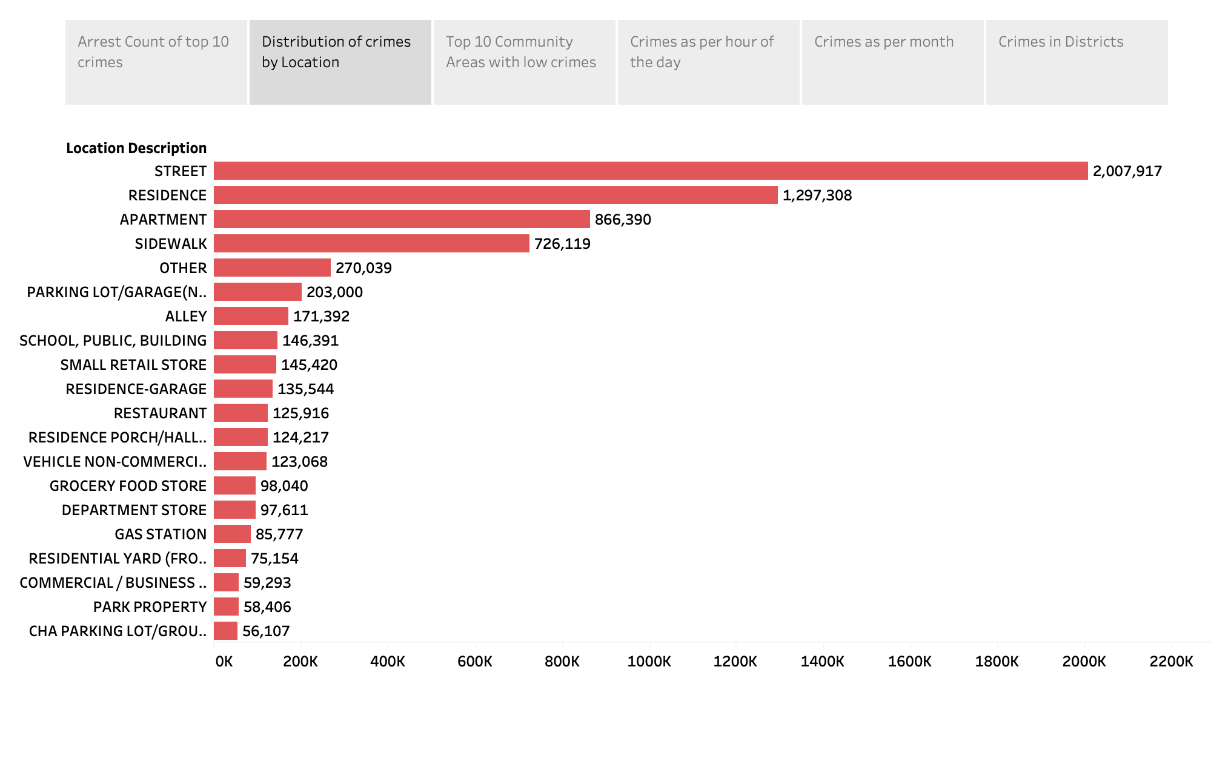
Crime can be committed anytime, anywhere or whenever you are out of luck.
Most number of crimes were committed on the streets.
The second location with high crime rates is residence areas followed by apartment.
Distribution of Crimes by Location

Slide 4
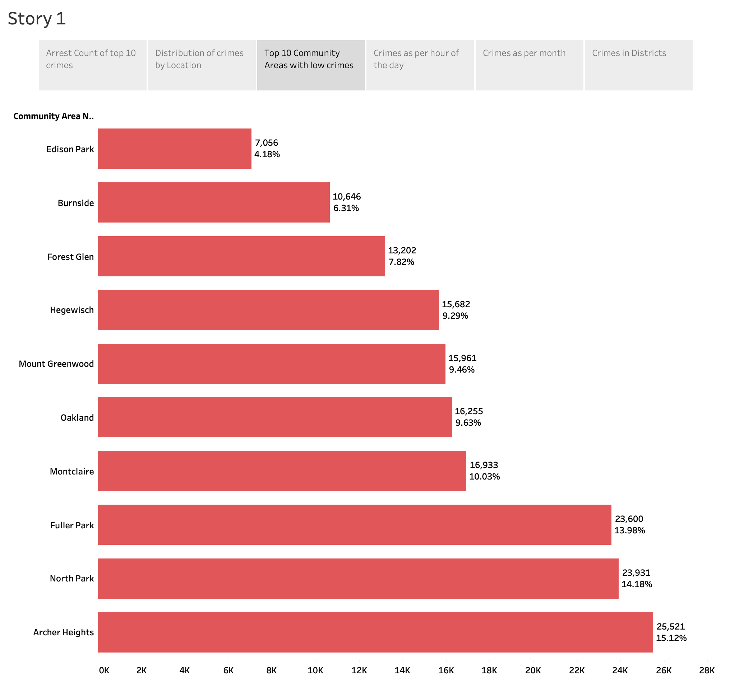
Last time we saw that Austin was the most dangerous place in Chicago.
This time we can see which place can be safer in Chicago if we plan to go on a trip or for jobs.
First place takes Austin with 18.73% crime rate.
Least number of crimes are taken place in Edison Park with just 4.18%.
Top 10 Community Area with Low Crimes

Slide 5
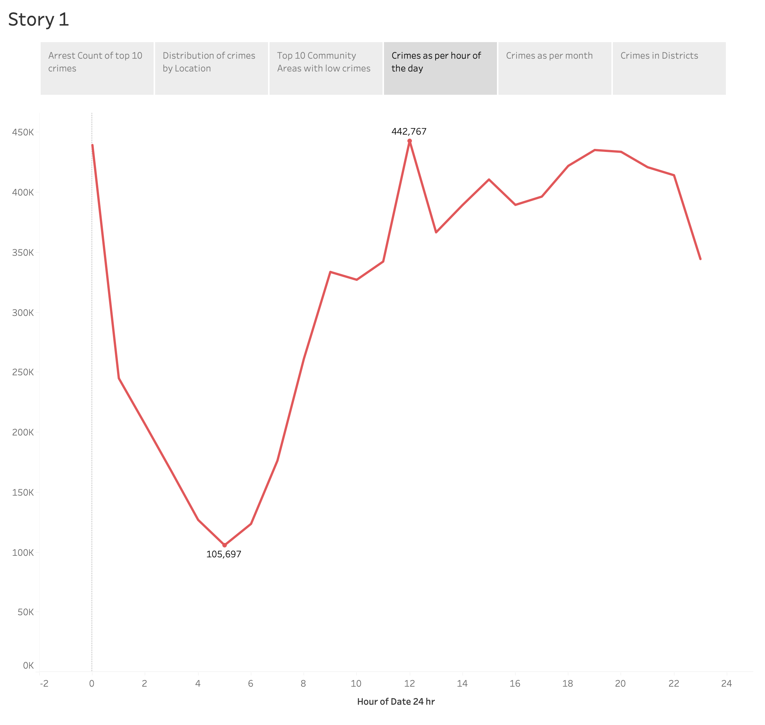
Here we will see that what hours of the day are safe, and which are not at all.
Generally, Crimes happen at night but here we are talking about Chicago crimes.
Therefore, most crimes are committed during lunch breaks that is between 12:00-14:00 PM. and least between 4:00-6:00 AM.
Crimes as per hours of the Day

Slide 6
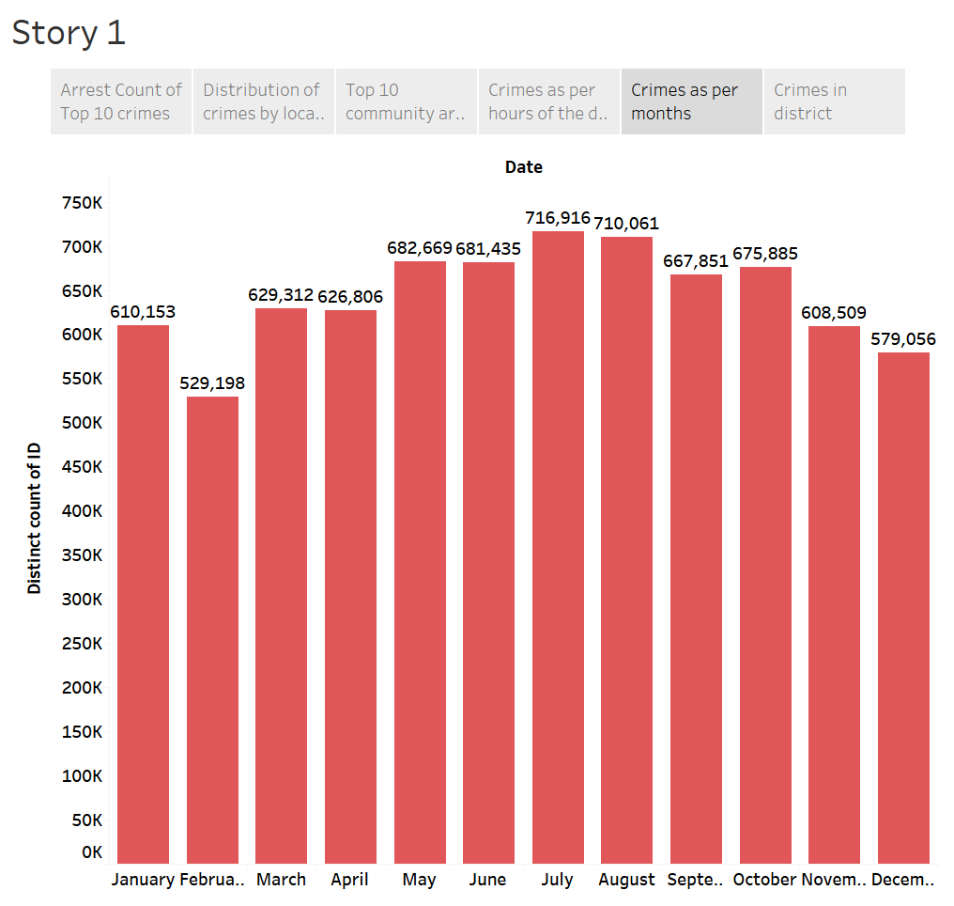
Most happening crimes happen in July, August and least during February and December.
Plan your travels or stays accordingly!
Crimes as per month

Slide 7
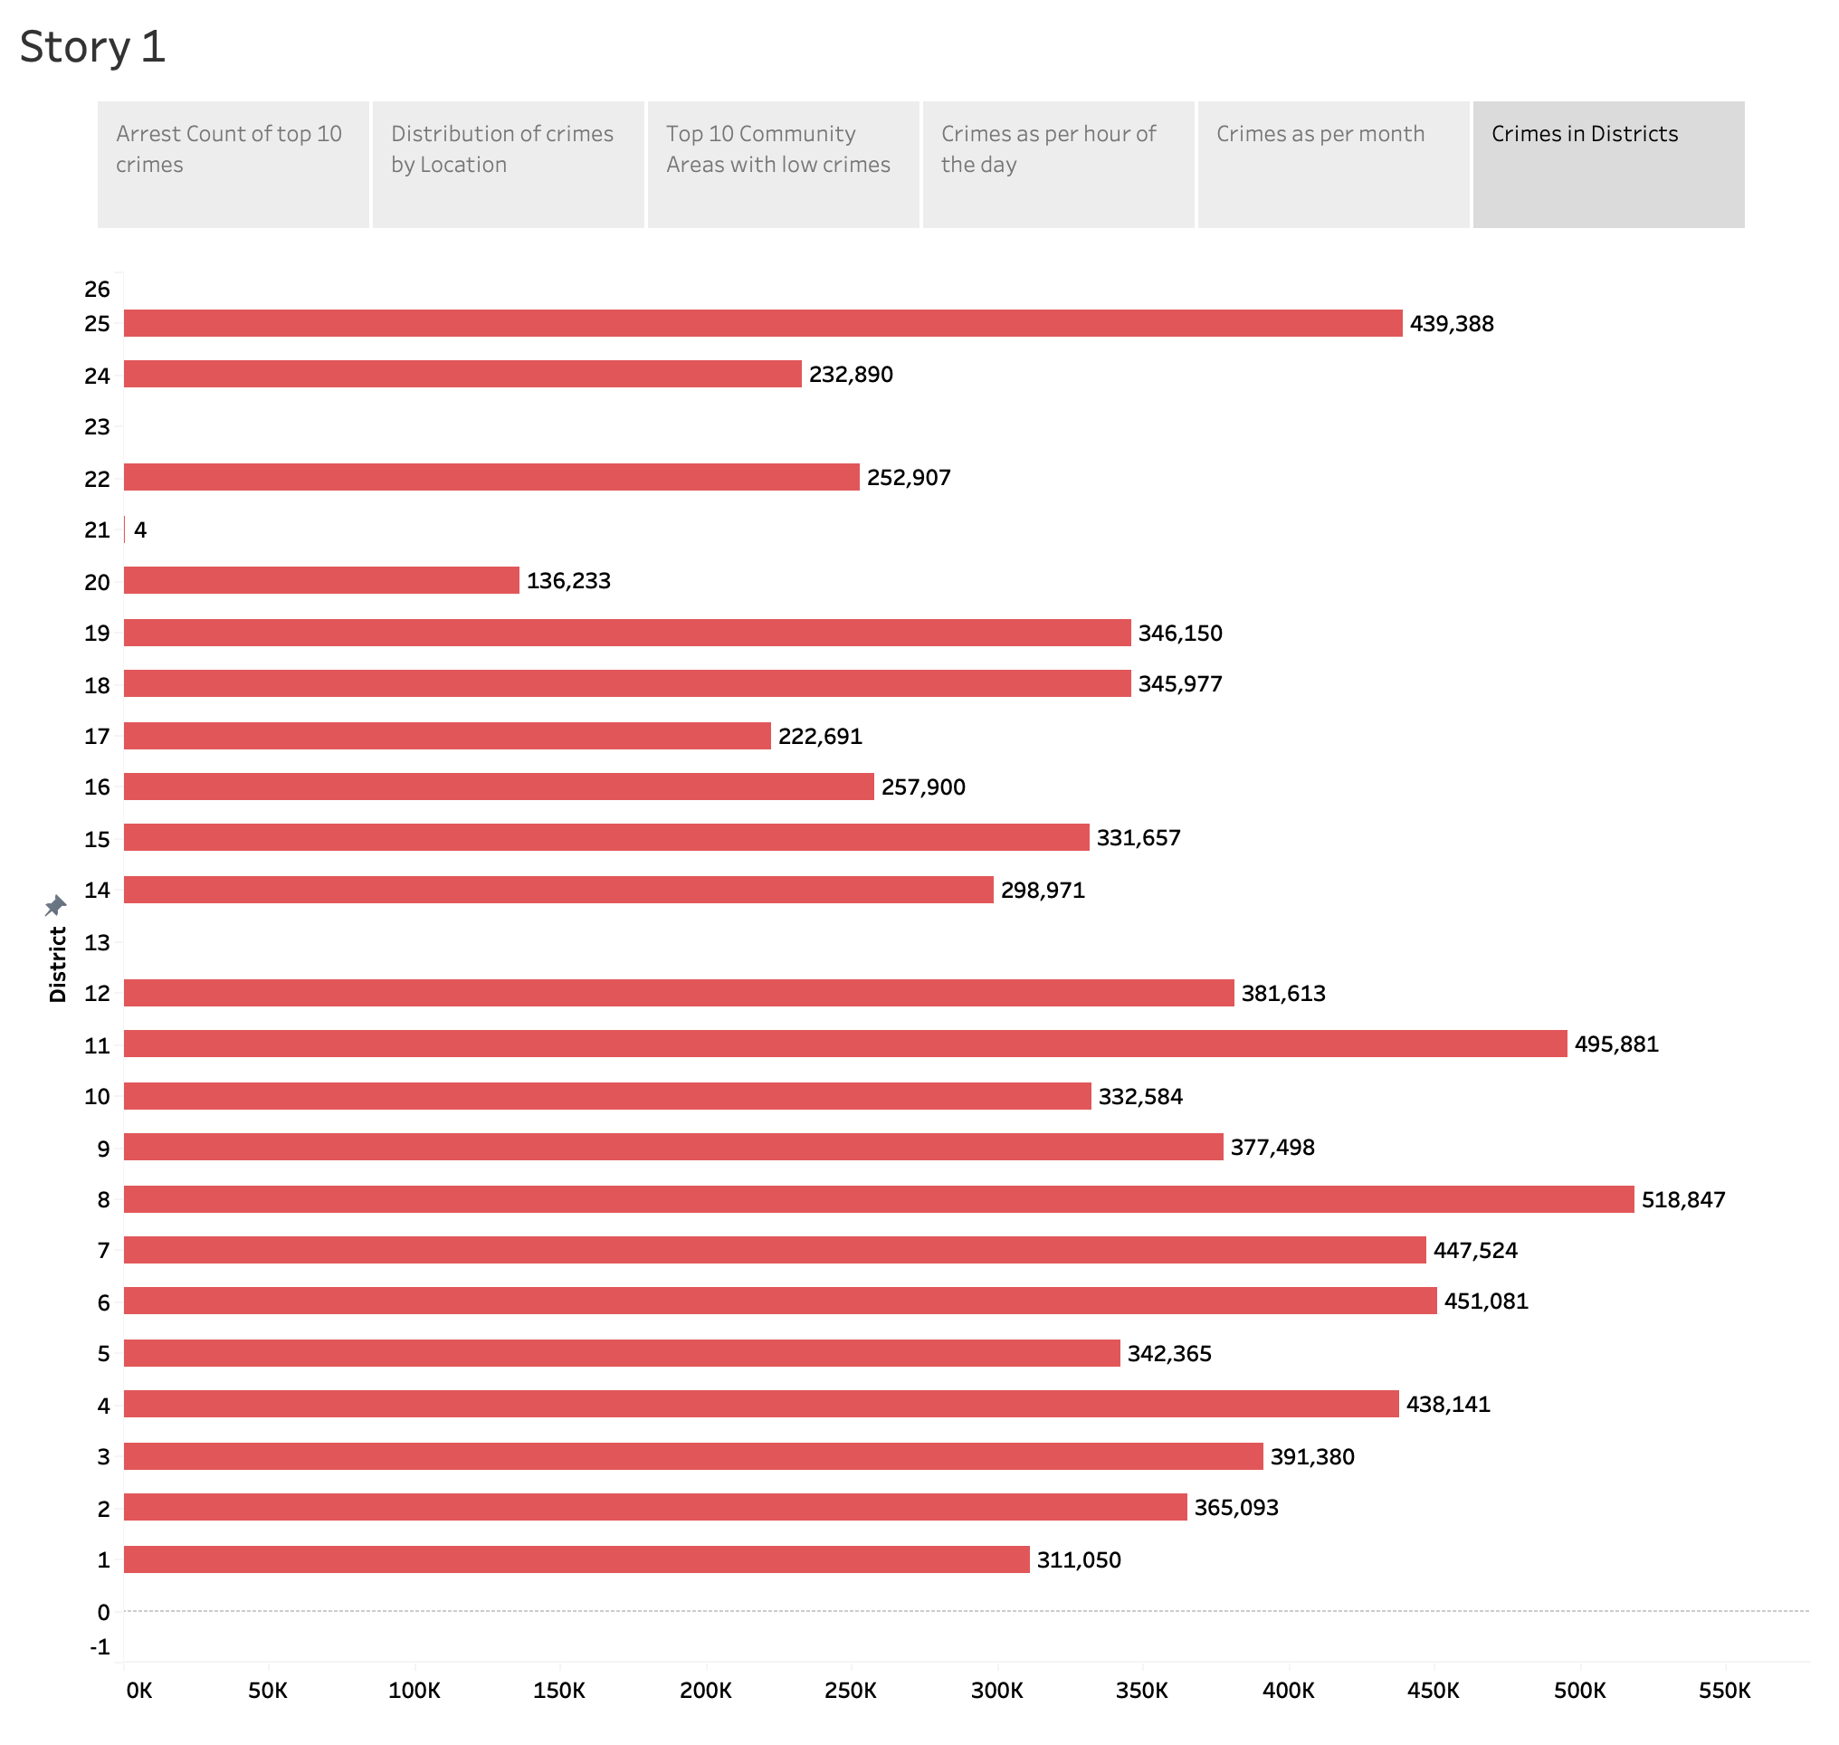
Crimes according to District numbers. So, most crimes are in district number 8 and least in 13.
Crimes in districts

Slide 8
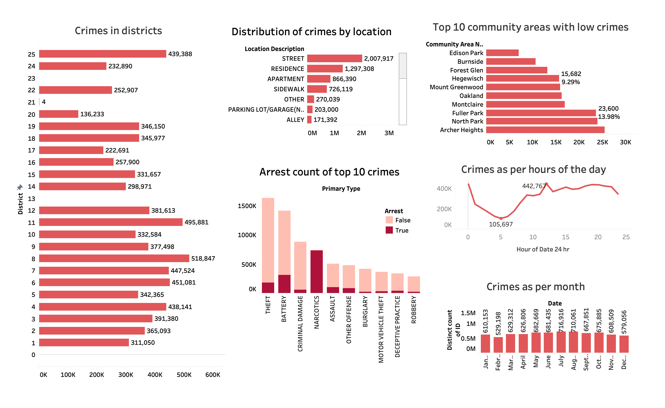
Crime Community area analysis : Dashboard

Slide 9
Business Metrics
Crime trend analysis
Public safety improvement
Crime hotspot identification
Criminal activity pattern recognition
Fraud detection and prevention

Slide 10
Thank You!

