Slide 1



PRAESCRIPTIO
A Final Year UG Project By-
Name: Ayushi Das
ID: 191001112047
Semester: 6th Semester
Date: 10th June, 2022
(Under the guidance of, Ms. Arpita Sen)

Slide 2
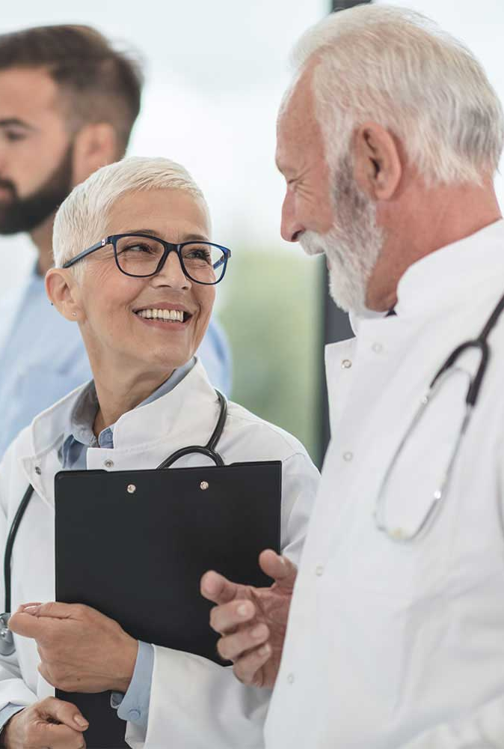
Problem Statement
In India the doctors to patient ratio is 1,700:1. Handling a sudden surge in the demand for doctor gets complicated.
Chances are, there might be some human error by the lab technicians while working and managing enormous scanned reports or lab samples.
Medical practitioners are not quick to trust new business models unless it is nationally or internationally certified.

Slide 3

Solution
With the help of preaescriptio, medical staffs can offer their services to more patient and reduce the existing gap in demand and supply of medical services faster and in efficient manner.
Automate the process of managing testing reports and reduce the burden of laboratory technicians.
Praescriptio will be integrated in the already existing business model which will be quick to deploy and start the testing phase.

Slide 4

Implementation
Machine Learning – It is the study of computer algorithms that can improve automatically through experience and by the use of data to predict future outcomes.
Deep Learning – It is a subfield of machine learning concerned with algorithms inspired by the structure and function of the brain called artificial neural networks.
Open Source Web Application – It is an application software that runs on a web server, unlike computer-based software programs that are run locally on the operating system of the device.

Slide 5
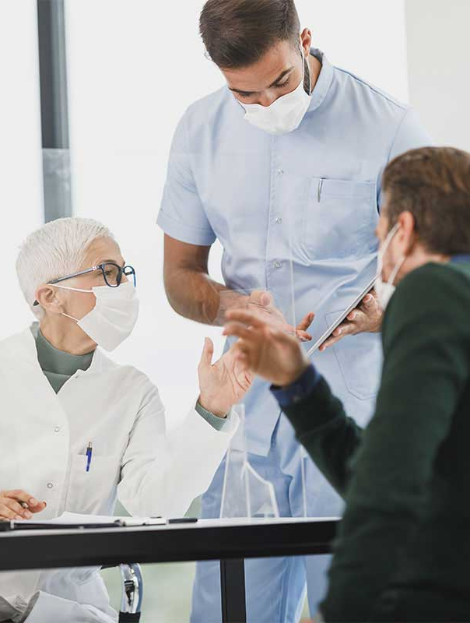
Features
Predict 42 common diseases based on any 5 prominent symptoms among the 132 common symptoms given in the dataset.
Get to know if you are affected with Malaria using your red blood cell image, among two classes: Infected and Uninfected.
Classify the brain MRI reports into 4 classes: Glioma, Meningioma, Pituitary and No-Tumour. Later Segment the brain tumours.
Classify the lungs X-Ray reports into 3 classes: Covid-19, Pneumonia and Normal.

Slide 6

Challenges
Finding reliable, accurate medical dataset which also consistent for the project output.
Connecting the backend to the frontend and ensuring in tune data flow.
Establishing precise accuracy for each predictive models for better results.
Training CNN models under limited set of system configuration.

Slide 7

Impacts
Quick diagnosis of suspected diseases.
An AI assistant for both medical practitioners of any experience level.
One stop solution, integrated within the hospital premises.
Reduced human labour during surge in demand.
Integrate two fast paced domains for easy and reliable human usage.

Slide 8

Future Scope of Work
Make use of Big Data generated by the disease prediction model to suggest Pharmaceutical Industries important drugs and their requirements in the market.
Including Optical Character Recognition for the processing of prescriptions.
Include a user management system to track down any updates in the model or reporting outliers.
Keep track of patient’s medical history to assist doctors with a specific patient-centric treatment.

Slide 9


Thank You

