Slide 1
Project Presentation of CO-OP Project at Industry (Module-2) (22CS421)
On
Aptiora
AI Powered Aptitude Learning Platform
Ayushi(2210990206) Nishtha Bansal (2210990620) Dhruv Aggarwal(2210990270)
Supervised By
Dr. Gifty Gupta
Department of Computer Science and Engineering,
Chitkara University, Punjab

Slide 2
Introduction
Aptiora is an online learning platform developed to help students prepare for Aptitude, Logical Reasoning, and Verbal Ability tests in an interactive and effective way.
The platform offers practice questions, quizzes, mock tests, and performance tracking to improve problem-solving skills, analytical thinking, speed, and accuracy.
Aptiora supports students in placement preparation, competitive examinations, and job assessments through a simple, user-friendly, and accessible learning experience.
2

Slide 3
Objective
The main objective of Aptiora is to help students prepare effectively for placement exams and competitive tests through an interactive and user-friendly learning platform.
Objectives
Improve logical thinking skills
Increase speed and accuracy
Provide practice materials on a single platform
Support students in placement preparation
Make learning simple, organized, and interactive
Aptiora aims to create an efficient and accessible learning experience for students.

Slide 4
Methodology, Approach & Techniques
Methodology:
The development of Aptiora followed a structured methodology to create an effective and user-friendly aptitude preparation platform.
Development Process:
Requirement Analysis – Identified the needs of students preparing for placements and competitive exams
System Design – Planned an easy-to-use interface and smooth navigation
Module Development – Created sections for aptitude, logical reasoning, verbal ability, and mock tests
Testing & Improvement – Removed errors and enhanced system performance
Deployment – Launched the platform online for easy accessibility
This methodology ensured an organized, efficient, and interactive learning experience for users.
4

Slide 5
Approach:
Requirement Analysis – Understanding student needs and exam patterns
UI/UX Design – Creating a simple and interactive interface
Module Development – Building aptitude, reasoning, and verbal sections
Testing & Validation – Ensuring accuracy and smooth performance
Deployment – Making the platform accessible online
Performance Tracking – Helping users analyze progress and improvement

Slide 6
Techniques Used:
Responsive Web Design for better user experience across devices
Component-Based Development using React
Type Safety with TypeScript
Dynamic Routing using React Router
Interactive UI Styling with Tailwind CSS
Data Visualization using Recharts
Smooth Animations with Framer Motion
Real-Time Notifications using Sonner
Canvas API Integration for interactive workspace features
Performance Testing & Debugging for system optimization

Slide 7
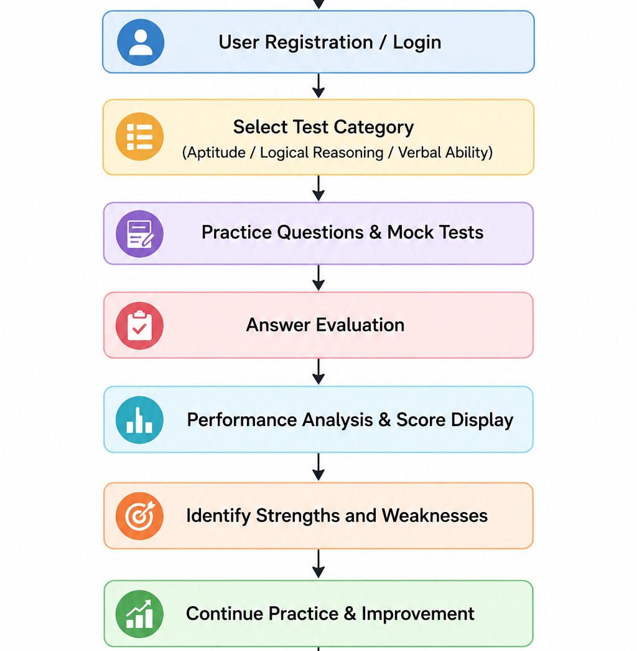
Flowchart
7

Slide 8
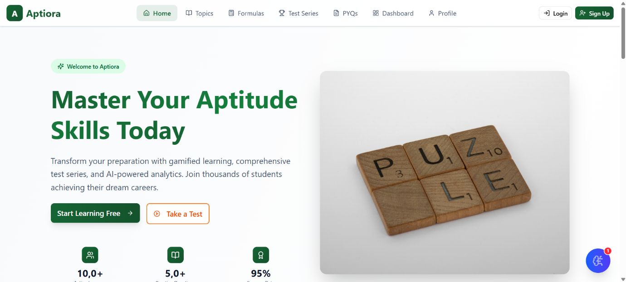
Screenshots

Slide 9
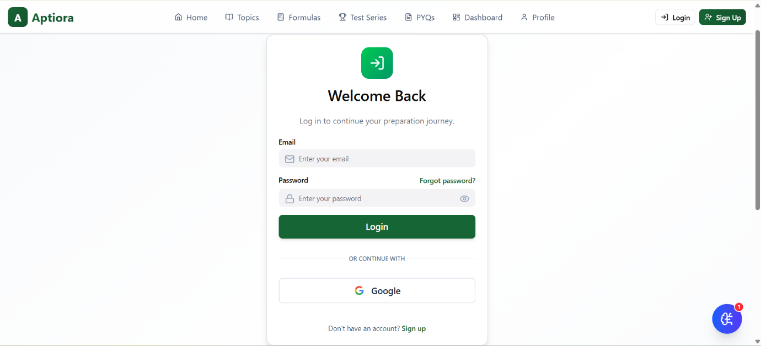
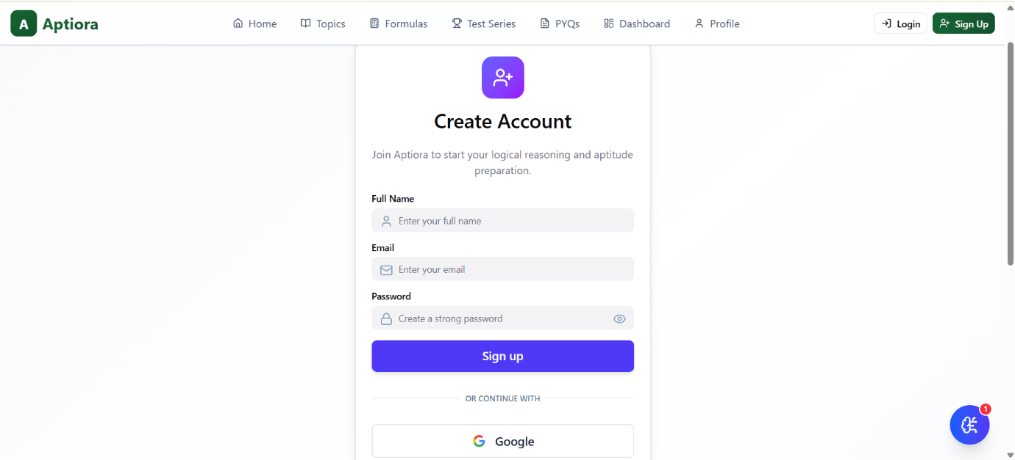
Screenshots

Slide 10
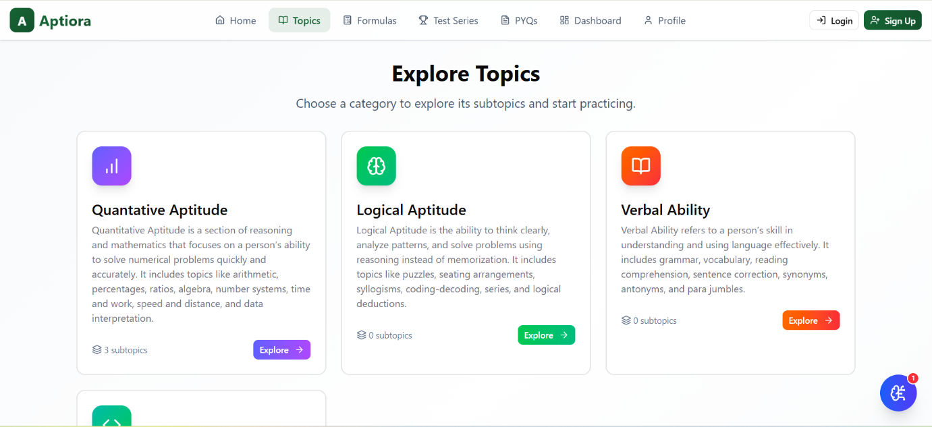
Screenshots

Slide 11
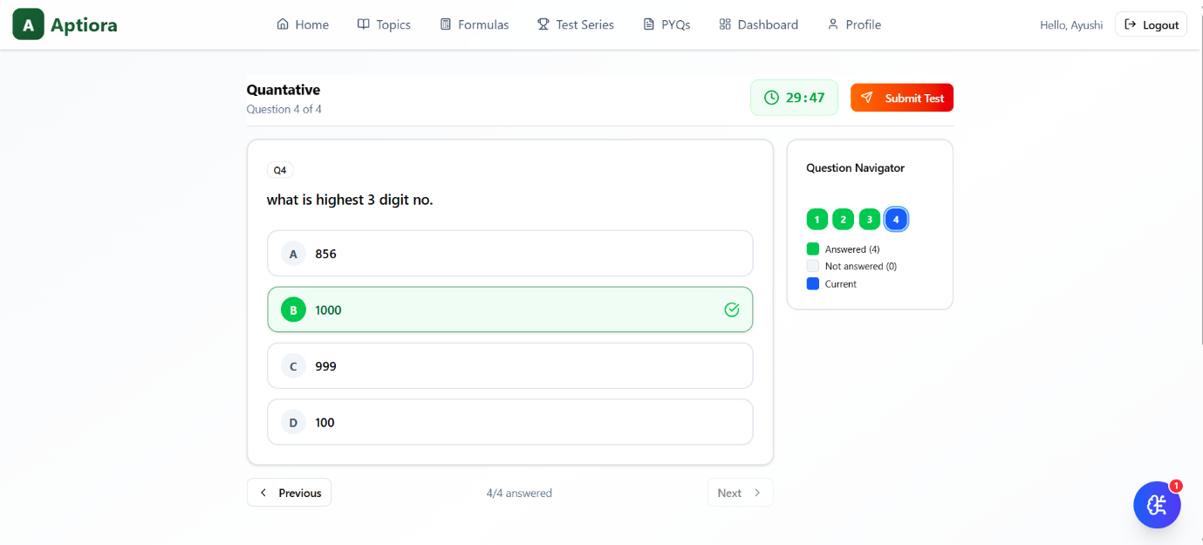
Screenshots

Slide 12
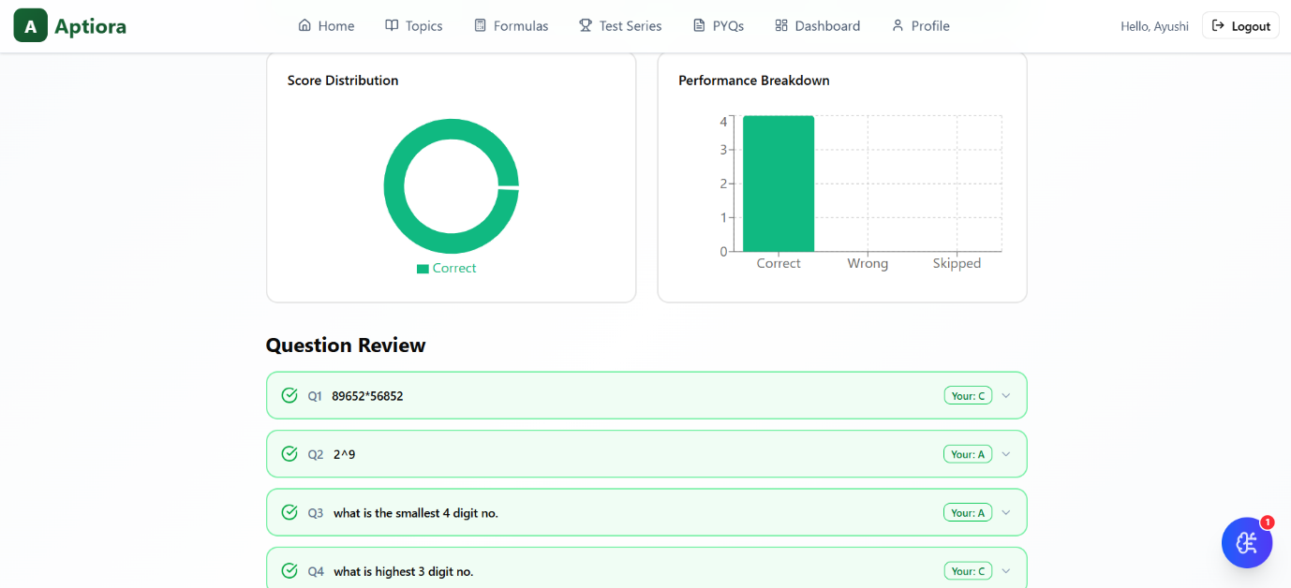
Screenshots

Slide 13
Conclusion
Aptiora is an effective and interactive learning platform that helps students improve their aptitude, logical reasoning, and verbal ability skills. Through practice questions, quizzes, mock tests, and performance analysis, the platform enhances problem-solving ability, speed, and accuracy.
By providing a simple, user-friendly, and accessible learning environment, Aptiora supports students in achieving better performance in placement exams, competitive tests, and job assessments.
13

Slide 14
References
React 18: https://react.dev/
TypeScript: https://www.typescriptlang.org/docs/
React Router: https://reactrouter.com/en/main
Tailwind CSS: https://tailwindcss.com/docs
Radix UI: https://www.radix-ui.com/primitives/docs/overview/introduction
Canvas API: https://developer.mozilla.org/en-US/docs/Web/API/Canvas_API
14

Slide 15
Thank You
15

