Slide 1
Project Title:
HAND GESTURE RECOGNITION
Team Member and Roll No.
Ashmita (2210990190)
Ayushi(2210990206)
Arshdeep Kaur(2210990169)

Slide 2
Index
Objective
Introduction
Approach and Techniques
Algorithm
Result
Source Code (screenshots)
Reference

Slide 3
Objective
The objective of a hand gesture recognition project is to develop a system that can accurately understand and respond to hand movements captured through a camera feed, enabling users to interact with digital interfaces, devices, or applications using intuitive gestures.
By leveraging computer vision techniques and machine learning algorithms, the project aims to detect, classify, and interpret specific hand gestures in real-time, facilitating tasks such as controlling presentations, navigating through user interfaces, or interacting with virtual environments.

Slide 4
Introduction
The hand gesture recognition project aims to revolutionize human-computer interaction by harnessing the power of computer vision and machine learning. By utilizing a camera feed, the system interprets hand gestures in real-time, providing users with a seamless and intuitive means of controlling digital interfaces, applications, or devices.
With this system, you could do cool things like controlling a presentation just by moving your hands or playing a game without needing a controller.

Slide 5
Approach & Techniques
1.Feature Extraction: Finding important details like edges or shapes in hand gesture images.
2. Machine Learning Models: Using smart programs (like CNNs) to learn from hand gesture examples and recognize different gestures.
3. Real-time Processing: Making our system super fast by trimming unnecessary parts and doing multiple tasks at once, so you can interact smoothly with apps or games using hand gestures.

Slide 6
Algorithm
Hand Detection: This step is about finding where the hands are in a video or image. We use techniques like looking at what's moving (background subtraction) or figuring out where fingers are to spot where hands are.
Gesture Segmentation: Once we find the hands, we need to separate them from the background. Think of it like cutting out a picture of your hand from a photo. We then look at the shape, outlines, or special points on the hand to understand what gesture it's making.
Gesture Classification: Now that we have the hand gesture isolated, we need to figure out what it means. We use fancy algorithms (like SVMs or CNNs) to teach the computer to recognize different gestures. It's like teaching a computer to recognize that a thumbs-up means "good job.“
Dynamic Gesture Tracking: Gestures aren't just one-time things; they can change and move over time. So, we need to keep an eye on the gesture as it moves across different frames of a video. This helps us have smooth and continuous interaction with devices, like controlling a game with hand movements.

Slide 7
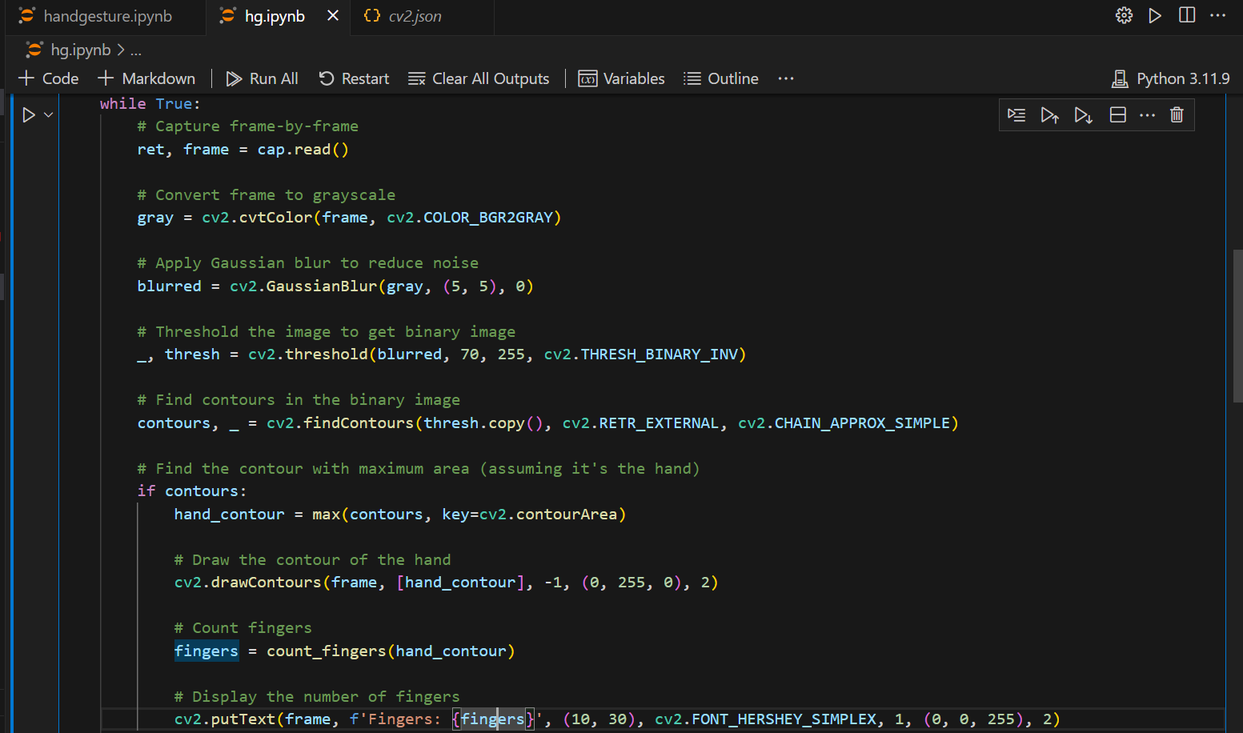
Screenshot

Slide 8
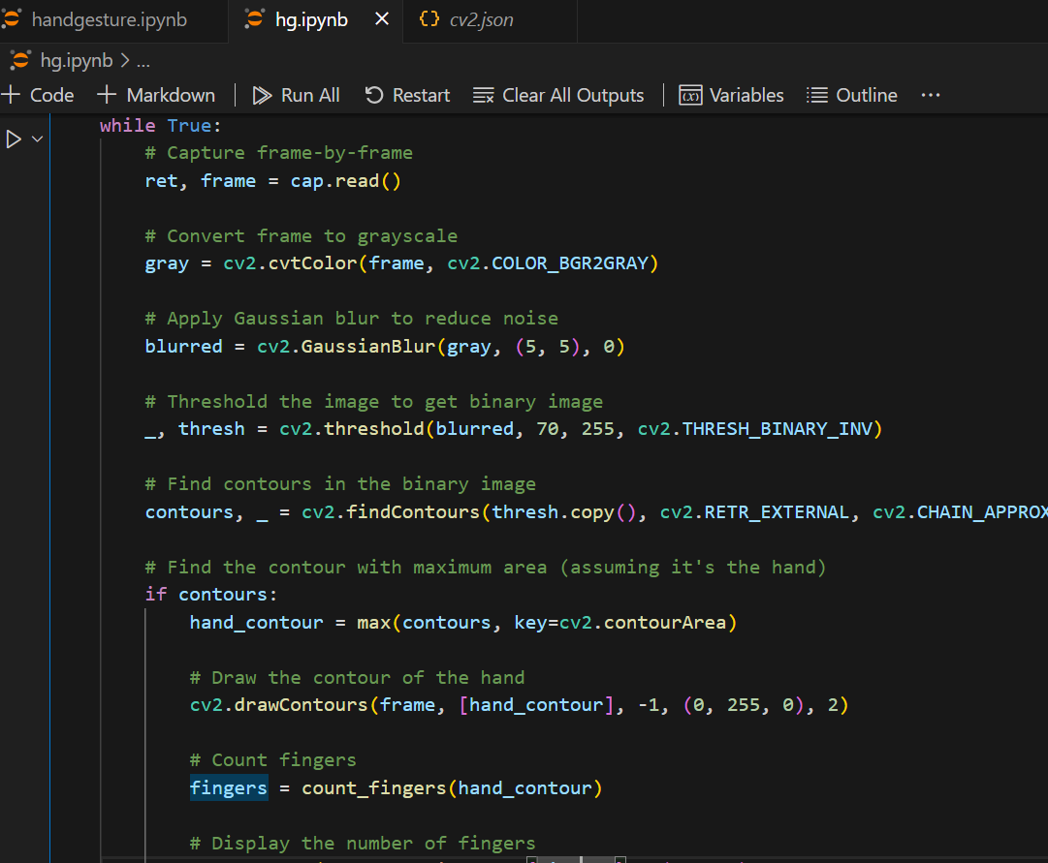
Screenshot

Slide 9
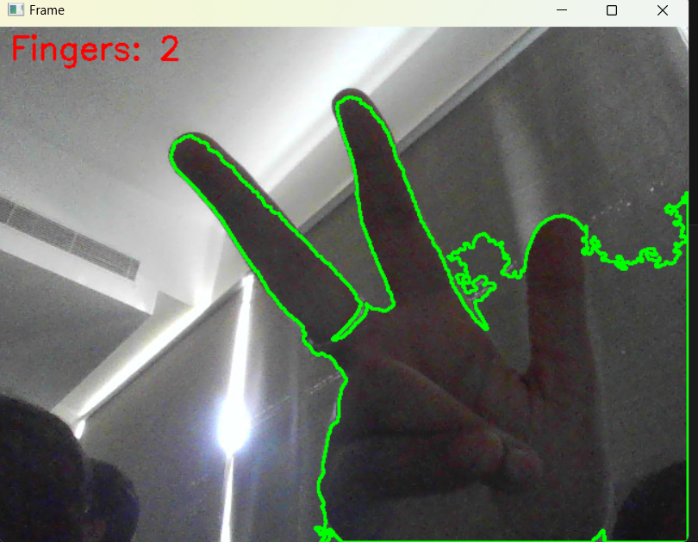
Screenshot

Slide 10
Reference
Geekforgeeks.org
Kaggle.com
Youtube.com
Google.com

Slide 11


