Slide 1



RIDESYNC
CSCI5308
INSTRUCTOR: DR. TUSHAR SHARMA
ASSISTED BY: GHAZAL SOBHANI

Slide 2
MEMBERS
DEV. TEAM -08
AYUSHI MALHOTRA (B00978595)
MEER PATEL (B00981041)
NITHIN BHARATHI (B00958670)
PURUSHOTHAM PARTHY (B00959397)
SIVASUBRAMANIAN VENKATASUBRAMANIAN (B00956463)

Slide 3
CLIENTS
TEAM -09
DRASHTI PATEL (B00981274)
JAISHANKAR MOHANRAJ (B00975938)
KUNJ PATHAK (B00947856)
NIKITA DAVIES (B00973059)
TANUJ DOSHI (B00979829)

Slide 4

CONTENT
01
OVERVIEW
02
PROJECT DASHBOARD STATUS
03
INDIVIDUAL CONTRIBUTIONS
04
USER STORIES
05
DEMO
06
PROJECT STATUS
07
LEARNING

Slide 5





OVERVIEW
Resource Sharing:
Share rides, Optimize resources
Traffic Alleviation :
Alleviates congestion, smoother travel.
Time and Cost Savings:
Efficient, economical travel options. Helps find compatible ride companions.

Slide 6





PROJECT DASHBOARD
Stories Completed: 13
Total Stories: 14
Story Points: 49

Slide 7

INDIVIDUAL CONTRIBUTION
MEMBERS STORIES
AYUSHI MALHOTRA (B00978595) 5
MEER PATEL (B00981041) 8
NITHIN BHARATHI (B00958670) 5
PURUSHOTHAM PARTHY (B00959397) 5
SIVASUBRAMANIAN V (B00956463) 7

Slide 8
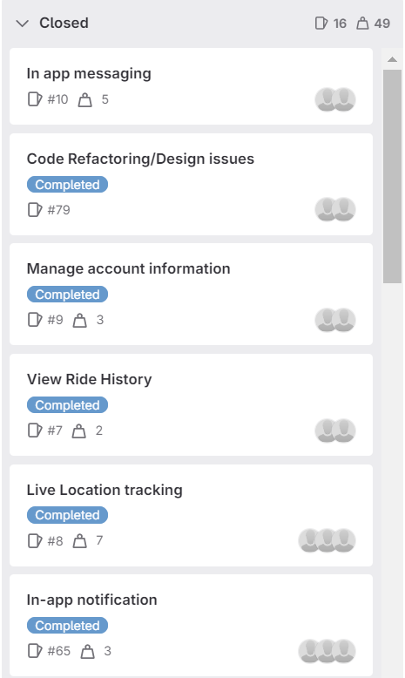
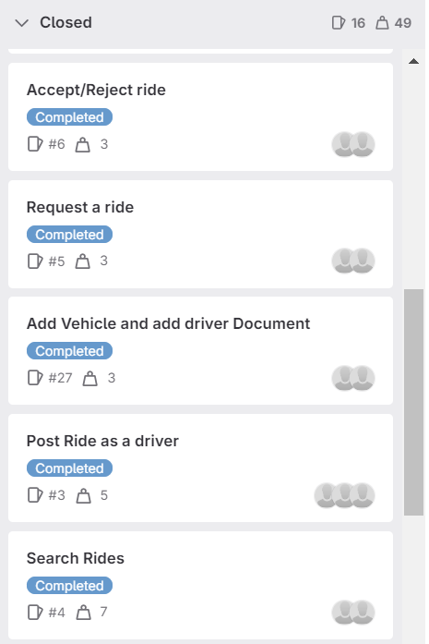
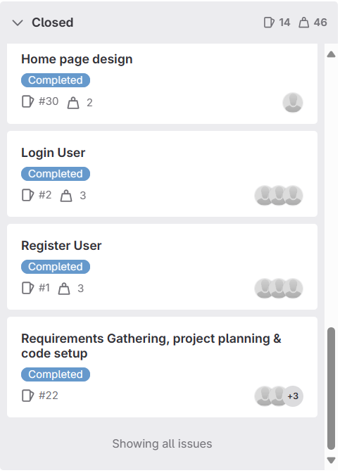
USER STORIES

Slide 9
DEMO

Slide 10
PROJECT
STATUS
GOALS STATUS
POST RIDE COMPLETED
ACCEPT/REJECT RIDE COMPLETED
RIDE MGMT.- DRIVER COMPLETED
FIND RIDE COMPLETED
RIDE MGMT. - RIDER COMPLETED
IN APP MESSAGING COMPLETED
LIVE LOCATION TRACKING COMPLETED
SOS MESSAGE BACKLOG
RECURRING RIDES BACKLOG

Slide 11
LEARNINGS
Exposure to New Technologies:
The team gained exposure to new technologies
User Experience:
If given more time the team would like to spend it on developing an improved user experience.
Payment System:
Integrating a payment system would have been next on the list of tasks the team would have liked to acheive.

Slide 12

THANK YOU

