Slide 1



Query-based Graph Cuboid Outlier Detection
Ayushi Dalmia*, Manish Gupta^{*+}, Vasudeva Varma*
IIIT Hyderabad, India* Microsoft, India⁺

Slide 2
Introduction
C
C
X₁
Y₂
A
B
B
B
B
A
B
B
X₁, Y₁
X₁, Y₁
X₁, Y₂
X₁, Y₂
X₁, Y₂
X₁, Y₂
B
B
B
A
C
B
A
X₁, Y₁
X₁, Y₁
X₁, Y₂
X₂, Y₂
X₁, Y₁
Attributed Heterogeneous Network G
Query Q
Notes:
Attributed Heterogeneous Information Networks indicate those graphs which contain nodes of different types, red, blue and green and each node is associated with a set of attributes. Here there are two attributes X and Y. The attribute X takes values { X_{1,} X₂ } while Y takes values { Y_{1,} Y₂ } Next, given such a graph and a query Q, we want to find out those regions of the graph which are of interest for this query. For simplicity identify those regions which have a large number of matches. The different regions of the graph are obtained by projecting the graph across different node attributes. For each unique value of the attribute or a unique combination of the attributes we get a projection of the graph.

Slide 3
Introduction
C
C
X₁
Y₂
A
B
B
B
B
A
X₁, Y₁
X₁, Y₁
X₁, Y₂
X₁, Y₂
X₁, Y₂
X₁, Y₂
B
B
B
A
C
X₁, Y₁
X₁, Y₁
X₁, Y₂
X₂, Y₂
X₁, Y₁
Attributed Heterogeneous Network G’s projection on attribute values X_{1,} Y₂
Notes:
For example, if we project the network across the attribute values X_{1,} Y₂ we get a projection as shown in the figure. Only those nodes which are a subset of the projected set of values would appear in the network. We only take those edges which are incident only on these nodes.

Slide 4
Introduction
C
C
X₁
Y₂
A
B
B
B
B
A
X₁, Y₁
X₁, Y₁
X₁, Y₂
X₁, Y₂
X₁, Y₂
X₁, Y₂
B
B
B
A
C
X₁, Y₁
X₁, Y₁
X₁, Y₂
X₂, Y₂
X₁, Y₁
Attributed Heterogeneous Network G’s projection on attribute values X_{1,} Y₁
Notes:
This is the projection you get if you project the original network across values X_{1,} Y₁ .
For each unique value of the attribute we get a projection of the graph. Each such projection is called a graph cuboid. Note that if there are n attribute values there are 2^n possible projection of the graph. Thus, if there are a large number of attribute values, the number of possible graph cuboids would grow exponentially. Next given a query we try to find the matches of the query in graph cuboid. Now, some of the graph cuboids may have exceptional number of matches. On the basis of the outlier score, which we define later, we rank these cuboids and the cuboids having exceptionally high score are considered graph cuboid outlier. Let us consider some real world examples.

Slide 5


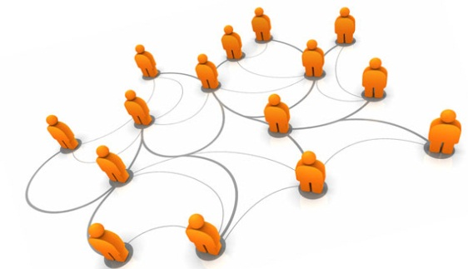





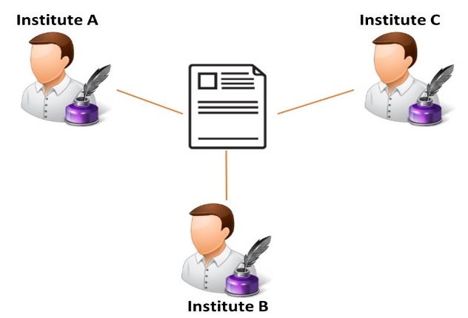
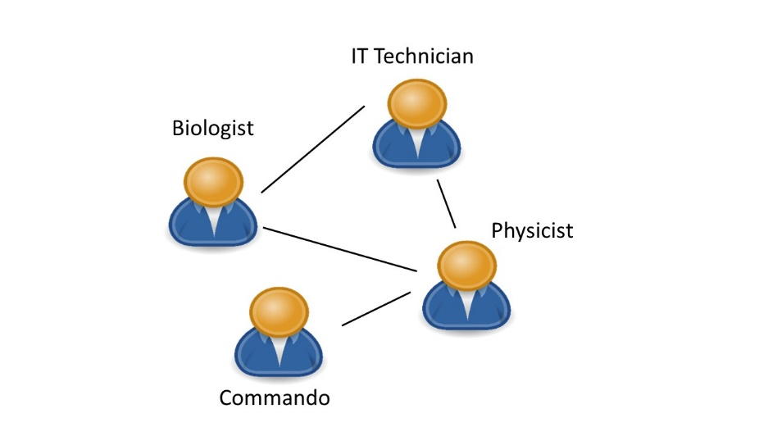
Real World Problems
DBLP Network
Organization Networks
Exceptional Collaboration
Team Selection
Projection Attribute: Research Area
Projection Attribute: Division of the organisation
Notes:
Let us consider the DBLP network. The DBLP network consists of nodes as authors, papers, conference venues as nodes and the edges are constructed as follows: if two authors co-authored a paper, if a paper was published at a particular venue. Each node of author paper or conference venue can be associated with a primary research area or a set of research areas. Now, different graph cuboids of the network can be obtained by projecting the network across different research areas. Given the graph cuboids, one might be interested to find out in which cuboid which is essentially a research area or a set of research areas there was an exceptionally large number of collaboration between the authors of Institute A, B and C. The user can expect to find out a research area or a group of research area for which some large funding was made by multi-institutional projects leading to papers from institutes A, B and C
To take another example we can consider an organisation network, where the nodes of the network are people and the edges represent they have worked together in some mission in the past. We project this graph across the attribute divisions of the organisation. A person can be an expert in multiple divisions of the organisation. Now, given a new project mission, the user might want to know in which missions should I try to find out teams of people who can help me accomplish this mission. The user can expect to find out divisions of the organisation which have handled similar missions earlier.

Slide 6
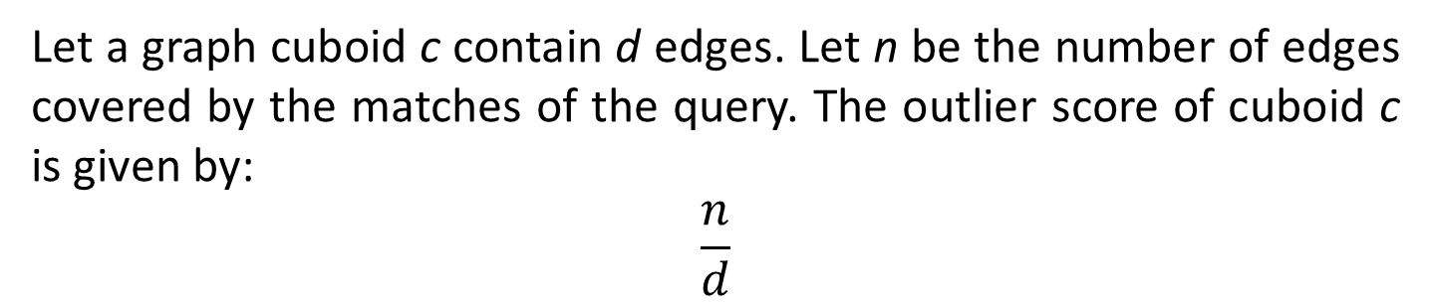
Graph Cuboid Outlier Score
Let a graph cuboid c contain d edges. Let n be the number of edges covered by the matches of the query. The outlier score of cuboid c is given by:
$$\frac{n}{d}$$
B
B
12
C
C
13
Network G
Query Q₁
X₁
Y₂
B
6
5
4
3
2
A
B
B
B
B
A
1
n= |{(5,9), (10,9)}|
d= |{(6,5), (5,9), (10,9)}|
X₁, Y₁
X₁, Y₁
X₁, Y₂
X₁, Y₂
X₁, Y₂
X₁, Y₂
10
7
B
B
9
8
11
B
B
B
A
C
Query Q₂
X₁, Y₁
X₁, Y₁
X₁, Y₂
X₂, Y₂
X₁, Y₁
C
A
Attributed Heterogeneous Network G’s projection on attribute values X_{1,} Y₁
n= |{ }|
d= |{ (6,5), (5,9), (10,9) }|
Notes:
If a particular graph cuboid has d edges, and n of its edges are covered by the matches of the query Q, then the outlier score of the graph cuboid is given as n/d. It is essentially a measure of how dense is the cuboid with respect to the query Q.
For example, for the graph cuboid obtained on projecting across attribute values X1, Y1 , the number of edges present are 3. Again, the number of edges covered by the matches for query 1 are 2. Thus, the outlier score of the cuboid is 2/3. Similarly for Query 2, the number of matches are 0, thus no edges are covered by the matched. Thus, the outlier score is 0

Slide 7
The Basic Underlying Problem
Given
Attributed Heterogeneous Network G
Heterogeneous Subgraph Query Q
Find
Top-K graph cuboid outliers for the query
Challenges
Subgraph isomorphism is NP-Hard
The number of matches for the query can be large
The number of cuboids can be very high
Notes:
Thus, the basic underlying problem is given an attributed heterogeneous network G and a heterogeneous network query Q, we want to find the top K graph cuboid outliers. The major challenges are, firstly, subgraph isomorphism is NP-Hard. The number of matches for the query can be really large and the number of cuboids can be very high. In this work we try to address the second challenge. We try to find the graph cuboid outliers without computing all the matches of the query.

Slide 8
Baseline Algorithm
Network G
Breadth First Traversal
from each Node
up to Distance D
Offline Index Construction
SPath
Index
Distance D
Cuboid Edge Count
Find Candidate Nodes
Query Q
Matches
Candidate Nodes
GCOutlier Score Computation
Map Matches to Cuboids
Match Computation
Online Query Processing
GCOutliers
Notes:
1. The baseline algorithm consists of two parts . The offline index construction part and the online query processing part.
2. In the offline index construction phase, given a network G and a parameter D, we build two indexes: Spath and Cuboid edge count. The index construction is a one time process. The Spath is a previously proposed low cost indexing mechanism which can be used to obtain subgraph matches. It captures the type-wise neighbourhood topology of every vertex. For a vertex v, it keeps the nodes of every type at hop d from the vertex using breadth first traversal. The cuboid edge count list is used to generate the number of edges covered by a particular graph cuboid.
3. Next given a query Q, we try to find out the candidate nodes. The candidate nodes are those nodes which have high possibility of belonging to a match and is obtained from the Spath index based on the neighbourhood topology.
4. After obtaining the candidate nodes, we grow the candidate nodes, path at a time to obtain the matches for the query Q .
5. Next, we map these matches to the graph cuboids. Note that an edge of the match can belong to multiple cuboids.
6. We now compute the GCOutlier Score for each cuboid and rank them to get the top K GCOutliers.

Slide 9
Baseline Algorithm: Indices
Spath Index:
For every vertex v, it stored the type-wise neighbouring nodes at a distance D. This index is used by the subgraph matching algorithm
Cuboid Edge Count:
Number of edges covered by each graph cuboid. Given an edge e(u,v) we assign it to those cuboids which contains the attribute values of both u and v.
This list is used to compute the Graph Cuboid Outlier Score.

Slide 10
Baseline Algorithm: Example
12
C
C
13
Network G
Y₂
Query Q
X₁
6
5
4
3
2
2
3
A
B
B
B
1
B
B
B
A
X₁, Y₁
X₁, Y₁
X₁, Y₂
X₁, Y₂
X₁, Y₂
X₁, Y₂
10
9
8
7
11
1
4
B
B
B
A
C
B
A
X₁, Y₁
X₁, Y₁
X₁, Y₂
X₂, Y₂
X₁, Y₁
M1
M3
M5
6
5
5
5
4
A
B
B
B
B
X₁, Y₁
X₁, Y₁
X₁, Y₁
10
9
X₁, Y₁
X₁, Y₂
B
B
9
8
7
B
B
A
9
8
7
X₁, Y₁
X₁, Y₁
B
A
X₁, Y₁
X₁, Y₂
X₂, Y₂
X₁, Y₁
M4
X₂, Y₂
M2
5
3
4
3
2
1
6
4
B
B
B
A
A
B
B
B
X₁, Y₁
X₁, Y₁
X₁, Y₂
X₁, Y₂
X₁, Y₂
X₁, Y₂
X₁, Y₂
X₁, Y₂
Notes:
Consider the network G and query Q. We obtain the matches for this particular query using a precomputed Spath Index: (List them out)

Slide 11
Cuboid | # Edges in the cuboid | # Matching Edges | GC Outlier Score
X₁ + Y₁ | 3 | 3 | 1.00
X₁ + Y₂ | 8 | 3 | 0.38
X₁, + Y₁ + X₂ | 3 | 3 | 1.00
X₁ + X₂ + Y₂ | 11 | 14 | 0.45
X₁ + X₁ + Y₂ | 14 | 7 | 0.50
X₁ + X₁ + X₂ + Y₂ | 18 | 11 | 0.61
Table 1: GCOutlier Score of Cuboids for Graph G
Computation of all the matches for a given query is expensive.
We only need the ranking of the graph cuboid.
Can we approximate?
Notes:
Next we map these edges to the respective cuboids and compute the GCOutlier Score. If we rank the cuboids, we see that cuboid X1 Y1 and X1 Y1 X2 are the top 2 GCOutlier.
Notice that we are not interested in obtaining all the matches of the cuboids. We only want to know the ranking of the cuboids. Computation of all the matches for a given query is expensive. Can we approximate?

Slide 12
Proposed Algorithm
We propose two approaches for the Graph Cuboid Outlier Detection (GCOD) problem:
Graph Cuboid Outlier Detection using Random Sampling (GCOD-RS)
Graph Cuboid Outlier Detection using Regression Models (GCOD-RM)
Notes:
We propose two approaches for the Graph Cuboid Outlier Detection Problem
Using random sampling
Using regression models

Slide 13
GCOD-RS
Baseline Algorithm
Network G
Breadth First Traversal
from each Node
up to Distance D
Offline Index Construction
SPath
Index
Distance D
Cuboid Edge Count
Find Candidate Nodes
Query Q
Matches
Candidate Nodes
Random Sample
GCOutlier Score Computation
Map Matches to Cuboids
Match Computation
Online Query Processing
GCOutliers
Notes:
The random sampling algorithm is an adaptation of the baseline algorithm where instead of growing the matches from all the candidate nodes, we grow the matches from a random sample of the candidate nodes. We hope that the random sampling would affect all the graph cuboids equally and thus the relative ranking of the graph cuboid would stay the same. However, random sampling is dumb. If we use a very small sample of the candidate nodes, we might get a poor accuracy on the graph cuboids outlier. Thus, we try to explore a smarter way. In the regression model approach we do a more principled sampling.

Slide 14
GCOD-RM
Network G
Breadth First Traversal
from each Node
up to Distance D
Offline Index Construction
SPath
Index
Cuboid Edge Count
Distance D
Get Candidates
Query Q
Map Matches to Cuboids
Refined
Candidate
Nodes
Test
Regression
Candidate Nodes
SPath
Index
Train
Random Sample
GCOutlier Score Computation
Matches
Train
Match Computation
Match Computation
GCOutliers
Online Query Processing
Notes:
1. The offline index construction phase remains the same.
2. 3. In the online index construction phase, after obtaining the candidate nodes, we rank the candidate nodes by the probability scores obtained from a node regression model to obtain a more refined nodes.
4. We obtain the node regression model by generating a small number of matches from a small sample of candidate nodes and train the node regression model.
5. After obtaining the refined list of candidate nodes, we obtain the matches of the query Q
6. Next, like the baseline algorithm, we map the matches to the cuboid, compute the GCOutlier score using the cuboid edge count list and return the top K outlier list

Slide 15
Features for GCOD-RM model
Graph Topology: Type-wise number of nodes in the d-hop neighbourhood of the node (d ∈ D)
Graph vs Query Topology: Extra type-wise number of nodes in the d-hop neighbourhood of the node compared to those expected by the corresponding query node (d ∈ D)
Total degree of the node
Type-wise degree of the node
Total number of d-hop neighbours of the node (d ∈ D)
Notes:
The features used to build the node regression model capture the neighbourhood topology of the vertices.
The graph topology captures the number of nodes in the d-hop neighbourhood of the node.
The Graph vs Query topology indicate, how loose a superset the graph node neighbourhood is compared to the expected query node neighbourhood
We also use the total degree of the node, type-wise degree of the node and the total number of the d-hop neighbours of the node as the features for the model

Slide 16
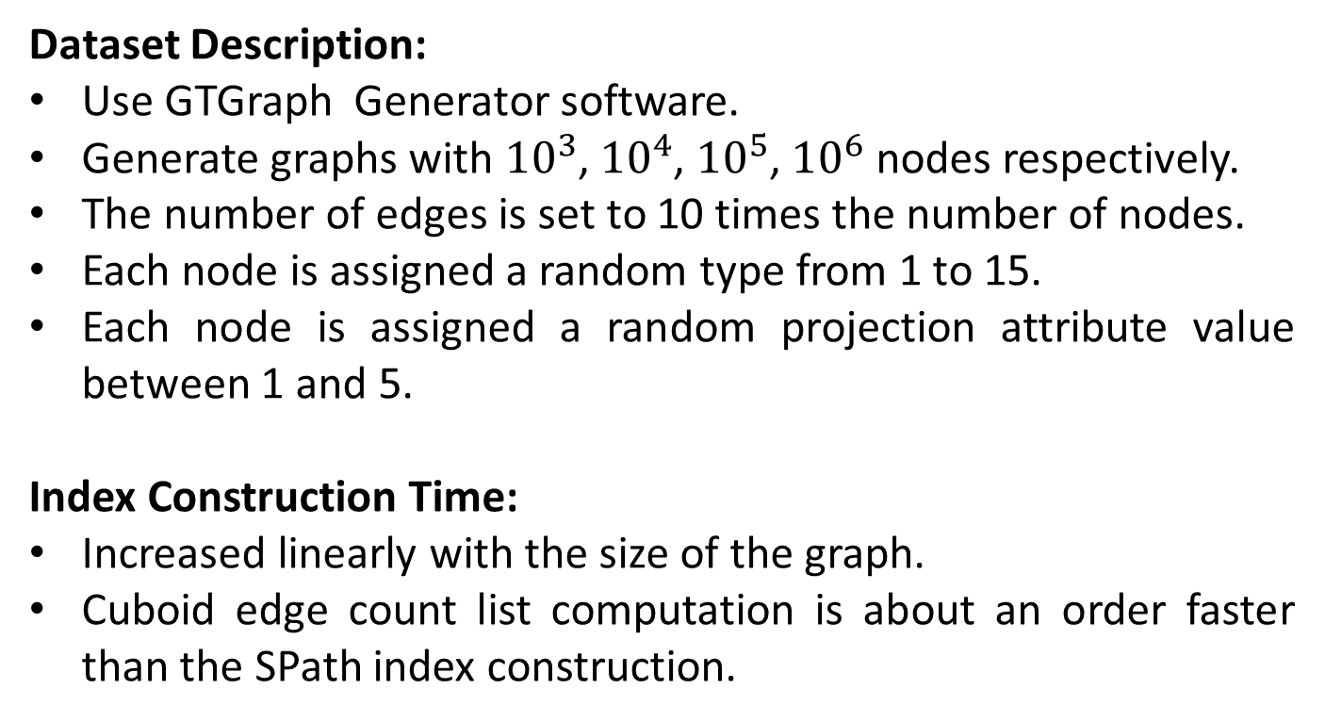
Experiment: Synthetic Dataset
Dataset Description:
Use GTGraph Generator software.
Generate graphs with ${10}^{3}$,${10}^{4}$, ${10}^{5}$, ${10}^{6}$ nodes respectively.
The number of edges is set to 10 times the number of nodes.
Each node is assigned a random type from 1 to 15.
Each node is assigned a random projection attribute value between 1 and 5.
Index Construction Time:
Increased linearly with the size of the graph.
Cuboid edge count list computation is about an order faster than the SPath index construction.
Notes:
We conduct extensive experiments on the Synthetic network as well as do case studies on real network. The synthetic networks are generated with graph of the order ${10}^{3}$,${10}^{4}$, ${10}^{5}$, ${10}^{6}$ nodes where the number of edges is set to 10 times the number of nodes. Each node is assigned a random type from 1 to 15. Each node is assigned a random projection attribute value between 1 and 5.
The offline index construction which is a one time process, increased linearly with the size of the graph and the cuboid edge count list computation is about an order faster than the Spath Index construction.

Slide 17
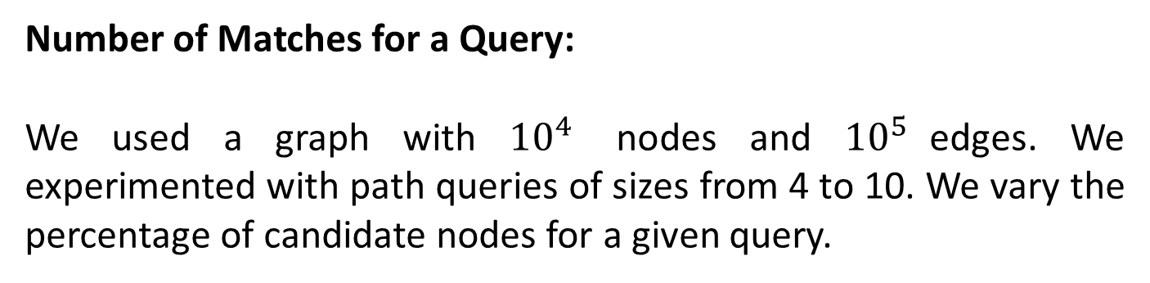
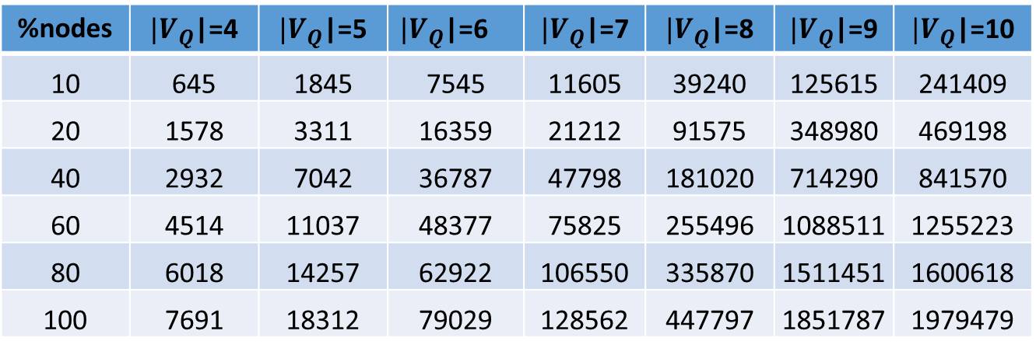
Experiment: Synthetic Dataset
Number of Matches for a Query:
We used a graph with ${10}^{4}$ nodes and ${10}^{5}$edges. We experimented with path queries of sizes from 4 to 10. We vary the percentage of candidate nodes for a given query.
%nodes | $|V_{Q}$|=4 | $|V_{Q}$|=5 | $|V_{Q}$|=6 | $|V_{Q}$|=7 | $|V_{Q}$|=8 | $|V_{Q}$|=9 | $|V_{Q}$|=10
10 | 645 | 1845 | 7545 | 11605 | 39240 | 125615 | 241409
20 | 1578 | 3311 | 16359 | 21212 | 91575 | 348980 | 469198
40 | 2932 | 7042 | 36787 | 47798 | 181020 | 714290 | 841570
60 | 4514 | 11037 | 48377 | 75825 | 255496 | 1088511 | 1255223
80 | 6018 | 14257 | 62922 | 106550 | 335870 | 1511451 | 1600618
100 | 7691 | 18312 | 79029 | 128562 | 447797 | 1851787 | 1979479
Table 2: Number of matches for a given query and percentage of candidate nodes
Notes:
This table summarizes the number of matches for a query of v nodes while taking x% of candidate nodes. As we can see the number of matches increases rapidly as the percentage of candidate nodes increase or the size of the query increases.

Slide 18
Experiment: Synthetic Dataset
Query Execution Time Comparison:
Notes:
Here we compare the query execution time for the Random Sampling and the Regression model approach. We see that the regression model approach takes more time than the random sampling approach due to training but this extra time taken is justified when compared with accuracy. The difference between these two curves indicate the training time taken.

Slide 19
Experiment: Synthetic Dataset
Accuracy Comparison:
Notes:
Here we compare the accuracy of the ranking of the outlier cuboids using three metrics: Spearman Rank Correlation, Kendall’s Tau, and Precision@10. For all three metrics we obtain an accuracy of greater than 60% by taking as low as 10% of the nodes. Overall we see that Regression Model performs better than the random sampling model.

Slide 20
Experiment: Synthetic Dataset
Time vs Accuracy Comparison:
Notes:
Next we compared the time versus accuracy trade off for different queries. We compare the Spearman Correlation coefficient. We see that the Random Model performs good for smaller queries while the Regression model performs good for longer queries.

Slide 21
Experiment: Real Dataset
Four Area Network :
A subset of the DBLP Network
We project across 4 research areas and 4 blocks of years.
Number of nodes: 74K
Number of edges: 320K
Number of Types: 4 (Author, Conference, Term, Paper)
Dimension Projected Upon: Research Area and Years
Delicious Dataset
A social bookmarking site for tagging webpages.
We project this into 10 categories (arts, science, music)
Number of nodes: 83K
Number of edges: 588K
Number of Types: 3 (URL, user, tag)
Dimension Projected Upon: 10 Categories

Slide 22
Case Studies: Real Dataset
Queries on Four Area Dataset
Aims to find research areas and range of years for which the paper is authored by atleast 4 authors Result: Databases, 1989-1993, 1994-1998, 1999-2003, 2004-2008
Author
Q₁
Author
Paper
Author
Author
Queries on Delicious Dataset
Q₂
Aims to find categories for which the users have tagged atleast four urls Result: Sports Category with tags like bike, football, rugby etc
Url
Url
User
Url
Url
Notes:
We tried to perform some interesting case studies. We used two datasets, the four area, which is a subset of the DBLP network and the delicious dataset, which is a popular tagging website and consists of users urls and tags. For the 4 area network, we project the network across research areas and range of years. We try to find out in which research areas and and range of years for which the paper is authored by atleast 4 authors. We see that a large number of collaboration is present in the research area of Databases across all year ranges. The Delicious dataset is projected across different categrories, like science, arts, technology, sports. We try to find out which is the most popular category among the users by finding the categories for which the users have tagged atleast four urls. We see that the most popular category is sports with tags like bike, football, rugby etc.

Slide 23
Conclusion
Given:
Attributed Heterogeneous Network G
Heterogeneous Subgraph Query Q
Find:
Top-K graph cuboid outliers for the query
Propose the problem of graph cuboid outlier discovery
Propose query-specific node and edge regression models methods to learn the probability of a node or an edge being a part of some match. Use this model to do principled sampling on candidate nodes while obtaining the matches
Showed efficiency and effectiveness on multiple synthetic and real datasets
Notes:
Mostly read this aloud and start taking questions. Keep this slide on instead of the Thank you slide

Slide 24
Thank you!

Slide 25
References
[1] Chen, C., Yan, X., Zhu, F., Han, J., Yu, P.: Graph OLAP: Towards Online Analytical Processing on Graphs. In: ICDM. (2008) 103–112
[2] Akoglu, L., McGlohon, M., Faloutsos, C.: Oddball: Spotting Anomalies in Weighted Graphs. In: PAKDD. (2010) 410–421
[3] Gupta, M., Gao, J., Sun, Y., Han, J.: Integrating Community Matching and Outlier Detection for Mining Evolutionary Community Outliers. In: KDD. (2012) 859–867
[4] Gupta, M., Gao, J., Yan, X., Cam, H., Han, J.: On Detecting Association-based Clique Outliers in Heterogeneous Information Networks. In: ASONAM. (2013) 108–115
[5] Qi, G.J., Aggarwal, C.C., Huang, T.S.: On Clustering Heterogeneous Social Media Objects with Outlier Links. In: WSDM. (2012) 553–562
[6] Henderson, K., Eliassi-Rad, T., Faloutsos, C., Akoglu, L., Li, L., Maruhashi, K., Prakash, B.A., Tong, H.: Metric Forensics: A Multilevel Approach for Mining Volatile Graphs. In: KDD. (2010) 163–172
[7] Gupta, M., Mallya, A., Roy, S., Cho, J.H.D., Han, J.: Local Learning for Mining Outlier Subgraphs from Network Datasets. In: SDM. (2014) 73–81
[8] Gupta, M., Gao, J., Yan, X., Cam, H., Han, J.: Top-K Interesting Subgraph Discovery in Information Networks. In: ICDE. (2014) 820–831
[9] Zhuang, H., Zhang, J., Brova, G., Tang, J., Cam, H., Yan, X., Han, J.: Mining Query-Based Subnetwork Outliers in Heterogeneous Information Networks. In: ICDM. (2014)
[10] Aggarwal, C.C., Zhao, Y., Yu, P.S.: Outlier Detection in Graph Streams. In: ICDE. (2011) 399–409
[11] Zhao, P., Han, J.: On Graph Query Optimization in Large Networks. PVLDB 3 (2010) 340–351

Slide 26
References
[12] Chandola, V., Banerjee, A., Kumar, V.: Anomaly Detection: A Survey. ACM Comp. Surveys 41 (2009) 15:1–15:58
[13] Hodge, V.J., Austin, J.: A Survey of Outlier Detection Methodologies. AI Review 22 (2004) 85–126
[14] Gupta, M., Gao, J., Aggarwal, C., Han, J.: Outlier Detection for Temporal Data. Morgan & Claypool (2014)
[15] Aggarwal, C.C.: Outlier Analysis. Springer (2013)
[16] Noble, C.C., Cook, D.J.: Graph-Based Anomaly Detection. In: KDD, ACM (2003) 631–636
[17] Gao, J., Liang, F., Fan, W., Wang, C., Sun, Y., Han, J.: On Community Outliers and their Efficient Detection in Information Networks. In: KDD. (2010) 813–822
[18] Pincombe, B.: Anomaly Detection in Time Series of Graphs using ARMA Processes. ASOR Bulletin 24 (2005) 2–10
[19] Id´e, T., Kashima, H.: Eigenspace-based Anomaly Detection in Computer Systems. In: KDD. (2004) 440–449
[20] Gupta, M., Gao, J., Sun, Y., Han, J.: Community Trend Outlier Detection using Soft Temporal Pattern Mining. In: ECML-PKDD. (2012) 692–708
[21] Gupta, M., Gao, J., Han, J.: Community Distribution Outlier Detection in Heterogeneous Information Networks. In: ECML-PKDD. (2013) 557–573
[22] Chakrabarti, D., Zhan, Y., Faloutsos, C.: R-mat:

