Slide 1
String algorithms…

Slide 2
Basic algo
Sliding window algo
String hashing/rolling hash
Rabin-karp matching algo

Slide 3
Intermediate algo
Prefix functions and kmp algo
Z-function and its application
Suffix array and its applications
Trie DS: implementation and algo

Slide 4
Advanced algo
Aho corasick algo
Suffix automation and its application
Manachers’s algorithm

Slide 5
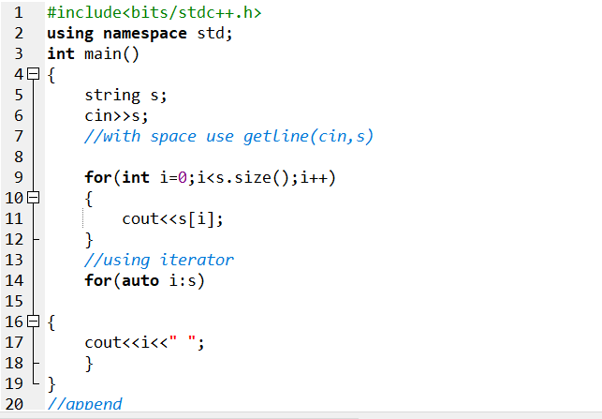
Basic stl string functions

Slide 6
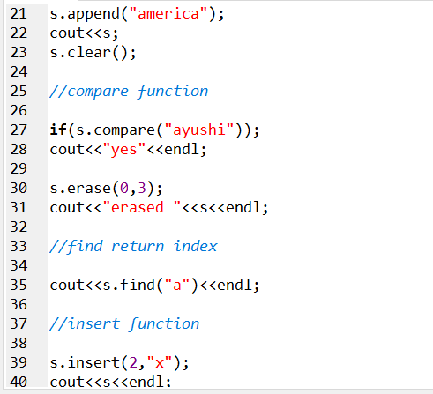

Slide 7
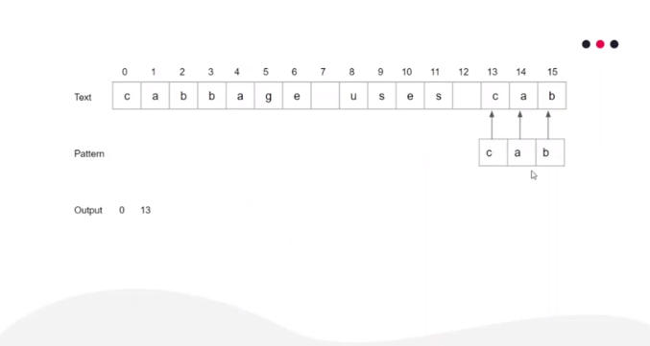
Sliding window algorithm
Problem statement
Given a text t and pattern p find whether p exist in t or not. In case it exist print all occurrence of pattern in text.

Slide 8
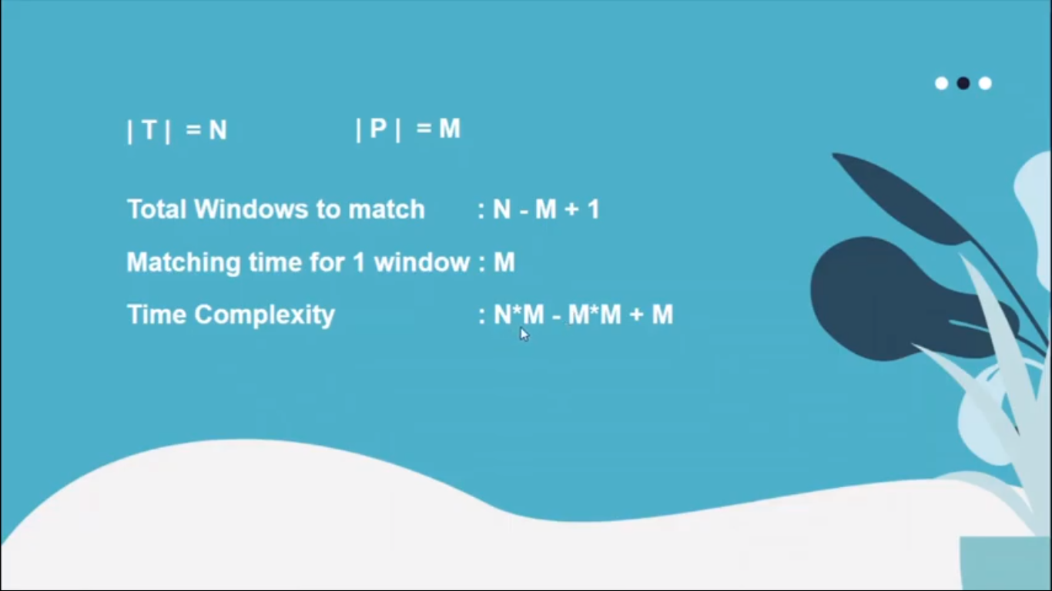
Time complexity

Slide 9
CODE

Slide 10
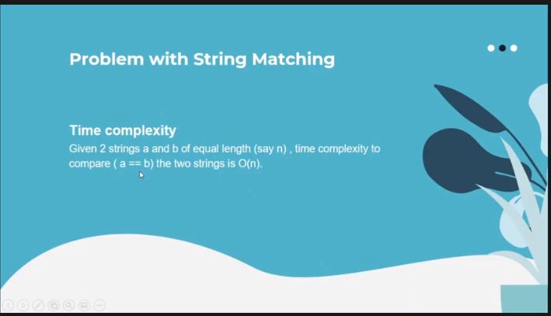
String hashing

Slide 11
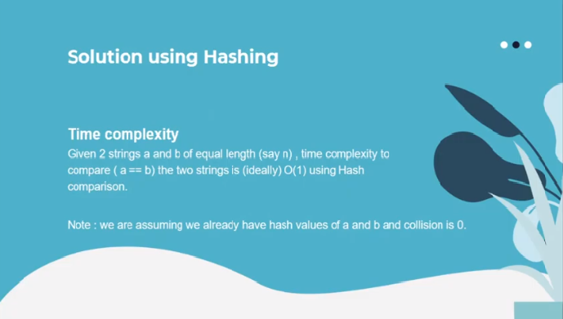

Slide 12
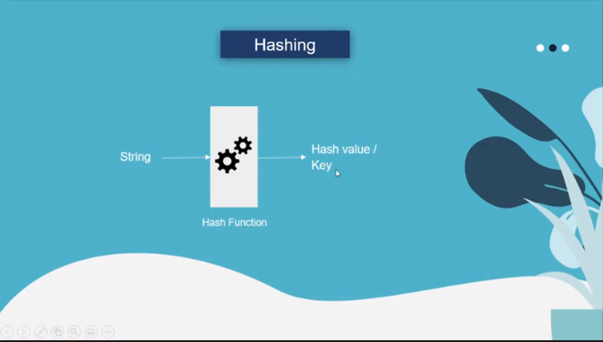

Slide 13
