Slide 1
Competive programming
tutorial

Slide 2
Prime numbers

Slide 3
Better way
#include<bits/stdc++.h>
using namespace std;
int main()
{
int n,count =0;
cin>>n;
for(int i=2;i*i<=n;i++)
{
if(n%i==0)
{
cout<<"no"<<endl;
exit(0);
}
}
cout<<"true";
}

Slide 4
Naïve approach

Slide 5
Why we need sieve?
Preprossing time : O(Nlog(lonN))
Answers query: O(1)
Extra space: O(N)
Run a loop till sqrt of (n)

Slide 6
sieve
#include <bits/stdc++.h>
using namespace std;
void SieveOfEratosthenes(int n)
{
bool prime[n+1];
memset(prime, true, sizeof(prime));
for (int p=2; p*p<=n; p++)
{
if (prime[p] == true)
{
for (int i=p*2; i<=n; i += p)
prime[i] = false;
}
}
for (int p=2; p<=n; p++)
if (prime[p])
cout << p << " ";
}
int main()
{
int n;
cin>>n;
cout << "Following are the prime numbers smaller "
<< " than or equal to " << n << endl;
SieveOfEratosthenes(n);
return 0;
}

Slide 7
Nth prime number
#include<bits/stdc++.h>
#define vi vector<int>
using namespace std;
vi primes;
bool ar[90000001];
void sieve()
{
long long maxn=9000000;
ar[0]=ar[1]=true;
for(int i=1;i*i<=maxn;i++)
{

Slide 8
if(ar[i]==false)
{
for(int j=i*i;j<=maxn;j+=i)
{
ar[j]=true;
}
}
}
for(int i=2;i<=maxn;i++)
{
if(ar[i]==false)
primes.push_back(i);
}

Slide 9
}
int main()
{
int q;
long long n;
cin>>q;
sieve();
while(q--)
{
cin>>n;
cout<<primes[n-1]<<endl;
}
return 0;
}

Slide 10
/Binary Exponentiation
#include<bits/stdc++.h>
using namespace std;
void power(int n,int base)
{
int res=1;
while(n)
{
if(n%2)
{
res*=base;
n--;

Slide 11
}
else
{
base*=base;
n/=2;
}
}
cout<<res;
}
int main()
{
int n,base;
cin>>n>>base;
power(n, base);
}

Slide 12
Prime factorization
Brute force appraoch
#include<bits/stdc++.h>
using namespace std;
int main()
{
int n;
cin>>n;
for(int i=2;i<=n;i++)
{

Slide 13
if(n%i==0)
{
int count=0;
while(n%i==0)
{
count++;
n/=i;
}
cout<<i<<"^"<<count<<endl;
}
}
}

Slide 14
Optimized approach

Slide 15
Matrix exponention
Given matrix a and an integer n calculate a^n
Time complexity = O(m^3*n)
After modification
Time complexity = O(m^3 * logn)

Slide 16
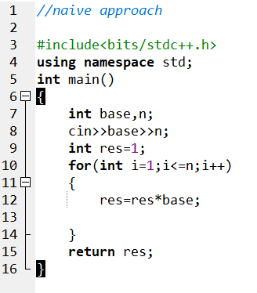

Slide 17
For matrix naïve approach

