Slide 1
CHANNELIZATION
Channelization is a multiple-access method in which the available bandwidth of a link is shared in time, frequency, or through code, between different stations.
Frequency-Division Multiple Access (FDMA)
Time-Division Multiple Access (TDMA)
Code-Division Multiple Access (CDMA)

Slide 2
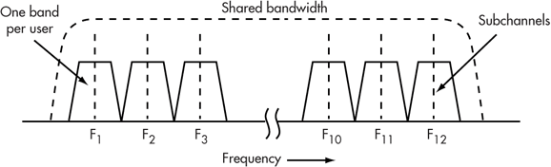
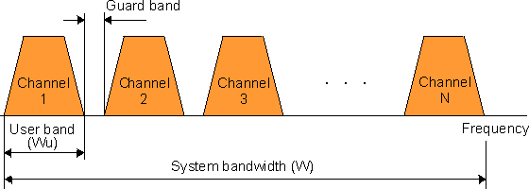
In FDMA, the available bandwidth
of the common channel is divided into bands that are separated
by guard bands.

Slide 3
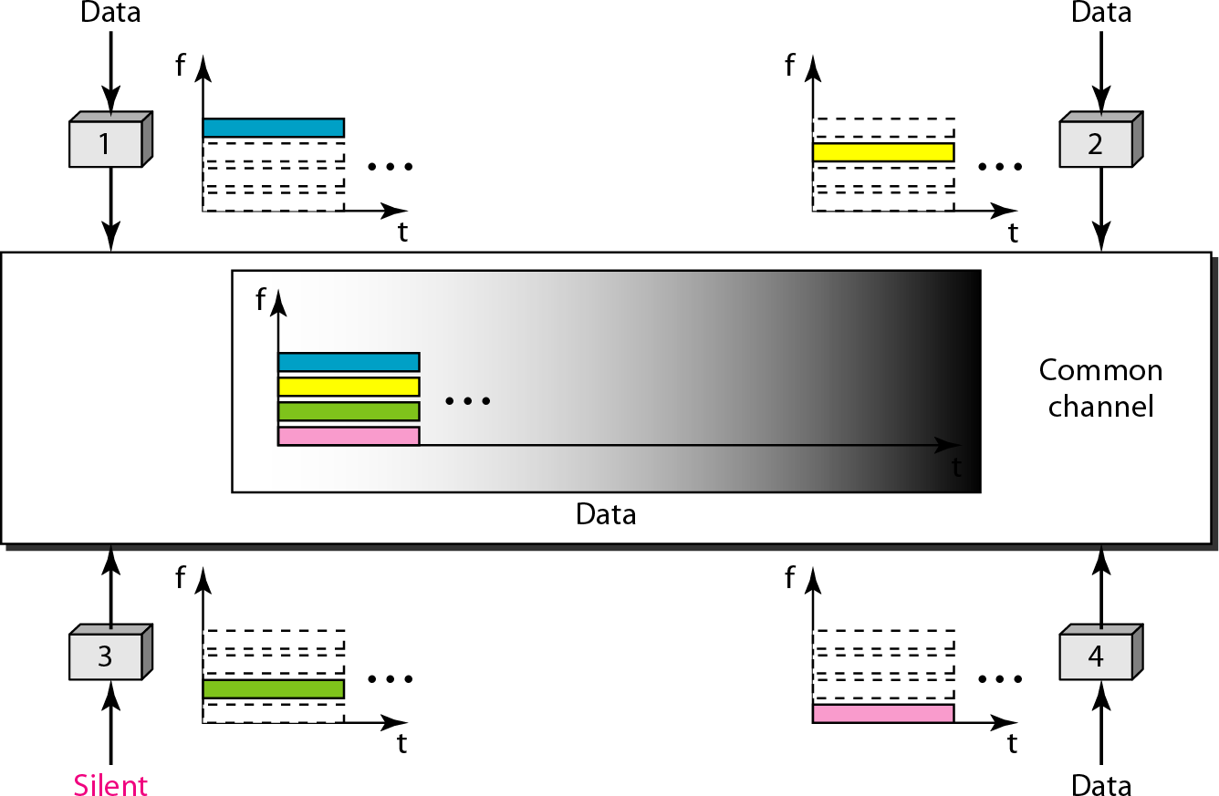
Frequency-division multiple access (FDMA)

Slide 4
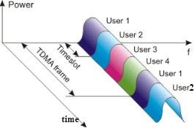
In TDMA, the bandwidth is just one channel that is timeshared between different stations.

Slide 5
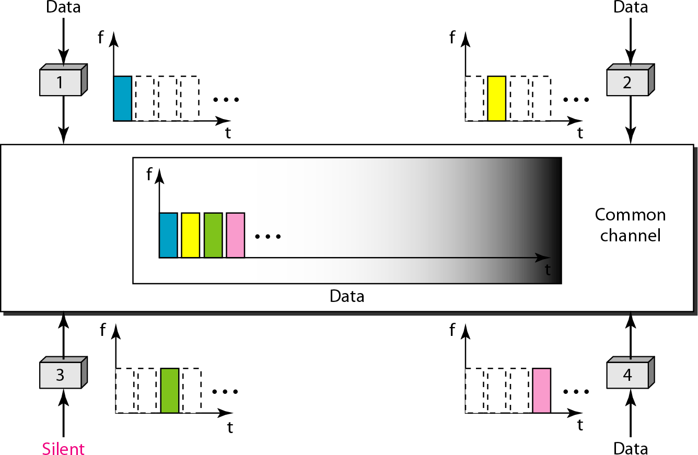
Time-division multiple access (TDMA)

Slide 6
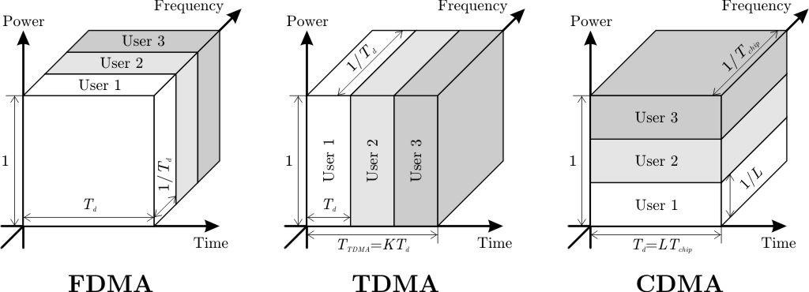
In CDMA, one channel carries all transmissions simultaneously.

Slide 7
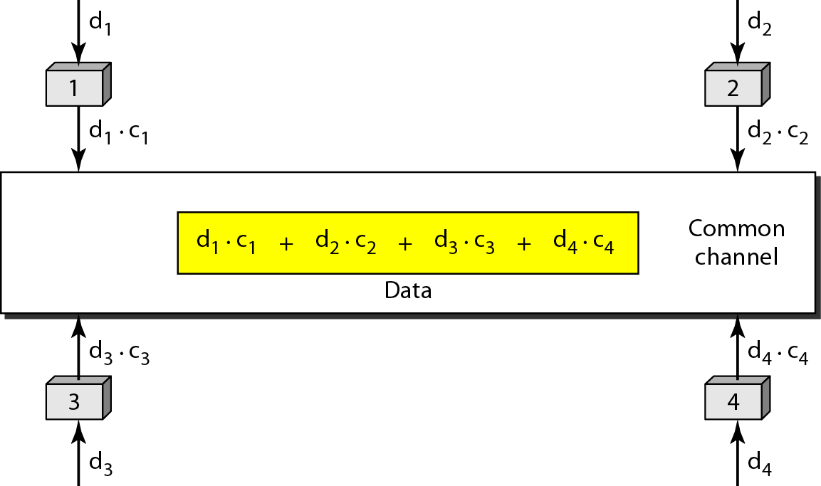
Simple idea of communication with code using CDMA

Slide 8
Data representation in CDMA
Chip sequences

Slide 9
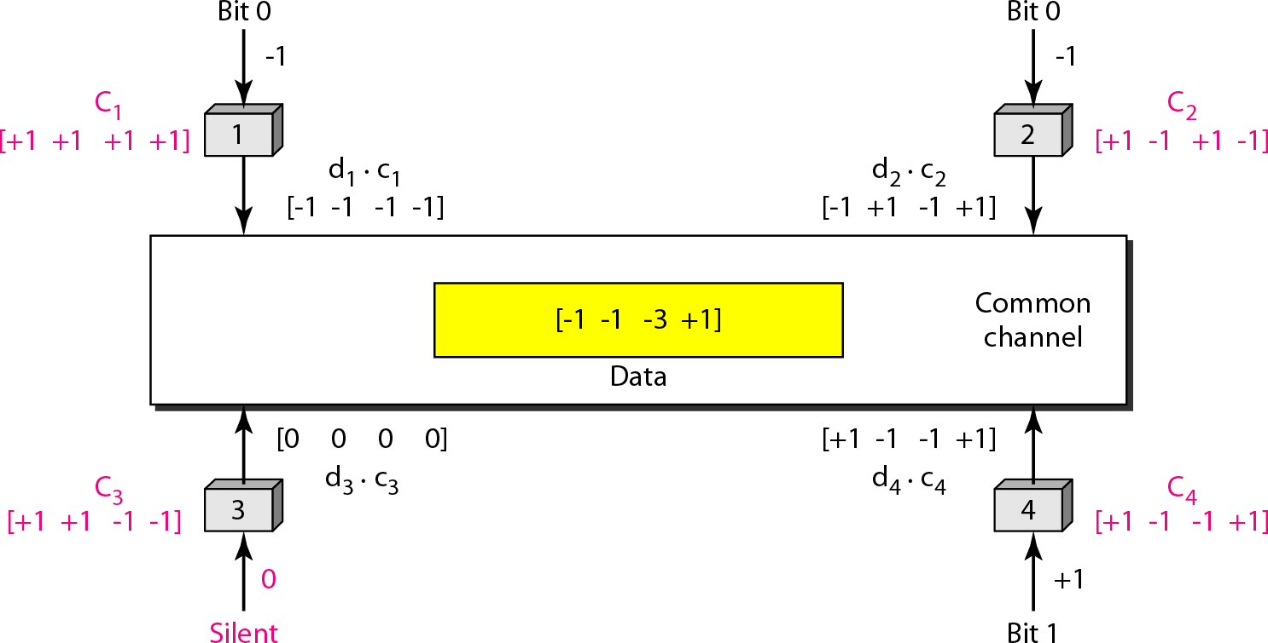
Sharing channel in CDMA

Slide 10
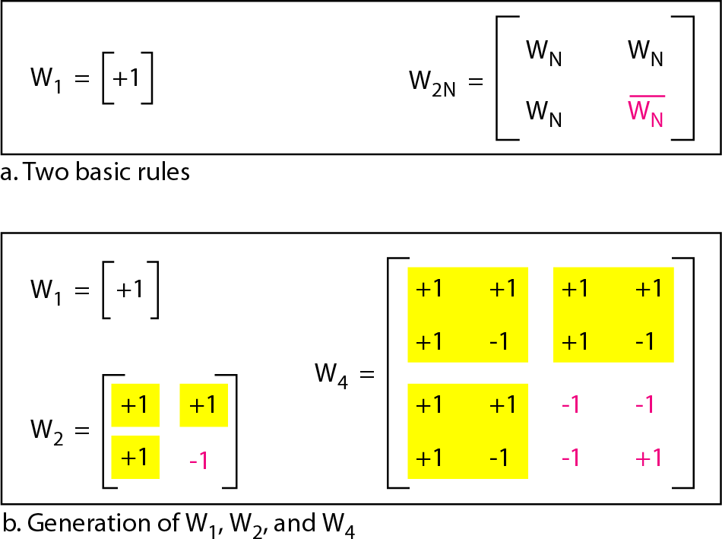
General rule and examples of creating Walsh tables

Slide 11



The number of sequences in a Walsh
table needs to be N = 2^{m}.
Walsh codes are the most common orthogonal codes used in CDMA applications. A set of Walsh codes of length n consists of the n rows of an n×n Walsh matrix. The matrix is defined recursively in previous diagram where n is the dimension of the matrix and the overscore denotes the logical NOT of the bits in the matrix. The Walsh matrix has the property that every row is orthogonal to every other row and to the logical NOT of every other row.
It is easily seen that a bitwise multiplication of any two rows produces 0.
For example, in the 8×8 matrix, row 3 multiplied by row 4 equals 1+(-1)+1+(-1)+1+(-1)+1+(-1)=0.

Slide 12
Find the chips for a network with
a. Two stations b. Four stations
Solution
We can use the rows of W2 and W4 in previous figure:
For a two-station network, we have
[+1 +1] and [+1 −1].
For a four-station network we have
[+1 +1 +1 +1], [+1 −1 +1 −1],
[+1 +1 −1 −1], and [+1 −1 −1 +1].

Slide 13
What is the number of sequences if we have 90 stations in our network?
Solution
The number of sequences needs to be 2^{m}.
We need to choose m = 7 and
N (Number of Stations) = 2⁷ or 128.
We can then use 90
of the sequences as the chips.

Slide 14
FDMA vs TDMA vs CDMA

Slide 15
Approach | TDMA | FDMA | CDMA
Idea | Divide sending time into disjoint time slots demand driven or fixed patterns. | Divide the frequency band into disjoint subbands | Spread the spectrum using orthogonal codes.
Terminals | All terminals are active for short periods of time on same frequency. | Every terminal has its own frequency uninterrupted | All terminals can be active at the same place at the same moment uninterrupted.
Signal separation | Synchronization in time domain | Filtering in the frequency domain. | Code plus special receivers.
Transmission scheme | Discontinuous | Continuous | Continuous
Advantages | Established fully digital, flexible | Simple, established, robust | Flexible, less frequency planning needed, soft handover
Disadvantages | Guard space needed (multipath propagation), synchronization difficult | Inflexible, frequencies are limited resource | Complex receivers, needs more complicated power control for senders

Slide 16
IEEE 802 Standards
In 1985, the Computer Society of the IEEE (The Institute of Electrical and Electronics Engineers) started a project, called Project 802, to set standards to enable intercommunication among equipment from a variety of manufacturers.
Project 802 is a way of specifying functions of the physical layer and the data link layer of major LAN protocols.

Slide 17
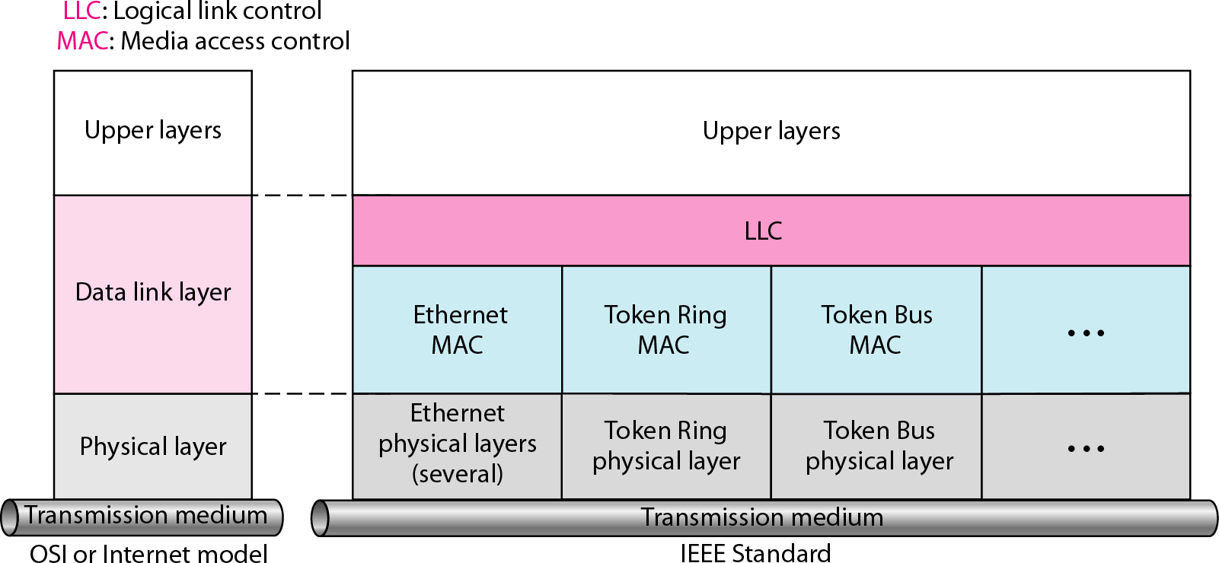
IEEE standard for LANs

Slide 18
IEEE standard for LANs
IEEE has standardized a number of LANs and MANs under the name of IEEE 802. A few have survived but many have not.
The most important of the survivors are 802.3
(Ethernet) and 802.11 (wireless LAN)
For 802.15 (Bluetooth) and 802.16 (wireless MAN), it is too early to tell.
Both 802.3 and 802.11 have different physical layers and different MAC sublayers but converge on the same logical link control sublayer (defined in 802.2), so they have the same interface to the network layer.

Slide 19
Notable IEEE Standards formats
IEEE 802 | LAN/MAN
IEEE 802.1 | Standards for LAN/MAN bridging and management and remote media access control (MAC) bridging.
IEEE 802.2 | Standards for Logical Link Control (LLC) standards for connectivity.
IEEE 802.3 | Ethernet Standards for Carrier Sense Multiple Access with Collision Detection (CSMA/CD).
IEEE 802.4 | Standards for token passing bus access.
IEEE 802.5 | Standards for token ring access and for communications between LANs and MANs
IEEE 802.6 | Standards for information exchange between systems.
IEEE 802.7 | Standards for broadband LAN cabling.
IEEE 802.8 | Fiber optic connection.

Slide 20
IEEE 802.9 | Standards for integrated services, like voice and data.
IEEE 802.10 | Standards for LAN/MAN security implementations.
IEEE 802.11 | Wireless Networking – "Wi-Fi".
IEEE 802.12 | Standards for demand priority access method.
IEEE 802.14 | Standards for cable television broadband communications.
IEEE 802.15.1 | Bluetooth
IEEE 802.15.4 | Wireless Sensor/Control Networks – "ZigBee"
IEEE 802.15.6 | Wireless Body Area Network (BAN) – (e.g. Bluetooth low energy)
IEEE 802.16 | Wireless Networking – "WiMAX"

Slide 21
IEEE 802.3(Wired LAN’s: Ethernet)
IEEE 802.3 is a working group and a collection
standards produced by the working group defining
of IEEE
the
physical layer and data link layer's media access control (MAC) of wired Ethernet. This is generally a local area network technology with some wide area network applications.
Physical connections are made between nodes infrastructure devices (hubs, switches, routers) by types of copper or fiber cable.
and/or various
802.3 also defines LAN access method using CSMA/CD.

Slide 22
What is Ethernet?
Ethernet is a family of computer networking technologies for local area networks (LANs) and metropolitan area networks (MANs). It was commercially introduced in 1980 and first standardized in 1983 as IEEE 802.3 and has since been refined to support higher bit rates and longer link distances.
Over time, Ethernet has largely replaced competing wired
LAN technologies such as token ring, FDDI, and ARCNET.

Slide 23
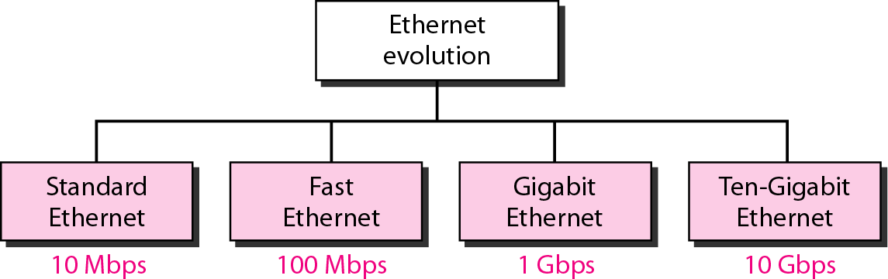
Ethernet evolution through four generations

Slide 24
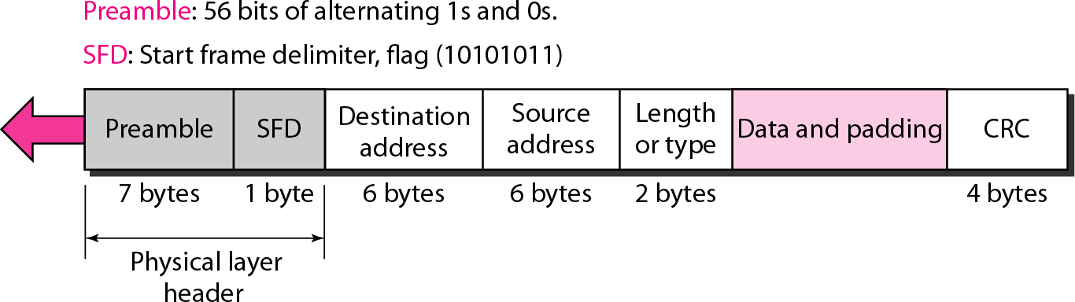
802.3 MAC Frame Format

Slide 25
Ethernet frame format (more details of terms used)
Preamble Bits + SFD:
(Preamble Sequence of 10101010s. 7 bytes)
(SFD, Start of Frame delimiter, for compatibility with 802.4 and 802.5)
Addresses: 2 or 6 bytes.
high-order bit of the destination address:
0 for ordinary addresses
1 for group addresses.
bit 46 - global or local address.
Type: specifies which process to give the frame to.
(Any number <=1500 is treated as length or as type otherwise.)
Data: up to 1500 bytes.
Pad: (optional) The frame must be at least 64 bytes in total!
Checksum: CRC based on this polynomial: x³²+x²⁶+x²³+x²²+x¹⁶+x¹²+x¹¹+x¹⁰+x⁸+x⁷+x⁵+x⁴+x²+x+1

Slide 26
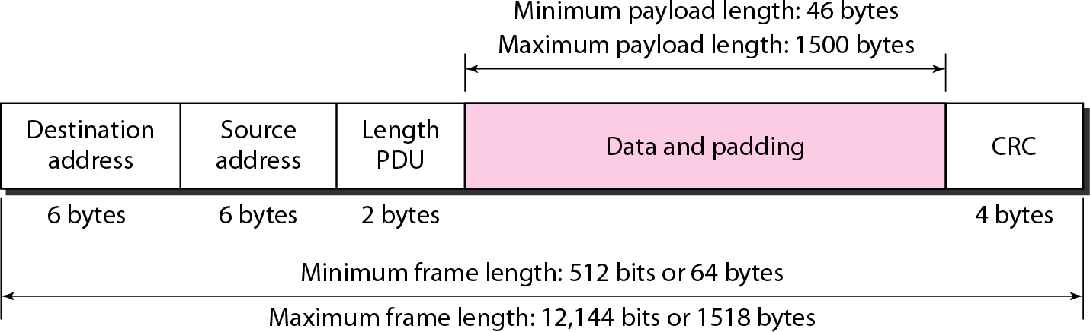
Minimum and maximum lengths

Slide 27
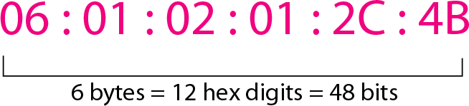
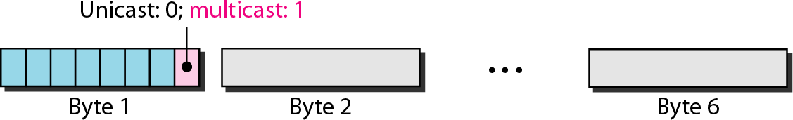
Example of an Ethernet address in hexadecimal notation
The least significant bit of the first byte defines the type of address.
If the bit is 0, the address is unicast; otherwise, it is multicast.
The broadcast destination address is a special case of the multicast address in which all bits are 1s.

Slide 28
Define the type of the following destination addresses: a. 4A:30:10:21:10:1A b. 47:20:1B:2E:08:EE
c. FF:FF:FF:FF:FF:FF
Solution
To find the type of the address, we need to look at the second hexadecimal digit from the left. If it is even, the address is unicast. If it is odd, the address is multicast. If all digits are F’s, the address is broadcast. Therefore, we have the following:
This is a unicast address because A in binary is 1010.
This is a multicast address because 7 in binary is 0111.
This is a broadcast address because all digits are F’s.

Slide 29
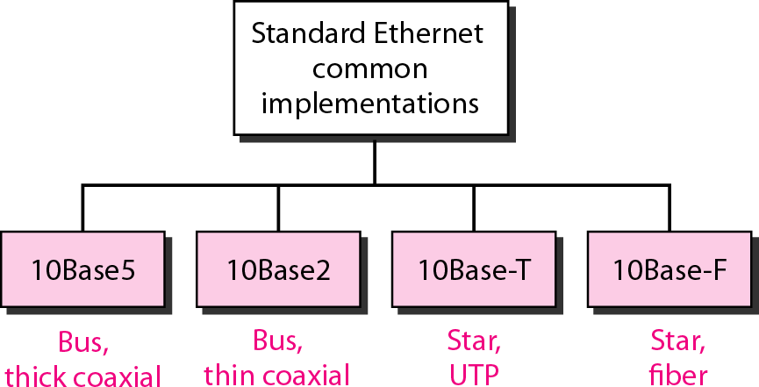
(802.3)
Categories of Standard Ethernet

Slide 30
Ethernet Cabling
Name | Cable | Max seg. (m) | Nodes per segment | Advantages
10Base5 | thick coax | 500 | 100 | The Original
10Base2 | thin coax | 185 | 30 | no hub
10Base-T | twisted pair (UTP) | 100 | 1024 | cheapest
10Base-F | fiber | 2000 | 1024 | long distance

Slide 31
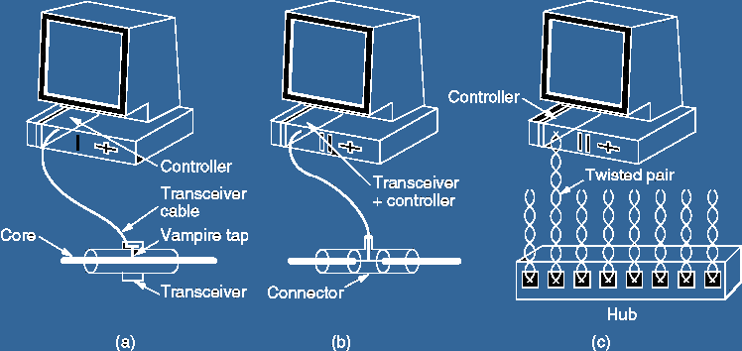
Three kinds of Ethernet cabling
10Base5 10Base2 10Base-T
Term Used:
A transceiver is a device comprising both a transmitter and a receiver that are combined and share common circuitry or a single housing.

Slide 32
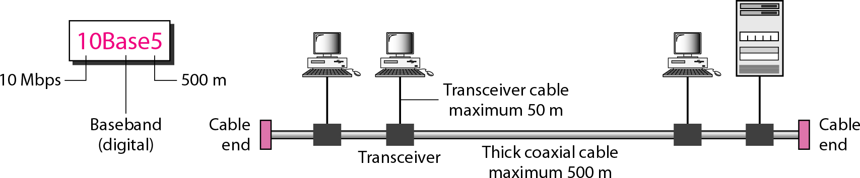
10Base5 implementation
Term Used:
A transceiver is a device comprising both a transmitter and a receiver that are combined and share common circuitry or a single housing.

Slide 33
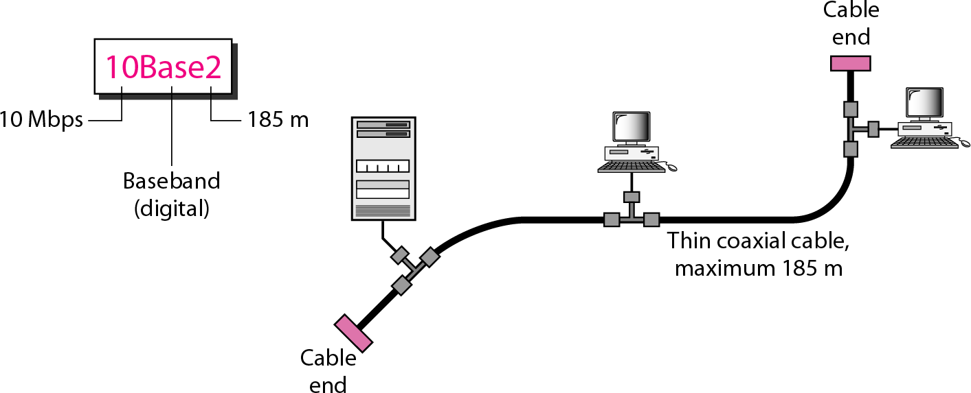
10Base2 implementation

Slide 34
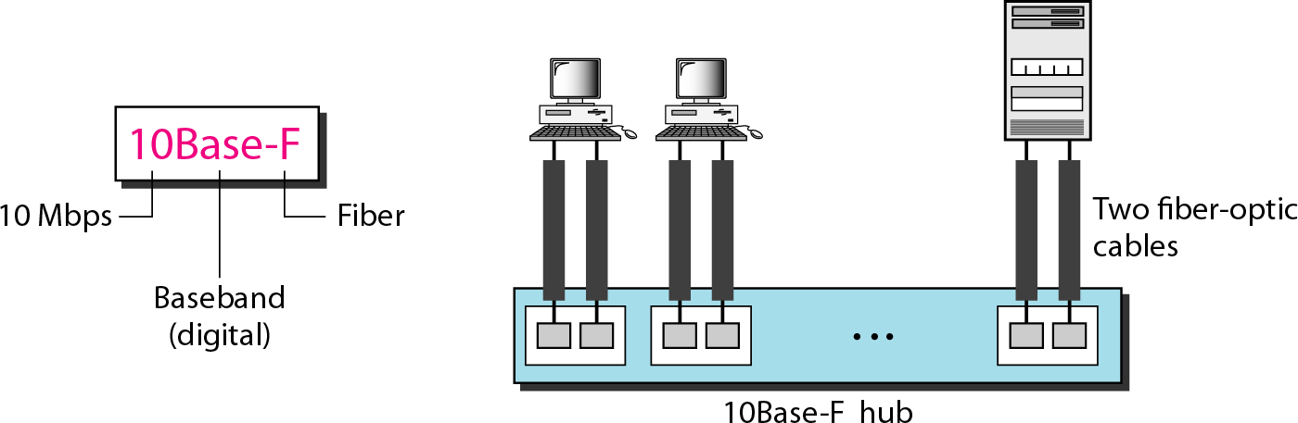
10Base-F implementation

Slide 35
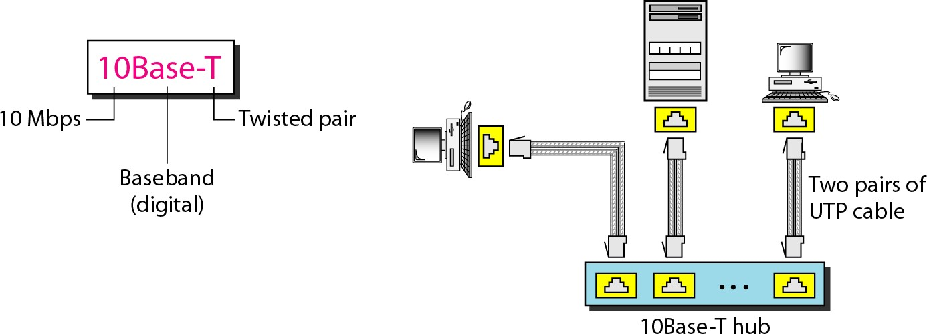
10Base-T implementation

Slide 36
Ethernet-802.3
Following table mentions different 10 Mbps Ethernet such as 10BASE5, 10BASE2, 10BASE-F and 10BASE-T.
Specification | 10BASE5 | 10BASE2 | 10BASE-F | 10BASE-T
Maximum segment length | 500 m | 185 m | varies from 400 m to 2000 m | 100m
topology | Bus | Bus | Star | Star
medium | 50-"omega" thick coax. | 50-"omega" thin coax. | multimode fiber | 100-"omega" UTP
connector | NICDB15 | BNC | ST | RJ-45
Medium attachment | MAU bolted to coax | ethernal or on NIC | External or on NIC | External or on NIC
stations/cable segment | 100 | 30 | N/A | 2(NIC, repeater)
Maximum | 5 | 5 | 5 | 5 segments

Slide 37
Fast Ethernet-802.3u
The ethernet working at the speed of 100Mbps is referred as fast ethernet. IEEE standard 802.3u fast ethernet/100BASE-T specified in May1995. The features of this type of fast ethernet are as follows:
Includes multiple Physical layers.
It uses original ethernet MAC but operates at 10 times higher speed.
It needs star wired configuration with central hub.
The MAC parameters are same as described for ethernet
above. There are three physical layers for fast ethernet.
100BASE-TX: Needs 2 pairs of cat.5 UTP/Type1 STP cables
100BASE-FX: Needs 2 strands of multimode fiber
100BASE-T4: Needs 4 pairs of cat.3
Following table summarizes different versions of 100BASE-T
physical layers -

Slide 38
Fast Ethernet-802.3u
Specification | 100BASE-Tx | 100BASE-Fx | 100BASE-T4
IEEE standard | 802.3u-1995 | 802.3u-1995 | 802.3u-1995
cabling | UTP cat.5 or STP | Multimode or single mode fiber | UTP cat.3/4/5
signal frequency | 125 MHz | 125 MHz | 25 MHz
No. of pairs needed | 2 | 2 | 4
No. of transmit pairs | 1 | 1 | 3
distance | 100m | 150/412/2000 m | 100m
Full duplex capabilities | Yes | Yes | No

Slide 39
Gigabit Ethernet-802.3z
The ethernet working at the speed of 1000Mbps (i.e. 1Gbps)
and above is referred as Gigabit ethernet.
Gigabit Ethernet uses 802.3 frame format same as 10Mbps ethernet and 100Mbps fast Ethernet It also operates in half duplex and full duplex modes. There are various Gigabit ethernet versions which operates at 1 Gigabit, 10 Gigabit, 40 Gigabit and 100 Gigabit per second speeds.
There are various versions for 10 Gbps ethernet such as
10GBASE-T, 10GBASE-R, 10GBASE-X and 10GBASE-W.
MAC parameters for gigabit ethernet are same as mentioned
above in ethernet. Except slot time which is 512 byte times.

Slide 40
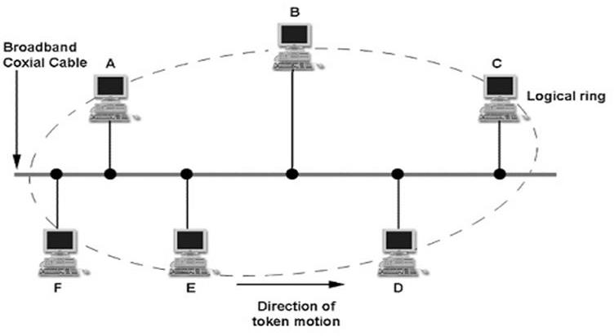
Token Bus – IEEE 802.4
A network which implements the modified Token Ring protocol over a "virtual ring" on a coaxial cable with a bus topology.
It is mainly used for industrial applications.

Slide 41
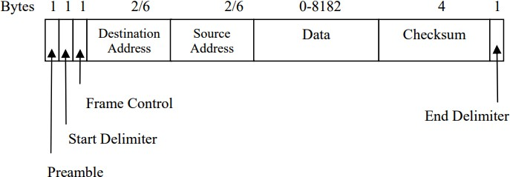
Token Bus – IEEE 802.4 (contd.)
The IEEE 802.4 is a popular standard for the bus based token passing LANs. In a token bus LAN, the physical media is a bus and a logical ring as shown in the figure is created. The token is passed from one user to other in a sequence, decided in the logical ring. IEEE 802.4 frame is as shown in the figure-

Slide 42
Token Bus – IEEE 802.4 (contd.)
The preamble is used to synchronize the receiver’s clock, which, unlike as in 802.3, may be as short as 1 byte. The start and end delimiter fields are used to mark the frame boundaries. The frame control field is used to distinguish data frames from control frames. For data frames, it carries the frame’s priority. The token bus defines four priority classes-0, 2, 4 and 6 for traffic, with 0 the lowest and 6 the highest. To understand priority classes, each station can be thought of being internally divided into four substations, one at each priority level.
When the token comes into the station over the cable, it is passed internal to the priority 6 sub station, which may begin transmitting frames, if it has any. When it is done, or when its timer expires, the token is passed internally to the priority 4 sub station and so on up to priority 0 so four timers are used to control the internal flow of token at a station. By setting the timers properly, a guaranteed fraction of the token holdingtime can be allocated to priority 6 traffic.
For control frames, frame control field is used to specify the frame types, which include, token passing and various ring maintenance frames. The data field may be up to 8182 bytes long, when 2 byte addresses are used and up to 8174 bytes long when 6 byte addresses are used. The checksum is used to detect transmission errors, which uses the same polynomialalgorithmas in 802.3.

Slide 43
Control Token or Token Passing
Another way of controlling access to a shared transmission
medium is by a control token (Token Passing)
The Control Token technique uses a control or permission token to share the communication resource between a number of nodes. The technique can be applied to both bus and ring network topologies.
This token is passed from one station to another according to a
defined set of rules
A station may transmit a frame only when it has possession of the token and after it has transmitted the frame, it passes the token on, to allow another station to access the transmission medium.

Slide 44


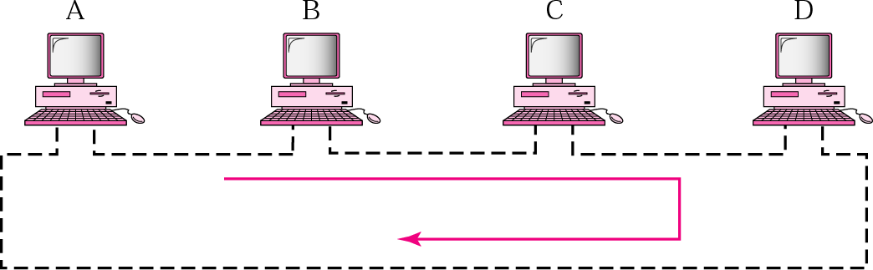
Token passing network
A token always circulates around a ring net.
A user grabs a token to transmit data

Slide 45
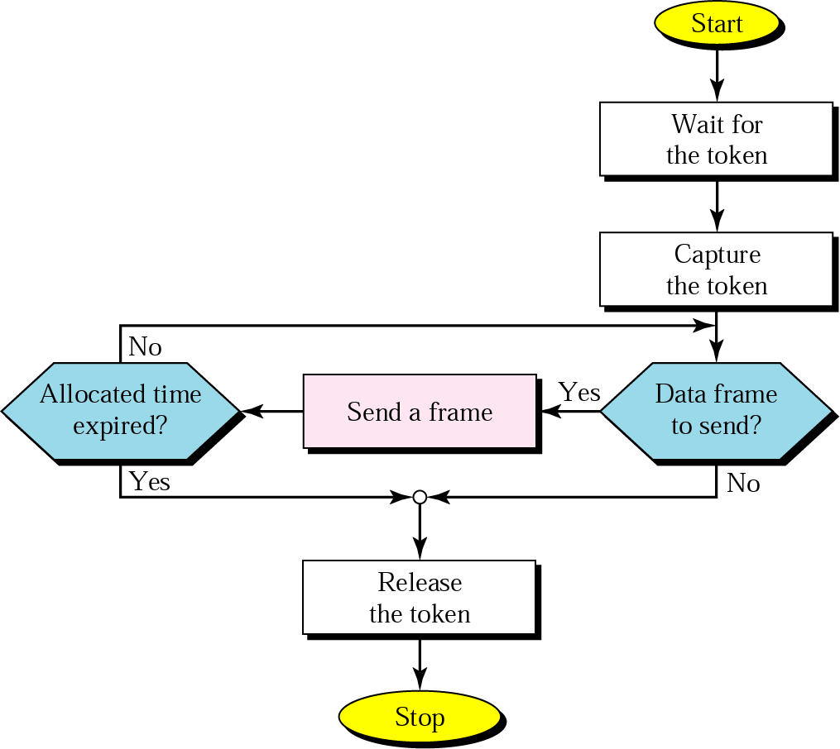
Control Token procedure

Slide 46
Token Ring – IEEE 802.5
A ring topology network developed in the 1970s. Supported
mainly by IBM.
A LAN protocol which resides at the data link layer (DLL) of the
OSI model.
In cases of heavy traffic, the token ring network has higher throughput than ethernet due to the deterministic (non- random) nature of the medium access.
Is used in applications in which delay when sending data must
be predictable
Is a robust network i.e. it is
management mechanisms
Can support data rates of around 16 Mbps.
Typically uses twisted pair
fault tolerant through fault

Slide 47
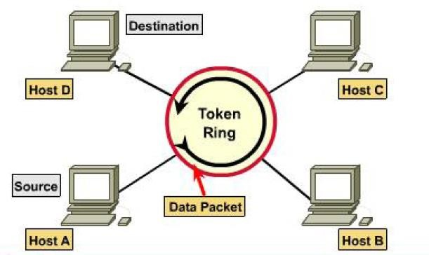
Token Ring – IEEE 802.5

Slide 48
Token Ring Operation
When nobody is transmitting a token circles.
When a station needs to transmit data, it converts the token into
a data frame.
When the sender receives its own data frame, it converts the
frame back into a token.
If an error occurs and no token frame, or more than one, is present, a special station (“Active Monitor”) detects the problem and removes and/or reinserts tokens as necessary.
The Abort frame: used to abort transmission by the sending
station.

Slide 49
Active and Standby monitors
Every station in a token ring network is either an Active monitor (AM) or Standby monitor (SM) station. There can be only one active monitor on a ring at a time. The active monitor is chosen through an election or monitor contention process.
The monitor contention process is initiated when
A loss of signal on the ring is detected,
An AM station is not detected by other stations, or
When a timer on an end station expires (the station hasn't seen a token in the past 7 seconds).
When any of the above conditions take place and a station decides that a
new AM is needed.
The AM performs a number of ring management functions and roles:
Master clock for the ring, synchronization.
Inserts a 24-bit delay into the ring for sufficient buffering.
To support exactly one token and there is no frame being transmitted.
Detects a broken ring.
Removes circulating frames from the ring.

Slide 50
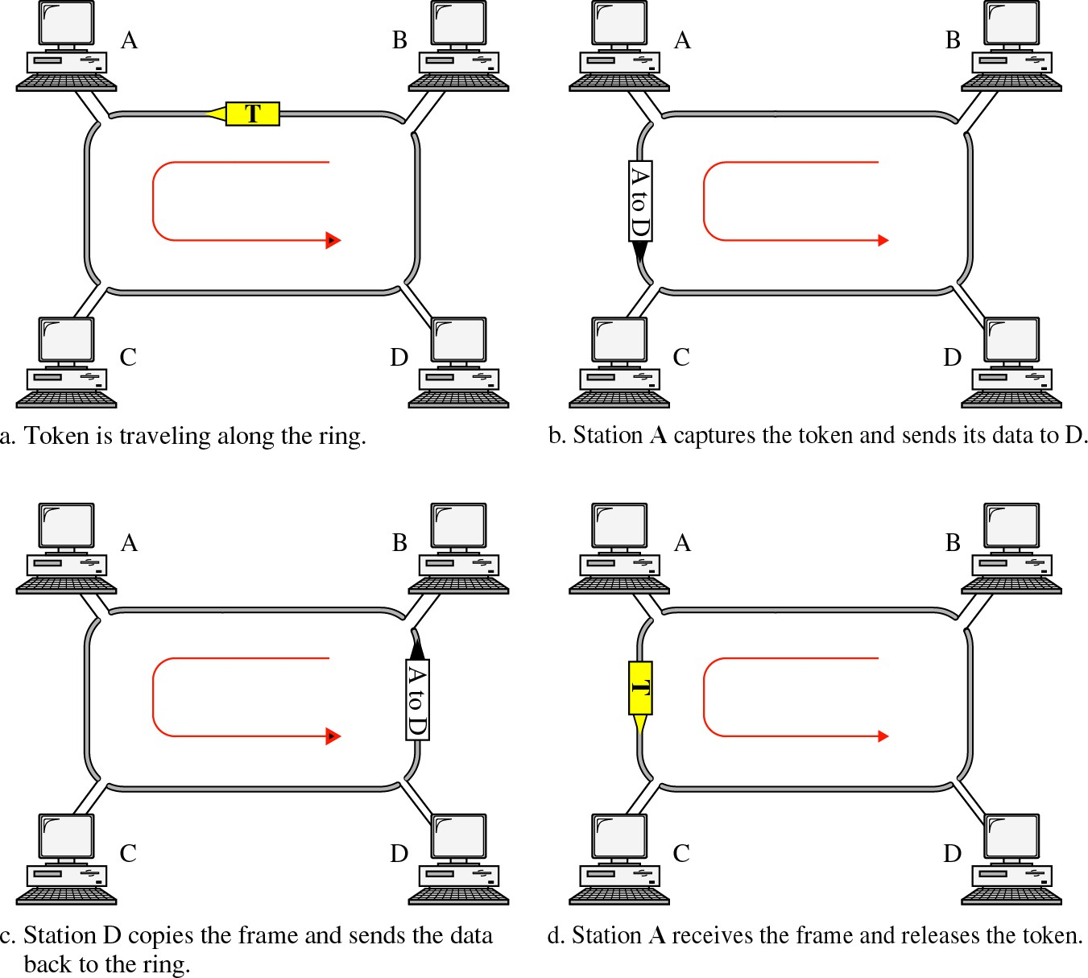

Slide 51
Token Ring frame formats
Data or command frame
SD | AC | FC | DA | SA | PDU from LLC (IEEE 802.2) | CRC | ED | FS
8 bits | 8 bits | 8 bits | 48 bits | 48 bits | up to 18200x8 bits | 32 bits | 8 bits | 8 bits
Token
Abort frame
SD | AC | ED
8 bits | 8 bits | 8 bits
SD | ED
8 bits | 8 bits
SD: Starting delimiter AC: Access control FC: Frame control
DA: Destination address
SA: Source address
PDU: data
CRC: check sum ED: End delimiter FS: Frame status

Slide 52
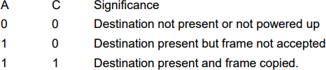
Token Ring frame formats
The starting and ending delimiter fields mark the beginning and ending of the frame. Each contains invalid differential Manchester patterns to distinguish them from data bytes. The access control byte contains the token bit, and also the monitoring bit, priority bits and reservation bits. The frame control byte, distinguishes data frames from various possible control frames. The frame status byte contains A and C bits. When a frame arrives at the interface of a station with the destination address, the interface turns on the A bit as it passes through. If the interface copies the frame to the station, it also turns on the C bit. A station might fail to copy a frame due to lack of buffer space or other reasons.
The ending delimiter contains an E bit which is set if any interface detects an
error.

Slide 53
Question:
A 8-Mbps token ring has a token holding timer value of 10 msec. What is the longest frame (assume header bits are negligible) that can be sent on this ring?
Answer:
At 8 Mbps, a station can transmit 80,000 bits or 10,000 bytes in 10 msec.
This is an upper bound on frame length.
From this amount, some overhead must be subtracted, giving a
slightly lower limit for the data portion.

