Slide 1
Red-Black Trees
CS302 Data Structures
Dr. George Bebis

Slide 2
Red-Black Trees
Binary search tree with an additional attribute for its nodes: color which can be red or black
Constrains the way nodes can be colored on any path from the root to a leaf.
Balanced tree → O(logN)

Slide 3
Example: RED-BLACK-TREE
26
17
41
NIL
NIL
30
47
38
NIL
50
NIL
NIL
NIL
NIL
NIL
For convenience, we add NIL nodes and refer to them as the leaves of the tree.
  Color[NIL] = BLACK

Slide 4
Red-Black-Trees Properties
(**Binary search tree property is satisfied**)
Every node is either red or black
The root is black
Every leaf (NIL) is black
If a node is red, then both its children are black
  No two consecutive red nodes on a simple path
  from the root to a leaf
For each node, all paths from that node to a leaf contain the same number of black nodes

Slide 5
Definitions
h = 4
bh = 2
26
h = 1
bh = 1
h = 3
bh = 2
17
41
NIL
NIL
h = 2
bh = 1
h = 2
bh = 1
30
47
h = 1
bh = 1
38
50
h = 1
bh = 1
NIL
NIL
NIL
NIL
NIL
NIL
Height of a node: the number of edges in the longest path to a leaf.
Black-height bh(x) of a node x: the number of black nodes (including NIL) on the path from x to a leaf, not counting x.

Slide 6
Height of Red-Black-Trees
A red-black tree with n internal nodes
has height at most 2log(N+1)
Need to prove two claims first …

Slide 7
Claim 1
Any node x with height h(x) has bh(x) ≥ h(x)/2
Proof
  By property 4, at most h/2 red nodes on the path from the node to a leaf
  Hence at least h/2 are black
h = 4
bh = 2
26
h = 1
bh = 1
h = 3
bh = 2
17
41
NIL
NIL
h = 2
bh = 1
h = 2
bh = 1
30
47
h = 1
bh = 1
38
50
h = 1
bh = 1
NIL
NIL
NIL
NIL
NIL
NIL

Slide 8
Claim 2
The subtree rooted at any node x contains at least 2^{bh(x)} - 1 internal nodes
h = 4
bh = 2
26
h = 1
bh = 1
h = 3
bh = 2
17
41
NIL
NIL
h = 2
bh = 1
h = 2
bh = 1
30
47
h = 1
bh = 1
38
50
h = 1
bh = 1
NIL
NIL
NIL
NIL
NIL
NIL

Slide 9
Claim 2 (cont’d)
Proof: By induction on h[x]
Basis: h[x] = 0 ⇒
x is a leaf (NIL[T]) ⇒
bh(x) = 0 ⇒
# of internal nodes: 2⁰ - 1 = 0
Inductive Hypothesis: assume it is true for h[x]=h-1
x
NIL

Slide 10
Claim 2 (cont’d)
Inductive step:
Prove it for h[x]=h
internal nodes at x=
internal nodes at l +
internal nodes at r + 1
Using inductive hypothesis:
internal nodes at x ≥ (2^{bh(l)} – 1) + (2^{bh(r)} – 1) + 1
x
h
l
r
h-1

Slide 11
Claim 2 (cont’d)
Let bh(x) = b, then any child y of x has:
  bh (y) =
  bh (y) =
b (if the child is red), or
bh(y)≥bh(x)-1
b - 1 (if the child is black)
bh = 2
x
bh = 1
26
y₁
y₂
bh = 2
17
41
NIL
NIL
30
47
NIL
38
NIL
50
NIL
NIL

Slide 12
Claim 2 (cont’d)
So, back to our proof:
internal nodes at x ≥ (2^{bh(l)} – 1) + (2^{bh(r)} – 1) + 1
≥ (2^{bh(x) - 1} – 1) + (2^{bh(x) - 1} – 1) + 1 =
2 · (2^{bh(x) - 1} - 1) + 1 =
2^{bh(x)} - 1 internal nodes
x
h
l
r
h-1

Slide 13
Height of Red-Black-Trees (cont’d)
A red-black tree with N internal nodes has height at most 2log(N+1).
Proof:
N
Solve for h:
N + 1 ≥ 2^{h/2}
log(N + 1) ≥ h/2 ⇒
h ≤ 2 log(N + 1)
bh(root) = b
height(root) = h
root
≥ 2^{b} - 1
≥ 2^{h/2} - 1
number
of internal
nodes
l
r
Claim 2
Claim 1

Slide 14
Operations on Red-Black-Trees
Non-modifying binary-search-tree operations (e.g., RetrieveItem, GetNextItem, ResetTree), run in O(h)=O(logN) time
What about InsertItem and DeleteItem?
  They will still run on O(logN)
  Need to guarantee that the modified tree will still be a valid red-black tree

Slide 15
InsertItem
What color to make the new node?
Red? Let’s insert 35!
  Property 4 is violated: if a node is red, then both its children are black
Black? Let’s insert 14!
  Property 5 is violated: all paths from a node to its leaves contain the same number of black nodes
26
17
41
30
47
38
50

Slide 16
DeleteItem
26
17
41
What color was the
node that was removed? Black?
Every node is either red or black
The root is black
Every leaf (NIL) is black
If a node is red, then both its children are black
For each node, all paths from the node to descendant leaves contain the same number of black nodes
30
47
38
50
OK!
Not OK! If removing the root and the child that replaces it is red
OK!
Not OK! Could change the
black heights of some nodes
Not OK! Could create
two red nodes in a row

Slide 17
Rotations
Operations for re-structuring the tree after insert and delete operations
  Together with some node re-coloring, they help restore the red-black-tree property
  Change some of the pointer structure
  Preserve the binary-search tree property
Two types of rotations:
  Left & right rotations

Slide 18
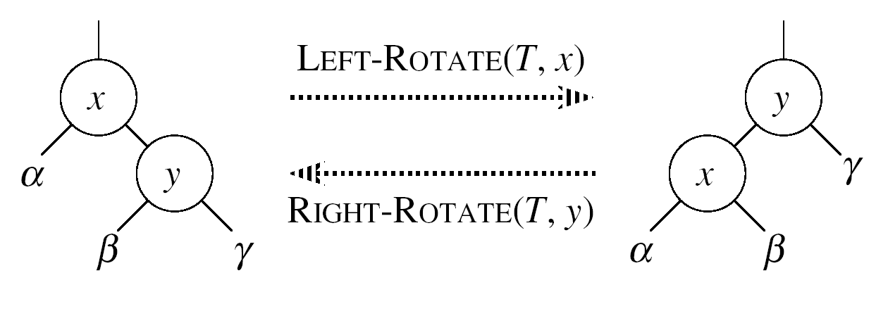
Left Rotations
Assumptions for a left rotation on a node x:
  The right child y of x is not NIL
Idea:
  Pivots around the link from x to y
  Makes y the new root of the subtree
  x becomes y’s left child
  y’s left child becomes x’s right child

Slide 19
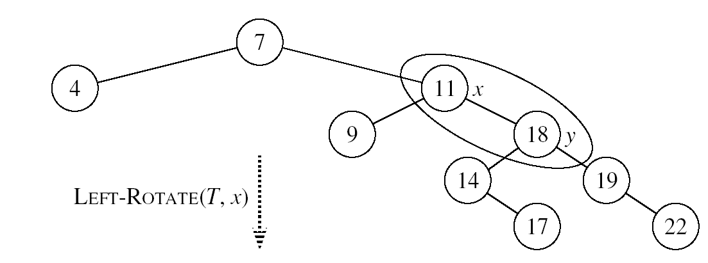
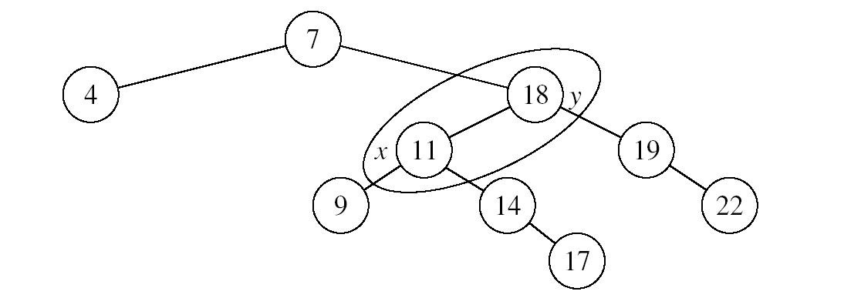
Example: LEFT-ROTATE

Slide 20
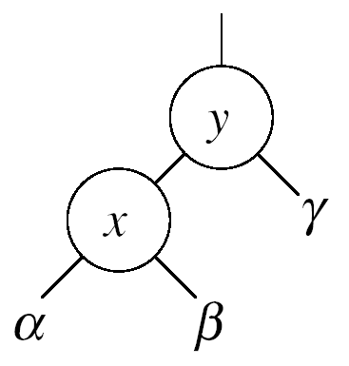
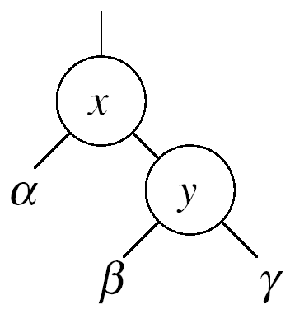


Right Rotations
Assumptions for a right rotation on a node x:
  The left child x of y is not NIL
Idea:
  Pivots around the link from y to x
  Makes x the new root of the subtree
  y becomes x’s right child
  x’s right child becomes y’s left child

Slide 21
InsertItem
Goal:
  Insert a new node z into a red-black tree
Idea:
  Insert node z into the tree as for an ordinary binary search tree
  Color the node red
  Restore the red-black tree properties
    i.e., use RB-INSERT-FIXUP

Slide 22
RB Properties Affected by Insert
OK!
Every node is either red or black
The root is black
Every leaf (NIL) is black
If a node is red, then both its children are black
For each node, all paths
from the node to descendant
leaves contain the same number
of black nodes
If z is the root
⇒ not OK
OK!
If p(z) is red ⇒ not OK
z and p(z) are both red
OK!
26
17
41
38
47
50

Slide 23
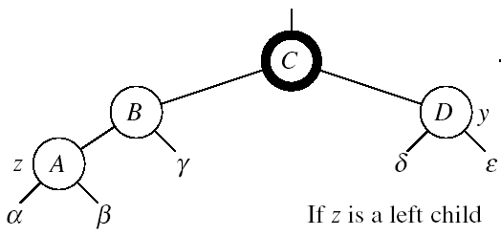
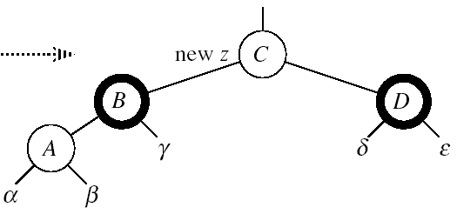
RB-INSERT-FIXUP
Case 1: z’s “uncle” (y) is red
(z could be either left or right child)
Idea:
p[p[z]] (z’s grandparent) must be black.
color p[z] ← black
color y ← black
color p[p[z]] ← red
z = p[p[z]]
  Push the “red” violation up the tree

Slide 24
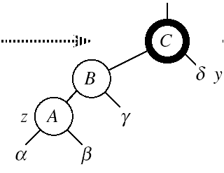
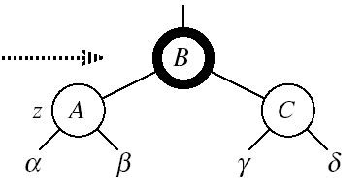
RB-INSERT-FIXUP
Case 2:
z’s “uncle” (y) is black
z is a left child
Idea:
color p[z] ← black
color p[p[z]] ← red
RIGHT-ROTATE(T, p[p[z]])
No longer have 2 reds in a row
p[z] is now black
Case 2

Slide 25
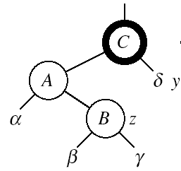
RB-INSERT-FIXUP
Case 3:
z’s “uncle” (y) is black
z is a right child
Idea:
z ← p[z]
LEFT-ROTATE(T, z)
⇒ now z is a left child, and both z and p[z] are red ⇒ case 2
Case 3
Case 2

Slide 26
Example
Insert 4
11
Case 1
11
Case 3
2
14
2
14
y
1
7
7
z
15
1
15
5
8
y
5
8
z and p[z] are both red
z’s uncle y is red
z and p[z] are both red
z’s uncle y is black
z is a right child
z
4
4
11
7
Case 2
z
7
14
y
2
11
z
2
8
15
1
5
8
14
1
5
z and p[z] are red
z’s uncle y is black
z is a left child
4
15
4

Slide 27
RB-INSERT-FIXUP(T, z)
while color[p[z]] = RED
do if p[z] = left[p[p[z]]]
then y ← right[p[p[z]]]
if color[y] = RED
then Case1
else if z = right[p[z]]
then Case2
Case3
else (same as then clause with “right” and “left” exchanged)
color[root[T]] ← BLACK
The while loop repeats only when
case1 is executed: O(logN) times
Set the value of x’s “uncle”
We just inserted the root, or
The red violation reached the root

Slide 28
Analysis of InsertItem
Inserting the new element into the tree O(logN)
RB-INSERT-FIXUP
  The while loop repeats only if CASE 1 is executed
  The number of times the while loop can be executed is O(logN)
Total running time of InsertItem: O(logN)

Slide 29
DeleteItem
Delete as usually, then re-color/rotate
A bit more complicated though …

Slide 30
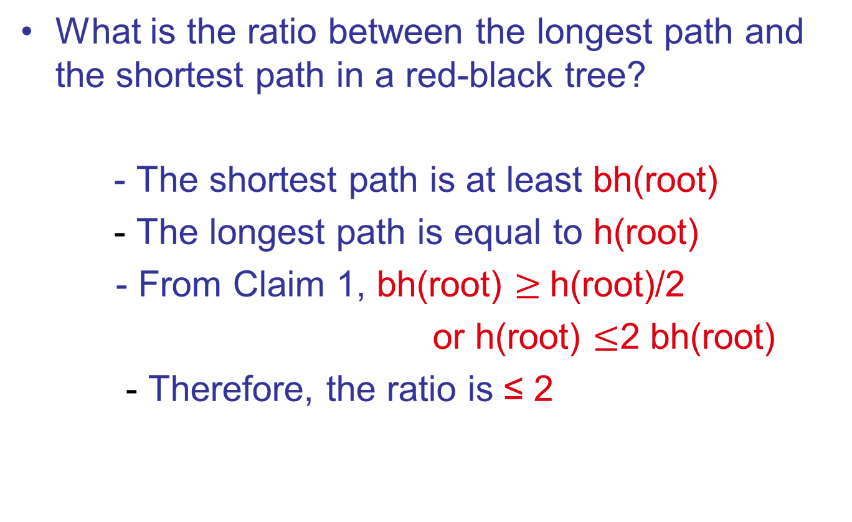
Problems

Slide 31
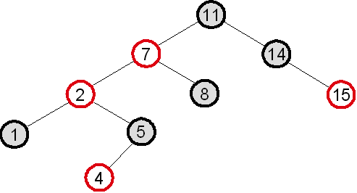
Problems
What red-black tree property is violated in the tree below? How would you restore the red-black tree property in this case?
  Property violated: if a node is red, both its children are black
  Fixup: color 7 black, 11 red, then right-rotate around 11
7
z
2
11
1
5
8
14
4
15

Slide 32
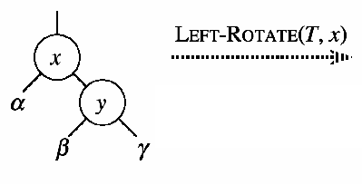
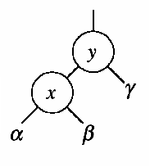
Problems
Let a, b, c be arbitrary nodes in subtrees α, β, γ in the tree below. How do the depths of a, b, c change when a left rotation is performed on node x?
  a: increases by 1
  b: stays the same
  c: decreases by 1

Slide 33
Problems
When we insert a node into a red-black tree, we initially set the color of the new node to red. Why didn’t we choose to set the color to black?
Would inserting a new node to a red-black tree and then immediately deleting it, change the tree?

