Slide 1
BIA
BOSTON INSTITUTE OF ANALYTICS
Web Application VAPT
of an E-Commerce Site
Using OWASP Juice Shop, Kali Linux and Burp Suite
Capstone Project Presentation
Presented by: AYUSHI KURHEKAR

Slide 2
Agenda
01
Introduction & objectives
02
Target, tools and scope
03
Methodology and test coverage
04
Tests, evidence and findings
05
Impact, limitations and recommendations
06
Conclusion and references

Slide 3
What Is Web VAPT?
Vulnerability Assessment
Penetration Testing
Systematic review of a web application to find security weaknesses such as access-control gaps, injection and misconfiguration.
Controlled, authorized attempts to exploit a weakness and prove its impact, with evidence that can be repeated.
How they work together
1 Discover
2 Test
3 Validate
4 Report
Browse the app and capture traffic in Burp.
Send controlled inputs with Burp Repeater.
Repeat and compare responses; classify results.
Record evidence, severity and fixes.
Project rule
A response code or an alert is not proof of a vulnerability. A test is only marked Confirmed when the evidence is repeatable.

Slide 4
Abstract & Objectives
Project goal
Why it matters
Assess an intentionally vulnerable e-commerce application (OWASP Juice Shop) for SQL injection, authentication and session weaknesses, broken access control, XSS and security misconfiguration, and report evidence-based findings.
E-commerce sites hold accounts, baskets and business data. Finding access-control and exposure issues early prevents account and data misuse.
Objectives
Capture normal traffic and build a baseline in Burp Suite.
Test input handling, login and logout, and access control with two accounts.
Check security headers, CORS and exposed files.
Classify results as Confirmed, Inconclusive or Not confirmed and recommend fixes.

Slide 5
Target, Tools & Scope
Item | Details
Target | OWASP Juice Shop, local instance at http://127.0.0.1:3000 (Docker image bkimminich/juice-shop)
Platform | Kali Linux with Docker; Firefox as the browser
Tools | Burp Suite Community Edition (Proxy, HTTP history, Repeater) and curl
Test window | 14–15 October 2026
Accounts | Two lab-created test accounts (Account A and Account B)
In scope | Local web pages and API endpoints, authentication and session, access control, input handling, headers
Out of scope | Public sites, third-party systems, denial-of-service, destructive tests, real user data

Slide 6
Methodology
1
1. Setup
Start Juice Shop in Docker; record environment and scope.
2
2. Capture
Route Firefox through Burp and capture normal traffic.
3
3. Baseline
Replay a normal request in Repeater and save it.
4
4. Test
Change one input at a time: quote, Boolean, other account ID, payloads.
5
5. Validate
Retest and compare with the baseline; do not assume a vulnerability.
6
6. Document
Save request, response and screenshot; classify and rate.

Slide 7
Test Coverage & Results at a Glance
Test ID | Area | Result
WEB-001/002/003 | SQL injection (search) | Inconclusive
AUTH-001/002/003 | Login behaviour | Not confirmed
AUTH-004 | Logout and session invalidation | Inconclusive
BAC-001 / BAC-003 | Cross-account basket access | Confirmed
BAC-002 | Confidential document without login | Confirmed
XSS-001-B | Stored XSS (feedback) | Inconclusive
XSS-002 | DOM XSS (search) | Observed – inconsistent
SEC-001 | Security headers and CORS | Informational
SEC-002 | FTP directory listing and files | Confirmed
Not confirmed means no vulnerability was shown by this test; it does not mean the area is secure.

Slide 8
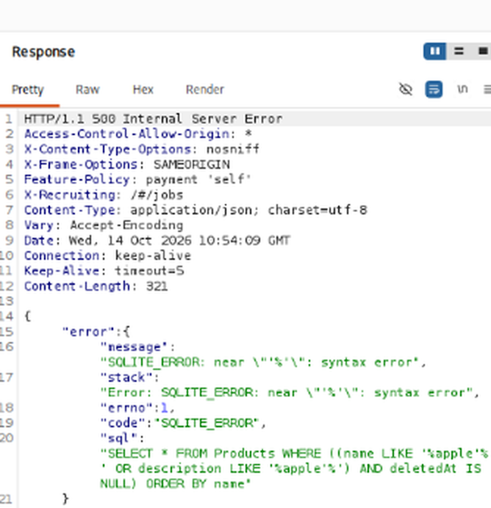
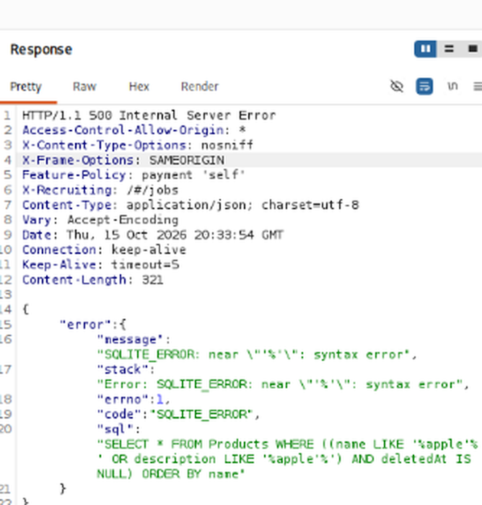
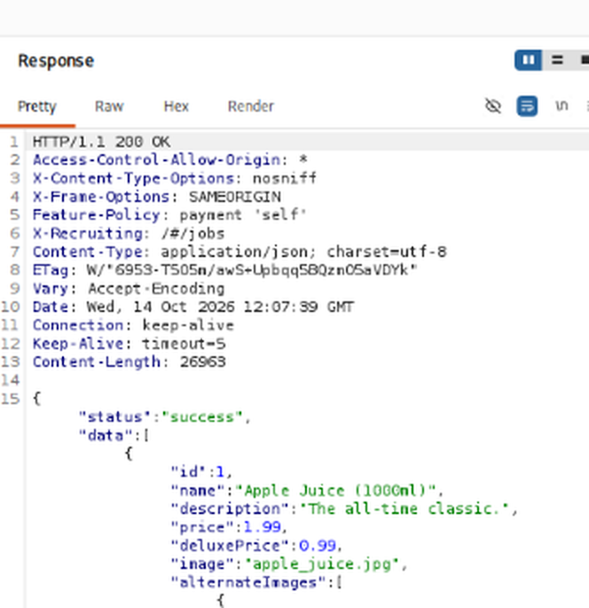
SQL Injection — Product Search
WEB-002 Single quote
WEB-002 Retest
WEB-003 Boolean retest
apple' returned HTTP 500 with an SQLITE_ERROR syntax error.
Retest reproduced the error and the response exposed the SQL query text.
Boolean input ' OR '1'='1 returned HTTP 200 with product JSON (first run: 400).
Result: Inconclusive
Verbose database error disclosure is confirmed. SQL injection itself was not confirmed because the Boolean result was not shown to return data beyond the normal search.

Slide 9
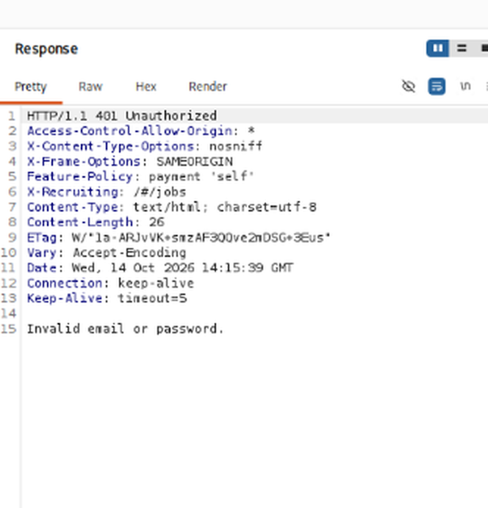
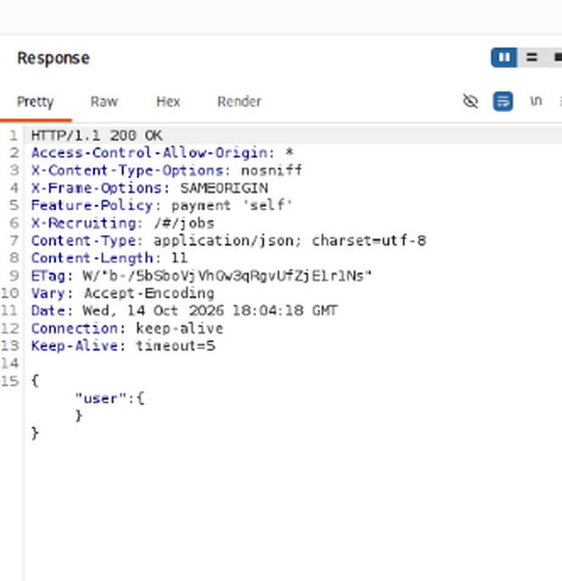
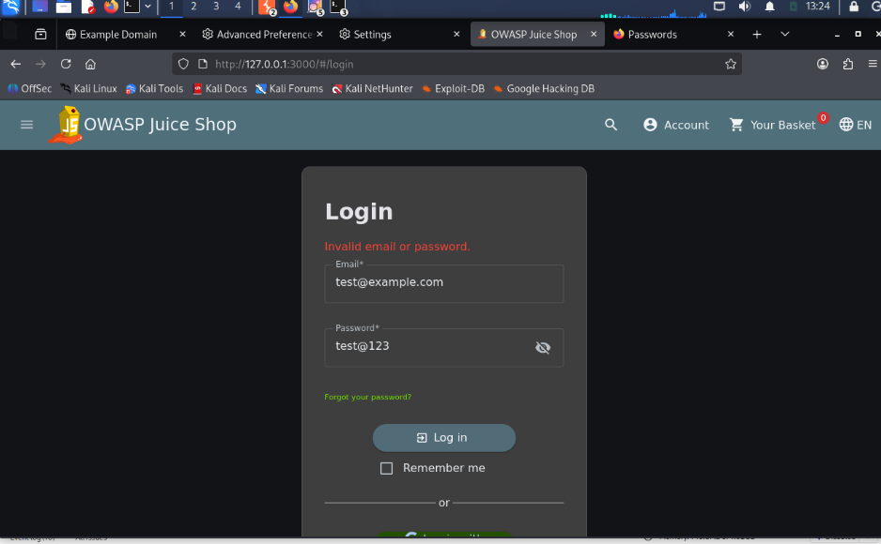
Authentication & Session Management
AUTH-001 Failed login (Burp response)
AUTH-001/003 Browser state
AUTH-004 Post-logout whoami
Invalid credentials: HTTP 401 "Invalid email or password."
Login page shows the generic error; the browser stayed logged out.
After logout, whoami returned HTTP 200 with an empty user object.
Results
Login handling behaved as expected (Not confirmed). Reuse of the old bearer token alone after logout was not conclusively shown, so session invalidation is Inconclusive.

Slide 10
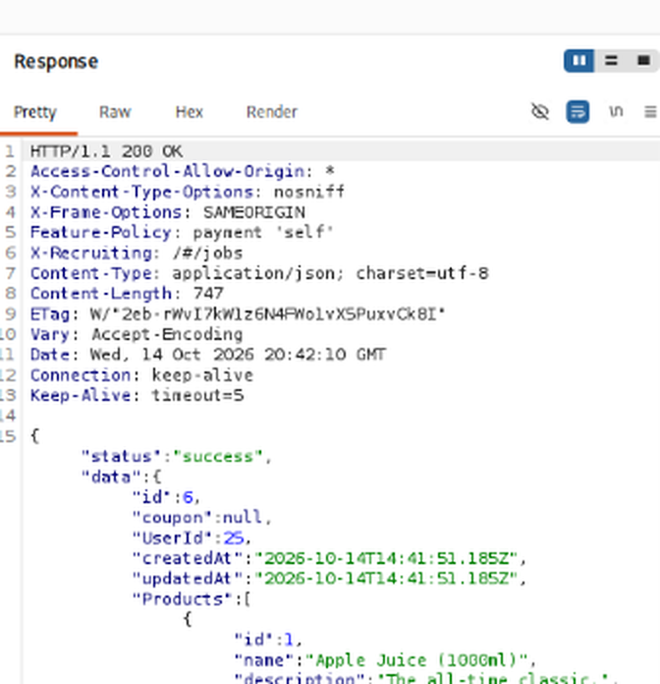
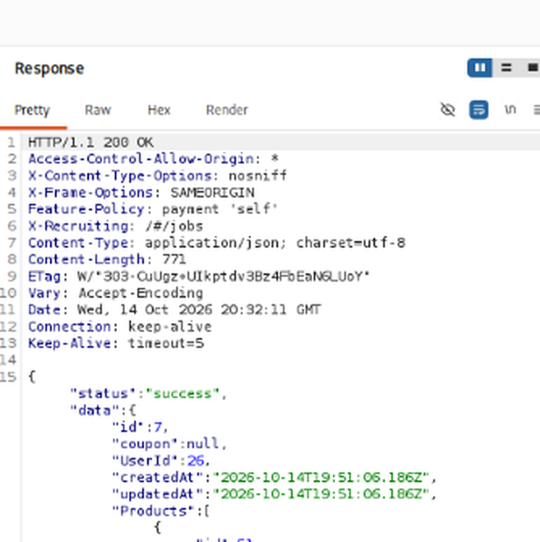
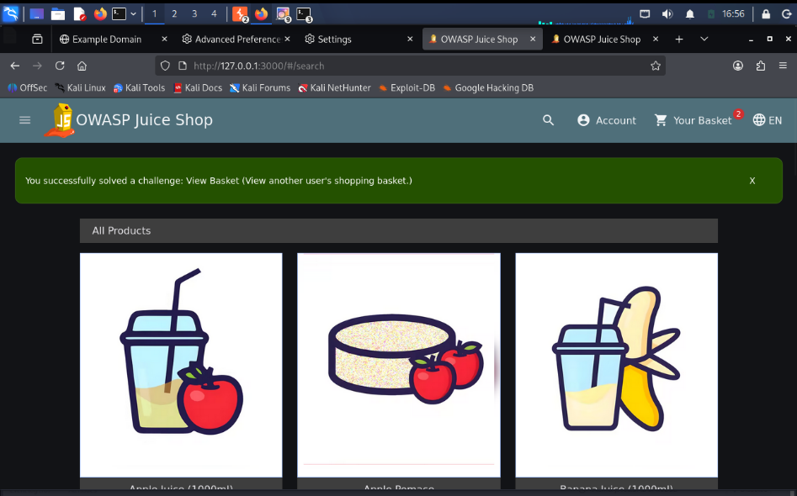
Broken Access Control — Basket Access
BAC-001 Baseline
BAC-001 Cross-account request
Challenge solved
Account A's own basket: /rest/basket/6 returns UserId 25.
/rest/basket/7 returned a basket owned by UserId 26 (Account B).
Juice Shop confirmed the "View Basket" challenge.
Result: Confirmed (Medium–High, provisional)
The server did not check basket ownership (IDOR/BOLA, OWASP A01:2021). The reverse test (BAC-003) also returned Account A's basket to Account B.

Slide 11
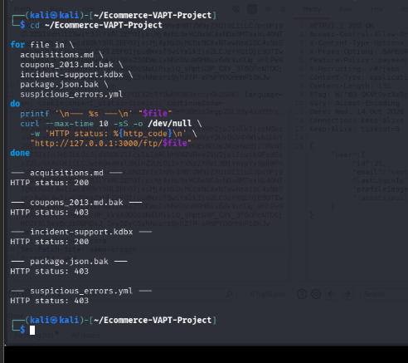
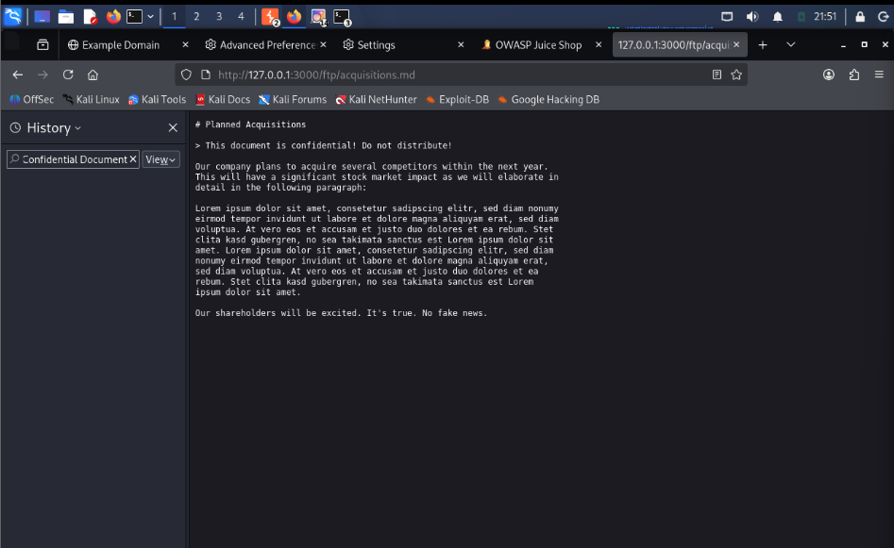
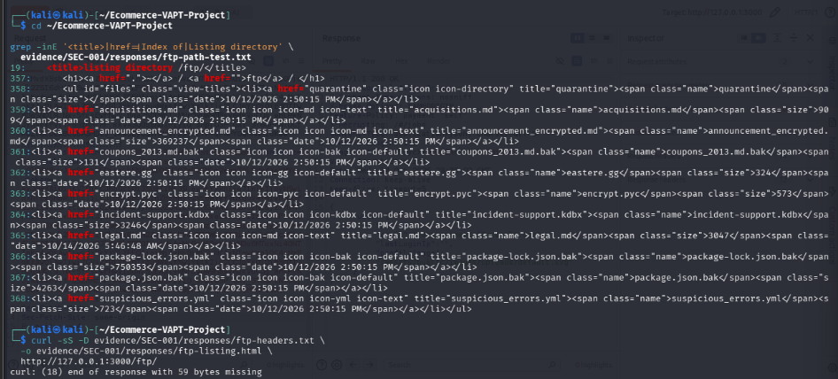
Exposed Document & FTP Directory Listing
BAC-002 Confidential document
SEC-002 Directory listing
SEC-002 File status checks
/ftp/acquisitions.md opened without authentication (private window).
/ftp/ returned HTTP 200 with a directory listing of files and folders.
acquisitions.md and incident-support.kdbx: 200; three other files: 403.
Result: Confirmed (BAC-002 Medium–High, SEC-002 Medium)
/ftp/quarantine/ is also listed, and robots.txt names /ftp. Exposure of the .kdbx file was shown by status code only; its contents were not extracted.

Slide 12
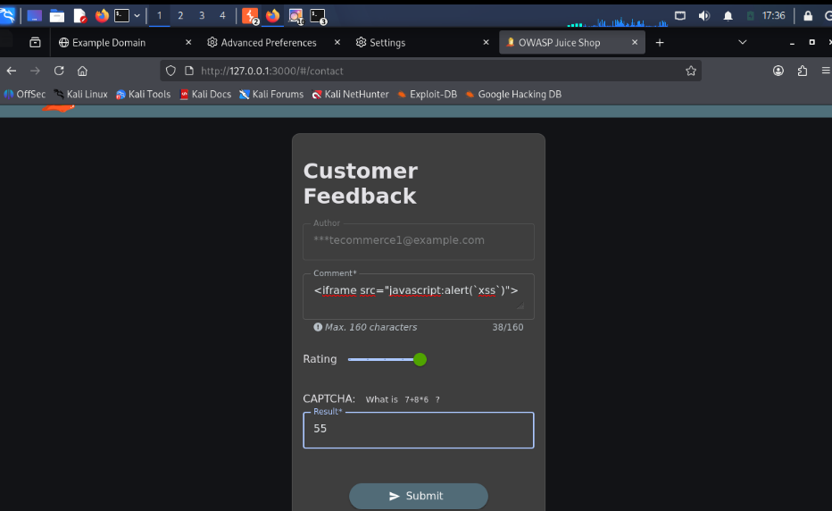
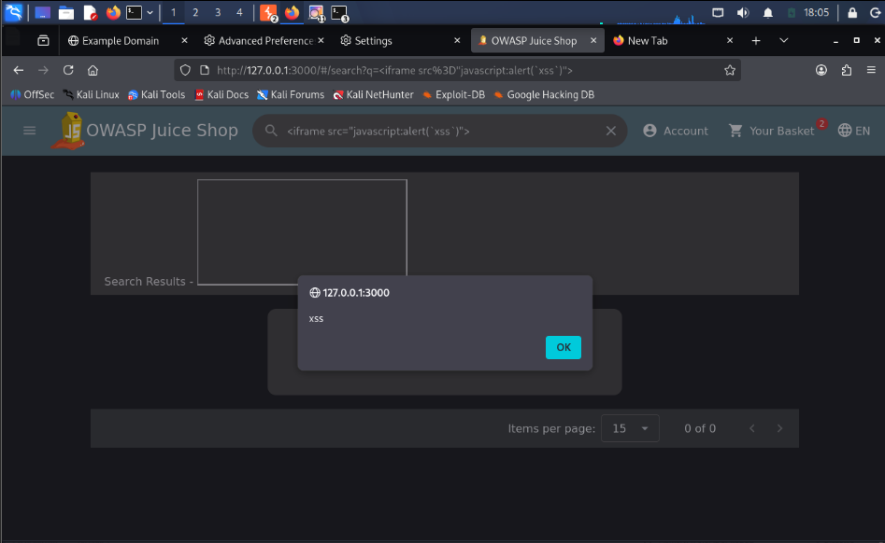
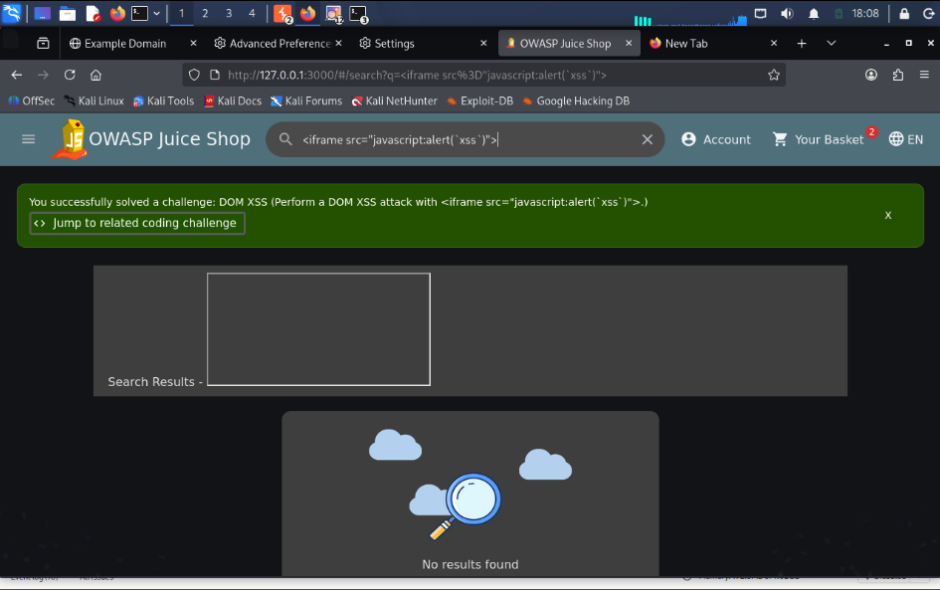
Cross-Site Scripting (XSS)
XSS-001-B Stored XSS attempt
XSS-002 DOM XSS alert
XSS-002 Challenge solved
Feedback form submitted with the iframe payload; request captured in Burp.
Payload in the search field produced an alert showing "xss".
Juice Shop marked the DOM XSS challenge as solved.
Results
DOM XSS: observed, but a retest showed no alert, so reproduction is inconsistent. Stored XSS: Inconclusive, because the payload was not returned in the saved comment and no page showing stored feedback was found.

Slide 13
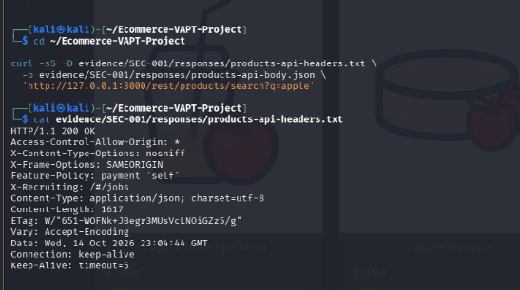
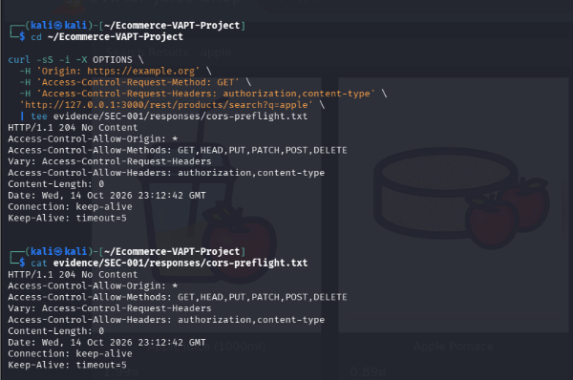
Security Headers & CORS
SEC-001 Response headers
SEC-001 CORS preflight
API response headers: Access-Control-Allow-Origin: *, nosniff, SAMEORIGIN.
OPTIONS preflight returned 204 with a wildcard origin and allowed methods.
Result: Informational (Low)
Wildcard CORS on public and authenticated endpoints without Allow-Credentials; CSP and Referrer-Policy not observed. A hardening item, not a confirmed exploitable CORS flaw.

Slide 14
Findings Summary
ID | Finding | Status | Severity
BAC-001/003 | Cross-account basket access (IDOR/BOLA) | Confirmed | Medium–High
BAC-002 | Confidential document without authentication | Confirmed | Medium–High
SEC-002 | FTP directory listing and file exposure | Confirmed | Medium
XSS-002 | DOM XSS in search field | Observed – inconsistent | Medium
SQLI-001 | SQL injection / verbose SQL error | Inconclusive | Low–Medium
XSS-001-B | Stored XSS in feedback | Inconclusive | Not rated
AUTH-004 | Logout / session invalidation | Inconclusive | Not rated
SEC-001 | Security headers and CORS | Informational | Low
AUTH-001/2/3 | Login behaviour | Not confirmed | None
Overall PoC severity: MEDIUM–HIGH (provisional qualitative ratings for a lab application; not CVSS-scored).

Slide 15
Impact Analysis
What the testing achieved
What the evidence did not establish
• Confirmed access-control and file-exposure issues with repeatable evidence
• Tested input, login, session, XSS and header behaviour with Burp Repeater
• Compared results with baselines before classifying
• SQL injection beyond a verbose error
• Stored XSS execution
• Reuse of a pre-logout token
• Contents of the exposed .kdbx file
Key lesson
A 200 OK or an error message alone is not a vulnerability. The deciding question is whether data or behaviour crosses a boundary it should not, such as another user's basket.

Slide 16
Mitigation Plan — Priority 1
BAC-001 / BAC-003 | HIGH
BAC-002 | HIGH
Cross-account basket access
• Enforce server-side ownership checks on every basket read, update and delete.
• Derive owner from authenticated session, not a client-supplied basket ID.
• Deny cross-account requests without returning basket data.
Unauthenticated confidential document
• Move private files outside the public web root.
• Require authentication and authorization for downloads.
• Review exposed content and access logs within approved scope.
SEC-002 | HIGH
Acceptance criteria
Directory listing and exposed files
• Disable directory indexing for /ftp/ and /ftp/quarantine/.
• Remove backups, key stores and confidential artifacts from public paths.
• Treat robots.txt as public information, not access control.
• Own-basket requests work as expected.
• Cross-account basket requests are denied and reveal no data.
• Unauthenticated direct file requests are denied.
• Directory paths no longer list files.
CONFIDENTIAL: Presented by AYUSHI KURHEKAR | WEB VAPT — E-COMMERCE (JUICE SHOP)

Slide 17
Mitigation Plan — Priority 2
Improve input handling, session controls and browser-facing security policy without overstating inconclusive tests.
SQLI-001 | VALIDATE
XSS-002 / XSS-001-B | VALIDATE
SQL error disclosure observed; SQL injection remains inconclusive.
• Use prepared/parameterized queries.
• Return generic client errors; keep diagnostic details in protected logs.
• Repeat controlled tests and review query construction.
DOM XSS was inconsistent; stored XSS was not demonstrated end-to-end.
• Trace input to DOM/rendering sinks.
• Prefer textContent/safe templates and context-aware output encoding.
• Add a tested Content-Security-Policy as defense in depth.
AUTH-004 | VALIDATE
SEC-001 | LOW / HARDENING
Logout token invalidation is inconclusive.
• Define the expected logout/session policy.
• Revoke server-side sessions/refresh tokens if immediate invalidation is required.
• Replay the same pre-logout test token against a protected endpoint.
Wildcard CORS observed; no exploitable CORS issue demonstrated.
• Allow only trusted origins required by the app.
• Review methods and allowed headers.
• Add Referrer-Policy and suitable CSP after compatibility testing.
CONFIDENTIAL: Presented by AYUSHI KURHEKAR | WEB VAPT — E-COMMERCE (JUICE SHOP)

Slide 18
Retest & Closure Criteria
Use the PoC workbook’s Mitigation Plan sheet to track evidence, owners, dates and remediation status.
1 | REPRODUCE
2 | VERIFY
3 | RECORD
Repeat the original test in the same lab conditions. Save the baseline request, modified request and response.
Confirm the intended boundary: no cross-account data, no anonymous private-file access, and no directory listing.
Capture dated screenshots and request/response evidence. Redact tokens, cookies and credentials before sharing.
STATUS DISCIPLINE
EVIDENCE-BASED REPORTING
Keep findings as “Proposed — not retested” until a documented retest verifies the fix. Inconclusive tests remain inconclusive until repeatable evidence resolves them.
A 200 OK, an error message, or a recommendation alone does not prove a vulnerability is fixed. Update status only when acceptance criteria pass.
CONFIDENTIAL: Presented by AYUSHI KURHEKAR | WEB VAPT — E-COMMERCE (JUICE SHOP)

Slide 19
Limitations
Lab only: an intentionally vulnerable training app, not a production system.
Time-boxed manual testing with Burp Community; two test accounts only.
Inconclusive tests (SQLi, stored XSS, token reuse) do not prove the area is secure.
DOM XSS reproduction was inconsistent; the exact code path was not found.
Severity ratings are provisional and not CVSS-scored; business impact was not assessed.
Screenshots from the lab can contain credentials or tokens; redact before wider sharing.

Slide 20
Recommendations
01
Enforce object-level authorization
Check basket ownership on the server for every request.
02
Protect or remove /ftp
Disable directory listing; keep confidential and backup files out of the web root.
03
Safe queries and errors
Use parameterized queries and generic error messages.
04
Fix XSS, add CSP
Sanitize search and feedback output; add a Content-Security-Policy.
05
Verify session invalidation
Revoke tokens at logout and retest the old token alone.
06
Tighten CORS and headers
Restrict allowed origins; add Referrer-Policy.
Mitigation status: proposed recommendations only — document a retest before marking any finding remediated.

Slide 21
Conclusion
This capstone carried out an evidence-led web VAPT of OWASP Juice Shop. Cross-account basket access, unauthenticated document access and FTP directory listing were confirmed. SQL injection, stored XSS and post-logout token reuse remain inconclusive, and DOM XSS was observed but not consistently reproduced.
Tests were validated against baselines before they were classified.
Access control is the most serious area: ownership checks were missing in both directions.
Next steps: fix and retest, and complete the inconclusive tests.

Slide 22
References
OWASP Juice Shop: https://owasp.org/www-project-juice-shop/
Juice Shop Pwning Guide: https://pwning.owasp-juice.shop/
OWASP Web Security Testing Guide: https://owasp.org/www-project-web-security-testing-guide/
OWASP Top 10:2021 A01 Broken Access Control: https://owasp.org/Top10/A01_2021-Broken_Access_Control/
OWASP Secure Headers Project: https://owasp.org/www-project-secure-headers/
MDN, CORS: https://developer.mozilla.org/en-US/docs/Web/HTTP/CORS
PortSwigger Burp Suite documentation: https://portswigger.net/burp/documentation
NIST SP 800-115: https://csrc.nist.gov/pubs/sp/800/115/final

Slide 23
Thank You!
Web Application VAPT of an E-Commerce Site
BIA Capstone Project

