Slide 1
Gene Prediction & Annotation: Background & Strategy
Team: F(Group-2)

Slide 2
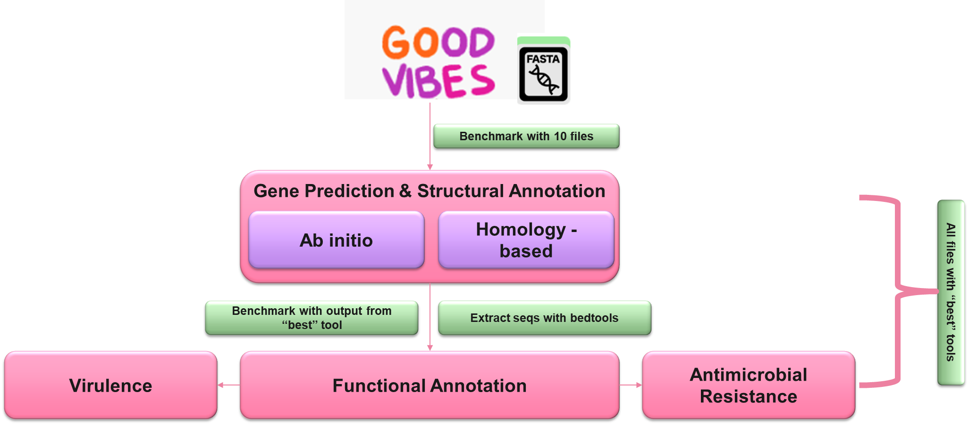
Background and workflow
Gene prediction and structural annotation
Functional annotation
Gene prediction: identifying the regions of genomic DNA that encode genes
Ab initio: statistical models distinguish coding/non-coding
Homology-based: similarity to known genes in other organisms
Structural annotation: identifying precise locations of the different elements in a genome (e.g., exons, introns, and untranslated regions (UTRs).
Gene prediction and structural gene annotation are closely intertwined processes, many tools do both
Association of biological information with gene or protein sequences
Virulence and antimicrobial resistance genes are often functional traits of interests for bacteria
Notes:
Subset our data – run ~10 files
Two general approaches for gene prediction:
Homology-based methods (or comparative genomics) predict genes based on similarity to known genes in other organisms.
Ab initio methods predict genes based solely on the genomic sequence, often using statistical models like hidden Markov models (HMMs) to distinguish coding from non-coding regions.
Gene prediction and structural gene annotation are closely intertwined processes, and that’s why we are considering them together to improve accuracy and get comprehensive genome annotation.
The output from gene prediction, such as open reading frames and coding sequences will be used as input for functional annotation tools, including tools for checking if the genes code for virulence factors or antimicrobial resistance

Slide 3
15
13
2
Samples from Soybean Sprouts
Environmental Samples
Samples from Homo Sapiens

Slide 4
Gene Prediction: ab initio
Prodigal
GeneMarkS
MetaGeneAnnotator
Notes:
Hargobind
Prodigal
GenemarkS2
MetaGeneAnnotator
MetaGeneMark

Slide 5
Prodigal
Popular open-source software developed Oak ridge national lab and University of Tennesse.
Designed specifically to identify genes in prokaryotic genome sequences.
Use dynamic programming to find the protein coding regions and translation start sites in microbial genomes.
Key features:
Fast processing speed.
Accuracy: High sensitivity and specificity for predicting genes.
Handles complete and draft genome assemblies.
Detailed annotation report: Predicted protein translations, ribosome binding sites, start/stop positions.

Slide 6
GenemarkS:
Ab initio gene prediction tool developed by Georgia Tech.
Uses a Markov model approach to identify protein-coding regions.
Key features:
Self-training capability: Non-supervised model building procedure.
High accuracy for identifying genes, translation start sites and precise positioning of sequence regions upstream to a gene start.

Slide 7
Metagene Annotator:
Prokaryotic gene predictor developed specifically for metagenomic sequences.
Developed at Tokyo institute of technology
Does ab initio prediction of genes based on GC content, codon usage, and ORF length.
Key features:
Fast processing
Models optimized for divergent species in metagenomics.
Handles fragments as low as 100 bp.
Output predicts amino acid sequences.

Slide 8
Homology- Based Tools
HMMER
MMseqS2

Slide 9
MMseqs2:
Open-source software tool for fast and sensitive similarity searches.
Developed to address the limitations of BLAST and PSI-BLAST in efficiency and sensitivity.
Allows flexible similarity searches based on k-mer matches, spaced seeds or alignment approaches.
Key features:
Database Clustering.
Memory efficient.
Cascaded searching.
Multiple alignment modes.
Parallel processing.

Slide 10
HMMER
Hidden Markov models for sequence analysis.
Statistically based HMM profiles can identify genes in unannotated prokaryotic sequence.
Sensitivity in detecting remote protein homologues due to statistical models used.
Specificity distinguish between real homology versus chance sequence similarities.
Key features:
Probabilistic output: interpretable E values, scores and probabilities.
Integration: can be intergrated with ab initio prediction tools.
Updatability: the database can be updated and improved for finding newly discovered gene families.

Slide 11
Prokka:
Gene annotation tools
bakta：
Initial Release: June 2014.
Last Update: December 14, 2021
a software tool for rapid annotation of prokaryotic genomes.
Completes genome annotation through steps such as gene identification, protein coding prediction, and functional annotation.
identify genes, predict proteins, and provide annotation information such as gene names, functions, and gene families.
Initial Release: Jan 15, 2020
Last Update: Jan 23, 2024
Bakta is designed for fast and standardized annotation of microbial genomes. Unlike Prokka, bakta does not need taxon-specific databases.
Bakta pays special attention to the reliable detection and annotation of short ORFs, which are often missed by other tools.
This tool would be used for the final comparison and if we are told not to use pipeline-based tools then we would use tools: Aragorn, RNAmmer and SignalP.

Slide 12
EggNOG-mapper:
RAST：
(Rapid Annotation using Subsystem Technology)
Initial Release: October 2015
Last Update: January 28, 2022
alignment-based gene functional annotation tool
compares input DNA or protein sequences with the known EggNOG database and assigns functional annotations
provides extensive functional annotations, including gene families, functional domains, metabolic pathways.
limited by the quality and coverage of the EggNOG database.
Initial Release: October 2007
Last Update: January 14, 2022
An online server that structurally and functionally annotates a prokaryotic genome.
Utilizes a combination of subsystem-based annotation and comparative genomics.
Performance vary depending on the complexity of the genome and the availability of closely related reference genomes.
Notes:
5th point: , which can be useful for understanding the biological characteristics of microbial genomes.

Slide 13
Comparison of Selected Tools for Gene Annotation
Tool | Function | Major Pros | Major Cons
Prokka | Rapid annotation of prokaryotic genomes. Completes genome annotation through steps such as gene identification, protein coding prediction, and functional annotation. | Fast and comprehensive; Easy to use; Integrates multiple tools for a thorough annotation | Can have slower runtime performance and limited flexibility regarding user-provided annotation data
Bakta | Fast and standardized annotation of microbial genomes. Special attention to the reliable detection and annotation of short ORFs. | Fast runtime comparable to other tools; Does not require taxon-specific databases; Good at detecting short ORFs often missed by others | Newer tool, less tested in diverse research contexts
RAST | Structurally and functionally annotates prokaryotic genomes into curated subsystems. Provides online pathway visualizations and metabolic reconstructions. | Has comprehensive annotations including pathways and subsystems; Online server available for easy access | Requires internet connection for the online server; Slow compared to command-line tools
eggNOG-mapper | Alignment-based gene functional annotation tool. Compares input sequences with the EggNOG database for functional annotations. | Extensive functional annotations including gene families and metabolic pathways; Supports both DNA and protein sequences | Dependent on the quality and coverage of the EggNOG database

Slide 14
Virulence Factors
PathoFact
Modular pipeline to identify virulence factors, bacterial toxins, and antimicrobial resistance genes
Uses Hidden Markov Models (HMM) and random forest model for prediction
Utilizes several databases including VFDB and DEG
HyperVR
New tool developed in 2023
Predicts virulence factors and AMR genes
Uses classical ensemble learning methods and deep learning
Higher precision and recall, but increased computational time
Notes:
Charith
VFDB
PathoFact
HyperVR?

Slide 15
Antibiotic resistance (AMR)
AMRFinder+
ResFinder
Initial Release: 2018
Last Update: 2021
https://github.com/ncbi/amr/wiki
Cited by 361
NCBI
Identifies AMR genes, resistance-associated point mutations, and select other classes of genes using protein annotations and/or assembled nucleotide sequence
Relies on NCBI’s curated Reference Gene Database
Detect antimicrobial resistance genes in bacterial genomes such as antibiotic resistance genes (ARGs) and multidrug resistance genes (MDRs)
Support for Large-scale Genome Analysis
Initial Release: 2012
Last Update: January 2021
https://github.com/cadms/resfinder
Cited by 4691
Web-based/ User friendly
Uses BLAST for identification of acquired ARGs in total or partial sequenced isolates of bacteria
compatible with various sequencing platforms and can analyze data from both short-read and long-read sequencing technologies

Slide 16
Benchmarking
No. of database entries
% of proteins classified as annotated
Processing time per file
% of proteins classified as hypothetical
RAM (gigabytes) required
% of proteins classified as unannotated

Slide 17
Internal Deadlines
Task | Week 1 2/29 | Week 2 3/7 |  | Week 3 3/14
Gene Prediction & Structural Annotation | Anna Hargobind Charith
Functional Annotation |  | Ayushi Anirudh Lucy
Virulence |  |  | Charith
Antimicrobial Resistance |  |  | Anna
Results/Visualization |  |  |  | Everybody
Consolidating Code & Uploading to GitHub |  |  |  | Everybody

Slide 18
CITATIONS
Hyatt, D., Chen, GL., LoCascio, P.F. et al. Prodigal: prokaryotic gene recognition and translation initiation site identification. BMC Bioinformatics 11, 119 (2010). https://doi.org/10.1186/1471-2105-11-119
Besemer, J et al. “GeneMarkS: a self-training method for prediction of gene starts in microbial genomes. Implications for finding sequence motifs in regulatory regions.” Nucleic acids research vol. 29,12 (2001): 2607-18. doi:10.1093/nar/29.12.2607
Noguchi, Hideki et al. “MetaGeneAnnotator: detecting species-specific patterns of ribosomal binding site for precise gene prediction in anonymous prokaryotic and phage genomes.” DNA research : an international journal for rapid publication of reports on genes and genomes vol. 15,6 (2008): 387-96. doi:10.1093/dnares/dsn027
Steinegger, M., Söding, J. MMseqs2 enables sensitive protein sequence searching for the analysis of massive data sets. Nat Biotechnol 35, 1026–1028 (2017). https://doi.org/10.1038/nbt.3988
Finn, Robert D et al. “HMMER web server: interactive sequence similarity searching.” Nucleic acids research vol. 39,Web Server issue (2011): W29-37. doi:10.1093/nar/gkr367
Schwengers, Oliver, et al. "Bakta: rapid and standardized annotation of bacterial genomes via alignment-free sequence identification." Microbial genomics 7.11 (2021): 000685.
AMRFinder+: Feldgarden M, Brover V, Gonzalez-Escalona N, Frye JG, Haendiges J, Haft DH, Hoffmann M, Pettengill JB, Prasad AB, Tillman GE, Tyson GH, Klimke W. AMRFinderPlus and the Reference Gene Catalog facilitate examination of the genomic links among antimicrobial resistance, stress response, and virulence. Sci Rep. 2021 Jun 16;11(1):12728. doi: 10.1038/s41598-021-91456-0. PMID: 34135355; PMCID: PMC8208984.

Slide 19
Citations
ResFinder: Florensa AF, Kaas RS, Clausen PTLC, Aytan-Aktug D, Aarestrup FM. ResFinder - an open online resource for identification of antimicrobial resistance genes in next-generation sequencing data and prediction of phenotypes from genotypes. Microb Genom. 2022 Jan;8(1):000748. doi: 10.1099/mgen.0.000748. PMID: 35072601; PMCID: PMC8914360.
PathoFact: a pipeline for the prediction of virulence factors and antimicrobial resistance genes in metagenomic data: de Nies, L., Lopes, S., Busi, S.B. et al. Microbiome 9, 49 (2021). https://doi.org/10.1186/s40168-020-00993-9
HyperVR: a hybrid deep ensemble learning approach for simultaneously predicting virulence factors and antibiotic resistance genes: Boya Ji, Wending Pi, Wenjuan Liu, Yannan Liu, Yujun Cui, Xianglilan Zhang, Shaoliang Peng, NAR Genomics and Bioinformatics, Volume 5, Issue 1, March 2023, lqad012
Torsten Seemann, Prokka: rapid prokaryotic genome annotation, Bioinformatics, Volume 30, Issue 14, July 2014, Pages 2068–2069, https://doi.org/10.1093/bioinformatics/btu153
Carlos P Cantalapiedra, Ana Hernández-Plaza, Ivica Letunic, Peer Bork, Jaime Huerta-Cepas, eggNOG-mapper v2: Functional Annotation, Orthology Assignments, and Domain Prediction at the Metagenomic Scale, Molecular Biology and Evolution, Volume 38, Issue 12, December 2021, Pages 5825–5829, https://doi.org/10.1093/molbev/msab293
Aziz, R.K., Bartels, D., Best, A.A. et al. The RAST Server: Rapid Annotations using Subsystems Technology. BMC Genomics 9, 75 (2008). https://doi.org/10.1186/1471-2164-9-75

Slide 20
THANK YOU!

