Slide 1
Read Sequence Cleaning & Genome Assembly, Results
Team: F

Slide 2
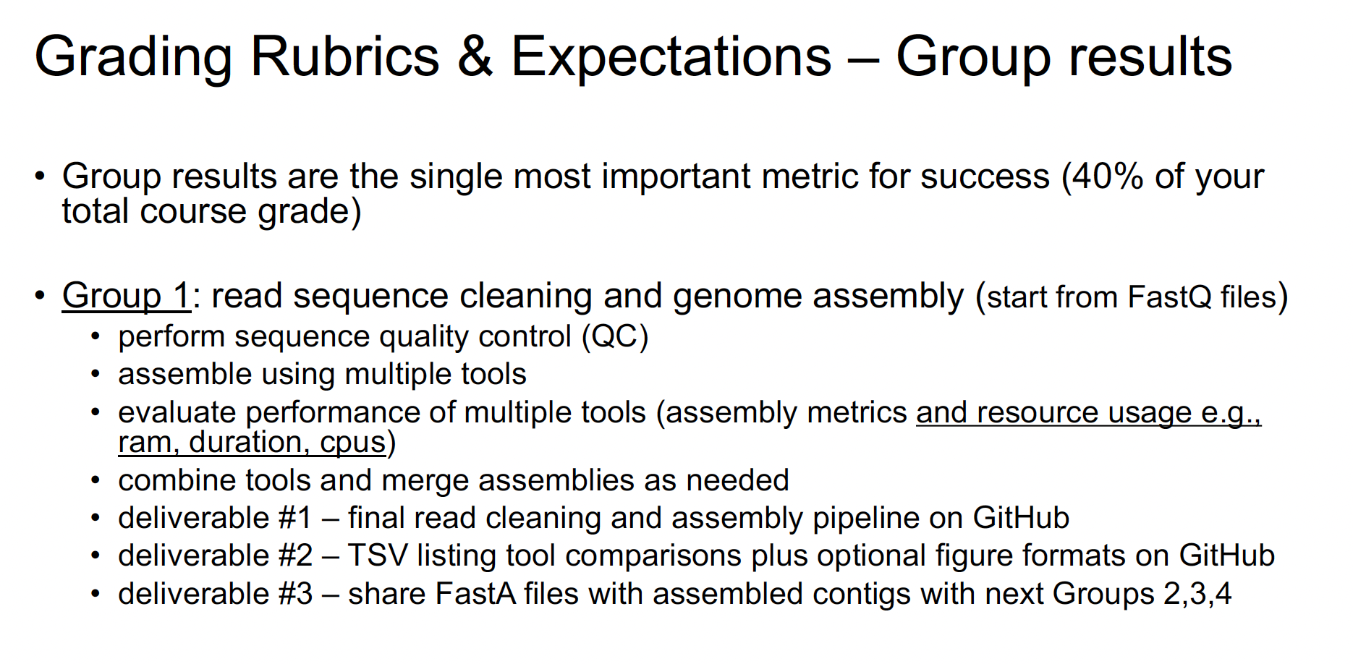
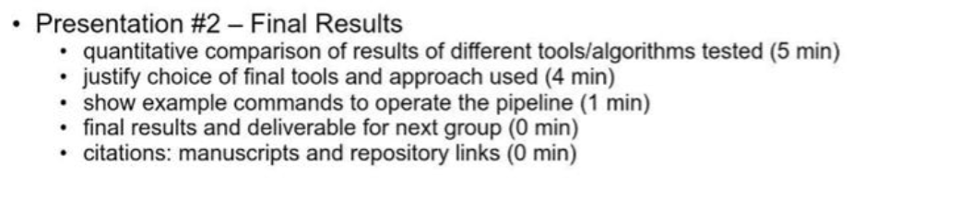

Slide 3
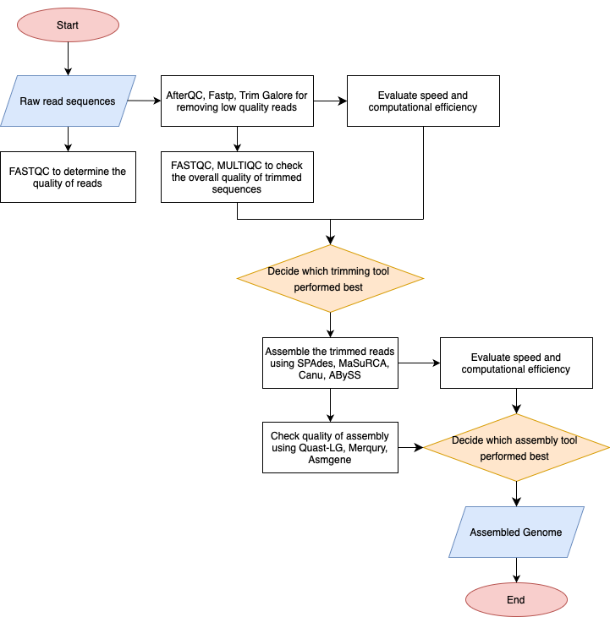

Slide 4
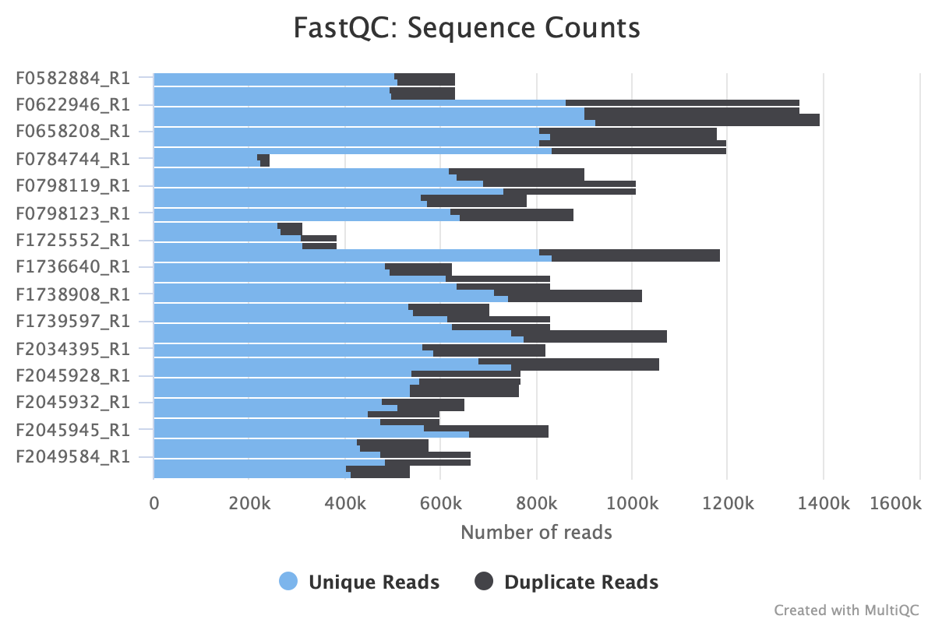
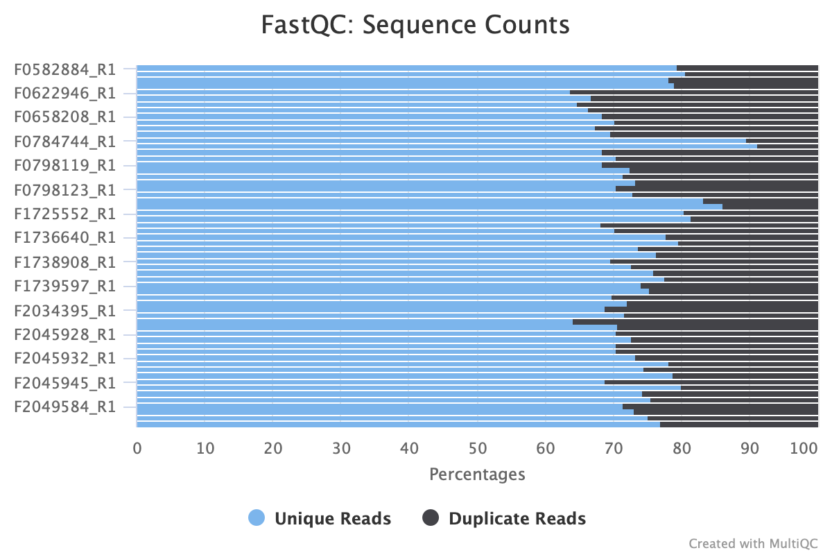
Raw Data Quality Assessment with FastQC

Slide 5
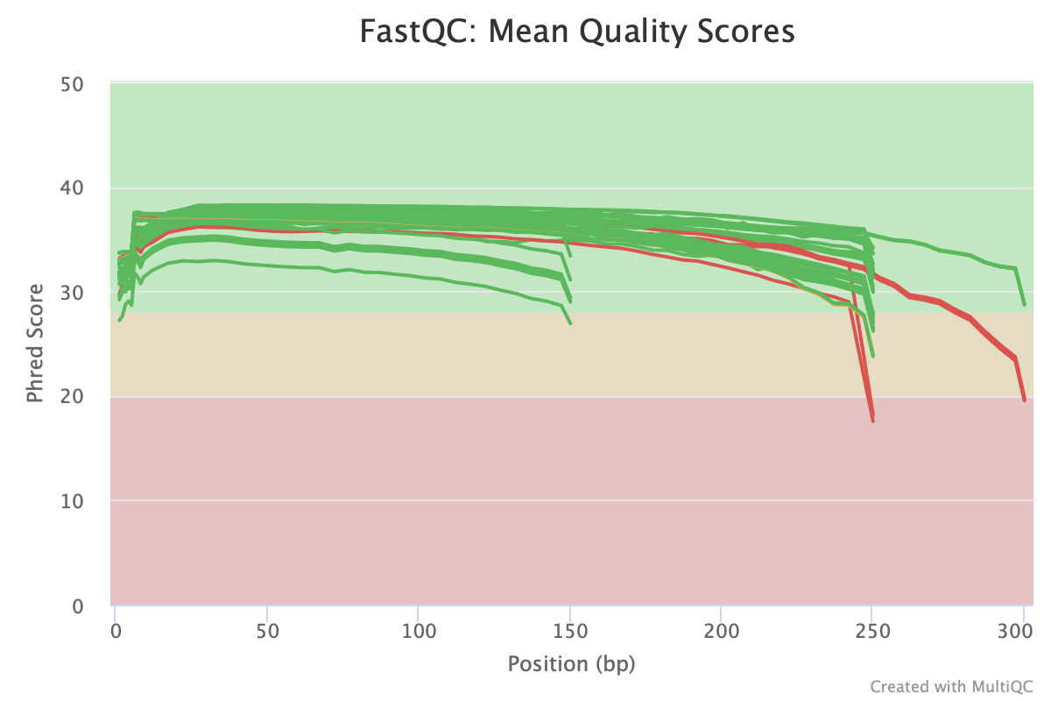
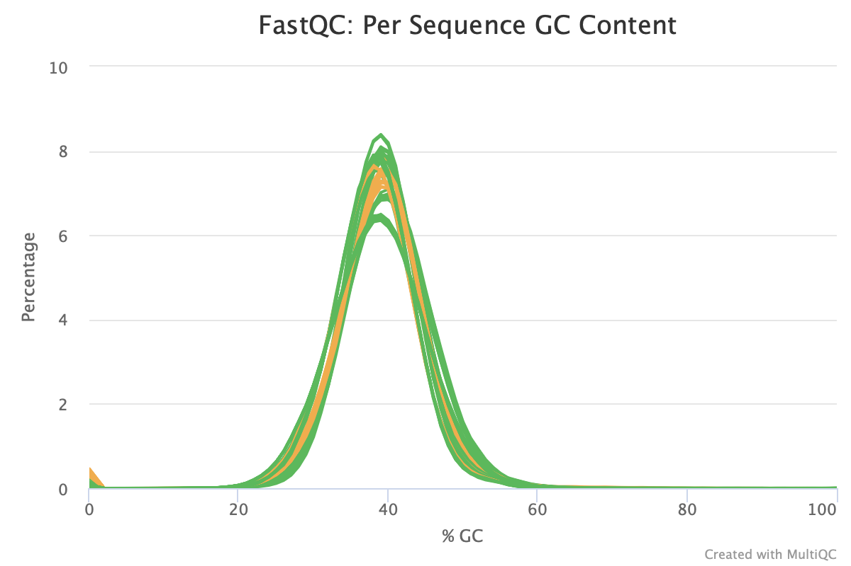
Raw Data Quality Assessment with FastQC

Slide 6
AfterQC vs. Fastp vs. Trimmomatic (Done on 10 files)
Analysis | Trimmomatic | AfterQC | Fastp
Runtime | ~8m 10.29s | 1 hr > for just two files | ~4m 25.906s
CPU used | 6 threads | 1 thread | 6 threads
Maximum Resident set size | 174976 | - | 999984 KB
Throughput | 6 parallel tracks for 82 seconds | - | 6 parallel tracks of computation for 42 seconds
CPU time: | ~7m 21.249s | - | ~4m 2.22s
Avg file processing | 49.2 sec/file | - | 25.9 sec/file
Utilization | 90% | - | 92%

Slide 7
Fastp and bbduk Setting
Fastp
Parameter | Value | Description
--thread | 6 | worker thread number, default is 3 (int [=3])
--qualified_quality_phred | 30 | the quality value that a base is qualified. Default 15 means phred quality >=Q15 is qualified. (int [=15])
--unqualified_percent_limit | 20 | how many percents of bases are allowed to be unqualified (0~100). Default 40 means 40% (int [=40])
bbduk: remove all reads that have a 31-mer match to PhiX allowing one mismatch.
Notes:
fastp -w 6 --qualified_quality_phred 30 --unqualified_percent_limit 20 --dont_eval_duplication -i $R1 -I $R2 -o "nodupli/trimmed_$R1" -O "nodupli/trimmed_$R2" -h "final/${substring}fastp_report.html" -j "final/${substring}fastp.json" -z 6

Slide 8
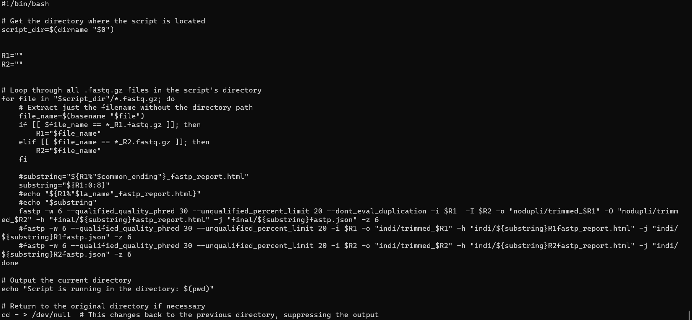

Slide 9
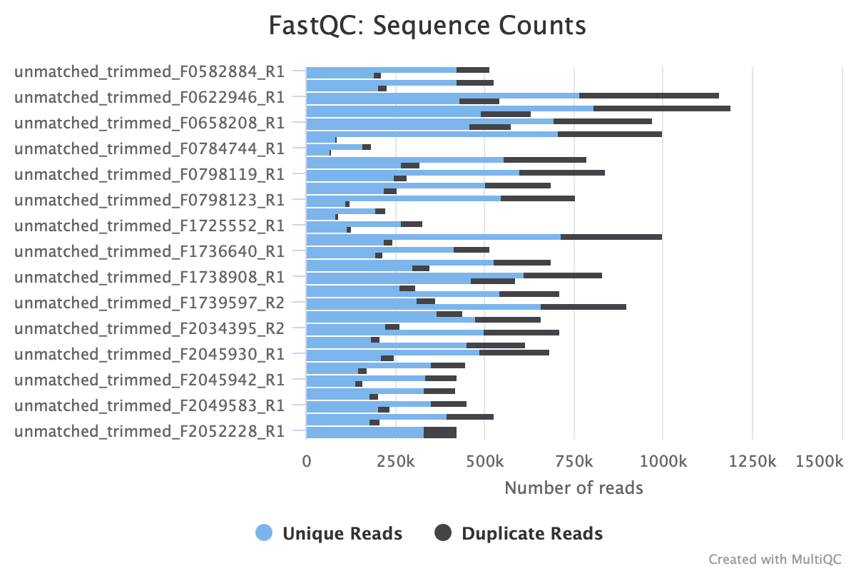
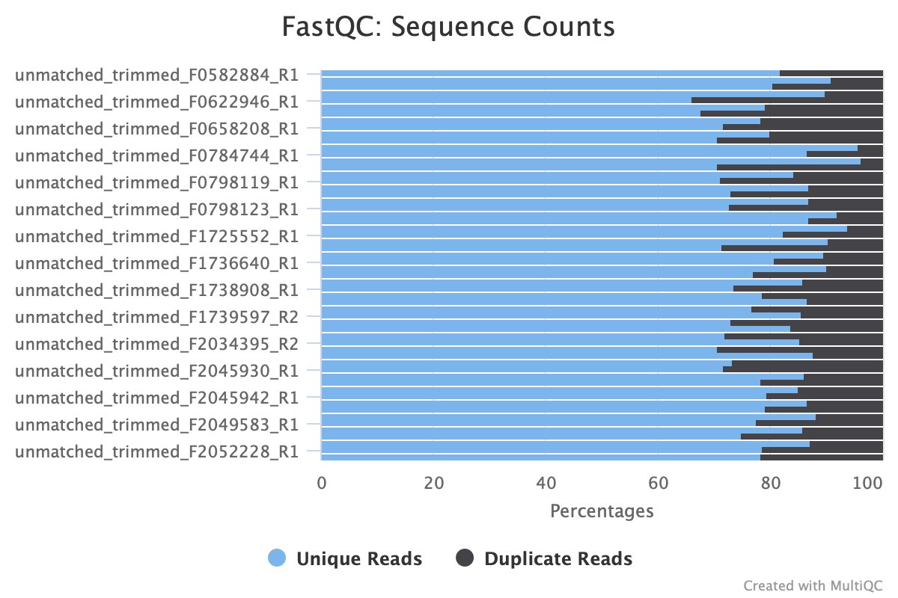
Quality Assessment After Trimming

Slide 10
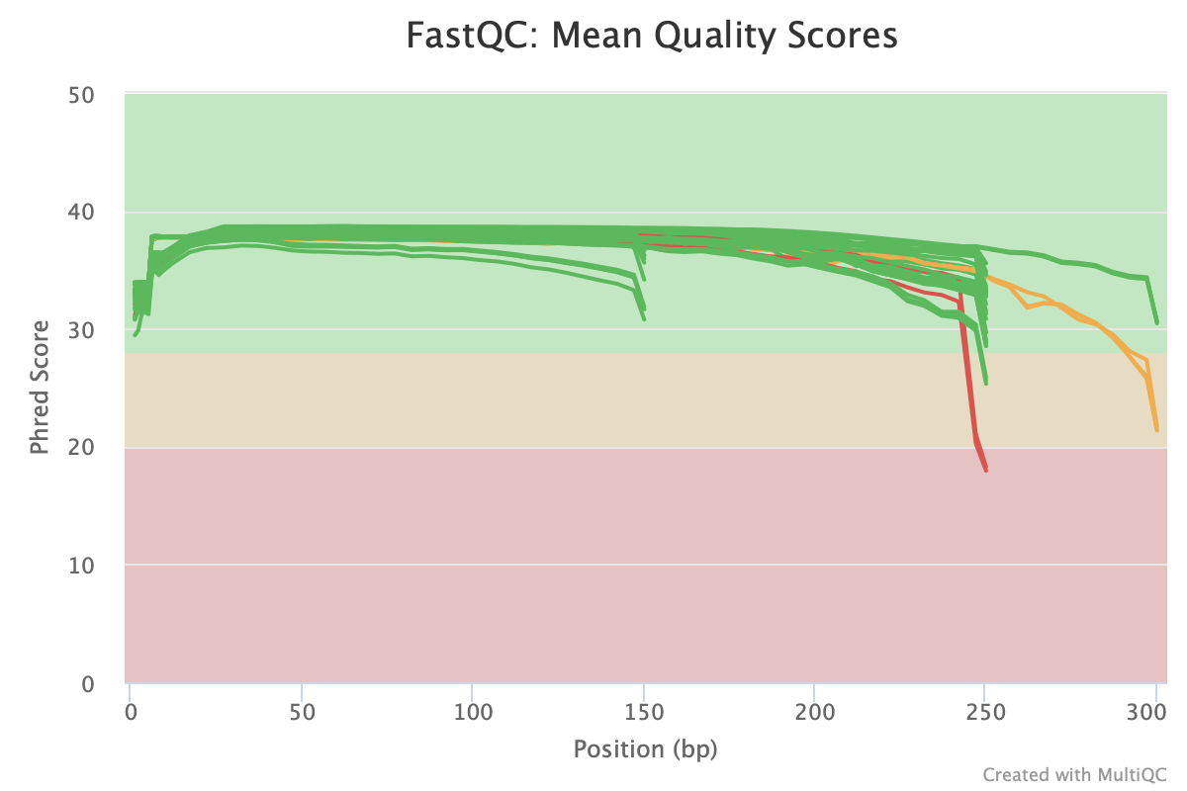
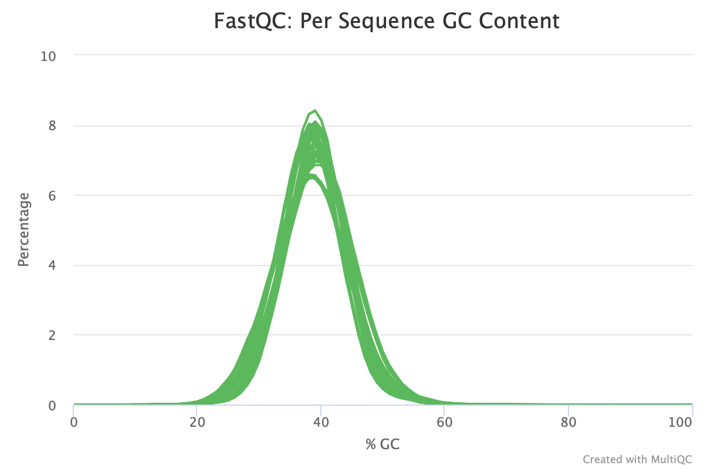
Quality Assessment After Trimming

Slide 11
Assembly and filter Setting
Parameters | Function
-k (kmer value) | Smaller k-mer value increases the sensitivity to detect overlaps between reads, but increase computational complexity. Larger k-mer value improve assembly accuracy.
-c (converage) | Higher coverage provides more confidence in the assembled sequence but may increase computational resources. Lower coverage may result in gaps or errors in the assembly.
-m/-l min-length | Shortest acceptable length for contigs or scaffolds in the assembly. Improve the quality of the assembly by retaining longer and potentially more informative sequences.
Notes:
fastp -w 6 --qualified_quality_phred 30 --unqualified_percent_limit 20 --dont_eval_duplication -i $R1 -I $R2 -o "nodupli/trimmed_$R1" -O "nodupli/trimmed_$R2" -h "final/${substring}fastp_report.html" -j "final/${substring}fastp.json" -z 6

Slide 12
Example Commands for Assembly
$ skesa --fastq "$r1" "$r2" --contigs_out "$contigs"/skesa_assembly.fa 1> "$contigs"/skesa.stdout.txt 2> "$contigs"/skesa.stderr.txt
$ python filter.contigs.py -i "$skesa_dir/$i"/skesa_assembly.fa -o "$filtered_contigs"/filtered_contigs.fa 1> "$filtered_contigs"/filter.stdout.txt 2> "$filtered_contigs"/filter.stderr.txt

Slide 13
Assembly tools compared
Tools | SKESA | Velvet | ABYSS
Runtime | Total : 32m Per sample : ~1.06m | Total : 37m Per sample : ~1.2m | Total : 58m15 Per sample : ~2m
Peak Memory Usage | 3344M+ | 1794M+ | 1106M+
kmer value | 19-99 | 31 | 33
Average # of contigs post filter | ~118.93 | ~149.53 | ~138.83

Slide 14
Other tools:
SPAdes
Unicycler: with short reads, unicycler essentially functions as a SPAdes optimers
Unable to run paired-end assembly due to unequal number of reads in paired read input files.
With one read input file, the output contigs do not produce enough outputs (roughly ~2 contigs per file)

Slide 15
Example Commands for Quast
$ quast.py ./filterab/* -o ./qe_op/abyss
$ quast.py ./filtered_skesa_asm/*/*.fa -o ./qe_op/skesa

Slide 16
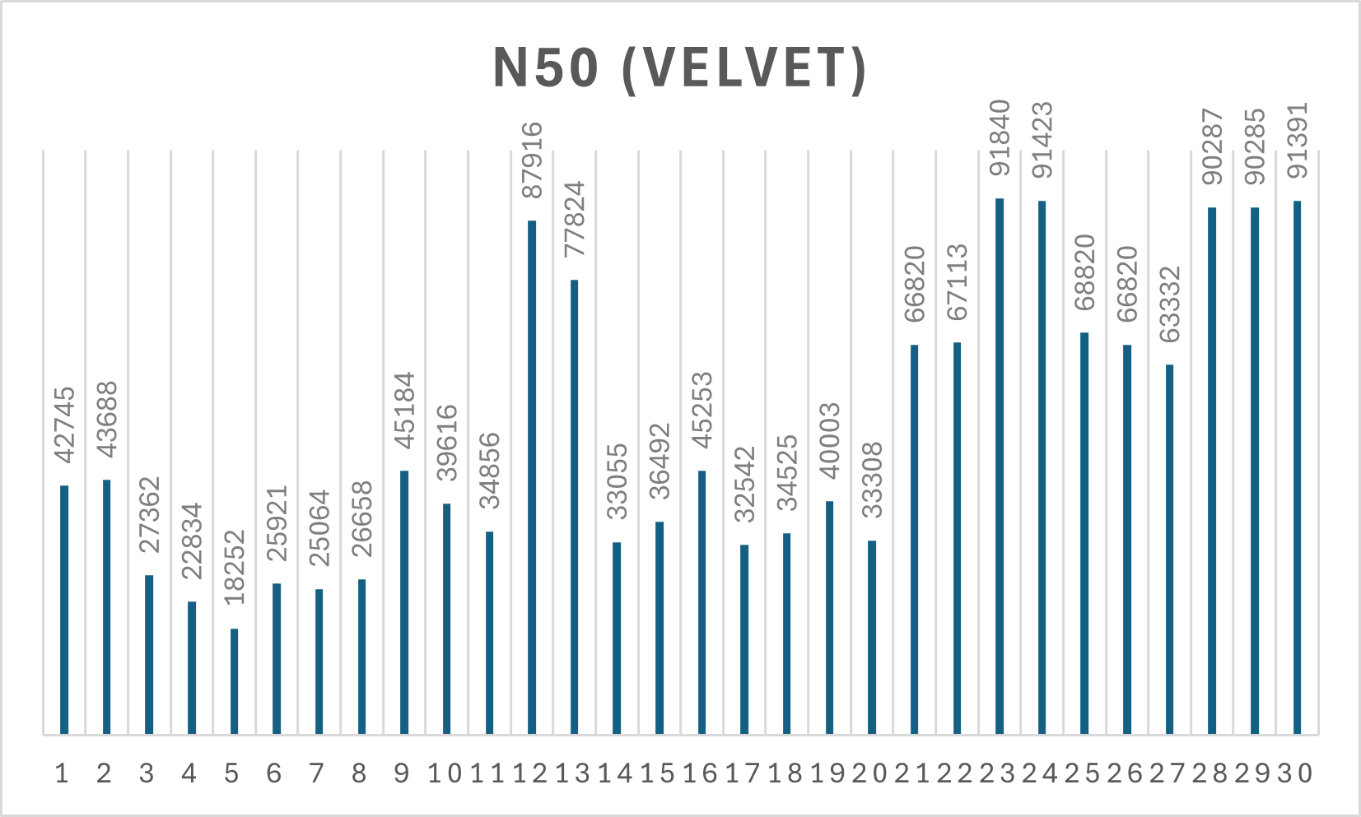
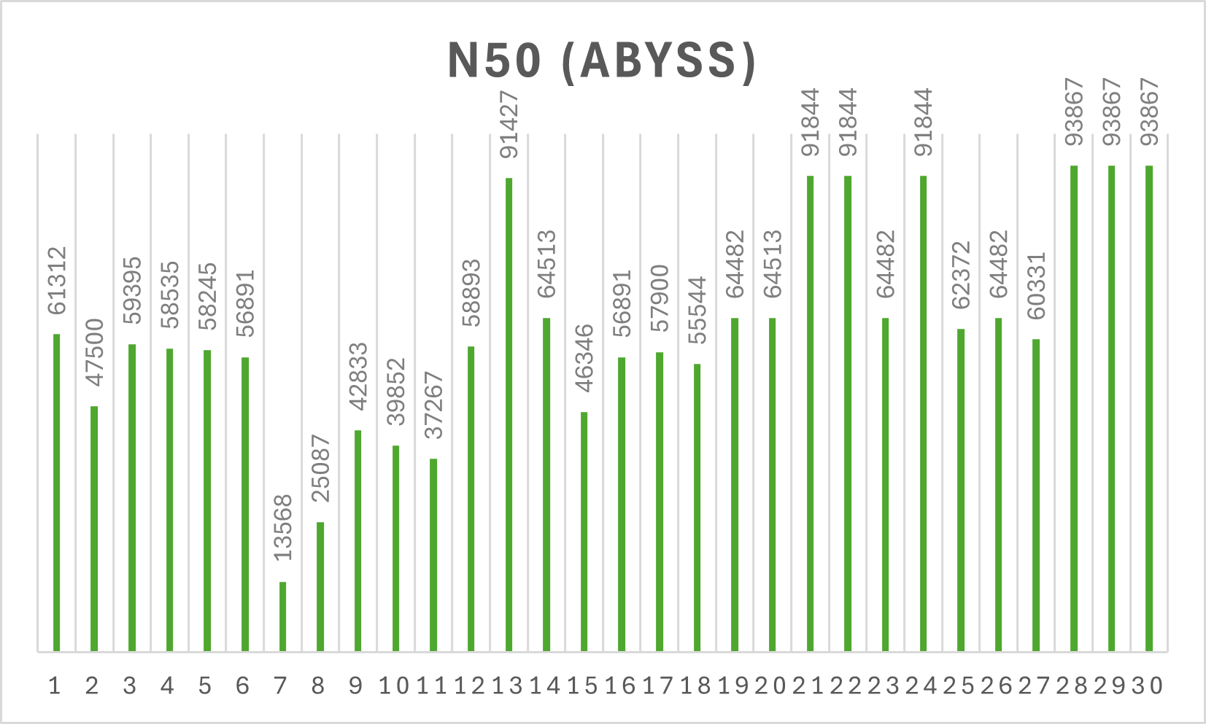
Running Quast and Comparing Results (N50)
Velvet, Abyss > Skesa

Slide 17
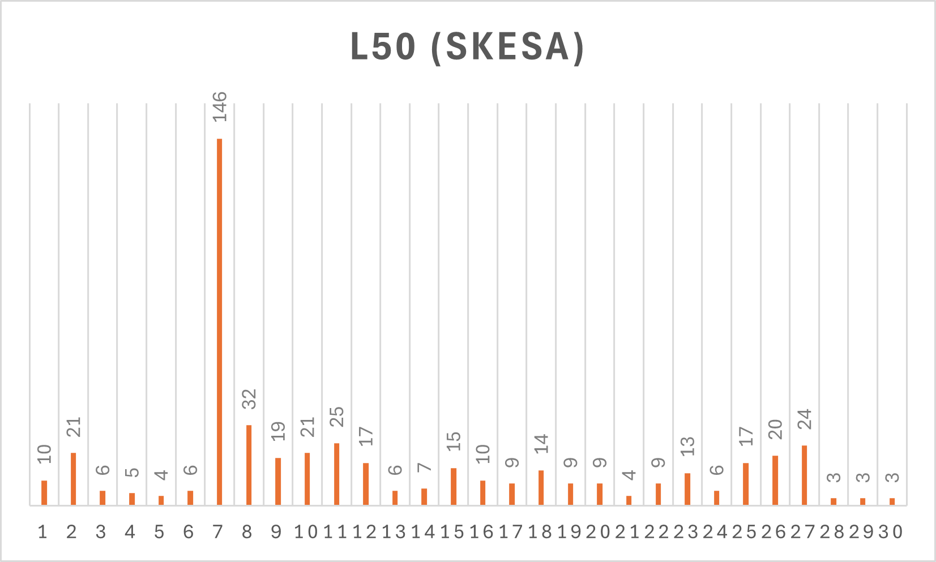
Running Quast and Comparing Results (L50)
Skesa > Velvet, Abyss

Slide 18
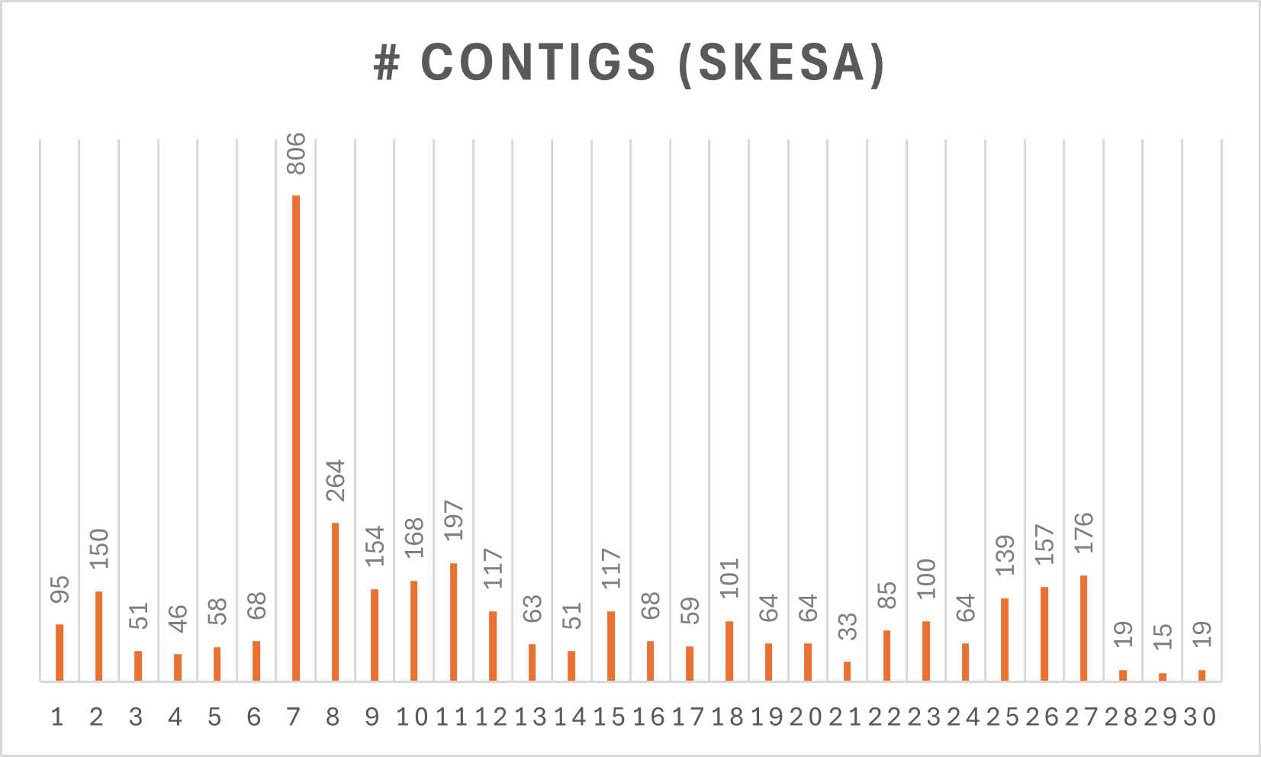
Running Quast and Comparing Results
(# contigs)
Skesa > Velvet, Abyss

Slide 19

BUSCO
BUSCO Command:
Parameters:
Parameter | Description
-i | Input file(fasta file)
-m | It can be genome, proteins or transcriptome

Slide 20
Results Overview:
Key findings:
Assembler Performance in Assembly Continuity:
SKESA > ABySS > Velvet.
Assembler Performance in Contig/Scaffold Length:
SKESA > ABySS > Velvet.
ABySS and SKESA generally have slightly higher completeness, single-copy BUSCOs, lower fragmentation and missed BUSCO's compared to Velvet.

Slide 21
BUSCO OVERVIEW
PROS:
BUSCO uses a predefined set of conserved genes called 'Lineage dataset', allowing for consistent evaluation and comparison of assemblies.
It gives a complete view of the assembly's quality by checking for complete, duplicated, and partially missing genes as well including other metrics.
CONS:
BUSCO only tells you if a gene is present or absent, without giving information on its structure or surroundings in the genome.
The lineage dataset might not cover all possible genes for every organism, potentially leading to incomplete assessments.

Slide 22
Citations:
Fastp: Shifu Chen, Yanqing Zhou, Yaru Chen, Jia Gu, fastp: an ultra-fast all-in-one FASTQ preprocessor, Bioinformatics, Volume 34, Issue 17, September 2018, Pages i884–i890, https://doi.org/10.1093/bioinformatics/bty560
Trimmomatic: Bolger, Anthony M et al. “Trimmomatic: a flexible trimmer for Illumina sequence data.” Bioinformatics (Oxford, England) vol. 30,15 (2014): 2114-20. doi:10.1093/bioinformatics/btu170
Multiqc: https://multiqc.info/
Afterqc: https://github.com/OpenGene/AfterQC
Fastqc: https://github.com/s-andrews/FastQC
Bbduk: Bushnell B, Rood J, Singer E (2017) BBMerge – Accurate paired shotgun read merging via overlap. PLOS ONE 12(10): e0185056. https://doi.org/10.1371/journal.pone.0185056
Abyss: https://github.com/bcgsc/abyss Simpson JT, Wong K, Jackman SD, Schein JE, Jones SJ, Birol I. ABySS: a parallel assembler for short read sequence data. Genome Res. 2009 Jun;19(6):1117-23. doi: 10.1101/gr.089532.108. Epub 2009 Feb 27. PMID: 19251739; PMCID: PMC2694472.
SKESA: https://github.com/ncbi/SKESA?tab=readme-ov-file Alexandre Souvorov, Richa Agarwala and David J. Lipman. SKESA: strategic k-mer extension for scrupulous assemblies. Genome Biology 2018 19:153. doi.org/10.1186/s13059-018-1540-z

