Slide 1
Group1 - Team F
Read sequence cleaning and genome assembly
Hargobind Singh, Khushi Vora, Kim Yeojin, Lucy Johns, Mehak Bindra, Pavithra Avula
January 30, 2024

Slide 2
Background
Read Sequence Cleaning
Error Correction
Quality Control
Removal of Contaminants
Adaptor Trimming
Genome Assembly
Completeness
Variant Calling
Genome Annotation
About Dataset
Environmental Samples
Soybean Sprouts
Homo Sapiens
Notes:
In the project, we first do the error connection and check the quality of the fastq data. Next, we do genome assembly and pieced together to reconstruct the original sequence. Both steps contribute to the overall accuracy and reliability of genomic data, which is essential for follow-up analysis.
To remind, overall project of this course is conducting an outbreak investigation which identifying the species that cause the outbreak, pinpointing the origin and source of the outbreak.
Both genome assembly and read cleaning contribute to the overall accuracy and reliability of genomic data, which is essential for various applications.
Identification of Disease-Associated Variants. -- aim ?
conducting an outbreak investigation.
• Outbreak investigation will entail identifying the species/strain of bacteria that cause the outbreak, pinpointing the origin and source of the outbreak, characterizing the functional profile of the virulent isolates (i.e. virulence factors and antimicrobial profile), making specific recommendations about outbreak response and treatment.

Slide 3
In exercise… (baseline comparison)
View quality assessment: FastQC
Widely used tool for quality control (QC)
Provides detailed and graphical reports on various quality metrics
Remove low quality reads: trimmomatic
A versatile tool for trimming, filtering, and cleaning
Assemble: SKESA
Strategic K-mers with Enhanced Scaffolding Assembly (SKESA)
de novo genome assembly

Slide 4
Guideline for presentation #1
Each group will give 2 class presentations, 10 min
Presentation #1 – Background & Strategy
background and overview of area, core concepts (1 min)
description of possible tools/algorithms that will be used – qualitative comparison (3 min)
proposed approach and analysis workflow (5 min)
description of task delegation – who does what (1 min)
citations: manuscripts and repository links (0 min)

Slide 5
Guideline for presentation #2
Group 1: read sequence cleaning and genome assembly (start from FastQ files )
perform sequence quality control (QC)
assemble using multiple tools
evaluate performance of multiple tools (assembly metrics and resource usage e.g.,
ram, duration, cpus)
combine tools and merge assemblies as needed
deliverable #1 – final read cleaning and assembly pipeline on GitHub
deliverable #2 – TSV listing tool comparisons plus optional figure formats on GitHub
deliverable #3 – share FastA files with assembled contigs with next Groups 2,3,4

Slide 6
Quality Control and Trimming
AfterQC
Automatic Filtering, Trimming, Error Removing and Quality Control for FASTQ data
Incorporates additional functionalities such as adapter removal and read filtering based on quality, length and abnormal sequences
Fastp
The author of AfterQC reimplemented this tool in C++ with multithreading support to make it much faster
Ultra-fast FASTQ preprocessor with useful quality control and data-filtering features
Trim Galore
A wrapper tool around Cutadapt and FastQC

Slide 7
Quality Control and Trimming
 | AfterQC | Fastp | Trim Galore
Language | Python + C | C++ | Perl
Publication Year | 2017 | 2018 | 2012
Last update | 2020 | 2023 | 2019
Quality Trimming | O | O | O
Adaptor Trimming | O | O | O
Multi-threading | X | O | X*
* Multi-core

Slide 8
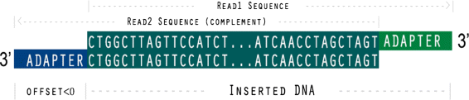
Quality Control and Trimming
Adaptor trimming

Slide 9
Quality tests – Quality control and trimming
Per base sequence quality.
Per sequence quality score.
Overrepresented sequences.
Adapter/primer content.
GC content

Slide 10
Assembly
SPAdes: A New Genome Assembly Algorithm and Its Applications to Single-Cell Sequencing
GenomeQC: a quality assessment tool for genome assemblies and gene structure annotations
Canu: A tool tailored for long-read sequencing data. Canu is effective for assembling large and complex genomes.
ABySS: A tool which works well for large genomes when using short-read sequencing data, especially in a high-performance computing environment.

Slide 11
Assembly
ABySS - https://github.com/bcgsc/abyss
Initial release in 2009, last updated in 2023
Intended for short paired-end reads
Known for its scalability, efficiently handling very large genomic datasets
Employs a k-mer based approach; k-mers are processed to remove read errors; mate-pair information is used to extend contigs
Utilizes the de Bruijn graph method (a distributed representation of a de Bruijn graph, which allows parallel computation of the assembly algorithm)

Slide 12
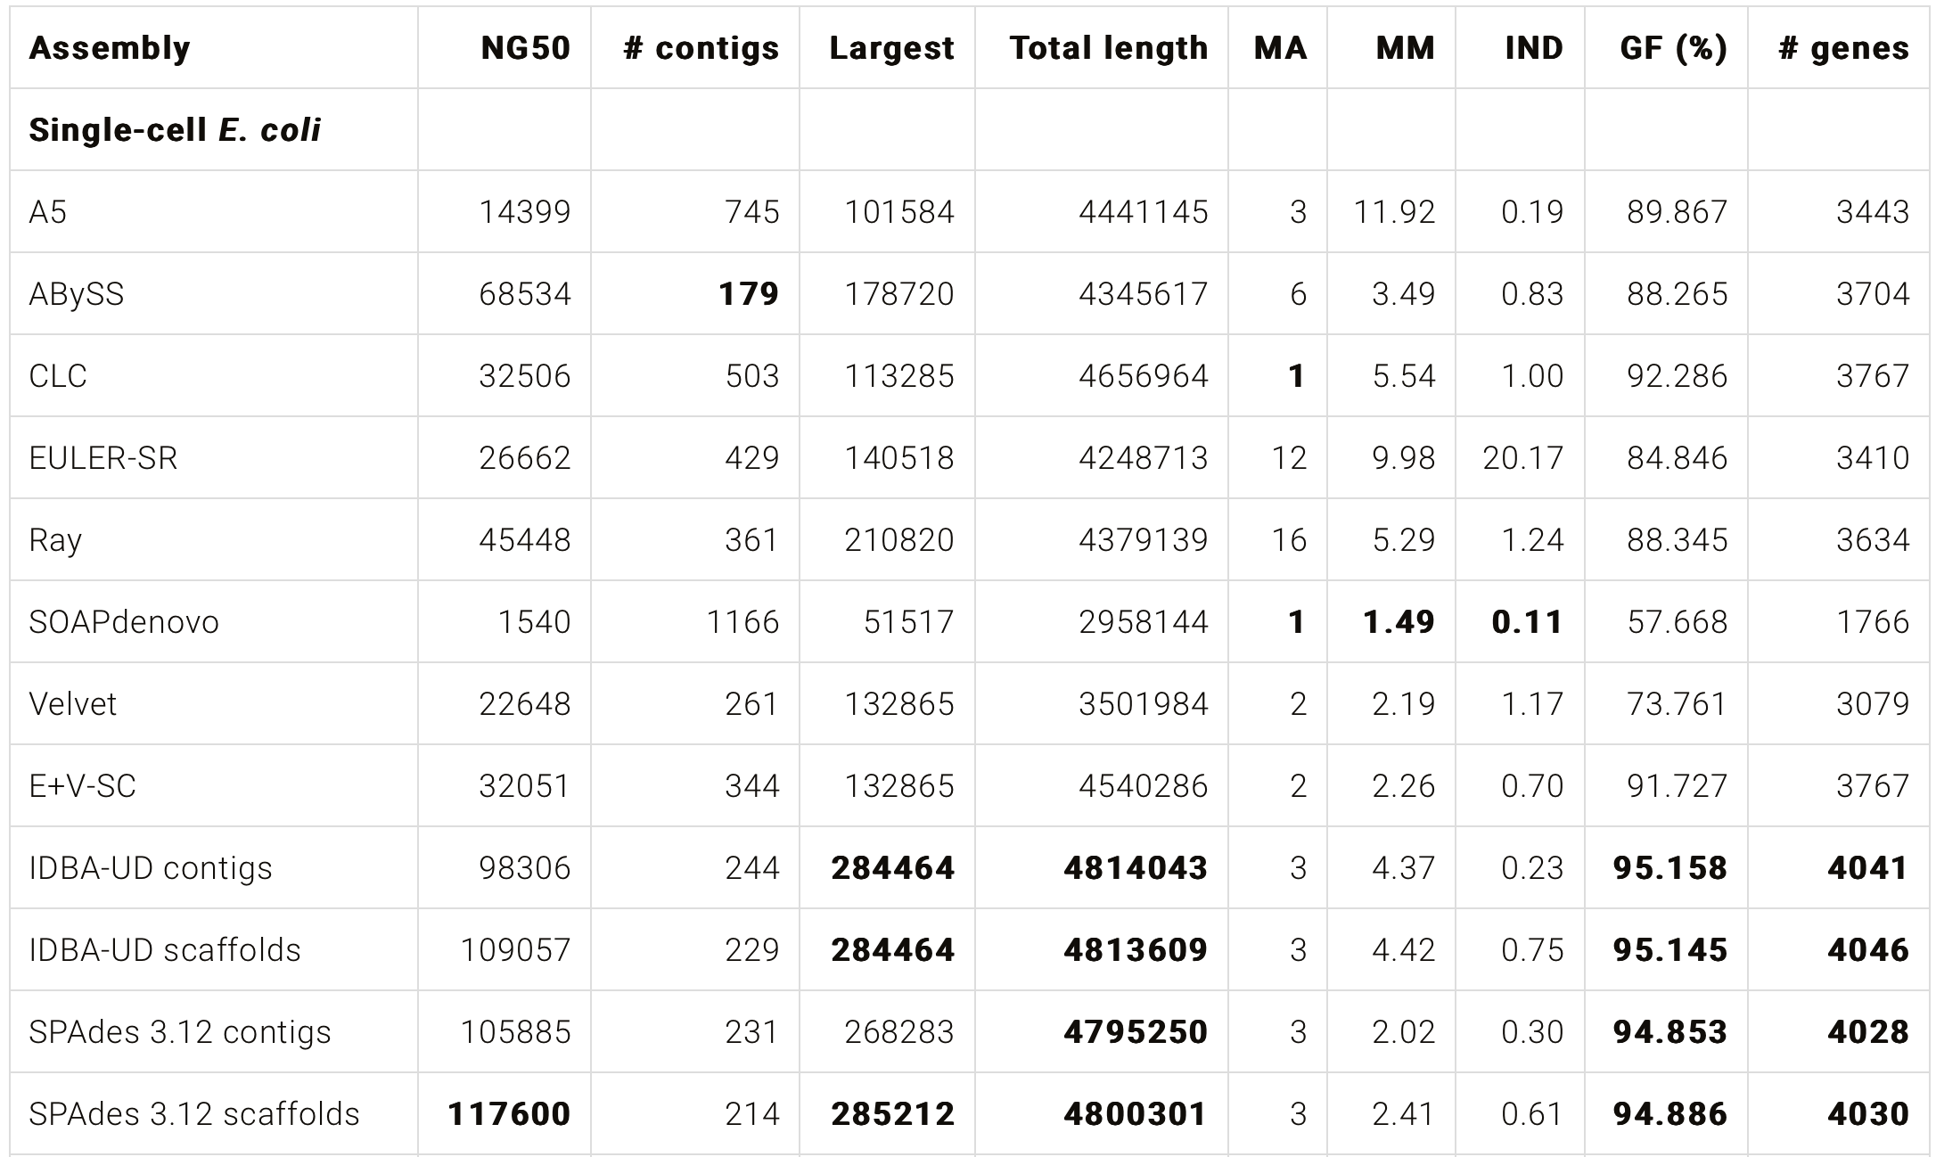
Assembly​
SPAdes- https://github.com/ablab/spades
Initial release in 2012, last updated in 2022
Designed for small genomes - assembly of both single-cell and standard (multicellular) bacterial genomes
SPAdes can take as input several paired-end and mate-pair libraries simultaneously
Based on multisized de Bruijn graph and k-bimer adjustment
scaffolding:

Slide 13
Assembly
Canu - https://github.com/marbl/canu
Initial release in 2015, last updated in 2021
Designed for high-noise single-molecule sequencing - optimized to handle the challenges posed by single-molecule sequencing data such as higher error rates and low or uneven coverage
Hierarchical assembly pipeline
Detect overlaps in high-noise sequences
Generate corrected sequence consensus and trim
Assemble and scaffold for better genome assembly
String graph assembler

Slide 14
Assembly
MaSuRCA - https://github.com/alekseyzimin/masurca
Initial release in 2013, last updated in 2023
Supports hybrid assembly; includes a new module to build mega-reads for hybrid Pacbio (or Nanopore) + Illumina reads
Combines the efficiency of de Bruijn graph and Overlap-Layout-Consensus (OLC) assembly approaches

Slide 15
Quality Assessment of Assembly
Quast-LG - https://quast.sourceforge.net/quast-lg.html
Evaluates large-scale genome assemblies (up to mammalian-size)
Uses minimap2 internally for fast alignment
k-mer based completeness and correctness
Concept of upper bound assembly (theoretical limits on the assembly completeness and contiguity for a given genome and set of reads)

Slide 16
Quality Assessment of Assembly
Merqury - https://github.com/marbl/merqury
Merqury estimates base-level accuracy and completeness
Reference-free assembly evaluation - k-mer spectrum of read set can be used for independently evaluating assembly quality without the need of a high-quality reference

Slide 17
Quality Assessment of Assembly
BUSCO - GitHub - metashot/busco: Assessing the quality of genomes using busco
Basic assembly statistics using BBTools
Assess genome completeness and contamination using BUSCO.

Slide 18
Quality Assessment of Assembly
Asmgene - https://lh3.github.io/2020/12/25/evaluating-assembly-quality-with-asmgene
Evaluates the correctness of assembly
Generally, can’t reliably tell misassemblies from SVs which leads to overestimated misassembly rate
Align all annotated transcripts to a reference genome and select the longest isoform among overlapping transcripts ; do the same for assembly and compare number of single copy/multi copy genes

Slide 19
Proposed Approach and Analysis Workflow
Check raw read quality using [FastQC, MultiQC]
Quality Control using [AfterQC, Fastp, Trim Galore]
Check quality post QC using [FastQC, MultiQC]
Choose trimming tools based on read quality
Assembly using [SPAdes, MaSuRCA, Canu, ABySS]
Check quality of assembly using [Quast-LG, Merqury, Asmgene]
Choose assembly method based on assembly quality
Evaluate speed and computational efficiency at each step

Slide 20
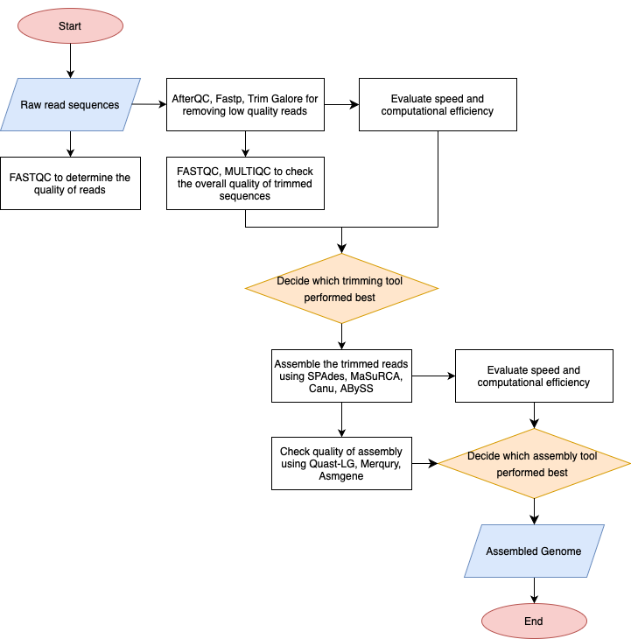
Processing time
Peak Memory usage
Ability to multi-thread

Slide 21
Metrics for evaluation of software/packages
Speed and computational efficiency:
Processing time
Peak Memory usage
Ability to multi-thread

Slide 22
02/06
02/13
02/16

Slide 23
Task Delegation
QC + Trimming: Hargobind, Yeojin
Assemble Tools: Lucy, Pavithra
Assembly Quality: Khushi, Mehak

Slide 24
Citations
Chen, S., Huang, T., Zhou, Y. et al. AfterQC: automatic filtering, trimming, error removing and quality control for fastq data. BMC Bioinformatics 18 (Suppl 3), 80 (2017). https://doi.org/10.1186/s12859-017-1469-3
Shifu Chen, Yanqing Zhou, Yaru Chen, Jia Gu, fastp: an ultra-fast all-in-one FASTQ preprocessor, Bioinformatics, Volume 34, Issue 17, September 2018, Pages i884–i890, https://doi.org/10.1093/bioinformatics/bty560
Aleksey V. Zimin, Guillaume Marçais, Daniela Puiu, Michael Roberts, Steven L. Salzberg, James A. Yorke, The MaSuRCA genome assembler, Bioinformatics, Volume 29, Issue 21, November 2013, Pages 2669–2677, https://doi.org/10.1093/bioinformatics/btt476
Bankevich A, Nurk S, Antipov D, Gurevich AA, Dvorkin M, Kulikov AS, Lesin VM, Nikolenko SI, Pham S, Prjibelski AD, Pyshkin AV, Sirotkin AV, Vyahhi N, Tesler G, Alekseyev MA, Pevzner PA. SPAdes: a new genome assembly algorithm and its applications to single-cell sequencing. J Comput Biol. 2012 May;19(5):455-77. doi: 10.1089/cmb.2012.0021. Epub 2012 Apr 16. PMID: 22506599; PMCID: PMC3342519
Simpson JT, Wong K, Jackman SD, Schein JE, Jones SJ, Birol I. ABySS: a parallel assembler for short read sequence data. Genome Res. 2009 Jun;19(6):1117-23. doi: 10.1101/gr.089532.108. Epub 2009 Feb 27. PMID: 19251739; PMCID: PMC2694472
Koren S, Walenz BP, Berlin K, Miller JR, Bergman NH, Phillippy AM. Canu: scalable and accurate long-read assembly via adaptive k-mer weighting and repeat separation. Genome Res. 2017 May;27(5):722-736. doi: 10.1101/gr.215087.116. Epub 2017 Mar 15. PMID: 28298431; PMCID: PMC5411767
Alla Mikheenko, Andrey Prjibelski, Vladislav Saveliev, Dmitry Antipov, Alexey Gurevich, Versatile genome assembly evaluation with QUAST-LG, Bioinformatics, Volume 34, Issue 13, July 2018, Pages i142–i150, https://doi.org/10.1093/bioinformatics/bty266
Rhie, A., Walenz, B.P., Koren, S. et al. Merqury: reference-free quality, completeness, and phasing assessment for genome assemblies. Genome Biol 21, 245 (2020). https://doi.org/10.1186/s13059-020-02134-9

