Slide 1










Infosys Springboard Internship 5.0
Voice Based Patient Call System
Presented by-
Team
Batch 4
Mentored by-
SHILPIE

Slide 2
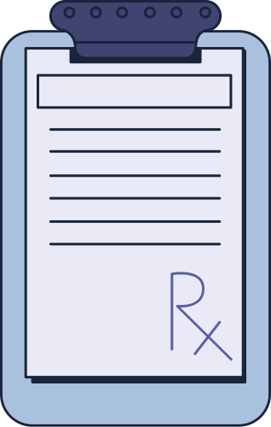
Faster Response to
Emergencies
Hands-Free and Accessible
Communication
Reducing Nurse Workload
and Burnout
Improved Hospital Workflow
Integration with Smart Health
care Systems
Enhanced Patient Experience and
Satisfaction
Why is a Voice-Based Patient Call System Needed?

Slide 3
Problem Statement
Delayed Nurse Response: Patients often experience delays in getting assistance due to manual call systems.
Lack of Prioritization: Current systems do not differentiate between urgent and non-urgent requests, resulting in inefficient resource utilization.
Problem 1
Problem 2
Limited Communication Channels: Patients typically rely on a single-button system that lacks clarity and context about their needs.
Inconsistent Monitoring: Administrators have limited visibility into response times and nurse workload, making it harder to track service quality.
Problem 3
Problem 4

Slide 4
Proposed Solution
Voice-Based Patient Requests: Patients can initiate requests using natural language through a voice-enabled interface.
AI-Driven Prioritization: An AI engine classifies requests based on urgency (e.g., emergency, assistance, or routine).
Solution 1
Solution 2
Real-Time Mobile Notifications: Nurses receive real-time notifications with detailed information about the patient's request.
Comprehensive Monitoring: Administrator can access a real-time dashboard displaying response times, nurse workload, and service quality metrics to ensure efficient monitoring.
Solution 3
Solution 4

Slide 5
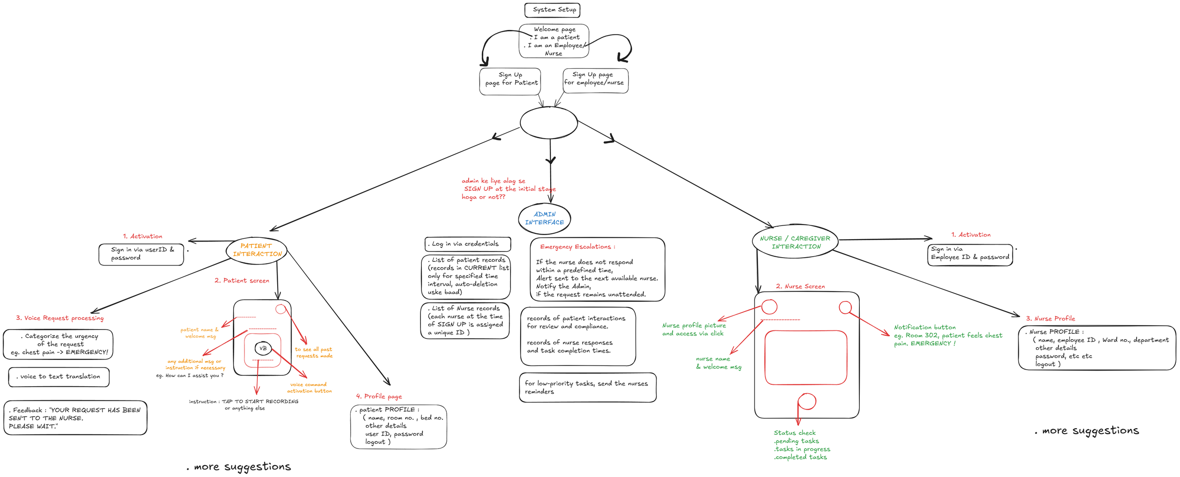
fLowchart

Slide 6

SYsTEM Workflow
Step by Step :
Patient Request: The patient speaks into the device to make a request (e.g., “I need water” or “I feel pain”).
Speech Recognition: The request is converted from voice to text using Gemini Speech Services.
Natural Language Processing: The system processes the request using NLP to extract intent and context.
Priority Assignment: AI assigns a priority level to the request (Critical, Important, Normal).
Backend Processing: The backend server handles the request, stores it in the database, and sends it to the appropriate nurse.
Real-Time Notification: Nurses receive notifications on their mobile app with request details and priority.
Response and Status Update: The nurse attends to the request and updates the status (Pending, In Progress, Resolved). The update is reflected in real-time across the system.

Slide 7
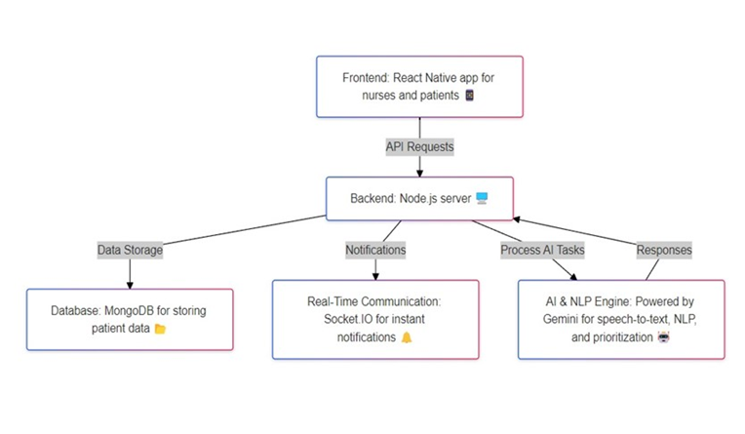
SysTEM ArChiTECTUre
Real-Time Communication: Api driven updates & database synchronization using MongoDB atlas

Slide 8
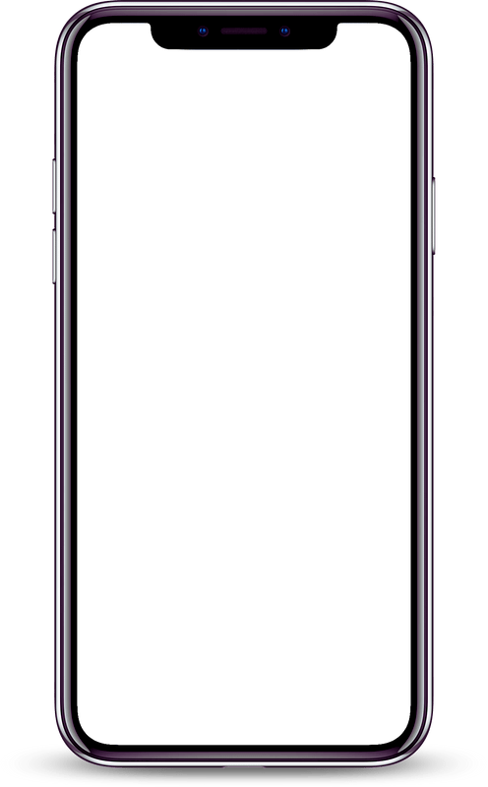
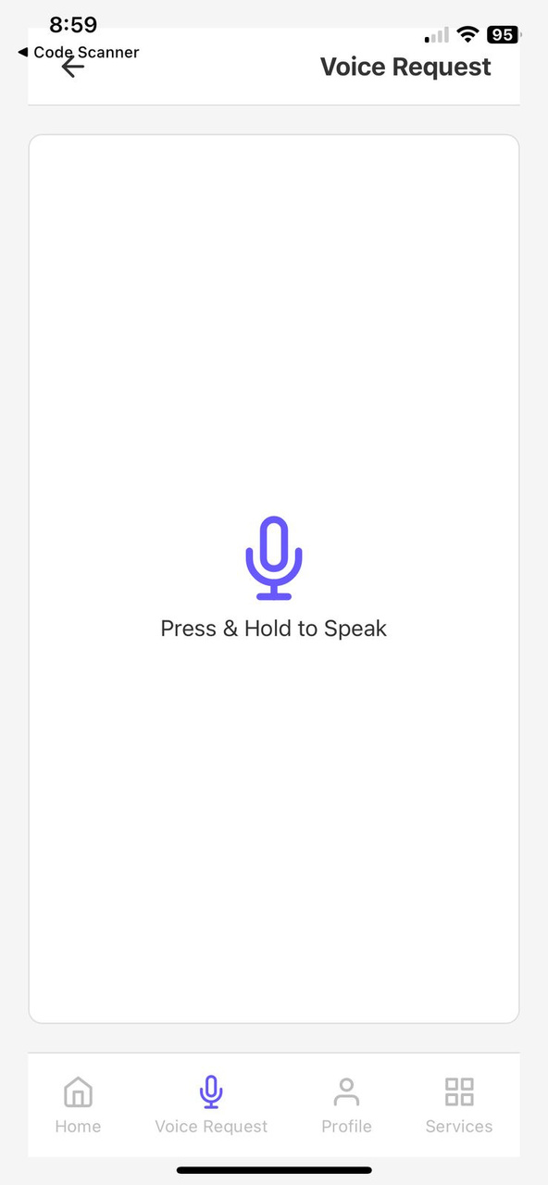
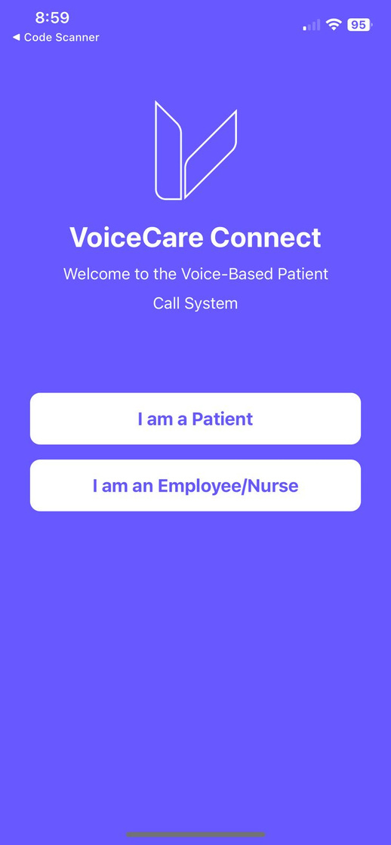
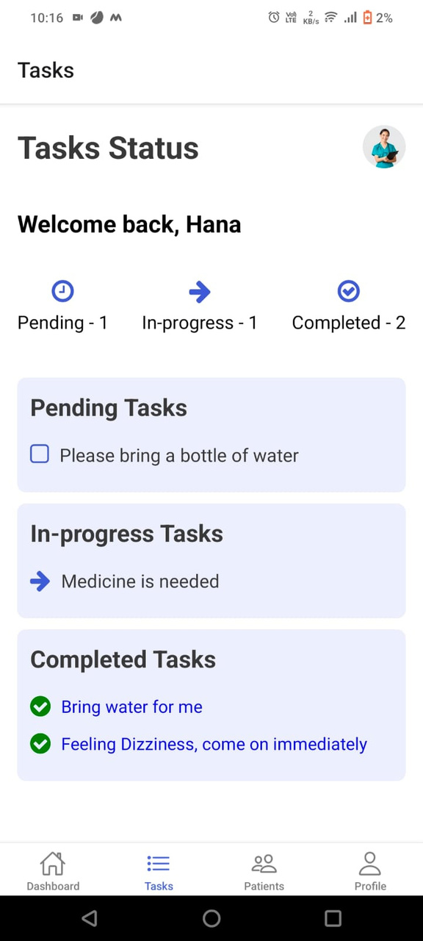
App UI

Slide 9





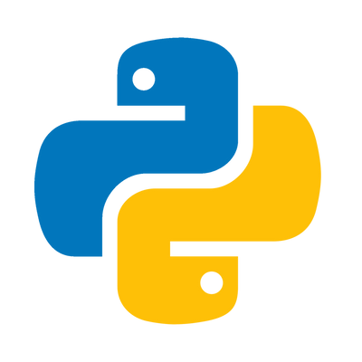

TechNology Stack
React Native: Cross-platform mobile UI framework.
Node.js: Scalable JavaScript server-side runtime.
Express.js: Web framework for HTTP routing.
Expo : Preview, test, and debug React Native.
MongoDB: NoSQL database for dynamic healthcare data storage
Python : Implemented Python NLP for voice-based system.
JWT (JSON Web Tokens): Ensures secure user authentication and session management.

Slide 10


KeY FeatureS
Voice-Based Interface
Patients can use their voice to request assistance, eliminating the need for complex interactions.
AI & NLP-Driven Processing
The AI engine interprets requests and assigns appropriate priority levels.
Role-Based Access Control
Real-Time Communication
Different interfaces and functionalities for patients, nurses, and administrators.
API driven updates and database synchronization using MongoDB atlas.

Slide 11
ConclusioN
The Voice-Based Patient Call System revolutionizes hospital communication by leveraging modern technologies like AI, NLP, and real-time notifications. It ensures timely responses, reduces nurse workload, and enhances patient satisfaction.

Slide 12

Thank You For Your Attention

