Slide 1
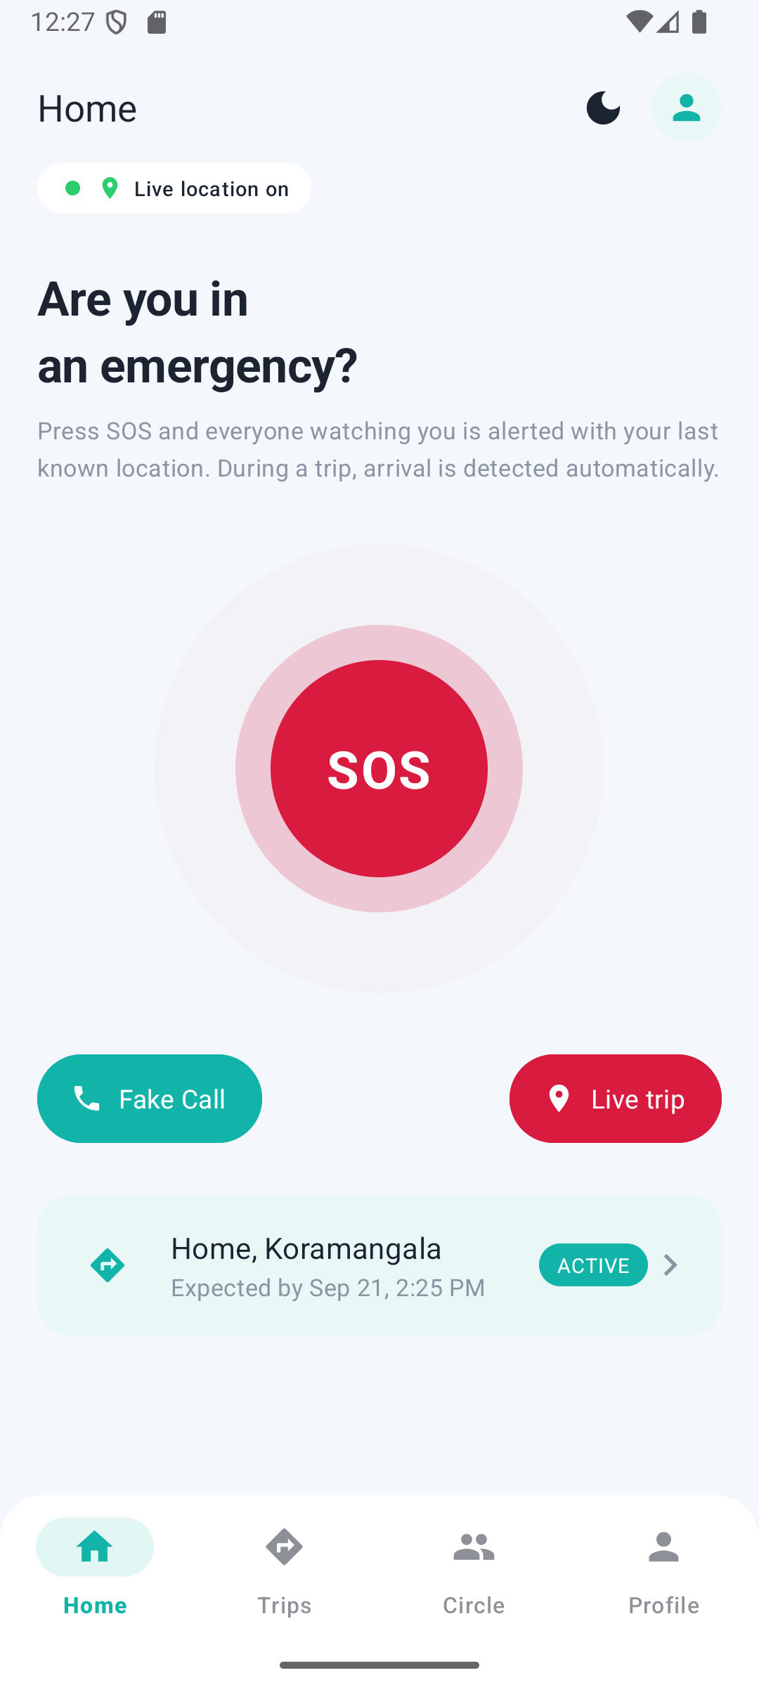
PingHome
A wearable-free safety companion that watches over solo commuters — automatically, quietly, and only when it matters.
PROGRESS PRESENTATION
[Team member names] · [Course / Guide] · [Date]
Notes:
Replace the bracketed placeholders with your names, course and date. Everything in this deck reflects what is actually built and tested as of the presentation date.

Slide 2
The problem
Why existing safety apps don't get used
Acting is hard in the moment
Gap
1
Existing apps need you to open them and press something exactly when you are least able to.
Something that does nothing until you don't arrive — and then acts on your behalf, with the people you chose.
Always-on tracking gets switched off
2
Constant location sharing trades privacy for safety, so people disable it — and then it's useless.
Nobody notices a non-arrival
3
If you simply don't get home, no app raises the alarm by itself.
PingHome · Progress Presentation · 2

Slide 3
How PingHome works
One trip at a time — no tracking before, nothing after
1
2
3
4
Start a trip
Arrive → done
Late → nudge → escalate
SOS any time
Destination on the map, expected arrival, grace period, and which trusted contacts watch (alert-only or location).
A geofence detects arrival automatically. Trip closes, sharing stops, location history is purged. No taps.
Past arrival + grace? "Still safe?" nudge. No answer? Watchers are alerted with the last known location.
One press alerts every watcher immediately — with or without a trip in progress.
Plus a fake incoming call to exit an uncomfortable situation — local only, never creates an alert.
PingHome · Progress Presentation · 3

Slide 4
System architecture
The backend owns the truth; the phone owns the senses
push notifications
Android app
(Java · XML)
Spring Boot backend
Azure Virtual Machine
Firebase Cloud
Messaging
HTTPS/REST + JWT
Google Play Services
GPS · Geofencing (on-device)
Azure Database for MySQL
Backend owns
auth, trips, watchers, escalation, alerts, privacy rules.
Phone owns
UI, GPS/geofence, map, push handling, fake call.
OpenStreetMap tiles (osmdroid)
Azure Application Insights
PingHome · Progress Presentation · 4

Slide 5
Technology stack
Android | Java · XML · Material 3 · Retrofit/OkHttp · Play Services Location + Geofencing · FCM · osmdroid (OpenStreetMap)
Backend | Java 21 · Spring Boot 3 · Spring Security · JWT + BCrypt · Spring Data JPA/Hibernate · Flyway · @Scheduled
Database | MySQL 8 locally → Azure Database for MySQL (flexible server) when deployed
Cloud | Azure Virtual Machine · Azure Database for MySQL · Azure Application Insights · Firebase Cloud Messaging
Tooling | Maven · Gradle · Android Studio · Git · Azure CLI deployment scripts
Java + XML on Android and Spring Boot on the backend were project requirements; every other choice was made to keep the system free to run and simple to explain.
PingHome · Progress Presentation · 5

Slide 6
Cloud services — four genuinely integrated
All within Azure's free-account allowance and Firebase's free plan
Azure Virtual Machine
Azure Database for MySQL
Azure Application Insights
Firebase Cloud Messaging
Runs the Spring Boot backend as an always-on service behind Caddy (automatic HTTPS). Always-on matters: the escalation timer lives inside the process.
The persistent store. Same JDBC config as local MySQL, TLS enforced; Flyway creates the schema on first boot.
Request, exception and log telemetry through the Java agent — the scheduler's nudge/escalate lines are visible in the portal.
Push notifications: nudges, escalations, watcher alerts. Verified end-to-end on device.
Why Azure and not Google Cloud (the original plan): Cloud SQL has no free tier, and Google Payments repeatedly refused to enable billing on personal accounts. University-owned cloud tenancy was deliberately not used. Twilio SMS fallback is implemented but off by default.
PingHome · Progress Presentation · 6

Slide 7
What's built: backend
Complete, tested, and verified against a real MySQL database
26
7
16
Escalation, seen for real
REST endpoints
database tables
automated tests, all passing
From the backend log, 21 Sep:
20:54:46 Sent safety nudge for trip 1
20:59:45 Escalated trip 1 – no safety confirmation within nudge timeout
A test trip's arrival time passed while nobody touched the app. The scheduler nudged the traveller by push, waited the 5-minute timeout, and escalated — exactly as designed.
Registration & login with BCrypt password hashing and JWT sessions
Trusted contacts; trips with watchers at ALERT_ONLY or LOCATION_DURING_TRIP
Escalation scheduler: arrival + grace → nudge → timeout → escalate & notify
SOS: creates and escalates an alert immediately; duplicate taps deduplicated
Ownership and watcher-permission checks on every trip/location endpoint
Flyway-managed schema; Demo Mode profile for short timers during a live demo
PingHome · Progress Presentation · 7

Slide 8
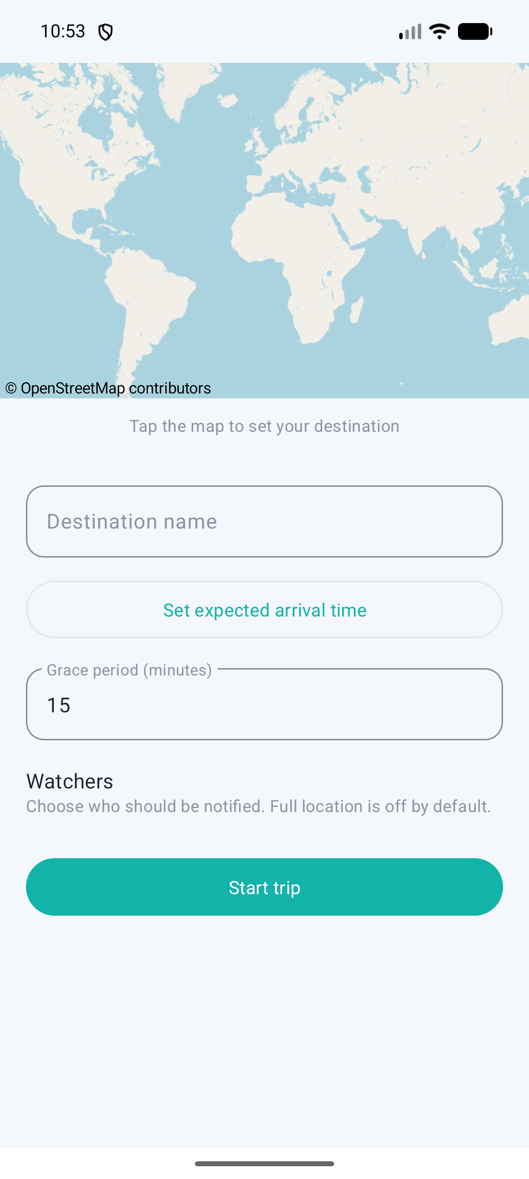
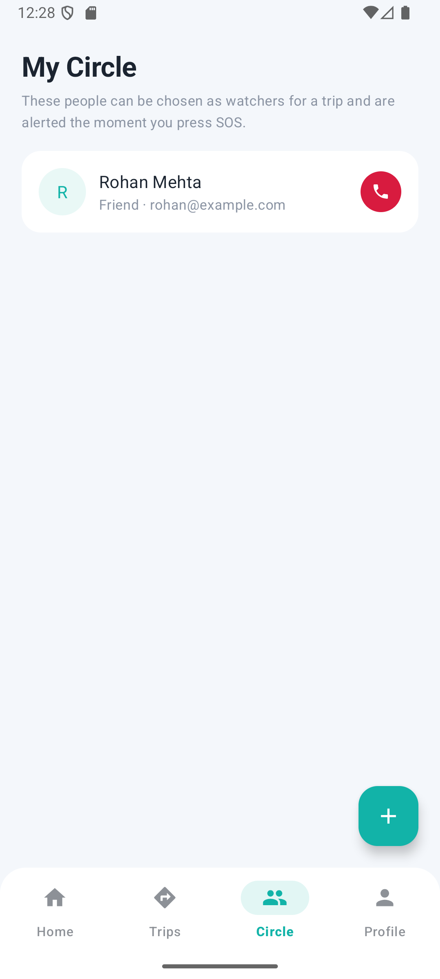
What's built: Android app
16 screens · builds with the Android Gradle Plugin · runs on the emulator
SOS-first Home: pulsing SOS, live-location badge, Fake Call, current trip
Trip creation on an OpenStreetMap picker (no API key, no billing)
Geofence arrival detection — Android Geofencing API, not GPS polling
FCM push handling; fake incoming call (local only)
Watcher views: trips being watched, last known location, alerts
Light/dark theme (remembered)
Home — SOS first
New trip — map picker
Circle — trusted contacts
PingHome · Progress Presentation · 8

Slide 9
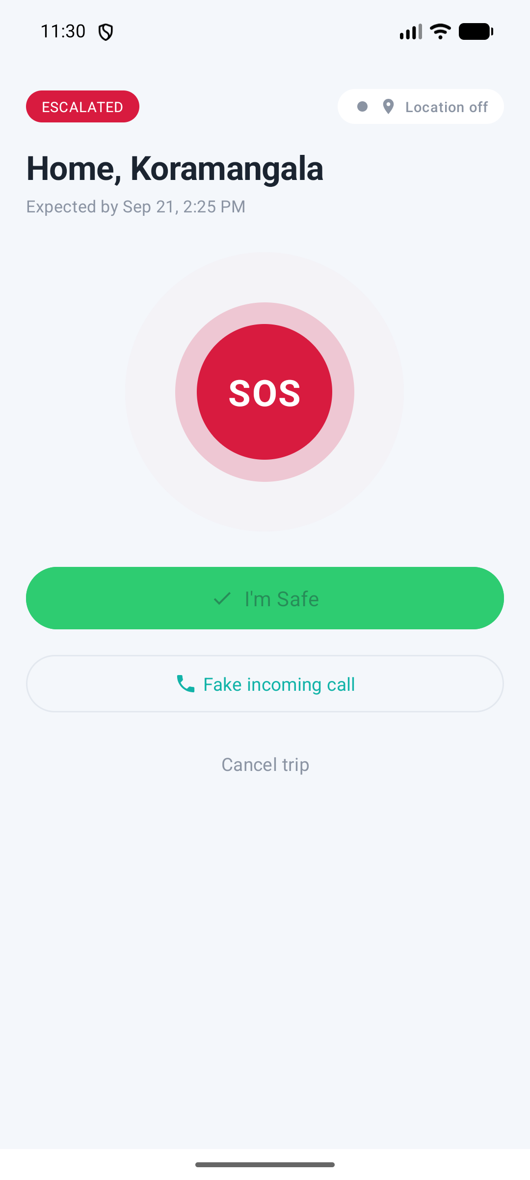
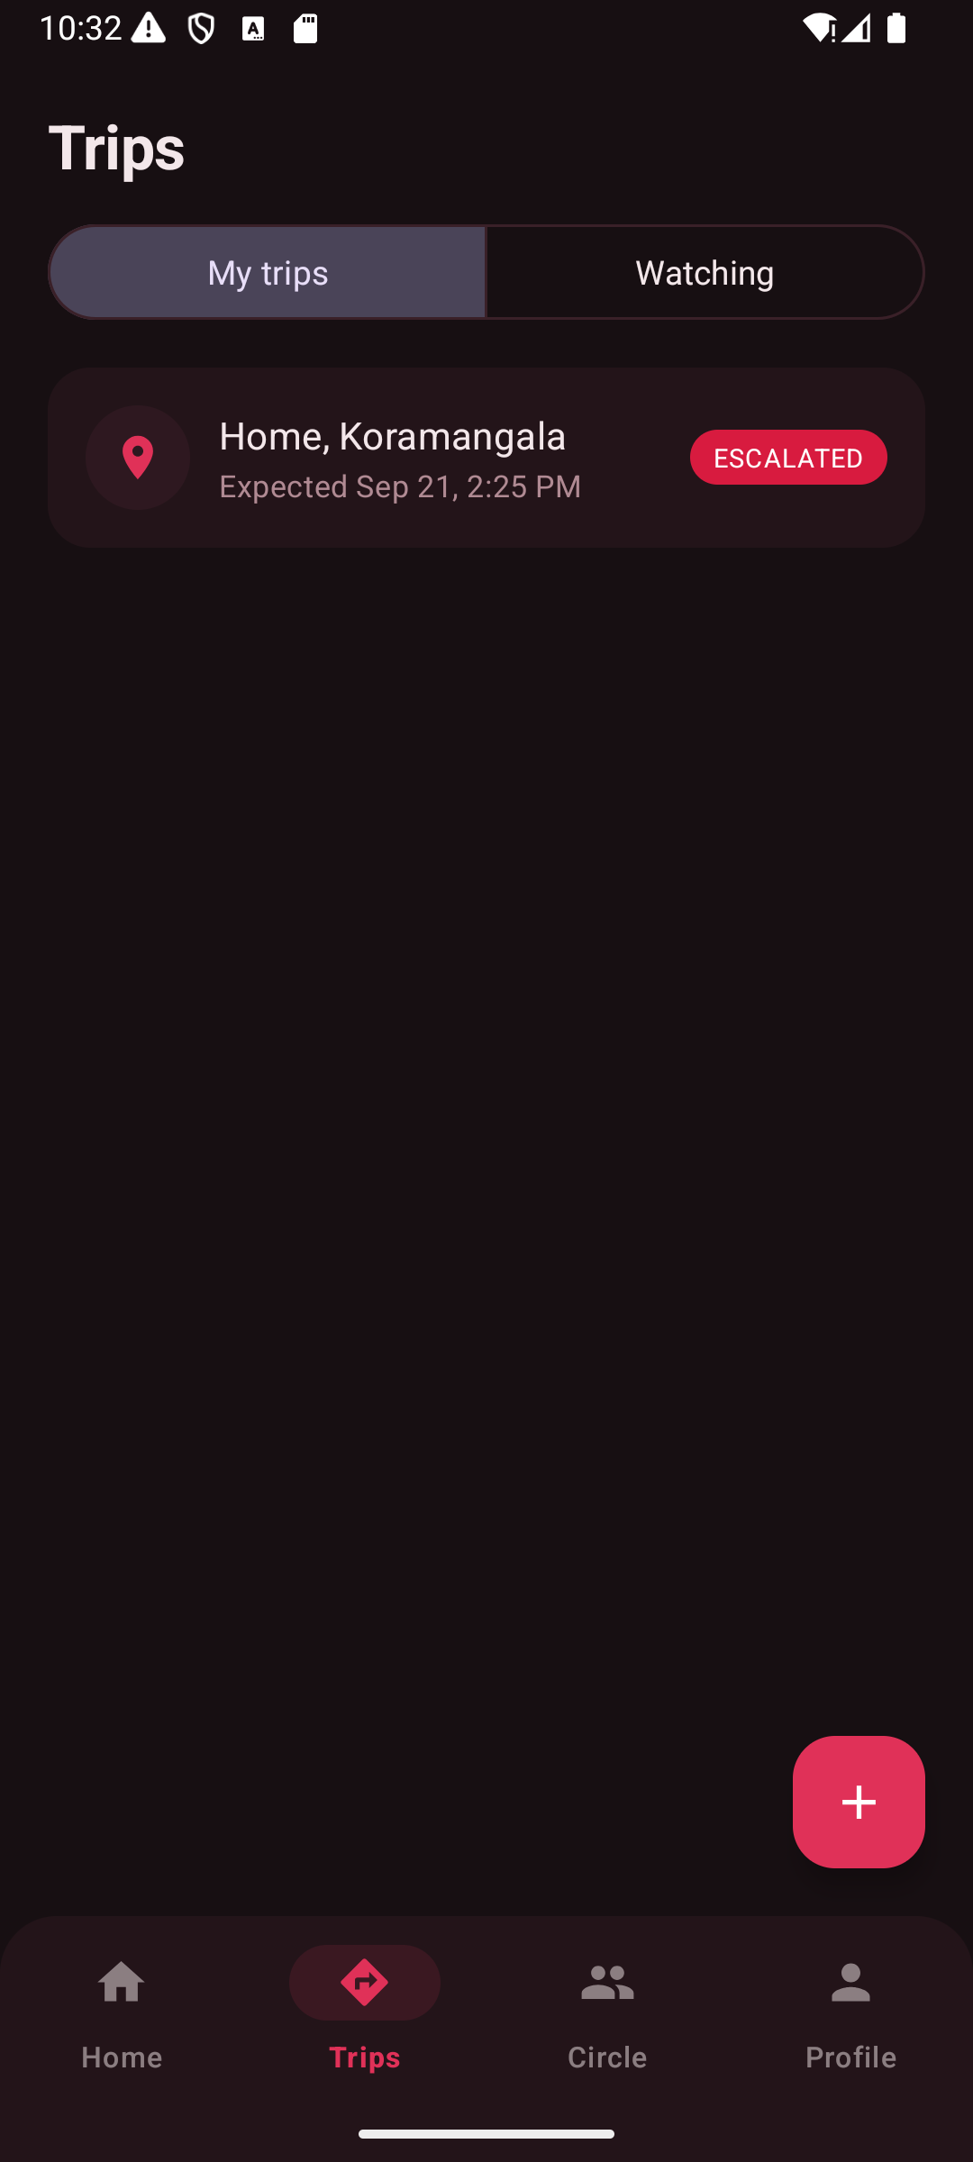
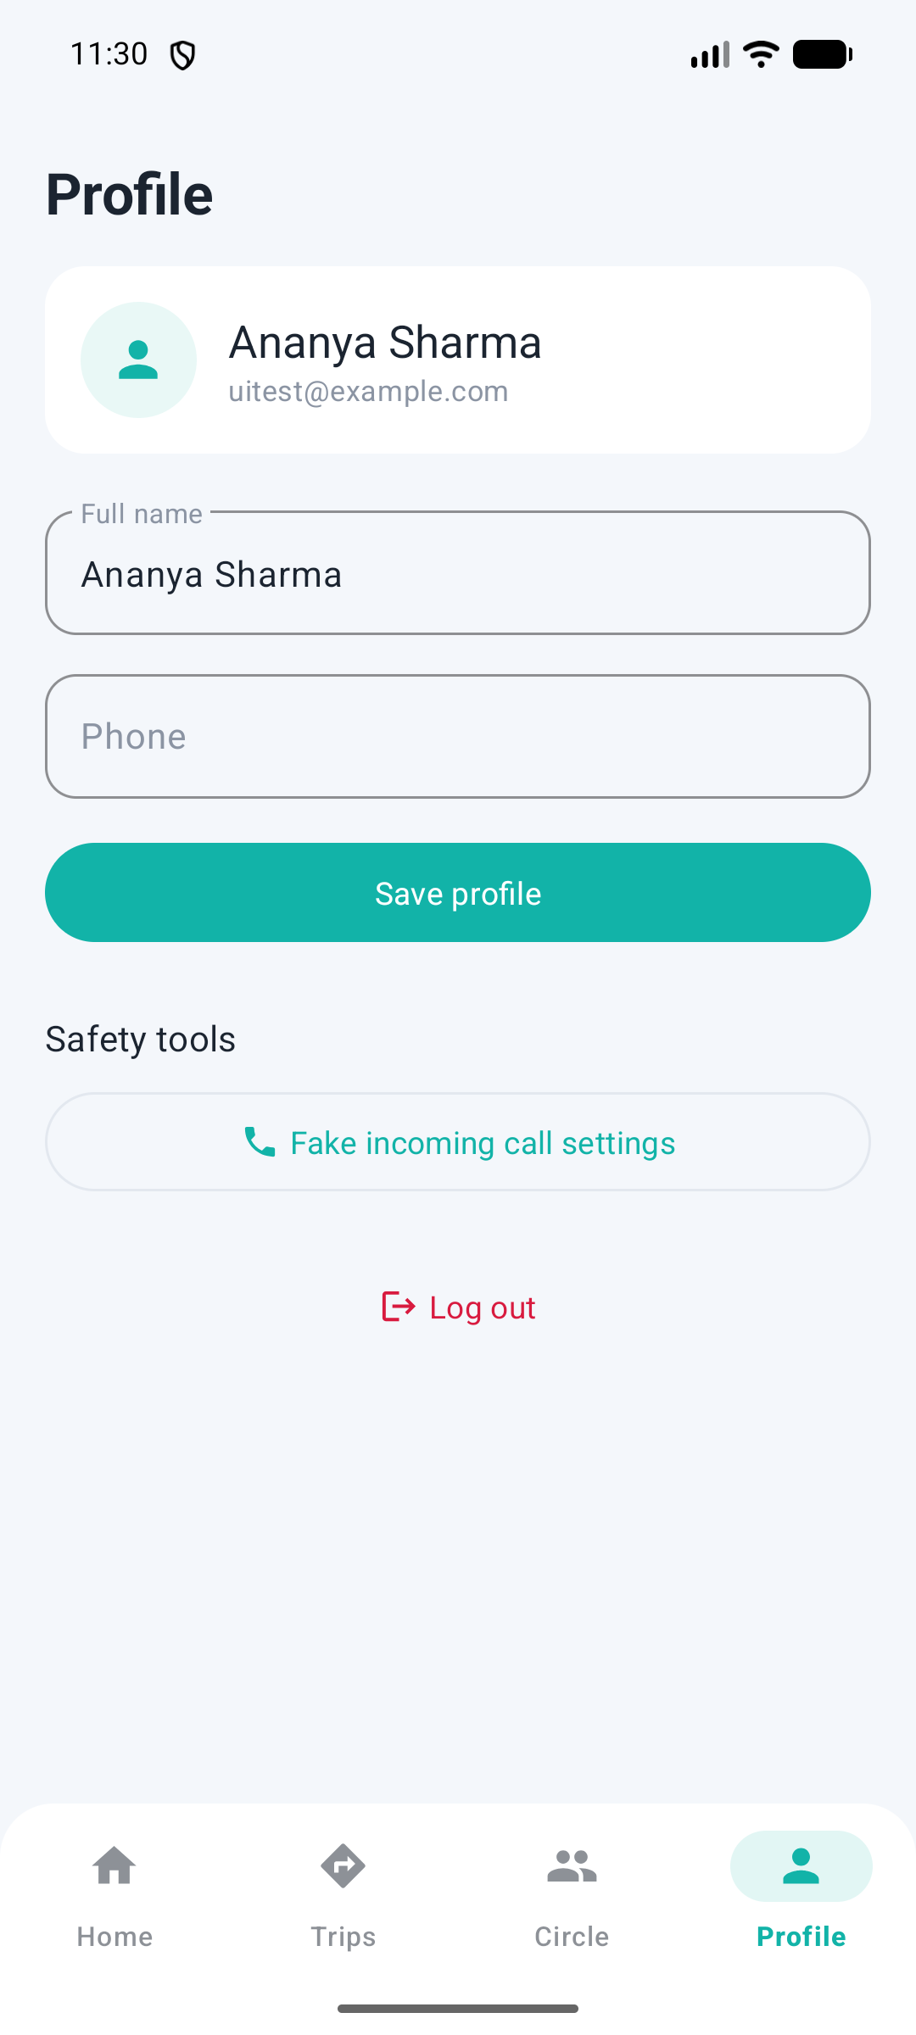
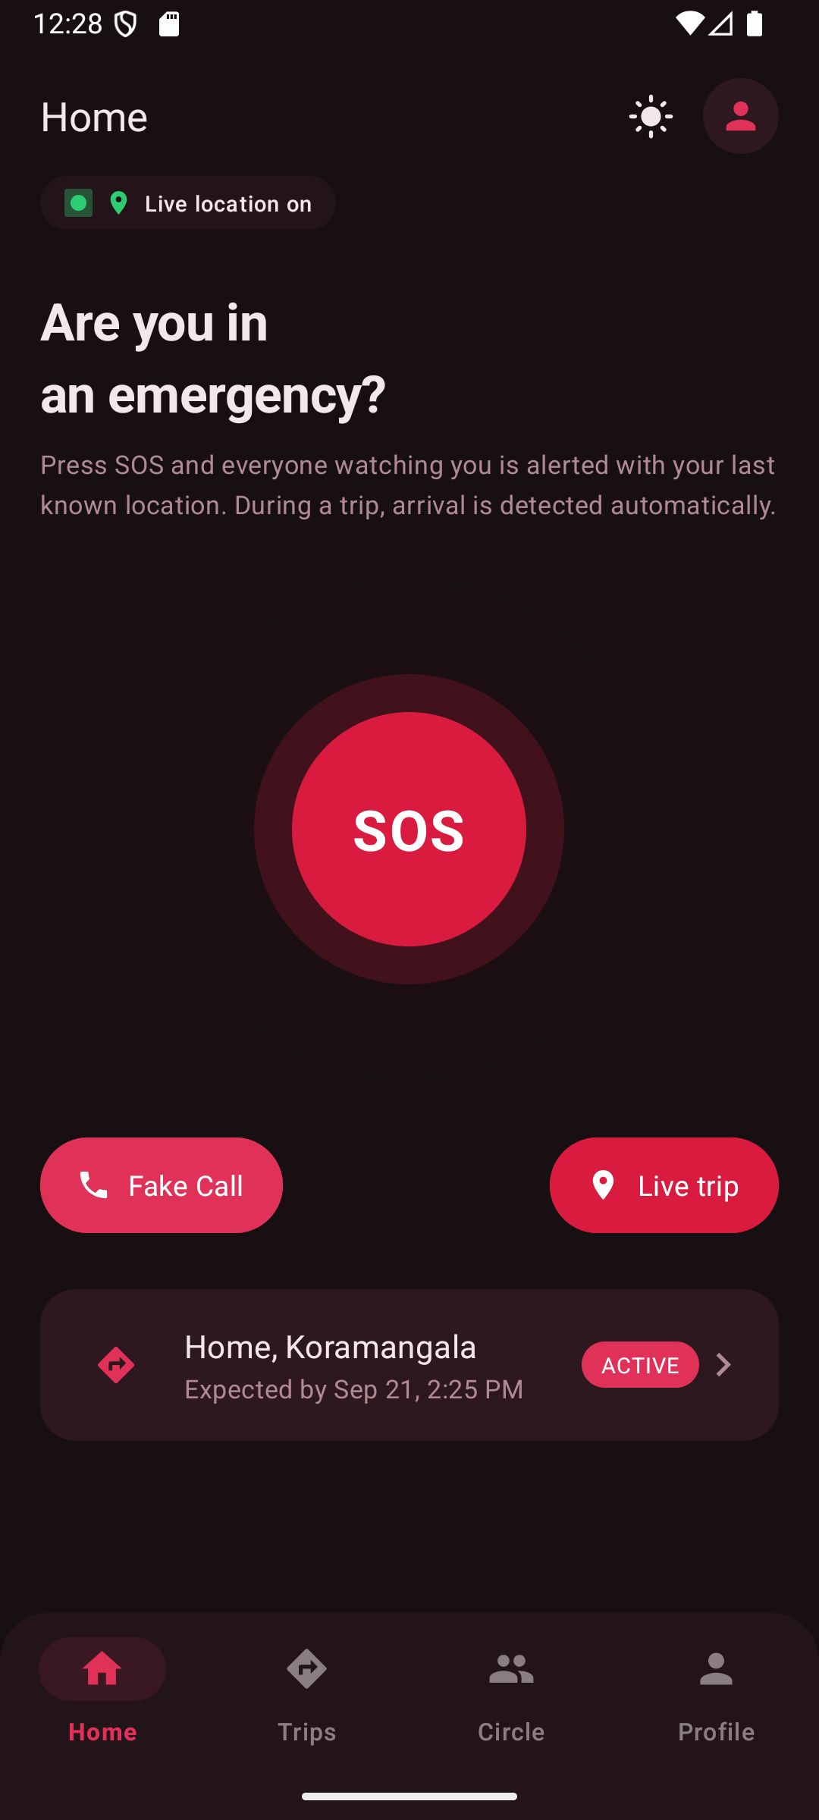
More screens
Real data from the local backend — not mock-ups
Active trip
Trips — mine & watching
Profile
Home — dark mode
PingHome · Progress Presentation · 9

Slide 10
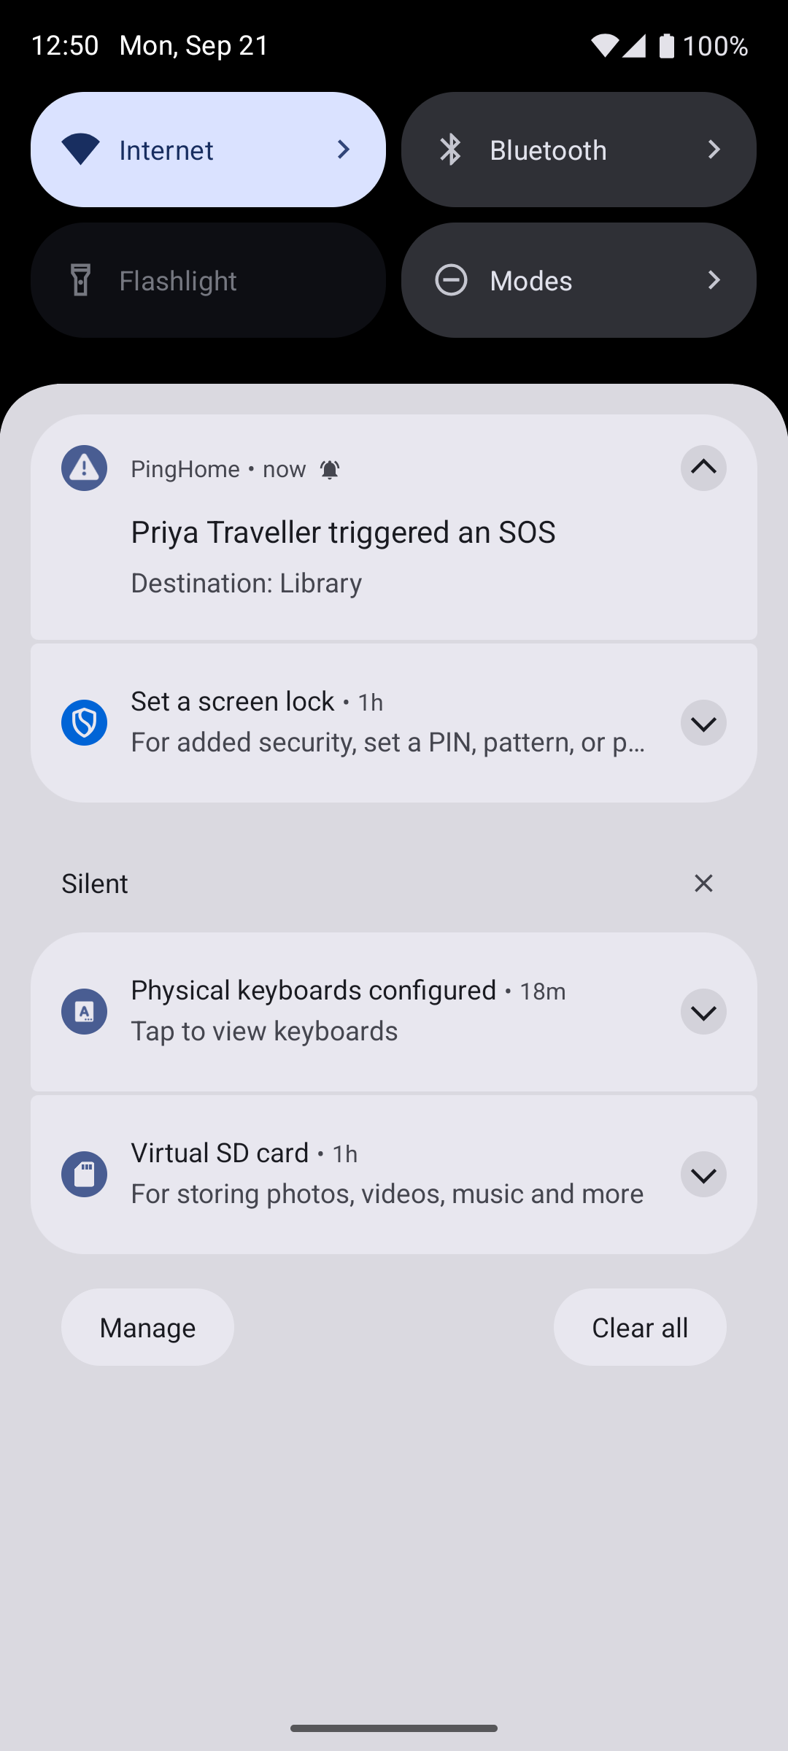
Push notifications — verified end-to-end
Real Firebase project, real device token, real delivery
1
App launches and registers its FCM device token with the backend (PUT /api/users/me/fcm-token → 204).
2
Another user's trip has this device's account as a watcher; they press SOS.
3
Backend creates + escalates the alert and hands the push to Firebase (Admin SDK, service-account key).
4
Firebase delivers it: "Priya Traveller triggered an SOS — Destination: Library" — arrived in seconds.
Delivery is best-effort by nature (FCM); the app never claims guaranteed delivery. The optional Twilio SMS fallback exists for critical alerts and is disabled by default.
Watcher's phone (emulator)
PingHome · Progress Presentation · 10

Slide 11
Security & privacy
Designed in, not bolted on
Passwords & sessions
BCrypt hashing; JWT sessions stored in encrypted preferences on the phone; the deployed profile refuses to start with the development secret.
Authorization
Every trip/location/alert endpoint re-checks who is asking. Changing an ID in a request returns 403 — never someone else's data.
Watcher permissions
ALERT_ONLY vs LOCATION_DURING_TRIP, chosen per trip. Permanent tracking is never the default.
Location lifecycle
Nothing before a trip. Samples only during it. Purged the moment it completes; the API then rejects location reads and writes.
Secrets
Only environment variables and gitignored files. No keys, tokens or passwords in the repository.
PingHome · Progress Presentation · 11

Slide 12
Testing status — the required scenarios
Only what has actually been run is marked verified
# | Scenario | Status
1 | Safe arrival through geofence | Backend verified by test · on-phone geofence walk pending
2 | Manual "I'm Safe" (idempotent) | Verified
3 | Missed arrival → nudge → escalation | Verified by test and observed live (20:54 nudge → 20:59 escalate)
4 | Manual SOS → watcher alert | Verified end-to-end incl. real push on device
5 | Physical wearable SOS over BLE | Descoped — hardware wearable dropped from the project
6 | Fake call creates no alert | By design (local only) · manual check pending
7 | Privacy after completion | Verified
8 | Unauthorized access rejected | Verified (403)
9 | Duplicate events handled | Verified
10 | Poor connectivity / retry | Implemented (retry, dedup guard) · not fault-injection tested
PingHome · Progress Presentation · 12

Slide 13
Scope changes & challenges
What changed since the original plan, and why
Google Cloud → Azure
Google Maps → OpenStreetMap
Google Payments refused to enable billing on personal accounts (three attempts). Azure's free account covers the whole stack; backend code unchanged — only deployment configuration.
Google Maps requires a billing-enabled project. Swapped the map library only; GPS and geofencing were always on-device and unaffected.
Wearable dropped
Serverless would break escalation
The physical ESP32 button is no longer part of the deliverable. SOS is the in-app button. The BLE relay code remains in the codebase but is out of scope.
The escalation timer runs inside the backend process. Platforms that scale to zero pause it silently — so the backend runs on an always-on VM.
Found by running it, then fixed
Overlapping action buttons hid "add contact"; a layout error broke the build; denying background location looped the permission prompt.
PingHome · Progress Presentation · 13

Slide 14
What's next
Remaining work to the final demo
This week
Deploy the backend to Azure
Scripts written (VM, MySQL, App Insights, HTTPS); Azure account created. First real run is the next step.
After deploy
Release APK against the cloud URL
Rebuild pointed at the HTTPS backend; the same push test again, but from the cloud.
Before demo
Walk the manual scenarios on device
Geofence arrival (emulator location), fake call, watcher screens, connectivity loss.
Before demo
Demo rehearsal in Demo Mode
5-second scheduler and 1-minute nudge so escalation can be shown live in under two minutes.
After demo
Teardown after evaluation
One command deletes the Azure resource group; nothing left that can bill.
Cost plan: the Azure free account has a hard spending cap for its first 30 days; the deployment is timed to sit inside that window, then deleted.
PingHome · Progress Presentation · 14

Slide 15
Limitations & future scope
Stated honestly
Known limitations
Future scope (deliberately out of scope now)
Location samples are pushed only while the Active Trip screen is open (arrival detection still works in the background)
Push delivery is best-effort — FCM cannot guarantee delivery
OpenStreetMap's public tile servers are volunteer-run; a product would use a commercial tile service
Poor-connectivity behaviour is implemented but not fault-injection tested
Physical wearable button (BLE) — designed and partly built, dropped for this delivery
SMS fallback via Twilio for critical alerts (implemented, off by default)
Background location service during trips
Not planned: police/emergency dispatch APIs, AI danger detection, smartwatch app, social features
PingHome · Progress Presentation · 15

Slide 16
Where the project stands
26
16
16
API endpoints
app screens
automated tests
4
7
9
cloud services
database tables
documentation files
Backend complete and tested · Android app complete and running · push verified · cloud deployment next
Thank you — questions?

