Slide 1
Name: Sonam Bagde Class: BSC [5th Semester] Batch: S1 Subject: Microbiology Topic: Rubella

Slide 2
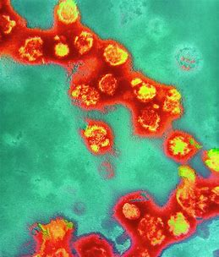
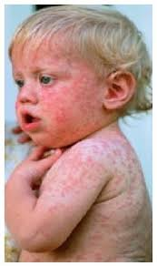
Contents:
Introduction
Rubella epidemic
Symptoms of Rubella
Transmission of Rubella
Serious Effects of Rubella
Rubella Treatment
Rubella Prevention
Rubella Vaccine

Slide 3
Introduction
Rubella is a contagious disease that mostly affects children. It causes symptoms like a rash, fever, and eye redness. It’s usually mild in kids, but it can be serious in pregnant women. You may also hear rubella called the “German measles” or the “three-day measles.”
The best way to protect yourself and your children from infection is to get vaccinated with the measles, mumps, and rubella (MMR) vaccine.
Rubella. Also known as the German measles, rubella is caused by the rubella virus

Slide 4
Rubella epidemic (united states, 1964-1965)
12.5 million rubella cases
2,000 encephalitis cases
11,250 abortions(surgical/spontaneous)
2,100 neonatal deaths
30,000 CRS cases
Deaf- 11,600
Blind- 3,580
Mentally retarded- 1,800
The largest rubella epidemic in the united states occurred in 1964-1965, and resulted in the birth of an estimated 30,000 infants with congenital rubella syndrome. As many as 85% of pregnant woman with clinical rubella delivered babies with congenital rubella. The highest percentage of congenital rubella occurred when the pregnant mothers had rubella during the first trimester

Slide 5
Symptoms of Rubella
Rubella is usually mild in children. Sometimes it doesn't cause any symptoms
A pink or red-spotted rash is often the first sign of infection. It starts on the face and spreads to the rest of the body. The rash lasts about 3 days. This is why rubella is sometimes called the "3-day measles."
Along with the rash, you or your child might have:
A mild fever -- from 99 F to 100 F
Swollen and pink-colored eyes (conjunctivitis), Headache
Swollen glands behind the ears and on the neck
Stuffy, runny nose, Cough
Sore joints (more common in young women),
General discomfort

Slide 6
Transmission of Rubella
Rubella spreads when someone who is infected coughs or sneezes tiny germ-filled droplets into the air and onto surfaces. People who catch the virus are contagious for up to a week before and a week after the rash appears.
Some people don't know they're infected because they don't have symptoms, but they can still pass the virus to others. If you’ve been diagnosed with rubella, tell the people who’ve been around you, especially any pregnant women.

Slide 7
Serious Effects of Rubella
The most serious of these could happen during pregnancy, when the virus can pass from mother to baby in the womb. The risk is highest during the first 3 months of pregnancy.
Babies who are infected can have serious birth defects called congenital rubella syndrome (CRS). This is very rare in the United States, but a baby can get it if they travel to another country where the virus spreads.
CRS is a group of health problems in a baby that can include:
Heart defects, Cataracts
Deafness
Delayed learning
Liver and spleen damage
Diabetes, Thyroid problems

Slide 8
Rubella Treatment
It’s a virus, so antibiotics won’t work.
Most of the time, the infection in children is so mild, it doesn't need to be treated. You can bring down your child's fever and ease aches with pain relievers like children's acetaminophen or ibuprofen. Don't give your child or teen aspirin because of the risk for a rare but serious condition called Reye's syndrome.
If you’re pregnant and think you’ve caught rubella, call your doctor right away. You may be able to take antibodies called hyperimmune globulin to help your body fight the virus.
As for home remedies for rubella, there aren’t any that make the virus go away faster. But rest and pain relievers can help with self-care in mild cases, if needed.

Slide 9
Rubella Prevention
The best way is to get vaccinated. Children need two doses of the MMR vaccine. They should get the first when they’re between 12 and 15 months old. They should get the second between 4 and 6 years old.
Babies who’ll be traveling to a country where rubella is common can get vaccinated as early as 6 months old.
If you're a woman of childbearing age and you haven't been vaccinated, get the MMR vaccine at least 1 month before you get pregnant. This is most important if you plan to travel to countries where rubella spreads.

Slide 10
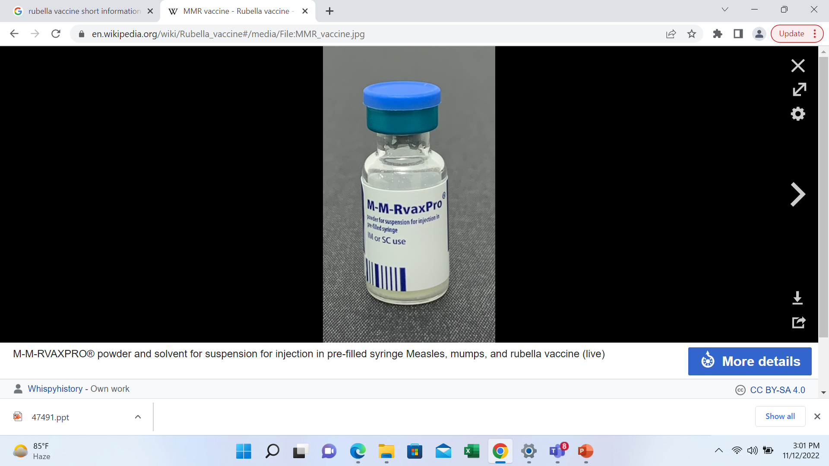
Rubella Vaccine
The rubella vaccine is a live attenuated vaccine. It is available either by itself or in combination with other vaccines. Combinations include with measles (MR vaccine), measles and mumps vaccine (MMR vaccine) and measles, mumps and varicella vaccine (MMRV vaccine).
A rubella vaccine was first licensed in 1969.
Rubella Vaccine recommend 2 doses. First dose should be given through 12 to 15 months. And 2nd dose at the age of 4 to 6 years.

Slide 11
THANK YOU

